Slide 1

AVANI SANGHVI ENRLL. NO.:170410107099 TY CE-2 BATCH-B
SOFTWARE ENGINEERING
->CMM STANDARDS

Slide 2
What is CMM ?
CMM :: Capability Maturity Model
Also called as SEI-CMM.
Developed by the Software Engineering Institute (SEI) of the Carnegie Mellon University
Framework that describes the key elements of an effective software process.

Slide 3
Describes an evolutionary improvement path for software organizations from an ad hoc, immature process to a mature, disciplined one.
Provides guidance on how to gain control of processes for developing and maintaining software and how to evolve toward a culture of software engineering and management excellence.

Slide 4
It is not a software process model. Capability Maturity model is used as a benchmark to measure the maturity of an organization’s software process.
The model describes a five- level evolutionary path of increasingly organized and systematically more mature processes.

Slide 5
What are the CMM Levels ?
Level – 1 : Initial
Level – 2 : Repeatable
Level – 3 : Defined
Level – 4 : Managed
Level – 5 : Optimizing

Slide 6
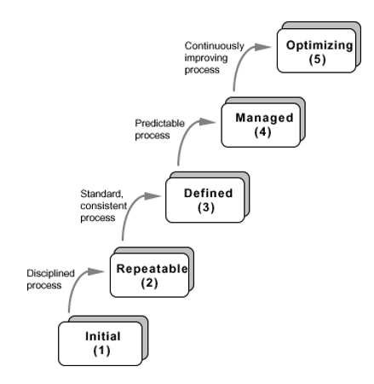

Slide 7
Level -1 : Initial
Work is performed Informally
A software development organization at this level is characterized by ad hoc activities and occasionally even chaotic (organization is not planned in advance)
Few processes are defined and success depends on individual efforts

Slide 8
Level – 2 : Repeatable
Work is Planned and Tracked
This level of software development organization has a basic and consistent project management processes to track cost, schedule and functionality. The process is in place to repeat the earlier successes on projects with similar applications.

Slide 9
Level – 3 : Defined
Work is Well-Defined
At this level the software process for both management and engineering activities are /defined and documented.

Slide 10
Level – 4 : Managed
Work is Quantitatively Controlled
Software Quality Management : Management can effectively control the software development effort using precise measurements. At this level, organization set a quantitative quality goal for both software process and software maintenance.
Quantitative Process Management : At this maturity level, the performance of processes is controlled using statistical and other quantitative techniques and is quantitatively predictable.

Slide 11
Level – 5 : Optimizing
Work is based upon Continuous Improvement
The key characteristics of this level is focusing on continuously improving process performance. Key features are :
Process Change Management
Technology Change Management
Defect Prevention

Slide 12
Why measure software and software process ?
Obtain data that helps us to better control
Schedule
Cost
Quality of software products

Slide 13
A list of CMM-5 Certified Companies in India
Infosys Technologies Limited
Tata Consultancy Services
Wipro Technologies
Citicorp Overseas Software Limited

Slide 14
Thank You

