Slide 1





PROTOTYPE MODEL
Name : Brinda Shah
Enrollment no :170410107101
Batch:B
TY CE-2

Slide 2
WHAT IS PROTOYPE?
Prototype is the process of quickly putting together a working model (a prototype) in order to test various aspects of a design.
A Prototype is an early sample or model built to test a concept or process or to act as a thing to be replicated or learned from.
. A prototype is a model or a program which is not based on strict planning, but is an early approximation of the final product or software system

Slide 3

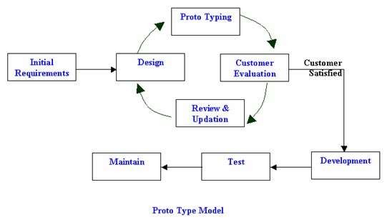
PROTOTYPE MODEL

Slide 4
Steps of Prototyping Model
Requirements Gathering and Analysis:
A prototyping model begins with requirements
analysis, and the requirements of the system are defined in
detail. The user is interviewed in order to known the requirements of the system.
Quick Design:
When requirements are known, a preliminary design or quick design for the system is created. It is not a detailed design. However it includes the important aspects of the system, which gives an idea of the system to the user.
Build Prototype :
Information gathering from quick design is modified to form a prototype. It represents a ’rough’ design of the required system.

Slide 5
Steps of Prototyping Model
Customer Evaluation:
After delivering the system developer needs to provide training about how to use the system. This activity is supported by customer evaluation, and if any changes are found then updation is done.
Review And Update:
There might be also change in input data or system enviorment. All this require modification of software.
After customer is satisfied final design and further process is carried out.
This model doesn't include all the features but provides client basic idea about the proposed system.

Slide 6
Types Of Prototype Model
Throw away/Rapid Prototyping: The prototype is developed as a part of throw away approch will not form final solution. This type of prototyping uses very little efforts with minimum requirement analysis to build a prototype.
Throw away prototypes are useful way of exploring ideas and gaining feedback from end-user.
Evolutionary Prototyping: Evolutionary prototyping approch is used when exat requirement of the solution cannot be set in advance. Using evolutionary prototyping only well understood requirements are included in the prototype and the other requirements are added when they are understood.

Slide 7
Incremental Prototyping : Incremental approch can be liked “building blocks”;incrementing each time a new component is added or integrated,based on overall design.the advantage of this method is end-user have the oppurtnity to test the developed component and their functionality.
Extreme Prototyping : Extreme prototyping is used in the web development domain. It consists of three sequential phases. First, a basic prototype with all the existing pages is presented in the html format. Then the data processing is simulated using a prototype services layer. Finally the services are implemented and integrated to the final prototype. This process is called Extreme Prototyping used to draw attention to the second phase of the process, where a fully functional UI is developed with very little regard to the actual services.

Slide 8
Need of prototype model
A prototype is made. Completely built sample model is shown to user and based on his feedback
.
Prototypes are an essential part of the design process: realizing a design in a physical form. This is beneficial in proving whether a new product is viable, in terms of its mechanical, electronic and ergonomic design. Having a working prototype demonstrates the benefits of your idea to industry, in a convincing way, to help inspire confidence in the idea.

Slide 9
Advantages of Prototype model
Reduces development time.
Reduces development cost.
Requires user involvment.
Missing functionality can be identified easily.
Encourages innovation and flexible designs.
Results in higher user satisfaction.

Slide 10
Good guarantees of success.
It is very simple model so it is easy to understand.
No need of specialize experts require to build model.
It is flexible so easy to modified the model.
High user involvement to build the model .
It is faster then other models.

Slide 11
Disadvantage
Insufficient analysis: The focus on a limited prototype can distract developers from properly analyzing the complete project. This can lead to overlooking better solutions, preparation of incomplete specifications or the conversion of limited prototypes into poorly engineered final projects that are hard to maintain.
User confusion of prototype and finished system: Users can begin to think that a prototype, intended to be thrown away, is actually a final system that merely needs to be finished or polished. Users can also become attached to features that were included in a prototype for consideration and then removed from the specification for a final system.

Slide 12
If the user is not satisfied with the developed prototype, then a new prototype is developed . This process goes on until a perfect prototype evolves . Thus , this model is time consuming and expensive.
The developer loses focus of the real purpose of prototype and compromises on the quality of the product . For example , he may apply some of the inefficient algorithms or inappropriate programming languages used in developing the prototype .

Slide 13
Prototyping can lead to false expectations. It often creates a situation where the user belives that the development of the system is finished when it is not.
The primary goal of prototyping is rapid development. Thus , the design of the system may suffer as it is built in a series of layers without considering integration of all the other components.
Developer misunderstanding of user objectives
Expense of implementing prototyping
Excessive development time of the prototype

Slide 14
Applications:
Software Prototyping is most useful in development of systems having high level of user interactions such as online systems. Systems which need users to fill out forms or go through various screens before data is processed can use prototyping very effectively to give the exact look and feel even before the actual software is developed.
Software that involves too much of data processing and most of the functionality is internal with very little user interface does not usually benefit from prototyping. Prototype development could be an extra overhead in such projects and may need lot of extra efforts.

Slide 15


