Slide 1
WaterFall Model
NAME-KRIMA SHAH
ENROLLMENT NO-170410107102
TY-CE-2 BATCH-B

Slide 2
What is Waterfall Model?
The waterfall model is a linear, sequential approach to the software development life cycle (SDLC) that is popular in software engineering and product development. The waterfall model emphasizes a logical progression of steps.

Slide 3
One should use the waterfall model only when:
- Requirements are very clear and fixed.
There are no ambiguous requirements.
The project is short.
low budget projects.

Slide 4
History of Waterfall Model
Firstly presented by Herbert Benington in 1956.
Which was republished in 1983.
Winston Royes formally cited this as article in 1970.
But Royes did not mention Waterfall term in that.
‘Waterfall’ term was first used by Bell in 1976.
The US dept. of Defense worked with this for software development in 1985 and stated the six phases of the model.

Slide 5
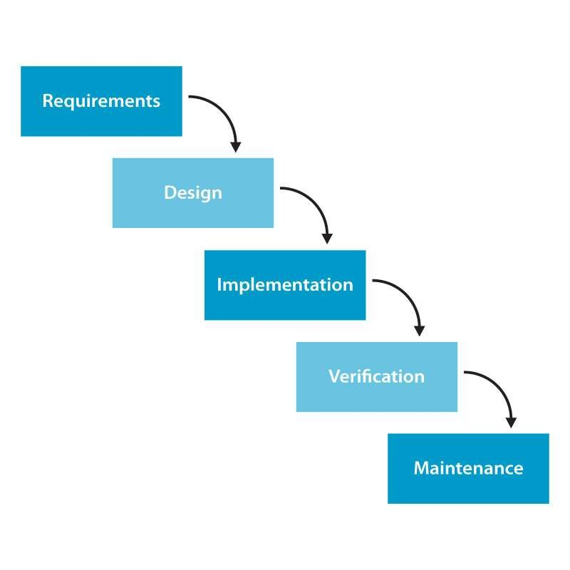
WaterFall Model :

Slide 6
Advantages of waterfall model:
Good for small projects.
Clearly defined stages.
Easy to use and follow.
When you move to the next phase, you have a clear picture o previous phases.
Design errors are identified early,before any software is writte
Change is limited.
Stakeholders and customers are engaged regularly.

Slide 7
Disadvantages of waterfall model:
Not useful for large project.
High amounts of risk and uncertainty.
Difficult to add or change requirements if they are identified and needed after the first phase.
There is a big problem if testing fails the software.
Can take a long time to deliver.

Slide 8
Limitations of WaterFall model:
Does not show iteration in software life cycle.
Does not show overlap between phases.
Software requirements are tested late in life cycle.
Operational system available late in life cycle.
Does not support partial system development.

