Slide 1
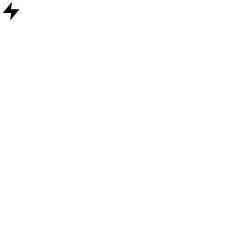
ENERGY GRID ANALYTICS
Predictive Load Shedding &
Grid Stability Classification
Cost-Sensitive Machine Learning + SHAP Explainability, on the UCI Electrical Grid Stability Simulated Dataset
Project Review — Current Stage

Slide 2
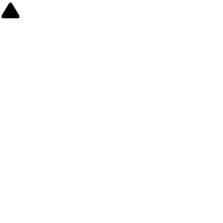
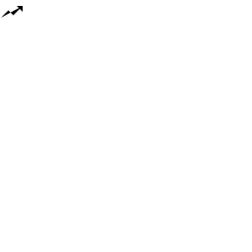
THE PROBLEM
Grids fail fast, and warnings are physical
Sudden supply/demand swings
Expensive failure mode
Wasteful over-caution
Solar & wind injection and heatwave demand spikes can destabilize grid frequency within seconds.
Overloading risks damaging multi-million dollar transformers — hardware that takes months to replace.
Over-generating or shedding load unnecessarily wastes power and money on the other side of the tradeoff.
Goal: forecast grid stability ahead of time, so micro-load-shedding can be triggered proactively — not reactively.
Grid Stability Analytics — Project Review
2

Slide 3
THE DATA
UCI Electrical Grid Stability Dataset
10,000
Feature groups
simulated grid states
tau1 – tau4
Reaction time of each participant (seconds) — how fast they respond to price signals
12
p1 – p4
Power produced/consumed. p1 = −(p2+p3+p4) by physical constraint
physical & economic input features
g1 – g4
Price elasticity coefficient — how strongly each participant reacts to price
4
stab / stabf
Max real eigenvalue of the linearized system → thresholded into stable / unstable label
grid participants (1 producer, 3 consumers)
Note: stab/stabf is excluded from model inputs — it IS the label pre-thresholding, so training on it would be leakage.
Grid Stability Analytics — Project Review
3

Slide 4





METHODOLOGY
The pipeline, end to end
1
2
3
4
5
Data prep
→
Cost matrix
→
Train models
→
Tune threshold
→
SHAP analysis
Drop leaky
`stab` column;
keep 12 true inputs
FN (missed
instability) costs
10× an FP
Cost-sensitive
XGBoost + SVM,
tuned via 5-fold CV
Pick decision
cutoff that
minimizes cost
Explain predictions,
find stability
threshold
Grid Stability Analytics — Project Review
4

Slide 5

DESIGN DECISION
Not all mistakes cost the same
False Negative — missed instability
Cost ratio applied
Model says 'stable' when grid is actually failing → cascading outage / transformer damage risk.
10 : 1
FN cost : FP cost
False Positive — false alarm
Applied two ways:
• scale_pos_weight (XGBoost) / class_weight (SVM), tuned via 5-fold CV on expected cost
• decision threshold re-optimized post-hoc — not the default 0.5
Model says 'unstable' when grid is fine → minor, wasted precautionary curtailment.
Grid Stability Analytics — Project Review
5

Slide 6
MODELS
Two classifiers, head to head
 | XGBoost | SVM (RBF)
Tuned parameter | scale_pos_weight = 6 | class_weight = {0:1, 1:5}
Test AUC | 0.990 | 0.996
Cost-optimal expected cost | 0.112 | 0.087
Train–test AUC gap | 0.009 | 0.001
Role in this project | SHAP explainability | Primary / best classifier
SVM wins on both accuracy and cost — likely because the true stability boundary is a smooth nonlinear function, which suits an RBF kernel better than tree splits.
Grid Stability Analytics — Project Review
6

Slide 7

VALIDATION
Is it overfitted? No.
How to tell
Overfitting shows up as a big gap between training and test performance — the model memorized rather than generalized.
Here, the gap is 0.001–0.009 AUC — the model performs almost identically on data it has never seen.
Grid Stability Analytics — Project Review
7

Slide 8
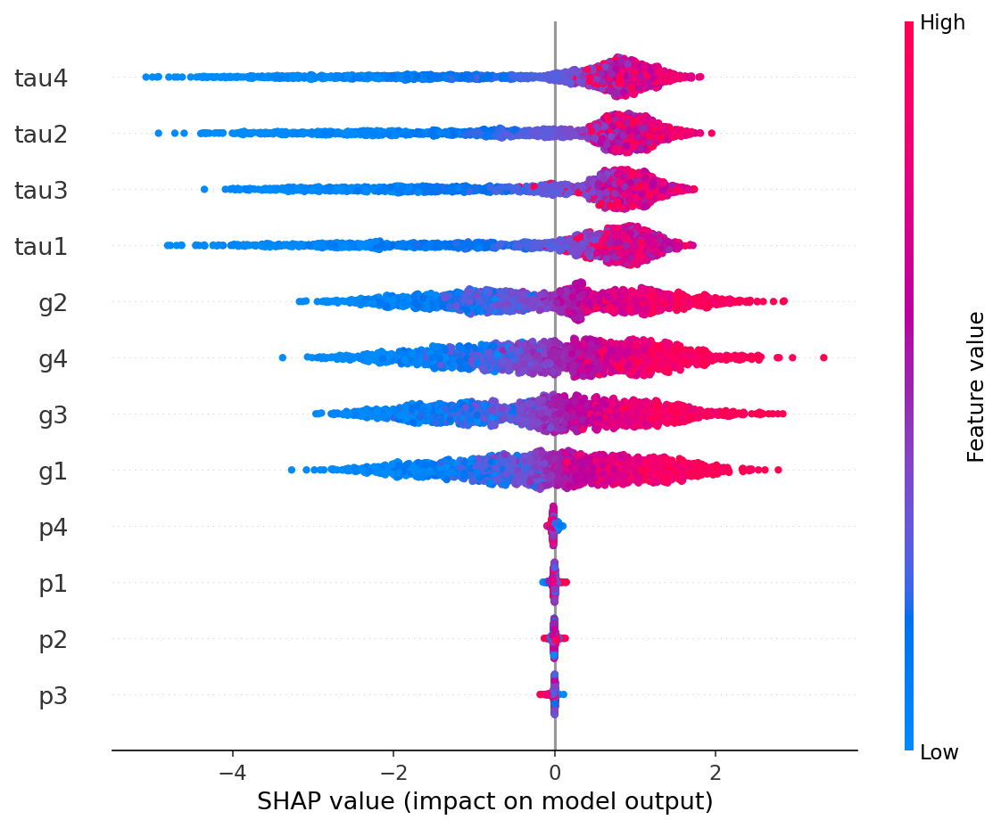
EXPLAINABILITY
What actually drives the prediction
SHAP, in one line
Shows which input pushed the prediction toward 'stable' or 'unstable', and by how much — no black box.
Key finding
Reaction time (tau) and price elasticity (g) dominate. Raw power (p) barely matters — each p is constrained to sum to zero, so it carries little independent signal.
Grid Stability Analytics — Project Review
8

Slide 9
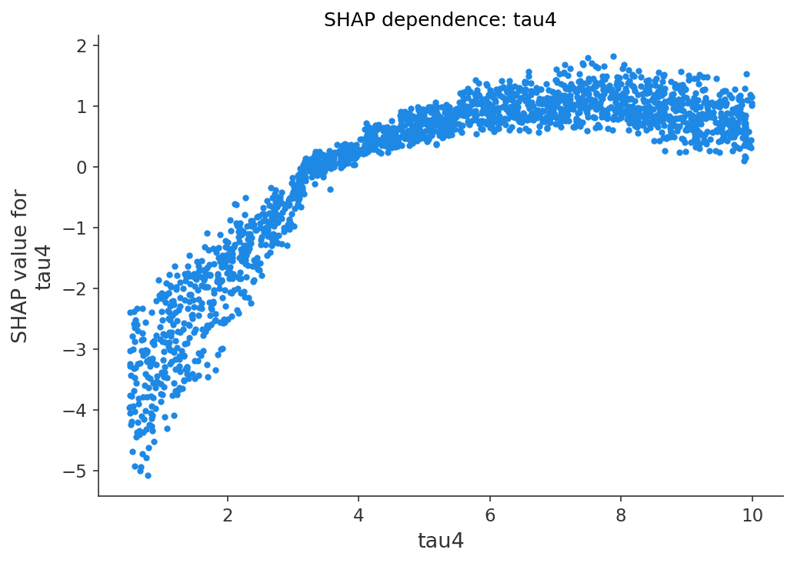
KEY FINDING
Where the grid flips from stable to unstable
≈ 3.3 s
reaction time (tau4 / tau1)
Below ~3.3s, participant reaction time pushes the model toward 'stable'. Above it, the same variable pushes toward 'unstable'.
This is empirical — derived from the trained model, not yet cross-checked against the closed-form eigenvalue condition.
Grid Stability Analytics — Project Review
9

Slide 10
PROJECT STATUS
What's done, and what this is not
Completed
Not yet / out of scope
• Data prep with leakage correctly removed
• Not connected to real grid telemetry — simulated data only
• Cost-sensitive XGBoost + SVM, both tuned via CV
• Not an actuator — classifies, doesn't shed load itself
• Threshold re-optimized for expected cost
• 10:1 cost ratio is a reasoned assumption, not calibrated
• Overfitting checked — confirmed not overfit
• Full SHAP explainability + numeric threshold
• 3.3s threshold not yet cross-checked against the closed-form eigenvalue condition
Grid Stability Analytics — Project Review
10

Slide 11
Summary
A working, cost-aware classifier that not only predicts grid stability with >99% AUC,
but explains — in physical terms — exactly why.
Grid Stability Analytics — Project Review
11

