Slide 1


DEPARTMENT OF MECHANICAL ENGINEERING
YEAR – II SEMESTER – IV
24ME451 – MINI PROJECT – II
SECOND REVIEW – AUTOMATIC RAIN SENSING CAR WIPER
Date: 20.02.2026
PROJECT BATCH – 5

Slide 2

PROJECT BATCH DETAILS
Project Batch – 5
Name of the project supervisor: Mr.C.Suren, Associate Professor / MECH
Details of the project members:
S. No. | Register No. | Name of the student | Location
1. | 963324114024 | GOKUL C | ANJUGRAMAM
2. | 963324114025 | HARI PRASAD R | JAMES TOWN
3. | 963324114029 | JERICHO S | JAMES TOWN
4. | 963324114032 | JOSE ASWIN R | JAMES TOWN

Slide 3
ABSTRACT
The issue of driver's safety is of great importance in today's automotive industry. In many cases, a lack of proper vision is responsible for accidents during heavy rainfall. In many cases, manual errors like not increasing the speed of the wiper by the driver lead to accidents. Today's car wipers work on the principle of manual switching. In this paper, we proposed an automatic rain sensing wiper system that detects rain and starts automatically and stops when the rain stops. The automatic rain sensing car wiper system is not only automatic but also intelligent. The wiper system detects the rainfall automatically and starts itself. The Wiper system is also intelligent. When the droplets of rainfall on the sensor, the sensor detects the intensity and the speed of the wiper are automated accordingly. The higher speed of rotation indicates the higher rainfall. There will be no need for manual intervention for controlling wiper. In this project, we use Arduino along with a rain sensor, an LCD 16x2 module, and a servo motor. The moisture is measured via analog output pins which are present in the rain sensor, the wiper starts rotating when a threshold of moisture is exceeded. The module used here is completely based on LM393 op-amp. The information sensed by the rain sensor is sent to Arduino. The Arduino is an Atemga8 based microcontroller board. Interactive electronic devices can be designed and created by using Arduino, which is a platform to develop the working of electronic devices. It consists of an on-board power supply and a USB port to communicate with the pc. The collected information from the rain sensor is processed and analyzed by Arduino and it further controls the servo motor based on the processed information. The information about the intensity of the rainfall and speed of the wiper is informed to the driver by means of a 4-bit LCD module which is kept near the driver's seat. The rain sensor is kept at the side of the windshield, outside the car. The rain sensor is connected to the servo motor. The blades of the wiper are connected to the servo motor. All the devices are connected to Arduino which is connected to the power source inside the car.
Keywords— Automatic, Sensing, Wiper, Arduino, Rain sensor module

Slide 4
INTRODUCTION
A car wiper is a device which is used to remove droplets of rainwater from a windscreen. Nowadays, each and every vehicle is provisioned with the wiper to avoid the accidents and to decrease the human intervention in controlling the wiper to ensure luxury. A wiper generally consists of a metal arm and a long rubber blade. In some vehicles, pneumatic power is used. Here, the metal arm gets powered by an electric motor. The blade moves in clock-wise and counter clock-wise direction on the glass, pushing the water from the surface of the glass. Modification of speed is automatically done based on the intensity of the rainfall. Two synchronized radial type arms are used in most of the automobiles, whereas pantograph arms are used in commercial automobiles. Wipers are automated in many ways. These days’ automobiles consist of a series of mechanical parts which are automated by an electric motor. In this, we propose an unmanned wiper which senses rain and starts automatically and switches off automatically when the rain stops. By using this, there will be no need for physical intervention of human to control the speed of the wiper. For this purpose, we use a rain sensor to detect the rain and then the signal is managed by Arduino and takes the required action.

Slide 5
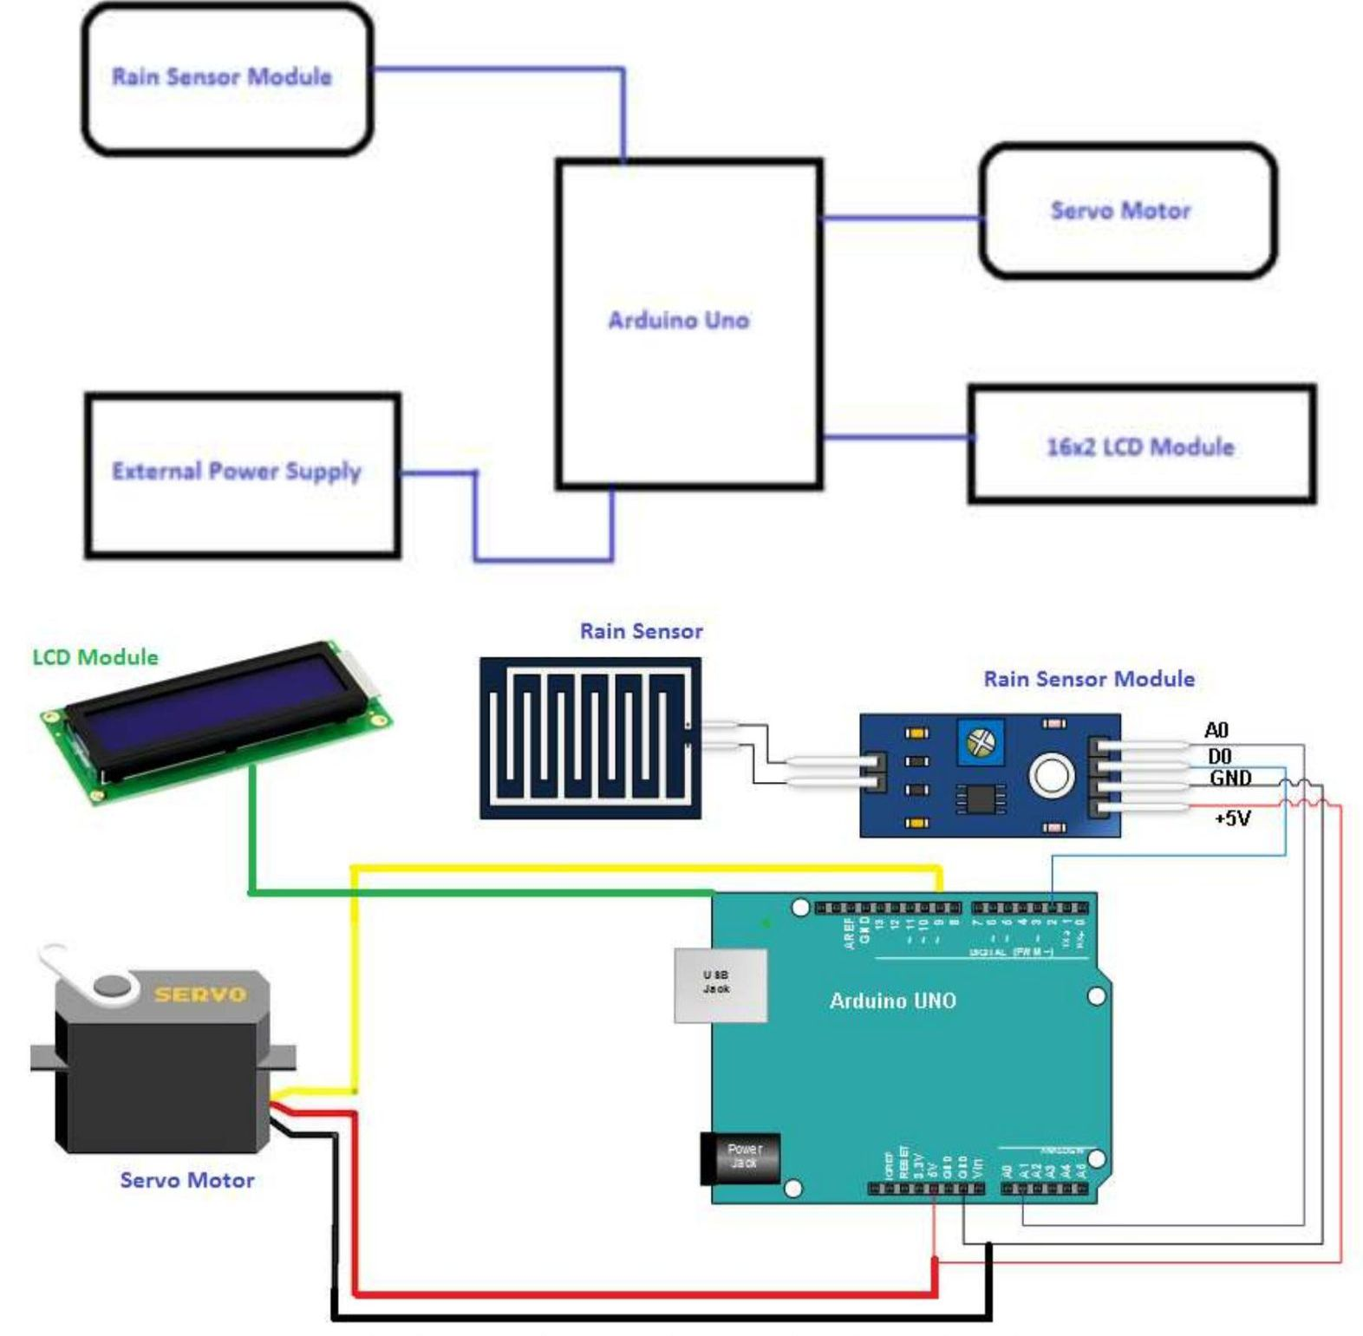
2.BLOCK DIAGRAM
2.1 Architecture diagram

Slide 6
3. LITERATURE SURVEY
In this work, they proposed an automatic wiper control system which is economical, efficient and has a good output. This paper uses a resistive rain sensor. They developed a wiper which is practically verified and a sensor is developed which is an equivalent mathematical model. The rain sensor generally has a predetermined rotational geometry. When the droplets of the rainfall on the sensor, the droplets form a layer on the surface of the sensor causing non-linearity to its resistance. To decrease the non-linearity and to increase the efficiency of the system, the response from the sensor is to be linearized. The response can be linearized by using the linearization circuit with the equivalent electrical model of the sensor. To achieve the changes in the speed based on the output provided by the rain sensor, customized PIC micro-controller is used in the paper named “ A novel and cost-effective resistive rain sensor for automatic wiper control: circuit modeling and implementation” by Mukul Joshi, M. A Joshi, Vinayak Sagare, D. N. Sonawane.
Reddy P. Abhilash et al.; International Journal of Advance Research, Ideas and Innovations in Technology
In this paper, fuzzy logic was used to operate the collected analog data from the rain sensor. The program was programmed to use fuzzy logic in collecting data. The wiper motor is controlled by the microcontroller which uses pulse width modulation. The reason for using the fuzzy logic in this project is only because it can be easily rearrangeable. They are used to redesign things. It can be used to construct different wipers for different vehicles without changing any hardware configuration. After a successful configuration, it can be placed in a vehicle and used. This is based on the paper named “Design and implementation of a reconfigurable automatic rain sensitive windshield wiper” by Lubna Alazzawi, Avik Chakravarty

Slide 7
4. EXISTING SYSTEM
Every year during the rainy season, more than 2 million people die worldwide because of accidents in the rainy season according to world health organization. People end up dying because of small mistakes. Today’s car wipers need human intervention to start the wiper and to control its speed. In this type of manual switching, the driver needs to switch on the wiper when needed and need to adjust the speed of the wiper as required. This causes inconvenience to the driver during rainfall. He can neither concentrate on driving nor focus on the adjustment of the speed of the wiper. This type of scenario leads to accidents. In the current scenario, only luxury vehicles employ intelligent rain-sensing windshield wiper systems.

Slide 8
5. METHODOLOGY
In this paper, we propose an automatic car wiper system which turns on automatically when the rain starts and stops when the rain stops. In this paper, there will be no need for physical intervention of man for controlling car wiper. In this paper, we use a servo motor, rain sensor Arduino and an LCD module for control in the wiper system. Whenever the rain falls, the rain sensor detects the intensity of the rainfall and sends the information to Arduino. The information collected by the rain sensor is processed by the Arduino and send the processed information to the servo motor to take the desired action. The rain sensor consists of digital analog output pins from where the intensity of the rain is calculated. The information which is sent to the microcontroller is responsible for controlling the speed of the wiper and based on the intensity of the rainfall. The LCD will show the intensity of the rainfall.

Slide 9
6. DETAILS OF COMPONENTS
6.1 Arduino
Arduino is easy to use a type of software which allows us to write the code for controlling hardware and electronics. Arduino boards can sense the inputs like sensing a finger on the sensor, controlling a light in a pattern, placing a finger on a button etc. for example, whenever a finger is placed on a button, light switches ON and whenever it is removed, the light switches OFF. The Arduino Uno microcontroller board can be controlled by sending instructions to it in the form of a code. The code used here is based on Arduino programming. Arduino Software is used for processing.

Slide 10
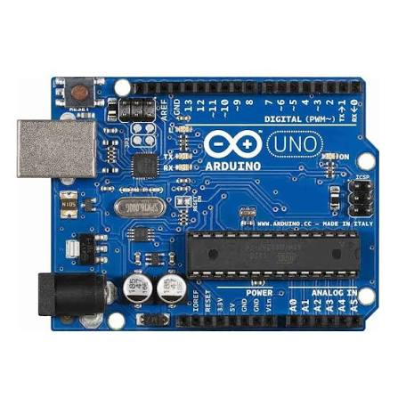
Arduino uno :
The Arduino Uno is a microcontroller board used to build electronics projects. It reads inputs (like sensors or buttons), processes them, and controls outputs (like LEDs, motors, or displays).
Fig. 2: Arduino Uno board

Slide 11
6.2 Rain Sensor
Rain sensors are generally used for sensing the droplets of rainfall. A threshold limit is set to every rain sensor. When the droplets or humidity reaches the threshold limit, the rain sensor sends the information to the one which takes the desired action. The rain sensor is equipped with digital analog pins through which the humidity can be sensed. When the sensed humidity is more than the threshold limit, then the desired action is performed. When the rain sensor is wet, it changes from 100000 to 2M ohms acting as a
variable resistor. So, when the board is wet the more conduction of current is more. A0, D0, GND, and VCC are the analog output, digital output, Ground and positive voltage respectively. Rain sensors are provided with two loop pins that are + and-, which are sensor board hook up A and B respectively.

Slide 12
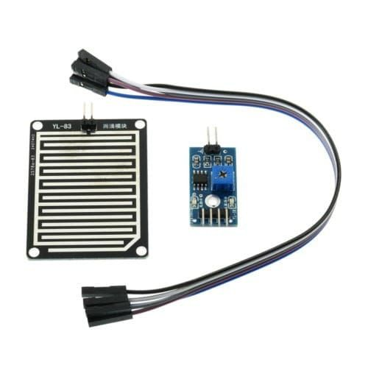
Fig. 3: Rain Sensor

Slide 13
6.3 Servo Motor
A servo motor generally consist of an output shaft through which the positioning of the shaft to a certain angle can be done using a coded signal which is sent by the servo. Servo motors are very useful in day-to-day life and are used in many appliances. Servo motors are very efficient and economical. Servo motors are small in size and can be placed in appliances for performing the desired action more effectively. Servo motors are very efficient and low energy consuming motors. These servo motors are controlled by using pulse width modulation, where a control wire is used to send electrical pulses. Minimum, Maximum pulse and repetition rate are the three types of pulse width modulations. A servo motor has a total movement of 180° of which it turns 90° in either direction. The servo motor rotates in clockwise as well as counter clock-wise direction.

Slide 14
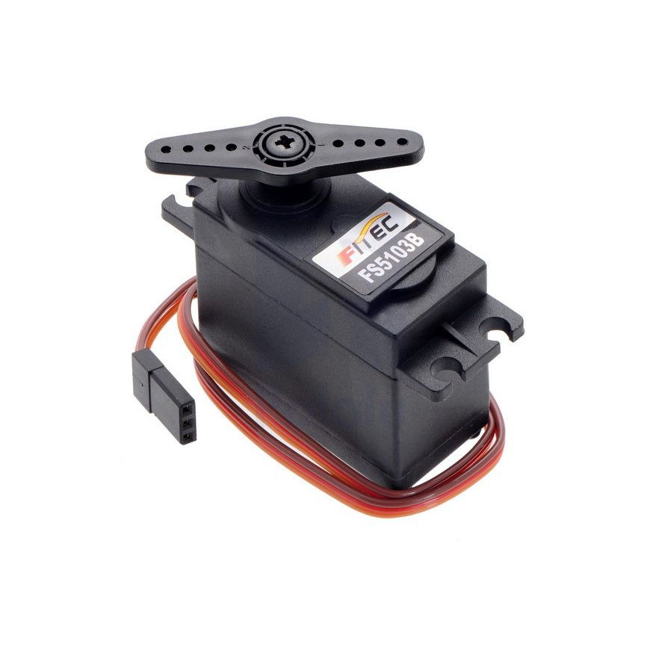
Fig. 4: Servo Motor

Slide 15
6.4 Implementation
The rain sensing wiper system is constructed using Rain Sensor, Servo motor, LCD module, and Arduino. Whenever the droplets of the rain on the rain sensor, it senses the rainfall and sends Arduino the necessary information for the process to carry on. Arduino is a microcontroller board which is generally an Atemga8. The information sent by the rain sensor is processed by the Arduino and controls the servo motor based on the information processed. The LCD module is to display the information about the speed of the wiper and intensity of the rain. The rain sensor, which senses the rainfall is placed at the side corner of the windshield outside the car. The wiper blades are connected with the servo motor and are powered by it. LCD module is kept inside the car nearby the driver’s vision. The rain sensor, LCD module, and the servo motor are connected with Arduino, which is present in the car connected to a dc source. The speed of the servo motor is increased whenever the intensity rises from low to high. There are three different speeds for the Low, Medium and High intensity of the rainfall. When the intensity of the rainfall increases, the rotation speed of the wiper will decrease automatically. Accordingly, the LCD module displays the information..

Slide 16
7. RESULT
The LCD module displays the intensity of rainfall ranging from NIL to low, medium, high. When there is no rainfall, the LCD display will show the intensity of rainfall as NIL. When the rain begins, the rain sensor senses the rain automatically and sends a signal to the LCD and displays the intensity of the rainfall ranging from low to high. When the intensity of the rainfall changes, the rain sensor senses the intensity and sends a signal to the servo motor and the servo motor will increase the speed of rotation accordingly.

Slide 17
8.application
1. Automatic Wiper Control
Wiper starts automatically when rain is detected.
2. Speed Control Based on Rain Intensity
light rain → slow wiping
Heavy rain → fast wiping
3. Improves Driver Safety
Driver can focus on driving, not on switching wiper speeds.
4. Useful in Sudden Rain
Helps during unexpected rain, mist, or drizzle.
5. Reduces Manual Effort
No need to manually operate wiper switch repeatedly.
6. Better Visibility
Keeps windshield clear automatically.
7. Used in Modern Cars
Common in high-end and smart vehicles.

Slide 18
9.Advantages
1.No need to operate manually – wiper turns ON automatically when rain starts.
2.Improves driving safety – clear visibility is maintained during sudden rain.
3.Reduces driver distraction – driver can focus on road instead of adjusting wiper speed.
4.Automatic speed control – wiper speed changes based on rain intensity (light/medium/heavy).
5.Saves time and effort – very useful in unexpected rain situations.
6.Better comfort – smooth and convenient driving experience.
7.Efficient wiping – avoids unnecessary wiping when there is no rain.
8Reduces wear and tear – wiper runs only when needed, increasing blade life.
9.Works well in different conditions – like drizzle, heavy rain, and splashes.
10.Modern smart feature – adds value and advanced look to the vehicle.

Slide 19
Work plan
S. No. | Week | Planned work | % of completion
1. | JAN – 2ⁿᵈ week |  | 10 %
2. | JAN – 3ʳᵈ week |  | 20 %
3. | JAN – 4ᵗʰ week |  | 30 %
4. | FEB – 1ˢᵗ week |  | 40 %
5. | FEB – 2ⁿᵈ week |  | 50 %
6. | FEB – 3ʳᵈ week |  | 60 %
7. | FEB – 4ᵗʰ week |  | 70 %
8. | MAR – 1ˢᵗ week |  | 80 %
9. | MAR – 2ⁿᵈ week |  | 90 %
10. | MAR – 3ʳᵈ week |  | 100 %

Slide 20


