Slide 1
AZURE DATA FACTORY
Screenshots & Practical Guide
A visual walkthrough of setup, authoring, monitoring, management, security, and linked services.
29 annotated screenshots • Key concepts • Practical use cases

Slide 2
How to use this guide
Each section pairs the original Azure portal screenshot with a short explanation and a real-world use case.
01
Create & configure
02
Author & build
Basics, Git, networking, encryption, tags
Workspace, pipelines, datasets, data flows, Power Query
03
Monitor
04
Manage
Pipeline runs, trigger runs, runtimes, debug, alerts
Linked services, settings, Purview, Git, ARM templates
05
Security & reuse
06
Connect data
Triggers, parameters, libraries, credentials, keys
Integration runtime setup and ADLS Gen2 linked service
Tip: “0 items” or “No results” usually means no matching runs/resources are listed—not automatically that the service is broken.

Slide 3
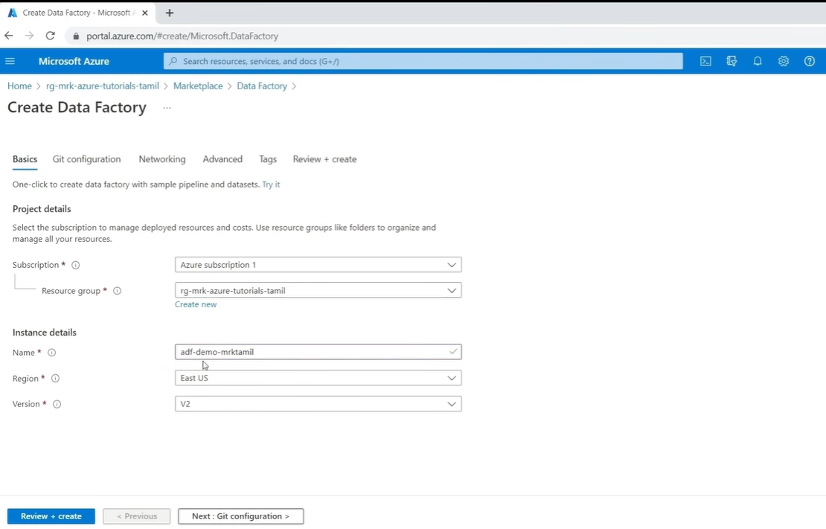
Create Data Factory – Basics
PURPOSE
Create the Azure Data Factory resource that will host your data integration work.
KEY POINTS
Subscription: Azure account that manages resources and billing.
Resource group: Container for related Azure resources.
Name: Unique name for the Data Factory.
Region: Azure location where the resource is deployed.
Version: V2 is the Data Factory generation shown.
USE CASE
Create a factory as the starting point for pipelines that move sales data from databases and files into a central data lake.
Azure Data Factory • Visual walkthrough
03

Slide 4
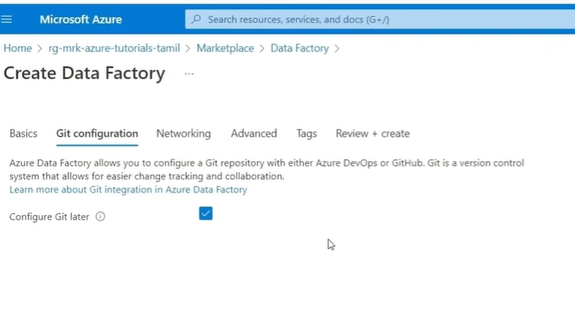
Git Configuration During Creation
PURPOSE
Choose whether to configure source control while creating the factory.
KEY POINTS
Azure DevOps or GitHub can store pipeline definitions and track changes.
Configure Git later lets you skip repository setup during creation.
Git is useful for collaboration, review, and version history.
USE CASE
A developer commits a pipeline change to Git so teammates can review it before publishing.
Azure Data Factory • Visual walkthrough
04

Slide 5
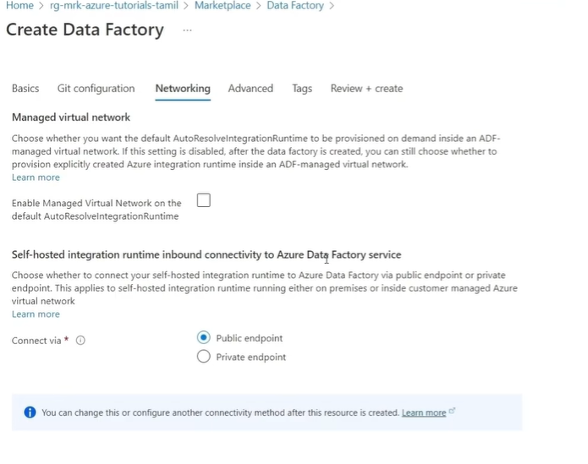
Networking
PURPOSE
Control how Azure Data Factory connects to services and data sources.
KEY POINTS
Managed Virtual Network can provide network isolation for supported connections.
Public endpoint: connect through a public service endpoint.
Private endpoint: use private IP connectivity where supported.
Choose connectivity based on security and network requirements.
USE CASE
A company processing sensitive data may use private connectivity to reduce exposure to the public internet.
Azure Data Factory • Visual walkthrough
05

Slide 6
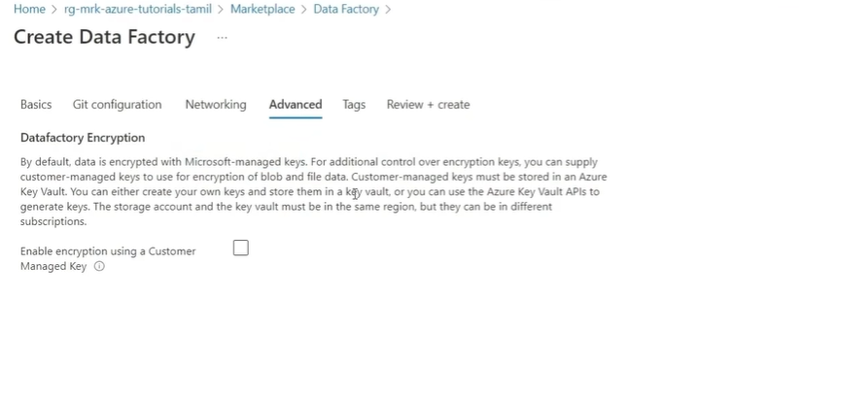
Advanced – Encryption
PURPOSE
Choose encryption-key management for the Data Factory.
KEY POINTS
Microsoft-managed keys are the default and are managed by Azure.
Customer-managed keys (CMK) can be configured through Azure Key Vault.
CMK offers more control over key access and rotation but requires extra setup.
USE CASE
A regulated organization manages encryption keys to align with its security and compliance policies.
Azure Data Factory • Visual walkthrough
06

Slide 7
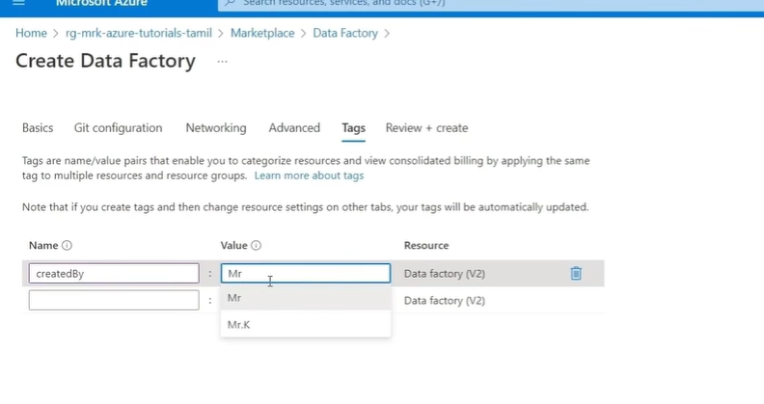
Tags
PURPOSE
Tags are name/value pairs that help organize Azure resources and report costs.
KEY POINTS
Example: createdBy = Mr.K
Example: environment = Development
Example: department = DataEngineering
Use consistent tags to identify ownership and group resources.
USE CASE
A team reviews resource ownership and spending by department or environment.
Azure Data Factory • Visual walkthrough
07

Slide 8
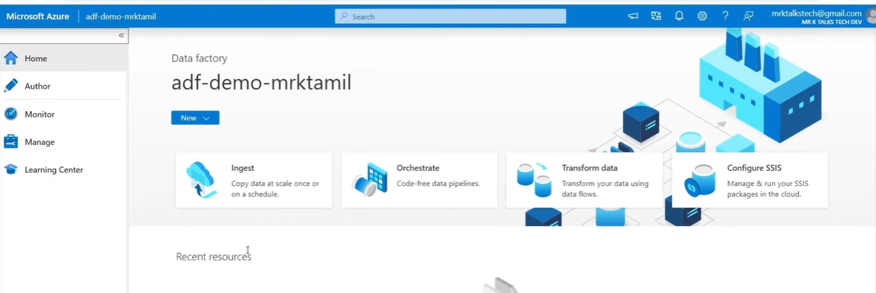
Data Factory Workspace Overview
PURPOSE
The main workspace is where you author, manage, and monitor data integration.
KEY POINTS
Author: create pipelines, datasets, linked services, and data flows.
Monitor: inspect pipeline runs, failures, and duration.
Manage: configure connections, runtimes, triggers, and security.
Learning Center: tutorials, videos, and templates.
Ingest, orchestrate, transform, and run SSIS packages from the workspace.
USE CASE
Automate sales-data ingestion, transform it, and load it for analytics and Power BI reporting.
Azure Data Factory • Visual walkthrough
08

Slide 9
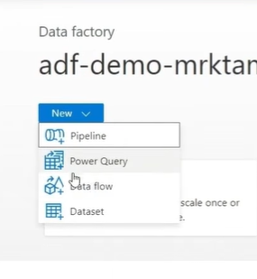
New Menu – Create Components
PIPELINE
Orchestrates activities into a workflow.
KEY POINTS
Power Query: low-code data preparation.
Data flow: visual transformations such as joins, filters, and aggregates.
Dataset: describes the location and format of data used by activities.
USE CASE
Build a pipeline that copies a CSV file, transforms records, and loads the results into a warehouse.
Azure Data Factory • Visual walkthrough
09

Slide 10
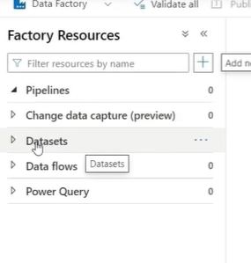
Factory Resources
PURPOSE
Factory Resources lists the main building blocks used to author data workflows.
KEY POINTS
Pipelines: coordinate and execute activities.
Datasets: describe source or destination data.
Data flows: visually transform data.
Power Query: prepare data with a low-code experience.
Change Data Capture (preview): support processing data changes where configured.
USE CASE
Create source/destination datasets, use a pipeline for orchestration, and add transformations when needed.
Azure Data Factory • Visual walkthrough
10

Slide 11
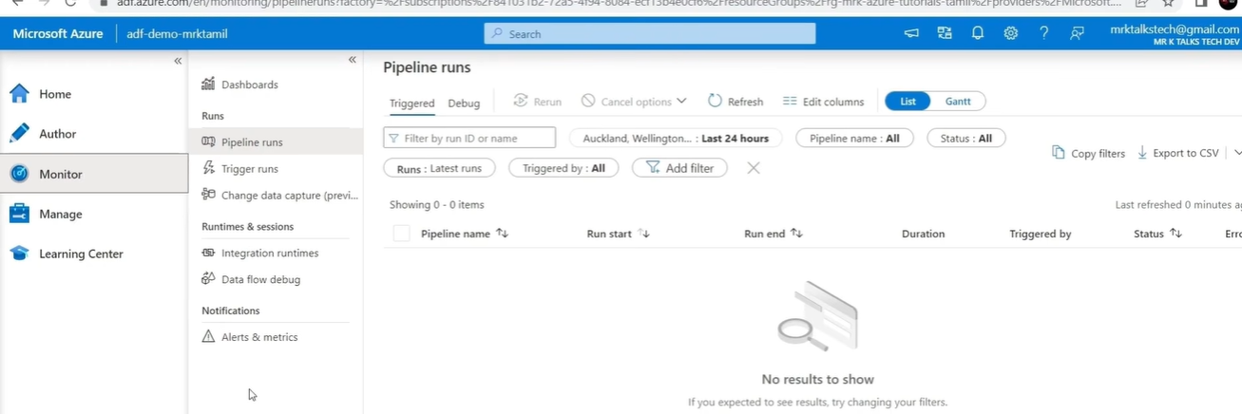
Monitor – Pipeline Runs
PURPOSE
View executions of pipelines and investigate their outcomes.
KEY POINTS
Check pipeline name, start/end time, duration, trigger, status, and errors.
Use filters to find a run by name, status, or time range.
Rerun a pipeline after investigating and fixing a failure.
SCREENSHOT NOTE
The page shows 0 items. No runs match the current filters/time range; it does not necessarily mean there is an error.
Azure Data Factory • Visual walkthrough
11

Slide 12
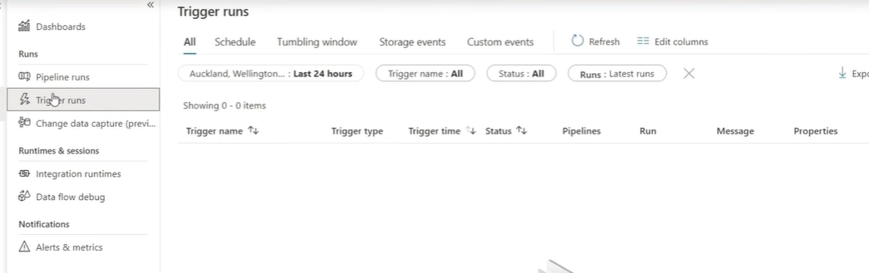
Monitor – Trigger Runs
PURPOSE
Inspect executions of triggers that start pipelines automatically.
KEY POINTS
Schedule: start at a specified time or recurring interval.
Tumbling window: process fixed, continuous time windows.
Storage events: start when a storage event occurs.
Custom events: start when a matching event is received.
SCREENSHOT NOTE
0 items are shown for the selected time range and filters. Create and activate a trigger before expecting runs.
Azure Data Factory • Visual walkthrough
12

Slide 13
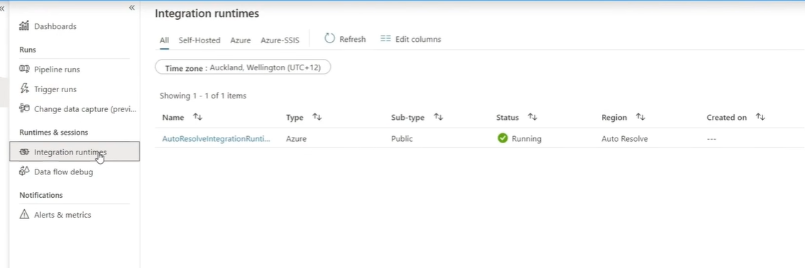
Monitor – Integration Runtimes
PURPOSE
Check the integration runtime available to execute supported data integration activities.
KEY POINTS
The screenshot shows AutoResolveIntegrationRuntime.
Type: Azure; subtype: Public; status: Running; region: Auto Resolve.
The Azure runtime provides compute for supported data movement and activities.
USE CASE
Copy data from Azure SQL Database to Azure Data Lake Storage using an Azure Integration Runtime.
Azure Data Factory • Visual walkthrough
13

Slide 14
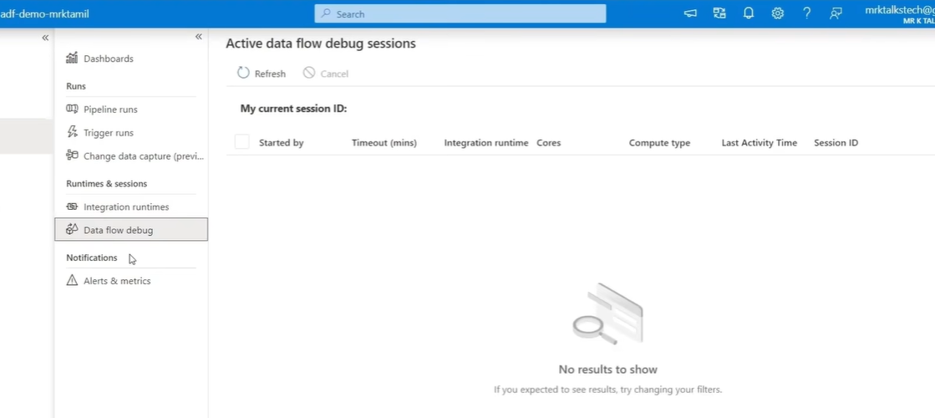
Monitor – Data Flow Debug
PURPOSE
Test and troubleshoot mapping data flows interactively before production execution.
KEY POINTS
Debug sessions use compute from an integration runtime.
Session details can include timeout, cores, compute type, and last activity.
Refresh the list or cancel a selected active session.
SCREENSHOT NOTE
No active debug sessions are listed in the screenshot.
Azure Data Factory • Visual walkthrough
14

Slide 15
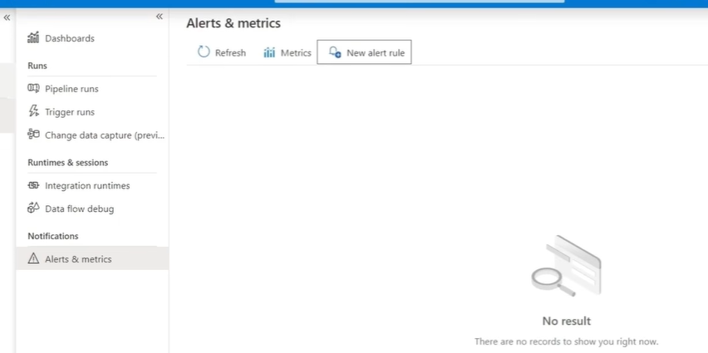
Monitor – Alerts & Metrics
PURPOSE
Review supported monitoring metrics and configure alerts for selected conditions.
KEY POINTS
Metrics: inspect available monitoring measurements.
New alert rule: define a condition and configure notifications.
Alerts can help teams notice failures or unusual behavior quickly.
USE CASE
Create an alert for a supported pipeline-monitoring condition so the support team can investigate promptly.
Azure Data Factory • Visual walkthrough
15

Slide 16
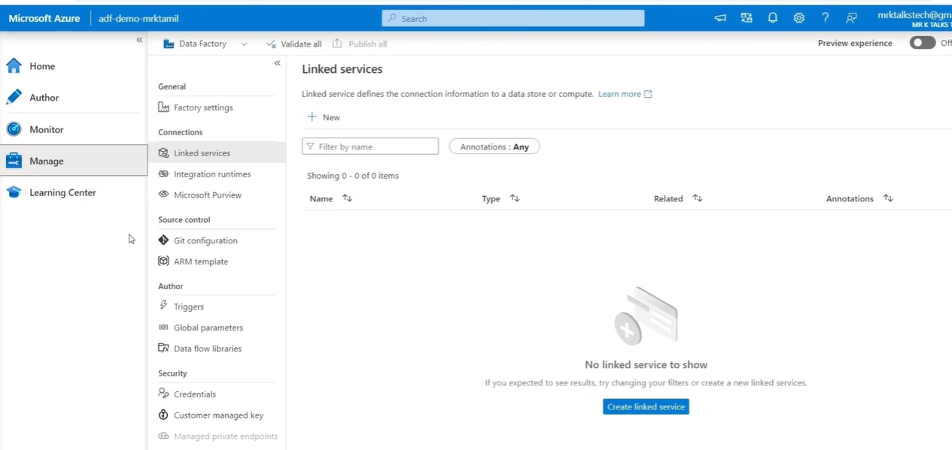
Manage – Linked Services (Empty)
PURPOSE
A linked service defines connection information for a data store or compute service.
KEY POINTS
Create a connection for each required source or destination.
Examples include Azure SQL Database, Blob Storage, and Data Lake Storage.
Use the connection in pipeline activities or datasets.
SCREENSHOT NOTE
No linked services are configured yet. Create the required connections before using them in a pipeline.
Azure Data Factory • Visual walkthrough
16

Slide 17
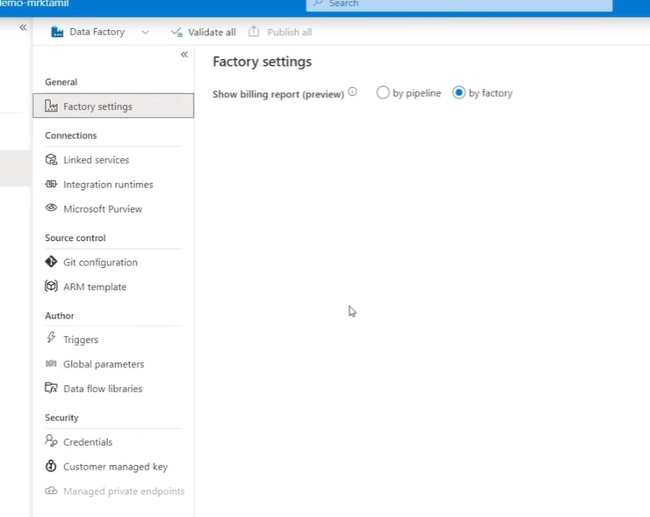
Manage – Factory Settings
PURPOSE
Factory-level settings include the billing-report view shown in this screenshot.
KEY POINTS
By pipeline: view billing information grouped by pipeline where supported.
By factory: view billing information for the overall Data Factory.
Use the view that best supports your cost investigation.
USE CASE
Compare pipeline-level costs to identify which workflows contribute most to overall usage.
Azure Data Factory • Visual walkthrough
17

Slide 18
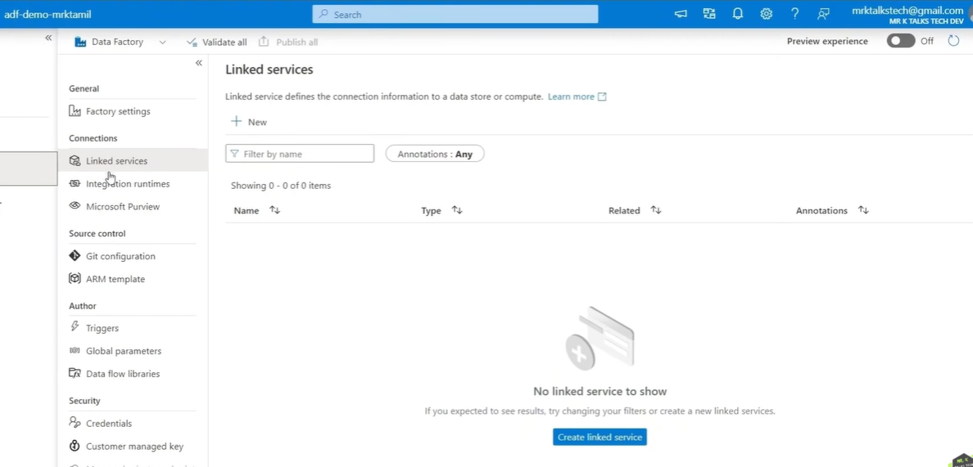
Manage – Linked Services
PURPOSE
Create and manage the connections used by your factory.
KEY POINTS
New: add a linked service.
Filter by name: find an existing connection.
Related resources and annotations help organize connections.
USE CASE
Create one linked service for Azure SQL Database and another for Data Lake Storage, then use both in a Copy Data activity.
Azure Data Factory • Visual walkthrough
18

Slide 19
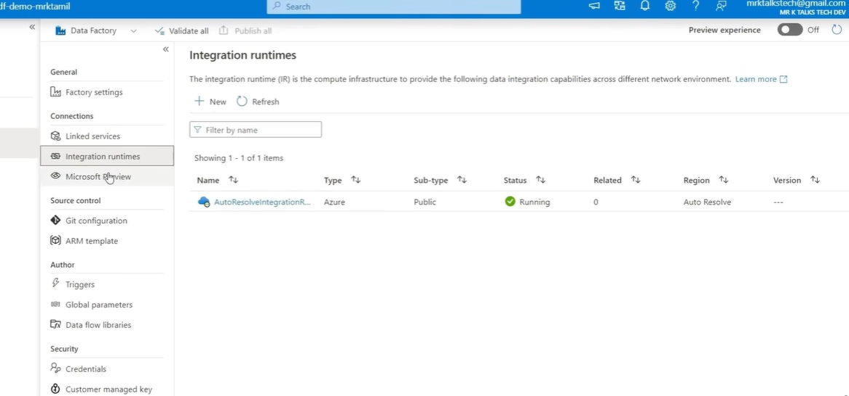
Manage – Integration Runtimes
PURPOSE
Configure the compute and connectivity infrastructure for data integration.
KEY POINTS
Azure: Azure-managed runtime for supported activities.
Self-hosted: access on-premises or private-network data sources.
Azure-SSIS: run supported SSIS packages in Azure.
SCREENSHOT NOTE
AutoResolveIntegrationRuntime is shown as Running, with Type Azure and Region Auto Resolve.
Azure Data Factory • Visual walkthrough
19

Slide 20
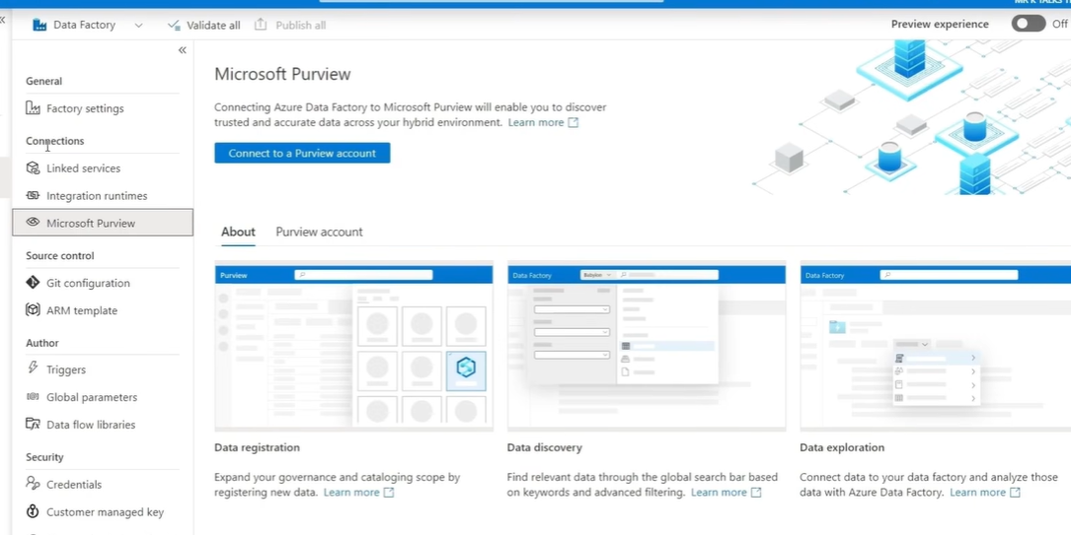
Manage – Microsoft Purview
PURPOSE
Connect Data Factory to Microsoft Purview for data discovery and governance capabilities.
KEY POINTS
Data registration: register data sources/assets.
Data discovery: search for relevant data assets.
Data exploration: examine assets and relationships.
Lineage and governance depend on configured sources and supported integrations.
USE CASE
Find the origin of a customer dataset and understand related data assets across systems.
Azure Data Factory • Visual walkthrough
20

Slide 21
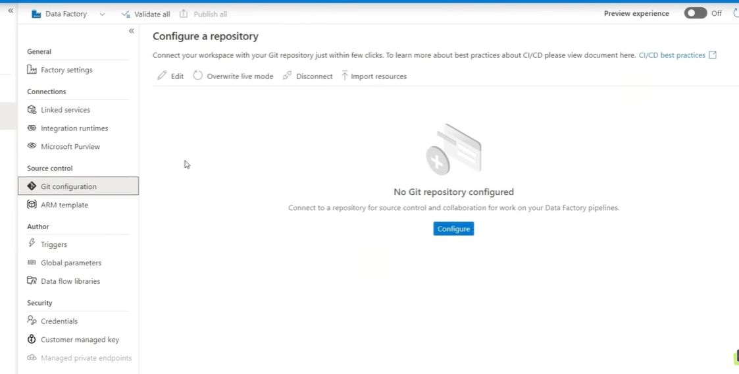
Manage – Git Configuration
PURPOSE
Connect the authoring workspace to a Git repository for source control.
KEY POINTS
Configure: connect to a repository.
Edit: change repository settings.
Overwrite live mode: replace live resources with content from the collaboration branch.
Disconnect: remove the connection; Import resources can bring resources into the workspace.
SCREENSHOT NOTE
No Git repository is configured in this screenshot.
Azure Data Factory • Visual walkthrough
21

Slide 22
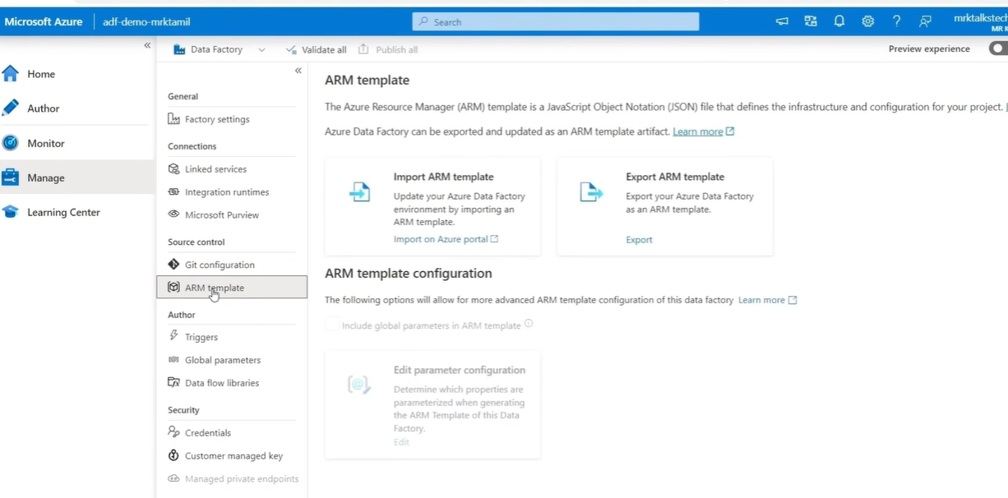
Manage – ARM Template
PURPOSE
Export and deploy Data Factory configuration using Azure Resource Manager (ARM) templates.
KEY POINTS
Export ARM template: package supported factory resources as JSON template artifacts.
Import ARM template: apply a template to create or update resources.
Parameter configuration controls which properties are parameterized.
Global-parameter template option is marked deprecated in the screenshot.
USE CASE
Promote factory configuration from Development to Test and Production with repeatable deployments.
Azure Data Factory • Visual walkthrough
22

Slide 23
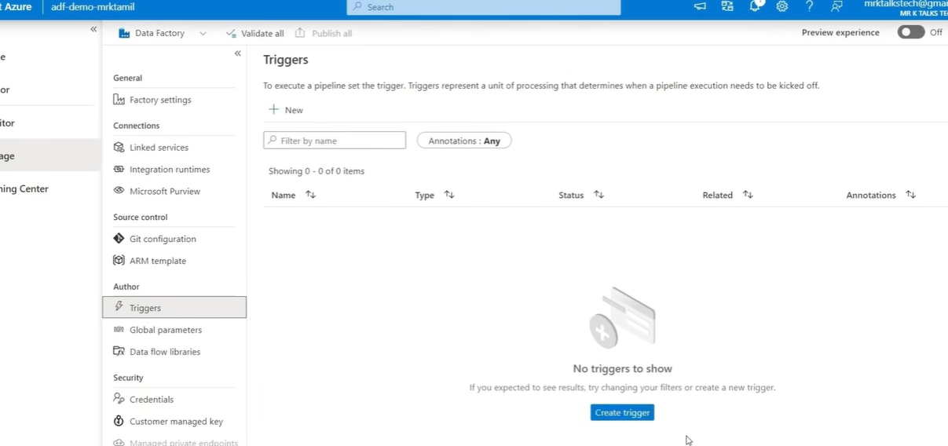
Manage – Triggers
PURPOSE
Define when a pipeline should start.
KEY POINTS
Schedule trigger: run at a time or recurring interval.
Tumbling window: run over fixed time windows.
Storage event: start when a matching storage event occurs.
A trigger must be configured and activated to start pipeline runs.
SCREENSHOT NOTE
No triggers have been created in this factory yet.
Azure Data Factory • Visual walkthrough
23

Slide 24
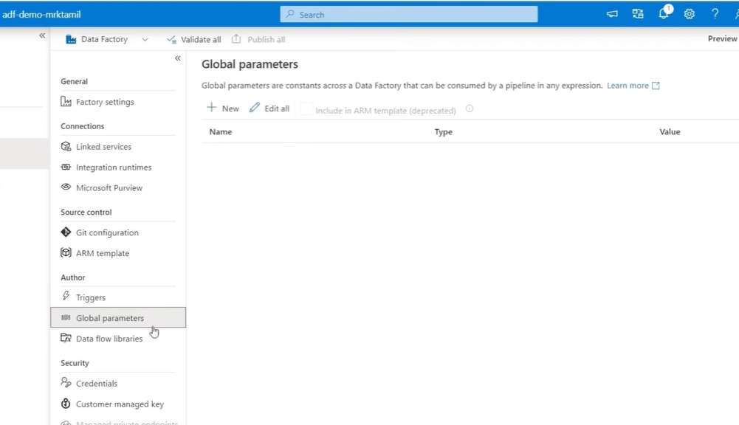
Manage – Global Parameters
PURPOSE
Global parameters are reusable factory-level values available to pipeline expressions.
KEY POINTS
Create a parameter with a name, type, and value.
Example: storageFolder (String) = salesdata.
Reference the shared value from multiple pipelines instead of repeating literals.
USE CASE
Change a common folder value in one place instead of editing several pipelines.
Azure Data Factory • Visual walkthrough
24

Slide 25
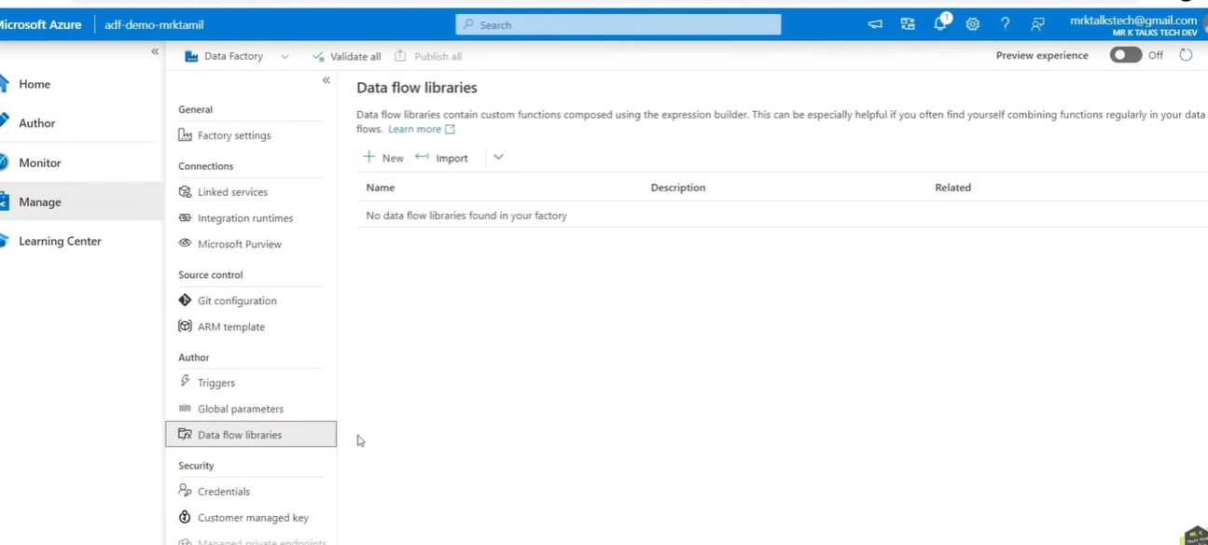
Manage – Data Flow Libraries
PURPOSE
Data flow libraries contain reusable custom functions for mapping data flows.
KEY POINTS
New: create a library; Import: bring in an existing library.
Reuse repeated transformation logic where supported.
This can reduce duplicated expressions and help standardize transformations.
USE CASE
Reuse a custom function that standardizes customer names across multiple data flows.
Azure Data Factory • Visual walkthrough
25

Slide 26
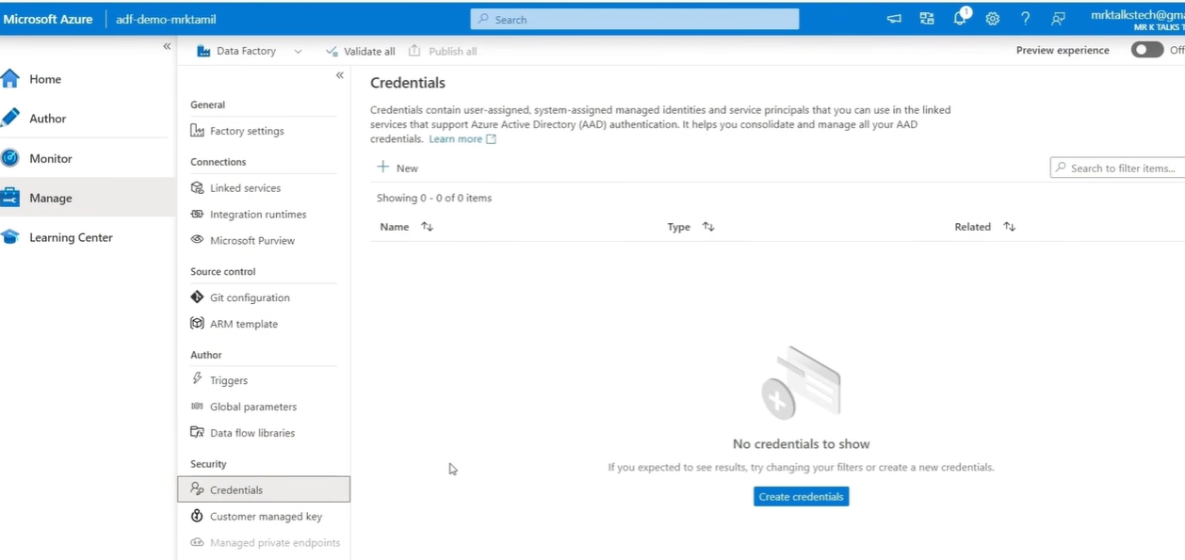
Manage – Credentials
PURPOSE
Credentials provide identity information for authentication in supported linked services.
KEY POINTS
Supported options can include managed identities and service principals.
Grant only the permissions required by the target service.
Avoid embedding secrets directly in pipeline definitions.
SCREENSHOT NOTE
No credentials are listed in the screenshot.
Azure Data Factory • Visual walkthrough
26

Slide 27
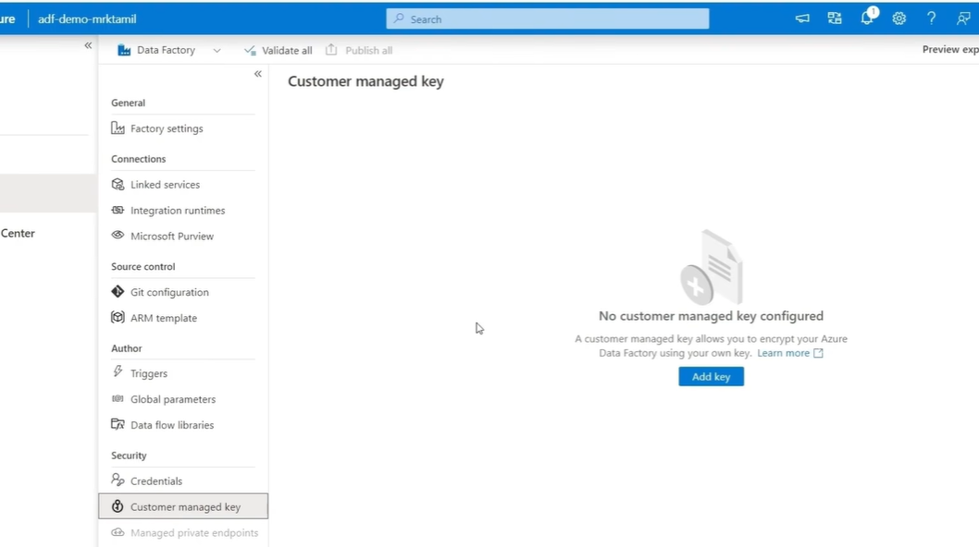
Manage – Customer-Managed Key
PURPOSE
Configure a customer-managed encryption key for the Data Factory where supported.
KEY POINTS
Keys are typically stored and managed through Azure Key Vault.
CMK provides more control over key access and rotation.
It requires correct key permissions and additional administration.
SCREENSHOT NOTE
No customer-managed key is configured in the screenshot.
Azure Data Factory • Visual walkthrough
27

Slide 28
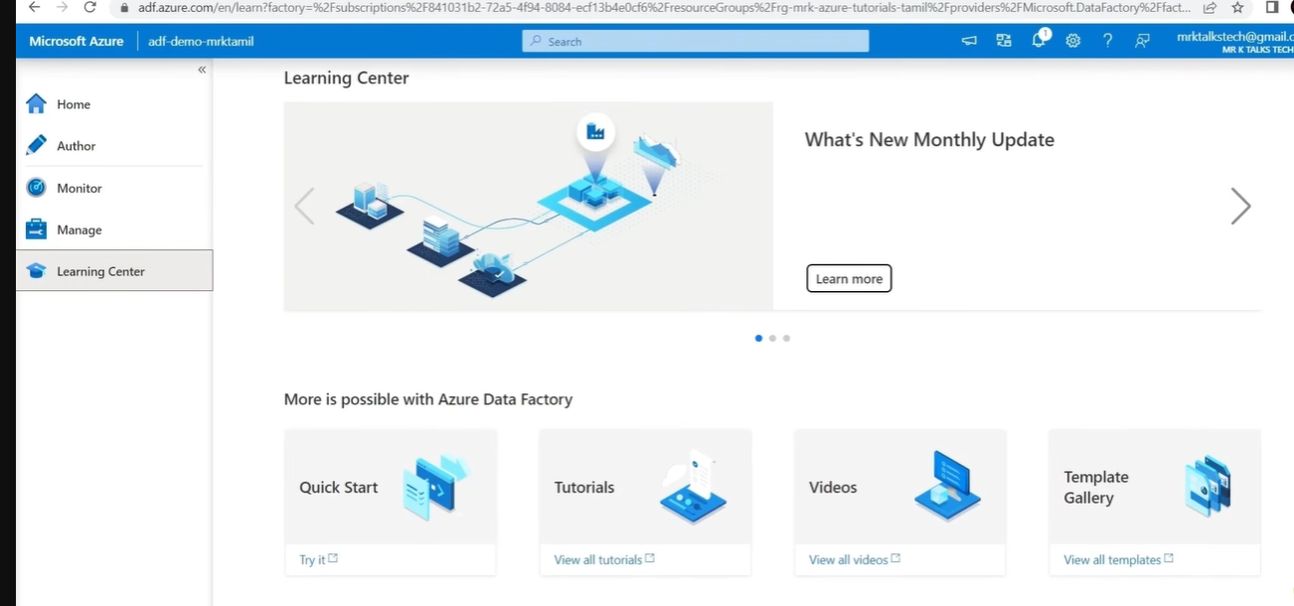
Learning Center
PURPOSE
Use built-in learning resources to learn and practice Azure Data Factory.
KEY POINTS
Quick Start: introductory steps.
Tutorials: guided exercises.
Videos: visual demonstrations.
Template Gallery: starting points for common workflows.
Monthly updates: learn about new features.
USE CASE
Follow a tutorial to build a pipeline that copies data from Azure SQL Database to Data Lake Storage.
Azure Data Factory • Visual walkthrough
28

Slide 29
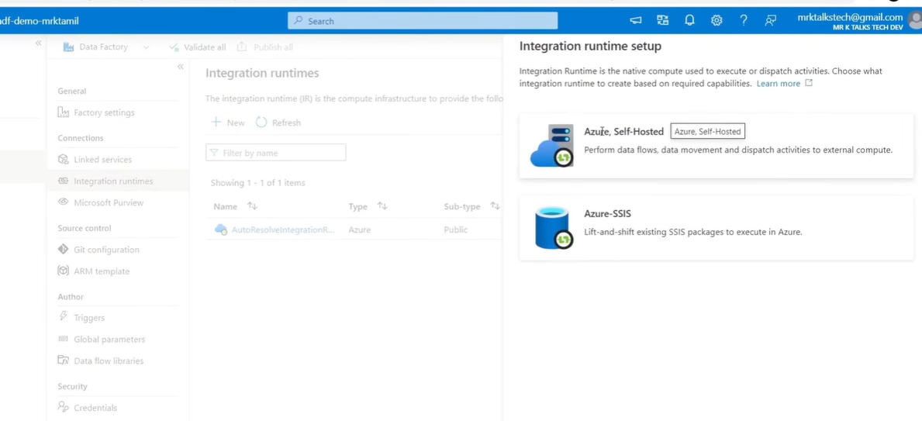
Create Integration Runtime
AZURE, SELF-HOSTED
Use a self-hosted runtime for connectivity to on-premises or private-network data sources and supported activities.
KEY POINTS
Install/configure the runtime on a server that can reach the source.
Azure-SSIS: provision runtime infrastructure to run supported SSIS packages in Azure.
Choose based on source location and workload.
USE CASE
Copy data from an on-premises SQL Server to Azure Data Lake Storage, or lift-and-shift existing SSIS packages to Azure.
Azure Data Factory • Visual walkthrough
29

Slide 30
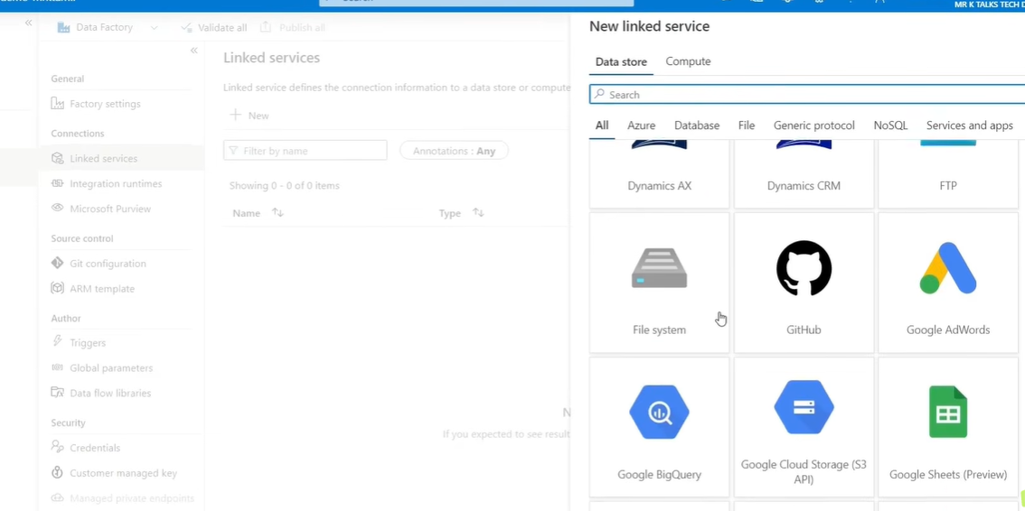
New Linked Service – Connector Gallery
PURPOSE
Select a connector for the data store, application, or compute service you want to connect to.
KEY POINTS
Browse tabs such as Azure, Database, File, NoSQL, and Services and apps.
Examples shown: FTP, File system, GitHub, BigQuery, Google Cloud Storage, and Google Sheets (Preview).
Connector availability and authentication options vary by service.
USE CASE
Choose the source and destination connectors needed for a copy pipeline.
Azure Data Factory • Visual walkthrough
30

Slide 31
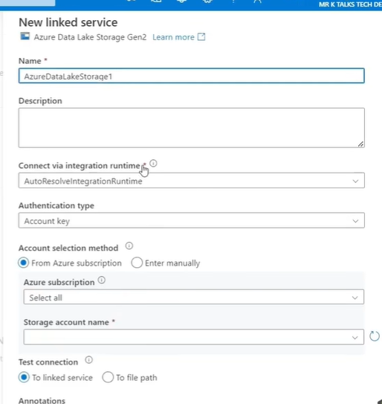
Linked Service – Azure Data Lake Storage Gen2
PURPOSE
Configure the connection from ADF to an Azure Data Lake Storage Gen2 account.
KEY POINTS
Name: identify the connection, e.g. AzureDataLakeStorage1.
Integration Runtime: select the runtime used for connectivity.
Authentication: Account key is selected in this screenshot.
Select the subscription/account or enter details manually.
Test connection to verify access.
USE CASE
Connect ADF to a storage account so a pipeline can read or write CSV, JSON, or Parquet files. For production, consider managed identity where supported.
Azure Data Factory • Visual walkthrough
31

