Slide 1
Bootstrap
kubernetes cluster

Slide 2
kubeadm
Kubeadm helps with installing and configuring kuberentes cluster.

Slide 3
Kubeadm commands
Kubeadm init – will initialise the kubernetes master node.
Kubeadm join – will initialise the worker node
Kubeadm token – used to create token. (0-9,a-z,A-Z,-)
Kubeadm version – will display the version
Kubeadm upgrade – will upgrade and down grade the kubernetes cluster.

Slide 4
Requirements
Atleast 3GB RAM
3 CPU or more
Full network connectivity
Disable swap on all nodes

Slide 5
Steps involve to creating kubernetes cluster
1. Create Vms which are part of k8s cluster (master and worker nodes).
2. Disable SELinux and SWAP on all nodes.
3. install kubeadm, kubelet, kubectl and Docker on all nodes.
4. initialize the master node (By initialising kubeadm init).
5. Configure Pod network
6.join worker nodes to the cluster

Slide 6
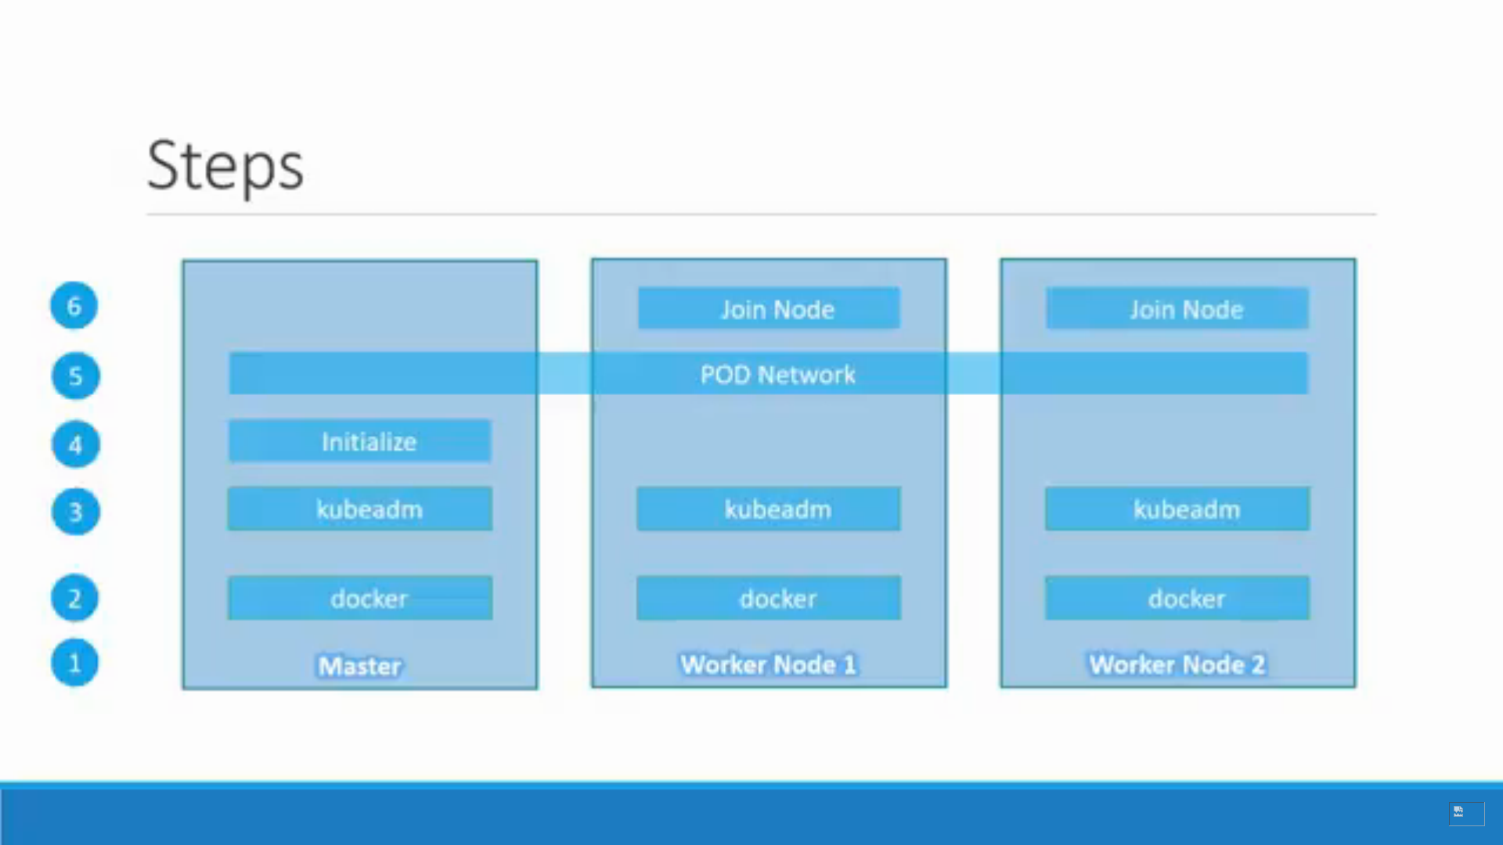

Slide 7
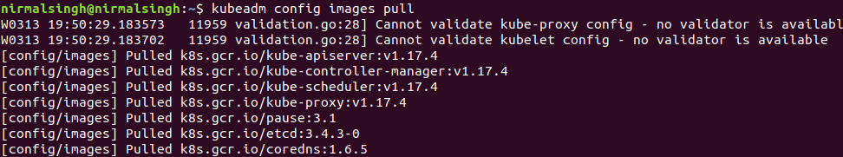
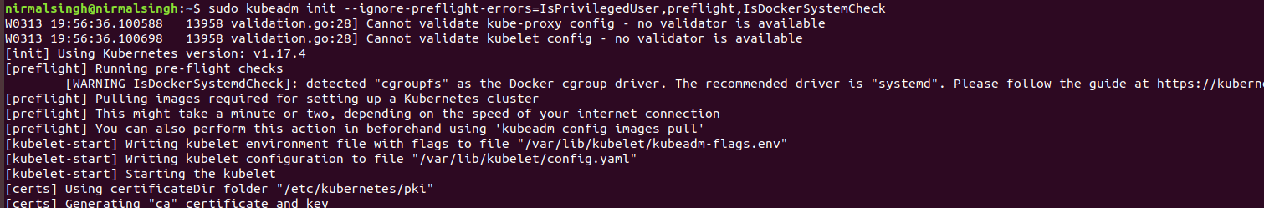
Demo Bootstraping the kubernetes cluster
Pull images
Kubeadm init

Slide 8
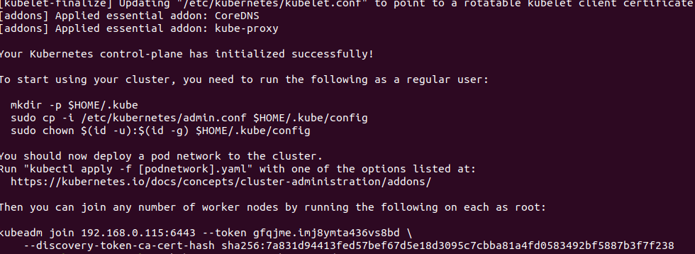

Slide 9
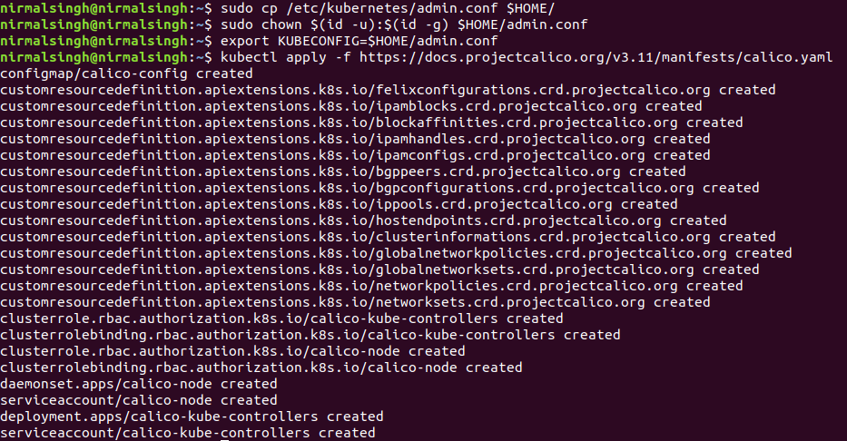
Installing pod network using calico.yaml

Slide 10
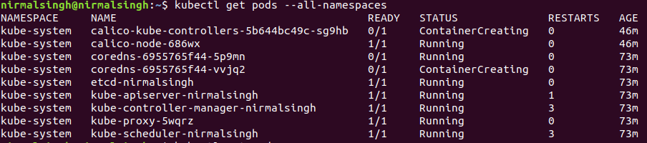
Check the pods

Slide 11

Check the master node

Slide 12
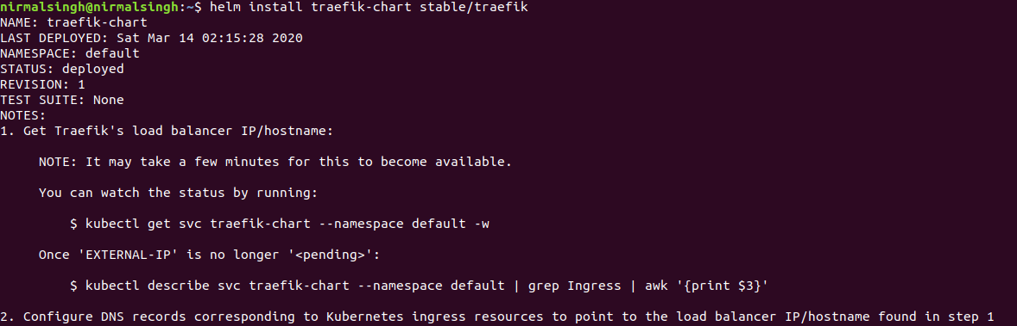
Deploy traefik to a cluster
We can deploy it using deployement object, daemon object or using helm chart.

Slide 13
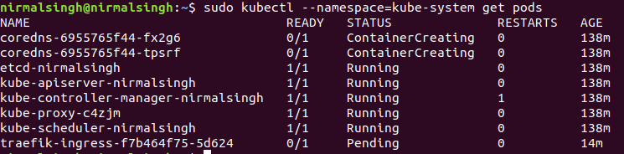
Check the traefik deployement.

