Slide 1

Presentation on Distributed Online Learning & Session Tracking
Of
BACHELOR OF ENGINEERING
IN
COMPUTER ENGINEERING
By
Mr.Tushar Eknath Nirmal Seat No: B400620163
Under the Guidance of
Prof.P.P. Kakade
Department of Computer Engineering
NGSPM’s Brahma Valley College of Engineering and Research Institute

Slide 2
OUTLINE
INTRODUTION
PROBLEM STATEMENT
MOTIVATION
PURPOSE,SCOPE AND OBJECTIVE
SYSTEM ARCHITECTURE
TECHNOLOGIES USED
FEATURES
DATABASE DESIGN
API DESIGN
FUTURE SCOPE
CONCLUSION

Slide 3
INTRODUCTION
In the contemporary educational landscape, online learning has become an integral component due to the increased reliance on remote education methods.
The shift from traditional classroom-based education to digital platforms has brought forth the need for an efficient, robust, and scalable system that can handle the challenges of distributed online learning.
"Distributed Online Learning and Session Tracking", aims to provide a seamless online platform for students and teachers to engage in educational activities while tracking student attendance and participation in online sessions effectively.

Slide 4
PROBLEM STATEMENT
Lack of Centralized Session Tracking: In traditional learning management systems, tracking student attendance and engagement is often limited.
Difficulty in Providing Seamless Online Classes: Many educational institutions face challenges in delivering online lectures seamlessly. A significant gap exists in integrating a reliable, user-friendly video conferencing tool that students can access without complex setup.
Challenges in Ensuring Data Accessibility and Accuracy: Traditional methods of tracking attendance, such as paper records or isolated digital tools, make it hard to ensure data accuracy.
Dependency on Multiple Platforms Without Integration: Most current systems lack the integration of various platforms, requiring users to log into multiple systems for different tasks (e.g., joining lectures, tracking attendance).

Slide 5
MOTIVATION
The motivation behind the "Distributed Online Learning and Session Tracking" project stems from the increasing global demand for flexible and scalable educational solutions, especially in light of the COVID-19 pandemic that forced educational institutions to adopt online learning models almost overnight.
Traditional classroom settings, while effective in delivering education, have inherent limitations in terms of flexibility, accessibility, and scalability.

Slide 6
OBJECTIVES
To build a centralized online learning platform
To track student attendance and session participation
To provide separate dashboards for students and teachers
To integrate online video sessions using Jitsi Meet

Slide 7
PROPOSED SOLUTION
Centralized platform with login-based access
Session links generated via Google Forms
Real-time integration with Jitsi Meet
Session tracking through Google Sheets

Slide 8
S
PURPOSE,SCOPE & OBJECTIVE
PURPOSE
SCOPE
OBJECTIVE
To provide Online Learning platform
To reduce the Paperwork of teachers and students
system is designed to provide them with unique functionalities
To track student attendance and participation via Google Sheets
aims to provide seamless experience in managing online education
implement a secure authentication mechanism

Slide 9



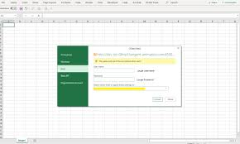



Provide link with Google Form
Jitsi API
Excel Sheet
Authorised Student
Dashboard
SYSTEM ARCHITECTURE
Database

Slide 10
MODULES OF THE SYSTEM
Student module
Teacher module
Admin module
VideoChat(Jitsi Integration) module
Google Form & Google Sheets Integration

Slide 11

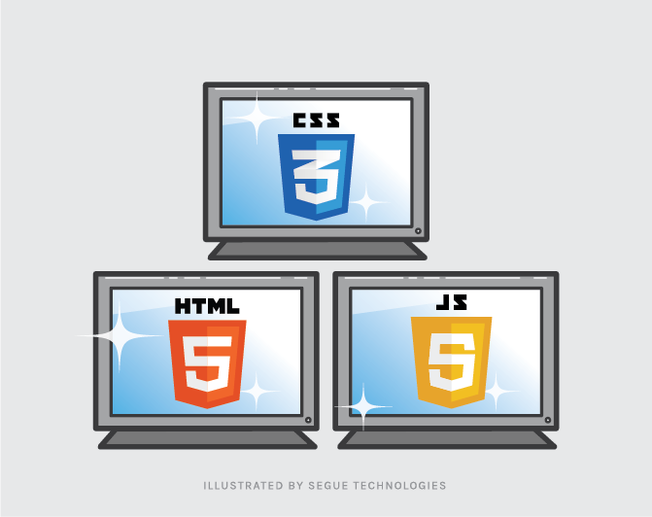
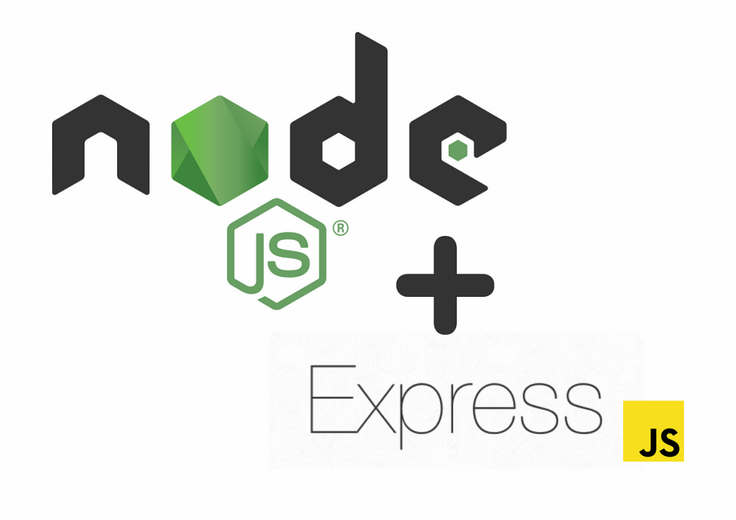

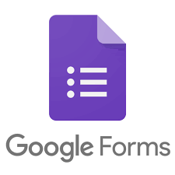

TECHNOLOGIES USED

Slide 12
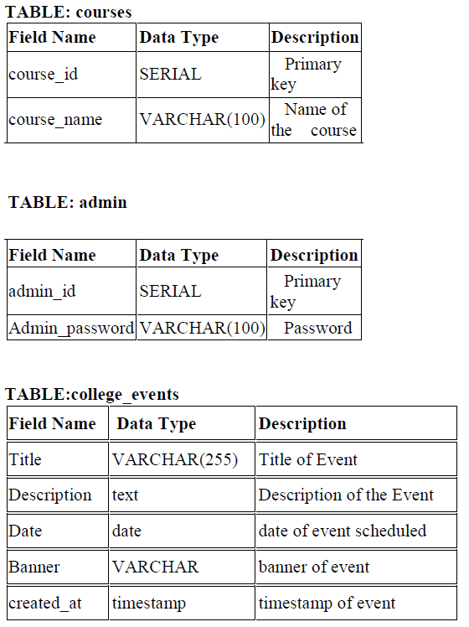
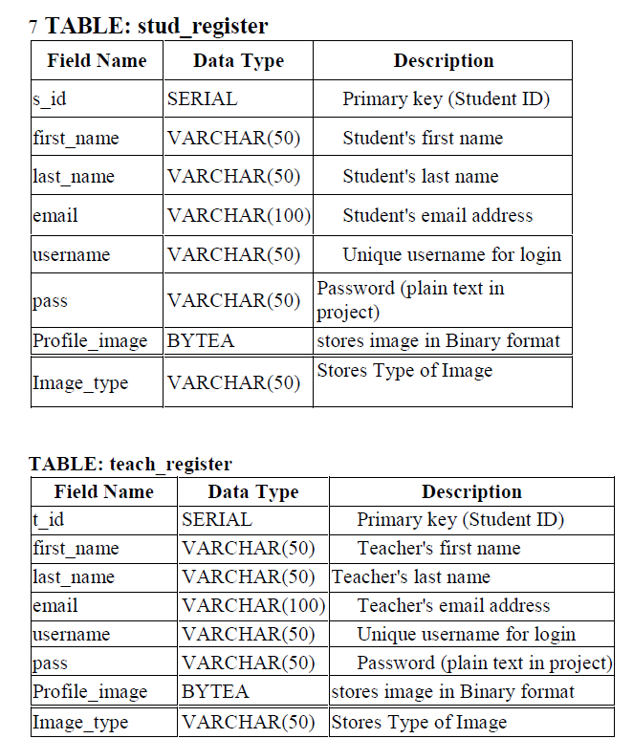
DATABASE DESIGN

Slide 13
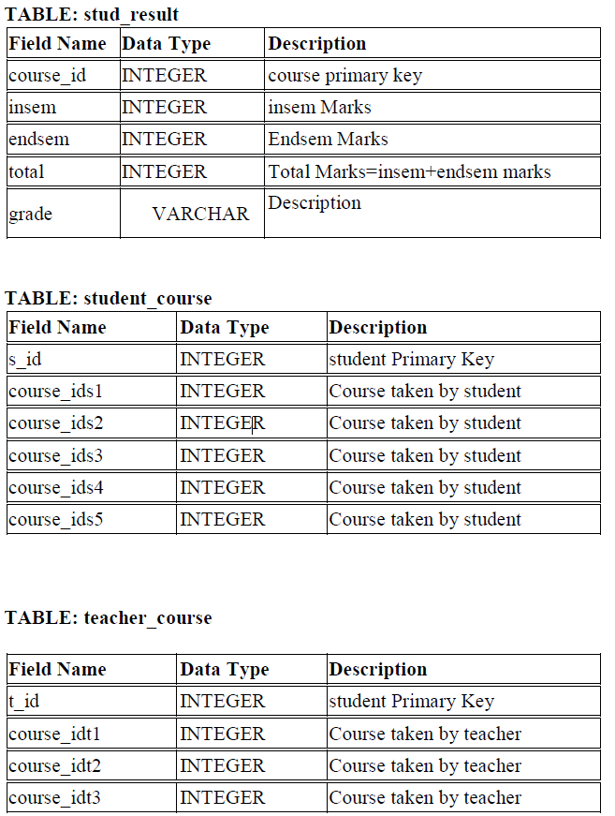
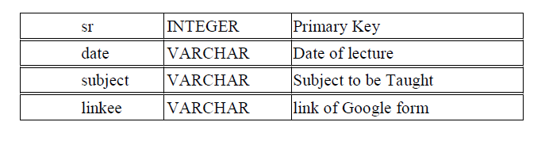
TABLE:videolink

Slide 14
FEATURES
Student/Teacher Login: Secure login system for students and teachers.
Dynamic Dashboard: Personalized student and teacher dashboards.
Session Tracking: Integration with Google Forms and Google Sheets for session data collection.
Online Lectures: Use of Jitsi Meet for video conferencing, and how students get meeting links via forms.
Logout:Secure logout process to end sessions.

Slide 15
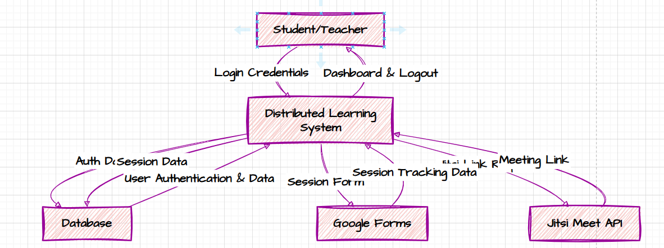
DATABASE DESIGN

Slide 16
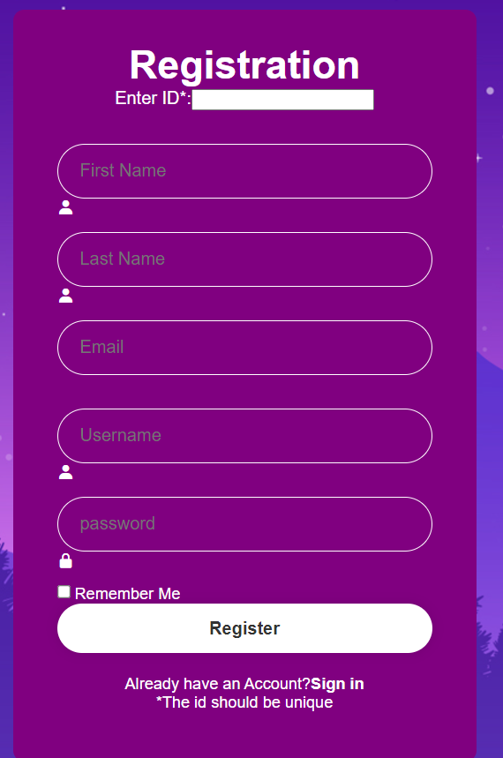
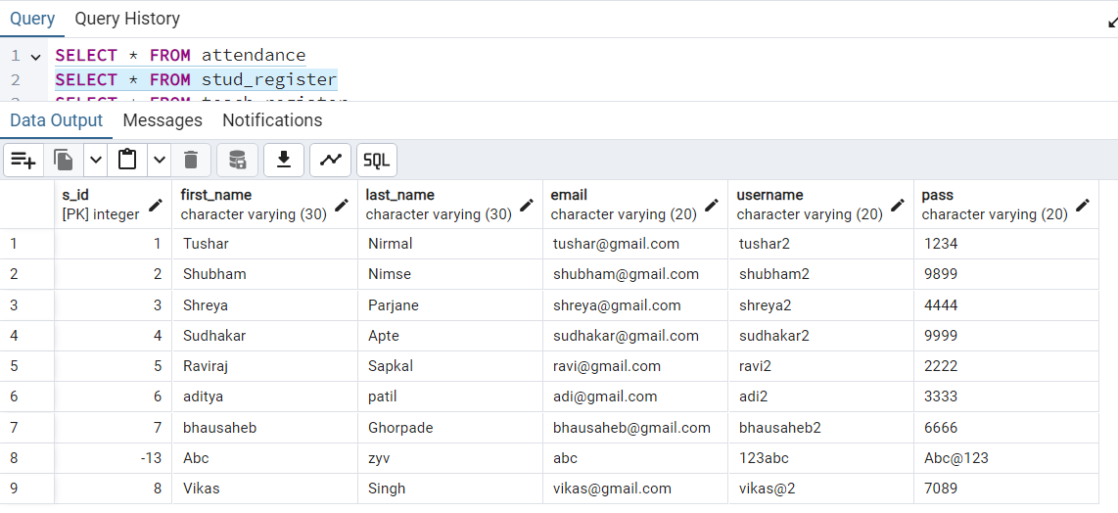

Slide 17
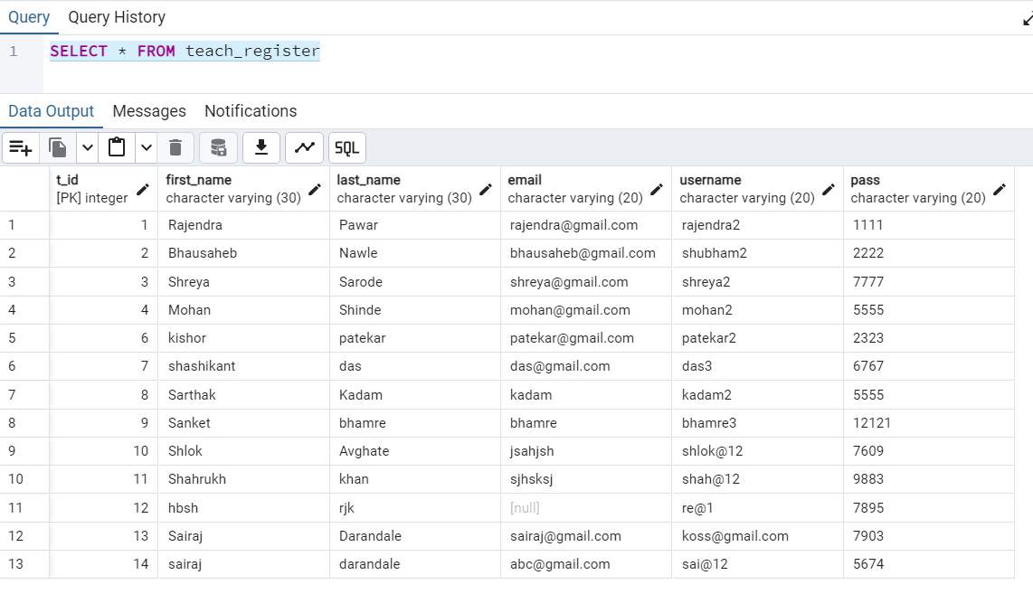

Slide 18
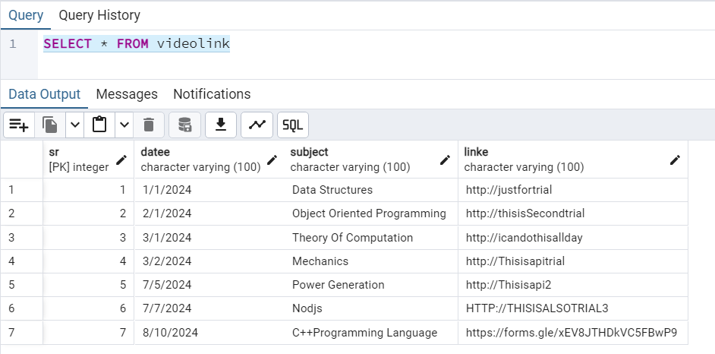

Slide 19
API DESIGN
1.Purpose of The API:
-Students/Teachers who fills the registration form,their data is stored in Database with the help of data.
-The Google form link provided by the teacher are stored in database using API and are retrived by Students by using API in Backend.
-There is also API for Login.
2.ERROR HANDLING
3.TECHNOLOGIES USED

Slide 20
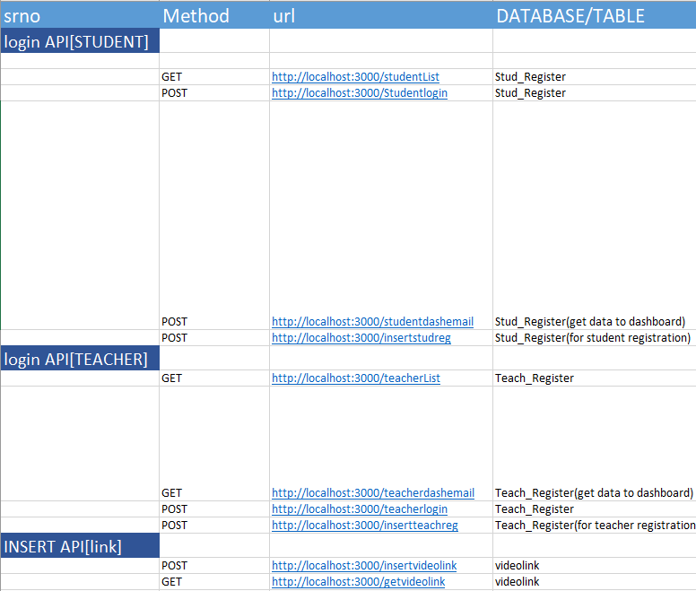
API ENDPOINTS

Slide 21
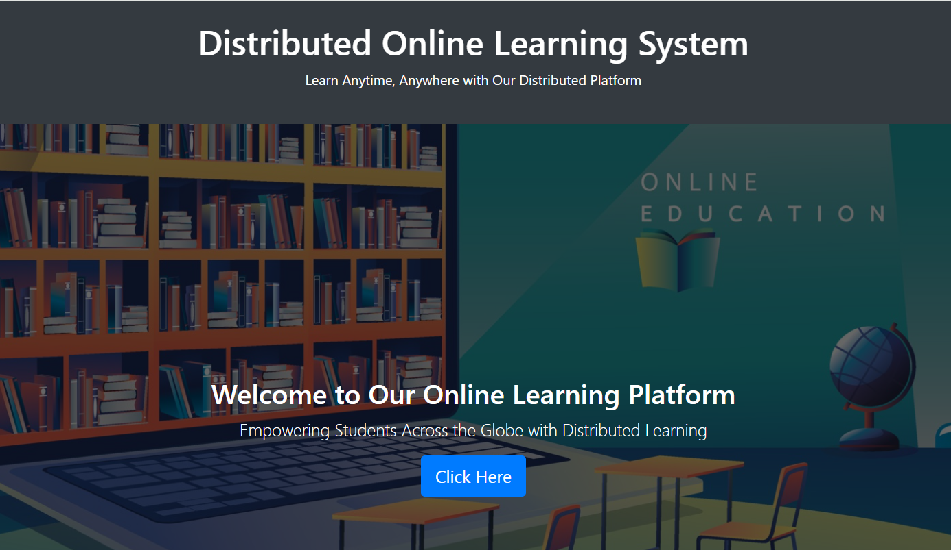

Slide 22
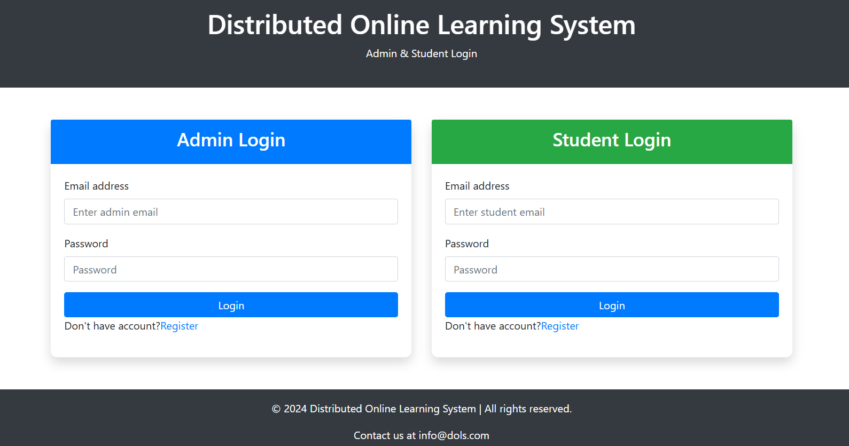

Slide 23
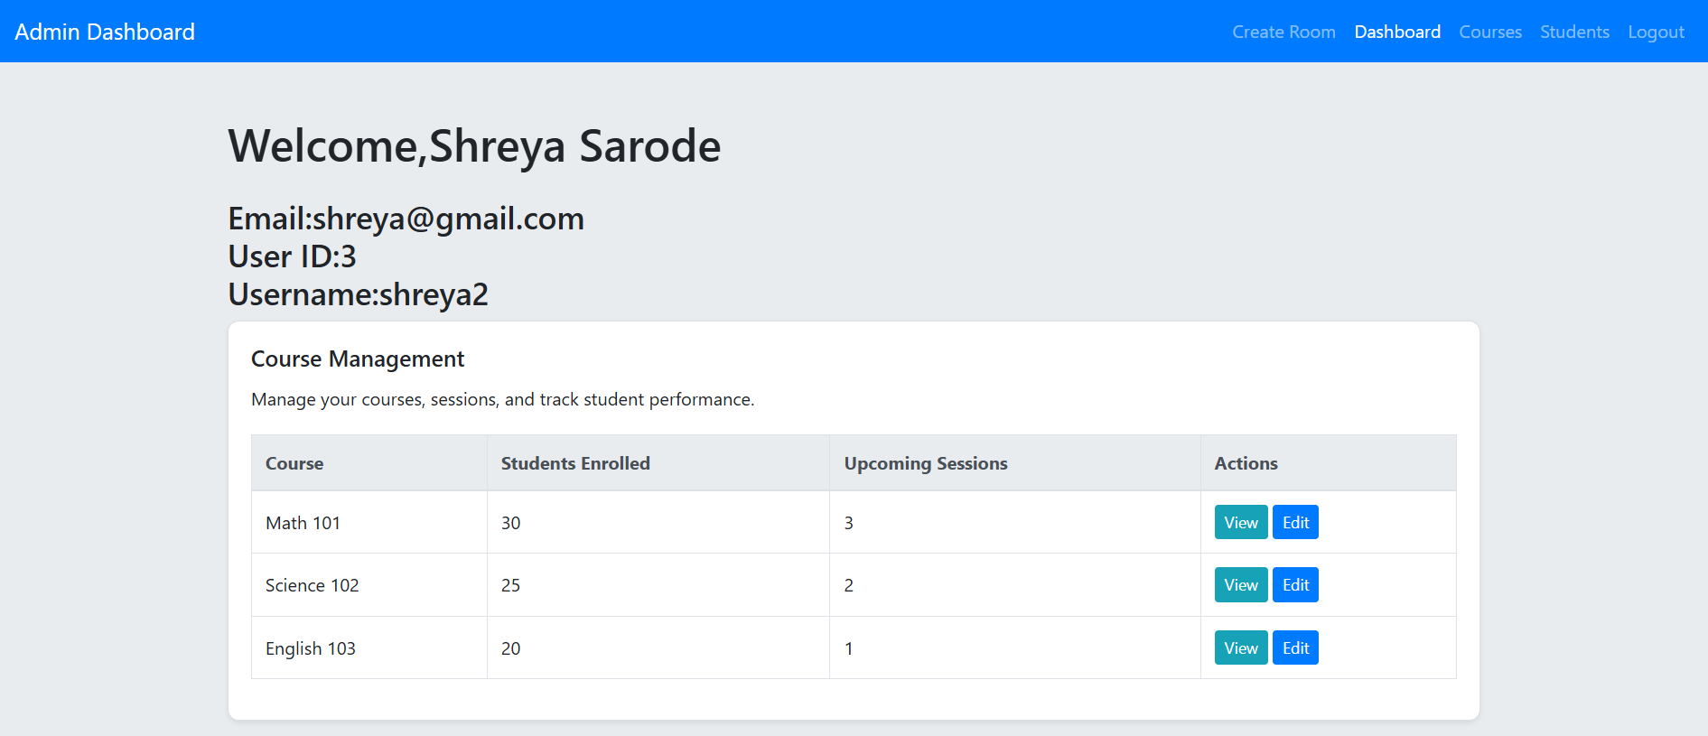
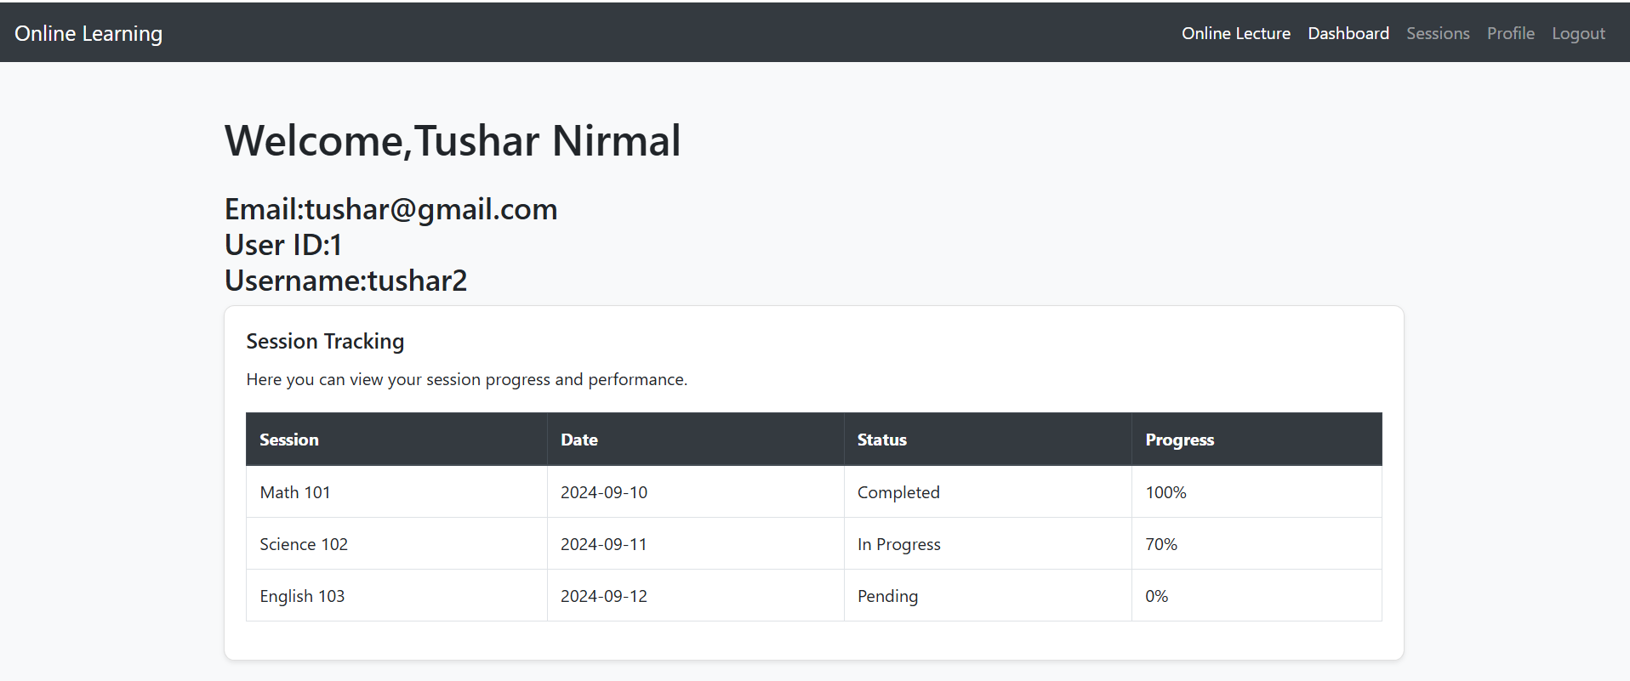

Slide 24
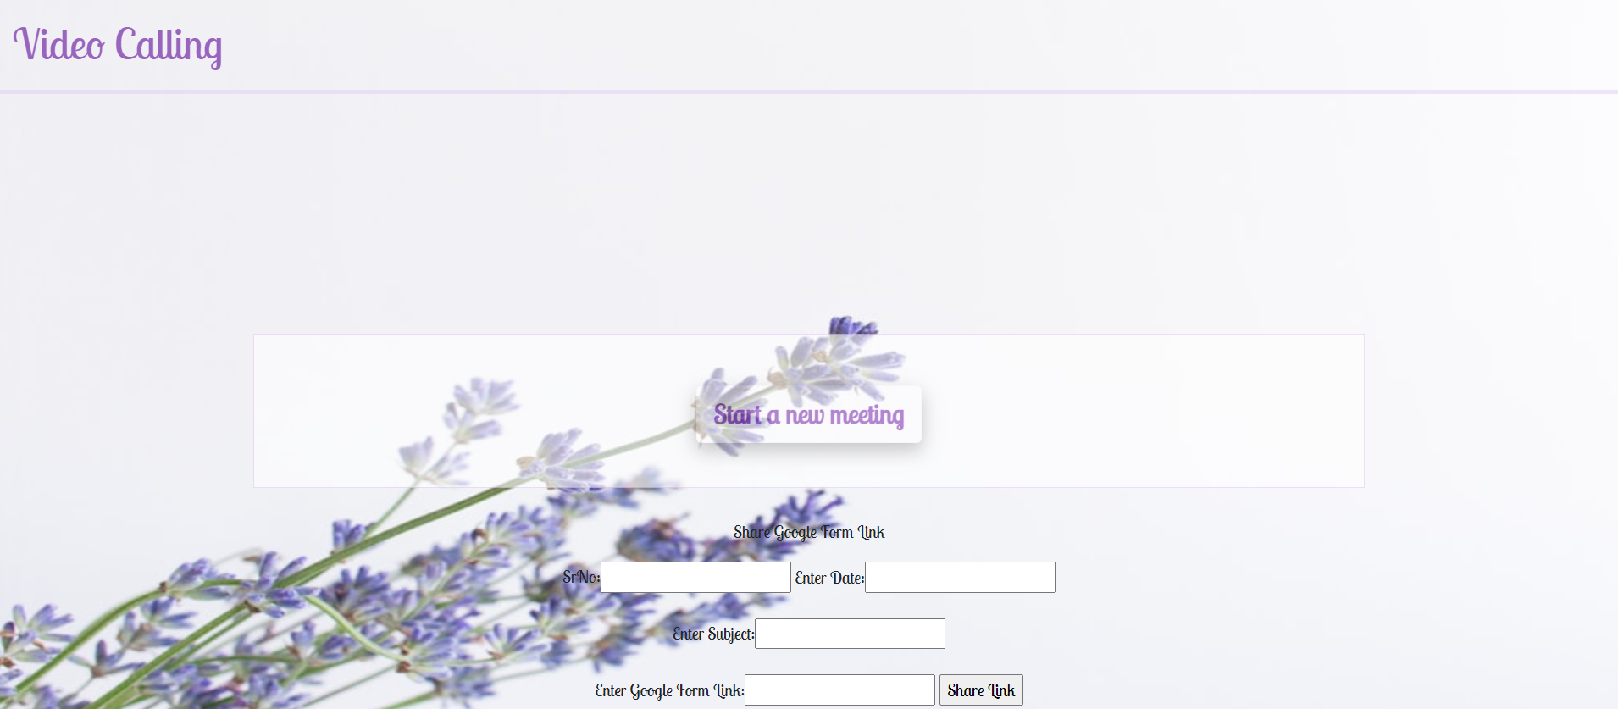

Slide 25
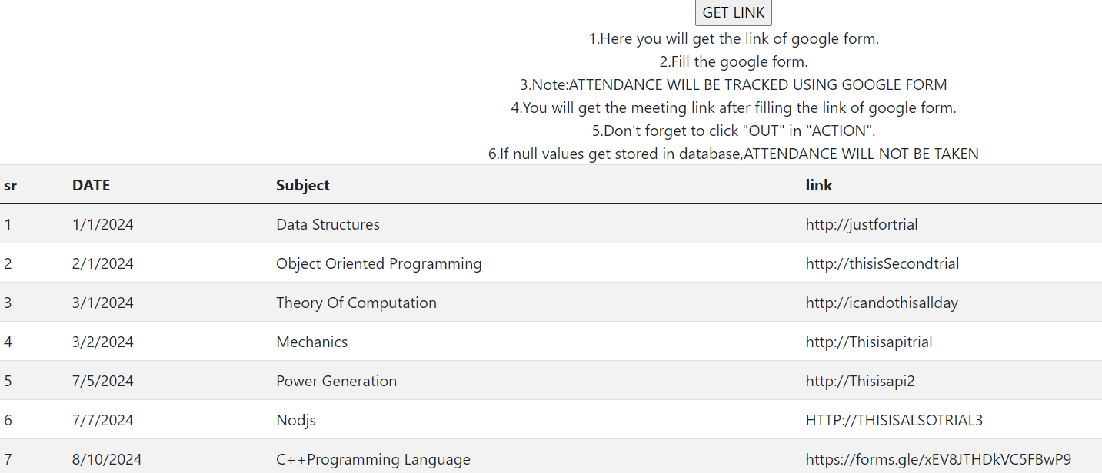

Slide 26
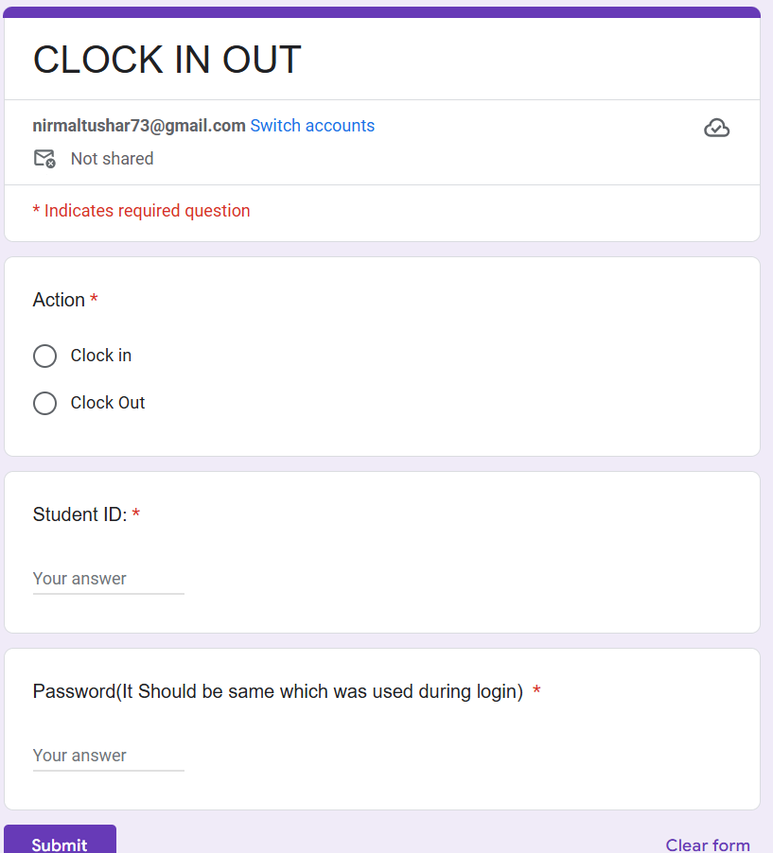
SESSION TRACKING PART

Slide 27
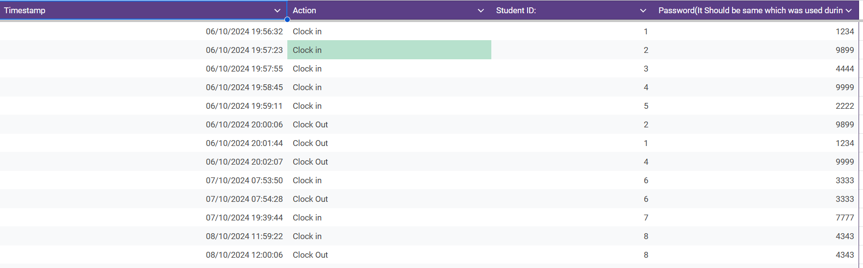

Slide 28
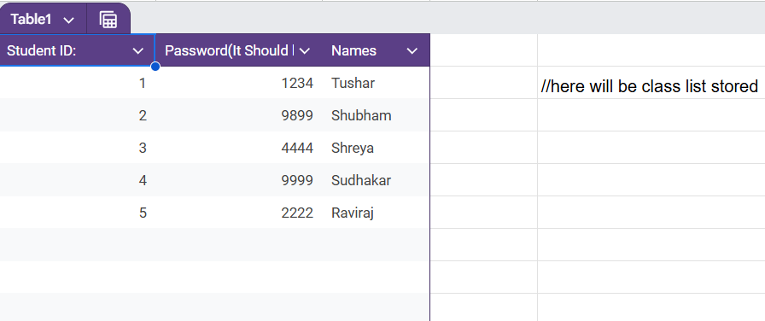

Slide 29
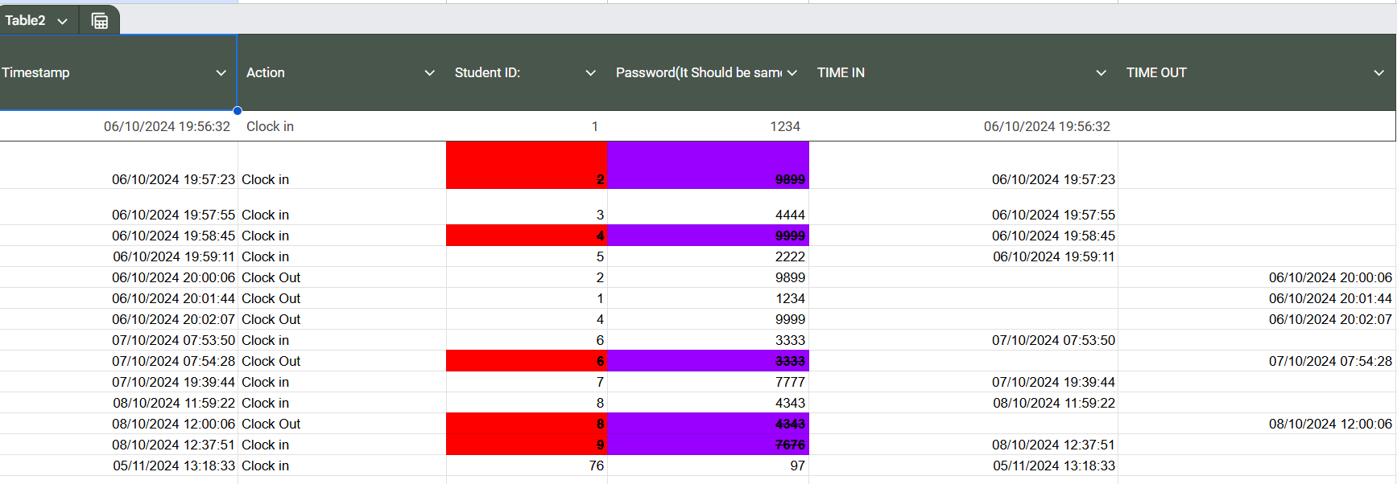
=COUNTIF(D:D,D2)=1
=ArrayFormula(IFS(A2:A="","",B2:B="Clock Out",A2:A,TRUE,""))

Slide 30
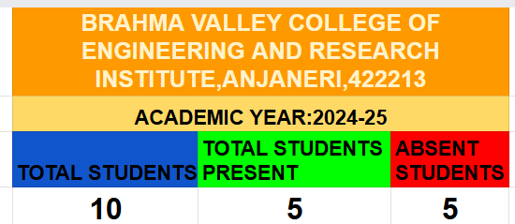
=COUNTUNIQUE(C2:C)
=COUNTUNIQUE(F2:F)

Slide 31
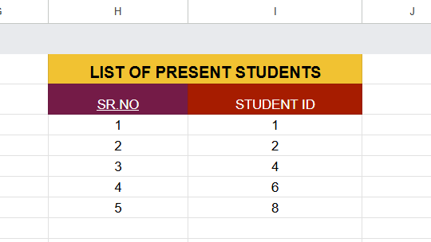
=UNIQUE(FILTER(C2:C, COUNTIF(C2:C,C2:C)>1))

Slide 32
Challenges Faced
API integration issues
Google Sheets limitations
Synchronization problems
Frontend/backend connection

Slide 33
Solutions Implemented
Workarounds used
Error handling in APIs
Simpler UI design for usability

Slide 34
FUTURE SCOPE
Enhanced Analytics: Integrate advanced analytics to track student engagement, attendance patterns, and
participation to help educators better understand student behavior and improve teaching methods.
Mobile App Development: Extend the platform to a mobile application, allowing students and teachers
to access features conveniently on smartphones and tablets.
AI-Based Recommendations: Implement AI-driven recommendations for course materials,
based on each student's participation and performance, to enhance personalized learning.

Slide 35

CONCLUSION
Comprehensive Solution for Online Learning: The project successfully addresses the challenges
in distributed learning by providing an integrated system for session tracking, secure login,
and seamless online lectures.
Enhanced User Experience: It offers a user-friendly experience for students and educators, making
the online learning process more efficient.
Scalability and Adaptability: With the use of web-based technology and a distributed approach,
the platform is scalable and can be easily adapted to various educational institutions.

