Slide 1
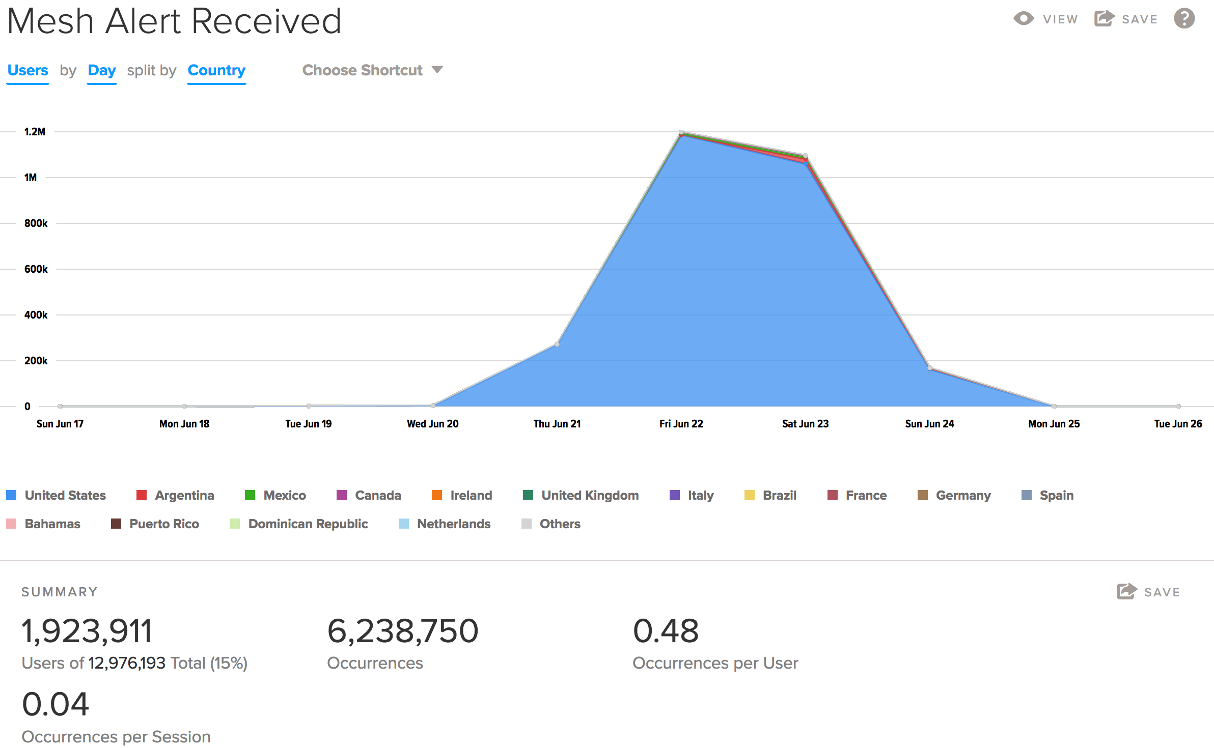
Android
G8 alerts enabled for mesh
”Mesh activated” notification bothered the audience, turned OFF and fixing for next release
~2M users received ~6M mesh alerts in a week
iOS
SDK ready / tested
Integration to begin July
Platform
Add sig to Severe and Real-time rain alerts in Q3 and enable on mesh
OFF for 8.0+
10%
100%
OFF for All
Notes:
Randy / Nicole

