Slide 1
EC-422 ARTIFICIAL INTELLIGENCE · COURSE PROJECT
AgriSense
AI for smart irrigation and crop health
1
Module 1 · Reinforcement learning decides when and how much to irrigate
2
Module 2 · A deep CNN diagnoses leaf diseases from a photo
Dushyant Kumar · 23145030
Nirmit Patil · 23145053
nirmit10000.github.io/agrisense/
Notes:
Good morning. Our project is AgriSense: AI for smart irrigation and crop health. It falls under the course theme of agriculture: intelligent irrigation, crop monitoring and resource optimisation. It has two AI modules: a reinforcement learning agent that decides when and how much to irrigate, and a deep learning model that recognises leaf diseases from a photo. Both run on a public website.

Slide 2
Problem statement: two decisions every farmer makes
Course theme
Agriculture: intelligent irrigation, crop monitoring and resource optimisation
1
Water: when, and how much, should I irrigate today?
2
Health: is this leaf diseased, and with what?
Decided by the calendar or by feel. Too much wastes water and drains away; too little stresses the crop.
Needs an expert who is rarely nearby. Late or wrong diagnosis means lost yield and wasted sprays.
Our problem statement
Use AI to recommend daily irrigation that saves water without losing yield, and to diagnose leaf diseases from a photo, delivered as a free website that works on a phone.
2
Notes:
The course theme we picked is agriculture: intelligent irrigation, crop monitoring and resource optimisation. On a farm this comes down to two decisions that are still mostly made by habit or guesswork. First, water: when should I irrigate, and how much? Second, crop health: this leaf looks wrong, is it a disease, and which one? Our problem statement is to support both decisions with AI, in a form any farmer could open on a phone.

Slide 3
Why it matters: water is wasted and crops are lost
~90 %
354 mm
40 %
of India's freshwater withdrawals go to agriculture
of irrigation per season drains away unused under a fixed 7-day calendar
Up to this share of global crop production is lost to plant pests and diseases each year
Source: FAO AQUASTAT
Source: our simulation, 60 test seasons
Source: FAO
The gap
Both decisions are made without data: irrigation by the calendar, diagnosis by eye. Both are the kind of pattern-and-decision problems AI is good at.
3
Notes:
Why does this matter? Agriculture takes about 90 percent of India's freshwater withdrawals, according to FAO AQUASTAT. In our own simulation of a typical fixed calendar, about 350 millimetres per season simply drains below the roots, because the calendar ignores rain, and the crop still loses yield in hot spells. On the crop-health side, the FAO estimates that up to 40 percent of global crop production is lost to plant pests and diseases every year. Early, correct diagnosis is the first step to preventing that.

Slide 4
Our solution: AgriSense, two AI modules in one website
1
Smart irrigation
2
Leaf disease detection
Reinforcement learning (tabular Q-learning)
Deep learning (MobileNetV2 CNN, transfer learning)
Input
Soil dryness, crop stage
3-day rain forecast, evaporative demand
Input
Photo of a maize or tomato leaf
AI
Reinforcement learning
AI
Deep learning
Output
Irrigate 0–40 mm today
Output
Top-3 diagnoses of 14 classes + heatmap + advice
45 % less water than a fixed calendar
93.7 % accuracy on unseen test images
Both modules run inside one free website: https://nirmit10000.github.io/agrisense/
4
Notes:
Our solution, AgriSense, has two AI modules. Module one is a reinforcement learning agent: it looks at soil moisture, crop stage, the rain forecast and how hot the day is, and recommends an irrigation amount. Module two is a convolutional neural network: you give it a photo of a maize or tomato leaf, and it returns the most likely disease, its confidence, a heatmap of where it looked, and advice. Both are packaged in one website that anyone can open.

Slide 5
How it fits together: train offline, run in the browser
1
Data
2
Train offline (Python)
3
Export as files
4
Serve and run
Weather + crop data
Open-Meteo 2010-2025, 3 cities; FAO-56 crop tables
Q-learning agent
50,000 simulated seasons per crop, 3 crops
Q-tables + seasons
JSON: learned rules and precomputed simulations
Static website
GitHub Pages
Irrigation simulator
Agent rulebook
Leaf Doctor (ONNX Runtime Web)
Results
Leaf images
PlantVillage, maize + tomato, 14 classes
MobileNetV2 CNN
ImageNet-pretrained, fine-tuned (transfer learning)
Leaf model
ONNX file (8.9 MB) + class list
No AI server.
The trained models are just files; the visitor's browser does the computing, so it is free to host and a leaf photo never leaves the device.
5
Notes:
Here is the whole system. On the left are the data sources: real weather from Open-Meteo, the FAO crop tables, and the PlantVillage leaf images. In the middle, we train both models offline in Python on a laptop. The trained models are then exported as plain files: the agent's Q-tables and precomputed seasons as JSON, and the neural network as an ONNX file. Those files are served by GitHub Pages as a static website. There is no server doing AI: the visitor's browser loads the files and runs both models itself, which is free, fast, and means a leaf photo never leaves the phone.

Slide 6
MODULE 1 · SMART IRRIGATION (REINFORCEMENT LEARNING)
Module 1 · Smart irrigation with reinforcement learning
Weather + forecast
Open-Meteo, real data
Field state
soil dryness, crop stage, rain forecast, ET0
Q-table lookup
360 states × 5 actions
Q-table lookup
360 states × 5 actions
Irrigation dose
0, 10, 20, 30 or 40 mm
Field simulator
FAO-56 water balance
reward updates the table (training only)
Why reinforcement learning?
1
Sequential
2
Delayed outcome
3
Uncertain
4
No labels
today's watering changes tomorrow's soil moisture
yield is known only at the end of the season
rain forecasts are imperfect
no dataset of 'correct' irrigation, so it learns from consequences
6
Notes:
Module one. Each day the agent reads the state of the field: soil dryness, crop growth stage, the rain forecast and evaporative demand. It looks up the best action in its learned Q-table and recommends an irrigation dose. During training, a field simulator works out what that dose does to the soil and crop and returns a reward, which updates the table. Why reinforcement learning? Because irrigation is a sequence of decisions: today's watering changes tomorrow's soil, the yield is only known at the end of the season, rain is uncertain, and there is no labelled dataset of 'correct' irrigation, so the agent has to learn from consequences.

Slide 7
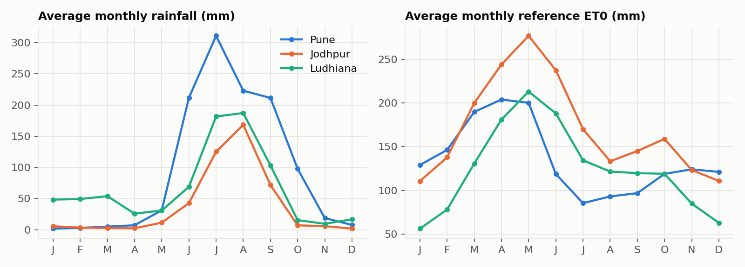
MODULE 1 · SMART IRRIGATION (REINFORCEMENT LEARNING)
Data: 16 years of daily weather, three contrasting climates
Pune
1122 mm/yr
Semi-arid tropical
Jodhpur
432 mm/yr
Arid (Thar desert)
Ludhiana
783 mm/yr
Sub-tropical (Punjab breadbasket)
Source
Open-Meteo API (ERA5), free, no key
Variables
daily rain, ET0, Tmax, Tmin
Train
seasons starting 2010-2020
Test
seasons starting 2021-2024 (never seen)
7
Notes:
We used the free Open-Meteo historical weather API, based on the ERA5 reanalysis. For every day from 2010 to 2025 we have rainfall and reference evapotranspiration, ET0, the drying power of the air. We chose three very different climates so the agent can't just memorise one place: Pune with a strong monsoon, Jodhpur in the Thar desert, and Ludhiana in Punjab with cold winters. Seasons starting 2010 to 2020 are used for training; 2021 to 2024 are kept aside for testing. The whole dataset is about half a megabyte.

Slide 8
MODULE 1 · SMART IRRIGATION (REINFORCEMENT LEARNING)
The environment: a field simulator built on FAO-56
rain + irrigation
crop water use (ET)
1
Crop demand
ETc = Kc(stage) × ET0
2
Stress factor
Ks = 1 if depletion ≤ RAW, else falls linearly to 0
3
Actual use
ETa = Ks × ETc
stress line (RAW used up)
4
Season yield (FAO-33)
overflow drains away (waste)
Ya / Ym = 1 − Ky · (1 − ΣETa / ΣETc)
root zone (total available water, TAW)
Crop values (Kc, root depth, p, Ky) from FAO-56 / FAO-33 tables for maize, wheat and tomato; sandy-loam soil.
8
Notes:
We can't run 50 thousand seasons on a real farm, so the agent trains in a simulator built on FAO-56, the international standard for crop water requirements. Think of the root zone as a bucket. Rain and irrigation fill it; anything above the brim drains away and is wasted. The crop drinks from it every day: ET0 times a crop coefficient Kc that changes with growth stage. While the soil holds more than a safe amount, called RAW, the crop is fine; below that line it is water-stressed. At the end of the season the FAO-33 equation turns the total water shortfall into a yield loss.

Slide 9
MODULE 1 · SMART IRRIGATION (REINFORCEMENT LEARNING)
Formulating irrigation as a Markov Decision Process
S
State: what the agent sees
A
Action: what it decides
R
Reward: how it is scored
Soil dryness: 10 levels
Crop growth stage: 4
Rain forecast, next 3 days: none / light / heavy
Evaporative demand (ET0): low / medium / high
= 360 states
Irrigate 0, 10, 20, 30, 40 mm today
Realistic drip / sprinkler doses
5 actions
− 1 per mm of water used
− 10 per mm of crop water shortage
− 1 per mm drained away
− 10 per irrigation event (pump, labour)
Yield matters 10× more than water
Episode = one crop season (125-145 days) from a random date, city and starting soil moisture. Forecast = real future rain ± 25 % error.
9
Notes:
Here is the exact formulation. The state is four things a farmer would look at: how dry the soil is, the crop's growth stage, whether rain is forecast in the next three days, and how hot and dry today is. Discretised, that is 360 states. The actions are five irrigation amounts. The reward is negative: a cost for every millimetre of water, a ten times higher cost for every millimetre the crop wanted but didn't get, a cost for water that drains away, and a small fixed cost per irrigation for the pump and labour. The ten-to-one ratio encodes the priority that losing yield is far worse than spending water.

Slide 10
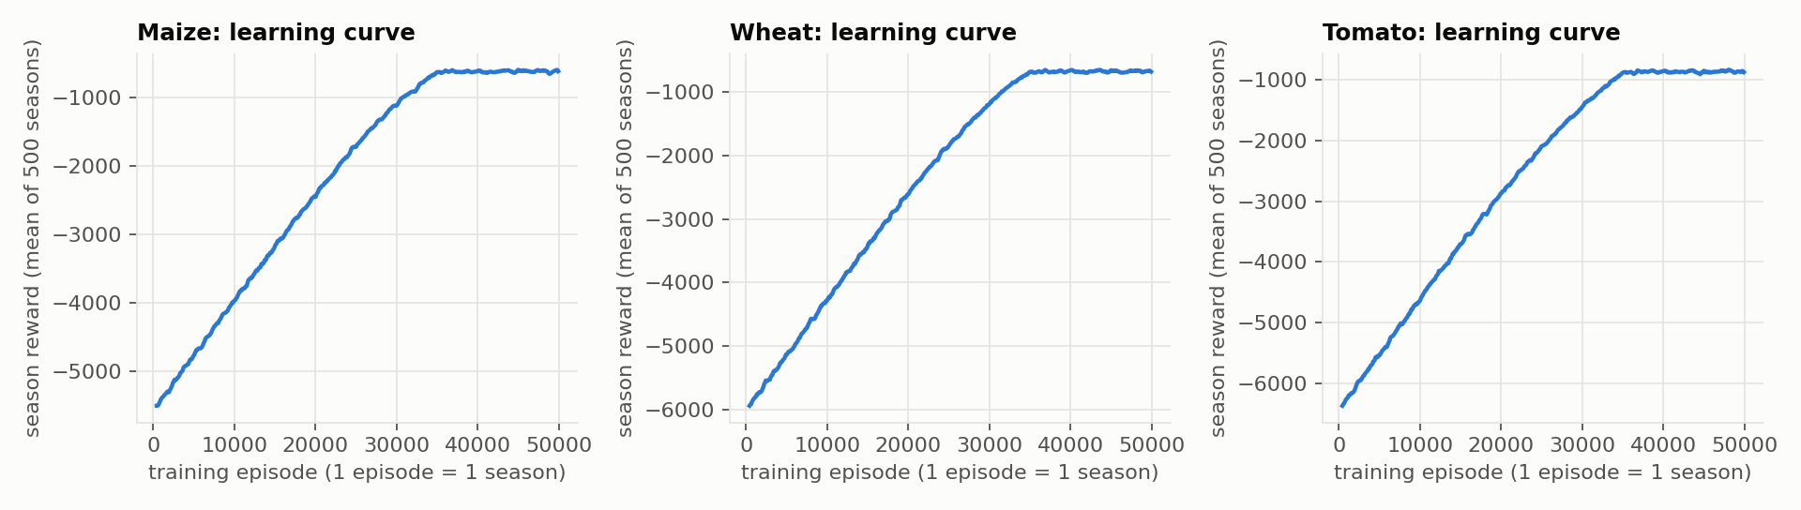
MODULE 1 · SMART IRRIGATION (REINFORCEMENT LEARNING)
Learning: tabular Q-learning
Q(s,a) ← Q(s,a) + α [ r + γ · max Q(s′,a′) − Q(s,a) ]
Q-table
360 states × 5 actions
Episodes
50,000 seasons per crop
Exploration ε
1 → 0.05
Why a table and not a deep network?
360 states is small enough to learn exactly
Trains in minutes on a laptop, no GPU
The whole policy can be printed and checked, so every decision is explainable
Learning rate α
0.1 → 0.01
Discount γ
0.95
Training time
≈ 1.5 min per crop (CPU)
10
Notes:
We used tabular Q-learning, the classic algorithm by Watkins. The agent keeps a table with one value per state and action: how good is it to give 20 mm when the soil is 70 percent dry and no rain is coming. After every simulated day it nudges that value towards the reward it got plus the value of the best action in the next state; that is this update rule. Early on it explores randomly; epsilon decays from 1 to 0.05. We also decay the learning rate so the values settle. One agent per crop, 50 thousand seasons each, about a minute and a half on a laptop. The curves rise and then flatten: the agent has converged. We chose a table rather than a deep network on purpose: 360 states is small, and a table can be printed and inspected.

Slide 11
MODULE 1 · SMART IRRIGATION (REINFORCEMENT LEARNING)
A fair test: four policies on seasons the agent never saw
Q-learning agent (RL)
Sensor threshold rule
60
Our agent. Uses soil, crop stage, forecast and ET0.
FAO expert rule. Perfect moisture sensor; refills to full when the safe limit is reached; no forecast.
unseen test seasons
3 cities × 5 crop-season combinations × 4 years (2021-2024)
Same weather and forecast errors for every policy
Fixed schedule
Rainfed (no irrigation)
Farmer's calendar: 40 mm every 7 days, whatever the weather.
Never irrigate. Lower bound.
Metrics: irrigation water · yield (% of max) · water wasted · stress days · water productivity (kg of crop per m³ of water)
11
Notes:
To know whether the agent is any good, we compare it with three baselines. Rainfed means never irrigate. Fixed schedule is the typical farmer calendar. The sensor threshold rule is the strong one: it is the FAO-recommended practice, it has a perfect soil moisture sensor, and it refills the soil exactly when the safe limit is reached. It just doesn't use the forecast. All four run on the same 60 test seasons from 2021 to 2024, with identical weather and identical forecast errors.

Slide 12
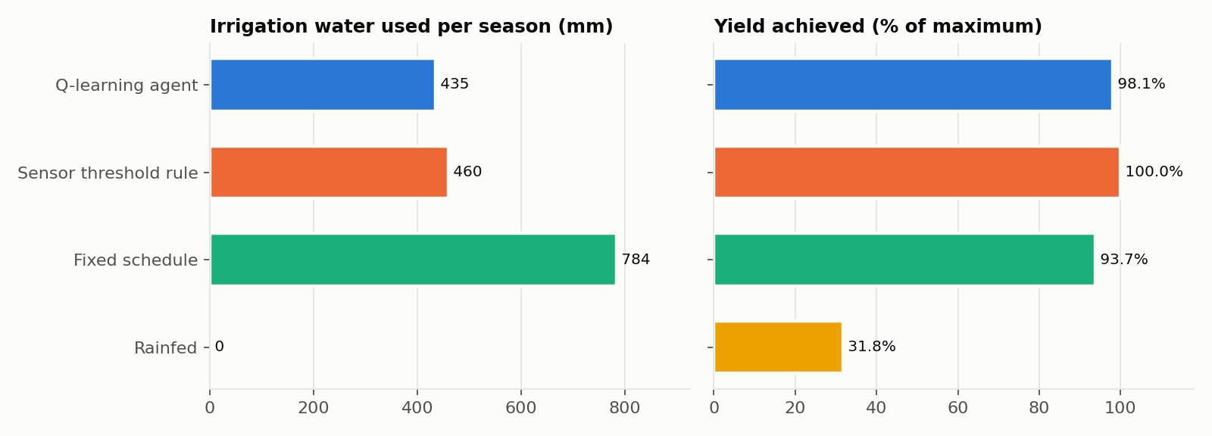
MODULE 1 · SMART IRRIGATION (REINFORCEMENT LEARNING)
Result: 45 % less water than the calendar, higher yield
45 %
less water than the fixed calendar
98.1 %
of maximum yield (calendar: 93.7 %)
6.30
Against the expert sensor rule:
5.5 % less water and less waste, for a 1.9-point yield trade-off. The agent reached expert level without being told the rule.
kg of crop per m³ of water, the best of all (sensor rule 6.13)
12
Notes:
Here are the headline numbers, averaged over all 60 test seasons. Compared with the fixed calendar, the agent uses 45 percent less water, about 435 millimetres instead of 784, and the yield goes up, from 93.7 to 98.1 percent of the maximum. Against the expert sensor rule it is roughly a tie: 5.5 percent less water for 1.9 points of yield. It produces the most crop per cubic metre of water of any policy. The key point is that the agent was never told the FAO rule; it reached an expert-level policy purely from trial and error. Its weakest city is Ludhiana, where yield drops to about 95 percent; we come back to that in the limitations.

Slide 13
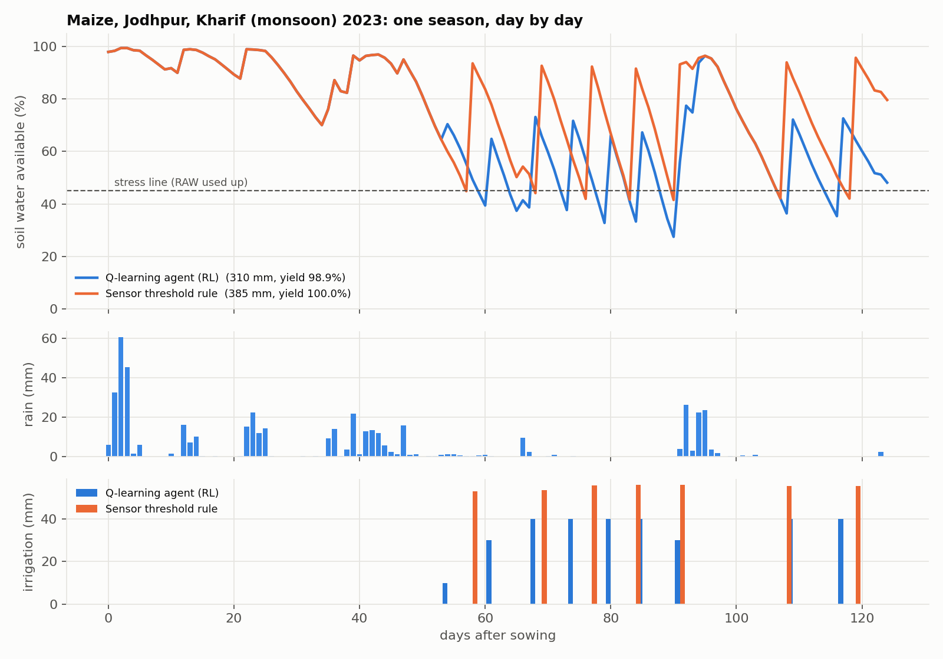
MODULE 1 · SMART IRRIGATION (REINFORCEMENT LEARNING)
One season: smaller doses that leave room for rain
1
Sensor rule
waits for the stress line, then refills to 100 %, so later rain can overflow
2
RL agent
smaller 30-40 mm doses keep room in the soil for rain
3
This season
310 mm vs 385 mm: 20 % less water
13
Notes:
This is one real test season: maize in Jodhpur, monsoon 2023. The top panel is soil moisture; the dashed line is where stress begins. The orange sensor rule waits until the line is reached, then fills the soil all the way up with about 55 millimetres. The blue agent gives smaller doses of 30 to 40 millimetres, which leaves room in the soil for any rain that follows, and it holds back when rain is forecast. That season it used 310 millimetres against 385 for the sensor rule, 20 percent less.

Slide 14
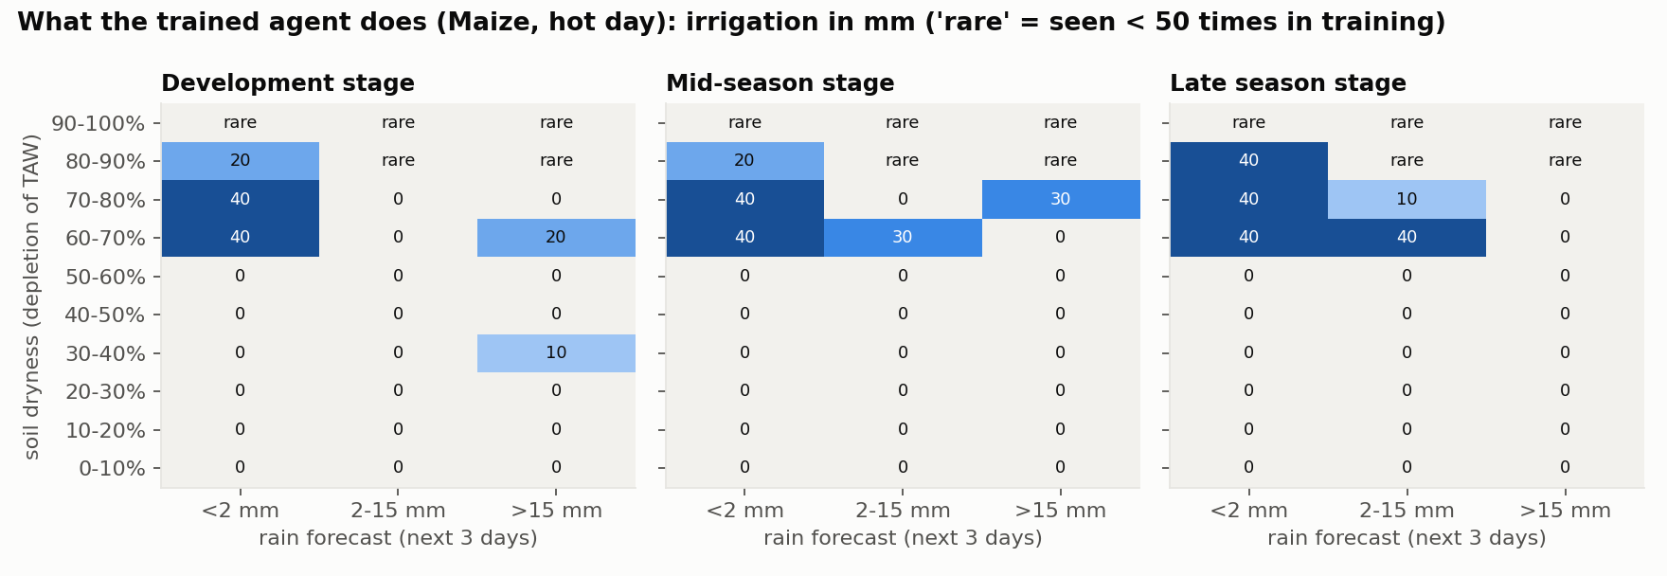
MODULE 1 · SMART IRRIGATION (REINFORCEMENT LEARNING)
What the agent learned can be read like a rulebook
1
Wait until ~60 % of soil water is used (FAO says 55 %): found without being told
2
Dry soil and no rain coming: apply the full 40 mm
3
Heavy rain forecast: irrigate less or not at all
14
Notes:
Because the policy is a table, we can open it. This is maize on a hot day. Rows are soil dryness, columns are the rain forecast. Three rules emerge that nobody programmed: don't irrigate until about 60 percent of the soil water is used, which is almost exactly the FAO threshold of 55 percent; when it's dry and no rain is coming, give the full 40 millimetres; and when heavy rain is forecast, give less or nothing. Cells marked rare are situations seen fewer than 50 times in training, so we don't read anything into them.

Slide 15
MODULE 2 · LEAF DISEASE DETECTION (DEEP LEARNING)
Module 2 · Leaf disease detection with a CNN
Leaf photo
from phone or upload
Pre-process
resize 224×224, normalise
MobileNetV2
pretrained feature extractor
MobileNetV2
pretrained feature extractor
Global avg pool
1280 features
Linear classifier
14 classes
Softmax
top-3 + heatmap
Diagnosis
disease, confidence, advice
Diagnosis
disease, confidence, advice
Feature maps are reused to draw the heatmap (class activation map): classifier weights × feature maps = where the model looked.
Why a CNN, and why transfer learning?
1
Visual pattern
2
Transfer learning
3
Small and fast
4
Explainable
disease shows as spots, rings and colour changes: exactly what convolutions detect
ImageNet weights already know edges and textures, so thousands of leaf photos suffice
MobileNetV2 has ~3.5 M parameters: small enough to run in a phone's browser
the heatmap shows which part of the leaf drove the prediction
15
Notes:
Module two diagnoses leaf diseases. The pipeline: a photo of a leaf is resized to 224 by 224 pixels and normalised. A MobileNetV2 convolutional network, pretrained on ImageNet, turns it into 1280 feature maps describing textures, spots and colours. Global average pooling squeezes each map to one number, and a linear classifier maps those 1280 numbers to our 14 classes. A softmax gives probabilities; we show the top three, plus a class activation heatmap computed from the same feature maps, and attach advice for the predicted disease. Why a CNN? Disease is a visual pattern, and CNNs are the standard tool for image recognition. Why transfer learning? Training from scratch needs millions of images; starting from ImageNet weights, the network already knows edges and textures, so a few thousand leaf photos are enough.

Slide 16
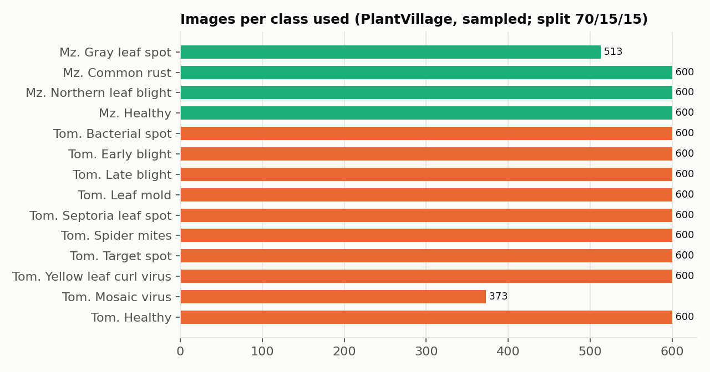
MODULE 2 · LEAF DISEASE DETECTION (DEEP LEARNING)
Data: PlantVillage leaf images, maize and tomato
Maize (4)
Tomato (10)
Gray leaf spot
Common rust
Northern leaf blight
Healthy
Bacterial spot
Early blight
Late blight
Leaf mold
Septoria leaf spot
Spider mites
Target spot
Yellow leaf curl virus
Mosaic virus
Healthy
8,086
5,660
1,213
1,213
Total images
Train
Validation
Test (unseen)
16
Notes:
For data we used PlantVillage, the standard public benchmark of labelled leaf photos. We kept only maize and tomato, the two crops our irrigation module also covers, giving 14 classes including the healthy ones. That is 8,086 images in total, split into training, validation and test sets; the test images are never seen during training. Wheat is not in PlantVillage, which is why the leaf module covers maize and tomato only.

Slide 17
MODULE 2 · LEAF DISEASE DETECTION (DEEP LEARNING)
Training: transfer learning in two phases
Phase 1: train the head
backbone frozen, new 14-class classifier · 40 epochs
Phase 2: fine-tune
unfreeze later layers, small learning rate · 3 epochs
Pick and test
best epoch on validation, final score on the untouched test set
Export
ONNX file (8.9 MB) for ONNX Runtime Web
Model
MobileNetV2 (ImageNet-pretrained, fine-tuned)
Input
224 × 224 RGB, ImageNet normalisation
Classes
14 (maize + tomato, incl. healthy)
Epochs
40 head + 3 fine-tune
Training time
12 min on a laptop CPU
Model file
8.9 MB
Why two phases?
Training the new head first protects the pretrained features; fine-tuning then adapts them to leaf textures without forgetting what they already know.
17
Notes:
Training happens in two phases. In phase one the pretrained MobileNetV2 body is frozen and only a new 14-class classifier on top is trained, so we don't destroy what the network already knows. In phase two we unfreeze the later layers and fine-tune them with a small learning rate, so the features adapt to leaves. We pick the model using the validation set and report accuracy only on the untouched test set. The finished model is exported to ONNX, a standard format that runs in the browser.

Slide 18
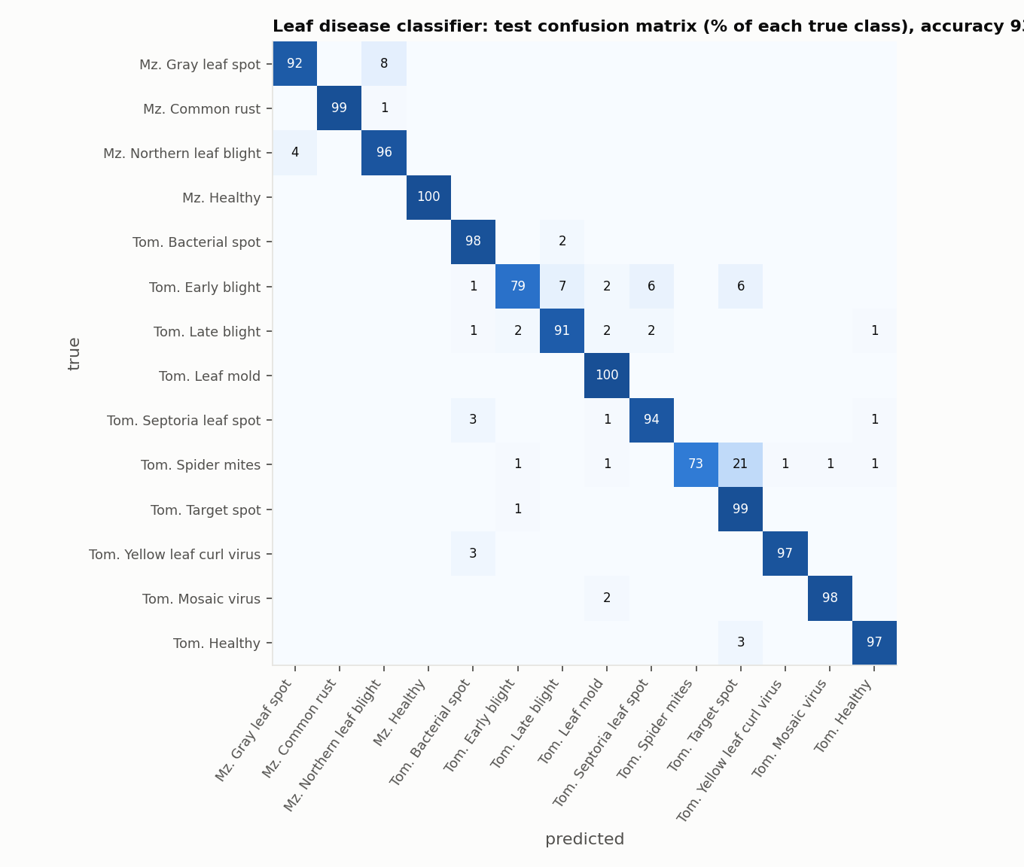
MODULE 2 · LEAF DISEASE DETECTION (DEEP LEARNING)
Result: 93.7 % accuracy on unseen leaf images
93.7 %
test accuracy on unseen images
0.937
macro F1 (all classes weighted equally)
1,213
test images, never seen in training
18
Notes:
On the test set, images the model never saw in training, it reaches 93.7 % accuracy and a macro F1 of 0.937. Macro F1 averages the F1 score over all 14 classes equally, so a rare class counts as much as a common one; that matters because PlantVillage is imbalanced. The confusion matrix shows where mistakes happen: almost everything sits on the diagonal, and the few errors are between diseases that look similar. The weakest class is Tomato Spider mites with an F1 of 0.85.

Slide 19
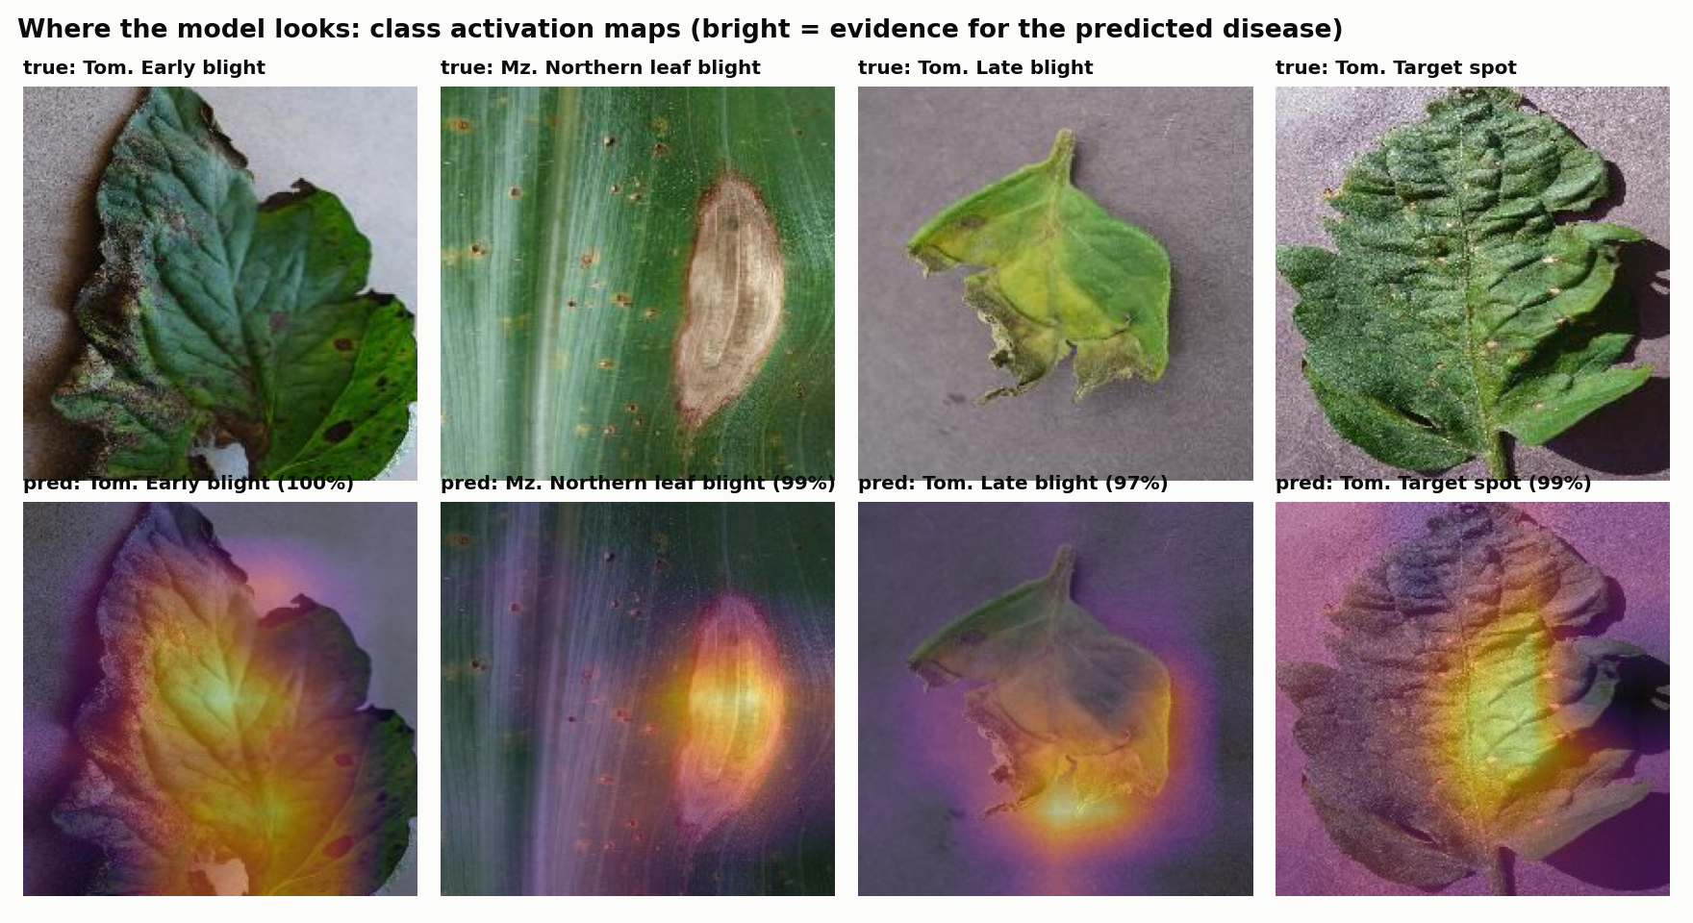
MODULE 2 · LEAF DISEASE DETECTION (DEEP LEARNING)
Explainable: the heatmap shows where the model looked
1
How it is computed
classifier weights for the predicted class × last convolutional feature maps
2
How to read it
bright = the region that drove the prediction; it should sit on the lesions
3
Why it matters
a farmer or expert can check the model is looking at the disease, not the background
Honest caveat
PlantVillage = lab photos on plain backgrounds. Field photos will be harder.
19
Notes:
A diagnosis is more trustworthy if we can see why. For every prediction we draw a class activation map: the classifier's weights for the predicted class multiplied with the network's last feature maps. Bright areas are the parts of the leaf that pushed the model towards that disease, and they should sit on the lesions, not on the background. One honest caveat: PlantVillage photos are taken in a lab on plain backgrounds, so real field photos, with soil, other leaves and harsh light, will be harder, and accuracy there will be lower. Fine-tuning on field datasets such as PlantDoc is the natural next step.

Slide 20
DEPLOYMENT · THE WEBSITE
The website: no server, everything runs in your browser
GitHub Pages
Visitor's browser (phone or laptop)
static files only
index.html + JavaScript
Q-tables + seasons (JSON)
weather + results (JSON)
leaf model (ONNX, 8.9 MB)
Irrigation pages
read JSON, draw seasons, look up the Q-table rulebook
Leaf Doctor
photo → ONNX Runtime Web (WebAssembly) → top-3 + heatmap
download
1
Private
2
Free
3
Anywhere
photos never leave the device
no server or GPU to pay for
works on any phone with a browser
Live at https://nirmit10000.github.io/agrisense/
20
Notes:
Both modules are deployed as one static website on GitHub Pages. Static means the server only hands out files: the page, the JavaScript, the agent's Q-tables and precomputed seasons as JSON, and the leaf model as an ONNX file. All the computing happens in the visitor's browser. The irrigation pages read the JSON and draw the seasons and the rulebook. The Leaf Doctor runs the neural network with ONNX Runtime Web, which uses WebAssembly, so a photo is processed on the phone itself and never uploaded anywhere. Hosting is free, there is nothing to maintain, and it works on any device with a browser.

Slide 21
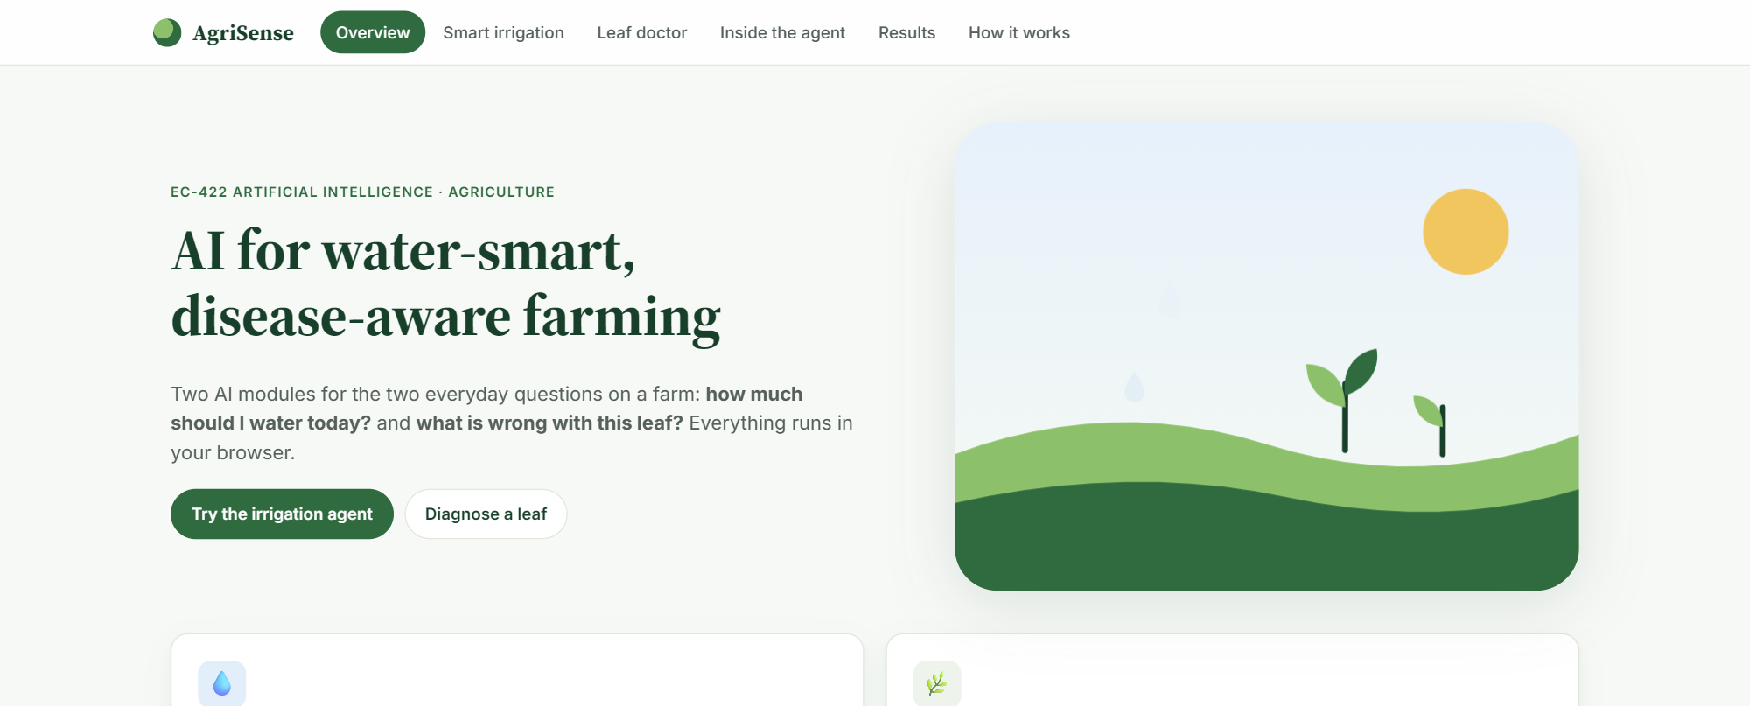
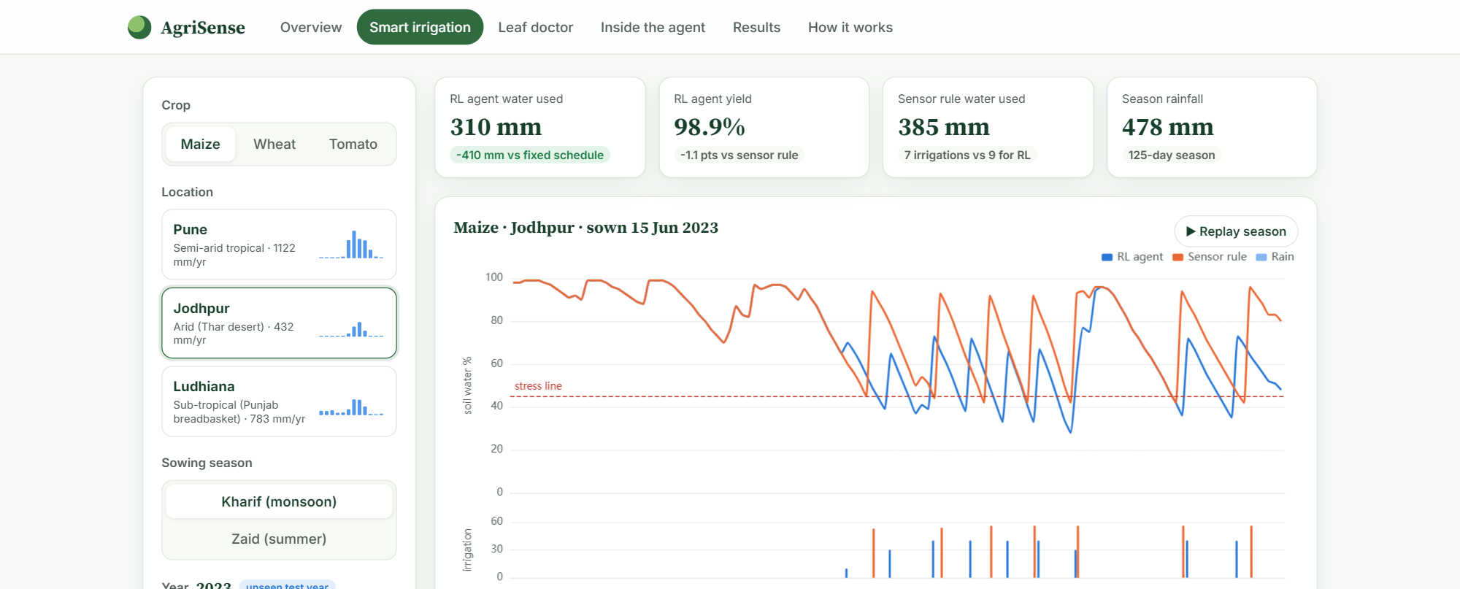
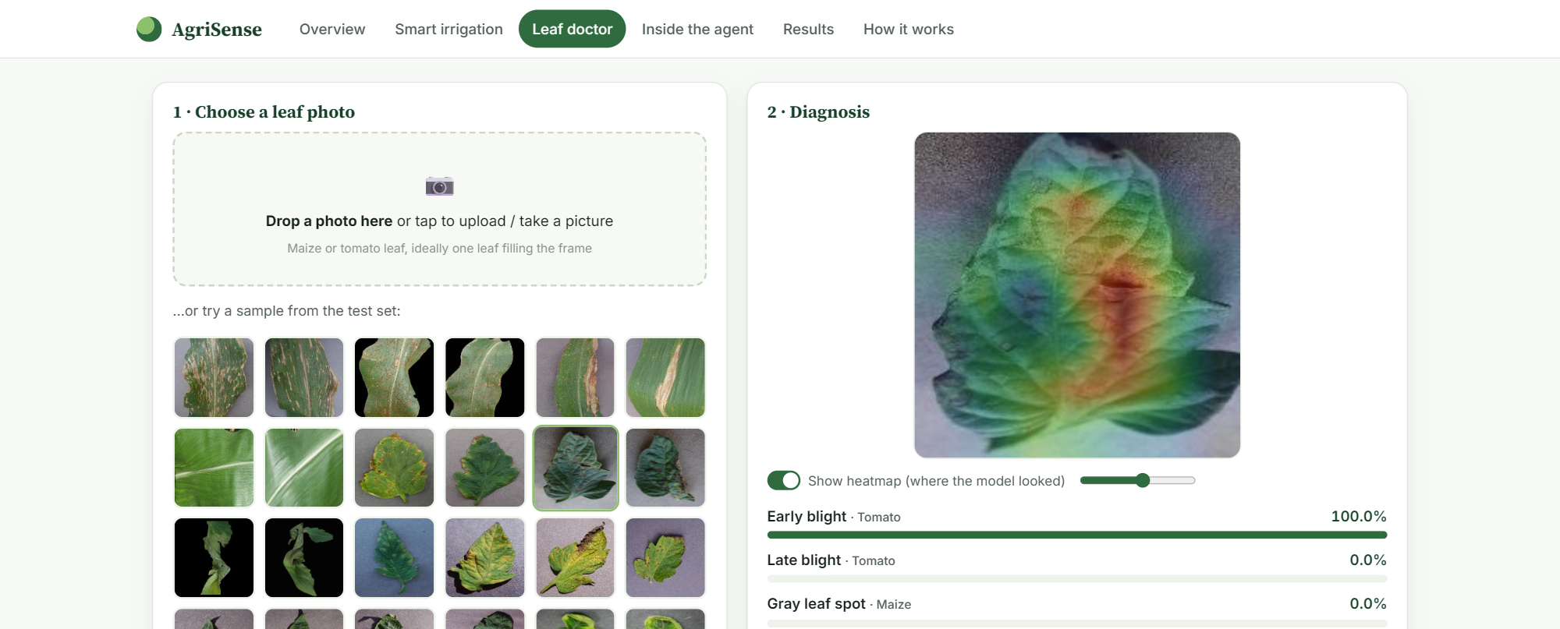
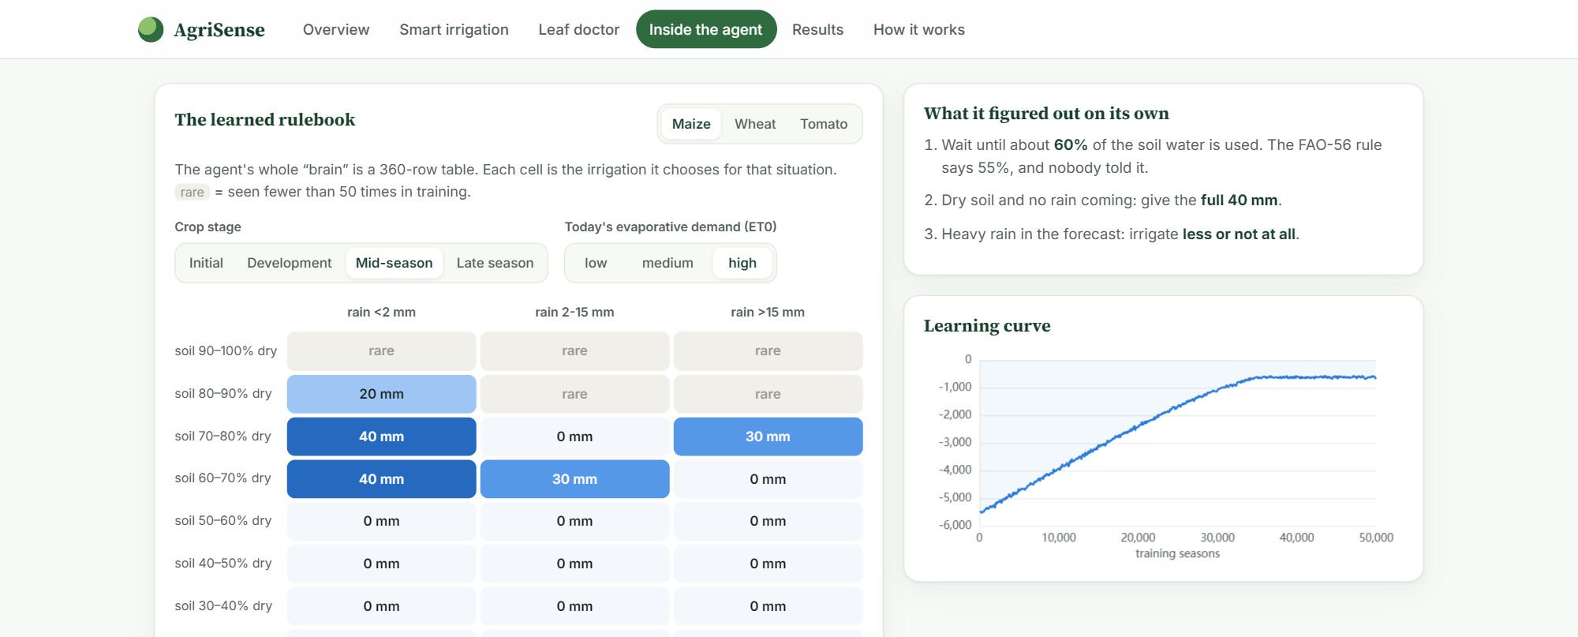
DEPLOYMENT · THE WEBSITE
A quick tour of the website
Home: both modules at a glance
Irrigation simulator
Leaf Doctor: diagnosis + heatmap
Inside the agent: the rulebook
21
Notes:
A quick tour before the live demo. The home page introduces both modules. The irrigation simulator lets you pick a crop, city, season and year and compare all four policies day by day. The Leaf Doctor takes a photo and returns the top three diagnoses with confidence, a heatmap and advice. And the agent page shows the learned rulebook for any growth stage and weather condition.

Slide 22
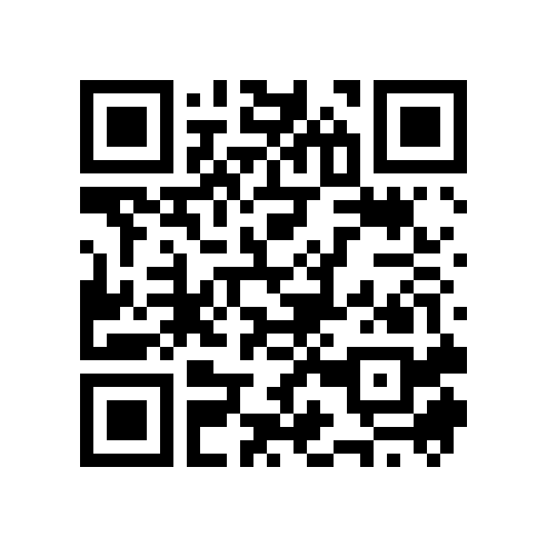
LIVE DEMO
Try it on your phone
nirmit10000.github.io/agrisense/
1
Irrigation simulator: Jodhpur, maize, 2023: agent vs sensor rule
2
Inside the agent: watch it hold back when rain is forecast
scan to open
3
Leaf Doctor: diagnose a sample tomato leaf, see the heatmap
22
Notes:
Now the live demo. Open the link or scan the QR code. First, the irrigation simulator: pick Jodhpur, maize, 2023 and show how the agent's soil moisture line stays above the stress line with less water. Second, the rulebook: change the forecast column and point out the agent waters less when rain is coming. Third, the Leaf Doctor: load a sample tomato leaf, show the top-3 diagnosis and the heatmap sitting on the lesions.

Slide 23
Limitations and next steps
!
Limitations
→
Next steps
Irrigation
Irrigation
Simulated field (FAO-56), not a field trial; seasonal yield model; synthetic forecast; coarse 360-state table (weaker in Ludhiana winters)
Deep Q-network on continuous inputs; real forecasts and IoT soil-moisture sensors; soil type as an input
Leaf disease
Leaf disease
PlantVillage = lab photos on plain backgrounds; maize + tomato only (no wheat); heatmap is coarse; no severity estimate
Fine-tune on field photos (e.g. PlantDoc); more crops; severity and treatment dosage
Together
Link the modules: a detected disease adjusts the irrigation plan; offline app
23
Notes:
To be honest about limitations. For irrigation: it is a simulated field, not a field trial; the yield model doesn't know that stress at flowering hurts more; the forecast is synthetic; and the table's coarse states are why Ludhiana winters are weaker. For leaf disease: PlantVillage photos are lab images on plain backgrounds, it covers only maize and tomato, and the heatmap is coarse. Next steps: a deep Q-network on continuous inputs, real soil-moisture sensors, fine-tuning the CNN on field photos, more crops, and linking the two modules, for example adjusting irrigation when a disease is detected.

Slide 24
Conclusion
45 %
98.1 %
93.7 %
0 servers
less irrigation water than a fixed calendar, with a higher yield
of maximum yield kept by the RL agent on unseen seasons
leaf-disease accuracy on unseen images (14 classes)
both models run in the visitor's browser, free to host
Thank you. Questions?
https://nirmit10000.github.io/agrisense/
24
Notes:
To conclude. Module one: a simple, explainable Q-learning agent used 45 percent less water than calendar irrigation with a higher yield, and matched an expert sensor rule while using slightly less water. Module two: a MobileNetV2 network diagnoses 14 maize and tomato leaf conditions with 93.7 % accuracy on unseen images, and shows where it looked. Both run free, in the browser, at the link on screen. Thank you, we're happy to take questions.

