Slide 1
EC-422 ARTIFICIAL INTELLIGENCE · COURSE PROJECT
AgriSense
AI for smart irrigation and crop health
1
Module 1 · Reinforcement learning decides when and how much to irrigate
2
Module 2 · A convolutional neural network diagnoses leaf diseases from a photo
Dushyant Kumar · 23145030
Nirmit Patil · 23145053
nirmit10000.github.io/agrisense/
Notes:
Good morning. Our project is AgriSense: AI for smart irrigation and crop health. It falls under the course theme of agriculture: intelligent irrigation, crop monitoring and resource optimisation. It has two AI modules: a reinforcement learning agent that decides when and how much to irrigate, and a convolutional neural network that recognises leaf diseases from a photo. Both are deployed on one website.

Slide 2
Problem statement: two decisions every farmer makes
Course theme
Agriculture: intelligent irrigation, crop monitoring and resource optimisation
1
Water: when, and how much, should I irrigate today?
2
Health: is this leaf diseased, and with what?
Decided by the calendar or by feel. Too much wastes water and drains away; too little stresses the crop.
Needs an expert who is rarely nearby. A late or wrong diagnosis means lost yield and wasted sprays.
Our problem statement
Use AI to recommend daily irrigation that saves water without losing yield, and to diagnose maize and tomato leaf diseases from a photo, both usable from one website.
2
Notes:
The course theme we picked is agriculture: intelligent irrigation, crop monitoring and resource optimisation. On a farm this comes down to two decisions that are still mostly made by habit. First, water: when should I irrigate, and how much? Second, crop health: this leaf looks wrong, is it a disease, and which one? Our problem statement is to support both decisions with AI.

Slide 3
Why it matters: water is wasted and crops are lost
~90 %
354 mm
40 %
of India's freshwater withdrawals go to agriculture
of irrigation per season drains away unused under a fixed 7-day calendar
Up to this share of global crop production is lost to plant pests and diseases each year
Source: FAO AQUASTAT
Source: our simulation, 60 test seasons
Source: FAO
The gap
Both decisions are made without data: irrigation by the calendar, diagnosis by eye. One is a sequential decision problem, the other a visual recognition problem: both are what AI is good at.
3
Notes:
Why does this matter? Agriculture takes about 90 percent of India's freshwater withdrawals, according to FAO AQUASTAT. In our simulation of a typical fixed calendar, about 350 millimetres per season simply drains below the roots, because the calendar ignores rain, and the crop still loses yield in hot spells. On the crop-health side, the FAO estimates that up to 40 percent of global crop production is lost to plant pests and diseases every year. Early, correct diagnosis is the first step to preventing that.

Slide 4
Our solution: AgriSense, two AI modules
1
Smart irrigation
2
Leaf disease detection
Reinforcement learning (tabular Q-learning)
Deep learning (MobileNetV2 CNN, transfer learning)
Input
Soil dryness, crop stage
3-day rain forecast, evaporative demand
Input
Photo of a maize or tomato leaf
AI
Reinforcement learning
AI
Deep learning
Irrigate 0–40 mm today
Top-3 of 14 classes + heatmap + advice
Output
Output
45 % less water than a fixed calendar
94.0 % accuracy on unseen test images
4
Notes:
AgriSense has two AI modules. Module one is a reinforcement learning agent: it looks at soil moisture, crop stage, the rain forecast and how hot the day is, and recommends an irrigation amount. Module two is a convolutional neural network: given a photo of a maize or tomato leaf, it returns the most likely disease with its confidence, a heatmap of where it looked, and management advice.

Slide 5
System architecture: train offline, run in the browser
1
Data
2
Train offline (Python)
3
Export as files
4
Serve and run
Weather + crop data
Open-Meteo 2010-2025, 3 cities; FAO-56 crop tables
Q-learning agent
FAO-56 field simulator, 50,000 seasons per crop
Q-tables + seasons
JSON: learned rulebook + every simulated season
Static website
GitHub Pages
Smart irrigation: season simulator, rulebook, results
Leaf doctor: CNN in the browser (ONNX Runtime Web)
Leaf images
PlantVillage, maize + tomato, 14 classes
MobileNetV2 CNN
ImageNet-pretrained, fine-tuned (transfer learning)
Leaf model
ONNX file + class list + advice
data
model / training
exported artefact
deployed output
Inference is client-side: irrigation results are precomputed JSON; the CNN runs in WebAssembly via ONNX Runtime Web.
5
Notes:
Here is the whole system as a flowchart. Column one is data: real weather from Open-Meteo with the FAO crop tables, and the PlantVillage leaf images. Column two is training, done offline in Python on a laptop: the Q-learning agent in our field simulator, and the MobileNetV2 network by transfer learning. Column three is what we export: the agent's Q-tables and all simulated seasons as JSON, and the network as an ONNX file. Column four is the website on GitHub Pages: it only serves files, and the visitor's browser does the computing, reading the JSON for irrigation and running the network with ONNX Runtime Web.

Slide 6
MODULE 1 · SMART IRRIGATION (REINFORCEMENT LEARNING)
Module 1 · Smart irrigation with reinforcement learning
Weather + forecast
Open-Meteo, real data
Field state
soil dryness, crop stage, rain forecast, ET0
Q-table lookup
360 states × 5 actions
Irrigation dose
0, 10, 20, 30 or 40 mm
Field simulator
FAO-56 water balance
reward + next state update the table (training only)
Why reinforcement learning?
1
Sequential
2
Delayed outcome
3
Uncertain
4
No labels
today's watering changes tomorrow's soil moisture
yield is known only at the end of the season
rain forecasts are imperfect
no dataset of 'correct' irrigation, so it learns from consequences
6
Notes:
Module one. Each day the agent reads the state of the field: soil dryness, crop growth stage, the rain forecast and evaporative demand. It looks up the best action in its learned Q-table and recommends an irrigation dose. During training, a field simulator works out what that dose does to the soil and the crop and returns a reward, which updates the table. Why reinforcement learning? Because irrigation is a sequence of decisions: today's watering changes tomorrow's soil, the yield is only known at the end of the season, rain is uncertain, and there is no labelled dataset of correct irrigation, so the agent learns from consequences.

Slide 7
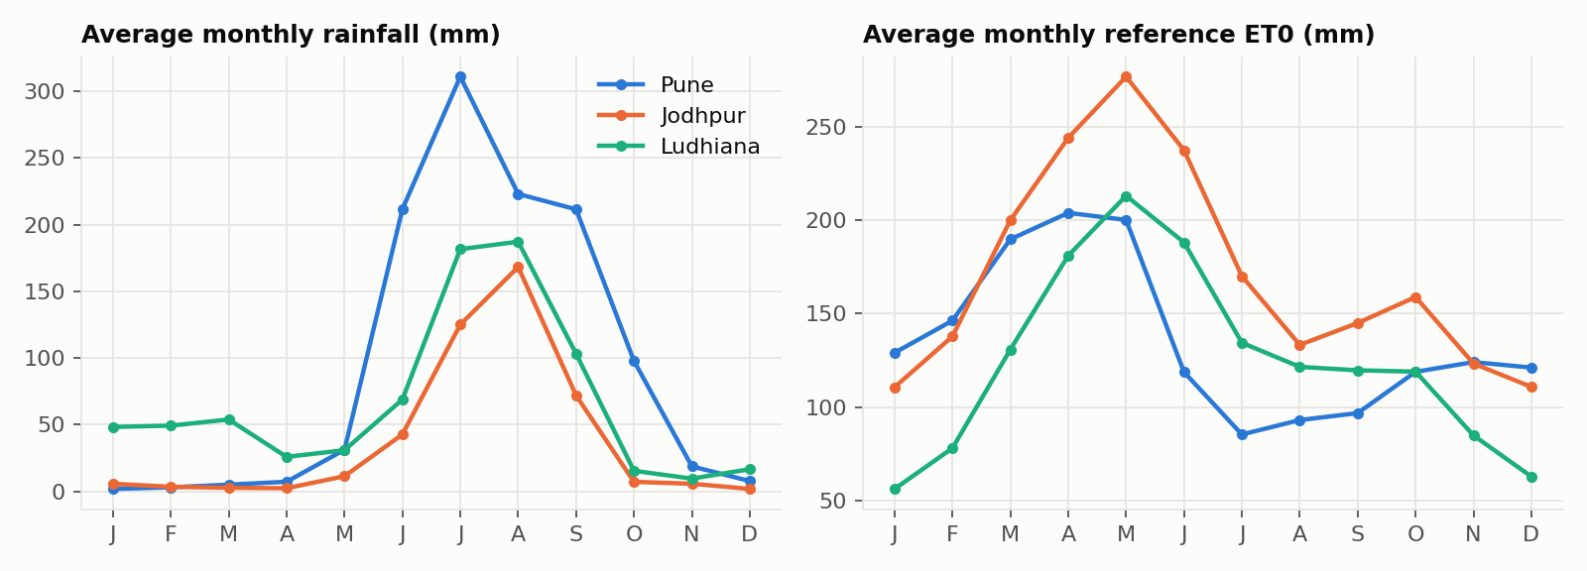
MODULE 1 · SMART IRRIGATION (REINFORCEMENT LEARNING)
Data: 16 years of daily weather, three contrasting climates
Pune
1122 mm/yr
Semi-arid tropical
Jodhpur
432 mm/yr
Arid (Thar desert)
Ludhiana
783 mm/yr
How to read it: left: average rain per month; right: monthly ET0 (higher = drier air, more water needed). Lines are cities.
What it shows: three very different water regimes, so one agent must generalise across monsoon, desert and winter-rain climates.
Sub-tropical (Punjab breadbasket)
Source
Open-Meteo API (ERA5 reanalysis)
Variables
daily rain, ET0, Tmax, Tmin
Train
seasons starting 2010-2020
Test
seasons starting 2021-2024 (never seen)
7
Notes:
We used the Open-Meteo historical weather API, based on the ERA5 reanalysis: daily rainfall and reference evapotranspiration ET0, the drying power of the air, from 2010 to 2025. The left chart is average monthly rainfall, the right one monthly ET0. Pune has a heavy monsoon, Jodhpur is the driest with the highest ET0, Ludhiana gets some winter rain and has cold winters. Three different water regimes means one agent must generalise rather than memorise a place. Seasons starting 2010 to 2020 are for training, 2021 to 2024 for testing only.

Slide 8
MODULE 1 · SMART IRRIGATION (REINFORCEMENT LEARNING)
The environment: a field simulator built on FAO-56
rain + irrigation
crop water use (ET)
1
Crop demand
ETc = Kc(stage) × ET0
2
Stress factor
Ks = 1 if depletion ≤ RAW, else falls linearly to 0
3
Actual use
ETa = Ks × ETc
stress line (RAW used up)
4
Season yield (FAO-33)
overflow drains away (waste)
Ya / Ym = 1 − Ky · (1 − ΣETa / ΣETc)
root zone (total available water, TAW)
Maize on sandy loam: TAW = 96 mm, RAW = p × TAW = 0.55 × 96 = 53 mm. Crop values from FAO-56 / FAO-33 tables.
8
Notes:
We can't run 50 thousand seasons on a real farm, so the agent trains in a simulator built on FAO-56, the international standard for crop water requirements. Think of the root zone as a bucket. Rain and irrigation fill it; anything above the brim drains away and is wasted. The crop drinks from it every day: ET0 times a crop coefficient Kc that changes with growth stage. While the soil holds more than a safe amount, called RAW, the crop is fine; below that line it is water-stressed. At the end of the season the FAO-33 equation turns the total water shortfall into a yield loss.

Slide 9
MODULE 1 · SMART IRRIGATION (REINFORCEMENT LEARNING)
Formulating irrigation as a Markov Decision Process
S
State: what the agent sees
A
Action: what it decides
R
Reward: how it is scored
Soil dryness: 10 levels
Crop growth stage: 4
Rain forecast, next 3 days: none / light / heavy
Evaporative demand (ET0): low / medium / high
= 360 states
Irrigate 0, 10, 20, 30, 40 mm today
Realistic drip / sprinkler doses
5 actions
− 1 per mm of water used
− 10 per mm of crop water shortage
− 1 per mm drained away
− 10 per irrigation event (pump, labour)
Yield matters 10× more than water
Episode = one crop season (125-145 days) from a random date, city and starting soil moisture. Forecast = real future rain ± 25 % error.
9
Notes:
The exact formulation. The state is four things a farmer would look at: how dry the soil is, the crop's growth stage, whether rain is forecast in the next three days, and how hot and dry today is. Discretised, that is 360 states. The actions are five irrigation amounts. The reward is negative: a cost for every millimetre of water, a ten times higher cost for every millimetre the crop wanted but didn't get, a cost for water that drains away, and a fixed cost per irrigation for pump and labour. The ten-to-one ratio encodes the priority that losing yield is far worse than spending water.

Slide 10
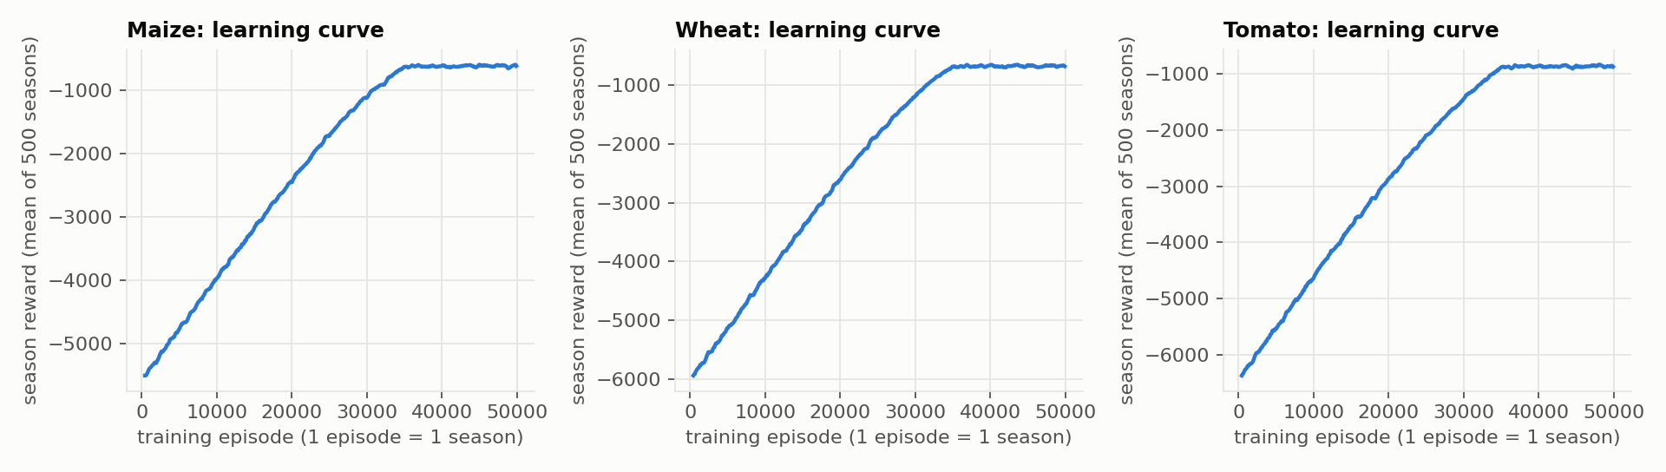
MODULE 1 · SMART IRRIGATION (REINFORCEMENT LEARNING)
Learning: tabular Q-learning
Q(s,a) ← Q(s,a) + α [ r + γ · max Q(s′,a′) − Q(s,a) ]
Q-table
360 states × 5 actions
Episodes
50,000 seasons per crop
Exploration ε
1 → 0.05
How to read it: x = training seasons, y = total season reward (negative: every mm and stress day costs; higher = better). One panel per crop.
What it shows: reward climbs while exploration decays, then flattens: learning has converged for all three crops.
Learning rate α
0.1 → 0.01
Discount γ
0.95
Training time
≈ 1.5 min per crop (CPU)
Why a table, not a deep network?
360 states is small enough to learn exactly, it trains in minutes on a laptop, and the whole policy can be printed and checked.
10
Notes:
We used tabular Q-learning. The agent keeps a table with one value per state and action: how good is it, in the long run, to give this dose in this situation. After every simulated day it nudges that value towards the reward it got plus the discounted value of the best action in the next state; that is the update rule. Early on it explores randomly, with epsilon decaying from 1 to 0.05, and the learning rate also decays so the values settle. The chart shows the average season reward during training, one panel per crop. Reward is negative because every millimetre and every stress day costs something; higher is better. It climbs steadily while exploration decays and then flattens: the agent has converged. We chose a table rather than a deep network on purpose: 360 states is small, and a table can be printed and inspected.

Slide 11
MODULE 1 · SMART IRRIGATION (REINFORCEMENT LEARNING)
How the agent decides: one day, step by step
1 · Observe the state
soil 70–80 % dry · mid-season · rain forecast < 2 mm · ET0 high
2 · Look up this row of the Q-table
3 · Act
irrigate 40 mm today
0 mm
10 mm
20 mm
30 mm
40 mm
-612
-571
-540
-522
-509
Pick the highest value → 40 mm. Values are illustrative: each is the expected total future reward of the season.
5 · Learn: nudge the Q-value (training only)
target = r + γ · max Q(s′) = −50 + 0.95 × (−480) = −506
Q ← −509 + α · (−506 − (−509)) = −509 + 0.05 × 3 ≈ −508.9
4 · Simulator responds
next day soil ≈ 30 % dry; reward r = −(40 water + 10 event) = −50
Repeated for every day of 50,000 simulated seasons, these small nudges turn the table into the rulebook shown later. After training only steps 1–3 are used.
11
Notes:
Here is one decision, step by step, so the algorithm is concrete. Step one: the agent observes the field. Say the soil is 70 to 80 percent dry, the maize is in mid-season, no rain is forecast for the next three days and the day is hot. That combination is one row of the Q-table. Step two: the row holds five numbers, one per dose. These values are illustrative, but the shape is real. They are all negative because they estimate the total future cost of the season. The highest, the least negative, is 40 millimetres. Step three: the agent irrigates 40 millimetres. Step four, during training only: the simulator moves the field to the next day and returns a reward of minus 50, which is 40 for the water plus 10 for the irrigation event, with no stress and no waste. Step five: the update rule nudges the Q-value towards that reward plus the discounted value of the best action tomorrow. Repeated millions of times, those small nudges become the rulebook.

Slide 12
MODULE 1 · SMART IRRIGATION (REINFORCEMENT LEARNING)
The benchmark: FAO's soil-moisture threshold rule
The rule (FAO-56 management-allowed depletion)
if depletion > RAW = p × TAW
irrigate depletion mm (refill to field capacity)
else do nothing
maize: TAW = 96 mm, p = 0.55, so it irrigates once 53 mm is used
RL agent vs the benchmark (60 unseen seasons)
RL agent
Sensor rule
Water per season
435 mm
460 mm
Wasted to drainage
1.6 mm
4.2 mm
Irrigation events
13.8
11.4
+
Why it is a strong benchmark
Yield (% of max)
98.1 %
100.0 %
Recommended expert practice; we give it a perfect soil sensor and any dose size, so it never stresses the crop (100 % yield).
Crop per m³ of water
6.30 kg
6.13 kg
Knows the FAO rule?
no, learned it
yes, hand-coded
−
Its blind spot
Takeaway expert-level behaviour learned from scratch, plus 5.5 % less water by using the forecast.
Ignores the forecast and always refills to 100 %, so rain right after an irrigation overflows and is lost.
12
Notes:
Beating a naive calendar is easy, so we also compare against a strong expert benchmark: the FAO-56 management rule. With a soil-moisture sensor, irrigate as soon as the depletion passes the readily available water, RAW, which for maize on our soil is 53 millimetres, and refill the root zone exactly to field capacity. We even give it advantages our agent does not have: a perfect sensor and any irrigation amount, not just five doses. It never stresses the crop, so it gets 100 percent yield. Its blind spot is that it ignores the forecast and always fills the soil to the brim, so rain that follows overflows. Against it, our agent uses 5.5 percent less water and wastes less, for 1.9 points of yield. The important point: the agent was never told this rule, yet reached the same level by trial and error.

Slide 13
MODULE 1 · SMART IRRIGATION (REINFORCEMENT LEARNING)
A fair test: four policies on seasons the agent never saw
Q-learning agent (RL)
Sensor threshold rule
60
Our agent. Uses soil, crop stage, forecast and ET0.
FAO expert rule. Perfect moisture sensor; refills to full at the safe limit; no forecast.
unseen test seasons
3 cities × 5 crop-season combinations × 4 years (2021-2024)
Same weather and forecast errors for every policy
Fixed schedule
Rainfed (no irrigation)
Farmer's calendar: 40 mm every 7 days, whatever the weather.
Never irrigate. Lower bound.
Metrics: irrigation water · yield (% of max) · water wasted · stress days · water productivity (kg of crop per m³ of water)
13
Notes:
We compare four policies. Rainfed never irrigates, the lower bound. Fixed schedule is the typical farmer calendar, 40 millimetres every 7 days. The sensor threshold rule is the expert benchmark we just saw. And our agent. All four run on the same 60 test seasons from 2021 to 2024: three cities, five crop-season combinations, four years, with identical weather and identical forecast errors.

Slide 14
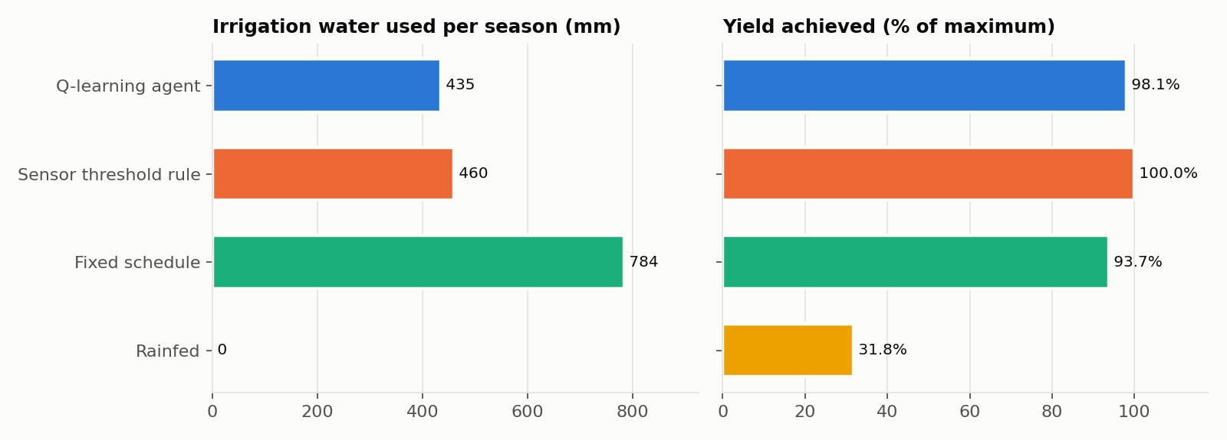
MODULE 1 · SMART IRRIGATION (REINFORCEMENT LEARNING)
Result: 45 % less water than the calendar, higher yield
45 %
less water than the fixed calendar
98.1 %
of maximum yield (calendar: 93.7 %)
6.30
How to read it: left: water used per season; right: yield as % of the maximum; averages over 60 unseen seasons, one colour per policy.
What it shows: the agent uses about the expert rule's water and far less than the calendar, while keeping yield above 98 %.
kg of crop per m³ of water, the best of all (sensor rule 6.13)
14
Notes:
The headline numbers, averaged over all 60 test seasons. The left bars are water used per season, the right bars yield as a percentage of the maximum. Compared with the fixed calendar, the agent uses 45 percent less water, about 435 millimetres instead of 784, and the yield goes up, from 93.7 to 98.1 percent. Against the expert sensor rule it uses 5.5 percent less water for a small yield trade-off, and it produces the most crop per cubic metre of water of any policy.

Slide 15
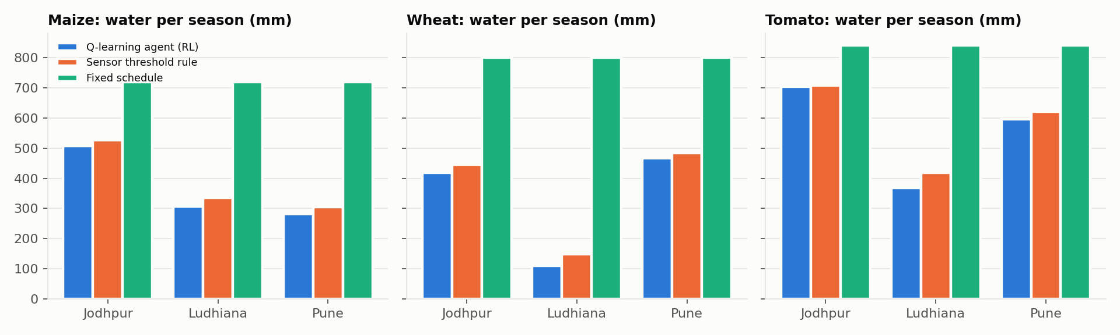
MODULE 1 · SMART IRRIGATION (REINFORCEMENT LEARNING)
One agent adapts to very different climates
How to read it: one panel per crop; inside it, one group per city; bar height = average irrigation water per season for each policy (blue = RL, orange = sensor rule, green = fixed calendar).
What it shows: needs vary about 3× between climates and the agent adapts without knowing the city; weakest is Ludhiana (yield 95.4 %).
15
Notes:
This chart breaks the water use down by crop and city. Each group of bars is one crop in one city; the bar height is the average water per season for each policy. Water needs differ by about a factor of three between climates, yet one agent per crop handles all of them; it is never told which city it is in. It always uses much less than the calendar and slightly less than the sensor rule. Its weakest city is Ludhiana, where yield drops to about 95 percent, most likely because the cold-winter states are coarse in our table.

Slide 16
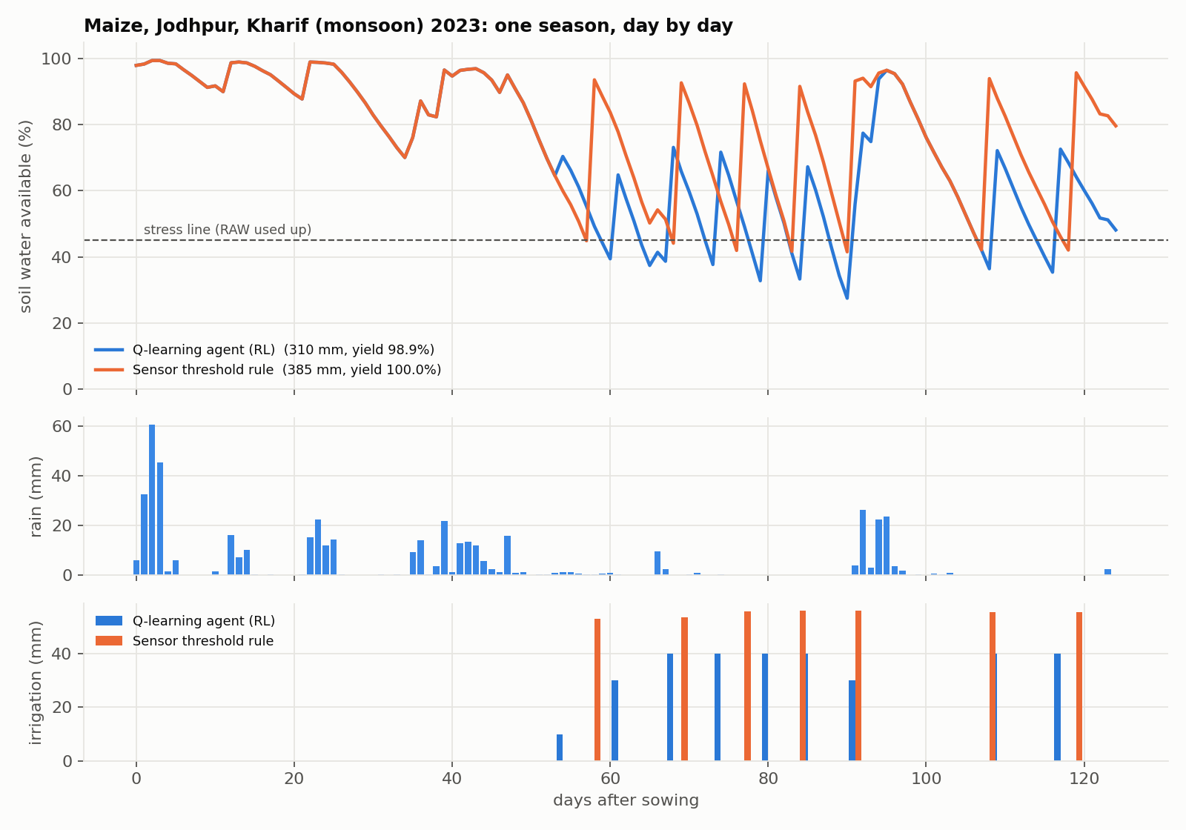
MODULE 1 · SMART IRRIGATION (REINFORCEMENT LEARNING)
One season: smaller doses that leave room for rain
1
Sensor rule
waits for the stress line, then refills to 100 %, so later rain can overflow
2
RL agent
smaller 30-40 mm doses keep room in the soil for rain
3
This season
310 mm vs 385 mm: 20 % less water
How to read it: top: soil water %, dashed = stress line; middle: rain; bottom: irrigation (blue = RL, orange = sensor rule).
What it shows: both keep the crop above the stress line; the agent does it with smaller, earlier doses and less water.
16
Notes:
This is one real test season: maize in Jodhpur, monsoon 2023. The top panel is the water available in the soil; the dashed line is where stress begins. The middle panel is rain and the bottom panel the irrigation events. The orange sensor rule waits until the line is reached, then fills the soil to the top with about 55 millimetres. The blue agent gives smaller doses of 30 to 40 millimetres, which leaves room for rain. That season it used 310 millimetres against 385 for the sensor rule, 20 percent less.

Slide 17
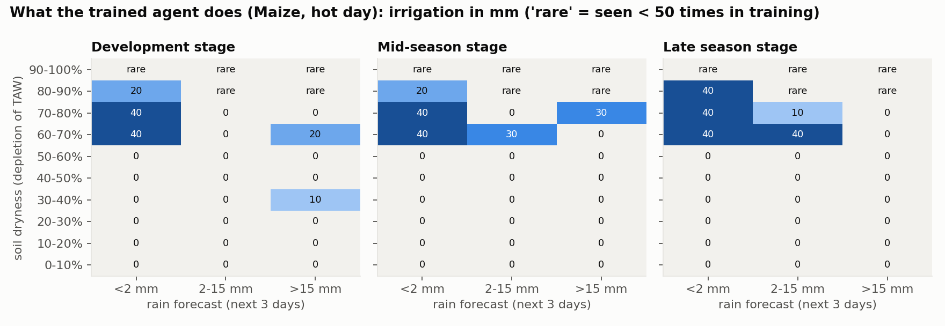
MODULE 1 · SMART IRRIGATION (REINFORCEMENT LEARNING)
What the agent learned can be read like a rulebook
How to read it: one panel per growth stage; rows = soil dryness, columns = rain forecast; each cell = the dose chosen (mm), darker = more; 'rare' = seen < 50 times.
What it shows: no water until ~60 % dry (FAO says 55 %), full 40 mm when dry with no rain coming, less when heavy rain is forecast.
17
Notes:
Because the policy is a table, we can open it. This is maize on a hot day, one panel per growth stage. Rows are soil dryness, columns the rain forecast, and the number in each cell is the dose the agent picks; darker means more water. Three rules emerge that nobody programmed: do nothing until about 60 percent of the soil water is used, close to the FAO threshold of 55 percent; when it's dry and no rain is coming, give the full 40 millimetres; and when heavy rain is forecast, give less or nothing. Cells marked rare were seen fewer than 50 times in training, so we don't read anything into them.

Slide 18
MODULE 2 · LEAF DISEASE DETECTION (DEEP LEARNING)
Module 2 · Leaf disease detection with a CNN
Leaf photo
phone or upload
Pre-process
resize, crop 224², normalise
MobileNetV2
7×7×1280 feature maps
Global avg pool
1280 numbers
Linear layer
1280 → 14
Softmax
probabilities
Diagnosis
top-3, heatmap, advice
feature maps × classifier weights = class activation heatmap
input
processing
learned layers
output
Why a CNN, and why transfer learning?
1
Visual pattern
2
Weight sharing
3
Transfer learning
4
Explainable
disease shows as spots, rings and colour changes: local patterns that convolutions detect
the same filter scans the whole leaf, so a lesion is found wherever it is
ImageNet weights already know edges and textures; thousands of leaf photos suffice
global pooling + one linear layer lets us draw an exact heatmap
18
Notes:
Module two diagnoses leaf diseases. The pipeline: a photo of a leaf is resized and centre-cropped to 224 by 224 pixels and normalised. A MobileNetV2 convolutional network, pretrained on ImageNet, turns it into 1280 feature maps of 7 by 7 describing textures, spots and colours. Global average pooling squeezes each map to one number, and a linear classifier maps those 1280 numbers to our 14 classes. Softmax gives probabilities; we show the top three, plus a class activation heatmap computed from the same feature maps. Why a CNN? Disease is a visual pattern, and convolutions detect local patterns anywhere in the image. Why transfer learning? From scratch we would need millions of images; starting from ImageNet weights, a few thousand leaf photos suffice.

Slide 19
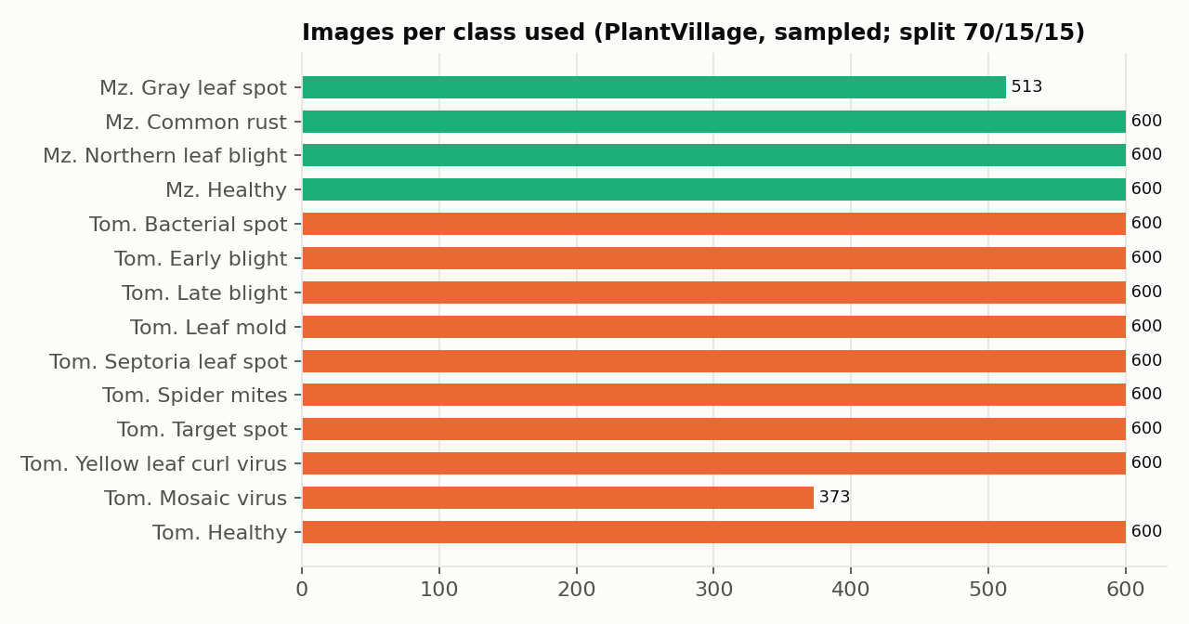
MODULE 2 · LEAF DISEASE DETECTION (DEEP LEARNING)
Data: PlantVillage leaf images, maize and tomato
Maize (4)
Tomato (10)
Gray leaf spot
Common rust
Northern leaf blight
Healthy
Bacterial spot
Early blight
Late blight
Leaf mold
Septoria leaf spot
Spider mites
Target spot
Yellow leaf curl virus
Mosaic virus
Healthy
How to read it: one bar per class (maize green, tomato orange); length = number of images used.
What it shows: classes are nearly balanced (capped at 600), so accuracy is not dominated by one class.
8,086
Total images
5,660
Train
1,213
Validation
1,213
Test (unseen)
19
Notes:
For data we used PlantVillage, the standard public benchmark of labelled leaf photos. We kept only maize and tomato, the crops our irrigation module also covers: 14 classes including the healthy ones. The chart shows how many images per class we used: we capped each class at 600 so no class dominates, and only two classes have fewer. That is 8,086 images in total, split 70, 15, 15 into training, validation and test; the test images are never seen during training. Wheat is not in PlantVillage.

Slide 20
MODULE 2 · LEAF DISEASE DETECTION (DEEP LEARNING)
Inside the model: the MobileNetV2 architecture
17 inverted-residual bottleneck blocks (detail on next slide)
Input
224×224×3 leaf photo
Conv 3×3
32 ch
112×112
Stage 1
16 ch · 1 block
112×112
Stage 2
24 ch · 2 blocks
56×56
Stage 3
32 ch · 3 blocks
28×28
Stage 4
64 ch · 4 blocks
14×14
Stage 5
96 ch · 3 blocks
14×14
Stage 6
160 ch · 3 blocks
7×7
Stage 7
320 ch · 1 block
7×7
Conv 1×1
1280 ch
7×7
pretrained, frozen
fine-tuned on leaves
Feature maps
7×7×1280
Global avg pool
→ 1280 numbers
Linear layer
1280 → 14 (new)
Softmax
14 probabilities
new layer we trained
input / output
In numbers: ~3.5 M parameters, ~300 M multiply-adds per image; image shrinks 224 → 7 while channels grow 3 → 1280; we fine-tuned the last 8 of 19 feature blocks and trained a new 14-way classifier.
20
Notes:
This is the network we used, MobileNetV2. A 224 by 224 colour image goes through one ordinary 3 by 3 convolution with 32 filters, then 17 inverted-residual bottleneck blocks, grouped into seven stages. Each stage halves the image size or keeps it, and increases the number of channels: from 112 by 112 down to 7 by 7, and from 16 up to 320 channels. Early stages detect edges and colours, later ones textures and lesion shapes. A final 1 by 1 convolution produces 1280 feature maps of 7 by 7. Global average pooling turns each map into one number, and our new linear layer maps the 1280 numbers to 14 disease classes. The colours show how we trained it: the early part keeps its ImageNet weights frozen, the last 8 blocks were fine-tuned on leaves, and the classifier is new.

Slide 21
MODULE 2 · LEAF DISEASE DETECTION (DEEP LEARNING)
The building block: an inverted residual bottleneck
skip connection (when input and output shapes match)
1×1 conv
expand × 6
ReLU6
3×3 depthwise
one filter per channel
ReLU6
Input
h × w × c
1×1 conv
project back
linear (no ReLU)
Output
h × w × c
+
narrow → wide → narrow: the reverse of a ResNet bottleneck, hence “inverted”
Depthwise-separable
Linear bottleneck
Residual
a normal 3×3 conv mixes space and channels at once: k²·C_in·C_out multiplies per pixel. Splitting it into 3×3 per channel + 1×1 mix costs k²·C_in + C_in·C_out, about 8–9× fewer for k = 3.
no ReLU after the narrow projection, so information is not thrown away in the low-dimensional layer.
adding the input back keeps gradients flowing through 17 blocks.
21
Notes:
Each of those 17 blocks has the same three steps. First a 1 by 1 convolution expands the channels six times, say from 24 to 144. Then a 3 by 3 depthwise convolution filters each channel separately, looking at the neighbourhood of every pixel. Then a 1 by 1 linear projection squeezes the channels back down, without a ReLU, because a ReLU in a narrow layer would destroy information. When the input and output have the same shape, a skip connection adds the input back, which makes deep networks easier to train. It is called inverted because a classic ResNet bottleneck goes wide, narrow, wide; this one goes narrow, wide, narrow. The trick that makes it cheap is the depthwise-separable convolution: splitting a normal 3 by 3 convolution into a per-channel 3 by 3 and a 1 by 1 mix needs about 8 to 9 times fewer multiplications.

Slide 22
MODULE 2 · LEAF DISEASE DETECTION (DEEP LEARNING)
Why MobileNetV2, and how it helped us
Parameters
Multiply-adds / image
Designed for
MobileNetV2 (ours)
~3.5 M
~0.3 B
phones
ResNet-50
~25.6 M
~4.1 B
servers / GPUs
VGG-16
~138 M
~15.5 B
servers / GPUs
How it helped this project
1
Trains on a laptop
2
Runs in the browser
3
Transfers to leaves
4
Exact heatmap
no GPU available: whole training took about 15 min on the CPU
small and fast enough to run on a phone with ONNX Runtime Web, so no AI server
ImageNet edge and texture detectors fit lesions; a few thousand photos suffice
global average pool + one linear layer makes the class activation map exact
22
Notes:
Why this model and not a bigger one? The table compares it with two classic networks. MobileNetV2 has about 3.5 million parameters and needs about 300 million multiply-adds per image. ResNet-50 has about 25 million parameters and 4 billion multiply-adds, VGG-16 138 million and 15 billion. For us that mattered in four concrete ways. It trained in about 15 min on a laptop CPU, because we had no GPU available. It runs inside a web browser on a phone in a fraction of a second, so the website needs no AI server. Its ImageNet features, edges and textures, transfer well to leaf lesions, so a few thousand photos were enough. And because it ends in global average pooling and a single linear layer, the heatmap we draw is exact rather than an approximation.

Slide 23
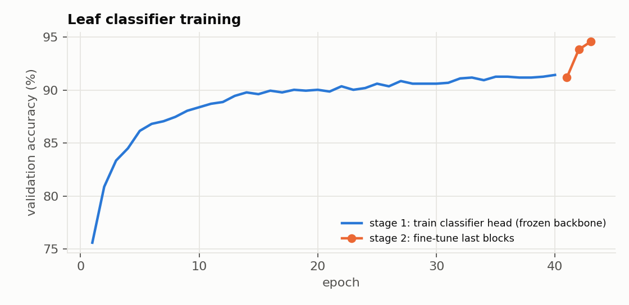
MODULE 2 · LEAF DISEASE DETECTION (DEEP LEARNING)
Training: transfer learning in two phases
Phase 1: train the head
body frozen, new 14-class layer · 40 epochs
Phase 2: fine-tune
last 8 blocks + head, small learning rate · 3 epochs
Pick and test
best epoch on validation; score once on the test set
Export
ONNX for ONNX Runtime Web
Input
224×224 RGB, ImageNet normalisation
Augmentation
random crops, flips, colour jitter
Optimiser
Adam, cross-entropy loss
Training time
about 15 min on a laptop CPU
Why two phases?
Training the new head first protects the pretrained features; fine-tuning then adapts them to leaf textures without forgetting what they already know.
How to read it: x = epoch, y = accuracy on the validation images; first the head phase, then fine-tuning.
What it shows: the frozen-feature head already does most of the work; fine-tuning the later blocks adds the rest.
23
Notes:
Training happens in two phases. In phase one the whole pretrained body is frozen and only the new 14-class linear layer is trained, so we don't damage what the network already knows. In phase two we unfreeze the last 8 feature blocks and fine-tune them together with the classifier at a small learning rate, so the high-level features adapt to leaves. We keep the epoch with the best validation accuracy and report the score once, on the untouched test set. The chart shows validation accuracy over the epochs: the head alone gets most of the way, and fine-tuning adds the rest. The model is then exported to ONNX for the browser.

Slide 24
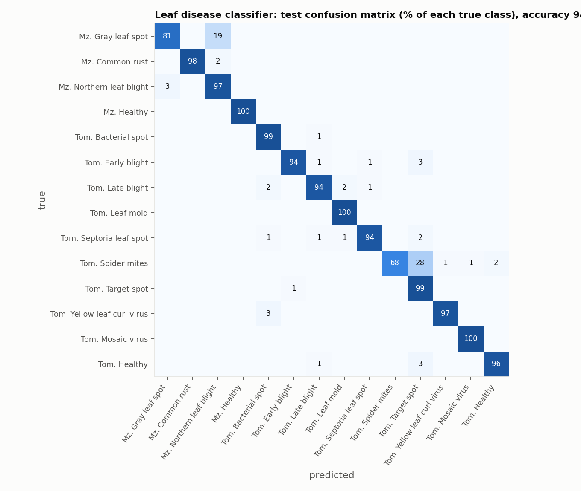
MODULE 2 · LEAF DISEASE DETECTION (DEEP LEARNING)
Result: 94.0 % accuracy on unseen leaf images
94.0 %
How to read it: rows = true disease, columns = predicted; the diagonal is correct, anything off it is a mistake.
What it shows: almost all on the diagonal; the confusions are among look-alike tomato spot diseases (tom. spider mites, tom. target spot, mai. gray leaf spot).
test accuracy on unseen images
0.940
macro F1 (all classes weighted equally)
1,213
test images, never seen in training
Weakest classes: Tomato spider mites (F1 0.81), Tomato target spot (F1 0.84), Maize gray leaf spot (F1 0.87)
24
Notes:
On the test set, images the model never saw in training, it reaches 94.0 % accuracy and a macro F1 of 0.940. Macro F1 averages over all 14 classes equally, so a weak class cannot hide behind the others. The confusion matrix: rows are the true disease, columns the prediction, and the diagonal is correct. Almost everything sits on the diagonal. The few mistakes are between diseases that look alike, mostly the tomato spot diseases; the weakest classes are tom. spider mites, tom. target spot, mai. gray leaf spot.

Slide 25
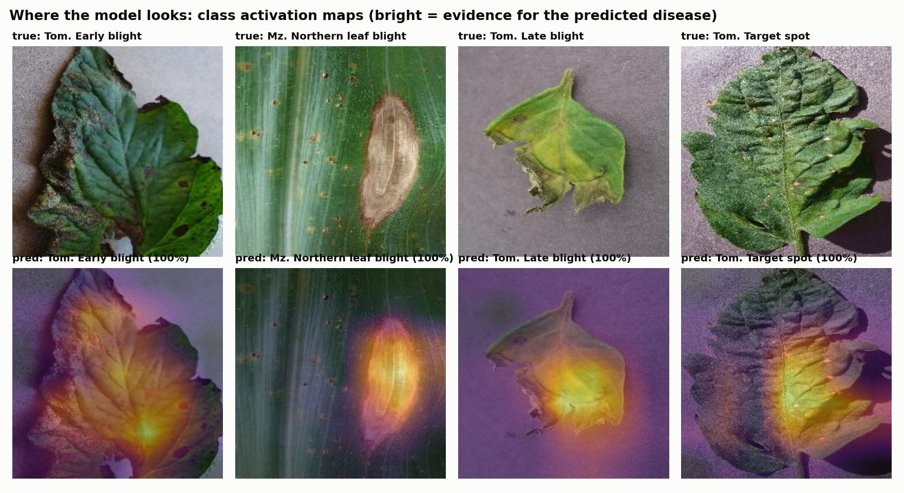
MODULE 2 · LEAF DISEASE DETECTION (DEEP LEARNING)
Explainable: the heatmap shows where the model looked
1
How it is computed
CAM_c(x, y) = Σ_k w_c,k · f_k(x, y): classifier weights × last feature maps
2
Why it is exact
class score = average of CAM_c + bias, because of global average pooling
3
Why it matters
an expert can check the model looks at the disease, not the background
Caveat
PlantVillage photos are single leaves on plain backgrounds; field photos with soil, other leaves and harsh light will be harder.
How to read it: top: test photos with true / predicted label; bottom: same photos with the heatmap (red = strongest evidence).
What it shows: the heat sits on lesions and discoloured patches, not the background: the model uses the right evidence.
25
Notes:
A diagnosis is more trustworthy if we can see why. For every prediction we draw a class activation map: the classifier's weights for the predicted class multiplied with the network's last 7 by 7 feature maps, and summed. Because the class score is exactly the average of this map plus a bias, the map is not a guess. In the figure, the top row is test photos with the true and predicted label, and the bottom row the same photos with the heatmap: red is the strongest evidence. The heat sits on the lesions, not on the background, so the model is using the right evidence. One caveat: PlantVillage photos are lab images on plain backgrounds, so field photos will be harder.

Slide 26
DEPLOYMENT · THE WEBSITE
The website: static files, models run in the browser
GitHub Pages
Visitor's browser (phone or laptop)
serves static files
index.html + JavaScript
Q-tables + 225 seasons (JSON)
results + weather (JSON)
leaf model (ONNX) + classes
Smart irrigation
season JSON
Charts
ECharts
Rulebook + results
per crop / city
HTTPS
Leaf photo
resize, crop, normalise
CNN
ONNX Runtime Web
Diagnosis
top-3 + heatmap
Three tabs: Overview · Smart irrigation · Leaf doctor
Live at https://nirmit10000.github.io/agrisense/
26
Notes:
Both modules are deployed as one static website on GitHub Pages. Static means the server only hands out files: the page and its JavaScript, the agent's Q-tables and all precomputed seasons as JSON, and the leaf model as an ONNX file. All the computing happens in the visitor's browser. The irrigation tab reads the JSON and draws any season, the rulebook and the results. The leaf doctor tab preprocesses the photo in JavaScript, runs the network with ONNX Runtime Web, which uses WebAssembly, and computes the softmax and the heatmap. We precomputed the irrigation seasons in Python so the website shows exactly the numbers in our report.

Slide 27
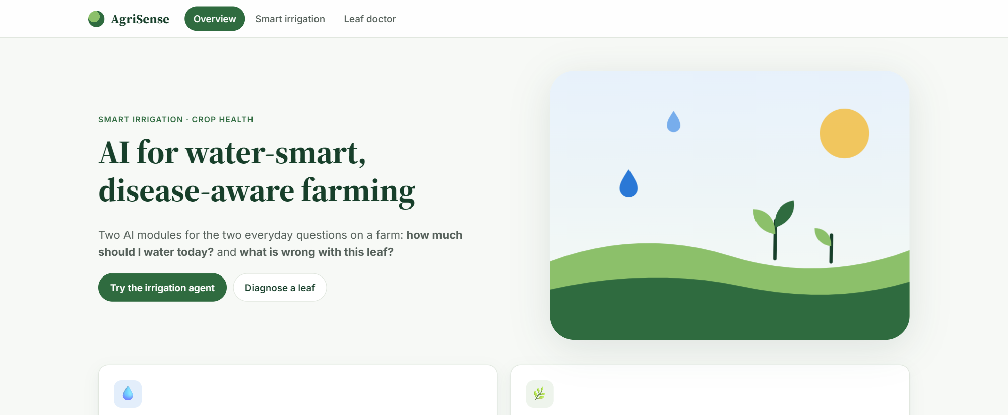
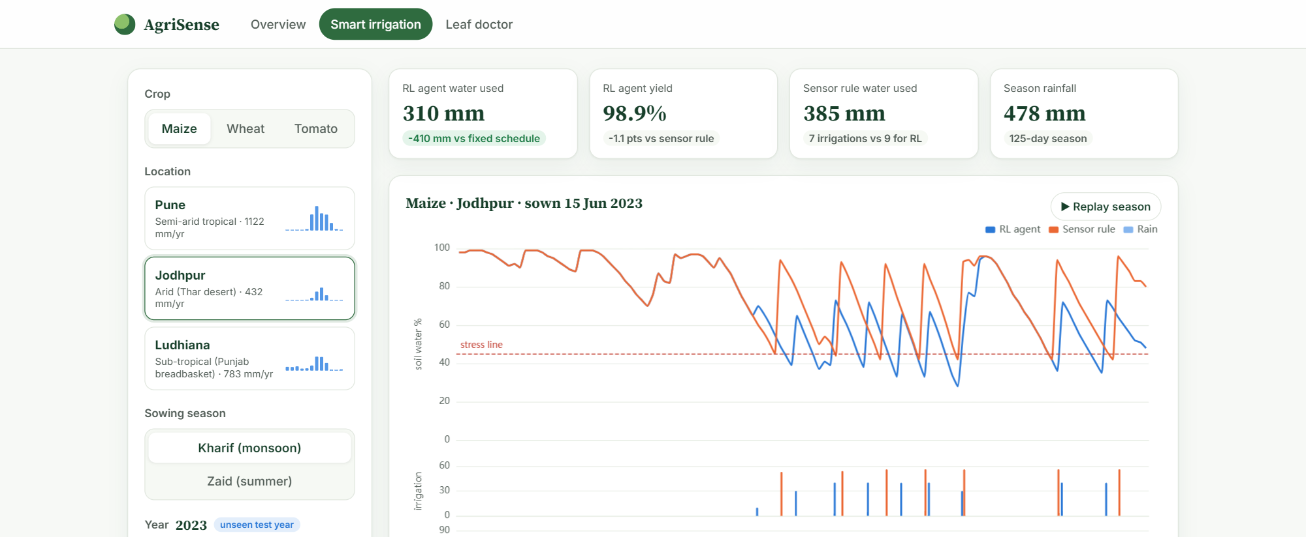
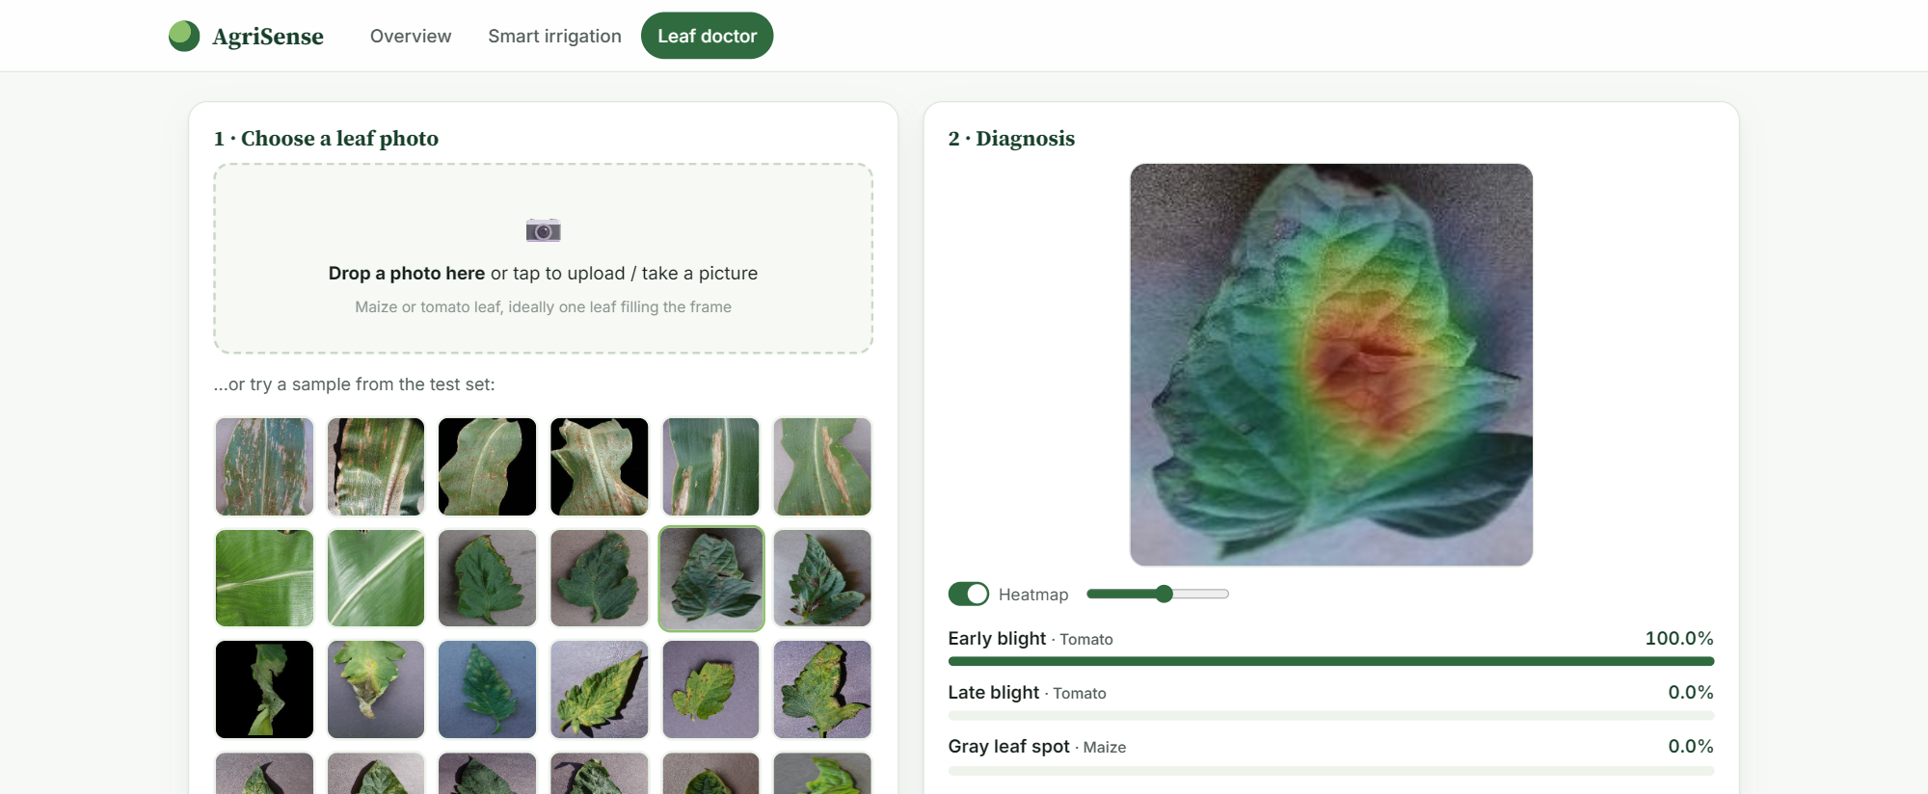
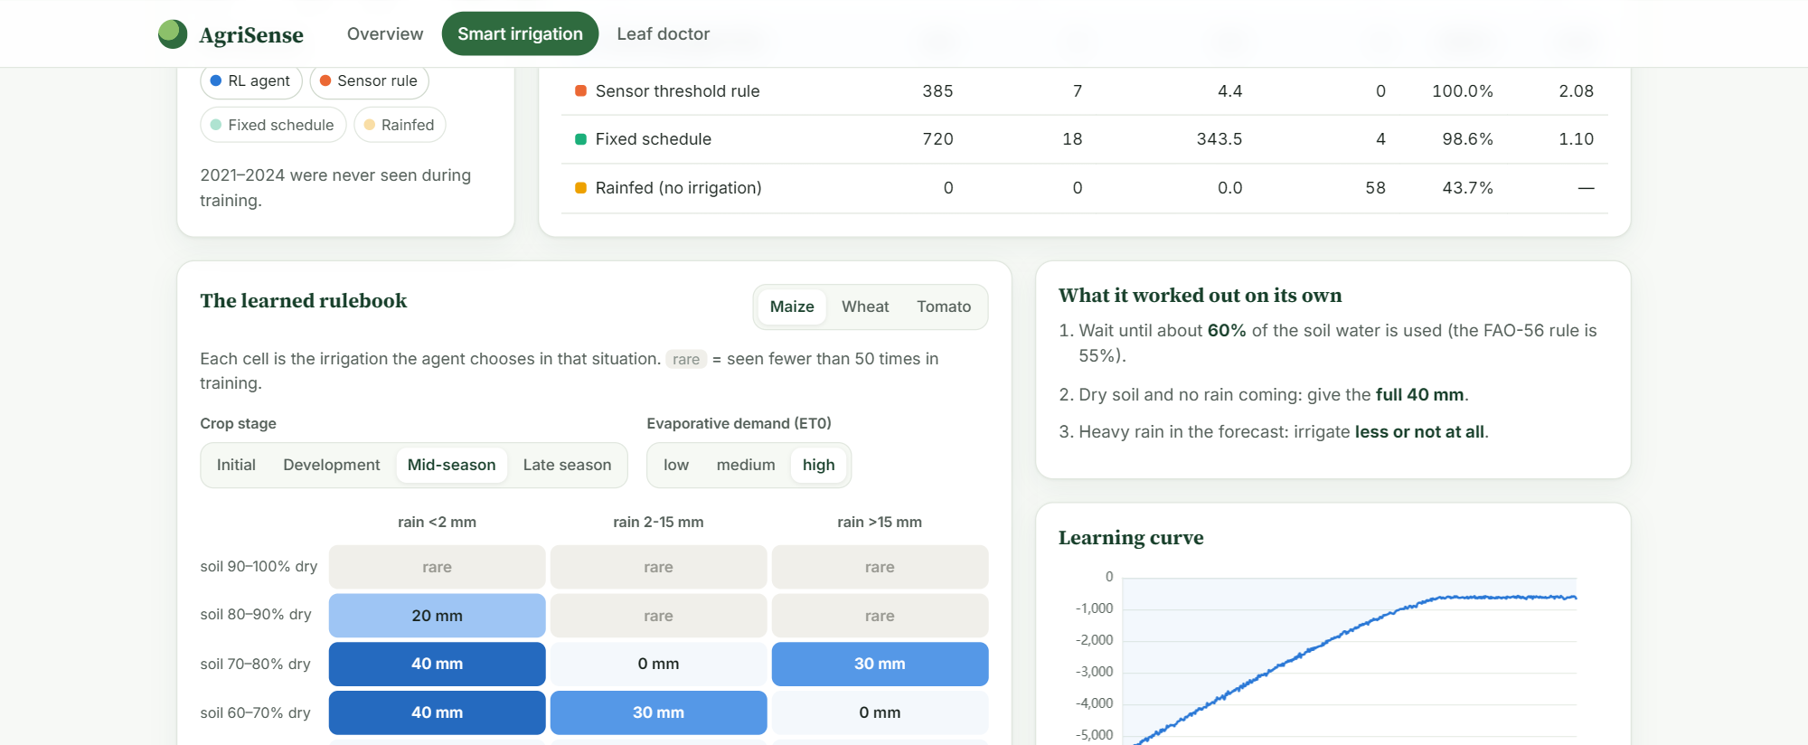
DEPLOYMENT · THE WEBSITE
A quick tour of the website
Overview: both modules
Smart irrigation: season simulator
Leaf doctor: diagnosis + heatmap
Smart irrigation: the learned rulebook
27
Notes:
A quick tour before the live demo. The overview introduces both modules. The smart irrigation tab lets you pick a crop, city, season and year and compare all four policies day by day, and it also shows the learned rulebook and the test results. The leaf doctor tab takes a photo and returns the top three diagnoses with confidence, a heatmap and advice.

Slide 28

LIVE DEMO
Try it on your phone
nirmit10000.github.io/agrisense/
1
Smart irrigation: Jodhpur, maize, 2023: agent vs sensor rule
2
Rulebook: watch the agent hold back when rain is forecast
scan to open
3
Leaf doctor: diagnose a sample tomato leaf, see the heatmap
28
Notes:
Now the live demo. Open the link or scan the QR code. First, smart irrigation: pick Jodhpur, maize, 2023 and show the agent's soil line staying above the stress line with less water. Second, the rulebook: switch the forecast and point out that the agent waters less when rain is coming. Third, the leaf doctor: load a sample tomato leaf and show the top-3 diagnosis and the heatmap on the lesions.

Slide 29
Limitations and next steps
!
Limitations
→
Next steps
Irrigation
Irrigation
Simulated field (FAO-56), not a field trial; seasonal yield model; synthetic forecast; coarse 360-state table (weaker in Ludhiana winters)
Deep Q-network on continuous inputs; real forecasts and IoT soil-moisture sensors; soil type as an input
Leaf disease
Leaf disease
PlantVillage = lab photos on plain backgrounds; maize + tomato only; coarse 7×7 heatmap; no severity estimate
Fine-tune the whole network on field photos (e.g. PlantDoc) with a GPU; more crops; severity
Together
Link the modules: a detected disease adjusts the irrigation plan
29
Notes:
Our limitations. For irrigation: it is a simulated field, not a field trial; the yield model does not know that stress at flowering hurts more; the forecast is synthetic; and the coarse table is why Ludhiana winters are weaker. For leaf disease: PlantVillage photos are lab images on plain backgrounds, it covers only maize and tomato, and the heatmap is coarse. Next steps: a deep Q-network on continuous inputs with real soil-moisture sensors and forecasts; fine-tuning the CNN on field photos and more crops; and linking the two modules, so a detected disease adjusts the irrigation plan.

Slide 30
Conclusion
45 %
5.5 %
98.1 %
94.0 %
less irrigation water than a fixed calendar, with a higher yield
less water than the FAO expert rule, learned without being told it
of maximum yield kept by the RL agent on unseen seasons
leaf-disease accuracy on unseen images (14 classes)
Thank you. Questions?
https://nirmit10000.github.io/agrisense/
30
Notes:
To conclude. Module one: a simple, explainable Q-learning agent used 45 percent less water than calendar irrigation with a higher yield, and matched the FAO expert rule while using 5.5 percent less water. Module two: a MobileNetV2 network diagnoses 14 maize and tomato leaf conditions with 94.0 % accuracy on unseen images and shows where it looked. Both run on the website on screen. Thank you, we're happy to take questions.

