Slide 1
EC544 Challenge One
Team members: Boheng Zhao, Huichong Fu,
Nirmit Shah, Yi Zhu

Slide 2
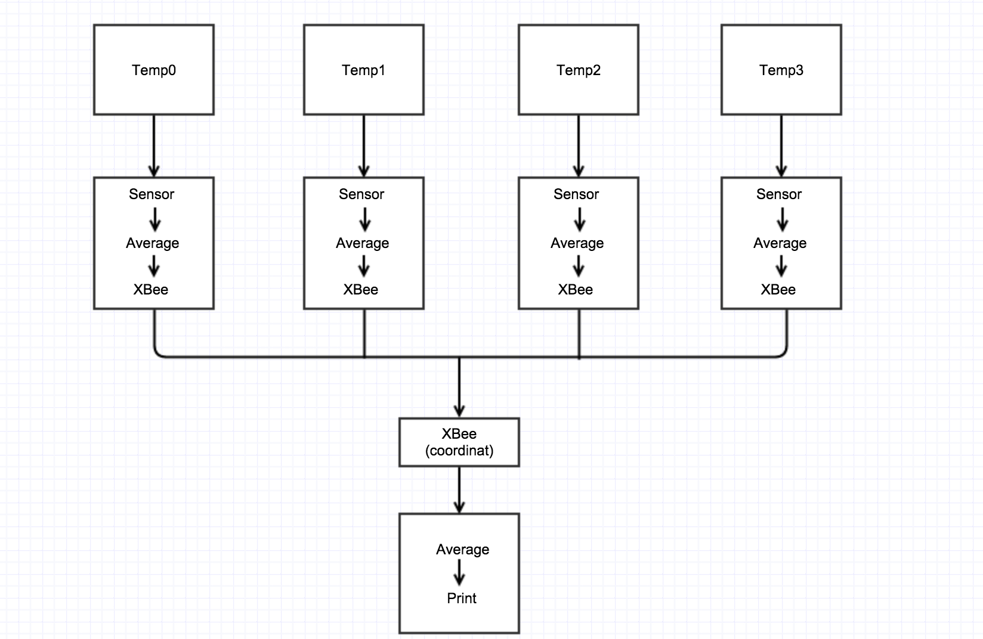
DATAFLOW

Slide 3
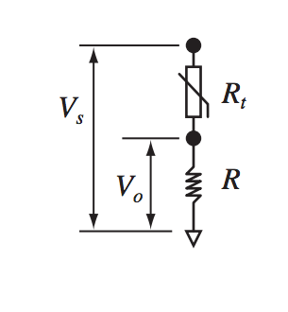

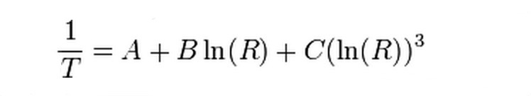
Basic Principle
Voltage divider rule
Steinhart-Hart Method

Slide 4
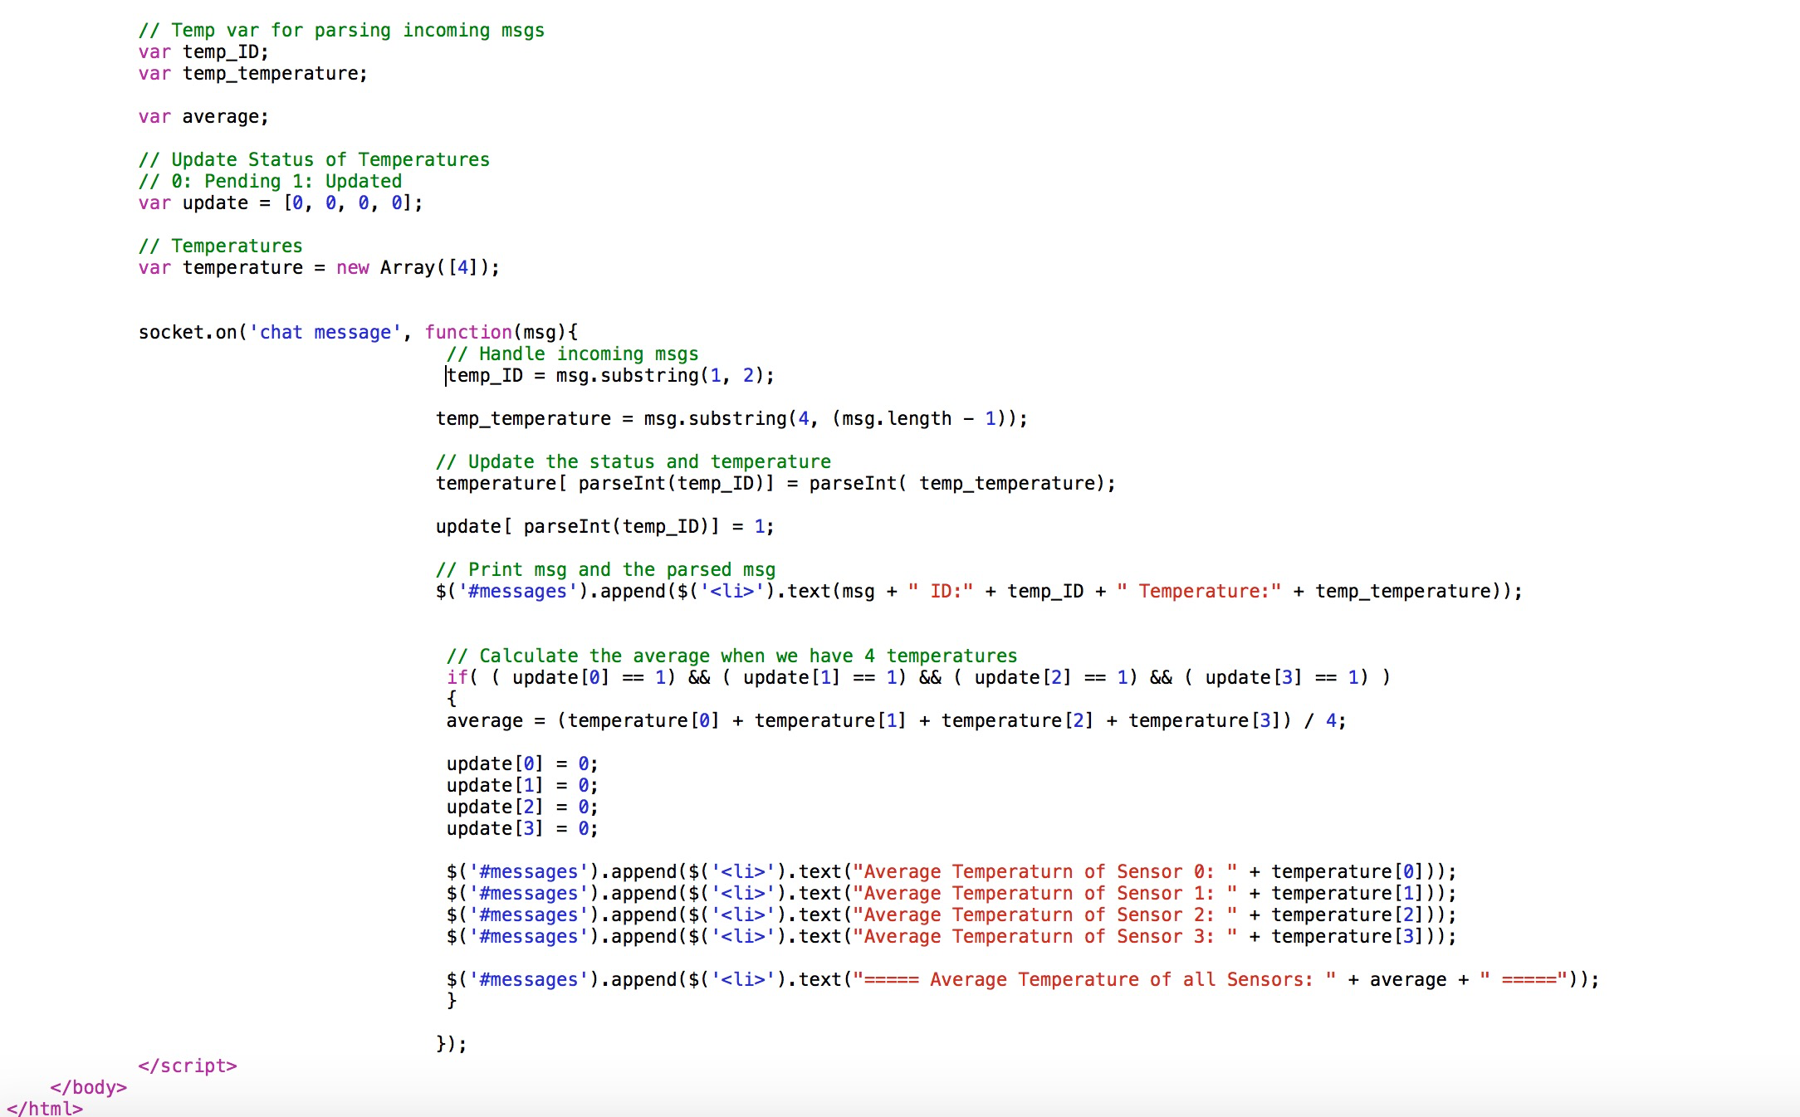
CODE

Slide 5
Challenges
Parse the messages transmitted by XBees
The only one who knows Javascript in our group dropped the class

Slide 6
THANK YOU

