Slide 1
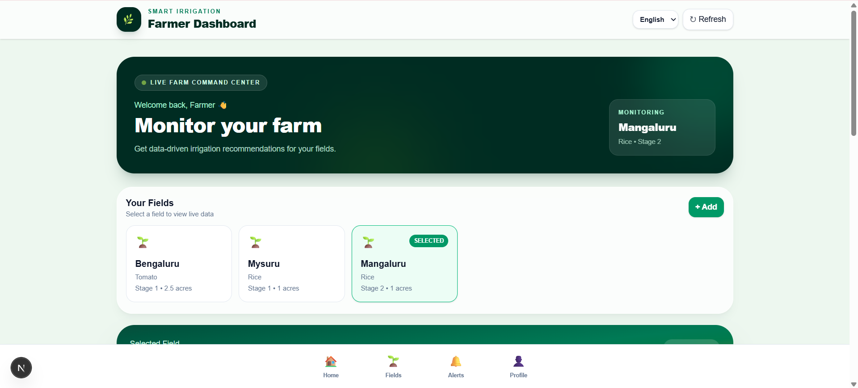

PRECISION AGRICULTURE & AI WATER MANAGEMENT
INFOSYS SPRINGBOARD VIRTUAL INTERNSHIP 7.0 · BATCH 3
AI Powered Smart Irrigation System for Predictive Water Management and Crop Optimization
AI-driven system that predicts irrigation requirements and provides field-specific irrigation recommendations and schedules using machine learning, sensor data and weather intelligence.
Automated Agriculture
Intervention free and optimized agriculture for better yields
Predictive Machine Learning
Predicts water deficits and automates precision runtime execution.
SMART AGRICULTURE · AI · PRECISION WATER MANAGEMENT
Mentor - Ms. Manasa Panasala
Coordinator - Mr. Venkoba

Slide 2
AI POWERED SMART IRRIGATION SYSTEM FOR PREDICTIVE WATER MANAGEMENT AND CROP OPTIMIZATION
01 — THE PROBLEM
Water Stress Meets Uncertain Irrigation
Agriculture accounts for 72% of global freshwater withdrawals. Traditional irrigation relies on fixed schedules or manual decisions, failing to account for soil moisture, weather forecasts, or crop growth stages.
01
02
03
Over-Irrigation Waste
Weather Uncertainty
Crop-Specific Dynamics
Water applied when soil is saturated leads to deep percolation, evaporation, and severe runoff.
Fluctuating temperature, rainfall, and evapotranspiration constantly change crop water demand.
Different crops, environmental conditions, and growth stages require tailored irrigation quantities and timing
72%
1.2B
GLOBAL FRESHWATER WITHDRAWALS
PEOPLE AFFECTED
Attributed directly to agricultural irrigation globally.
Live in agricultural areas facing severe water constraints.
Agriculture must produce substantially more food while freshwater availability faces unprecedented stress.

Slide 3
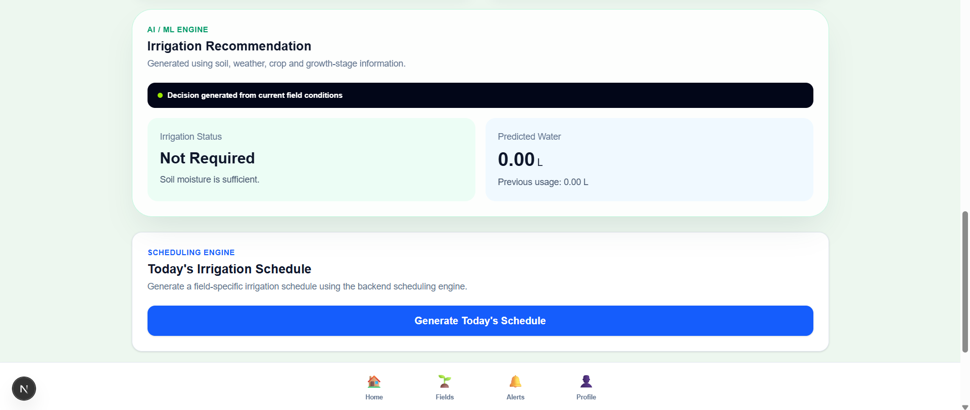
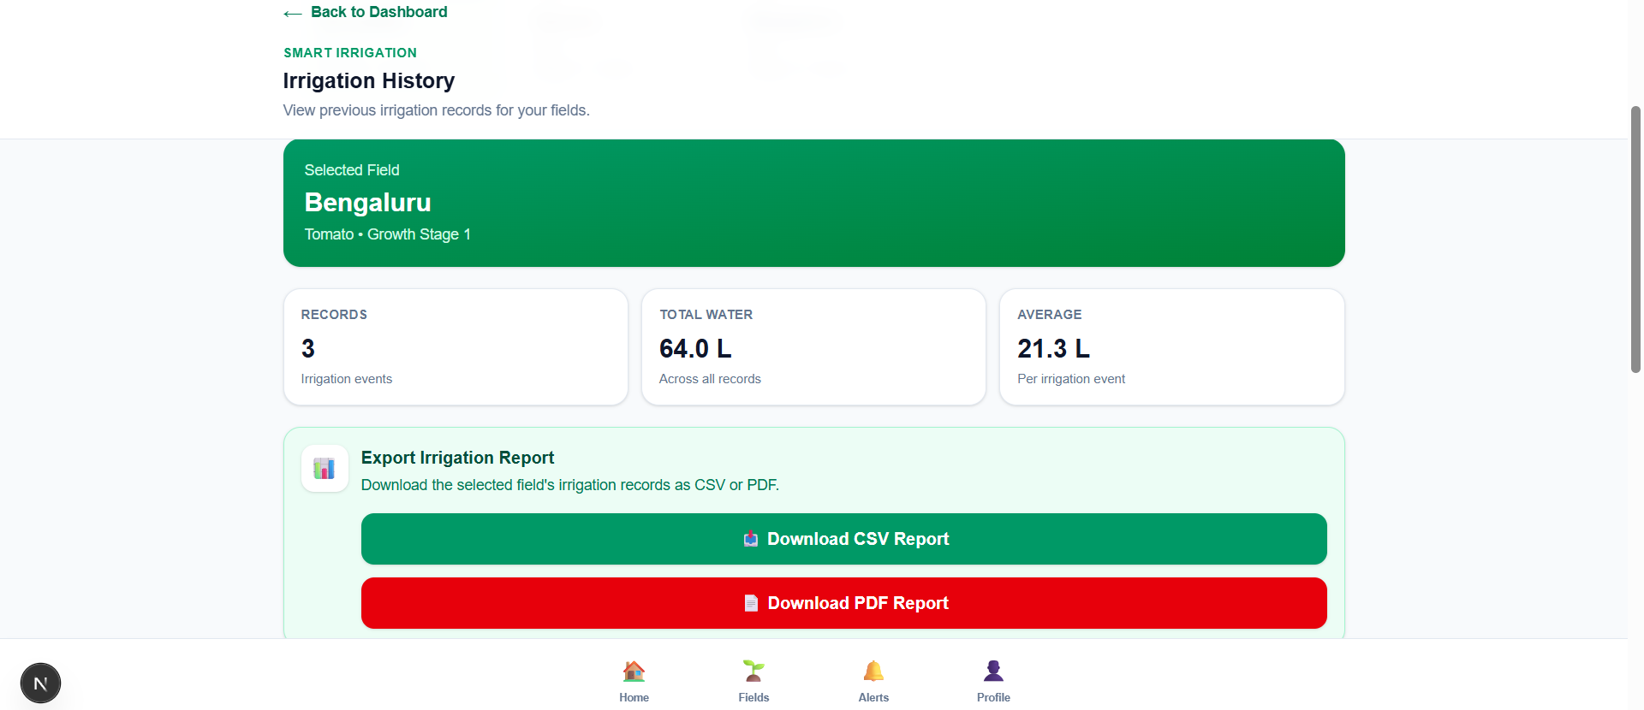
AI POWERED SMART IRRIGATION SYSTEM FOR PREDICTIVE WATER MANAGEMENT AND CROP OPTIMIZATION
02 — THE SOLUTION
AI-Powered Predictive Irrigation
Transforms irrigation from a reactive schedule into a predictive, data-driven control system that calculates upcoming crop water needs and automates precise zone watering.
01
02
03
04
05
SENSE
PREDICT
RECOMMEND
SCHEDULE
MONITOR
Soil moisture, temp & flow
ML estimates moisture deficit
Recommend type and quantity of irrigation required
Schedule irrigation
Monitor fields for changing moisture levels
Core Principle: Sense the field → Predict the need → Deliver only what the crop requires.

Slide 4


AI POWERED SMART IRRIGATION SYSTEM FOR PREDICTIVE WATER MANAGEMENT AND CROP OPTIMIZATION
03 — WHO USES IT
Three distinct operational layers unified under a single precision farming platform.
FARMERS
Monitor field conditions
View AI irrigation recommendations
View irrigation schedules
Monitor soil moisture
View weather information
View irrigation history
View sensor history
Receive alerts
Use regional-language support
Use voice assistant
Manage fields and profile
FIELD DATA → AI PREDICTION ENGINE → IRRIGATION CONTROL → PERFORMANCE FEEDBACK

Slide 5
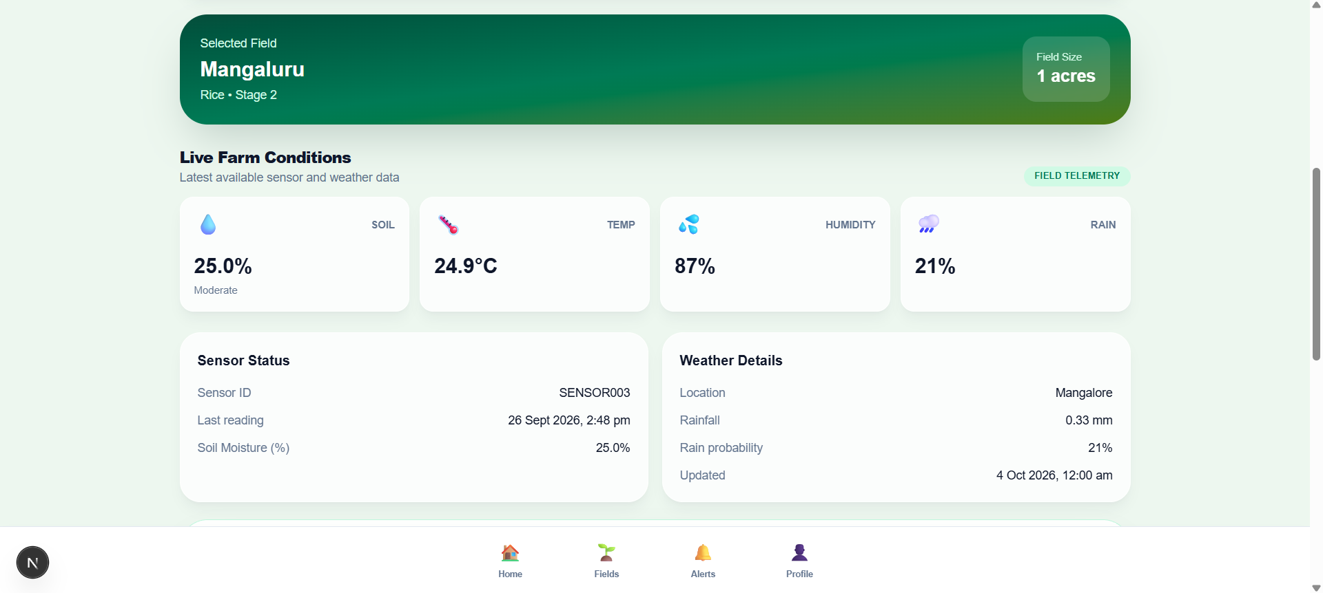
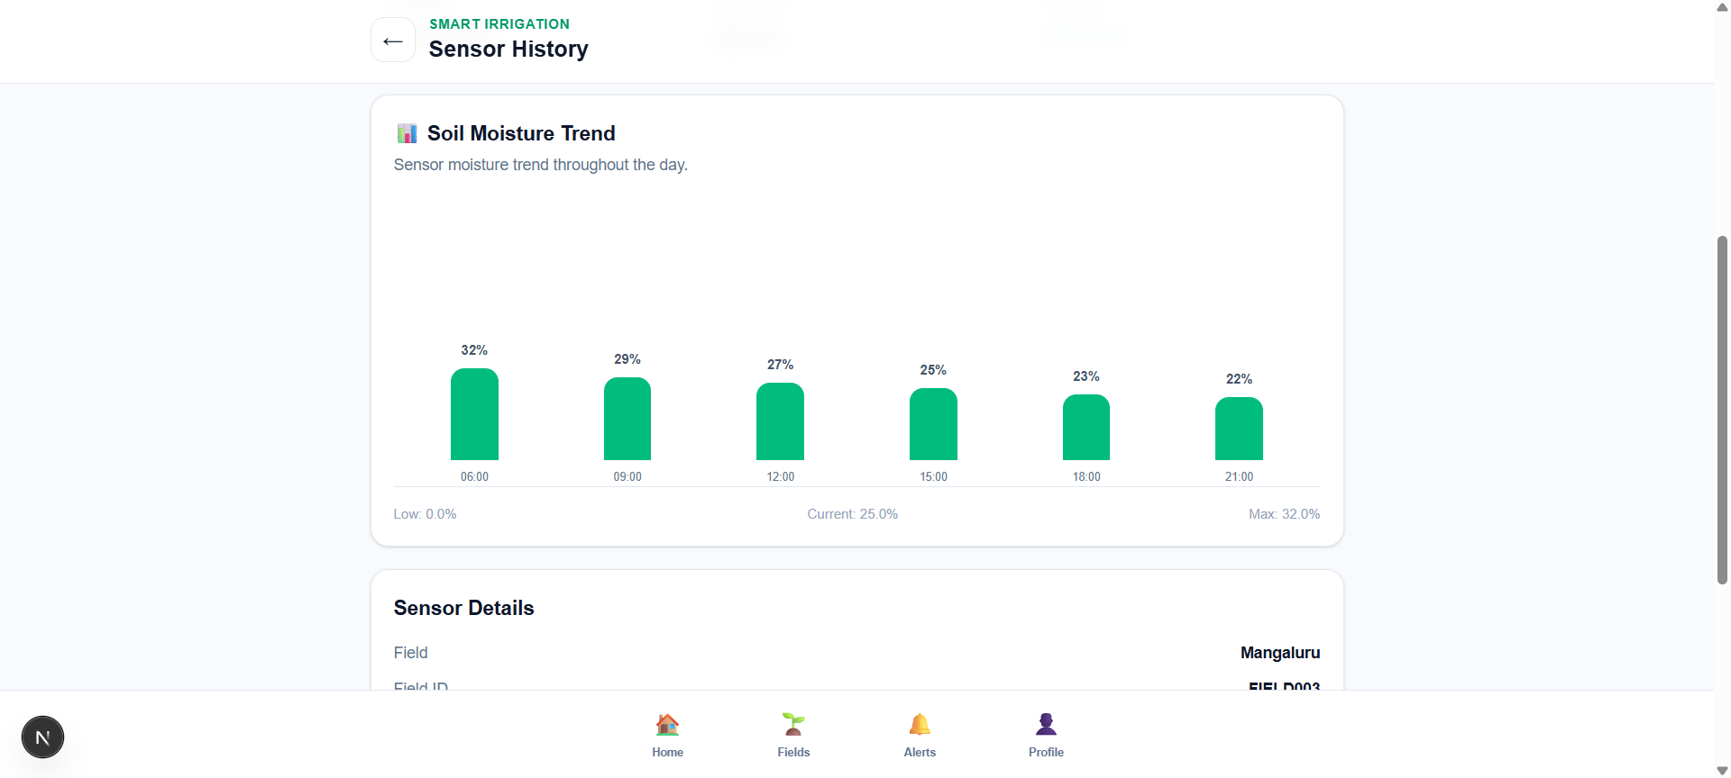
AI POWERED SMART IRRIGATION SYSTEM FOR PREDICTIVE WATER MANAGEMENT AND CROP OPTIMIZATION
04 — MODULE 01
Sense. Detect. Understand.
Creates a real-time digital representation of the field combining continuous simulated sensor telemetry representing field soil-moisture conditions, weather forecasts, and automated anomaly detection.
Real-Time Field Intelligence
Measures root-zone moisture, ambient temperature/humidity, rainfall precipitation and short-term weather forecasts.
Sensor Fusion Layer
Combines Soil Data + Weather Data + Crop Stage + Irrigation History to synthesize a unified real-time field state.
Sensor Validation and Missing-Data Checks
Identifies sensor failures, missing readings, and abnormal spikes to prevent corrupted data from affecting decisions.

Slide 6
AI POWERED SMART IRRIGATION SYSTEM FOR PREDICTIVE WATER MANAGEMENT AND CROP OPTIMIZATION
05 — MODULE 02
Right Water, Right Time
The AI predictive engine evaluates field inputs, crop characteristics, and weather models to calculate required irrigation volume and duration.
Feature Input Vectors
Soil moisture/type, crop growth stage, temp, humidity, rain probability and historical irrigation logs.
Evaluated Machine Learning Models
Random Forest (strong baseline),Gradient Boosting, and LSTM (sequential temporal sensor modeling).

Slide 7
AI POWERED SMART IRRIGATION SYSTEM FOR PREDICTIVE WATER MANAGEMENT AND CROP OPTIMIZATION
06 — MODULE 03
From Prediction to Action
Converts AI water recommendations into executed irrigation operations protected by safety interlocks and closed-loop verification.
1
2
3
4
5
6
SENSE
PREDICT
DECIDE
RECOMMEND
SCHEDULE
MONITOR
Read sensor and weather information
AI estimates need
Apply irrigation safety rules
Generate required water quantity
Create field-specific irrigation schedule
Store and display irrigation history
Closed-Loop Control Cycle
Multi-Layer Safety Interlocks
OBSERVE → PREDICT → ACT → MEASURE → UPDATE
Replaces fixed timers with adaptive, feedback-driven operations.
Evaluates soil-moisture limits, rain lockouts, pump availability, water reserves, sensor sanity, and farmer override prior to valve activation.

Slide 8
AI POWERED SMART IRRIGATION SYSTEM FOR PREDICTIVE WATER MANAGEMENT AND CROP OPTIMIZATION
07 — MODULE 04
Built to Hold Up
Ensures continuous, fail-safe operation and reliable decision-making even during cloud disconnections or weather API outages.
01 — DATA QUALITY GUARANTEE
02 — SAFE CONTROL INTERLOCKS
Sensor calibration, missing-data imputation, and anomaly filtering prevent bad measurements from influencing decisions.
Hard soil-moisture ceilings, immediate rainfall lockouts, and manual overrides prevent over-watering accidents.
03 — FAIL-SAFE EDGE OPERATION
04 — END-TO-END SYSTEM LOGGING
If cloud API connectivity is lost, local edge controllers fall back to conservative threshold-based safety rules.
Records telemetry, model predictions, executed valve commands, water flow response, and error events.
TESTING PIPELINE: Sensor → Data Layer → AI Model → Decision Engine → Valve/Pump → Field Feedback

Slide 9
AI POWERED SMART IRRIGATION SYSTEM FOR PREDICTIVE WATER MANAGEMENT AND CROP OPTIMIZATION
08 — IMPACT & RESEARCH METRICS
Validated Efficiency Gains
Delivering higher water productivity and energy savings through research-backed machine learning optimization.
27.6%
27.4%
+32.8%
30%
WATER SAVINGS
ENERGY REDUCTION
WATER PRODUCTIVITY
MAIZE WATER SAVINGS
Demonstrated in 2023 CNN irrigation study vs. conventional sprinklers.
Lower pumping runtime through optimized watering schedules.
Increased crop yield per unit of freshwater applied.
2026 ML study (27% for wheat, -20% energy, -25% runoff).
Important Note: Results depend on crop type, soil texture, local climate, irrigation methods, sensor precision, and calibration.

Slide 10
AI POWERED SMART IRRIGATION SYSTEM FOR PREDICTIVE WATER MANAGEMENT AND CROP OPTIMIZATION
09 — WHAT'S NEXT
Strategic technological roadmap for expanding platform capabilities and scale.
1
NEAR-TERM ROADMAP
2
LONG-TERM ROADMAP
•
Edge AI Deployment: Run inference locally for ultra-low latency without internet dependency.
•
Satellite & UAV Integration: Remote sensing ET data for macro field demand.
•
Crop-Stress Vision: Computer vision via drones/cameras to detect early leaf wilting.
•
Farm Digital Twin: Real-time simulation of soil, crop, weather, and water dynamics.
•
•
Solar Sensor Mesh: Low-power wireless node networks for off-grid fields.
Multi-Season Analytics: Predict seasonal water budgets and long-term yield.
•
Automated Fertigation: Dynamic fertilizer injection matching water dosing.
•
Regional Water Intelligence: Scale from individual farms to canal basin networks.

Slide 11
AI POWERED SMART IRRIGATION SYSTEM FOR PREDICTIVE WATER MANAGEMENT AND CROP OPTIMIZATION
10 — CONCLUSION
The Future of Predictive Farming
01 — VISION & STRATEGY
02 — OPERATIONAL EFFICIENCY
03 — EVIDENCE-LED SCALING
Transforms farming from fixed timetables into a predictive, feedback-driven process responding dynamically to actual crop needs.
Minimizes unnecessary water application, pump runtime, energy costs, and runoff while maintaining optimal soil moisture.
Demonstrates proven research results when models are calibrated locally according to crop, soil, climate, and irrigation methods.
BOTTOM LINE: Sense the field. Predict the need. Deliver only what the crop requires.

Slide 12
INFOSYS SPRINGBOARD VIRTUAL INTERNSHIP 7.0 · BATCH 3
THANK YOU
AI Powered Smart Irrigation System for Predictive Water Management and Crop Optimization
SMART AGRICULTURE · AI · PRECISION WATER MANAGEMENT

