Slide 1


COVID – 19 Trend Analysis
Team 5 – COSMOS DB
RISHAB SHEKAR GUNASHEKAR - 001040578
NIRMITI PATIL - 002103927
SRIRAM RAVINDRAN - 001003684

Slide 2
OBJECTIVE
Study
the statistics of COVID-19 cases and vaccinations throughout the world
Analyze
the COVID-19 data and derive insights on the case trends in different countries
Evaluate and compare
the countries where vaccinations have proved to reduce the number of cases and hospitalizations
Identify
the underlying causes of trends/ systematic patterns over time of the data
Visualize
the Time series data using Microsoft Power BI/ Tableau

Slide 3
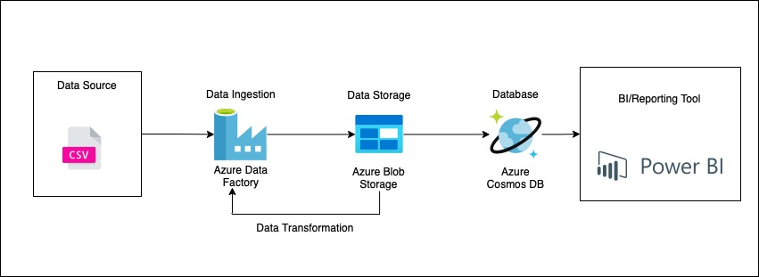
DATA ARCHITECTURE DIAGRAM

Slide 4
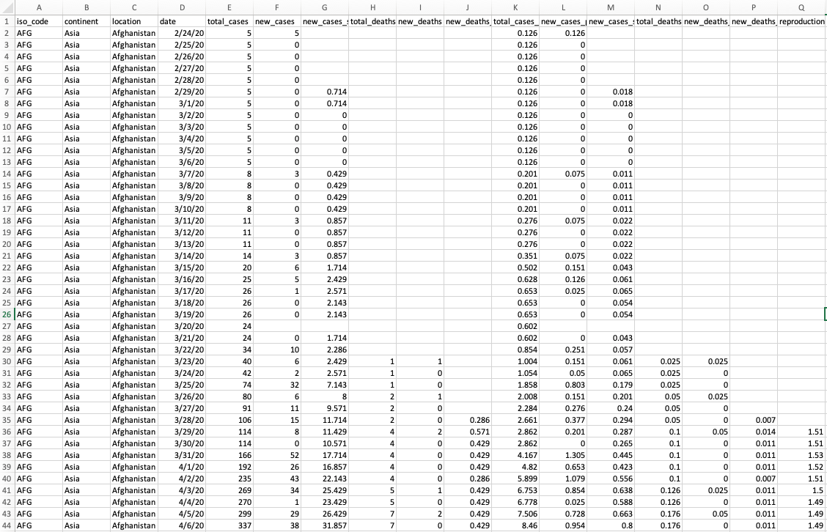
Dataset Overview

Slide 5
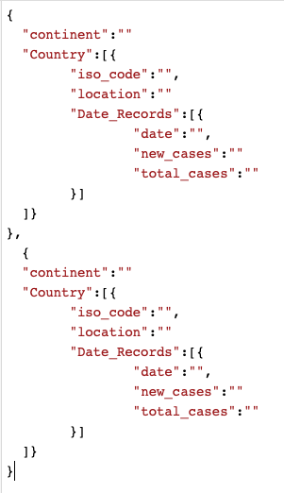
EXPECTED JSON STRUCTURE

Slide 6




Azure Services
Azure Blob Storage
Azure Data Factory
Azure Cosmos DB

Slide 7
ETL FLOW Using Azure data factory
Fetch CSV file, from website (API Fetch)
01
Load data into Blob Storage
02
Data Transformation using (Azure Data Flow)
03
Convert CSV to JSON
04
Stage data into Azure Blob Storage
05
Push data to Azure Cosmos DB
06

Slide 8
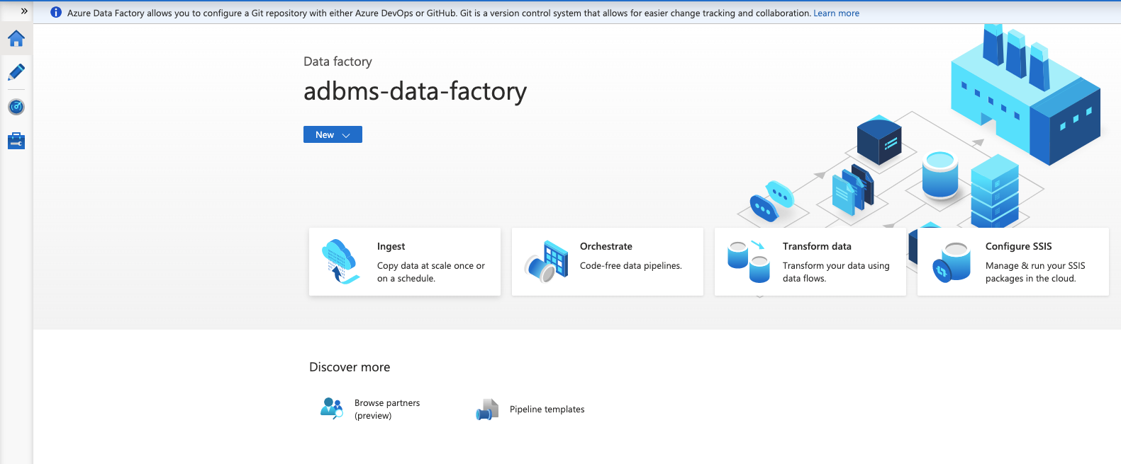
AZURE DATA FACTORY

Slide 9
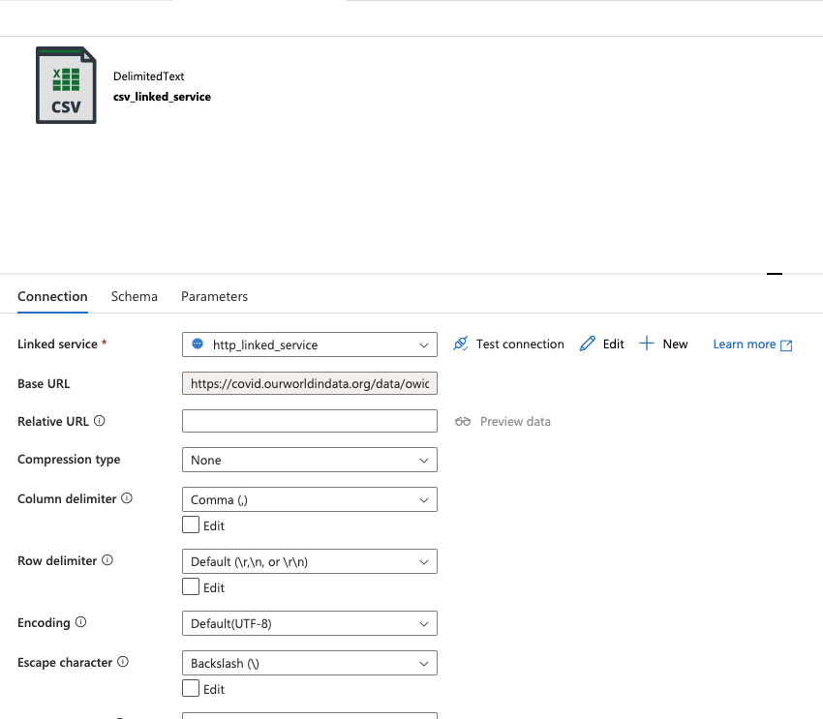
ETL FLOW Using Azure data factory

Slide 10
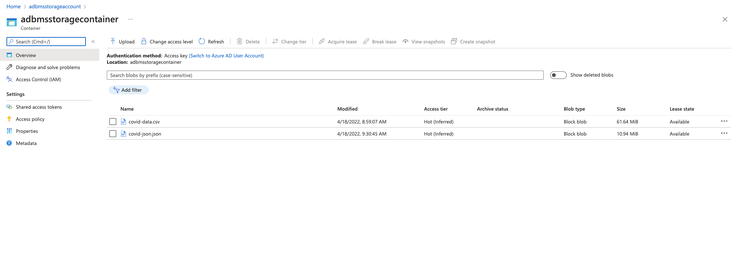
ETL FLOW Using Azure data factory

Slide 11
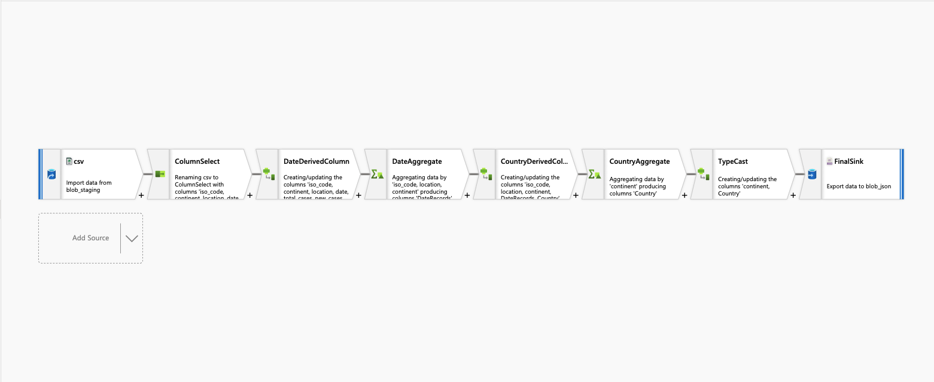

Slide 12
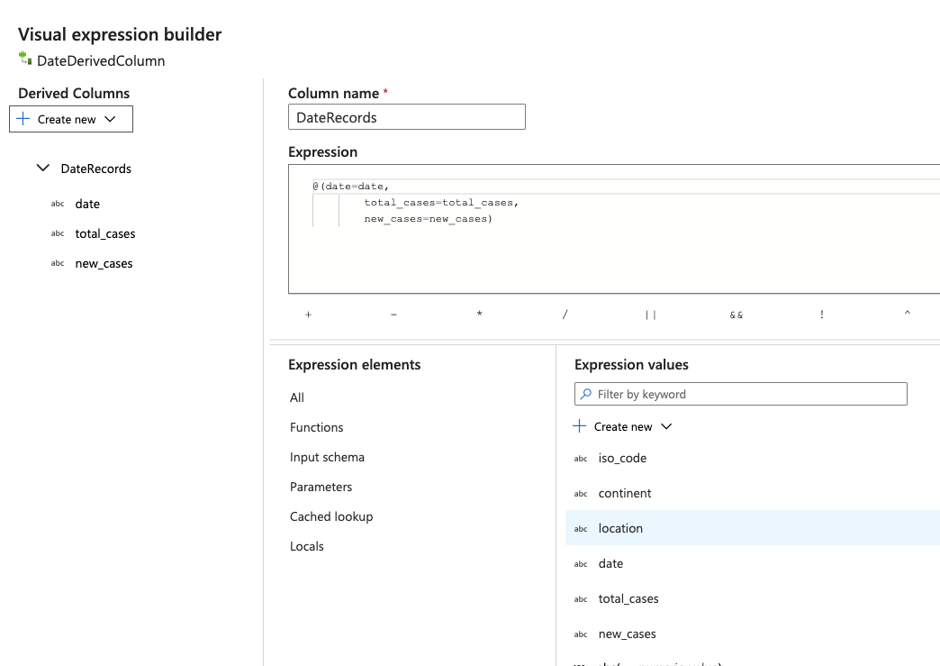
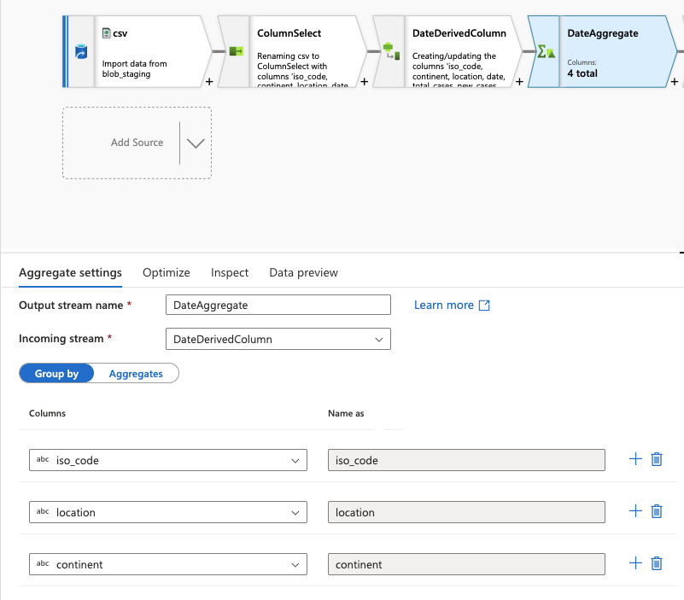

Slide 13
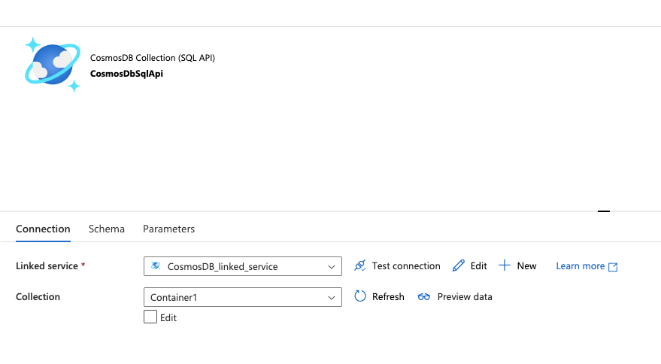
COSMOS DB Linked Service

Slide 14
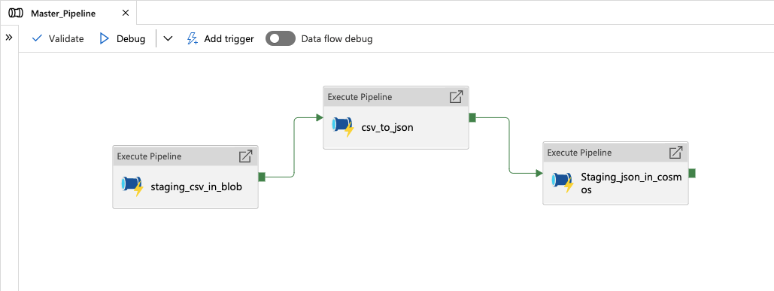
Master pipeline
Pipeline-1: To do API fetch using HTTP service and staging the data in csv format in Azure Blob Storage.
Pipeline-2: Converting CSV data to JSON data by creating a dataflow.
Pipeline-3: JSON Data Ingestion in Cosmos DB

Slide 15
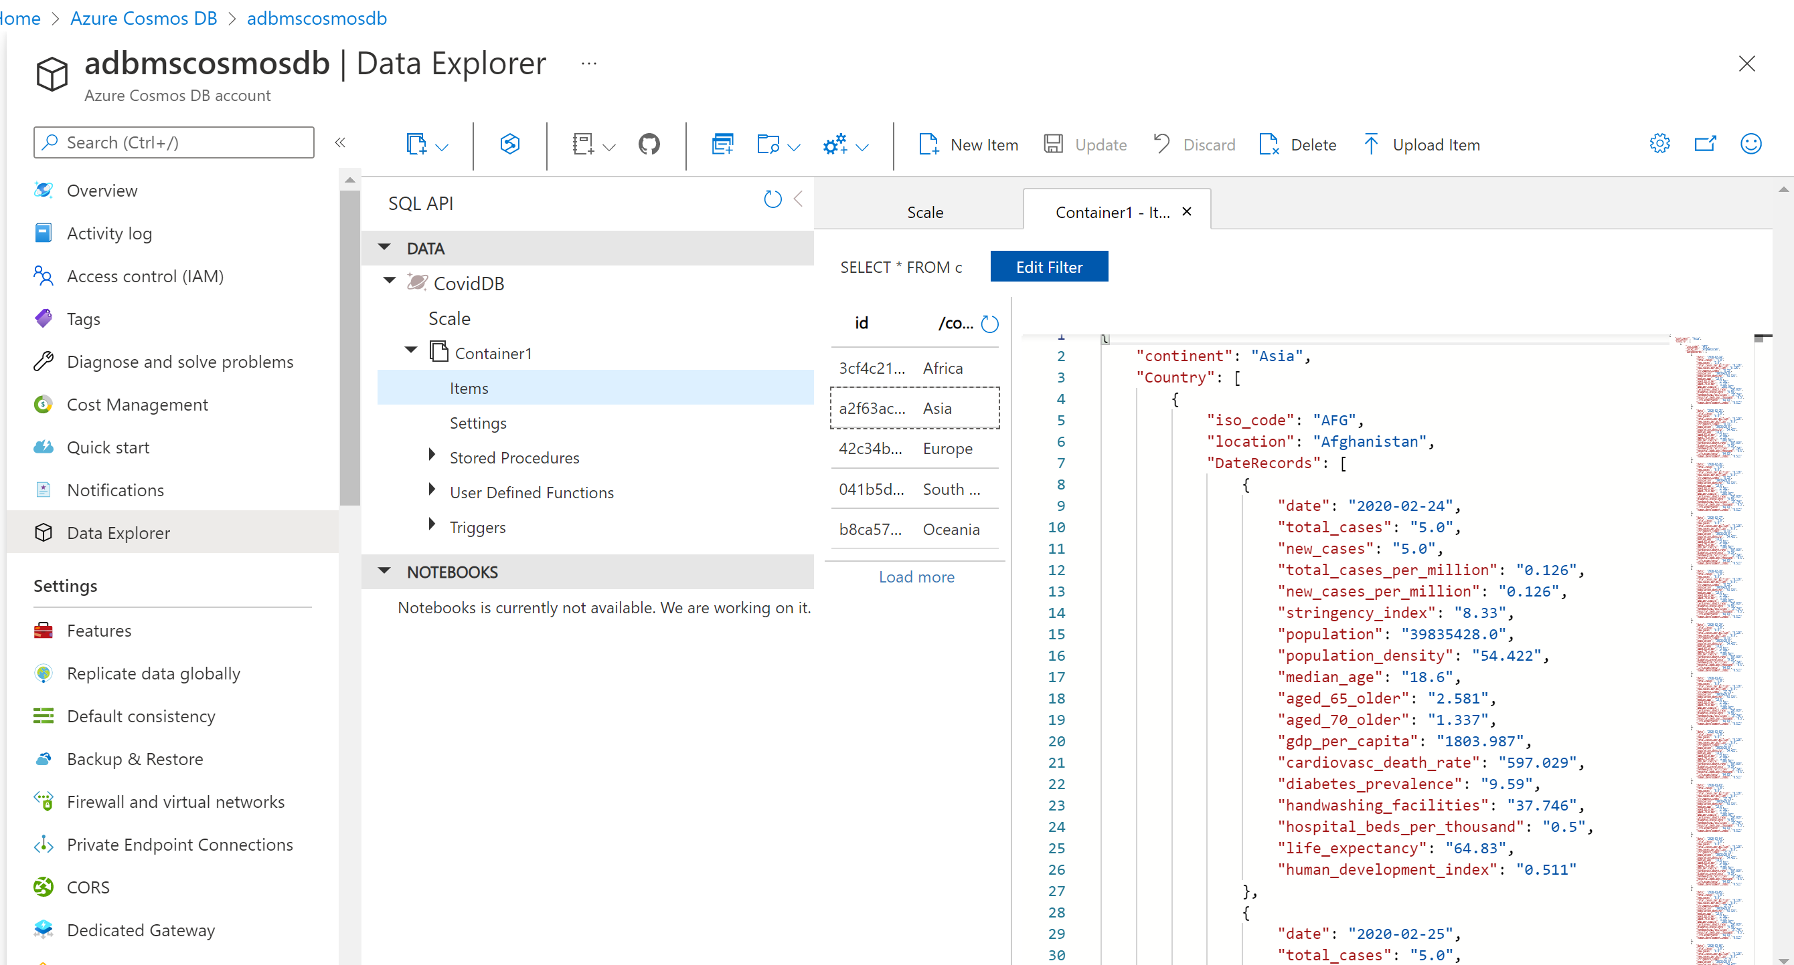

Slide 16
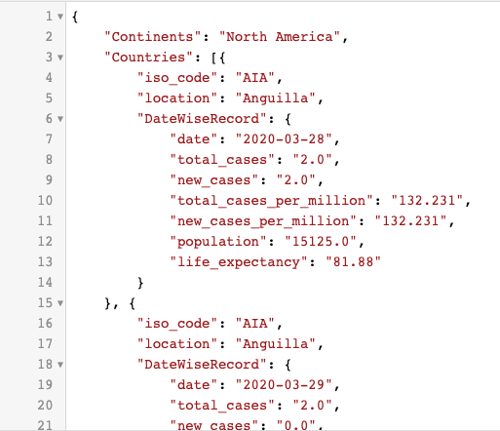
Final JSON STRUCTURE

Slide 17
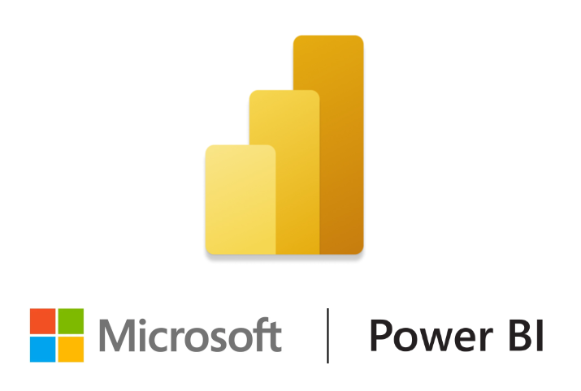
Power BI Dashboard

Slide 18
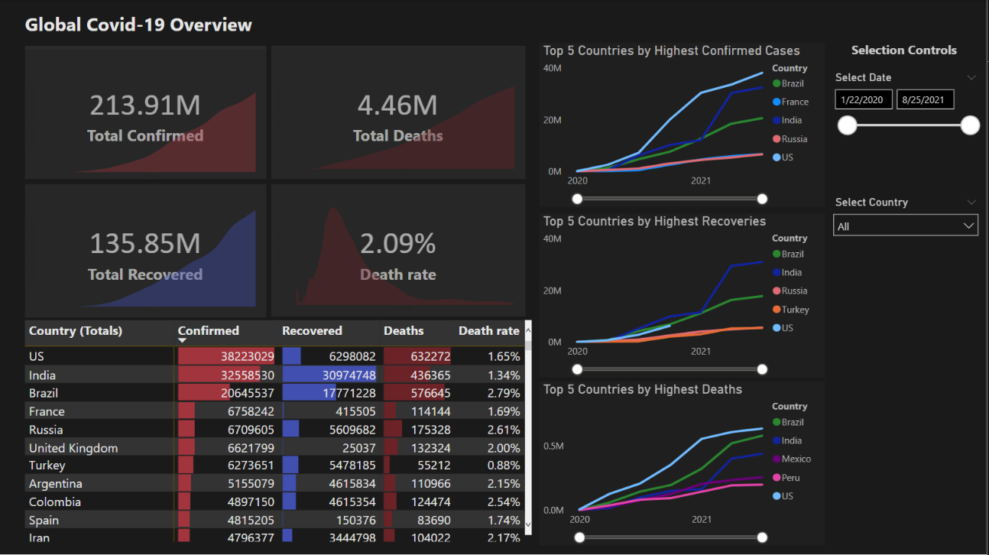

Slide 19
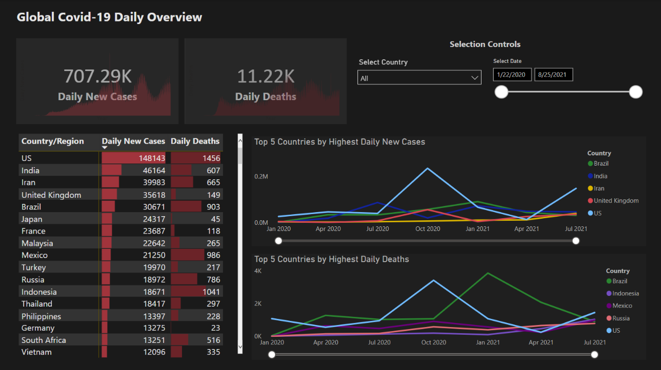

Slide 20
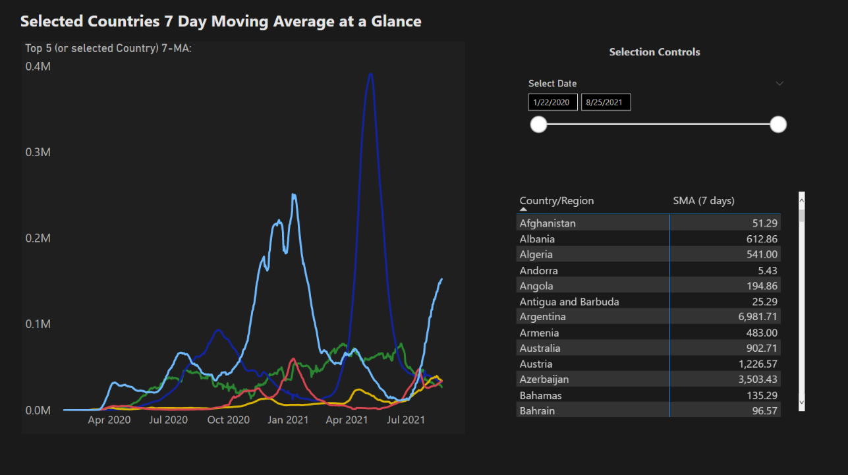

Slide 21
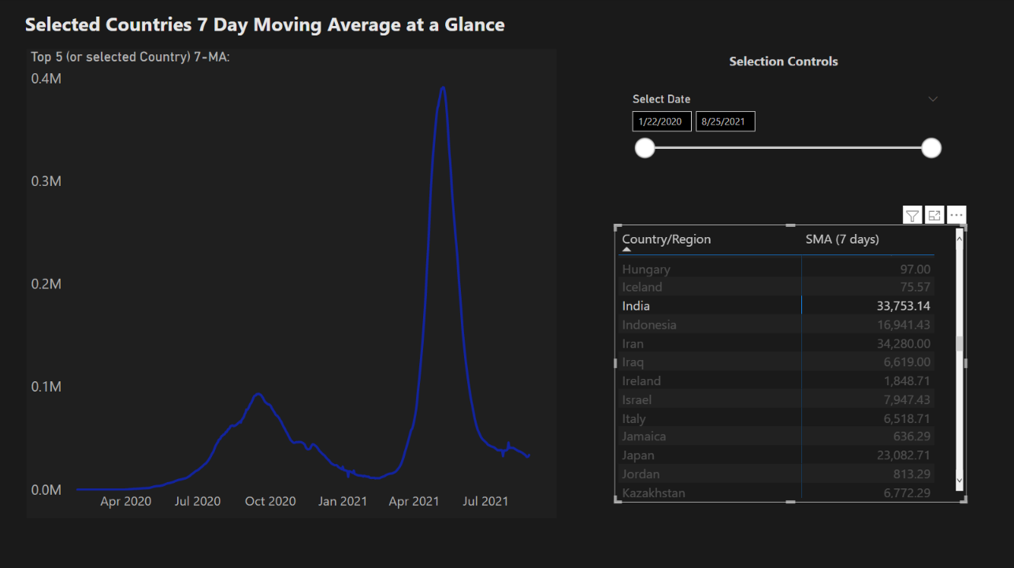

Slide 22
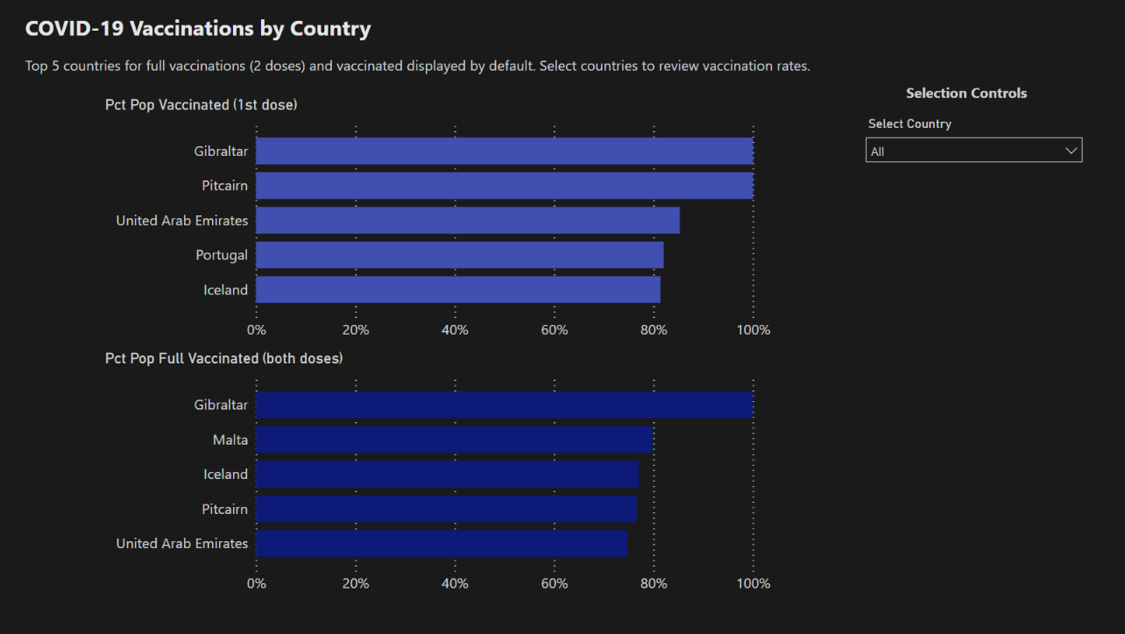

Slide 23
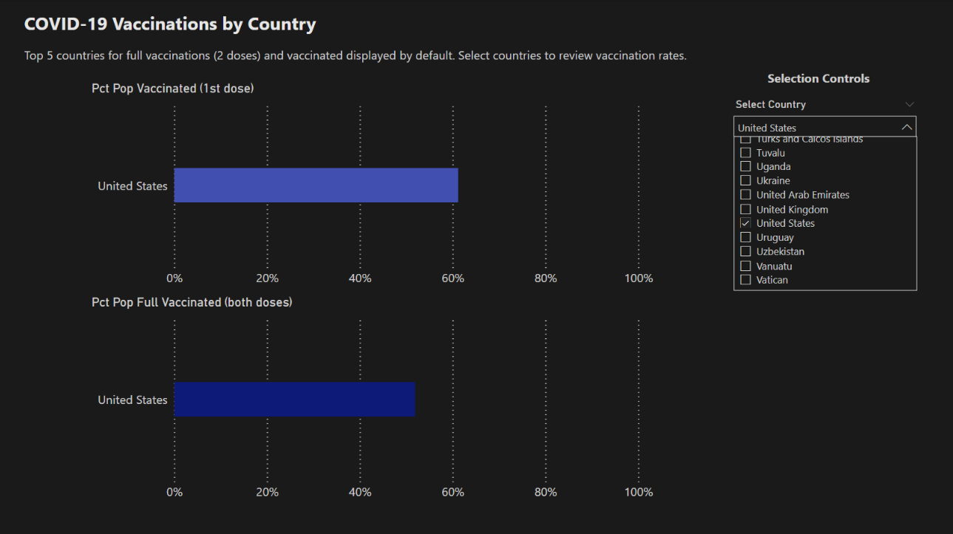

Slide 24


