Slide 1

FitBit Analysis
Presented By:
Ankita Indi - 002104957
Nirmiti Patil - 002103927
Saad Ghojaria - 002129718

Slide 2
Abstract
This project describes an analysis of the Fitbit Data. Our objectives are to describe
Calories burnt as per daily activity
to see active and inactive users
Calories burnt as per Our analysis covers three distinct algorithm.
First, we analyze the data and perform cleaning and merging necessary information of the Fitbit data. Next, we perform data transformation, standardization, imputation of data and other feature engineering to make the data more standard. Observe the model and gain insights of the data by getting the accuracy for the algorithm and to find its efficiency. Third, we perform data visualization to demonstrate the observations. We have used multiple libraries to get proper insights and visualization .

Slide 3
Abstract
INTRODUCTION
Dataset:
https://www.kaggle.com/datasets/nurudeenabdulsalaam/fitbit-fitness-tracker-data?select=dailyActivity_merged.csv We are using a Fitbit dataset from Kaggle.We have done a comparative study between the models-Linear Regression,Random Forest,XgBoost,K-Means Clustering algorithm. We have also performed Hypertuning using ridge ,lasso ,Elastic-Net Regression for Linear Regression,Elbow method for K-mean,Random Forest ,XGBoost and XGBRegressor We have split the dataset into training(60%) of the total dataset and the validation and test set are both made up to 20%.We perform some data visualization and infer some insights

Slide 4
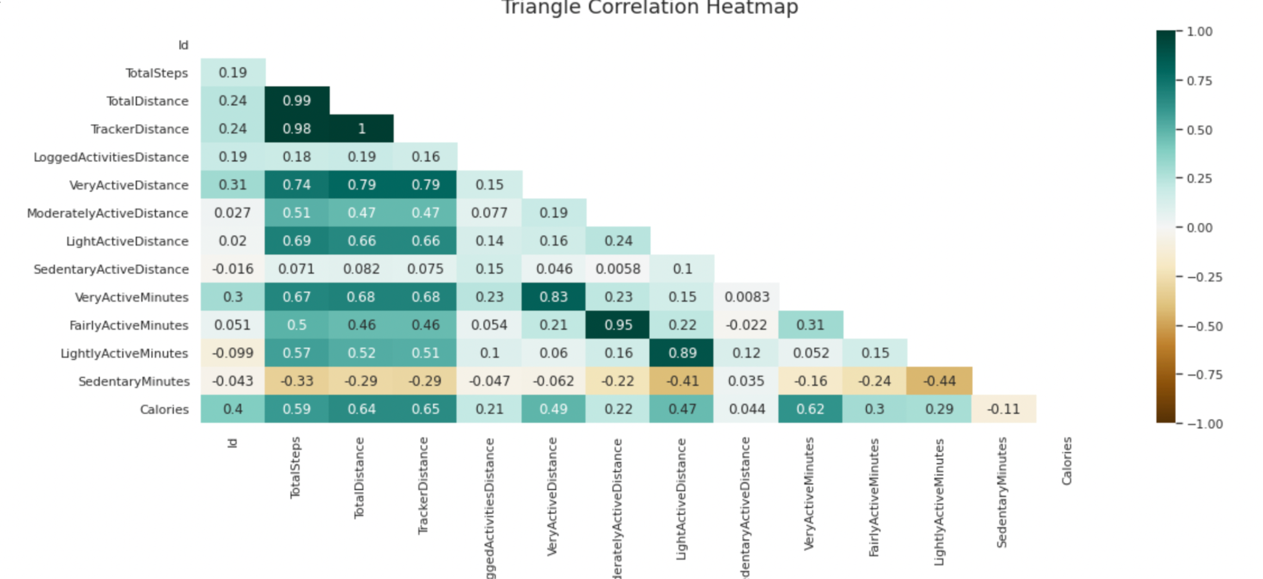
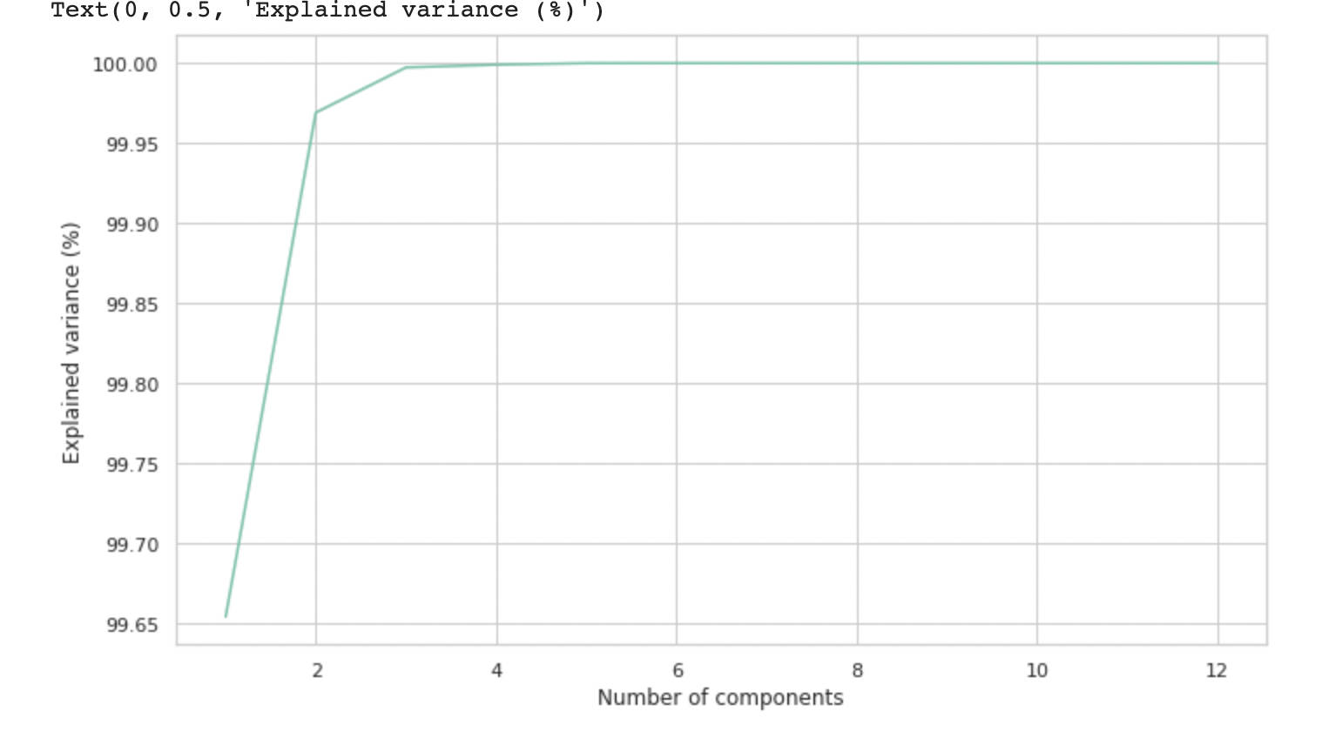
Different Data Engineering/Data Profiling methods
1. Data Preprocessing
2. Data Engineering
3. Correlation
4. Standard Scaler
5. Standardization
6. Min Max Scaler
7. Data Imputation - KNN Imputer
8. Extra tree classifier
9. PCA
10. Data Transformation
11. Data Profiling
12. Data Standardization
13. Lasso Regression

Slide 5
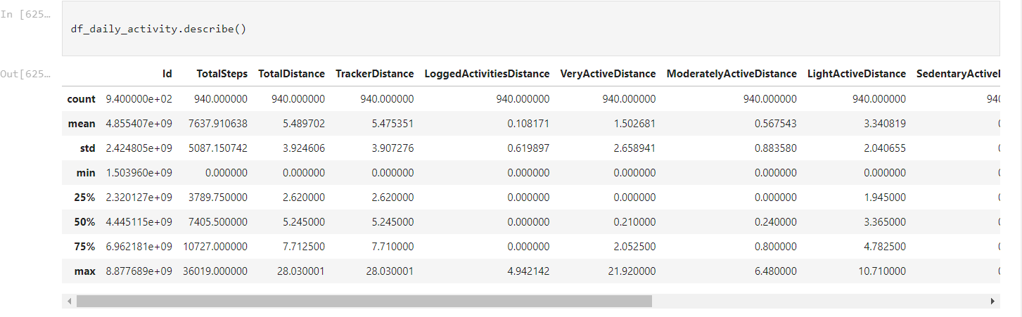
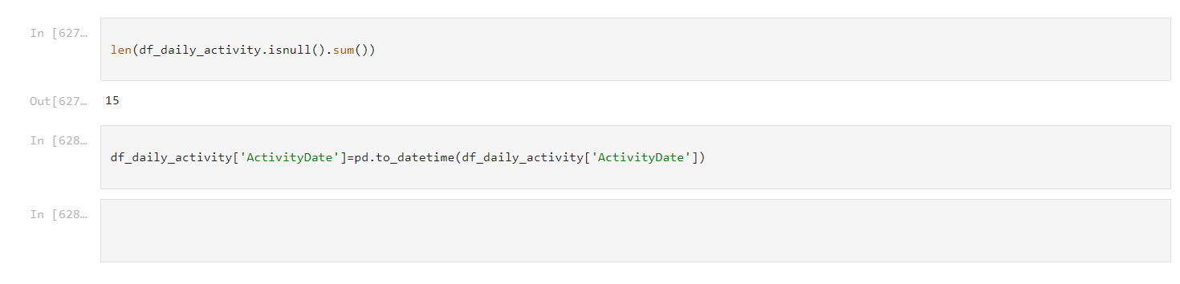
1. Data Preprocessing :
METHODS
Below are some highlights of how we processed the data .Once the data was cleaned,We used some Machine learning algorithms like Random Forest,XgBoost,Linear Regression and K-Means Clustering and performed hyperparameter tuning

Slide 6
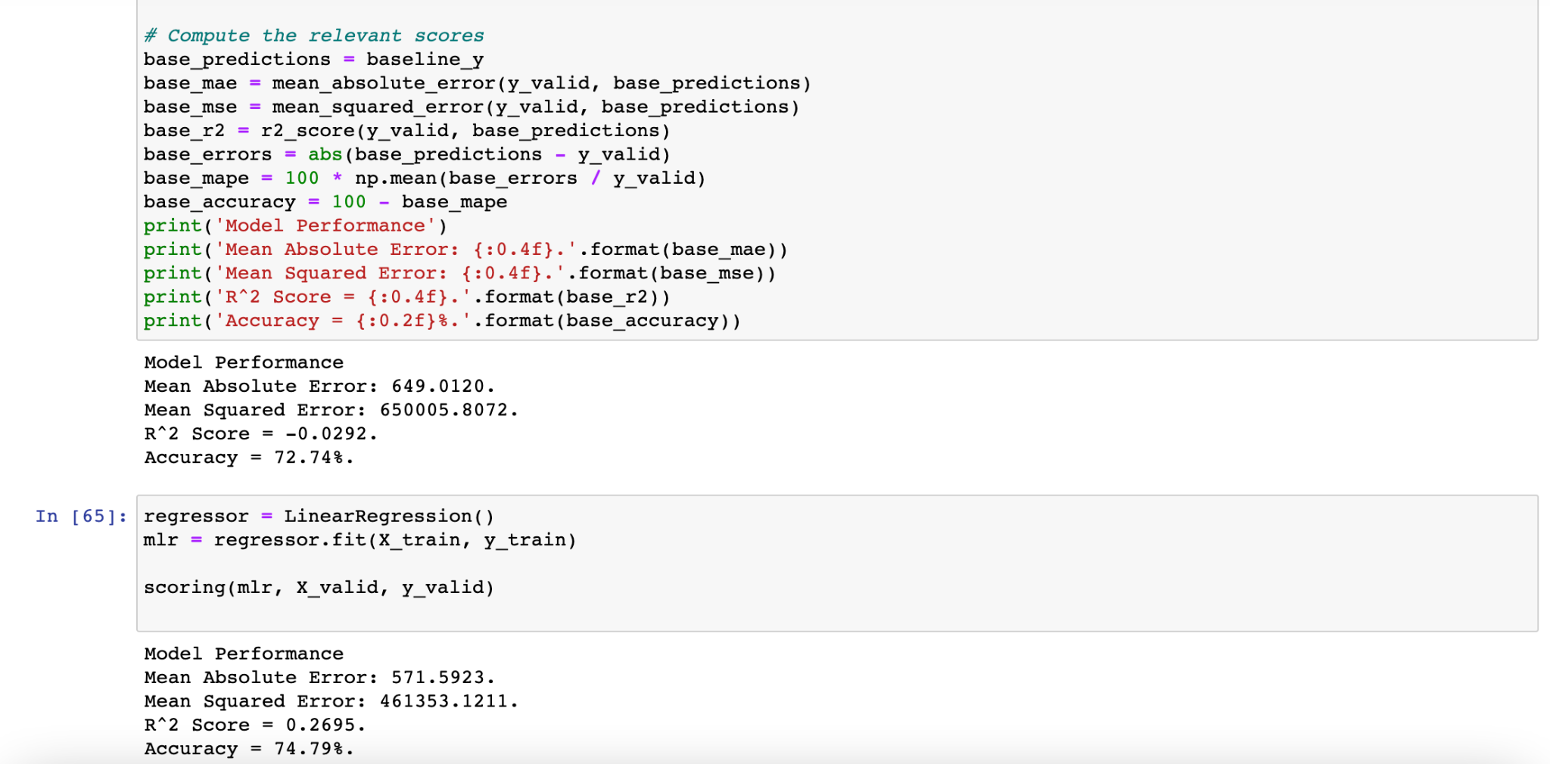
1. Linear Regression Model:
Accuracy for Linear Regression: 74.79%

Slide 7
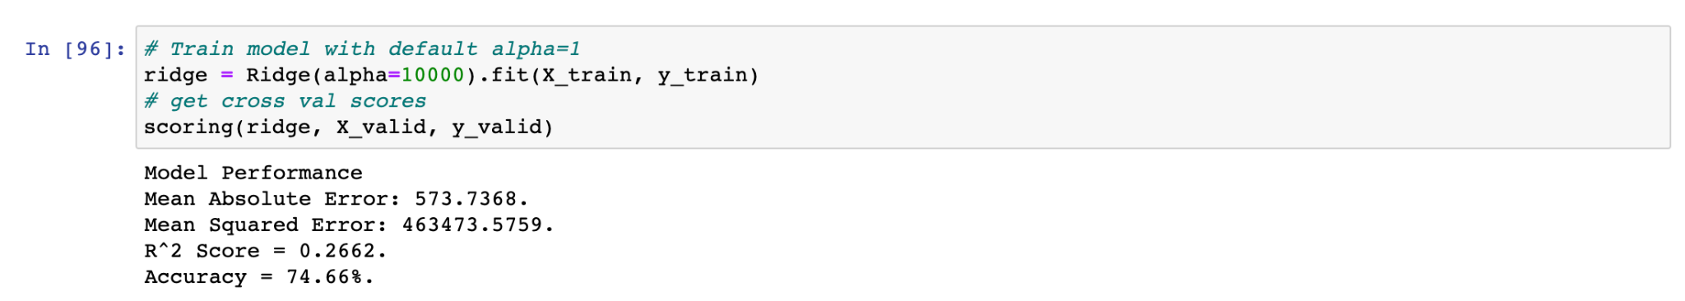
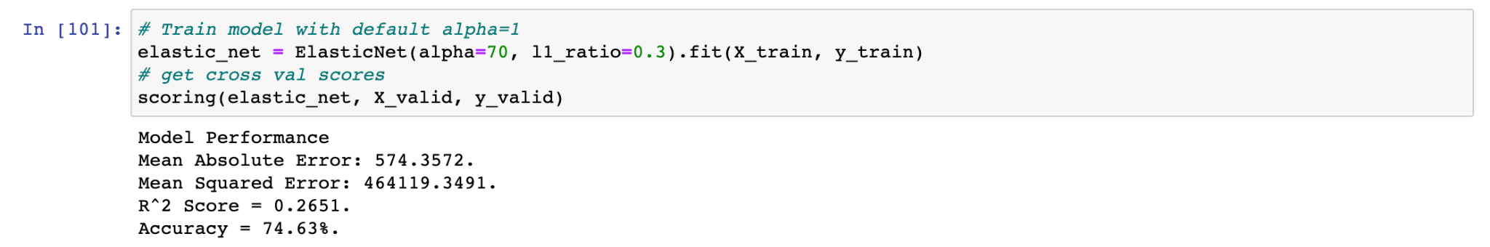
Methods
Linear Regression Model after Hypertuning:
1. Hypertuning using ridge:
Accuracy for Linear Regression: 74.66%
2. Hypertuning using lasso:
Accuracy for Linear Regression: 74.63%

Slide 8
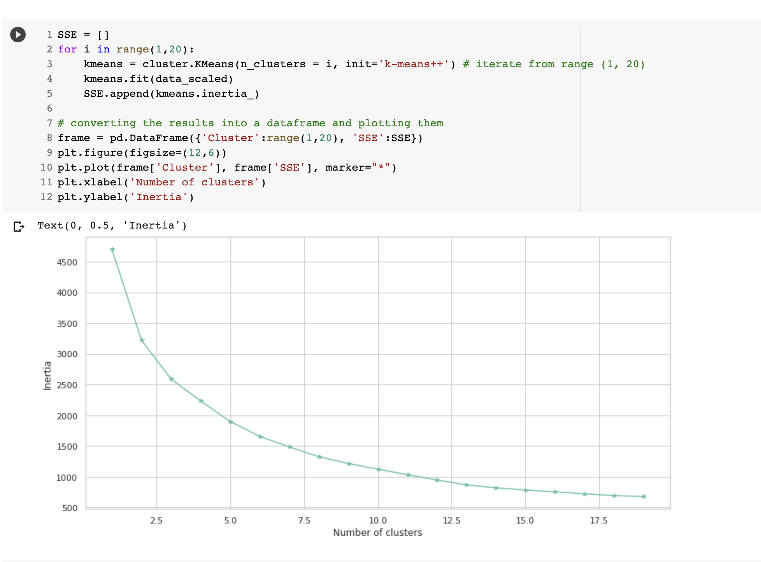
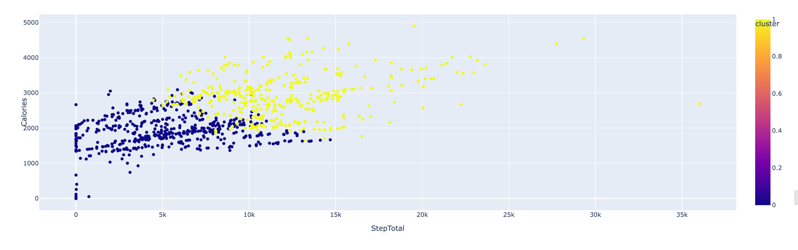
2. K-Means Clustering Method:
Visualization

Slide 9
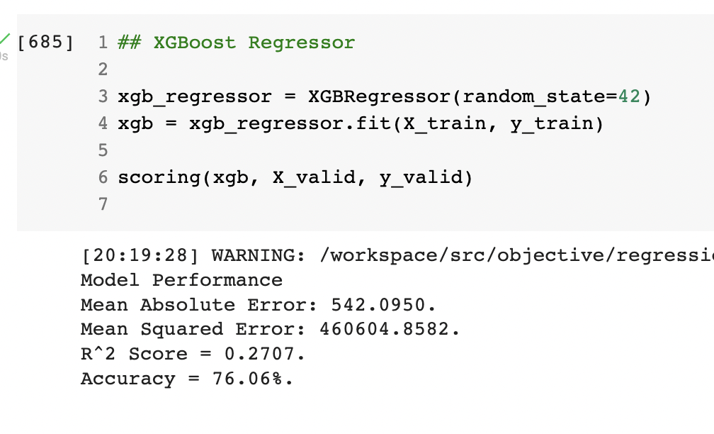
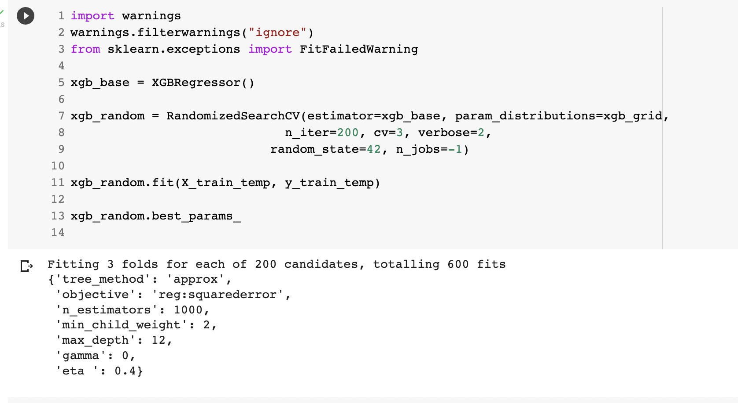
Methods
3. XgBoost
Hyperparameter Tuning

Slide 10
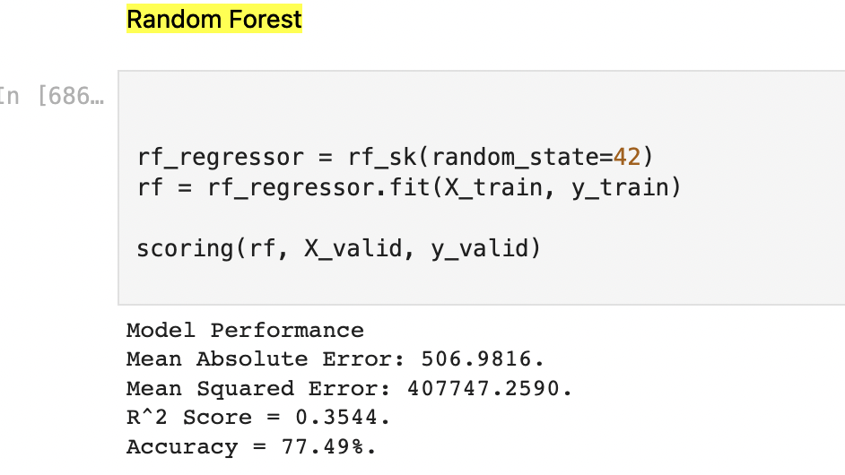
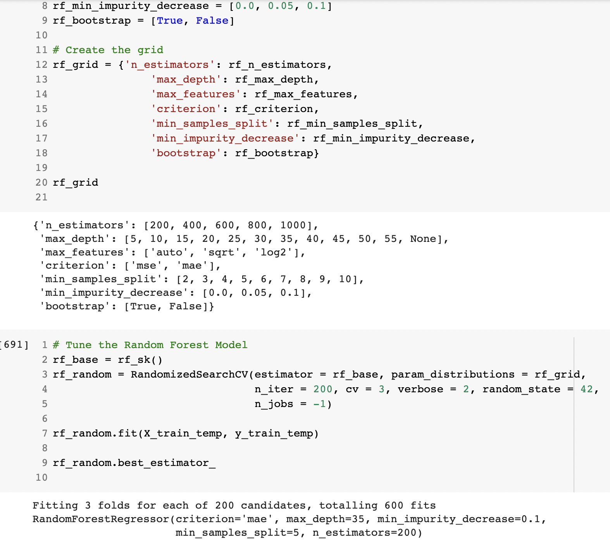
4. Random Forest

Slide 11
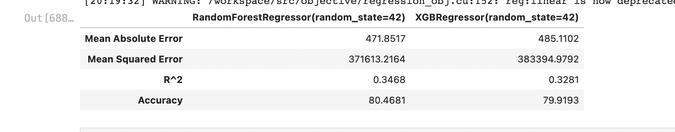
5. Accuracies after Hyper parameter tuning

