Slide 1
Prompt Complexity Classifier
Project in one line
Cost-Optimized LLM Routing Project
Input prompt → extract simple text features → XGBoost predicts the cheapest suitable model.
This project predicts whether a user prompt needs a weak, intermediate, or strong model.
The goal is to reduce API cost while keeping output quality acceptable.
Weak
Intermediate
Strong
Prepared as a simple final-year presentation

Slide 2
1. Problem and Goal
Why this project is needed
Problem
What the project does
Why it matters
Using a strong model for every prompt is costly.
Simple prompts do not need expensive inference, but complex prompts do.
1. Receives a prompt
2. Checks simple text features
3. Predicts required model class
4. Sends the prompt to the right model later in the full system
For the classifier part, only the routing decision is produced.
This gives a practical way to control LLM cost.
It is useful in chatbots, support tools, coding assistants, and enterprise assistants.
Goal
Build a router that chooses the smallest model that can still answer well.
This saves money and keeps response quality stable.

Slide 3
2. System Architecture
How the classifier is built
User Prompt
Text Features
XGBoost Model
Confidence Check
Final Class
Weak / Mid / Strong
Important point
Feature extraction
Confidence rule
The classifier itself is lightweight.
No embeddings are used, so the router stays fast.
Use prompt length, word count, punctuation, keyword flags, and a small heuristic complexity score.
If the model is unsure, we can move the decision up to a safer class.

Slide 4
3. Data Collection and Labeling
From where the training data comes
Prompt sources
How labels are created
We create a mixed dataset from common task types:
• factual questions
• reasoning tasks
• coding prompts
• debugging tasks
• creative writing
• planning and multi-step tasks
The key idea is variety, because model need depends on task type.
Generate prompt
For each prompt, we test weak, intermediate, and strong models.
The label is the minimum model that gives an acceptable answer.
This is better than just asking which answer sounds nicest.
Run on 3 models
Compare outputs
Optional score
A score can be stored too, for example:
weak = 0.3
intermediate = 0.6
strong = 0.9
This helps if later you want a regression view of complexity.
Assign label

Slide 5
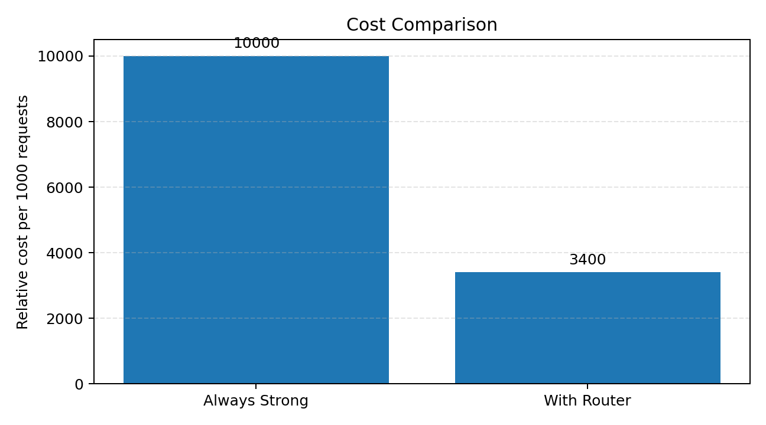
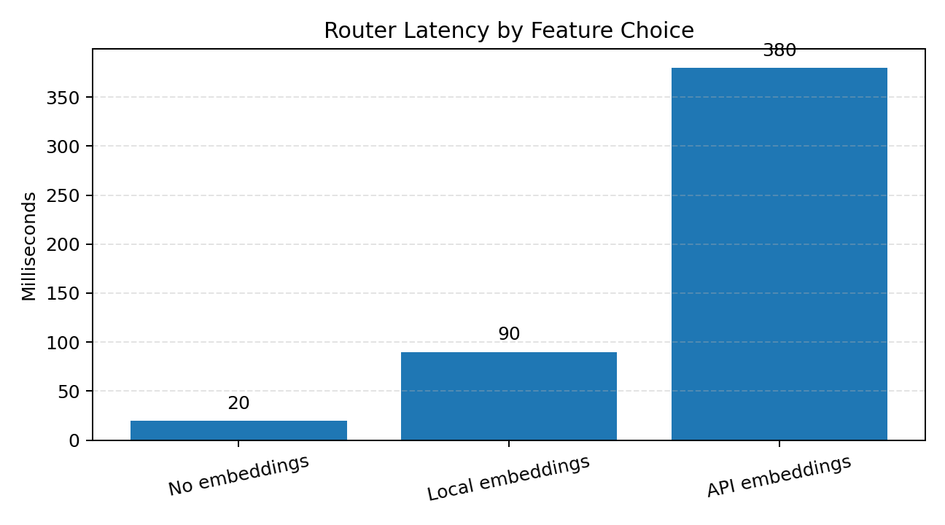
4. Features, Training, and Evaluation
What the model learns and how we measure it
Features used
• prompt length
• word count
• average word length
• number of sentences
• keyword flags
• code symbols
• number presence
• heuristic complexity score
Model choice
Evaluation plan
We use XGBoost because it is fast, works well on structured features, and is easy to explain in a project report.
We compare:
1. always using the strong model
2. using the routing classifier
Metrics: accuracy, F1-score, confusion matrix, cost reduction, and router latency.
The main project result is savings without a large quality drop.

Slide 6
5. Deployment and Final Flow
How the classifier fits into a working system
API Request
Feature Extractor
XGBoost Router
Decision Output
What to say in viva
Why this is useful
Future scope
The project is simple: it predicts the cheapest suitable model for a prompt.
It uses handcrafted features, so it is fast and easy to deploy.
It lowers cost, scales well, and can be added to any LLM application that needs routing.
Later we can test more data, better rules, and a feedback loop from real user traffic.
Thank you
Simple, fast, and cost-aware routing.

