Slide 1
TravelEase
Pro
Transport Booking System
Course: AI Assistance Coding Student Name: Mula Nirnaya Roll No : 2303A51060 Department: CSE Batch: 10

Slide 2
Introduction
What is TravelEase Pro?
TravelEase Pro is a fully functional, full-stack transport booking web application. It allows users to search, book, and manage transport across buses, trains, flights, cars, autos, and bikes all in one place. The platform replicates real-world booking portals like MakeMyTrip and RedBus with secure login, seat selection, and payment integration.
Key Highlights
User registration & JWT-secured login
Real-time seat availability & selection
Multi-modal transport search (bus, train, flight, car, auto, bike)
Razorpay payment gateway integration
Admin dashboard for managing bookings
Booking history, cancellation & PNR generation

Slide 3
Objectives
Multi-modal Booking
Secure Authentication
01
02
Build a single platform to search and book 6 modes of transport: bus, train, flight, car, auto, and bike.
Implement JWT-based login/register for users and a separate admin login with role-based access control.
End-to-End Payment
Admin Control Panel
03
04
Integrate Razorpay gateway to handle online payments with order creation and verification flow.
Provide an admin dashboard to view all bookings, user data, and transport records.
Real-time Seat Management
Deployment
05
06
Dynamically render seat maps and decrease availability upon successful booking.
Deploy on Render with MongoDB Atlas as the cloud database, making the app accessible globally.

Slide 4
Stakeholders
PRIMARY USERS
SYSTEM MANAGER
BUILDER
End Users / Travelers
Admin / Operator
Development
Search and book transport
Manage transport listings
Design system architecture
Manage and cancel bookings
View all user bookings
Implement features & APIs
Make online payments
Monitor revenue & status
Test and deploy the app
View booking history & PNR
Access control panel
Maintain codebase

Slide 5
Programming Languages, Tools & Software
FRONTEND
BACKEND
DATABASE
TOOLS & SERVICES
HTML5
Node.js
MongoDB Atlas
Razorpay
Structure & semantic markup
JavaScript runtime (v18+)
Cloud NoSQL database
Payment gateway (test mode)
CSS3
Express.js
Mongoose ODM
Render.com
Styling, layout & animations
REST API framework
Schema modeling & validation
Cloud hosting & deployment
JavaScript
JWT
GitHub
Client-side interactivity & API calls
Stateless authentication tokens
Version control & source repo
VS Code
Primary code editor
ChatGPT
Fixing code generation

Slide 6
AI Prompts Used to Generate Code
server.js
PROMPT →
"Build Express server for TravelEase. Setup: express, mongoose, cors, dotenv. Middleware: json, urlencoded. Serve static frontend. Connect to MONGO_URI. autoSeed() → create admin user, demo user, and 13 transport records (4 buses, 3 trains, 3 flights, 1 car, 1 auto, 1 bike). Define SPA routes. Listen on PORT."
routes/auth.js
PROMPT →
"Build Express auth routes using JWT + bcrypt. POST /register: validate, check duplicate email, hash password, sign JWT 7d. POST /login: find user, compare password, return token. POST /admin-login: role=admin only, sign JWT 1d. GET /profile (auth middleware). PUT /profile: update name+phone."
routes/bookings.js
PROMPT →
"Build booking routes (all need auth middleware). POST /create: accept full booking payload (transport type, from, to, date, seat class, passengers, pricing). Attach userId from JWT. Auto-generate bookingId (TRB+timestamp) and PNR in pre-save hook. GET /my-bookings. GET /:id. PUT /:id/cancel: set status cancelled, refund if paid."

Slide 7
AI Prompts Used to Generate Code
models/User.js
PROMPT →
"Build Mongoose User model. Schema: name, email (unique lowercase), password (minlen 6), phone, role (user/admin), avatar, isActive, createdAt. pre('save') hook: if password modified → bcrypt.hash(password, 12). Method comparePassword: bcrypt.compare."
models/Booking.js
PROMPT →
"Build Mongoose Booking model. Fields: userId (ObjectId ref User), userName/Email/Phone, transportType (bus/car/flight/train/auto/bike), from/to/journeyDate, passengers [{name,age,gender,seatNumber}], seatClass, pricing (pricePerSeat, totalAmount, taxes, discount, finalAmount), paymentStatus (pending/paid/failed/refunded), bookingStatus (confirmed/cancelled/completed/pending). pre('save'): auto-generate bookingId=TRB+8chars and pnr=8chars uppercase."
routes/transport.js
PROMPT →
"Build transport routes. GET /search: query by type+from+to (regex), return real DB records or MOCK fallback of 5 realistic transports. GET /cities: return 22 Indian cities array. GET /:id: find by ID. POST /:id/book-seat (auth): push seatNumber, decrement availableSeats. POST / and DELETE /:id: admin only."

Slide 8
System Workflow
1
2
3
4
5
6
7
▶
▶
▶
▶
▶
▶
User
Visits Site
Register /
Login
Search
Transport
Select Seats
& Class
Payment
(Razorpay)
Booking
Confirmed
PNR &
History
Admin Panel Path:
Admin Login
View Bookings
Manage Transport
Monitor Revenue
→
→
→

Slide 9
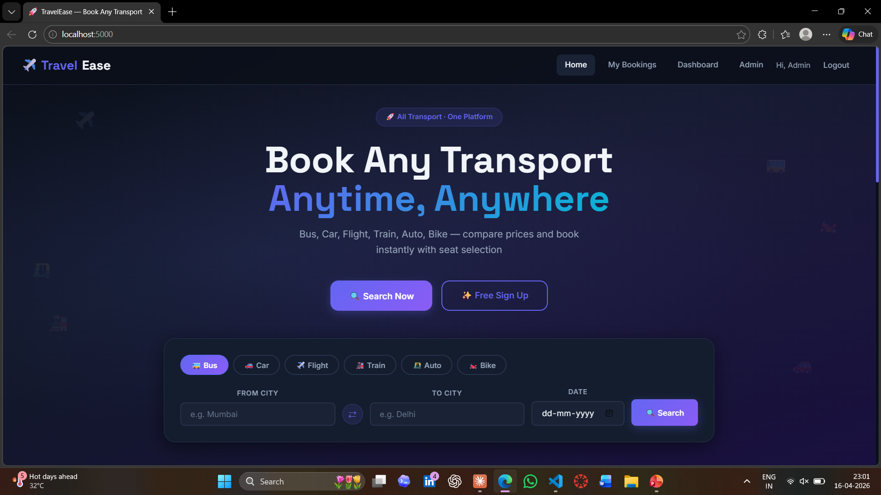
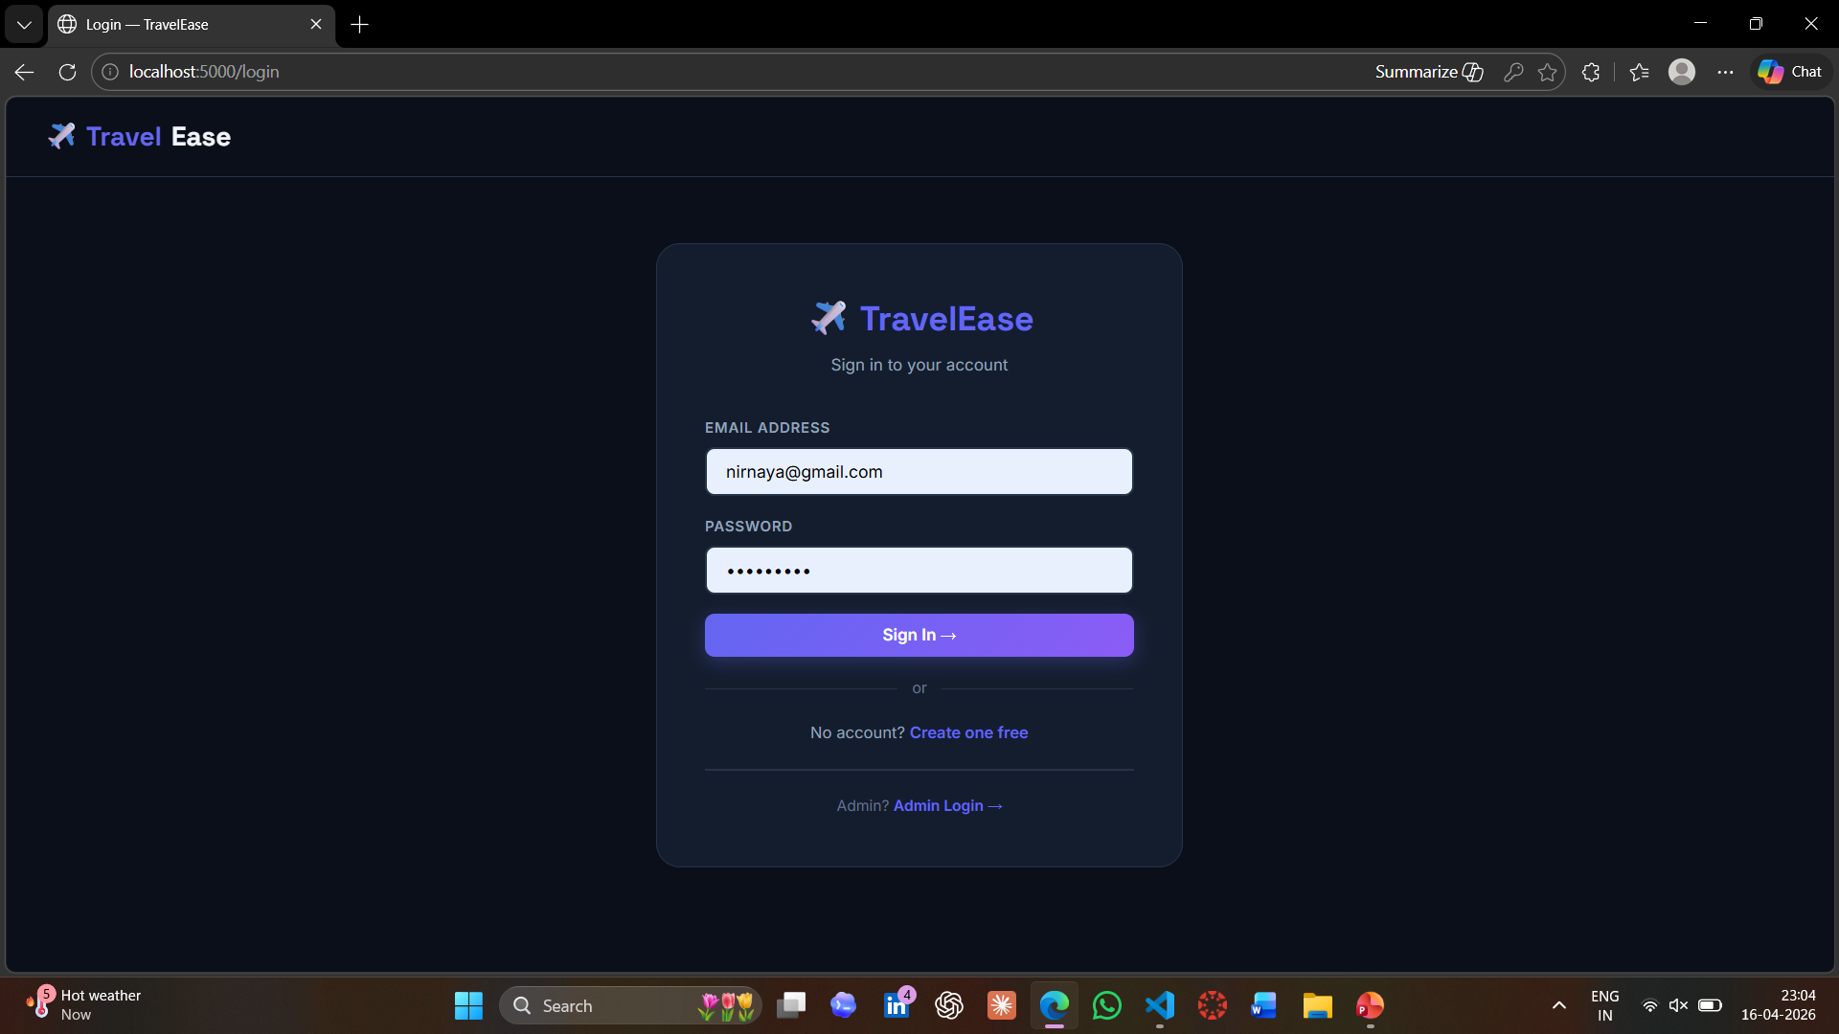
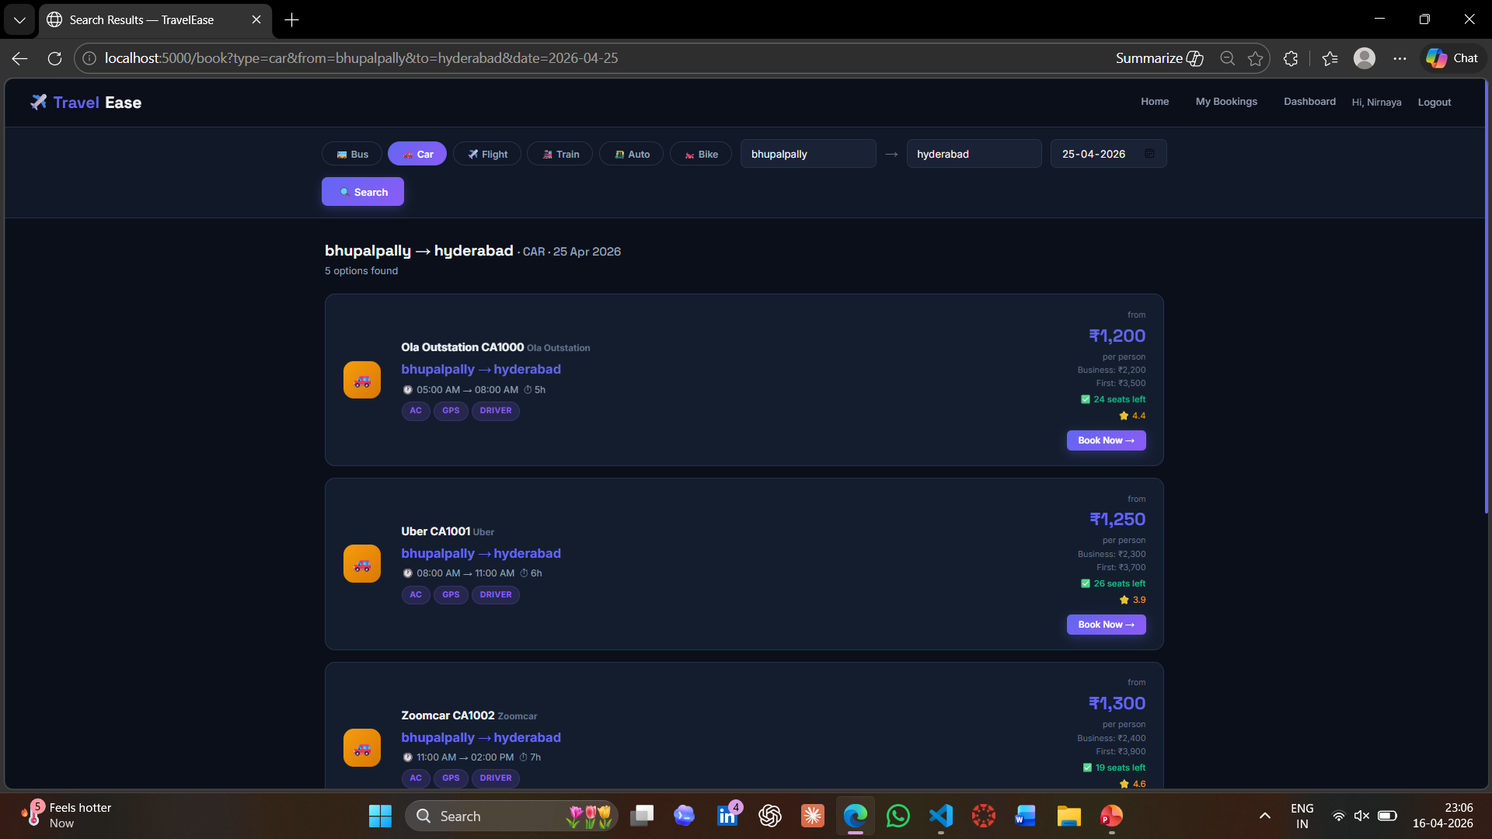
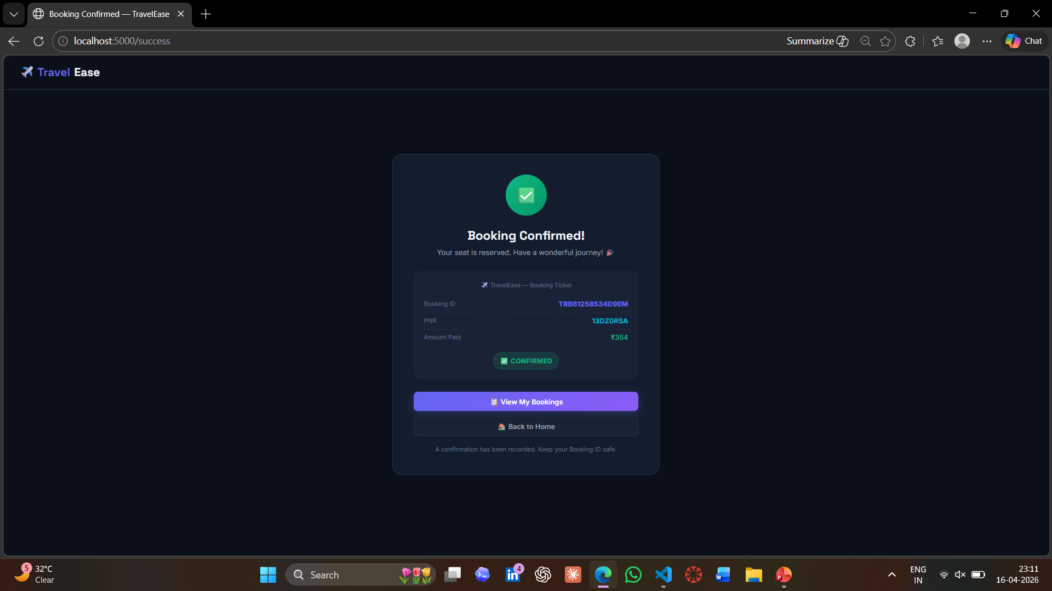
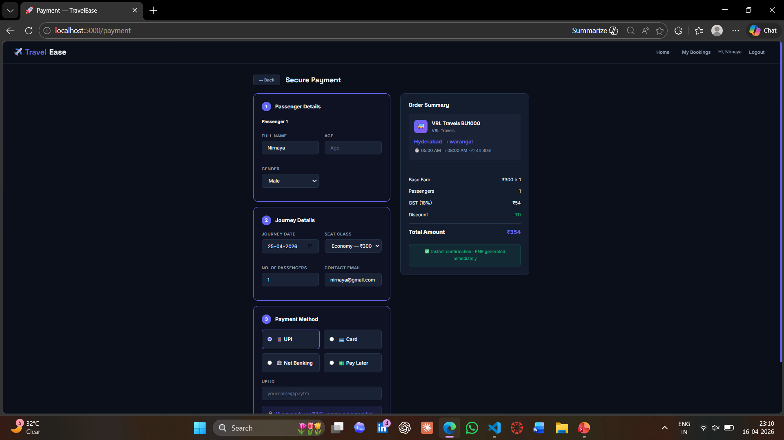
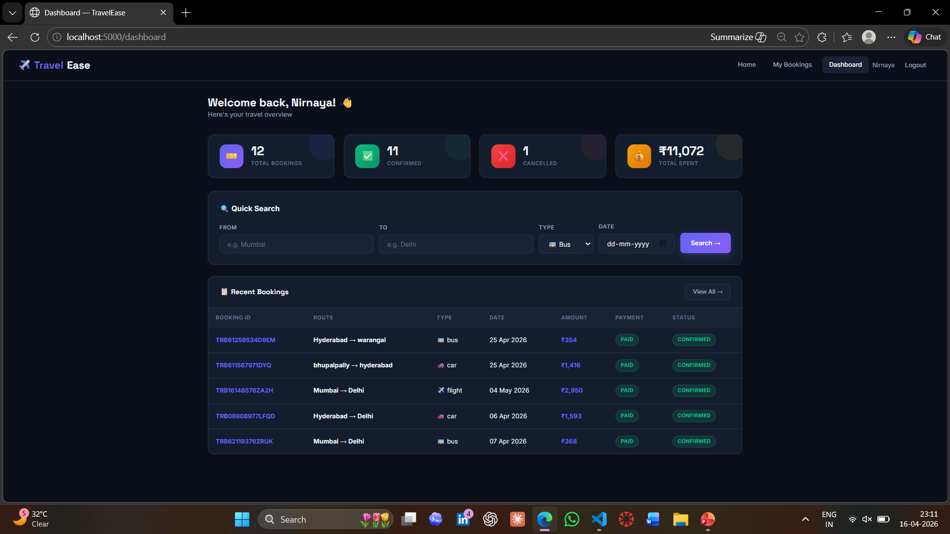
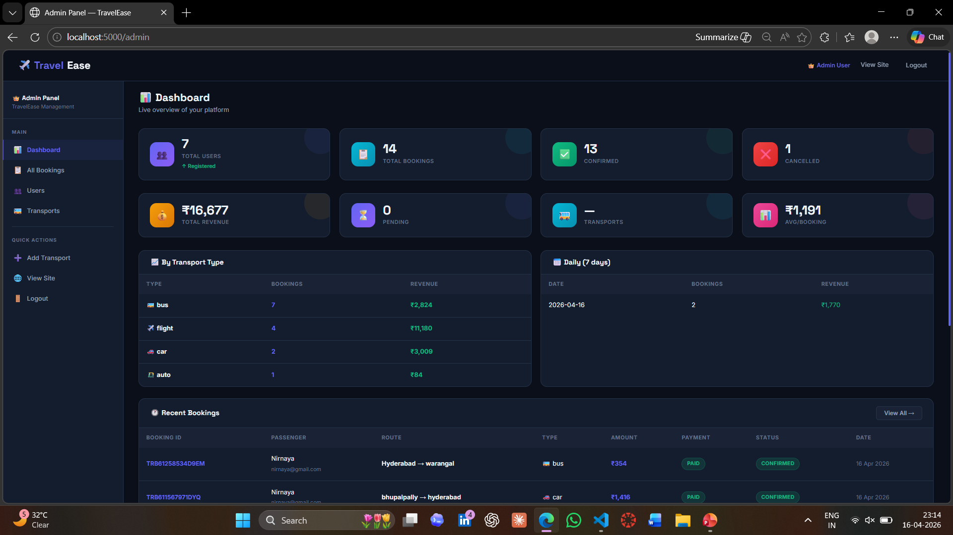
Frontend View — Application Pages
📸 Screenshot
Here
📸 Screenshot
Here
📸 Screenshot
Here
Home Page (index.html)
Login / Register
Search Results (book.html)
Search transport by type, source & destination. Hero section with mode selector.
JWT-secured user auth forms with validation.
Listed transport cards with price, seats, rating & booking CTA.
Booking Success
📸 Screenshot
Here
📸 Screenshot
Here
📸 Screenshot
Here
Confirmation page with PNR number and booking ID displayed.
Payment Page
My Bookings Dashboard
Admin Panel
Order summary + Razorpay integration for online payment.
All past bookings with status badges and cancel option.
Admin-only view with all user bookings and transport management.

Slide 10
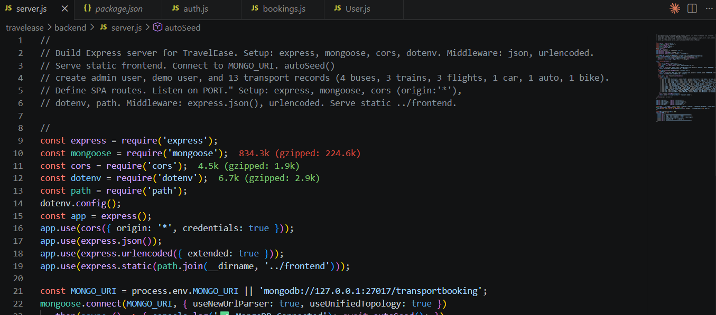
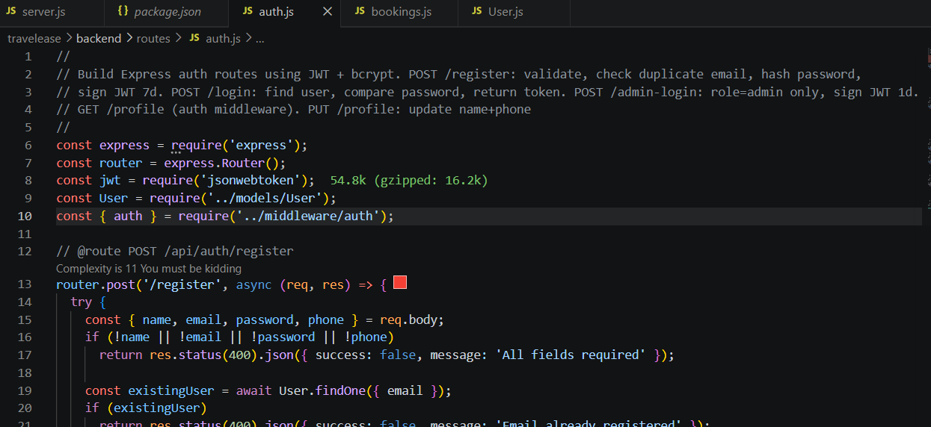
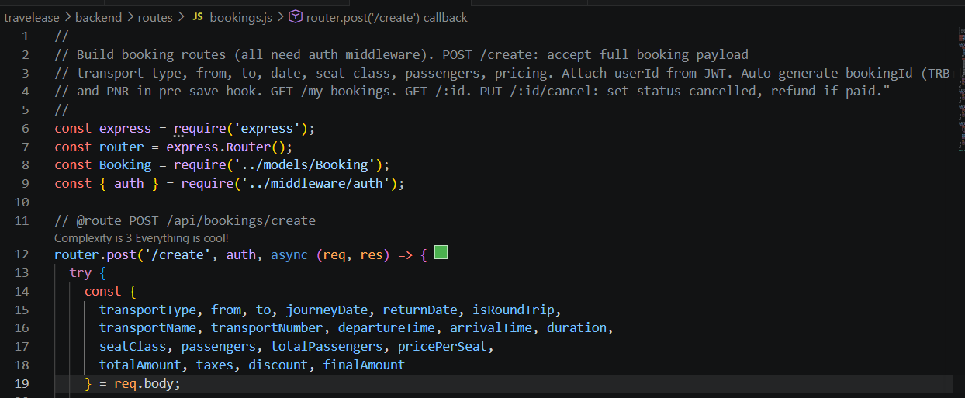
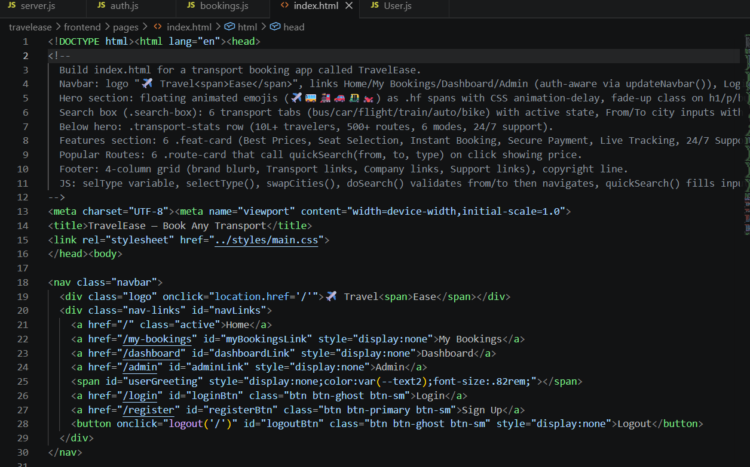
Proof of Prompts Generating Code
Screenshot 1 — server.js generation
Screenshot 2 — auth.js generation
Show prompt + Express server code response
Show JWT login/register prompt + code
[ Screenshot Here ]
[ Screenshot Here ]
Screenshot 3 — Booking model generation
Screenshot 4 — Frontend page prompt
Show Mongoose schema prompt + model code
Show HTML/CSS generation from prompt
[ Screenshot Here ]
[ Screenshot Here ]

Slide 11
References
Website URL:
https://travelease-iql4.onrender.com
VIDEO REFERENCES
YouTube — Node.js Express Tutorial for Beginners
YouTube — MongoDB Atlas Full Setup Guide (Fireship)
YouTube — JWT Login System (Web Dev Simplified)
YouTube — Razorpay Payment Integration in Node.js
AI TOOL
ChatGPT (chat.openai.com) — Used to generate backend routes, models, and server code
DOCUMENTATION / BROWSER SEARCH
Google Chrome — Searched how to connect MongoDB Atlas with Node.js
Google Chrome — Searched Express.js middleware setup and routing
Google Chrome — Searched how to deploy a Node.js app on Render.com

