Slide 1

Student Fee Management System
Nikunj Labana -B16CS021
Shivam Nirne - B16CS022

Slide 2
Features Of Project -
Pay Semester Fee
Pay Mess Fee
View his receipt
Can Change Password
Student’s Features

Slide 3
Features of Project
Can Register New Student
Update Session
Update Particular Fees
Can See Student Details
Can Remove Any Student
Admin’s Features

Slide 4
List Of Use Cases-
Log In
Register New Student
See Details
Update Details
Remove Student
Semester Fee Payment
Mess Fee Payment
See Receipt
Change Password

Slide 5
Structure Of Database /File System -
Following are the files that are made for proper functioning which contains data separately -
Student Database
Admin Credentials
Current Mess Fee
Sem Fee B.Tech Gen/OBC below 1 lac
Sem Fee B.Tech Gen/OBC 1 to 5 lac
Sem Fee B.Tech Gen/OBC above 5 lac
Sem Fee B.Tech SC/ST
Sem Fee M.Sc Gen/OBC
Sem Fee M.Sc SC/ST
Session

Slide 6
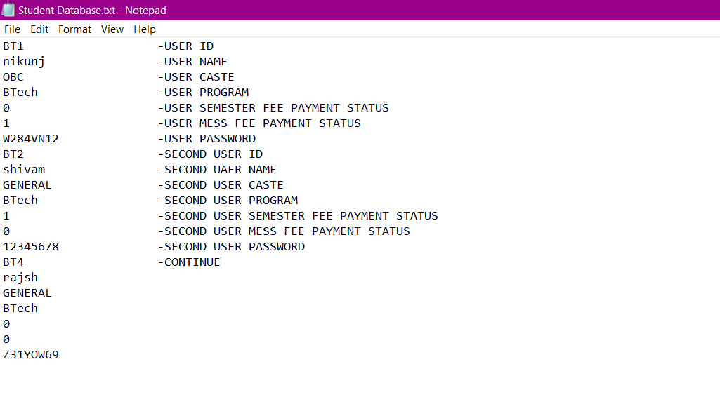
Structure of Student Database File -

Slide 7
Things That Could Not Be Implemented -
There is no online platform so that student can register himself , if he wants to register he has to go to Admin manually.
Not able to use Database like SQl etc.
There is nothing like notifications will appear and then according to that further process is implemented.
Admin Can’t update his password.

Slide 8
Statistics Of Unit And System Testing -
We have done Unit testing for each function which takes input and gives output. Corner Cases are used as test cases.
Automated Tools are not used.
All test cases are considered.
System Testing is done for each functionality.
Unit testing and System testing is explained briefly.

Slide 9
Unit testing-update fee
Test ID | Input Option Amount |  | Actual Outcome | Expected Outcome | Pass / Fail | Description | Verification
3.7.7.1 | 2 | 20000 | Fees of BTech SC/ST student is updated to 20000 | Fees of BTech SC/ST student is updated to 20000 | Pass |  | Verified
3.7.7.2 | 8 | 20000 | Enter valid Option | Enter valid Option | Pass | Option is not amongst 1 to 7. | Verified
3.7.7.3 | rdfgh | 20000 | Enter valid Option | Enter valid Option | Pass | String is given instead of int. | Verified
3.7.7.4 | 3 | erdtfgh | Enter valid amount | Enter valid Amount | Pass | String is given instead of int. | Verified

Slide 10
System testing-register student
Step | Test step | Input | Intended Result | Expected Result | Pass / Fail | Comments
1 | takeStudentDetails() Students Name,Caste and Program will be entered . | Student name ,Student Caste,Student Program Ex. Parvesh , GENERAL,BTech. | Status : If Caste and program selected are not correct then details will be asked to re-enter. And these will be stored in temporary variable. | Same as expected. | Pass | This stored data will be used in further process.
2 | giveUsernamePass() | BTech Counter from Btech counter file and Msc Counter from Msc counter file | Give Unique ID (using counter) and give a random password containing 8 characters. | Same as expected | Pass | This ID and password are also stored in temporary variables and will be used further.
3 | registerStudent() | none. | The data i.e. stored in temporary variables in previous steps will be written into a file and student will be registered successfully. | Same as expected | Pass | There is a file which contains all students data .

Slide 11
Meeting Appointment Scheduler
Cross Tested Project

Slide 12
List Of Use-Cases Tested -
Log In
Create Account
Request Appointment
Normal Appointment
Priority Appointment
Cancel Appointment
Appointment Decision
Update Schedule
View Profile
View Schedule

Slide 13
Statistics Of Test Cases -
All functions are tested(verified). Total functions were 11.
Number of correct functions =10.
Number of Incorrect functions=1.
1 Failure in system testing.
Username is not getting updated in database.

Slide 14
Conclusion -
We are successful in completing our project as per our thinking.
C++ is not a good for working on interfaces, we have to be very precise.
Learned what is the professional way of making software . And the things that are concerned while making it.
Using Database system is better than File handling.

Slide 15
Thank You

