Slide 1
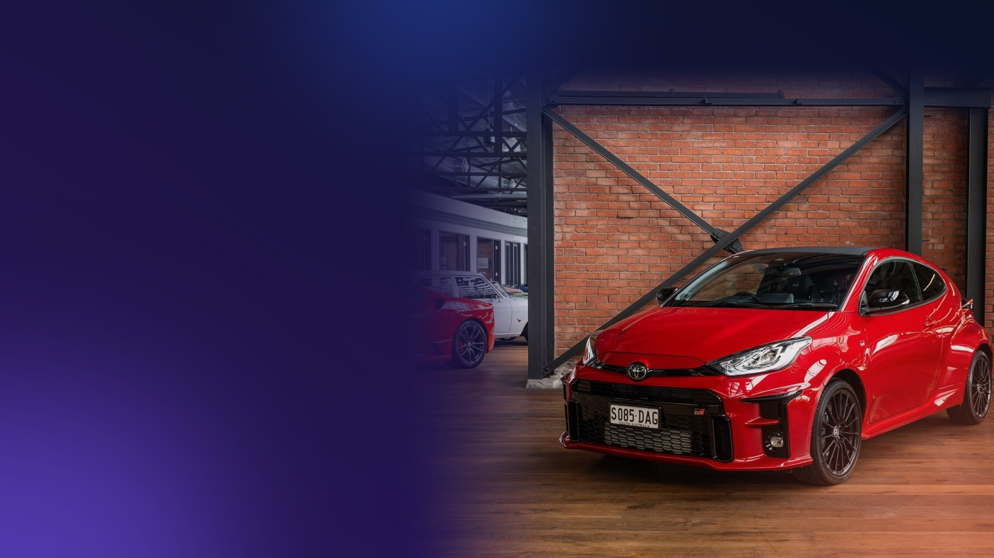
IT3051 FUNDAMENTALS OF DATA MINING · MINI PROJECT 2026
Used car prices, explained
How 14,011 real car listings became a price estimator that tells you how sure it is
Nirodha
IT23557956
Wijerathna
IT23630734
Ranasinghe
IT23780088
Gunasekara
IT23614208
Group KND_11
Notes:
Nirodha: Good morning, everyone. We are Group KND_11 and today we want to show you how we turned thousands of real used-car advertisements into a tool that tells you what a used car is worth, and how sure we are about it. Over the next quarter of an hour or so, the four of us will take you from the problem, through what we found in the data and how we built the estimator, to a live demonstration and our recommendations.

Slide 2

Four speakers, one story
1
2
3
4
N S Devapriya (Nirodha)
W G B S Wijerathna
R A N K Ranasinghe
T M A R Gunasekara
The problem and our solution
The data and what it showed
How we taught the computer
Using it, and what next
Slides 3–4 and 14
About 4.5 min
Slides 5–8
About 4.75 min
Slides 9–10
About 3.5 min
Slides 11–13
About 4.5 min
Cleaned the raw listings, built the XGBoost model and the web service
Explored the data and found the price patterns; built the Random Forest model
Designed the car features the models use; built the LightGBM model
Kept the test cars separate, filled missing values; built the Ridge model
Notes:
Nirodha: Here is how the next fifteen minutes are organised. I will explain the problem and our solution. Wijerathna will show you the data and what it taught us. Ranasinghe will explain how we taught the computer and how well it works. Gunasekara will demonstrate the system and give our recommendations. I will close and we will take your questions. Each of us will also say what we personally built, so you know who to ask about what.

Slide 3

Similar cars, very different prices
Presenting: Nirodha
$15,681
B
Buyers
Is this asking price fair?
price of the middle used car in our data
S
Sellers
What should I ask for my car?
$9,095 – $24,462
D
Dealers
where the middle half of all listings sit, a gap of more than $15,000
What is this trade-in worth, right now?
Why it matters: a wrong price costs money, time and trust in the market.
Notes:
Nirodha: Imagine you want to buy a ten-year-old sedan. You find two that look almost the same, and one costs thousands of dollars more. Which one is fair? In our data, the middle used car costs about $15,681, but the middle half of all listings stretches from $9,095 to $24,462. Sellers choose their own asking price, and there is no objective reference. That hurts everyone. Buyers risk overpaying, sellers do not know what to ask, and dealers who value trade-ins by hand can be slow and inconsistent. A fair, quick estimate helps all three make better decisions.

Slide 4
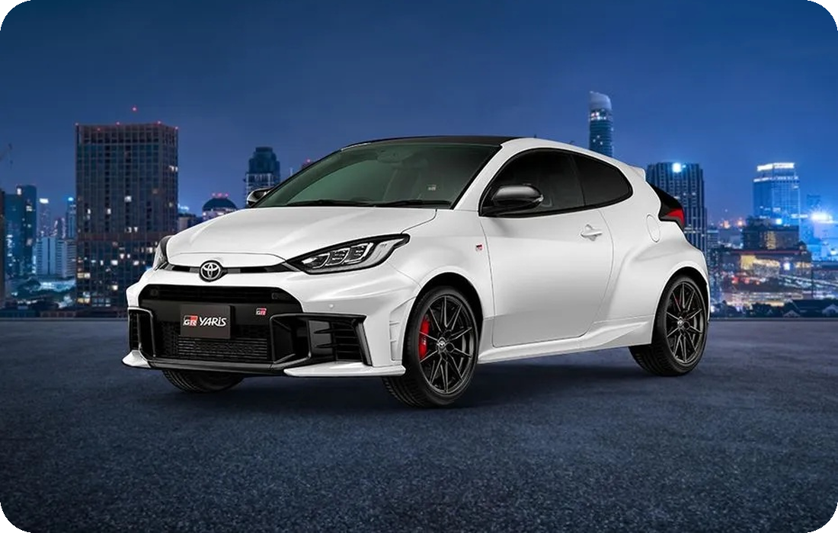
Tell us the car and we estimate the price
Presenting: Nirodha
1
You describe the car
2
We compare it with real listings
3
You get an answer you can use
→
→
Make, year, mileage, engine, equipment: about 15 simple fields
What the model learned from 14,011 cars that were really advertised
A price, a likely range and a check of any asking price
What you get back
Toyota GR Yaris
An estimated price in US dollars
A likely range, where the real price fell for 80% of test cars
A fair-price check if you enter an asking price
The answers of four different models side by side
Notes:
Nirodha: Our solution is simple to use. You enter the details of a car, such as its make, year, mileage, engine and equipment. Behind the scenes, our model compares it with what it learned from 14,011 real listings. You then get three things: an estimated price, a likely range, and, if you type in an asking price, a plain-language check on whether it looks fair. We built the web service that does this and I will let Gunasekara show it to you live in a few minutes. The important point is that it is a measured estimate, and it always shows its doubt.

Slide 5

We kept the listings we could trust
Presenting: Wijerathna
19,237
What we removed, and why
The same car advertised more than once
Impossible prices, such as $1 or $26 million
Odometer readings that cannot be real
Engine sizes and years outside normal cars
Listings downloaded
15,725
After removing repeated listings
14,011
Source: a public Kaggle dataset of used-car listings from Georgia
After removing unrealistic values
Notes:
Wijerathna: I looked after exploring the data. We started with 19,237 advertisements downloaded from a public dataset of Georgian used-car listings. Many were not usable. About 3,512 were repeats of the same car, and others had impossible values, such as a price of one dollar or a price of twenty-six million dollars. After cleaning, 14,011 listings remained, roughly 73% of what we downloaded. We would rather learn from fewer, trustworthy cars than from many doubtful ones.

Slide 6
Age comes first, then equipment and engine
Presenting: Wijerathna
42%
of the model's accuracy comes from knowing the car's age
How we measured it
We scrambled one factor at a time and checked how much worse the estimates became.
Notes:
Wijerathna: We wanted to know what really moves a price. To find out, we took our finished model and scrambled one factor at a time, for example mixing up the ages between cars, and watched how much worse the estimates became. The bigger the damage, the more that factor matters. Age is clearly first, responsible for about 42 per cent of the model's accuracy. Next come the number of airbags, which probably helps the model tell older and newer designs apart, then engine size and the type of gear box. Colour and the number of doors hardly matter at all, so you can ignore them when judging a car.

Slide 7
The patterns we found in the data
Presenting: Wijerathna
$23,521 vs $14,740
SUV / Jeep against sedan, median price
46% cheaper
right-hand-drive against left-hand-drive cars
$23,060 vs $14,834
diesel against petrol, median price
Notes:
Wijerathna: Here are the patterns that surprised us most. On the left, you can see how value falls with age for all cars, for petrol and for diesel. The decline is steep in the first ten to fifteen years and then flattens. On the right are three comparisons using the middle price of each group. SUVs and Jeeps cost a median of $23,521 against $14,740 for sedans. Diesel cars are priced at $23,060 against $14,834 for petrol, partly because diesel is common in large SUVs. And right-hand-drive cars sell for about 46 per cent less than left-hand-drive cars, which matters in a country that drives on the right. I also built the Random Forest model, one of the four we compare later.

Slide 8
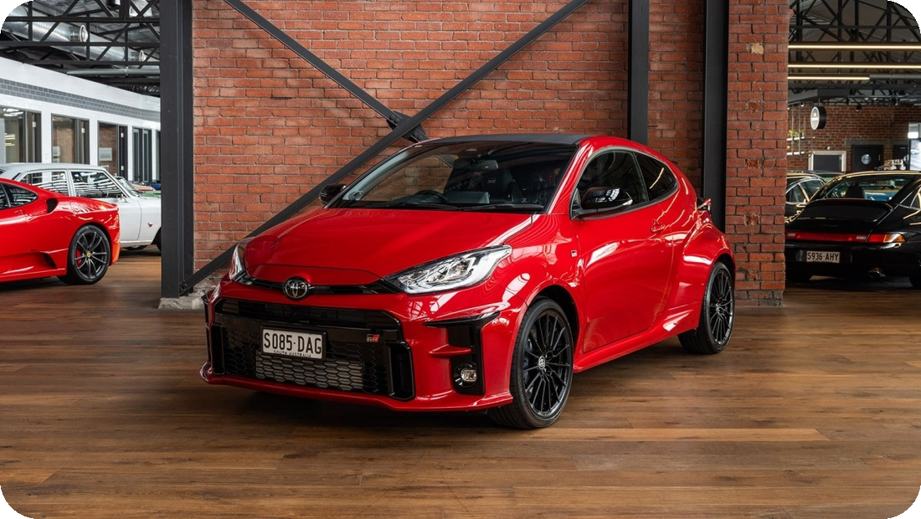
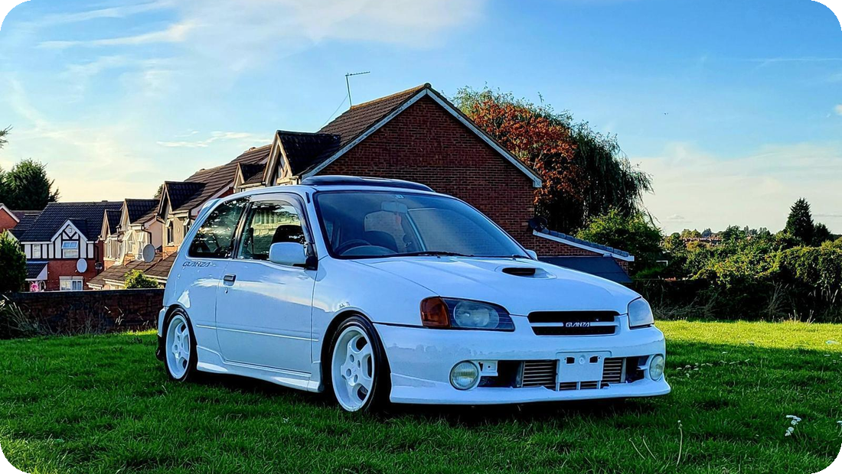
Same brand, very different cars
Presenting: Wijerathna
Toyota GR Yaris
Toyota Starlet Glanza
A modern, sporty hatchback
A 1990s turbo hatchback, modified by its owner
What our model sees
Age, engine and turbo, equipment, body type
What it cannot see
Modifications and the car's condition
Notes:
Wijerathna: Here is a simple way to see why one price does not fit all. Both of these are Toyotas, and both are small hatchbacks. On the left is a modern GR Yaris, the sporty version of today's Yaris. On the right is a Starlet Glanza, a turbo hatchback from the nineties that its owner has modified, with new wheels and a bigger intercooler. In our data there are 2,484 Toyotas, with a middle price of $16,308, so the brand alone tells you very little. What separates cars like these is age, engine and turbo, equipment and body type, and our model sees all of those. What it cannot see is modifications and the car's condition. A modified car like this Starlet can be worth much more or much less than the model says, and that is one of the limits Gunasekara will come back to.

Slide 9

Four ways of learning, compared fairly
Presenting: Ranasinghe
44%
75%
76%
76%
of price differences explained
of price differences explained
of price differences explained
of price differences explained
One straight-line formula
A crowd of decision trees
Fast boosted trees
Careful boosted trees
Simple and fast, but it cannot see how factors combine
Many trees vote on the price; steady and hard to fool
Trees built one after another, each fixing the last one's mistakes
The same idea with built-in brakes against memorising rare cars
Our choice
A fair exam: the models were tuned on one set of cars and then scored on 2,803 cars they had never seen.
Notes:
Ranasinghe: I will explain how we taught the computer. Before that, I prepared the car features the models learn from, for example the car's age, how many kilometres it drives per year, and whether it is a premium make or has a turbo. Then we tried four different approaches. The simplest uses one straight-line formula. The other three build many small decision trees, either as a crowd that votes, or one after another, each fixing the mistakes of the last. The number on each card is the share of price differences the model explains on 2,803 cars it had never seen. The straight line explains only about 44%, because real prices depend on combinations of things. The three tree methods all reach about three quarters. We chose XGBoost because it scored best on the rule we fixed in advance, though I want to be honest that the top three are close. I built the LightGBM model.

Slide 10
How well does it work?
Presenting: Ranasinghe
64%
of estimates are within 25% of the real price
$4,688
average error on cars the model had never seen
76%
of the differences in price are explained
Weakest for very cheap cars: those listings often do not follow the car's specification.
Notes:
Ranasinghe: So how good is it in everyday terms? About 64% of our estimates land within twenty-five per cent of the real price. On average the estimate is off by about $4,688, and overall the model explains about 76% of why prices differ. That makes it a useful guide, but not a guarantee, and that is why we always show a range. The chart on the right shows where the errors are. For mid-priced cars, the average error is under four thousand dollars. For very cheap cars, under three thousand dollars, the error is larger than the car's price, because those listings often do not follow the car's specification at all. We think it is important to tell you that openly.

Slide 11

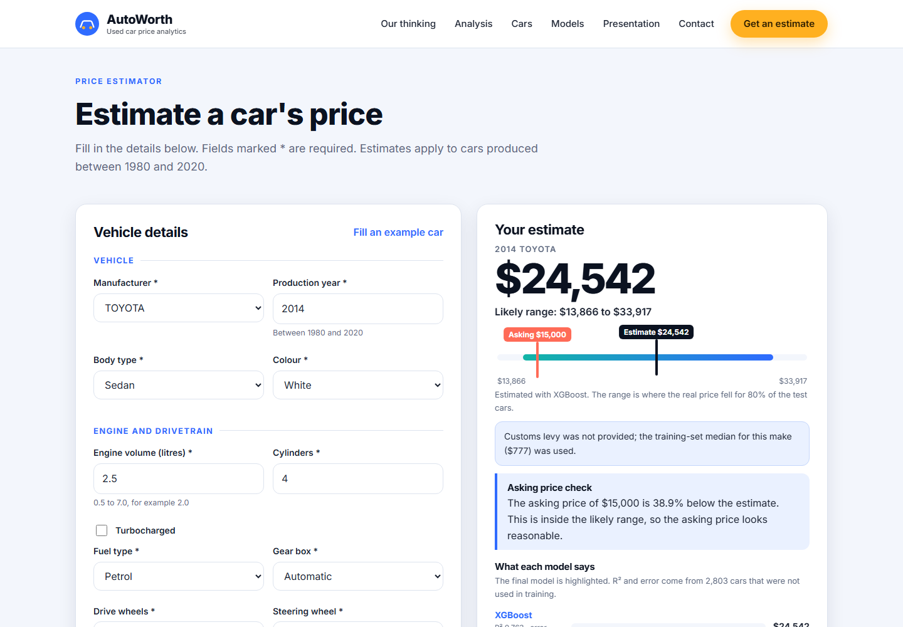
See it working
Presenting: Gunasekara
1
Choose the car
Use “Fill an example car” or enter the details
2
Press “Estimate price”
The answer appears in about a second
3
Read the range bar
Price, likely range and the asking price on one line
4
Check the asking price
A plain sentence says if it looks fair
Live demonstration: http://127.0.0.1:5000
Notes:
Gunasekara: Now let me show you the system from a user's point of view. This is the live website. [Open the estimator section.] I will click 'Fill an example car', which loads a 2014 Toyota sedan with a 2.5 litre petrol engine and 98,000 kilometres. I also type an asking price of fifteen thousand dollars and press 'Estimate price'. The big number is the estimate. Under it is the likely range, and the bar shows where the estimate sits inside that range, and where the seller's asking price sits too. Below the bar, a plain sentence says whether the asking price looks reasonable. At the bottom you can see what each of the four models says, so a big disagreement would be a warning sign. If I type something impossible, such as a production year of 2024, the page tells me exactly which field is wrong. My part of the project was keeping the test cars separate from the training cars and filling in missing values properly, which is why these numbers can be trusted. I also built the Ridge model. [Backup: if the live site does not load, use this screenshot.]

Slide 12



What we recommend
Presenting: Gunasekara
Buyers
Sellers
Dealers
Use the range as your starting point. A price far below it deserves extra checks of the car's history.
List close to the estimate. The range shows how much room you have to negotiate.
Check age and equipment first, they drive most of the price. Look closer when the four models disagree.
Evidence: 80% of real prices fell inside the range
Evidence: Typical estimate error: $4,688
Evidence: Age alone: 42% of accuracy
Notes:
Gunasekara: Based on the evidence, we recommend the following. For buyers: use the range as your starting point for a conversation. In our tests the real price fell inside the range for 80% of cars, so an asking price far below it deserves extra checks of the car's history. For sellers: list close to the estimate. The typical error is about $4,688, so the range tells you how much room to negotiate. For dealers: look first at the factors that carry most of the price, which are age and equipment, and use the estimate for quick, consistent trade-in values. Whenever the four models disagree strongly, take a closer look at that car.

Slide 13
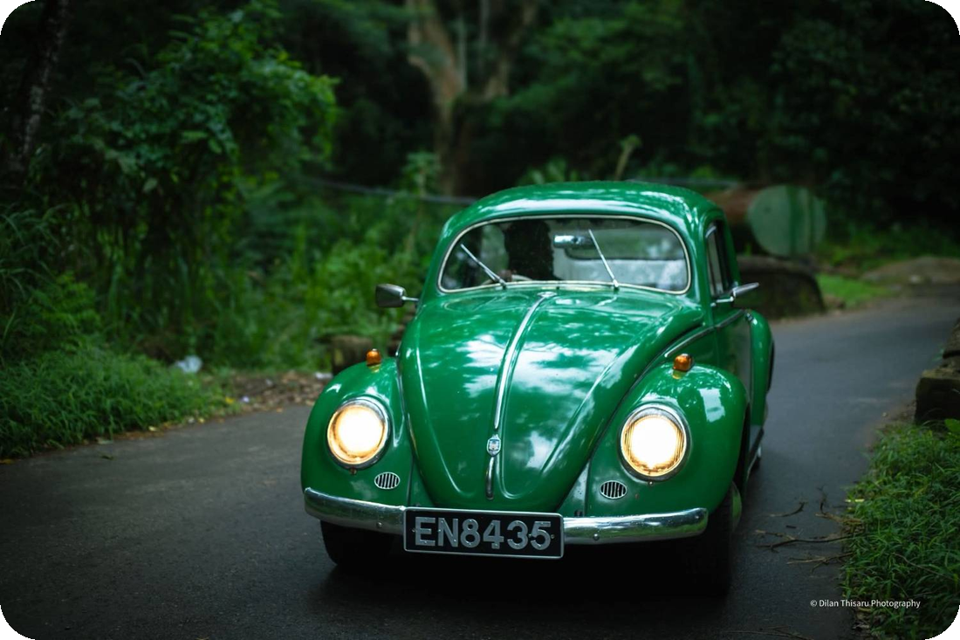
Limits, and what we would improve next
Presenting: Gunasekara
Limits we want you to know
What we would do next
Classic: before 1980
Very cheap listings are hard to predict
Only 1.6% of cars are from 2019–2020, so recent cars are the least certain
Modifications and condition are not recorded, so a modified car can be worth much more or less
One country and one period of time; classic cars from before 1980 are not covered
The range is wide: 0.565 to 1.382 times the estimate
Collect more recent listings
Use the car's model name, such as Camry
Give each car a range that fits it
Host the website online for everyone
Modified: not in the data
Honest limits make the estimate more useful, not less.
Beetle photo: Dilan Thisaru Photography
Notes:
Gunasekara: A good solution also knows its limits. Very cheap listings are hard to predict, because their prices often do not follow the car's description. The data also does not record modifications or condition, so a modified car, like the Starlet on this slide, can be worth much more or less than we say. The same goes for classic cars. A vintage Volkswagen Beetle like this one is older than anything in our data, and classics can hold or even gain value as they age, the opposite of the pattern we found for ordinary used cars, so the system does not accept cars from before 1980. Only 1.6 per cent of our cars were produced in 2019 or 2020, and none is newer, so the system only accepts cars from 1980 to 2020 and is least sure about the newest ones. The data comes from one country and one period. And the range is wide, from about 0.565 to 1.382 times the estimate, so the estimate is a guide and not a formal valuation. Next, we would collect more recent listings, use the car's model name, which we left out because there are so many, give each car a range that fits it, and host the website online so anyone can use it.

Slide 14
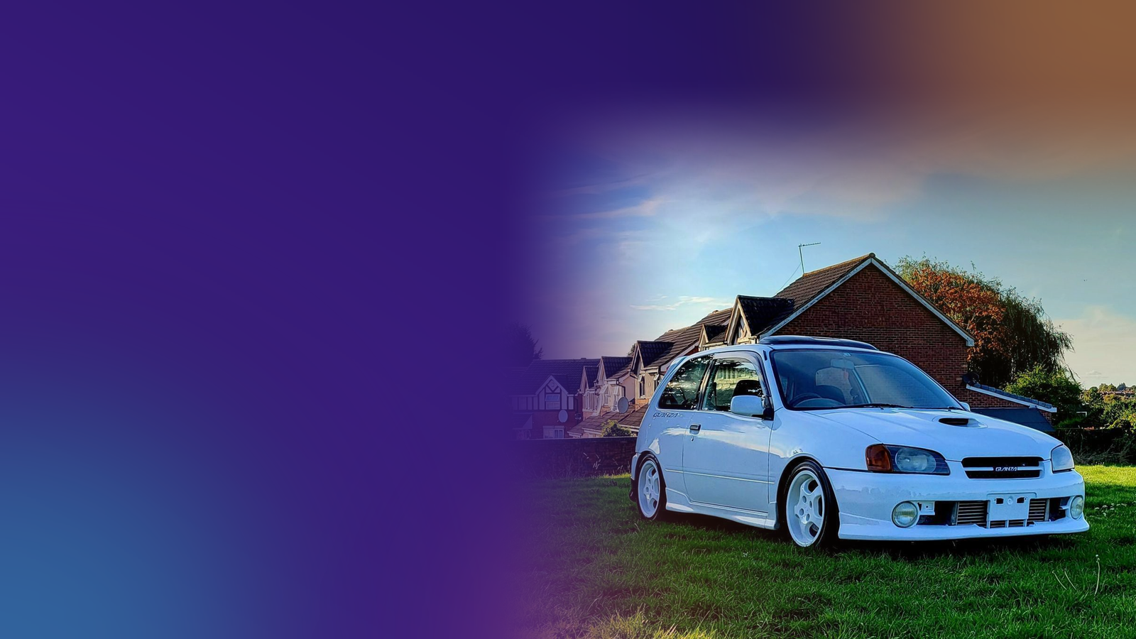
Thank you
Three things to remember
Age and equipment drive most of a used car's price
Our estimator gives a price, a likely range and a fairness check
We show our doubt, because an honest range is more useful
Questions?
Nirodha
Wijerathna
Ranasinghe
Gunasekara
Notes:
Nirodha: To finish, three things to remember. First, used car prices follow patterns, and age and equipment matter most. Second, our estimator turns those patterns into a price, a range and a fairness check that anyone can use. Third, we show our doubt, because an honest range is more useful than a falsely precise number. Thank you for listening. We are happy to take your questions, and each of us can explain our own part of the work in more detail.

