Slide 1



VISVESVARAYA TECHNOLOGICAL UNIVERSITY
“Jnana Sangama”, Belagavi, Karnataka - 590018
VIII SEM – Electrical & Electronics Engineering
INTERNSHIP PROJECT WORK
REGIONAL WEATHER MONITORING SYSTEM
By
NIROOP C NAIK
USN: 1RN17EE024
2021 Batch
Under the Guidance of
Mr. Jeejesh Kumar
Senior Applications Engineer
VI Solutions
Under the Guidance of
Mrs. Shwetha
Assistant Professor
RNS Institute of Technology
DEPARTMENT OF ELECTRICAL AND ELECTRONICS ENGINEERING
RNS INSTITUTE OF TECHNOLOGY
Channasandra, Dr. Vishnuvardhan Road, Bengaluru – 560 098

Slide 2

ABOUT VI SOLUTIONS
VI Solutions is one of the leading companies in building Advanced Communication Systems, Real Time Embedded Systems and other Industrial Automation services for applications in Department of Defense, Aerospace and Educational Institutions.
As an engineering company, it is known for it’s expertise in automated assembly lines, process automation, data acquisition and visual inspection.
VI Solutions is one of the leading companies in building Advanced Communication Systems, Real Time Embedded Systems and other Industrial Automation services for applications in Department of Defense, Aerospace and Educational Institutions.

Slide 3
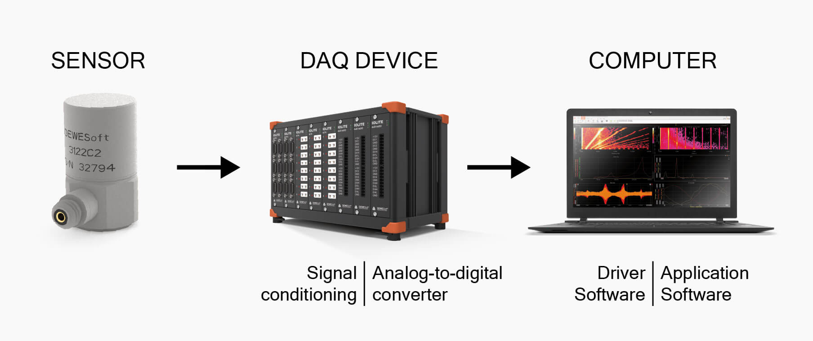
Introduction
Data Acquisition – Industrial Internet of Things
Data Acquisition, commonly abbreviated as either DAQ or DAS, we are referring to the process of making measurements of physical phenomena and recording them in some fashion in order to analyze them.
What Does a DAQ System Measure?
Data acquisition systems are principally in the business of measuring physical phenomena such as:
*Temperature *Voltage *Current *Strain and Pressure *Shock and Vibration
*Distance and Displacement *Weight *RPM, Angle, and Discrete Events

Slide 4
The Purposes of Data Acquisition
The primary purpose of a data acquisition system is to acquire and store the data. But they are also intended to provide real-time and post-recording visualization and analysis of the data.
A recent innovation is the combination of data acquisition and control, where a DAQ system is connected tightly and synchronized with a real-time control system.
Engineers in different applications have various requirements, of course, but these key capabilities are present in varying proportion:
Data recording
Data storing
Real-time data visualization
Post-recording data review
Data analysis using various mathematical and statistical calculations
Report generation

Slide 5
Abstract
Regional Weather Monitoring project was carried out using LabVIEW software which is used for data acquisition, instrument control and for industrial automation and is a graphical development environment.
Data is acquired from the web using an API (Application Program Interface). Open Weather Map API is used in this project to acquire data from the server using HTTP Client GET Method.

Slide 6
Objective
The main objective of this project is for the end-user to access weather data easily.
Other objectives include
Designing an effective Weather Data Acquisition System.
Utilising data already present in the web directly using APIs.
Using a graphical development environment like LabVIEW to acquire data.

Slide 7
LabVIEW
LabVIEW is systems engineering software by National Instruments for applications that require test, measurement, and control with rapid access to hardware and data insights.
It is used for data acquisition, industrial automation, test automation, instrument control and embedded system design.
It is a graphical development environment.
Programming is done in a flow chart like method called graphical data flow.
Picking and placing elements from the component list makes it easy to program.

Slide 8
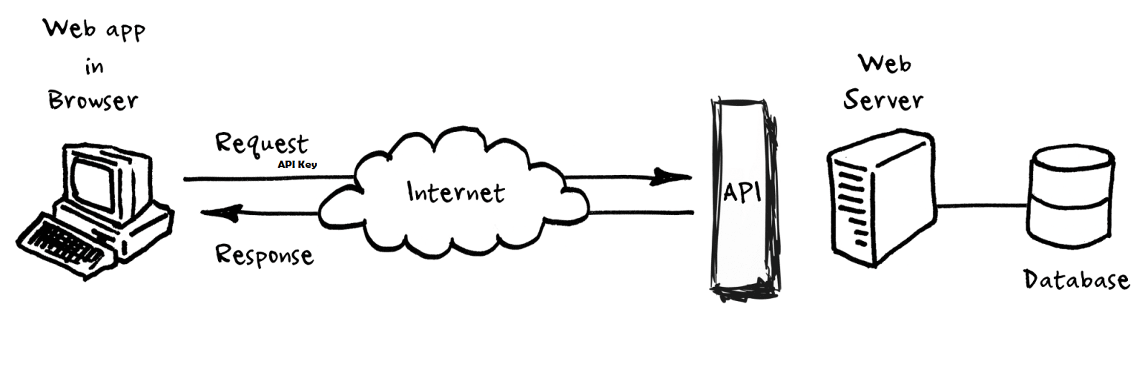
API Workflow
URL of API along with the API Key is sent to the server using GET Method from LabVIEW HTTP Client. An HTTP Client can be used to send requests and retrieve their responses)
If the API Key is valid, API server searches it’s database and sends back with the weather data of the region requested.

Slide 9
Overview
Data extracted from the openweathermap.org API is parsed (resolved).
All the outputs are connected to Graphical Meters.
Readings of Temperature, Humidity, Wind Speed, Wind Direction etc. are displayed on graphical meters.
Other outputs include information regarding Sky, Cloud Coverage, Visibility etc.

Slide 10
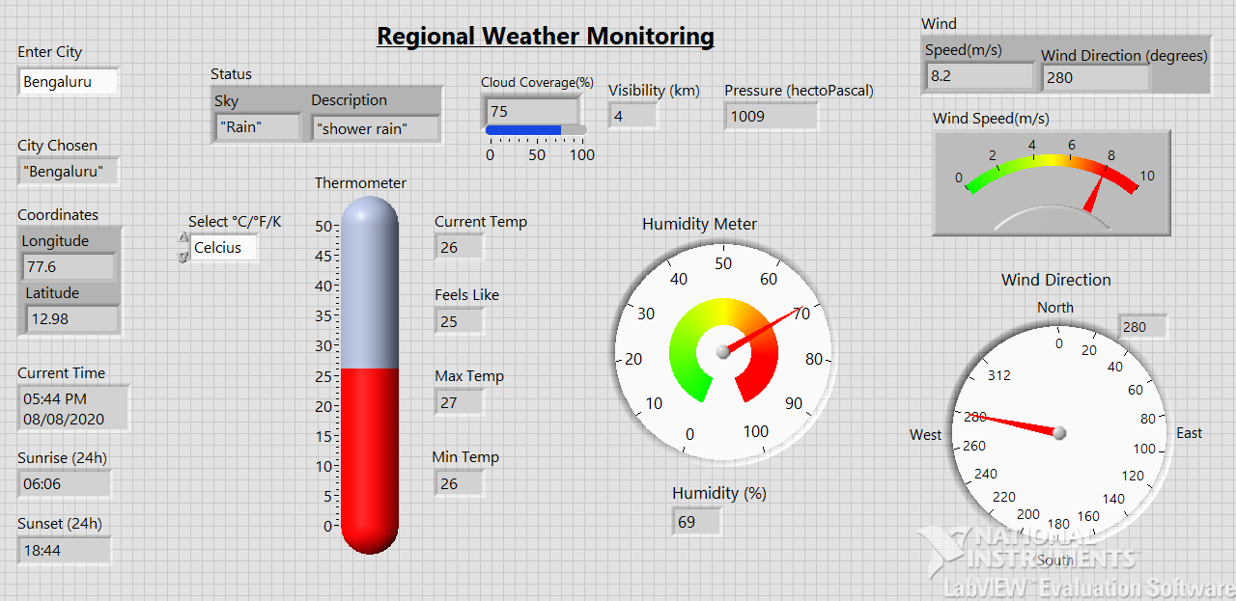
Front Panel: User Interface for easier readability

Slide 11
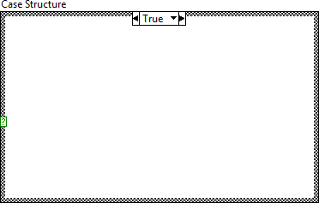
Case Structure
A Case structure has two or more subdiagram, or cases. Only one subdiagram is visible at a time, and the structure executes only one case at a time. An input value determines which subdiagram executes.
The Case structure is similar to switch statements or if...then...else statements in text-based programming languages. You must wire an integer, Boolean value, string, or enumerated type value to the selector terminal.
You can position the selector terminal anywhere on the left border of the Case structure. If the data type of the selector terminal is Boolean, the structure has a True case and a False case. If the selector terminal is an integer, string, or enumerated type value, the structure can have any number of cases.

Slide 12
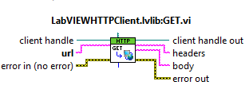
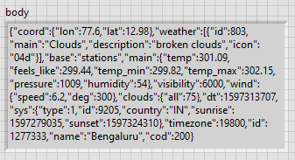
Work flow
1) A request is sent the server with API key using HTTP Client.
2) Raw data is obtained in form of JSON string
Not easily readable

Slide 13
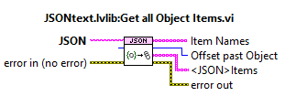
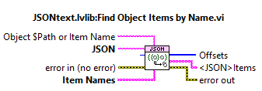
3) Data manipulation is done using pre-written graphical programs in LabVIEW.
4) Required data such as Temperature, Pressure, Humidity etc are extracted and are given to their respective graphical output meters.

Slide 14
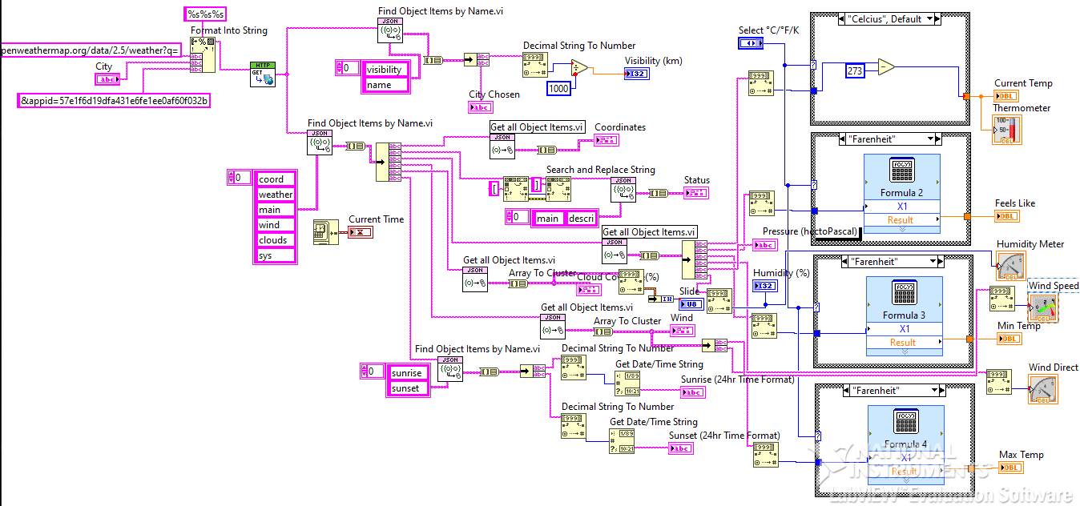
Graphical Program written for Data Manipulation to get required information

Slide 15
THANK YOU

