Slide 1
Final project "triPlan"
The Supervisor's name: Dr. Kfir Bar
The students' names:Nir Haviv, Batel Sasson, Naor Twig and Tamir Yardeni,.

Slide 2
Introduction
There are a lot of sites and blogs for sharing your experience and itinerary of a trip you have planned. Some people write a long story about what they have done and others can just write shortly some recommendations. In addition, some travel agencies publish their planning.
The data is not centralized,various and you have a lot of resources you can learn and read from.

Slide 3
The Need
In order to plan a trip, most people should read a lot of written data such as stories, recommendations, itineraries and choose what is right for them .In Addition,They probably open a map and calculate distances between sites and actually try to get the best trip you can achieve by the time you have. Some people also looking for best flights and hotels according their needs. To conclude – you need to work hard and spend a lot of time on planning a trip.

Slide 4
The Solution
The idea is to create an engine that will analyze a lot of texts about trips every day using a live streamer and with machine learning algorithm.
The algorithm will extract places from the text and will create structured data that presents shortly the itinerary of a trip.
We will let the user to choose by some parameters which kind of trip he is interested and offer him optional itineraries and display them on map .
By creating this engine we will achieve our goal of simplify the trip planning process by automate the reading phase which will be visualized in a comfortable map. A long text will be summarized to way points on map so we actually save a lot of time to our users.

Slide 5
The Academic Justification
The main feature of the app is build structured itineraries from a long text.
In order to do so, we must implement our knowledge in NLP and machine learning. We will need to collect huge amount of various data to train on, extract the information, use linguistics combined with machine learning in order to get better understanding of the words and sentences the writers use to describe their trip.

Slide 6
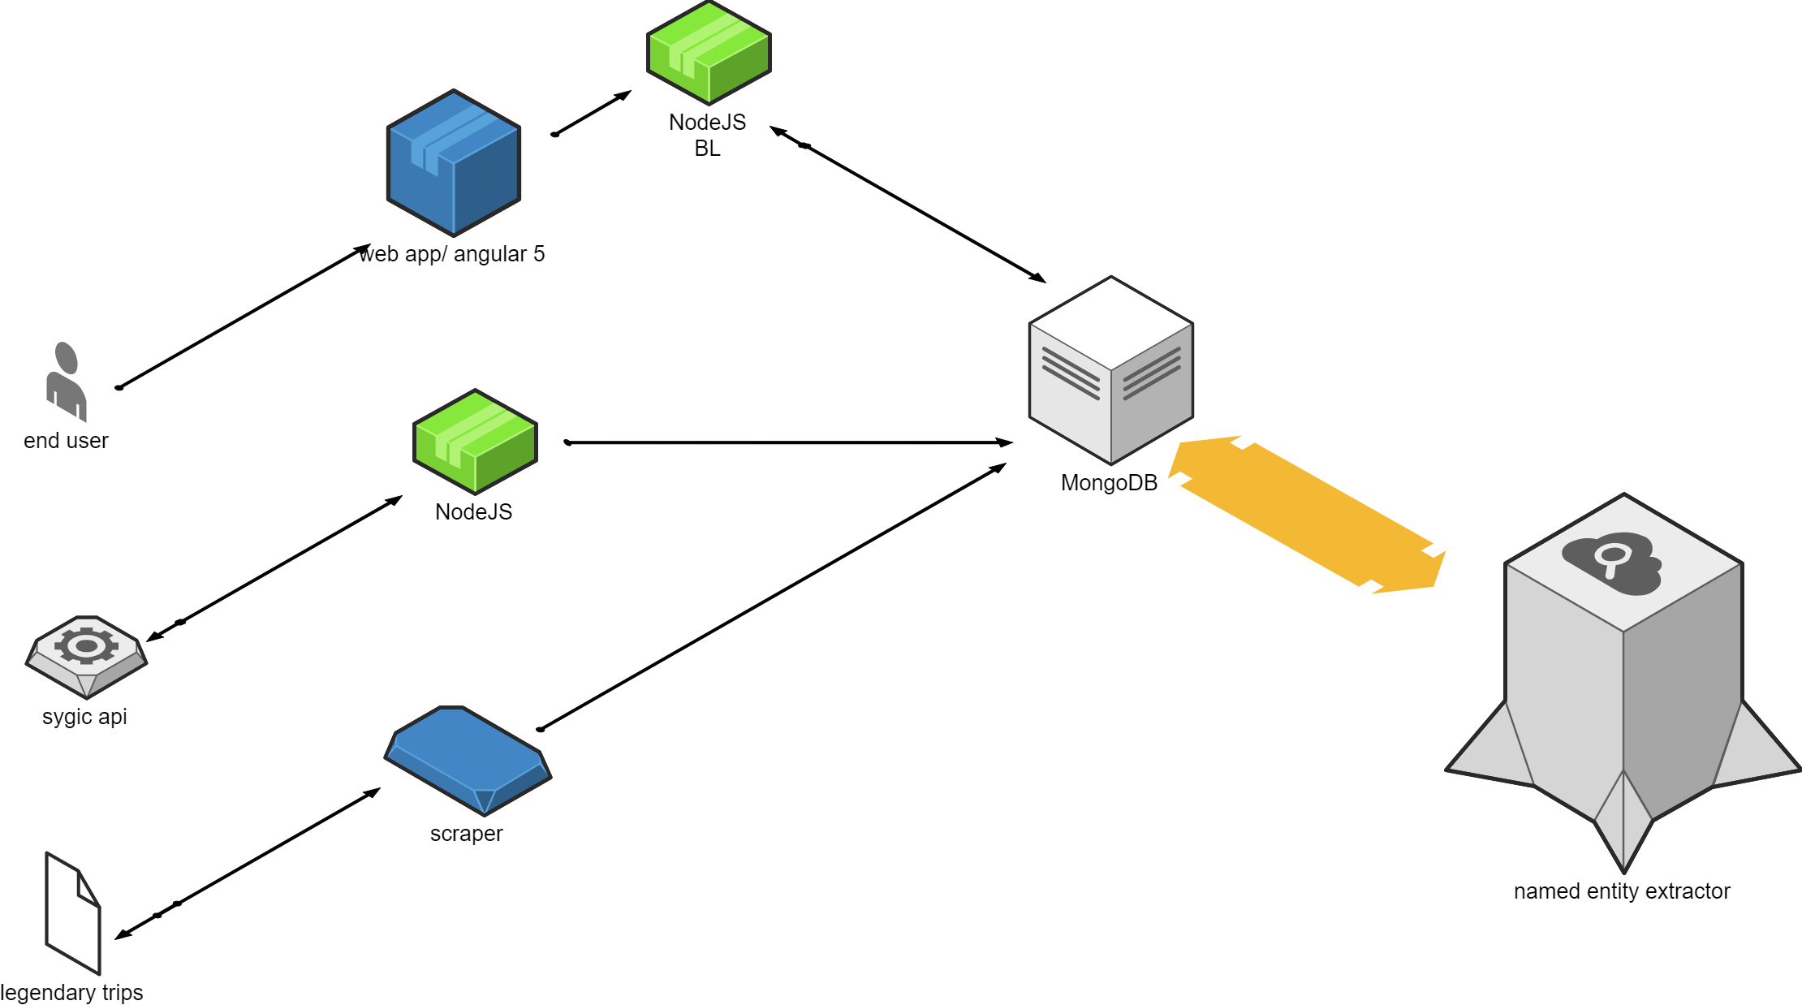
Architecture

Slide 7
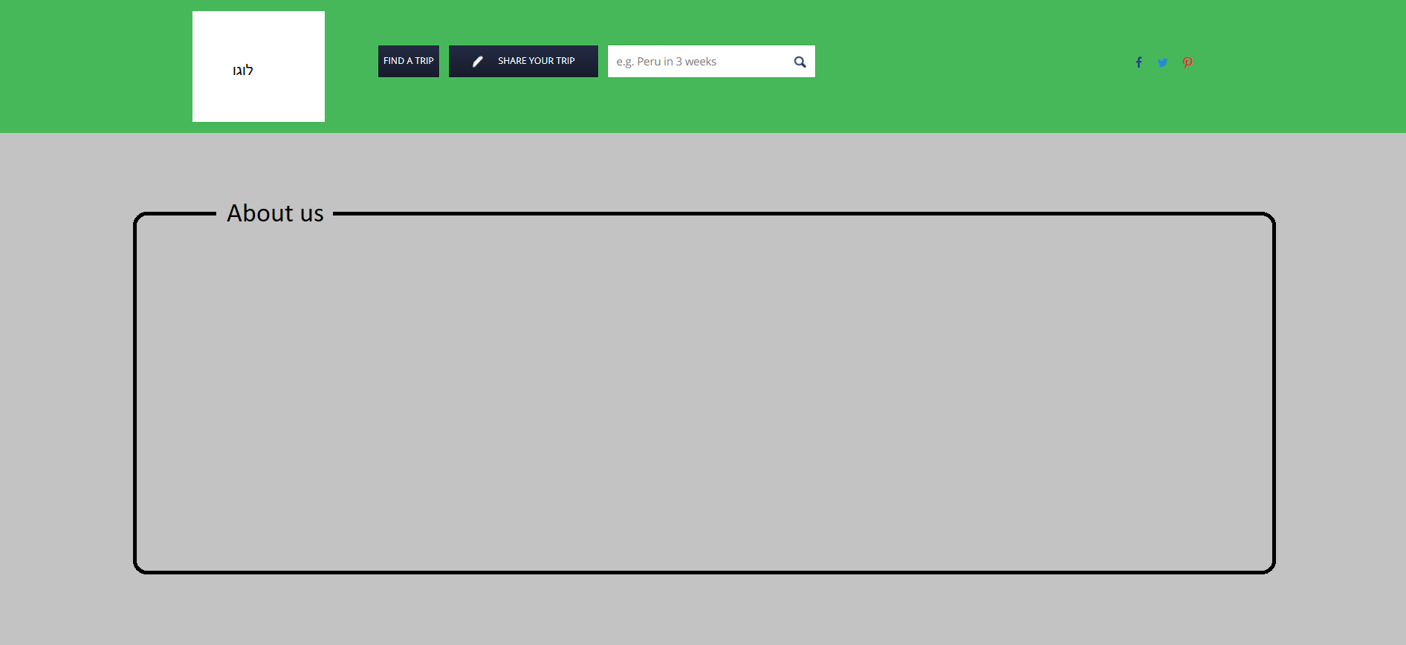
Main screen

Slide 8
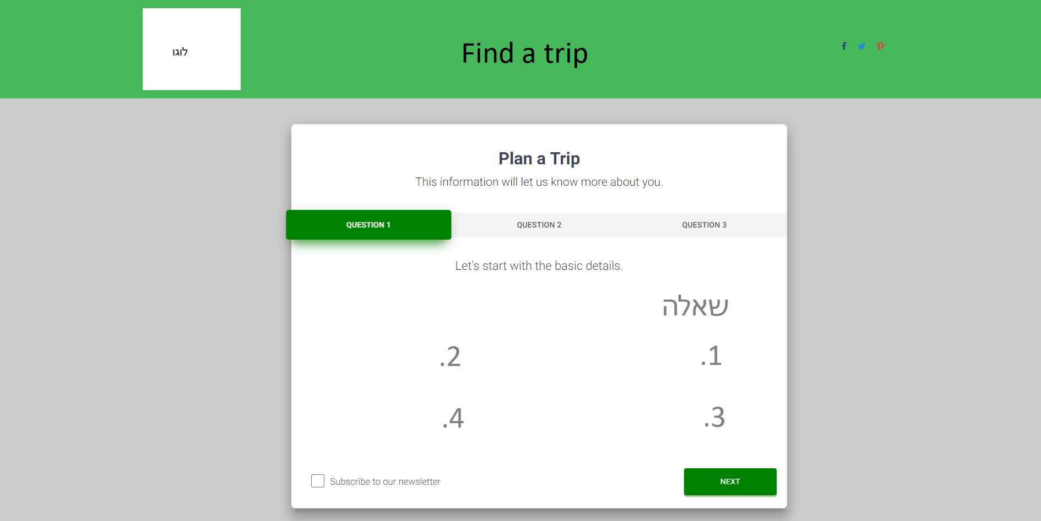
Find a trip screen

Slide 9
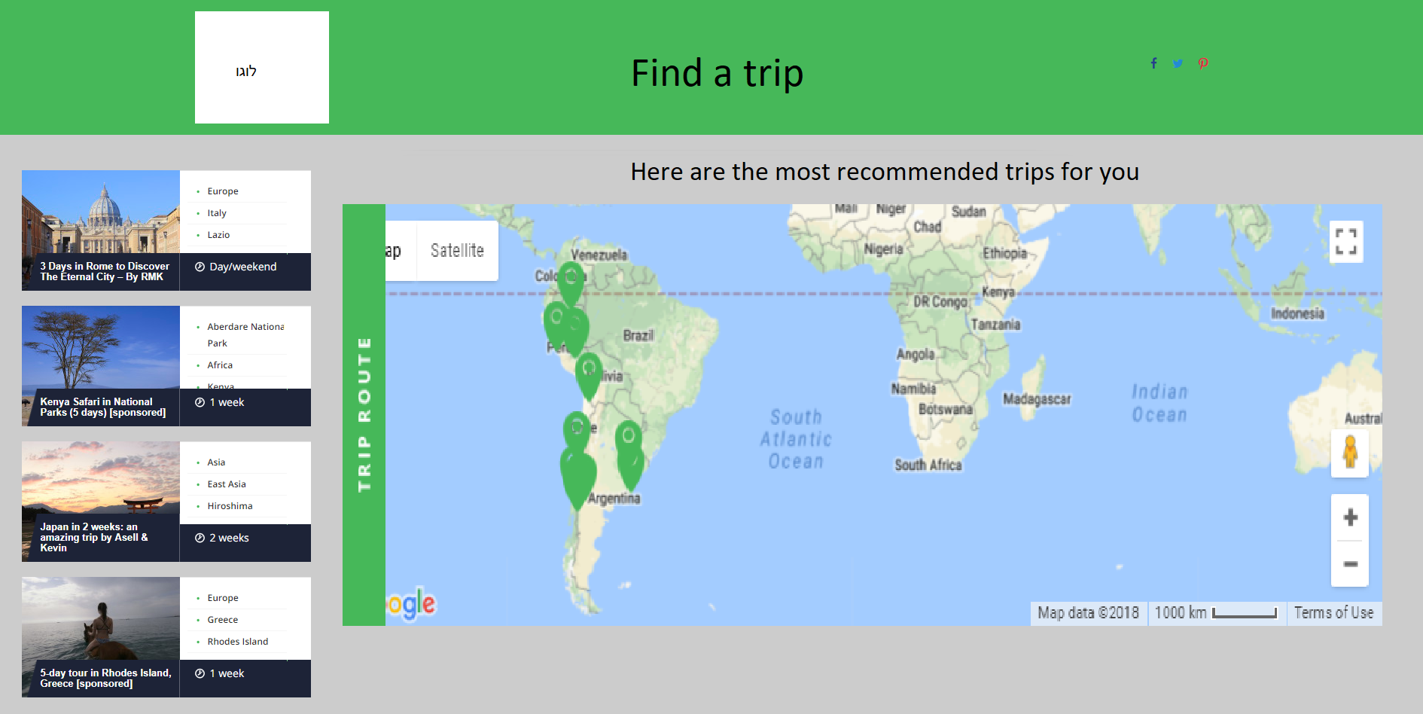
Results

Slide 10
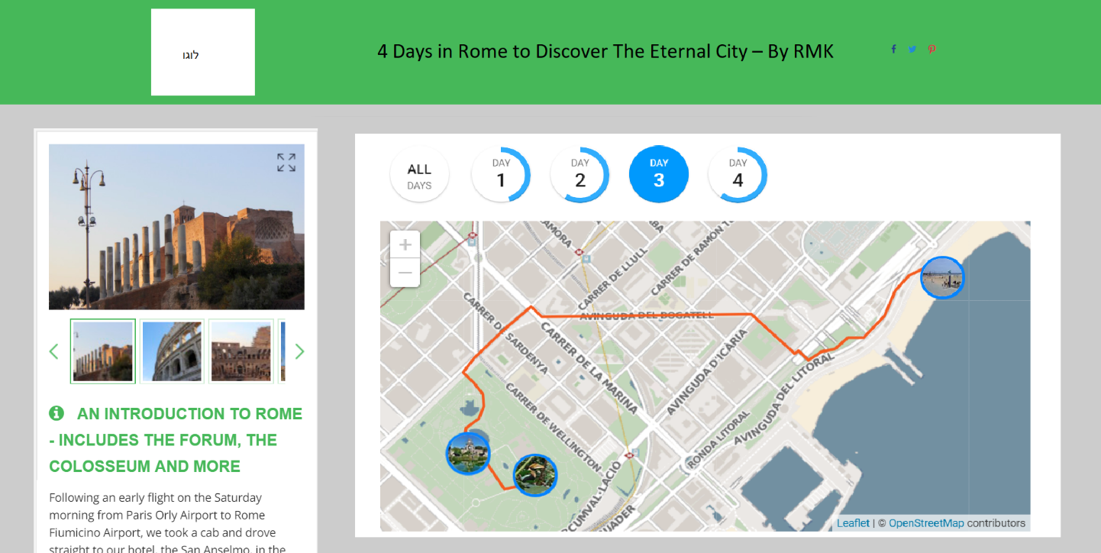
specific trip from results

Slide 11
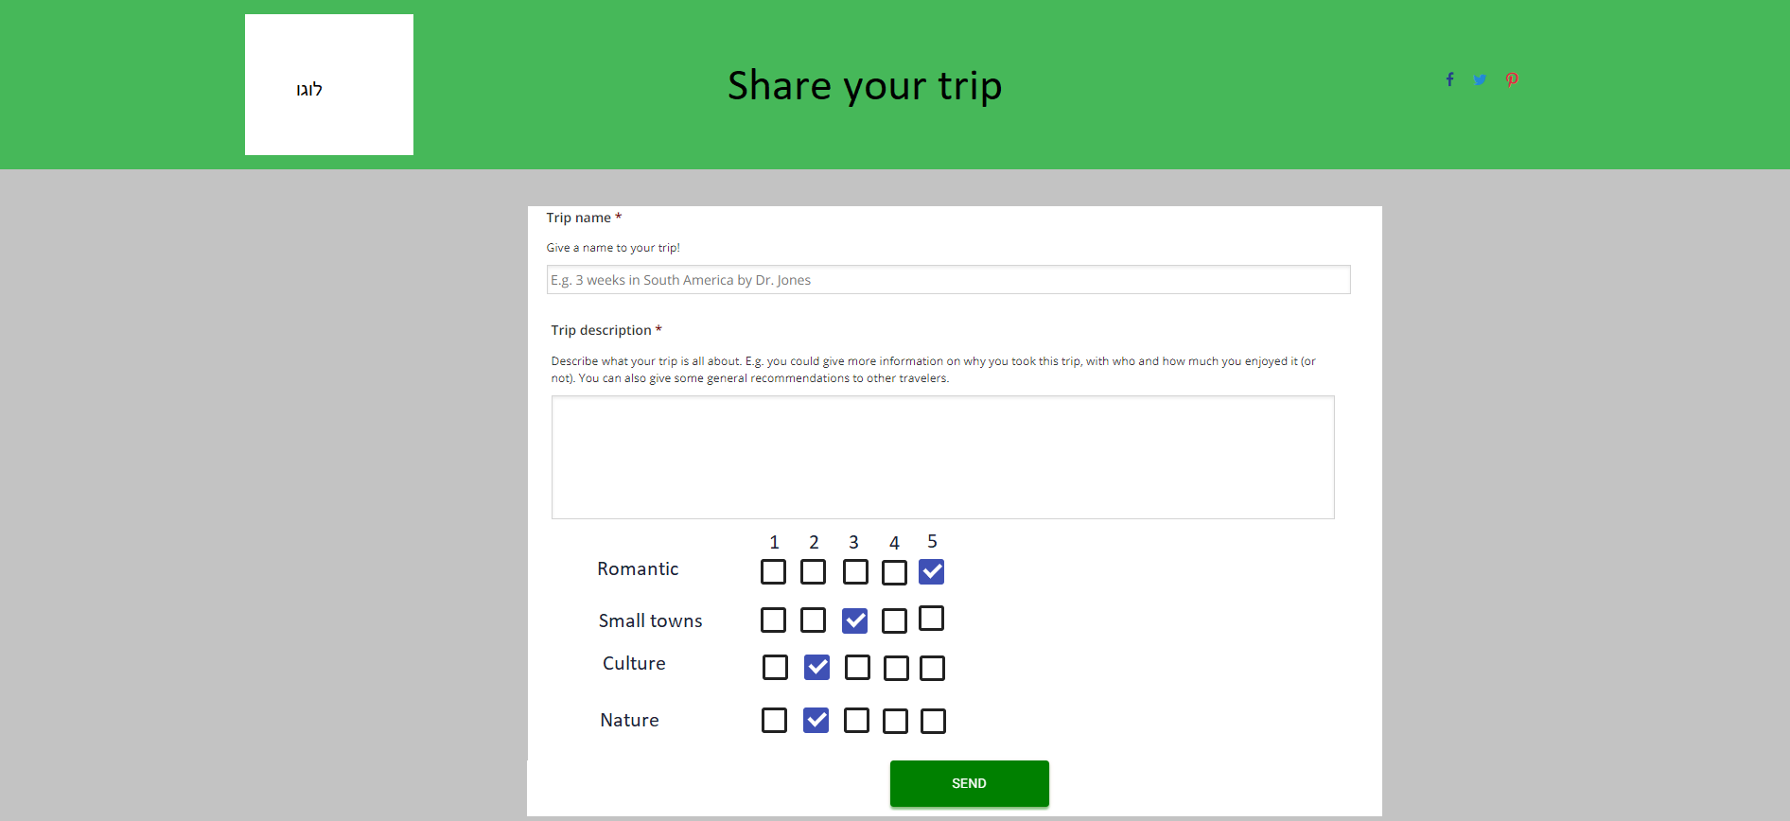
Add Your trip

Slide 12
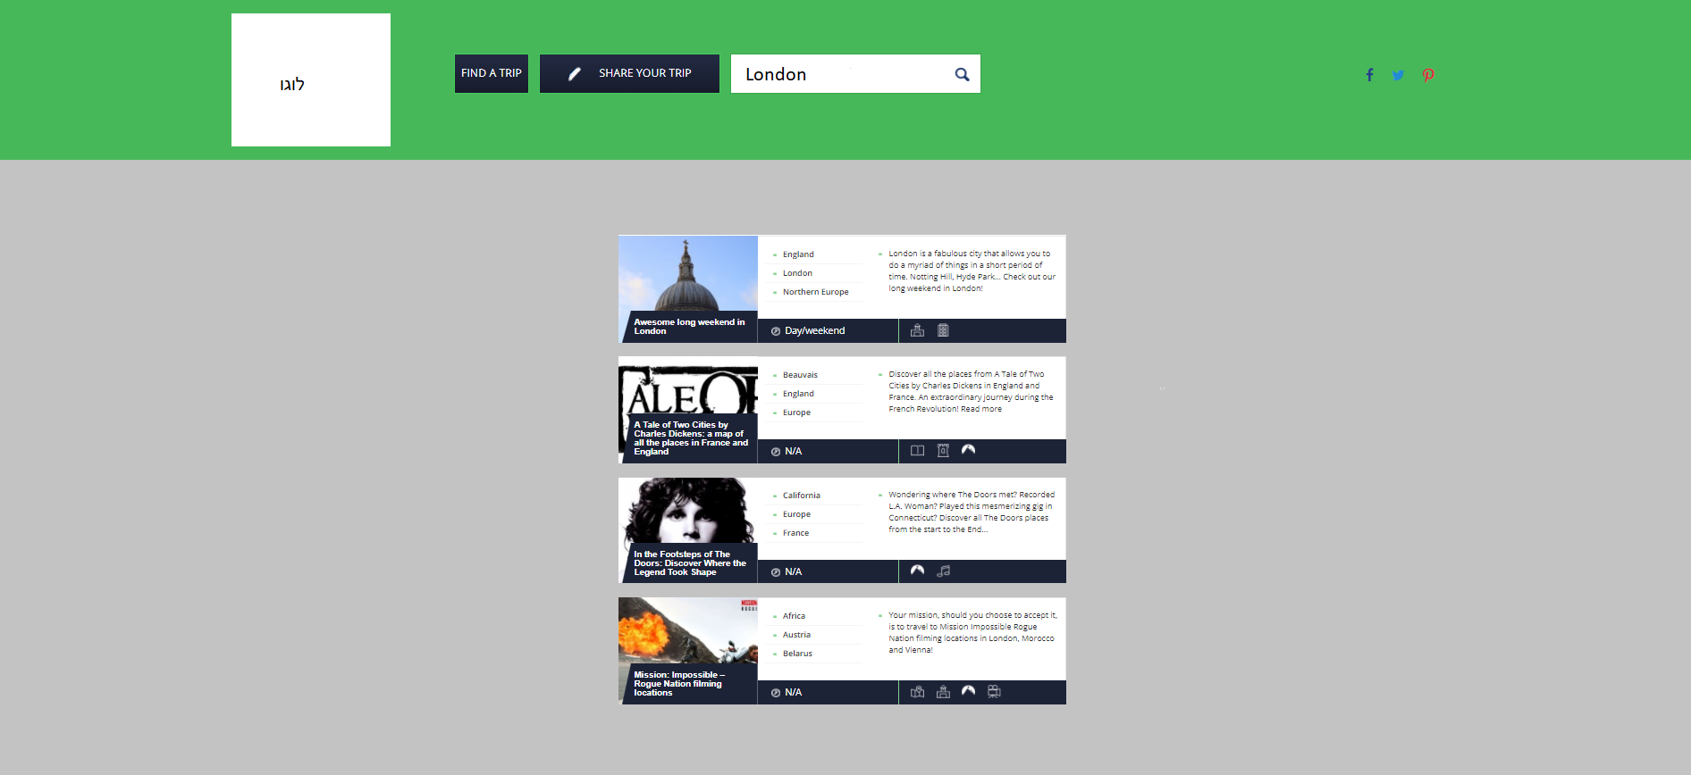
Search some trips by text only

Slide 13
The End

