Slide 1
Sisense R Integration
Nir Regev
Chief Data Scientist
Nir.Regev@sisense.com
June, 6th

Slide 2
Installation Instructions Step By Step
Save all files to c:/citybike
Install R https://cran.r-project.org/mirrors.html
Install Rstudio https://www.rstudio.com/products/rstudio/download/
Open Rstudio and:
install.packages("Rserve")
library(Rserve)
Test R connection in console/edit server preferences
Attach cube ecdata citibike.ecdata
Import dashboard NYCConnectTemplate.dash

Slide 3
Agenda
R and Data Science
Frontend R usage
Backend Elastic cube usage (RODBC)
Hands-On case study
NYC citibike project
Predict bicycle demand

Slide 4
List of prerequisites and installations
Basic statistical knowledge and programming experience
Install R recent version
Install Rstudio development environment recent version
Install Sisense
Establish Connection To R Server:
https://support.sisense.com/hc/en-us/articles/230652908-Connecting-Sisense-to-R-Server
Workshop cube, dashboards and R script (will be handed by me prior to workshop)
You’re good to go

Slide 5
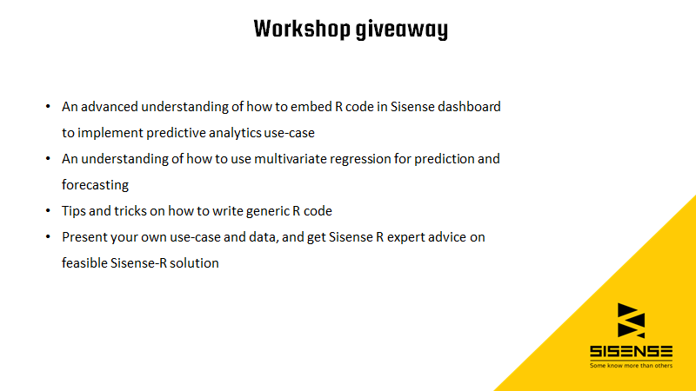

Slide 6
R/Data Science short survey
Please raise your hand if you ever developed in R
Please raise your hand if you ever developed in any statistical scripting environment (R, python, Matlab…)
Please raise your hand if you’re familiar with some Data Science common practices (data exploration, supervised/unsupervised learning, training\fitting a model, validation/testing….)
Please raise your hand if you have data scientists in your organization (or if you are one)
Notes:
Disclaimer: This talk might get techy with some R code snippets and some data science terminology

Slide 7




What is R?
R is an extremely rich open source interpreted programming language for statistics, data science and visualization
Over 5000 CRAN packages and many more community packages
It is widely used in many fields and organizations
Rich documentation,
many tutorials and online courses
Notes:
CRAN – Comprehensive R Archive Network
Facebook: EDA, Big Data Visualization, user behavior analysis related to status updates
Google: Advertising effectiveness, Economic Forecasting and Big Data statistical modeling
Twitter: Data Visualization and Semantic Clustering
Microsoft: Xbox recommendation system for matchmaking

Slide 8

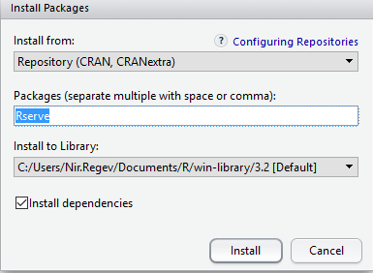
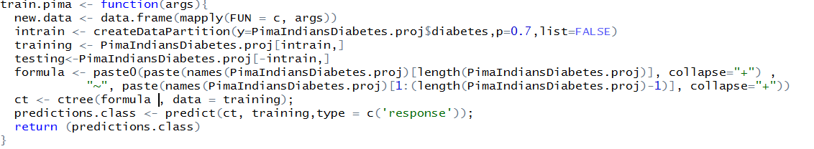
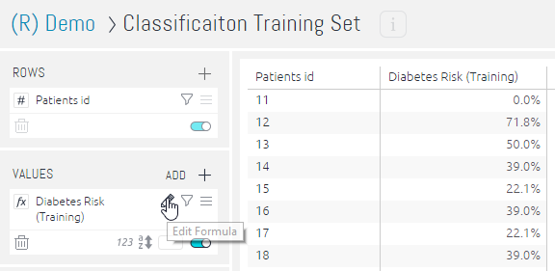
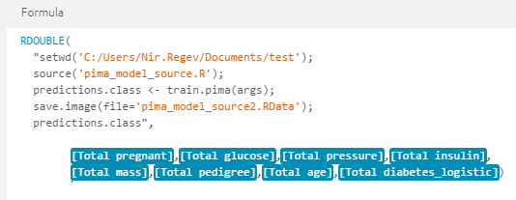
Basic Frontend R Code Integration Use-Case
1. Setup R Server
2. Install and load Rserve()
3. Develop R Script
4. Create a widget
5. Develop advanced formula
Next
Notes:
Currently, the CRAN package repository features 8330 available packages.

Slide 9
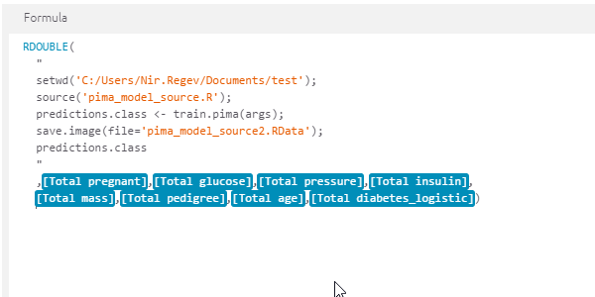
What’s in a formula
Calling R script (‘source’) – the neat and reuse approach
R code
args (widget data sent to R)
Back
Notes:
http://localhost:8081/app/main#/dashboards/571f4a00437ddafc2e00000c/widgets/571f9284437ddafc2e000030

Slide 10
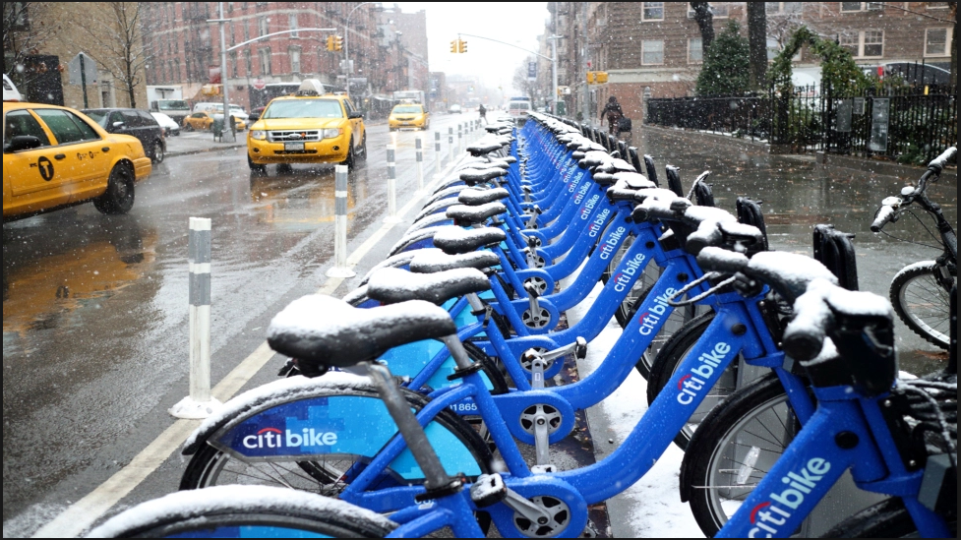
Use Case – Predict NYC city bike demand at a given date

Slide 11
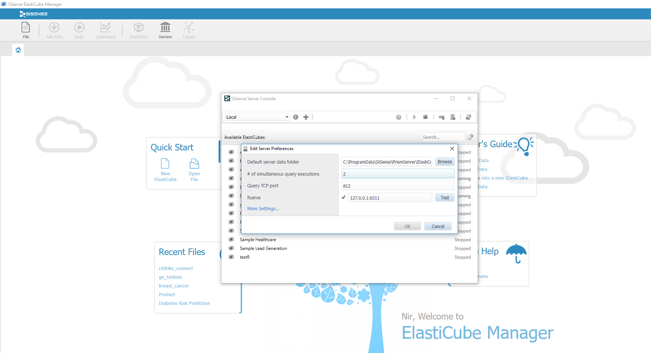
First things first (1)
Did you install R and Rstudio ?
If yes – make sure you have a valid connection

Slide 12
First things first (2)
Save the following files into c:/citybike
citibike.ecdata
NYCConnectTemplate.dash
lrmodel.R
citibike.csv
args

Slide 13
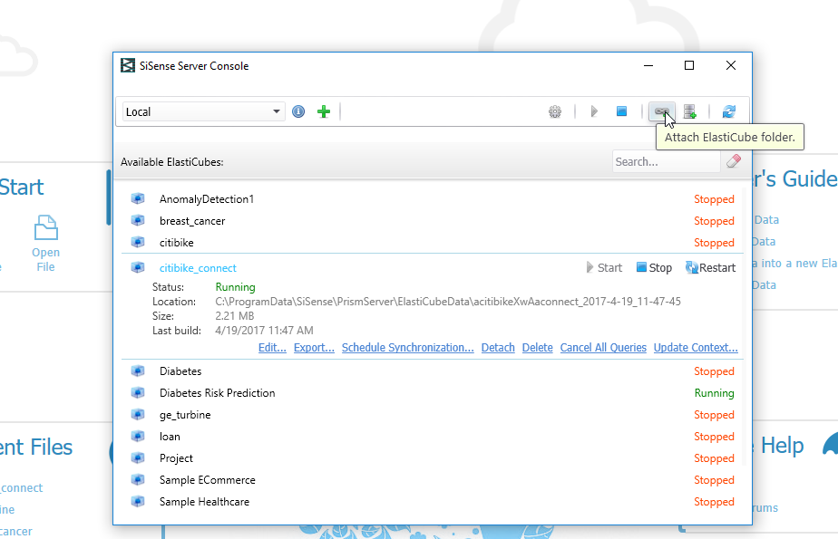
First things first (3)
Install and load RServe package
install.packages("Rserve“)
library(Rserve)
Attach the elastic cube so we’ll have data

Slide 14
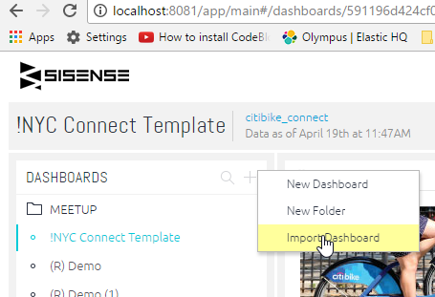
First things first (4)
Import a dashboard template I’ve prepared for you (NYCConnectTemplate.dash)
Press here

Slide 15
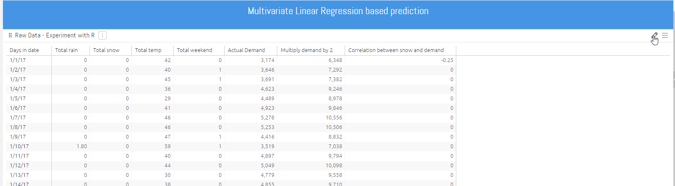
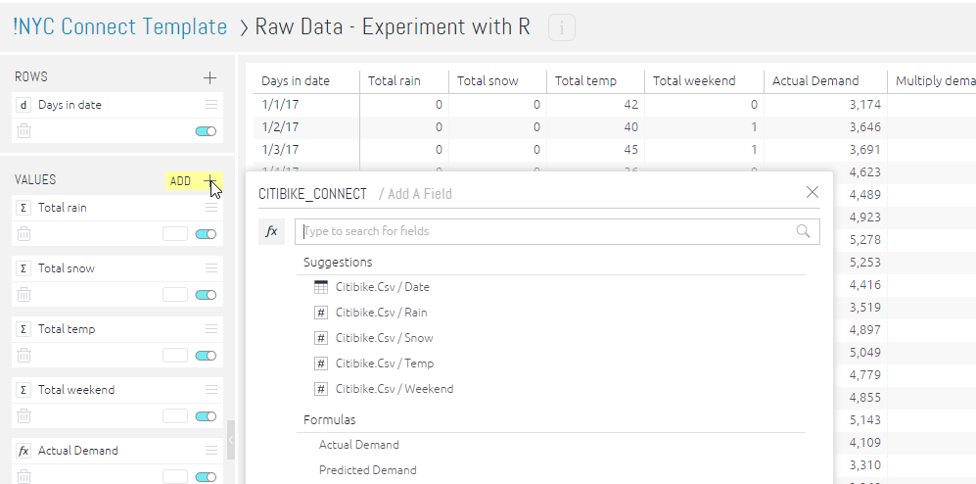
(1) Write your first Sisense R code
Go into the pivot widget
Add a new ‘Values’ formula
Press here

Slide 16
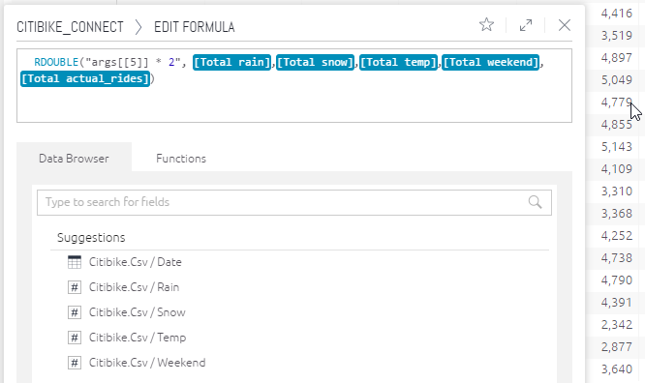
(1) Write your first Sisense R code
Write a formula that will multiply the demand (actual rides) by 2

Slide 17
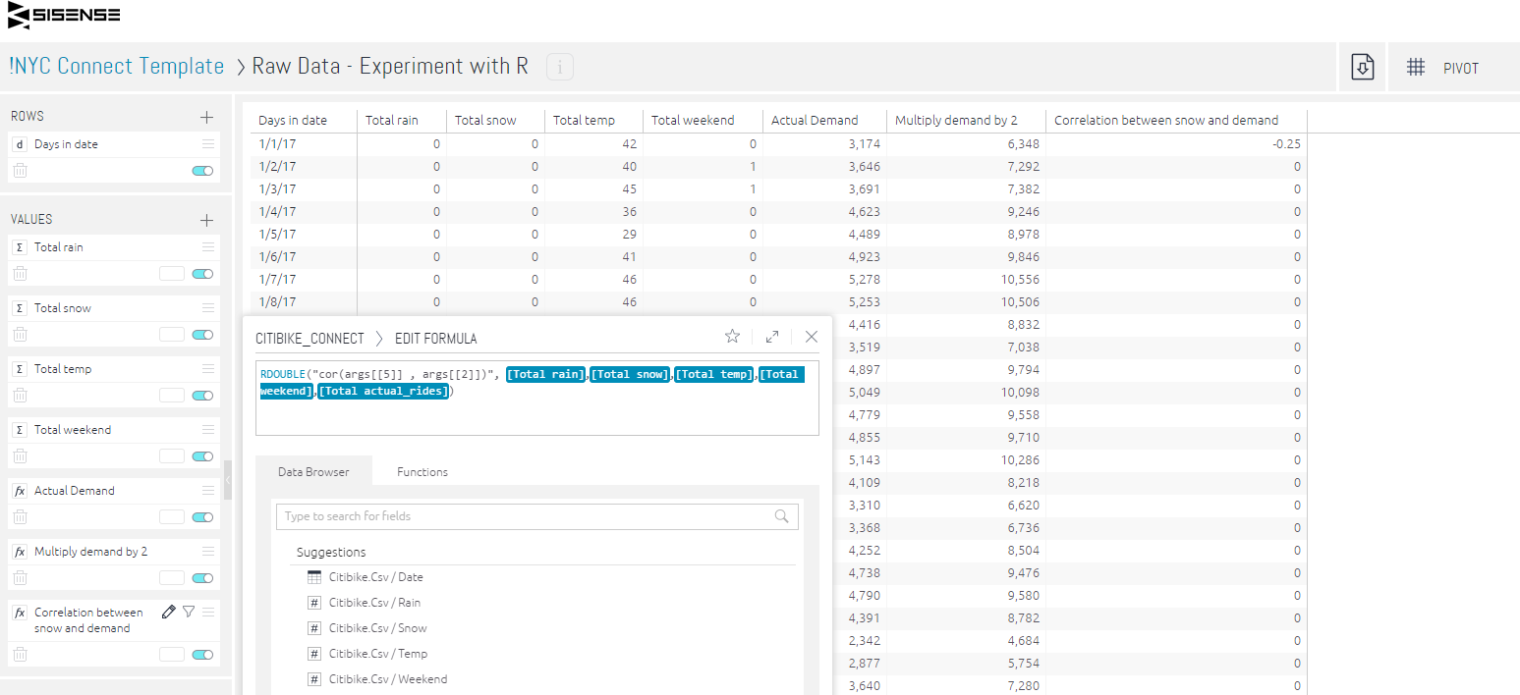
(2) Write your second Sisense R code
Write a formula that will calculate the correlation between snow and actual rides

Slide 18
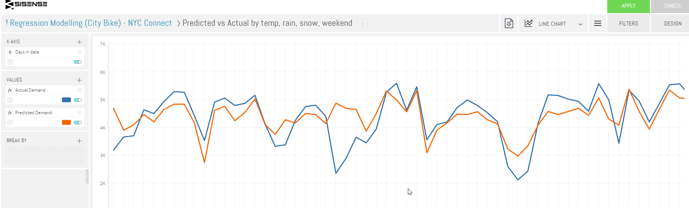
Call an R script for Predicting bike demand (1)
Save my script @ c:/citybike
Create a new line chart widget
Add the field date to X-AXIS
Add the field [Total actual_rides] and name it Actual Demand
Add a new VALUES formula…

Slide 19
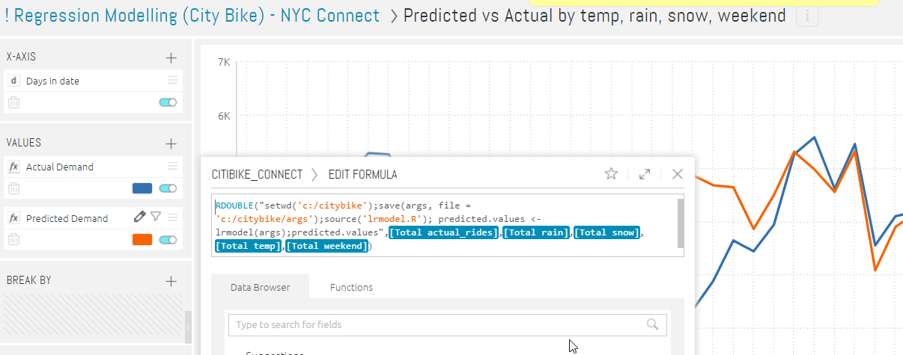
Call an R script for Predicting bike demand (2)
In the R code section surrounded by double quotes, statements separated by semi-column:
Set working directory to c:/citybike (if path doesn’t exist, create it)
Save the Sisense data into a file (for debugging purposes)
Load (source) the R script containing the forecasting/prediction model
Call the R script function ‘lrmodel’ with args (Data) and return the values into a new variable names ‘predicted.values’
Return to Sisense widget formula the ‘predicted.values’
1
2
5
3
4

Slide 20
Q&A

Slide 21
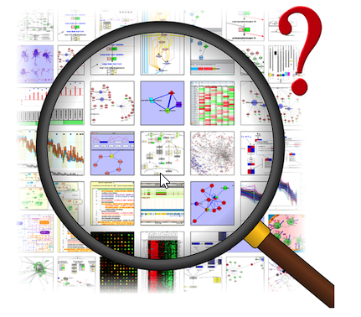
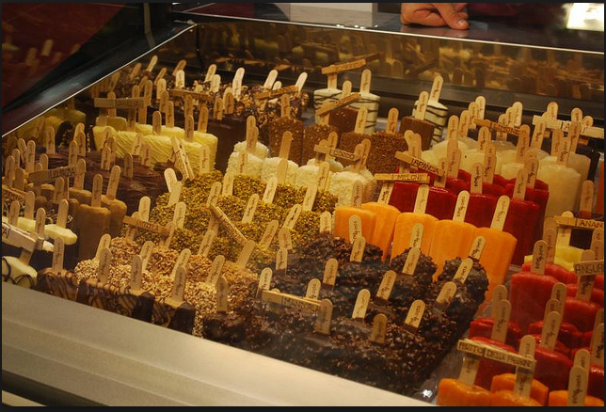
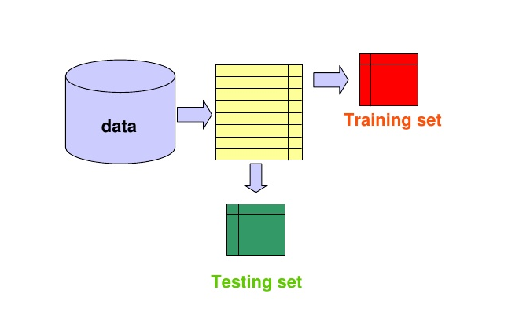

Typical Data Science Process
Data Exploration
Feature Selection (GLM)
Fit a model and test on new data
Predict

Slide 22
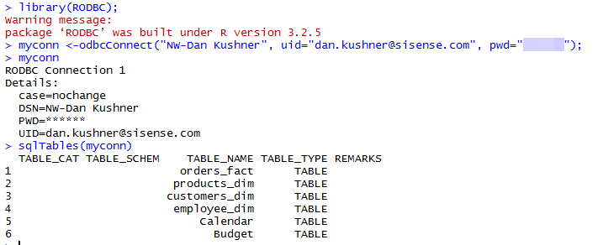
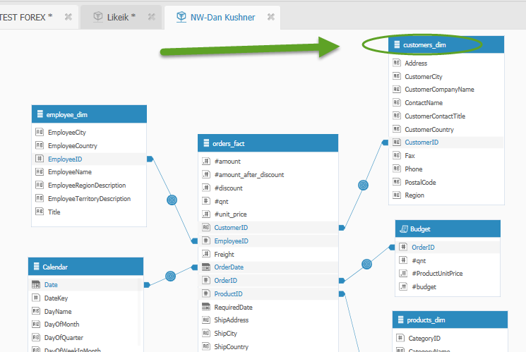

Sisense R Integration – Backend usage
R Console:
Notes:
http://www.sisense.com/documentation/sisense-odbc/

Slide 23
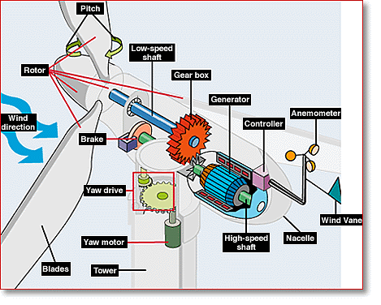
Wind Turbine Recurrent Failures Prediction

Slide 24
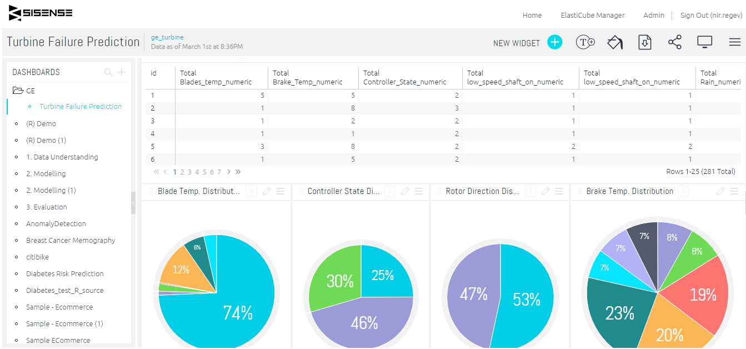
Use Sisense to Discover, Explore, Analyze and Predict

Slide 25
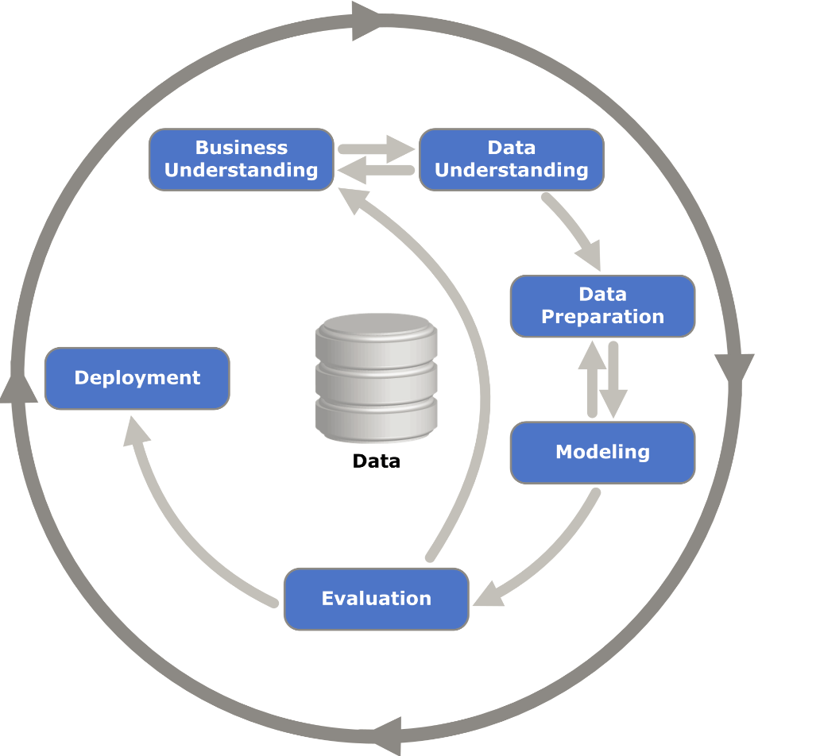
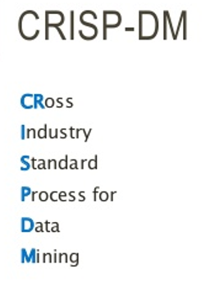
Data Mining Process Model
> 80%
Notes:
Business Understanding: understanding the project goals and requirements from a business point of view, transform this knowledge into a data mining problem definition and a detailed plan to achieve these goals
Data Understanding: we get samples of data extracts representing the business processes mapped in the previous step, get to know the data scheme, map data sources and how they connect, carry out basic exploratory data analysis : includes descriptive statistics, analysis of how variables are distributed, visualize, build correlation matrix, covariance matrix)
Data preparation: data cleansing (e.g., filtering out inconsistent data records), missing values, outlier detection, perform feature selection process: Select variables\features that have high predictive power with regarding to the target\outcome variable (what you want to classify or predict), you might want to extract new features by aggregating data, joining data from multiple sources, perform data manipulations (diff dates, scaling/normalizing, discretizing, arithmetic operation (Log, Exp)
Modeling: Build, train and fit models (linear regression, logistics regression, decision tree, neural network) to the data using the variables built on the preparation phase. Validate and testing the model from a data science point of view (confusion matrix, ROC, precision, recall, R squared)
Evaluation: Try, together with the project business owner and stake holders, to evaluate if the data mining model tackles all business aspects of the problem.
Deployment: Take the required step to transform the data mining models results into effective decision and actions in the organization business processes

