Slide 1
Religious
Language

Slide 2
The question of religious language
This unit is concerned with the question of whether religious language and propositions makes, or attempts to make, objective claims about the world. In other words whether it attempts to express truths about state of affairs, and is therefore cognitive.
OR
Whether religious language is not trying to express objective truths about the world, and is therefore an expression of attitude or worldview, that is non-cognitive.

Slide 3
Table of theories
Non-cognitive Theories | Cognitive Theories
Logical Positivism – A.J.Ayer Falsification – Karl Popper- Anthony Flew R.M.Hare | Basil Mitchell

Slide 4
Logical positivism (1)
Key Thesis: Logical positivism is a non-cognitivist theory of religious language. Logical positivism is the theory that claims that a proposition must pass the principle of verification, in order to count as cognitive. If a proposition does not pass the principle of verification then it is non-cognitive. According to Ayer, non-cognitive propositions are not significant.
The principle of verification claims that there are only two categories of propositions that count as cognitive, i.e that make claims about the objective world.

Slide 5
Logical positivism (2)
The principle of verification claims that there are only two categories of propositions that count as cognitive, i.e that make claims about the objective world.
1. Empirical claims – these are claims about the world, that can be verified or not.
2. Analytic claims – These are claims about the ideas and how they are related to each other. They can be verified or not, without recourse to sense experience.

Slide 6
Logical positivism (2)
‘The criterion which we use to test the genuineness of apparent statements of fact is the criterion of verifiability. We say that a criterion of factually significant to any given person, if and only if, he knows how to verify the proposition he purports to express – that is, if he knows what observations would lead him, under certain conditions, to accept the proposition as being true, or rejecting it as being false. If on the other hand, the putative proposition is of such a character that the assumption of its truth, or falsehood is consistent with any assumptions whatsoever concerning the nature of future experiences…it is a mere pseudo-proposition. The sentence expressing it may be emotionally significant to him; but it is not literally significant. And with regard to the question the procedure is the same.’
A.J.Ayer ‘Language, Truth and Logic.’ 1936

Slide 7
The argument of logical positivism
1. The principle of verification limits cognitive propositions to those that are either empirical or analytic.
2. ‘God exists’ is not an analytic proposition.
3. ‘God exists’ is not an empirical proposition.
4. Therefore, the proposition that ‘God exists’ is not cognitive.

Slide 8
The objections to the principle of verification.
1. The principle of verification means that we would need to abandon not only religious language, but historical and moral language also.
2. The broader principle allows religion in through the back door.
3. ‘Eschatological verification’ might make religious language meaningful, consistent with logical positivism.
4. The principle of verification does not pass its own test of verification.

Slide 9
Problem (1)
As the principle of verification stands it would not consider the following statement cognitive and therefore it would render it not significant.
‘King Harold was killed with an arrow to the eye in the battle of Hastings’
This proposition is disputed and there is no way we could now see the battle, or know analytically whether it is true. Therefore, it is not meaningful.
This is clearly an absurd conclusion, because we know, precisely what it means. We would be forced to abandon study of history and many other areas of knowledge if we kept to the principle of verification as it was formulated by Ayer.

Slide 10
Problem (1) continued
‘Accordingly, we fall back to the weaker principle of verification. We say that the question that must be asked about any putative statement of fact is not, ‘Would any observations make its truth or falsehood logically certain?’ But simply, ‘would any observations be relevant to the determination of its truth or falsehood? And it is only is a negative answer is given to this second question that we conclude that the statement under consideration is nonsensical’. A.J.Ayer 1936

Slide 11
Problem (2)
The weaker principle of verification claims that we should be able to verify in principle a particular proposition. So, for example, even if we cannot travel back in time to know how Harold was killed, if we found his body, and had DNA evidence that it was him, and that he died with an arrow to the eye, that would mean, that the best evidence available to use is that he died with an arrow to the eye.
The problem with this weaker principle is that it allows once religious claims to pass the principle of verification. There is every reason to count the design argument as evidence for the existence of an intelligent being.

Slide 12
Problem (3)
John Hick claims that we can make sense of the idea of eschatological verification. This is verification that would happen at the end of one’s life, in the resurrection or at the end of time.
Hick’s theory makes the claim that although some propositions cannot be verified now, they can be verified at some future date, and if this is so, those propositions can be rendered meaningful. For example, I cannot know now, that there is a city, at the end of a long desert road, but that can be verified in the future.
This could allow for the idea of the verification of the existence of God in the future, leaving open the idea that claims about God’s existence are in fact meaningful.

Slide 13
Problem 4
The key problem for the logical positivists is that the principle of verification is not itself an analytic or a synthetic claim. If that is the case, then it does not pass its own test of verifiability and so is not significant.
Ayer responds that he wants the principle of verification to act as his criterion of meaningful, and not as a hypothesis of what is meaningful.
’Thus, while I wish the principle of verification itself to be regarded, not as an empirical hypothesis, but as a definition, it is not entirely arbitrary’.

Slide 14
Problem (4) continued
The problem is that we are under no obligation to accept this definition of meaningful, and we can reject it, in order to, adopt a number of other definitions of meaningful.

Slide 15
The falsification principle
The thesis of falsification: This thesis claims that a proposition is falsifiable if there is a set of other propositions with which it was inconsistent. It makes the very basic claim, that for a proposition to have import, i.e. to be a proposition, it must logically rule out certain possibilities.

Slide 16
Falsification continued
For example, if we consider the claim that ‘planets move around the sun in an elliptical orbit’, then we are saying that ‘planets do not move around the sun, in a rectilinear orbit.’ In other words, we are ruling out a set of possible experiences. This is what means that the proposition has import, it is significant and thus expresses a hypothesis. If there was no thing that ruled it out, it would not be a scientific proposition.

Slide 17
Propositions
If I say ‘that planets move around the sun in an elliptical fashion’ this logically implies that ‘they do not move around the sun in another way.

Slide 18
The Parable of the gardener
‘Once upon a time two explorers came across a clearing in the jungle. In the clearing where, growing many flowers and many weeds. One explorer says, ‘some gardener must tend this plot’ The others disagrees, ‘there is no gardener’. So, they pitch their tents and set a watch. No gardener is ever seen. ‘But perhaps he is an invisible gardener.’ So, they set up a barbed wire fence. They electrify it. They patrol with bloodhounds. (For they remember how H.G.Wells’s The Invisible Man could be both be smelt and touched although he could not be seen.) But no shrieks ever suggest that some intruder has received a shock. No movements of movements of the wire ever betray and invisible climber. The bloodhounds never give a cry. Yet still the Believer is not convinced. ‘But there is a gardener, invisible, intangible, insensible to electric shocks, a gardener who has no sent and who makes no sound, a gardener who comes secretly to look after the garden which he loves. At last, the Sceptic despairs, ‘But what remains of your original assertion? Just how does what you call an invisible gardener differ from an imaginary gardener or even from no gardener at all?’

Slide 19
Anthony Flew concludes
‘Now it seems to people who are not religious as if there was no conceivable event or series of events the occurrence of which would be admitted by sophisticated religious people to be a sufficient reason for conceding “There wasn’t a God after all’ or “God does not really love us then’’.

Slide 20
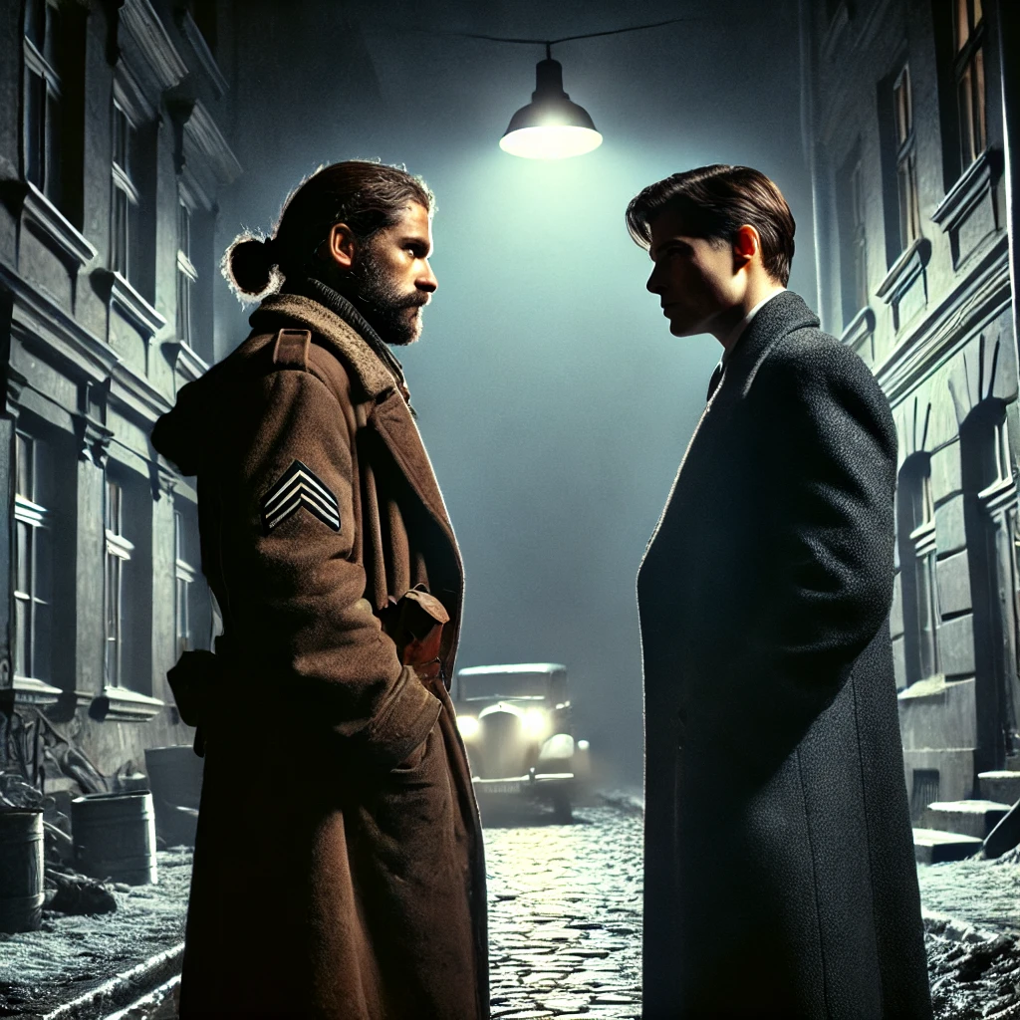
Basil Mitchell: The parable of the partisan (1)
Basil Mitchell agrees with Flew that we need to have evidence for a belief, and we should know what would count as evidence against a belief, we wish the belief to be meaningful. However, he claims that a belief can remain meaningful even if we do not necessarily withdraw it, in light of, evidence that counts against it. He develops the parable of the partisan to explain the idea.

Slide 21
Basil Mitchell: The parable of the partisan (2)
Perhaps this can be brought out by yet another parable. In time of war in an occupied country, a member of the resistance meets one night a stranger who deeply impresses him. They spend that night together in conversation. The Stranger tells the partisan that he himself is on the side of the resistance—indeed that he is in command of it, and urges the partisan to have faith in him no matter what happens. The partisan is utterly convinced at that meeting of the Stranger’s sincerity and constancy and undertakes to trust him.

Slide 22
Basil Mitchell: The parable of the partisan (3)
They never meet in conditions of intimacy again. But sometimes the Stranger is seen helping members of the resistance, and the partisan is grateful and says to his friends, ‘He is on our side.’ Sometimes he is seen in the uniform of the police handing over patriots to the occupying power. On these occasions his friends murmur against him; but the partisan still says, ‘He is on our side.’ He still believes that, in spite of appearances, the Stranger did not deceive him. Sometimes he asks the Stranger for help and receives it. He is then thankful. Sometimes he asks and does not receive it. Then he says, ‘the Stranger knows best.’ Sometimes his friends, in exasperation, say, ‘Well, what would he have to do for you to admit that you were wrong and that he is not on our side?’ But the partisan refuses to answer. He will not consent to put the Stranger to the test. And sometimes his friends complain, ‘Well, if that’s what you mean by his being on our side, the sooner he goes over to the other side the better.’

Slide 23
The conclusion
Basil Mitchell concludes that the belief that the stranger is on our side is a significant article of faith. It is neither the best hypothesis, nor just a vacuous proposition.

Slide 24
R.M.Hare and Bliks
R.M.Hare claimed that although beliefs about God where not strictly speaking cognitive, they were meaningful.
This is because all beliefs are made meaningful in what is called a ‘blik’. A blik ‘the German world for see’ is what is sometimes called a ‘worldview’. Our world view, or perspective affects how we interpret what we see.

Slide 25

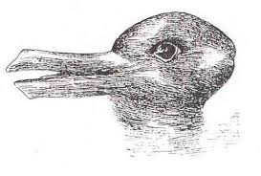
Consider the following images.

Slide 26

The parable of the paranoid student (1)
The parable of the paranoid student:
‘A certain lunatic is convinced that all dons want to murder him. His friends introduce him to all the mildest and most respectable dons that they can find, and after each of them has retired, they say, ‘you see, he doesn’t really want to murder you; he spoke to you in the most cordial manner; surely you are convinced now?’ But the lunatic replies, ‘Yes, but that was only a diabolical cunning; he really is plotting against me the whole time, like the rest of them; I know it I tell you.’ However, many kindly dons are produced, the reaction is still the same.’

Slide 27
The parable of the paranoid student (2)
Even though there is nothing that could change the students mind about the dons. He clearly does think something different about the dons than what we think about them, and so, he clearly has a meaningful belief. That is why we think he is mad.
‘He has an insane blik about dons, we have a sane one.’

