Slide 1
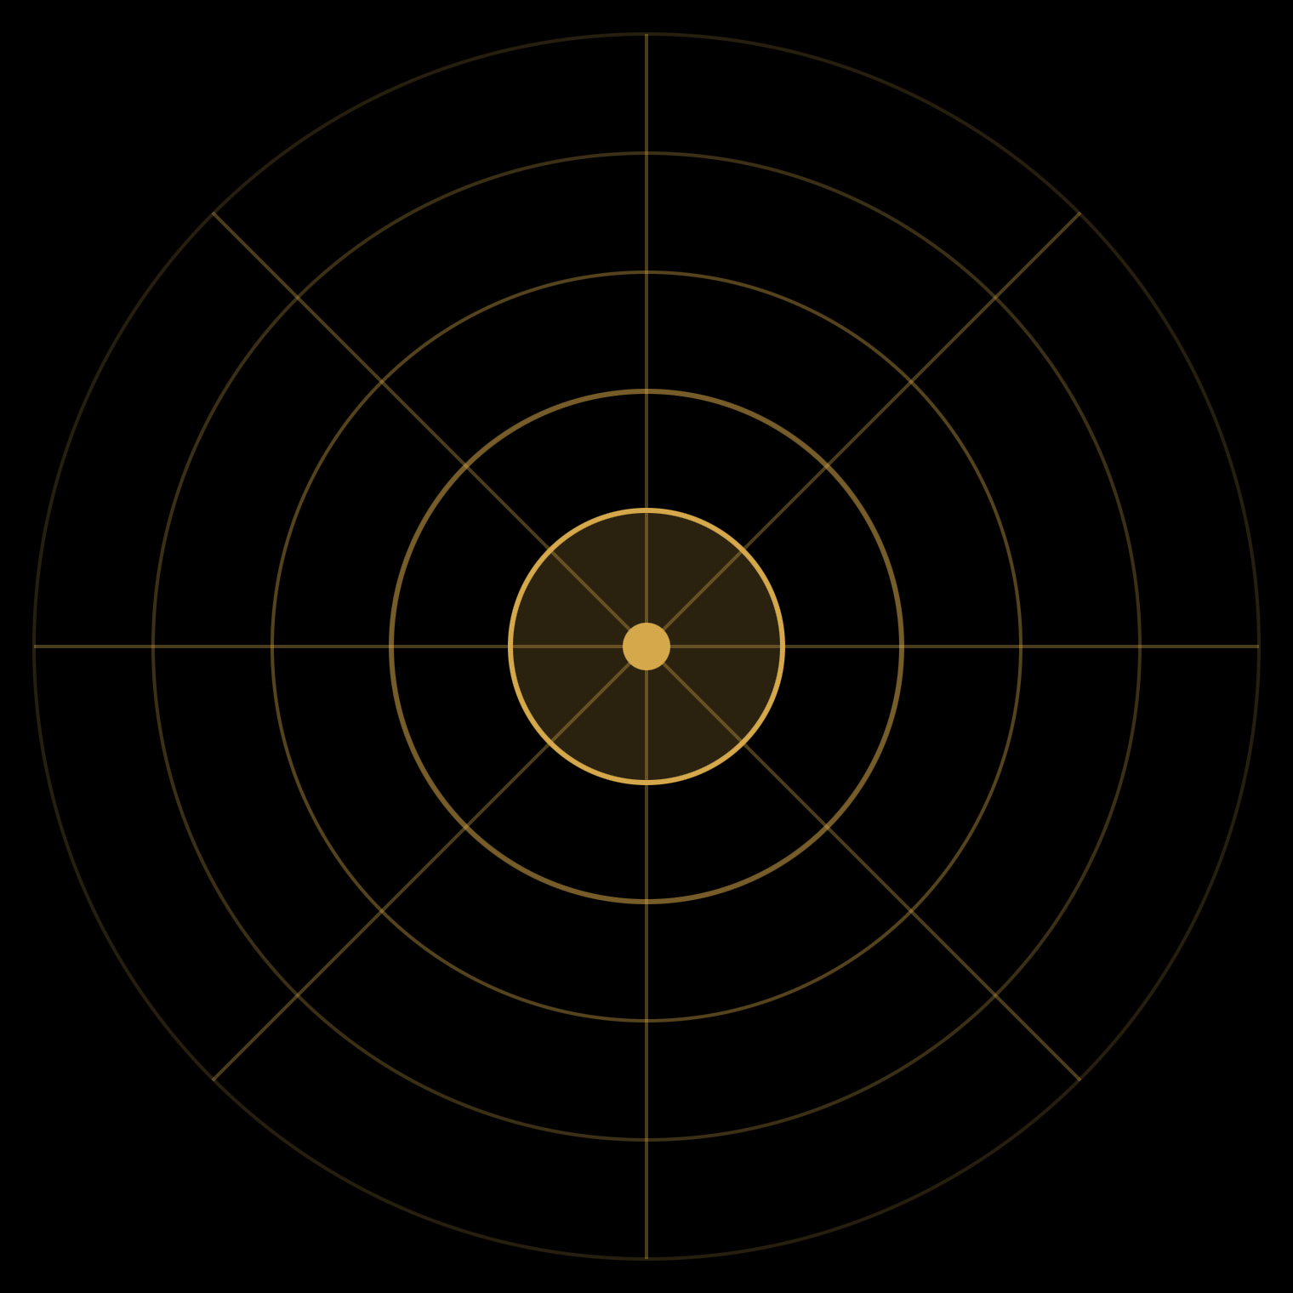
The Concept of God
A-LEVEL PHILOSOPHY · METAPHYSICS OF GOD
Omnipotence · Omnibenevolence · Eternity · Omniscience — and whether they fit together.
Notes:
The deck works through each divine attribute in turn, then the problem each raises for the coherence of the concept of God.

Slide 2
Four attributes, four problems
THE ROUTE
Attribute | The problem it raises
Omnipotence | The paradox of the stone
Omnibenevolence | The Euthyphro dilemma; metaphysical vs moral goodness
Eternity | What could it mean to exist “outside time”?
Omniscience | Can God know what we will freely do?
The question running through every section: is the concept of God coherent?
The Concept of God

Slide 3
God as the most perfect possible being
STARTING POINT
To think of God is to “attempt to conceive something than which nothing more excellent or sublime exists.” — Augustine, On Christian Doctrine
Perfection = more real
Perfection = self-sufficient
An imperfection is something failing to exist in a better way.
Depending on nothing, lacking nothing — so God is the ultimate reality, the ground of all that exists.
Introduction
Notes:
Not just the greatest thing that does exist, but a being than which nothing greater could exist.

Slide 4
Omnipotence
PART 1
and the paradox of the stone

Slide 5
Two definitions
OMNIPOTENCE
THE OBVIOUS ONE
AQUINAS
“The power to do anything”
“God can do anything possible”
Latin omni- (all) + potent (powerful). Includes the logically impossible?
The most power possible — and no more.
Power is the ability to do things. As perfect, God has perfect power.
Part 1 · Omnipotence

Slide 6
Could God make 2 + 2 = 5?
AQUINAS ON THE IMPOSSIBLE
2 + 2 = 5
What is impossible is a contradiction in terms: the words used to describe it contradict each other.
= nothing at all
So a “married bachelor” is not a meaningful description. What is logically impossible is not anything at all.
The limits of the logically possible are not limits on God’s power. There is still nothing God can’t do.
Part 1 · Omnipotence
Notes:
Some pious philosophers have said logic is no limit on God’s power. The handout’s point: there is no way to say this meaningfully.

Slide 7
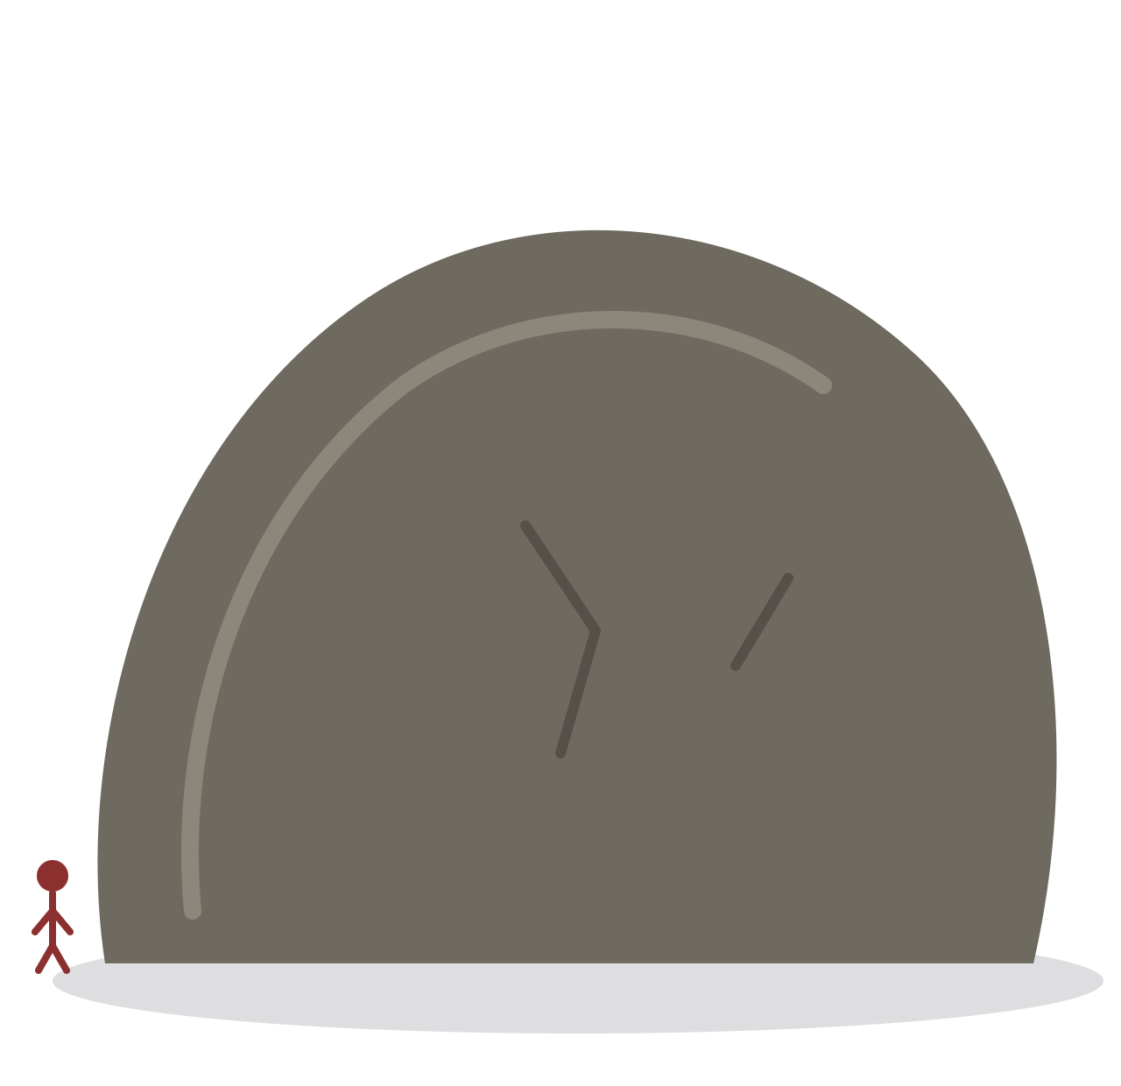
Can God create a stone that he can’t lift?
THE PARADOX OF THE STONE
If the concept of omnipotence is incoherent, so is the concept of an omnipotent being — God.
Part 1 · Omnipotence

Slide 8
Either answer seems to limit God
THE PARADOX OF THE STONE
Answer “No”
Answer “Yes”
Then there is something God cannot create.
Then there is something God cannot lift.
Conclusion: no being could have both powers — to create a stone it can’t lift and to lift that stone. So no being can be omnipotent; the concept is incoherent.
Part 1 · Omnipotence

Slide 9
“That stone is logically impossible”
REPLY 1 — AND WHY IT FAILS
“x makes a stone too heavy for x to lift” is not normally contradictory. But when x is omnipotent, it is. A stone an omnipotent being can’t lift describes nothing — so lacking the power to make it is lacking no possible power.
Objection: it begs the question
The reply uses the phrase “omnipotent being” as if it were coherent — the very thing in dispute. It assumes the truth of its conclusion in order to prove it.
Part 1 · Omnipotence

Slide 10
No limit on lifting means no limit on creating
REPLY 2 — THE BETTER RESPONSE
“God cannot create a stone God cannot lift” only means: if God can create a stone, God can lift it.
God can create a stone of any size — and then lift it.
So is there any stone God can’t create? No.
Therefore God lacks no power related to creating or lifting stones.
Unlike Reply 1, this does not assume the concept of an omnipotent being is coherent.
Part 1 · Omnipotence

Slide 11
Omnibenevolence
PART 2
Supreme goodness — metaphysical and moral

Slide 12
Metaphysical vs moral goodness
TWO SENSES OF “GOOD”
 | Metaphysical goodness | Moral goodness
Meaning | Goodness = perfection | Goodness = acting rightly
“God is perfectly good” | God is perfect in every way — power, knowledge and more | God’s will is always in accordance with moral values
Usual sense? | Less usual | The more usual sense
On the metaphysical reading, “God is perfectly good” says God is perfectly perfect.
Part 2 · Omnibenevolence

Slide 13
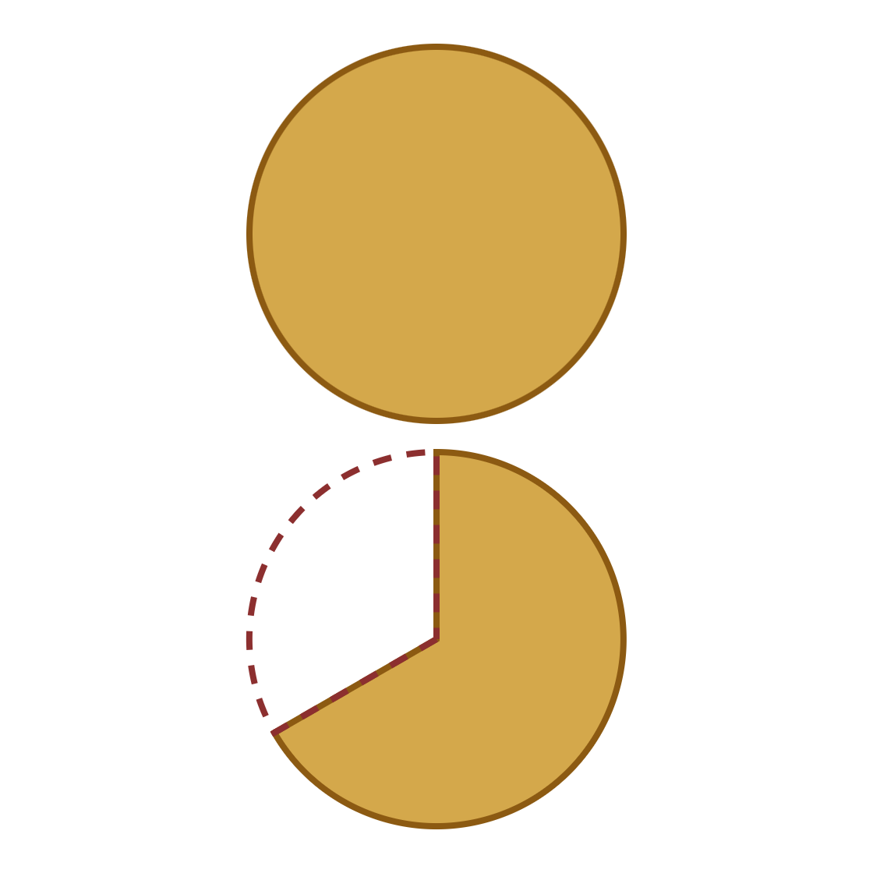
Connecting the two senses
PLATO AND AUGUSTINE
Evil is a lack — a “falling short”, an absence of goodness. It is not a genuine force standing against goodness.
Goodness, whole
So what is morally good is more real than what is not.
Result: the morally perfect and the metaphysically perfect are the same thing.
Evil: goodness missing
Part 2 · Omnibenevolence

Slide 14
The Euthyphro dilemma
PART 3
Can God be both omnipotent and good?

Slide 15
Is the pious loved because it is pious — or pious because it is loved?
ORIGINS: PLATO’S EUTHYPHRO
Euthyphro defines piety as “what the gods love”. Socrates asks which way round this runs.
 | Plato | Our version
Topic | Piety | Morality
Who | The gods | The monotheistic God
Focus | Defining piety without circularity | Is the concept of God coherent?
Part 3 · The Euthyphro dilemma

Slide 16
Two options — each costs God an attribute
THE DILEMMA
OPTION 1
OPTION 2
Morality is independent of God
Morality is whatever God wills
God wills what is right because it is right.
What is right is right because God wills it.
Cost: omnipotence — God cannot turn wrong into right.
Cost: goodness — anything God willed would be right.
Part 3 · The Euthyphro dilemma

Slide 17
Can independent morality be saved?
OPTION 1 UNDER PRESSURE
Defence: it is logically impossible for right to be wrong — so God’s inability is no limit on omnipotence.
Problem: “murdering babies is right” is not obviously a contradiction in terms. If what makes wrong wrong is something about the way the world is, an omnipotent being should be able to change it.
Further problem: nothing that exists is independent of God. A wholly independent morality sits badly with the concept of God.
God’s omnipotence, then, requires that we reject Option 1.
Part 3 · The Euthyphro dilemma

Slide 18
Three separate objections
OPTION 2 UNDER PRESSURE
1
2
3
The moral cost
The empty claim
Arbitrariness
If God willed the death of children, it would be right. We would no longer call God good.
“God is good” reduces to “God wills whatever God wills” — a tautology.
God invents morality, so no fact can be a reason for God’s will. Morality has no rational structure.
These push us back to Option 1 — but Option 1 conflicts with omnipotence. It seems we cannot meaningfully say both.
Part 3 · The Euthyphro dilemma

Slide 19
Goodness depends on God’s nature
RESPONSE 1
If God exists and is supremely good, everything morally good relates back to God as the ultimate reality.
Not because logic forbids it
Not because an outside standard forbids it
But because it is impossible for God not to be God
Good cannot be made evil — the impossibility comes from God’s own nature.
Part 3 · The Euthyphro dilemma

Slide 20
God’s will is structured by love
RESPONSE 2
God’s will does not respond to anything independent of it — but that does not make it arbitrary. God wills what he does because he loves, and this creates morality.
Objection
Reply
Why does God love what he does? If God loved otherwise, morality would be different.
Could God love differently and still be God? If we can form no clear conception of that, the objection fades.
Part 3 · The Euthyphro dilemma

Slide 21



Same property, different concepts
RESPONSE 3
“Water” and “H₂O”
“Good” and “what God wills”
Two concepts. People knew water before H₂O. Yet one thing in the world.
Two concepts. Yet the same property.
So “God is good” is not an analytic truth — no tautology. Morality depends on God metaphysically, not conceptually.
Part 3 · The Euthyphro dilemma

Slide 22
God and time
PART 4
Everlasting or eternal?

Slide 23


No beginning, no end — but in what way?
SELF-SUFFICIENCY AND TIME
If anything could bring God into existence or end it, God would depend on that thing. A perfect being depends on nothing — so God’s existence has no beginning or end.
Everlasting
Eternal
God is temporal: exists in time, throughout all time.
God is atemporal: outside time. Beginning and end only make sense in time.
Part 4 · God and time

Slide 24
BOETHIUS, VIA STUMP AND KRETZMANN
Eternity is “the complete possession all at once of illimitable life.”
An eternal being… | What this means
1. has life | A psychological life — not physical or biological, which is temporal
2. is illimitable | No beginning or end; cannot be limited
3. is atemporal | Its whole life is “now” — a present not flanked by past or future
4. has duration | A special, atemporal kind: no part of its life is ever absent
Features 1 and 2 fit an everlasting God too. Feature 3 is what rules everlastingness out.
Part 4 · God and time · Boethius, Consolation of Philosophy (wording as quoted by Stump and Kretzmann, “Eternity”)

Slide 25
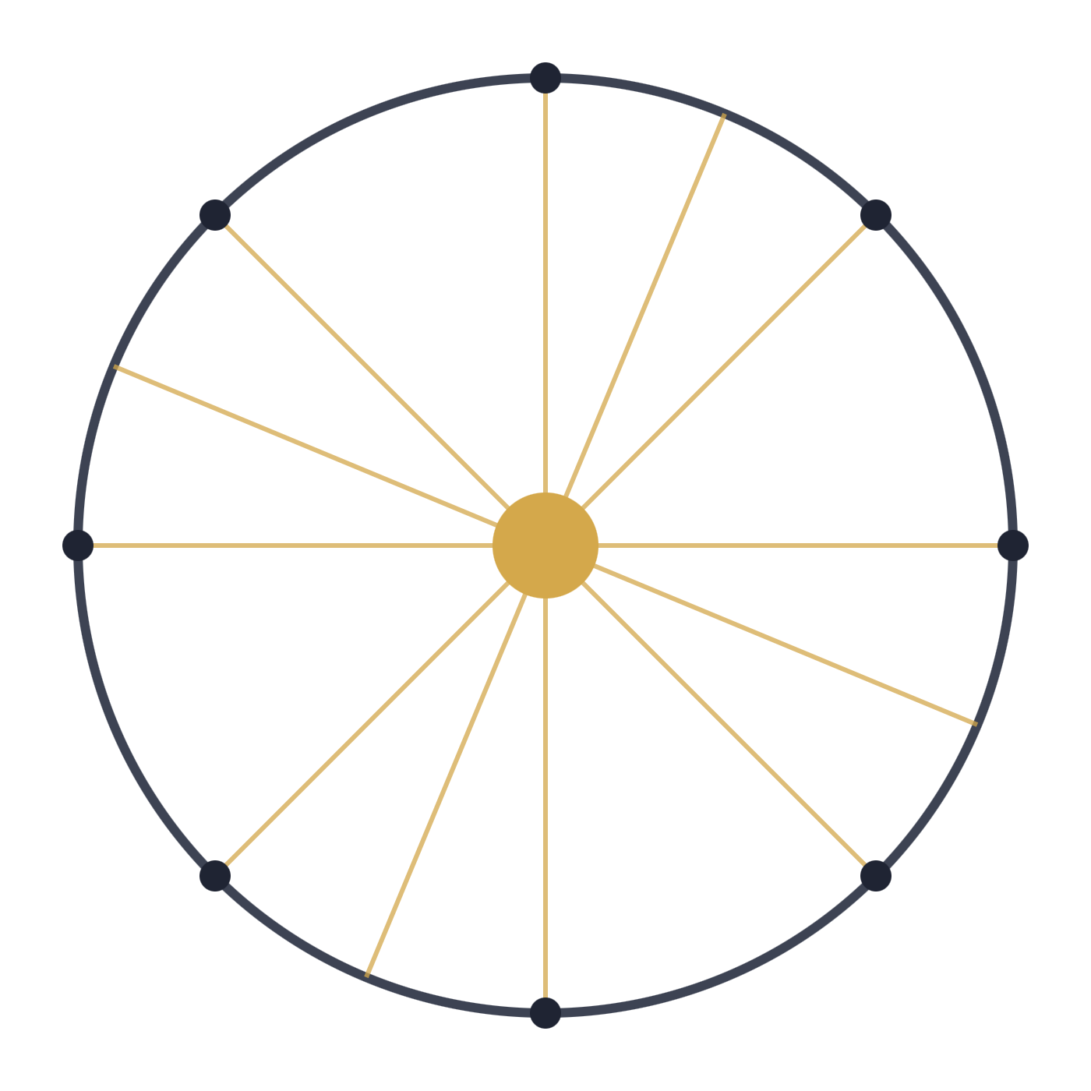
Time as the circle, God as the centre
moments in time
BOETHIUS’ PICTURE
God
From the centre, a line can be drawn to every point on the circumference. Every moment in time maps onto the one moment of God’s existence.
Only a picture: Boethius is not saying time goes in a circle.
Part 4 · God and time

Slide 26
Three kinds of simultaneity
STUMP AND KRETZMANN
Kind | Two things are simultaneous if… | Example
T-simultaneity | they exist at one and the same time | Descartes, Locke and Leibniz, 1646–1650
E-simultaneity | they exist in one and the same eternal present | Any two events in God’s life
ET-simultaneity | one is temporal, one eternal; from either standpoint both are present | You reading this, and God
T-simultaneity is transitive. ET-simultaneity is not: your 10th birthday and today are each ET-simultaneous with God, but not with each other.
Part 4 · God and time

Slide 27


To exist in time is barely to exist at all
ATEMPORAL DURATION
A temporal being
An eternal being
Its past no longer exists; its future does not yet. Only a fleeting present is real — true even of an everlasting God.
None of its existence has gone, none is yet to come. Everything God ever “was” or “will be” always “is”.
Part 4 · God and time

Slide 28
Omniscience and freedom
PART 5
Can God know what we will freely do?

Slide 29
Knowing everything it is possible to know
OMNISCIENCE
Latin omni- (all) + scient (knowing). But if humans have free will, perhaps the future cannot be known — so the safer definition is everything it is possible to know.
Aquinas: how God knows
Other philosophers
Directly — not by inference or through concepts. God knows each particular as the thing it is, like knowing what you are doing as you do it.
If God did not know all true propositions, there would be something God did not know. So God also has propositional knowledge.
Part 5 · Omniscience and freedom

Slide 30
If God knows in advance, am I free?
THE PROBLEM
 | Step
P1 | To act freely, I must be able to do the action or refrain from it.
P2 | If God knows what I will do before I do it, it must be true that I will do it.
C1 | So God cannot know what I will do and it be true that I don’t do it.
P3 | If it is true that I will do it, nothing I can do can prevent it coming true.
C2 | So if God knows what I will do, I cannot refrain from doing it.
C3 | So if God knows what I will do before I do it, that action is not free.
Part 5 · Omniscience and freedom
Notes:
The argument is conditional. It does not claim we are not free; it claims that IF God knows beforehand, we are not free.

Slide 31
Omniscient or good — but not both?
WHY THIS THREATENS THE CONCEPT OF GOD
Free will is a great good: it lets us choose good or evil, enter a relationship with God, and live morally significant lives. A supremely good God would want us to have it.
If we are free…
If we are not free…
…God is not omniscient.
…God is not supremely good.
Part 5 · Omniscience and freedom

Slide 32
God is everlasting, not eternal
SOLUTION 1
God exists in time. Because of free will, the future cannot be known — even by God.
That is no restriction: omniscience only means knowing everything it is possible to know, and God knows that at any given time.
Two questions to press
Is this a satisfactory view of omniscience? Is it a satisfactory view of God’s relationship to time?
Part 5 · Omniscience and freedom

Slide 33
P2 is ambiguous
SOLUTION 2 · COMPATIBILISM
Necessarily true
Not necessarily true
The conditional: if God knows I will do X, then I will do X. No one can know what is false.
The consequent: that I must do X. Paris is the capital of France — but it could have been another city.
I won’t refrain — but that doesn’t mean I can’t. So God can know, and I act freely.
Objection
If I can refrain, I can change the past (what God knew) or make God’s belief false. And how could knowledge be complete and infallible unless the future is already fixed?
Part 5 · Omniscience and freedom

Slide 34
God does not fore-know: there is no “before” for God
SOLUTION 3 · STUMP AND KRETZMANN
Every moment in time is ET-simultaneous with God. God knows events in the eternal now — as they happen, not before they happen.
So P2’s phrase “knows what I will do before I do it” is confused: it puts God’s knowledge in time.
We know what we are doing as we do it, and that does not stop us being free. The same goes for God’s knowledge.
Part 5 · Omniscience and freedom

Slide 35
The attributes
GLOSSARY · 1 OF 3
Term | Meaning
Omnipotence | The power to do anything possible — anything that can be done.
Omniscience | Knowing everything it is possible to know.
Omnibenevolence | Supreme goodness: perfect in every way, and/or a will always in accordance with moral values.
Metaphysical goodness | Goodness understood as perfection.
Moral goodness | Goodness understood as willing in accordance with moral values.
Self-sufficiency | Depending on nothing else for existence, and lacking nothing.
Glossary

Slide 36
Logic and argument
GLOSSARY · 2 OF 3
Term | Meaning
Logically impossible | A contradiction in terms; describes nothing at all.
Coherent | Free of self-contradiction; able to be meaningfully thought.
Begging the question | Assuming the truth of a conclusion in order to show it is true.
Tautology | A statement true by its own terms, which tells us nothing.
Analytic truth | True in virtue of the meanings of its terms alone.
Arbitrary | Done for no reason.
Contingent | True, but could have been otherwise.
Glossary

Slide 37
Time and freedom
GLOSSARY · 3 OF 3
Term | Meaning
Everlasting | Existing in time, throughout all time, with no beginning or end.
Eternal / atemporal | Existing outside time; the whole of life possessed “all at once”.
T-simultaneity | Existing at one and the same time.
E-simultaneity | Existing in one and the same eternal present.
ET-simultaneity | The relation between something eternal and something temporal: both present from either standpoint.
Transitive | If it holds between x and y, and y and z, it holds between x and z.
Compatibilism | Here: God’s foreknowledge is compatible with human free will.
Glossary

Slide 38
Each problem, each reply
RECAP
Problem | Strongest reply covered
Paradox of the stone | No limit on lifting means no limit on creating stones
Euthyphro dilemma | Goodness is God’s nature / structured by love / same property as God’s will
Eternity | Boethius; T-, E- and ET-simultaneity; atemporal duration
Omniscience and freedom | Everlasting God / compatibilism / God knows in the eternal now
Now open the workbook.
The Concept of God

