Slide 1

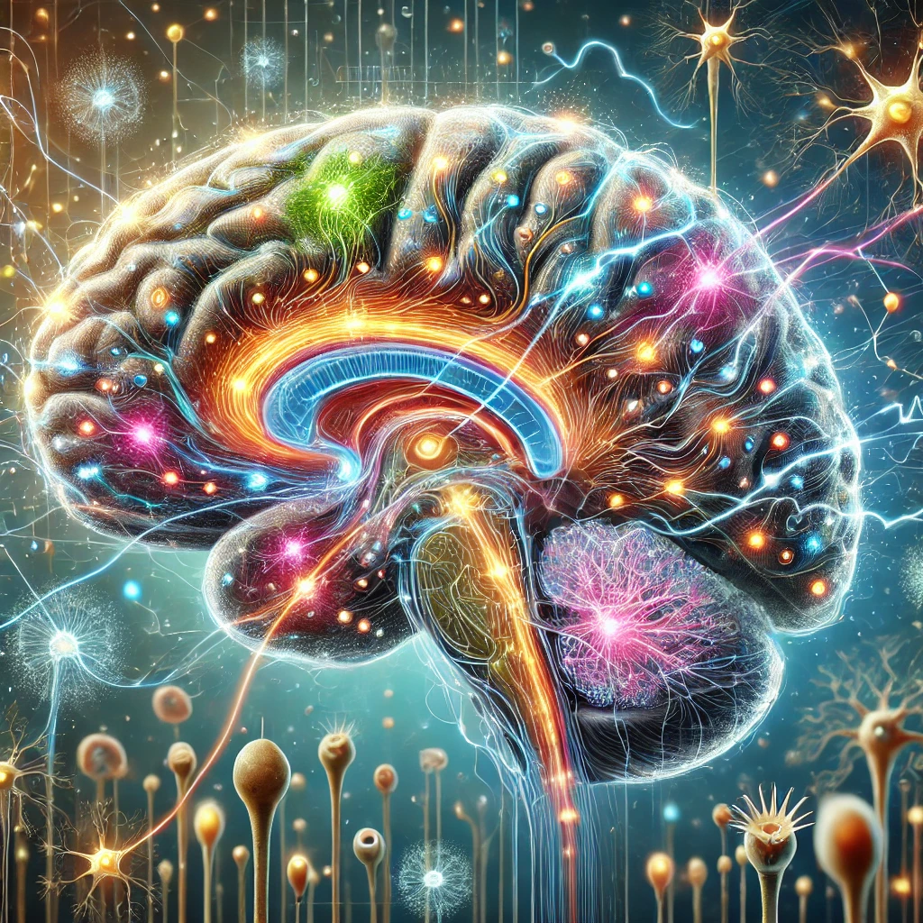
Functionalism
The Philosophy of mind

Slide 2
Key thesis
Functionalism is the theory that mental properties (such as being in pain) can be identified with (or reduced to) functional states. Functional states are states with specific sensory inputs and specific outputs; outputs are both behaviour and other mental states. What a mental state is ‘is what it does’. In other words, it is active, not static.

Slide 3
Two main categories of functionalism
Empirical functionalism: understands the functional states as identical with the property of ‘being in pain’ or ‘being happy’. This means it is not a theory about concepts/ideas, but it is an ontological theory about the being of these properties. This thesis was developed by Hilary Putnam.
Causal-role functionalism: the claim that we can understand the concept of pain as a functional state which causes (and thus explains) specific effects, such as mental states and behaviour.

Slide 4

Technical term
Function: A function is any process that takes a specific input (called the domain) and gives a specific output (called the range).
For example, in mathematics, ‘the square of…’ is a function.
For example,
$$2^{2}=4$$
2 is the input and 4 is the output and squared is the function. You can input any number you like, and you will have a definite set of outputs.

Slide 5
The organism and the brain act by producing outputs from specific inputs.
Input
Sensory information
For example: The light reflecting from an animal that is running towards you
Output
There are 2 possible outputs
Behaviour = running
Other functional state = believing life is in danger
input
output

Slide 6
Hilary Putnam
Hilary Putnam in his 1973 paper ‘The Nature of Mental States’ summed up his thesis thus
‘I propose the hypothesis that pain, or the state of being in pain, is a functional state of a whole organism’.

Slide 7
The argument put formally
All organisms capable of feeling pain are like probabilistic machines.
Every organism capable of feeling pain possesses a certain type of functional organisation.
An organism cannot be broken down into separate organisms.
For every organism there exists a subset of sensory inputs such that it is in pain when and only when some of its sensory inputs are in that subset.

Slide 8
The analogy of hardware and software
Think of how a computer has specific software that responds to certain inputs, like the typing of a keyboard. These computers have software, which is where the functions are inputted and work, and yet it needs hardware that allows it to work. In the same way that we have different computers with different hardware doing the same job, so likewise different animals with different hardware can have the same software.

Slide 9

Functionalism is compatible with dualism
Functionalism is compatible with dualism and with physicalism, although it is most commonly found among physicalists, as it is mechanistic. But there is no reason in principle why a non-physical property could not be attributed the ability to act as a function. Putnam writes that
‘In particular functional states are … compatible with dualism! Although it goes without saying that the hypothesis is mechanistic’.

Slide 10
Advantages of functionalism
1. Functionalism can make sense of multiple realizability which mind-brain identity theory cannot do.
2. Functionalism can make sense of weaknesses faced by behaviorism especially the case of the Super Spartans.
3. Functionalism and convergent evolution.

Slide 11
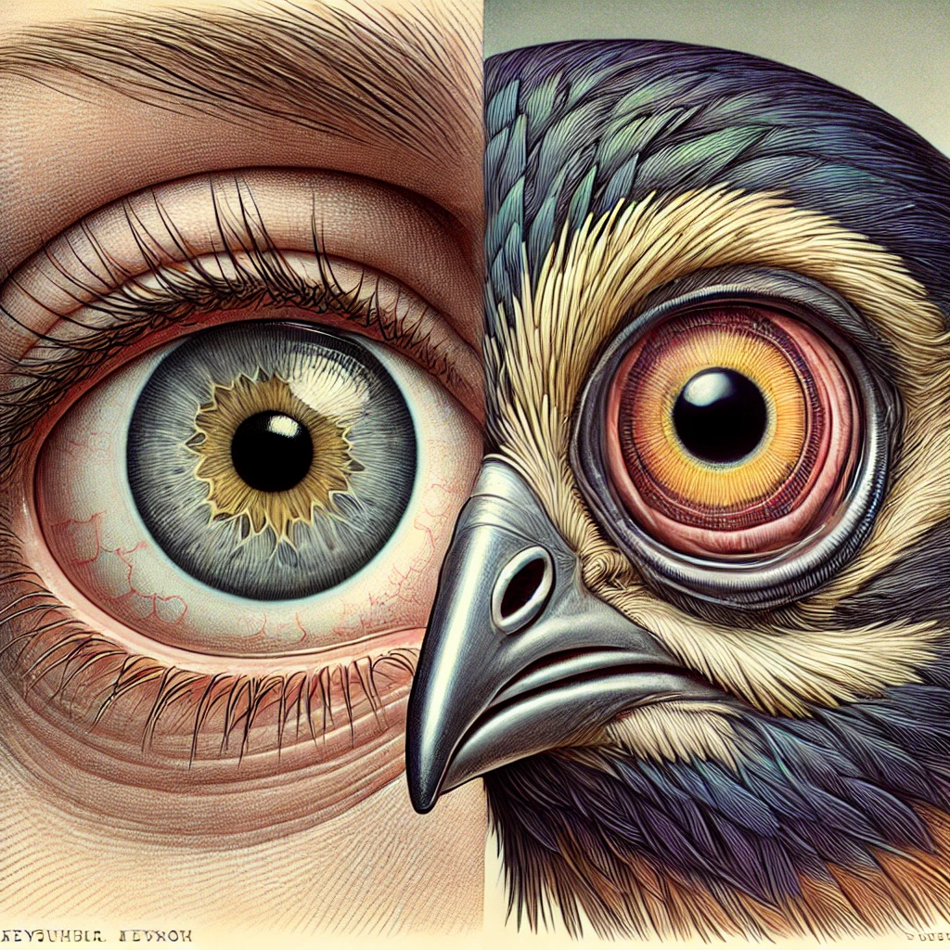
Functionalism and multiple realisability.
How does functionalism do better than mind-brain identity theory? As we noted previously, mind-brain identity theory claims that any mental property, for example being in pain, is identical to either a type of brain process or a token brain process. This means that any being whatsoever, whether it be animal or extra-terrestrial, will need to have these very specific brain processes if it is to count as being in pain. However, we already think, very plausibly, that animals and other creatures can feel pain, with very different brains, and so mind-brain identity theory seems very implausible.

Slide 12

Functionalism makes more sense than Behaviourism
Functionalism can explain why even though a certain organism is in pain it may not produce its usual outputs. For example, Putnam explains why being in pain may not mean that one always shouts out.
‘Namely the functional state we have in mind is the state of receiving sensory inputs which play a certain role in the functional organization of the organism. This role is characterised at least partially, by the fact that the sense organs responsible for the inputs in question are organs whose function is to detect damage to the body….this does not mean that the organism will always avoid the condition in question (“pain”); it only means that the condition will be avoided unless not avoiding it will lead to the attainment of a more valued goal.’
This means that even if I am in pain, I may be more worried about being discovered by a violent mob and thus keep quiet though I would certainly like to express my pain.

Slide 13

Functionalism and convergent evolution
Functionalism and convergent evolution: Convergent evolution is the phenomenon whereby two animals from different species, say a mammal and a marsupial, can look very similar. For example, the Tasmanian tiger (thylacine) looked remarkably like a dog, even though they have nothing in common on a genetic level. This is because they both lived in similar environments which demanded similar functions. The functions explain why they have the features they do; this is also true of hedgehogs and anteaters. We can thus see that it is possible for different species with different physical properties to realise the same mental property of being in pain. Putnam also compares the human eye and the eye of the octopus.

Slide 14
Disadvantages of functionalism
1.There ‘inverted qualia’ thought experiment.
2. The Chinese mind thought experiment.
3. Chalmers and the deep question of consciousness.

Slide 15

The inverted qualia experiment
We could imagine a situation where I see the colour blue when I look at the sky and you see the colour red. We have inverted qualia on red and blue things. But because we have grown up in the same linguistic community you say that you see ‘blue’ when in fact you see red, and none of us is aware that the other person is having different experiences of qualia. We would be functionally identical because when we both see the same wavelength, we would say the same thing and thus have the same output, and say ‘I see blue’ but we would not be identical on an experiential level. Therefore, mental property and function are not identical.

Slide 16
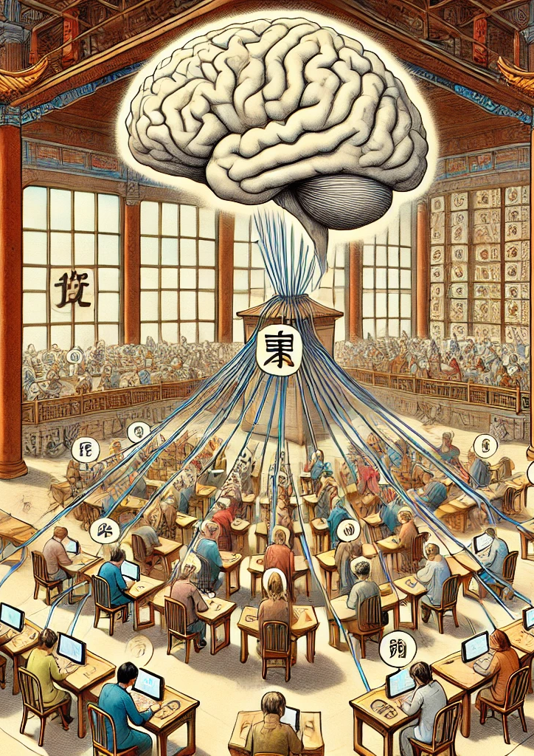
Ned Block and the Chinese mind
The Chinese Mind thought experiment developed by Ned Block claims that we could imagine the population of China (a population of over 1 billion people) replicating your brain process, duplicating the inputs and outputs of your brain. This could be done with walkie-talkies (today, the internet), and even though there would be perfect functional duplication there would be no one consciousness that the system was in. So, we can have functional duplication without consciousness. Whether this is viable in reality is irrelevant; in principle this could work, and it proves its point.

Slide 17

Chalmers and the deep problem of consciousness
What cannot be explained is the fact that this system is somehow connected to subjective consciousness. The fact that ‘it is like something’ to be conscious is a mystery that cannot be explained and is labelled the hard problem of consciousness by Chalmers.

Slide 18
Further reading
The causal theory of mind – D. M. Armstrong
The Nature of mental states – Hilary Putnam

