Slide 1
The problem of causation

Slide 2
The problem of causation and the problem of physics
(1) The philosophical problem of understanding two-way causation between a non-extended substance and an extended one.
(2) The law of the conservation of momentum/energy.

Slide 3
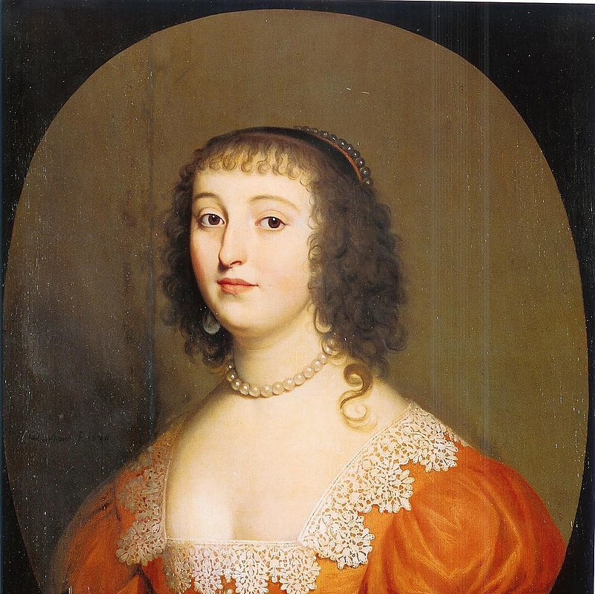
Princess Elisabeth of Bohemia
‘How man’s soul, being only a thinking substance, can determine animal spirits so as to cause voluntary action’.

Slide 4
The argument
Given that the mind is immaterial and unextended, and the body is extended and material, the laws of physics say that the mental cannot affect the physical because physical events can only have physical causes, and we cannot have non-physical causes of physical events. My mind cannot move my body, and we cannot explain according to Descartes how it could ever do that.

Slide 5
Causation as counterfactual
A counterfactual is a proposition that assumes that if a certain event did not obtain then another event further downstream would not have obtained.
For example, ‘If I had not opened my hands, the bottle of water would not have fallen to the floor’.

Slide 6
The problem of causation
We understand causation to be a product of a series of events that are linked in a chain from event A to event B. If there is a gap in the chain of events – if we have some categorical reason why the events cannot be linked – we can deny a causal link.

Slide 7

Causal chain
Causal chains explain why one bullet has one effect and another bullet has another effect.

Slide 8

Perception as a causal chain
We can understand our perception of a thing as the product of a causal chain. The light that reflects from the tree hits the retina of the eye, causing me to see the tree.

Slide 9
Newton’s law: the conservation of momentum
“The total linear momentum of a system remains constant in collisions/explosions provided no external forces are applied”.

Slide 10

The momentum stays the same in the system
There can be no loss of momentum in a whole physical system, which means that momentum is neither created nor destroyed in a physical system.

Slide 11

This means that Descartes’ substance dualism contradicts our best theories in physics.
This, in sum, is the problem of causation for substance dualism.

