Slide 1
Philosophy of mind

Slide 2
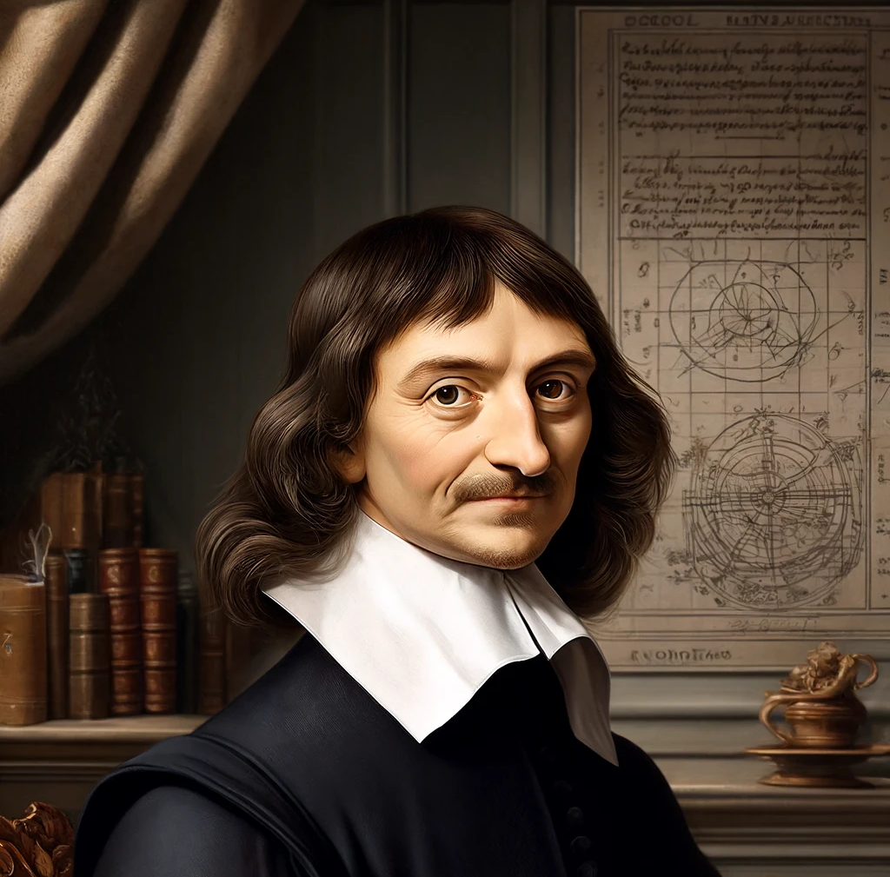
Substance Dualism

Slide 3
Substance Dualism
Key thesis: There are only two categories of substance
(1) Physical substances: which are by essence extended
(2) Mental substances: which are by essence thinking (conscious)

Slide 4
Substance dualism claims that…
The mind is a substance and not a property!

Slide 5
Two key arguments for substance dualism
(1) The argument from conceivability.
(2) The argument from division.

Slide 6
The argument from conceivability
‘First, I know that everything which I clearly and distinctly understand is capable of being created by God so as to correspond exactly with my understanding of it. Hence the fact that I can clearly and distinctly understand one thing apart from another is enough to make me certain that the two things are distinct, since they are capable of being separated, at least by God.’

Slide 7
Conceivability continued
‘Thus, simply by knowing that I exist and seeing at the same time that absolutely nothing else belongs to my nature or essence except that I am a thinking thing, I can infer correctly that my essence consists solely in the fact that I am a thinking (conscious) thing. It is true that I may have a body that is closely conjoined to me. But nevertheless, on the one hand I have a clear and distinct idea of a body in so far as this is simply an extended, non-thinking thing. And accordingly, it is certain that I am really distinct from my body, and can exist without it.’

Slide 8
We could put it thus…
(1) ‘I’ am possibly such as to be non-extended
(2) No physical body is possibly such as to be non-extended
(C) Therefore, I am not a body.

Slide 9
Objections
(1) We are not conscious when we are in deep sleep but we still exist.
(2) For this argument to work, we must assume that no individual thing can pass from being extended to being non-extended. (Cheshire cat becomes a grin)
(3) Is the ‘I’ a substance? It could be a bundle.
(4) Conceivability does not mean possibility. And Descartes needs God for his argument to work.

Slide 10

ARGUMENT 2
If it is possible for something to move from being three-dimensional to being two-dimensional and then one-dimensional, then Descartes’ argument from conceivability does not go through.
Think of the way the Cheshire cat changed from being three-dimensional to being a smile and then disappearing.

Slide 11
Against argument 2 Descartes can argue…
(1) that if something passes from being extended to being non-extended then it has been destroyed, because when its essence is destroyed, the thing is destroyed. For example, when my body returns to the elements it will not be me.

Slide 12
The significance of God
God ensures that anything which can be understood or conceived could be made to happen, not that it will actually occur at some time. So long as God could make it happen it is a possibility.
So, Descartes needs God to make the argument work. The existence of God cannot be assumed.

Slide 13
The argument from division
‘When I consider the mind – i.e. consider myself purely as a thinking thing - I can’t detect any parts within myself; I understand myself to be something single and complete…the faculties of willing, of understanding, of sensory perception and so on, these are not parts of the mind, since it is one and the same mind that wills, understands and perceives.’

Slide 14
Objection to the divisibility argument
The mind is divisible in at least two ways. (A) Psychologically, there are different sections of the mind that have different functions. (B) It would be possible to divide consciousness if we could divide the lobes of the brain. It may be that the unity of consciousness could be divided in principle.
The property of belonging to the human race is not divisible but is a physical property.

Slide 15
Descartes did think that mind and body were intermingled.
‘Nature teaches me, by these sensations of pain, hunger, thirst and so on that I am not merely present in my body as a sailor is present in a ship, but that I am very closely joined and, as it were, intermingled with it, so that I and the body form a unit.’

