Slide 1
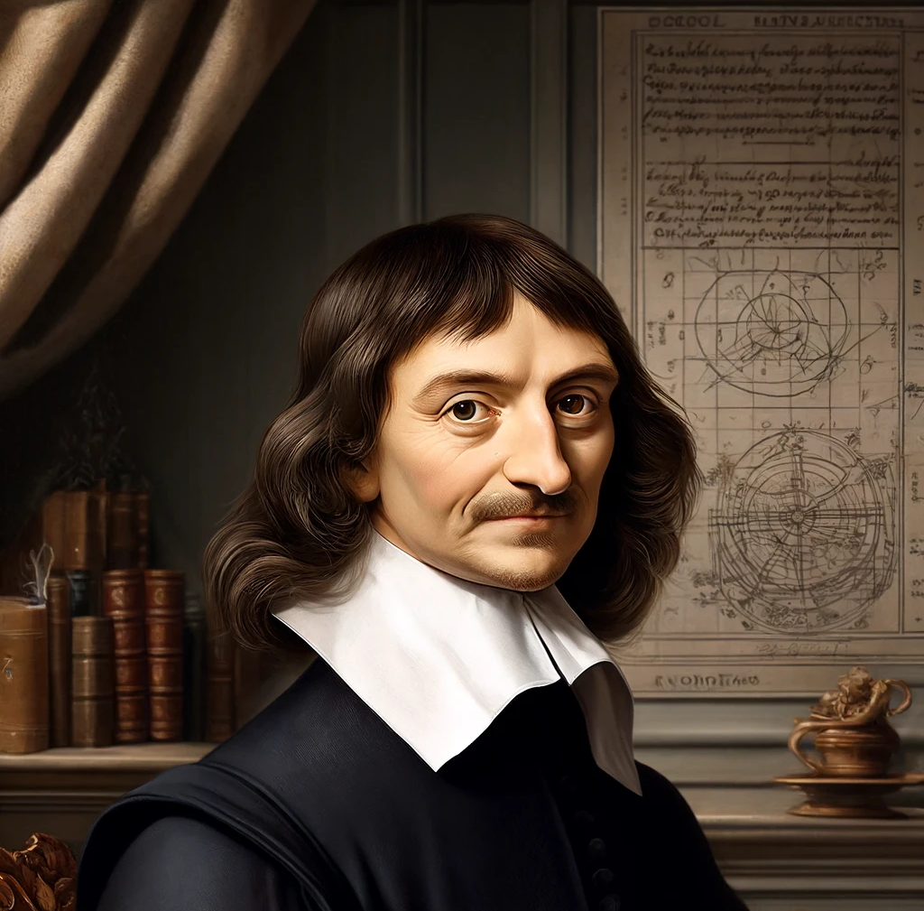
Direct Realism
The philosophy of perception

Slide 2
The questions in the philosophy of perception
The philosophy of perception is the area of epistemology that is concerned with how our senses relate us to the world. Do they relate us to the world directly and immediately or do they relate us to the world indirectly through some process or information in the brain?

Slide 3
Direct realism
Direct realism sometimes known as naïve realism is a common-sense theory of perception. It makes two key claims
We perceive things ‘directly’ – we see things as they are.
What we perceive is ‘real’ – it exists without the mind.

Slide 4

By Direct Realism we mean…
We see these tables as chairs they are, and we see them directly.

Slide 5
There are 4 problems with direct realism
Perceptual variation.
Illusion.
Hallucination.
The ‘time-lag’ argument.

Slide 6

Perceptual variation
The argument from perceptual variation is the claim that we do not see things directly. They point to the fact that when you see a chair from different perspectives the perceptions (experiences) we have change. (See the images on the right). If the chair out in the external world stays the same, my experience changes, so these two things cannot be the same. So, we do not see the chair directly we see it indirectly.

Slide 7
Direct realist response
The direct realist response says that the cause of perceptual variation is to do with the fact that we also perceive relational properties.
Relational properties are things like the distance between myself and the object. If the object is at a certain distance away from me, it will either look either smaller or larger than me.

Slide 8

Argument from illusion
The argument from illusion claims that there are specific times when what we see cannot be the same thing as the object out in the world. So, for example, when I see a pencil in a glass of water, the light will refract from the water and pencil and the pencil will look crooked. But we know that the pencil is straight, and yet the pencil appears crooked. So, what I see and what is out in the world are two different things. That means I do not see the pencil directly, but the something in my mind, that represents the pencil.

Slide 9
Direct realist response
The direct realist response will again point to relational properties. They will claim that when the pen is in water it will be in a certain relationship with light, and in a certain relationship with water. Therefore, you will perceive these relational properties which explains why the pen looks crooked.

Slide 10
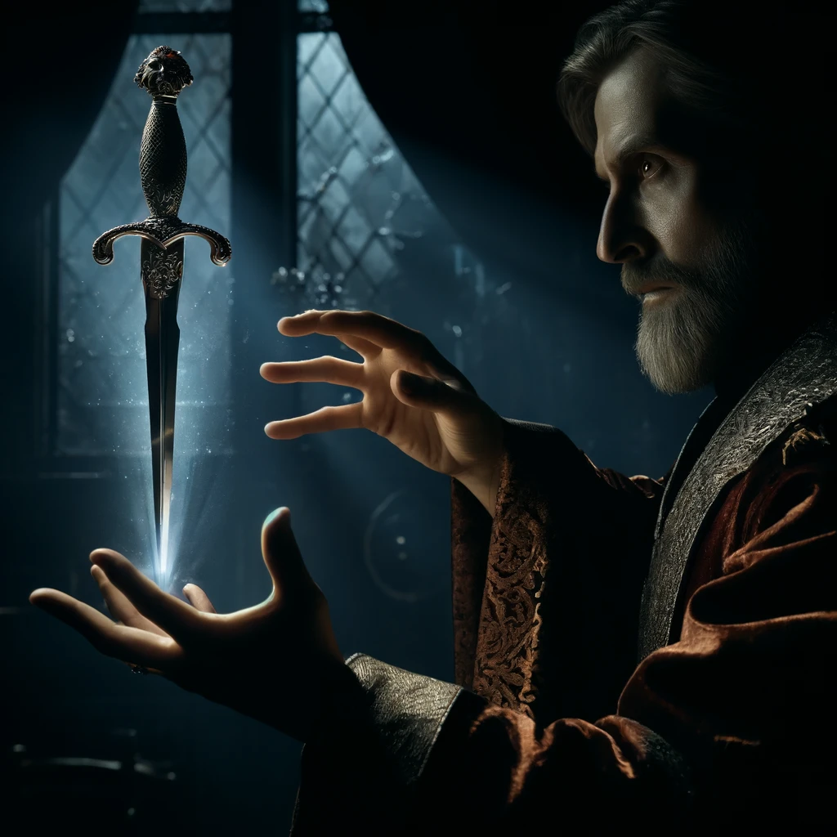
The Hallucination Argument
The argument from hallucination claims that sometimes we can have an experience or a perception of something that does not actually exist in the outside world. For example, Hamlet sees a knife in front of him that does not actually exist. Hamlet cannot tell by just surveying his experience that it is false, the hallucination it is ‘subjectively indistinguishable’ from real one. This means that when we are having perceptions they are being produced in part in our mind and cannot be attributed to the world only.

Slide 11
Direct realist response
The direct realist can point to what is known as the disjunctive theory of perception. They can say that when we are having normal perceptions we are in one specific mental state. But when we are suffering a hallucination, we are having a totally different mental state. We are either having normal perceptions OR we are having hallucinations, we can learn nothing about perceptions from hallucinations.

Slide 12

Time Lag Argument
The ‘time lag’ argument is an argument from physics which claims that our experience of objects is delayed over a period of time, by the speed of light. So, when we look at the stars, we see them as they were millions of years ago. When we see the sun, we see it as it was 8 minutes ago. This means that we do not see the sun as it is, we see it as it was, this means we do not see it directly we see it indirectly.

Slide 13
Explain direct realism (5)
Direct realism is a theory in the philosophy of perception that claims that we perceive objects in the external world directly, and that means immediately as they are. For example, when I see a table I perceive a table, not something in my mind that represents one. Secondly, it claims that the thing I see exists independently of my mind, and that it does not need my mind to continue to exist. For example, when I see the table, the table was there before I saw it and it will probably continue to exist after I perceive it. Direct realism is sometimes known as naïve realism.

Slide 14
Questions
Explain the idea of direct realism (5)
Explain the argument of perceptual variation (5)
Explain the argument from illusion (5)
Explain the argument from hallucination (5)
Explain the time lag argument (5)

