Slide 1
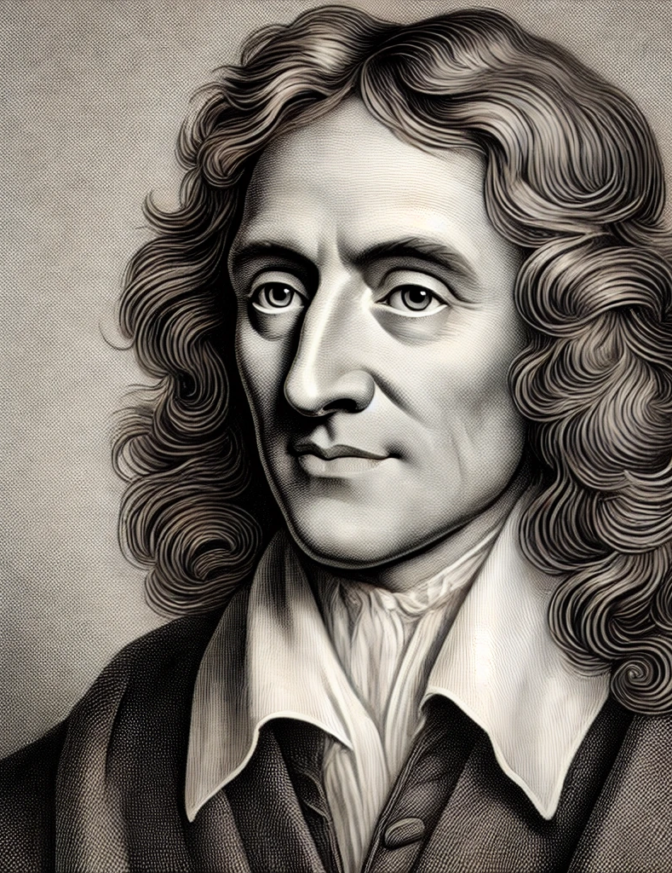
‘INDirect Realism’ (2)

Slide 2
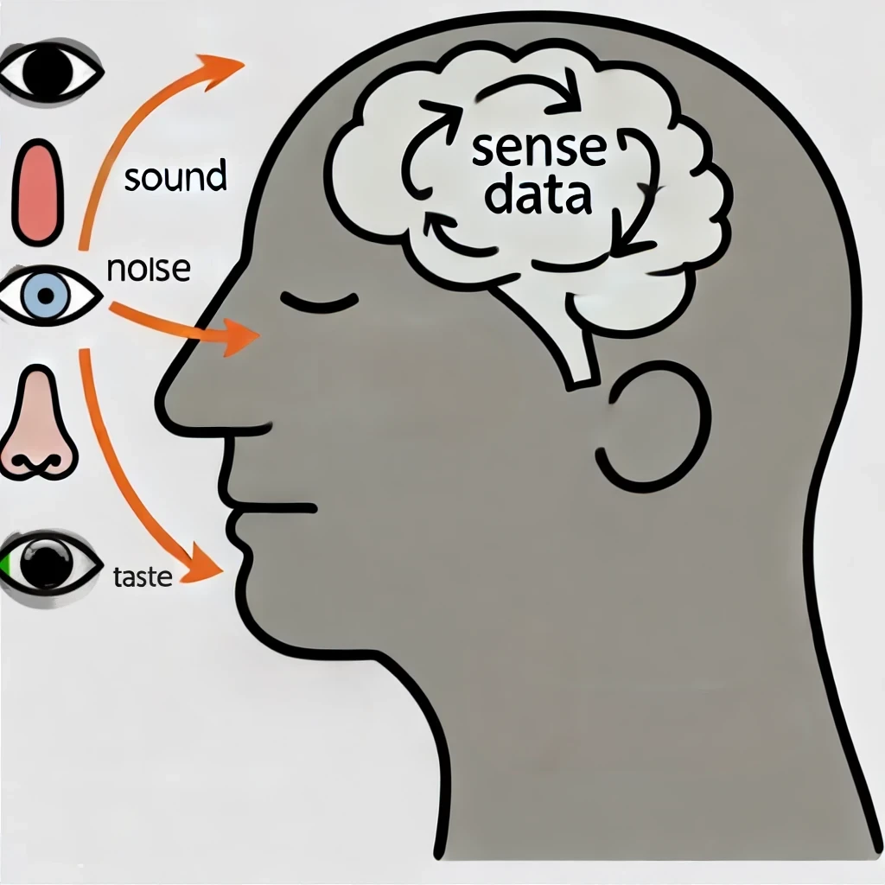
Indirect realism
Indirect realism is the thesis that claims we do perceive the external world, but our perception is indirect. This means that we do see the world through sense-data, the sense-data represent the world, because they are caused by it. Sense-data is information or mental states of the mind of a person. These states represent the external objects out in the world. It is realist because it claims that the external objects in the world exist. The theory is developed by John Locke and Bertrand Russell.

Slide 3
The theory is ‘Indirect’
The sense-data are mind-dependent, that is, they depend on a mind for their existence. Sense-data are known directly, immediately, and we have privileged and private access to them, while the objects in the world can only be inferred from sense-data. These external objects are known or present indirectly, via the sense-data.

Slide 4
The theory is ‘realist’
The realist aspect of the theory is the important claim that external objects in the world are real, this means they are independent of the mind, and that they continue to exist when the people are not perceiving them.

Slide 5
The arguments for indirect realism
The arguments for indirect realism are simply the arguments we have already seen against direct realism. Namely
(1) The argument from perceptual variation.
(2) The argument from illusion.
(3) The argument from hallucination.
(4) The time-lag argument.

Slide 6
There are two key objections to indirect realism
1. If indirect realism is true, we cannot know that there is an external world beyond sense-data?
2. How do sense-data represent the world?

Slide 7

Is there anything beyond our IMMEDIATE SENSE Data?
Russell claims that if we only have access to sense-data, then we cannot know that there is anything beyond our sense-data in the world that cause them. The best we can do is assume that there is. Therefore, we cannot know that there is a world beyond our direct experience.

Slide 8

The existence of the external world is the best hypothesis
It is true that we cannot know beyond any doubt that there are external objects that cause our sense data. However, if we consider all the other possible hypothesis, we understand that the most plausible hypothesis is that there is an external world.

Slide 9
Best hypothesis
So either
1:Sense data are caused by my mind or some other thing outside it like an evil demon.
OR
2: They are caused by things such as objects outside the mind.
That they are caused by things outside the mind seems the most sensible answer.

Slide 10
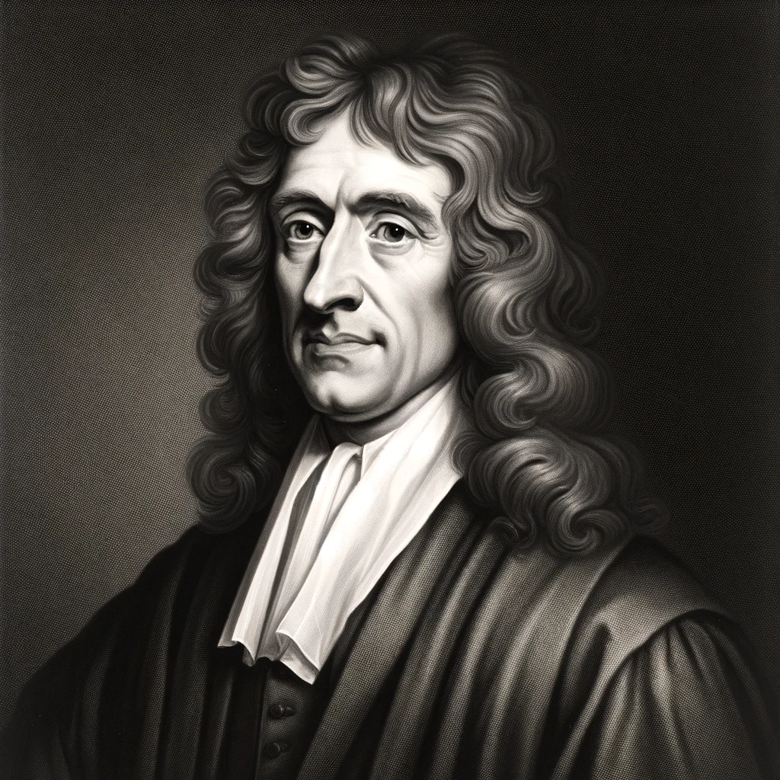
John Locke (1)
John Locke claims that we cannot avoid having certain sense data in our mind. For example, If I close my eyes, I can choose what I can imagine, but I cannot control my sense-data when I open my eyes.

Slide 11
John Locke (2)
We can also confirm one sense-perception with another. For example, if I see a fire I can go and feel if it is hot. If I hear a violin playing, I can go and see the violin and confirm it is there. If I see a fire I can feel its heat.

Slide 12
John Locke (3)
Sense data are not just ‘playing things of the imagination’. This means that when we see things we cannot just wish them away from our experience or indeed from the world with our mind alone.

Slide 13

Therefore, We can infer the existence of Physical Objects
3 reasons for this
1. Sense-data are not under our control like imagination.
2. We get the same information from different senses.
3. The complex relation between our actions and perceptions.

Slide 14
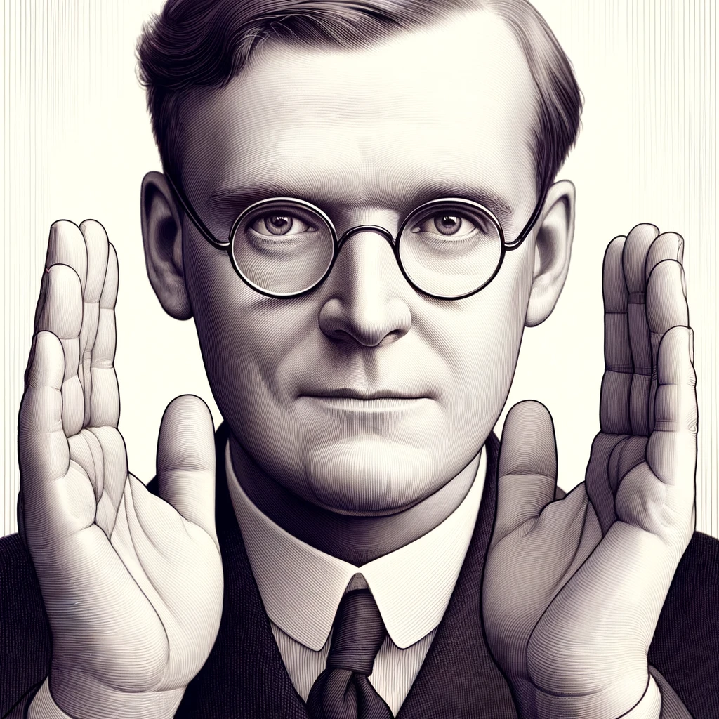
The direct realist can claim that we need more…
The direct realist thinks that the external world is more than a hypothesis but is known for certain.
G.E.Moore thought he proved the existence of the external world lifting his hands up in turn and saying ‘this is one hand and this is another’.

Slide 15
The problem of representation
If sense-data are in the mind, then they are probably chemical and biological events in the brain. The question becomes how a biological and chemical event in the brain can match up and represent a non biological and physical thing in the world. How does sense data represent objects? That seems impossible.

Slide 16

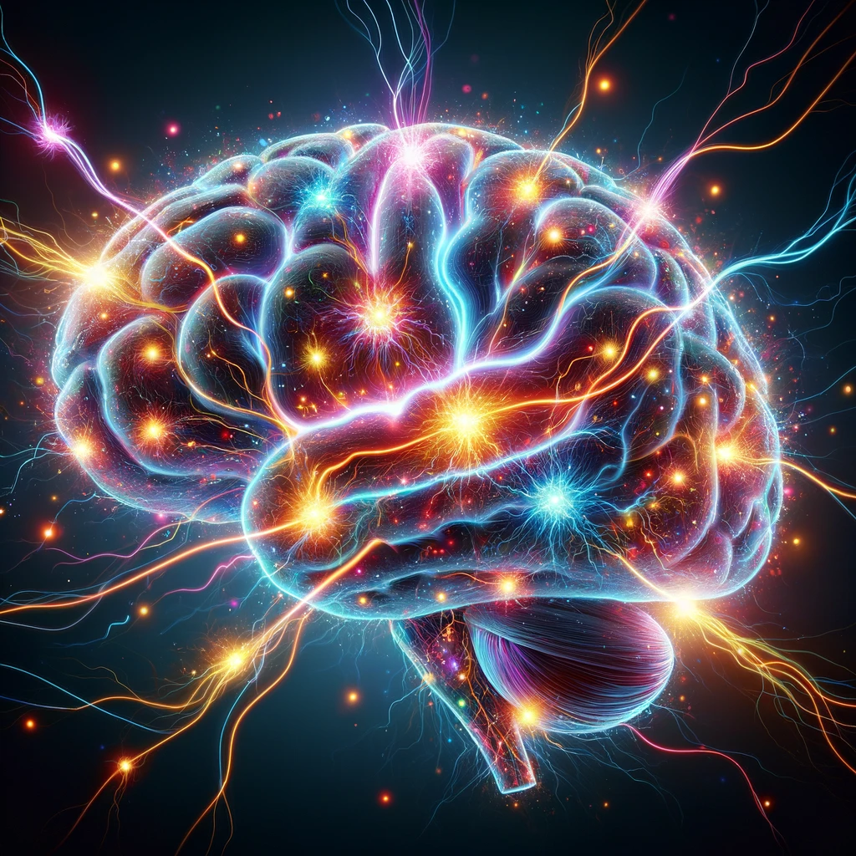
The problem of representation
External object
Represented by
Brain processes
How do biochemical events in the brain represent the external world?

Slide 17
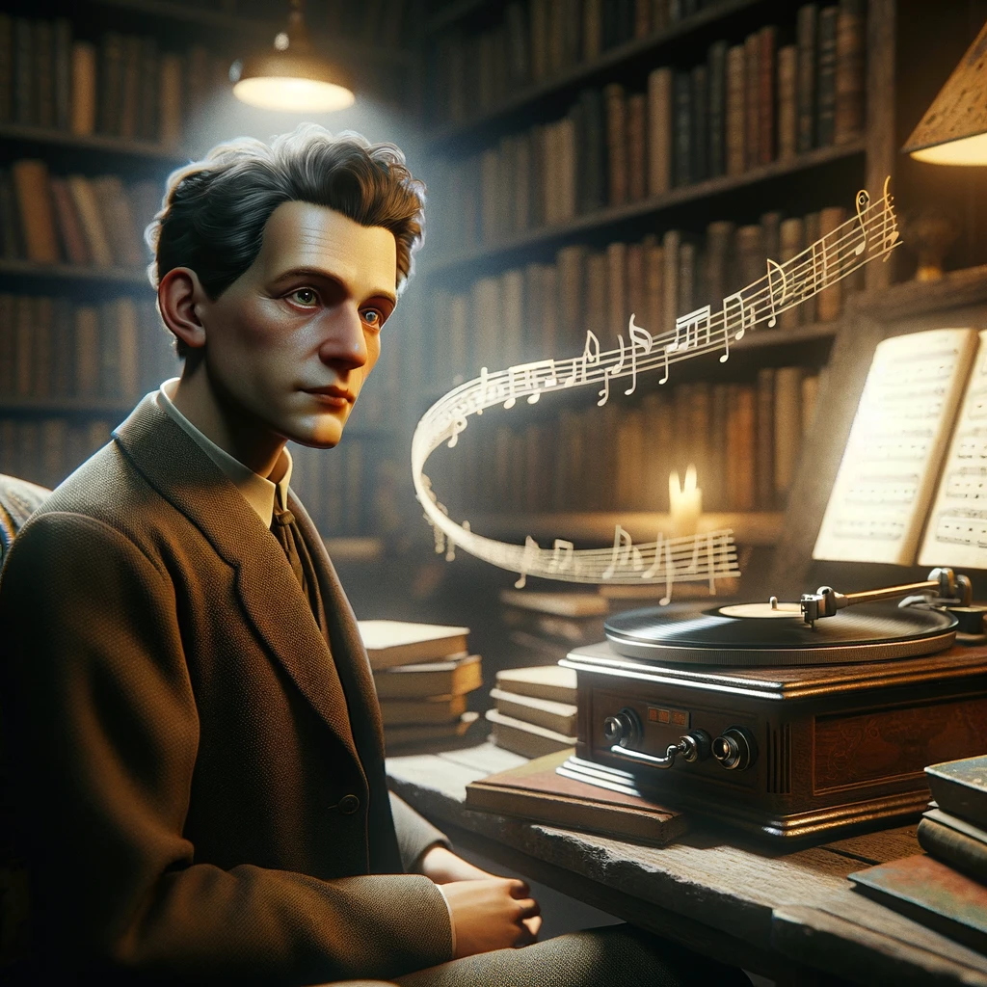
Wittgenstein would say that they share logical forms
Wittgenstein claims that brain process can represent the outside world even if they do not look like them, because they share logical form. Just as the music, the musical score and the groves on a record all share logical form, i.e they can be used to manifest each other.

Slide 18
Key terms to know
External objects: Objects that exist outside the mind and can cause certain sense-data in the mind.
Representation: The idea that one thing can represent another, i.e. be ‘like it’, ‘similar to it’ in some way. Make it present again to us.
Best hypothesis: The best theory given that we have a more than one possible explanation available.

