Slide 1

Scepticism and Knowledge
EPISTEMOLOGY
Can we really know anything? Two forms of scepticism, their reasoning, and why the challenge matters.
Notes:
Opening question for the class: name one thing you are absolutely certain of. Keep their answers — we test them later in the lesson.

Slide 2


Ordinary vs philosophical scepticism
Ordinary scepticism
Philosophical (radical) scepticism
Doubting claims we would happily admit we don’t know.
Doubting claims we ordinarily think we do know.
Example: “I don’t know whether there is an even number of stars in the Milky Way.”
Example: “I don’t know that the sun will rise tomorrow.”
Nobody is troubled by this.
This attacks common sense itself.
Notes:
Key point: the difference is the RANGE of claims doubted, not the attitude. Philosophical sceptics say the only justified attitude to these claims is suspension of judgement — neither belief nor disbelief. Source: Stanford Encyclopedia of Philosophy, “Skepticism” (Comesaña and Klein, 2026), section 1.

Slide 3

Local vs global scepticism
Local
Global
Doubts knowledge in one area only, e.g. the future or the external world.
Doubts all knowledge — even claims about our own minds.
How far does the doubt reach? (smallest → largest)
Cartesian
any belief about the external world
Pyrrhonian (global)
no proposition whatsoever
Humean
beliefs from non-deductive inference
Notes:
The SEP ranks three forms by how large the doubted class of propositions is. The authors use these labels without claiming historical accuracy. Ask: is global scepticism self-refuting? The SEP argues it is not obviously so — the Pyrrhonian suspends judgement on scepticism itself too.

Slide 4
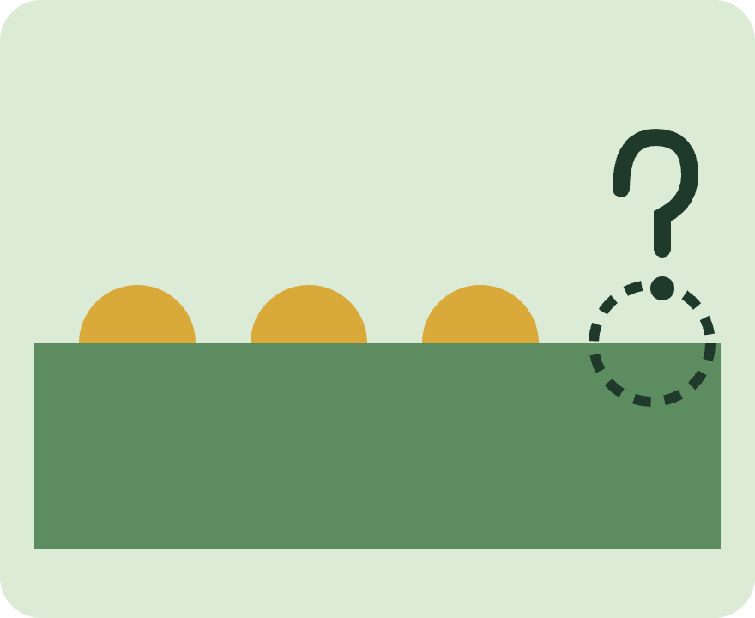
Humean scepticism: the problem of induction
FORM 1 · LOCAL
Induction relies on the Principle of the Uniformity of Nature: the unobserved will resemble the observed.
We could know PUN only by deduction or by induction.
Deduction gives only necessary truths — PUN is not necessary.
Induction already assumes PUN — circular.
So we cannot know PUN, and have no inductive knowledge.
Notes:
The Humean sceptic grants knowledge from direct experience and deduction — so this is local. Target: anything known by non-deductive inference, including much of science. Source: SEP section 3, reconstructing Hume’s Treatise (1739).

Slide 5
Evaluating Humean scepticism
Strength
Confront it
Concede it
Simple, valid structure. Even scientific laws rest on past observation, so the doubt spreads widely.
Inductive solution (Van Cleve): the circularity is harmless.
Rationalist (Kant): we know PUN a priori.
Popper: accept the conclusion — science and daily life don’t need inductive knowledge.
Judgement prompt: if Popper is right, is losing inductive knowledge really a loss at all?
Notes:
Responses range from confrontational (reject a premise) to concessive (accept the conclusion). All three named responses are from SEP section 3.

Slide 6

Cartesian scepticism: the evil demon
FORM 2 · BROADER
A sceptical hypothesis: a demon (or a brain in a vat) gives you all your experiences, so you can’t tell it apart from reality.
CP1 If I’m justified in believing “I have hands”, I’m justified in believing I’m not deceived.
CP2 I’m not justified in believing I’m not deceived.
So I’m not justified in believing I have hands.
Notes:
CP1 comes from the Closure Principle: if p entails q and you’re justified in believing p, you’re justified in believing q. Cartesian scepticism still allows knowledge of our own mental states (“it seems I have hands”), so it is broader than Humean but not fully global. Source: SEP section 4; Descartes, Meditations (1641).

Slide 7
Evaluating Cartesian scepticism
Attack CP1: Dretske’s zebras
Attack CP1: Nozick’s tracking
I know it’s a zebra, yet can’t rule out a disguised mule — so closure fails?
Knowledge needs sensitivity; but sensitivity looks too strong (the lemonade case).
Attack CP2: Williamson
Contextualism
Evidence is what we know — so the good case gives more evidence than the bad.
“Know” shifts with standards: sound in the seminar, false in everyday talk.
Weakness of the replies: each pays a price — rejecting closure, or needing a separate argument that we have some justification.
Notes:
All responses from SEP sections 4–5. Contextualism concedes most to the sceptic but, the SEP notes, still relies on an independent argument that we are minimally justified in rejecting sceptical hypotheses. Further: Wright’s “entitlement” — we may accept we are not deceived without evidence.

Slide 8
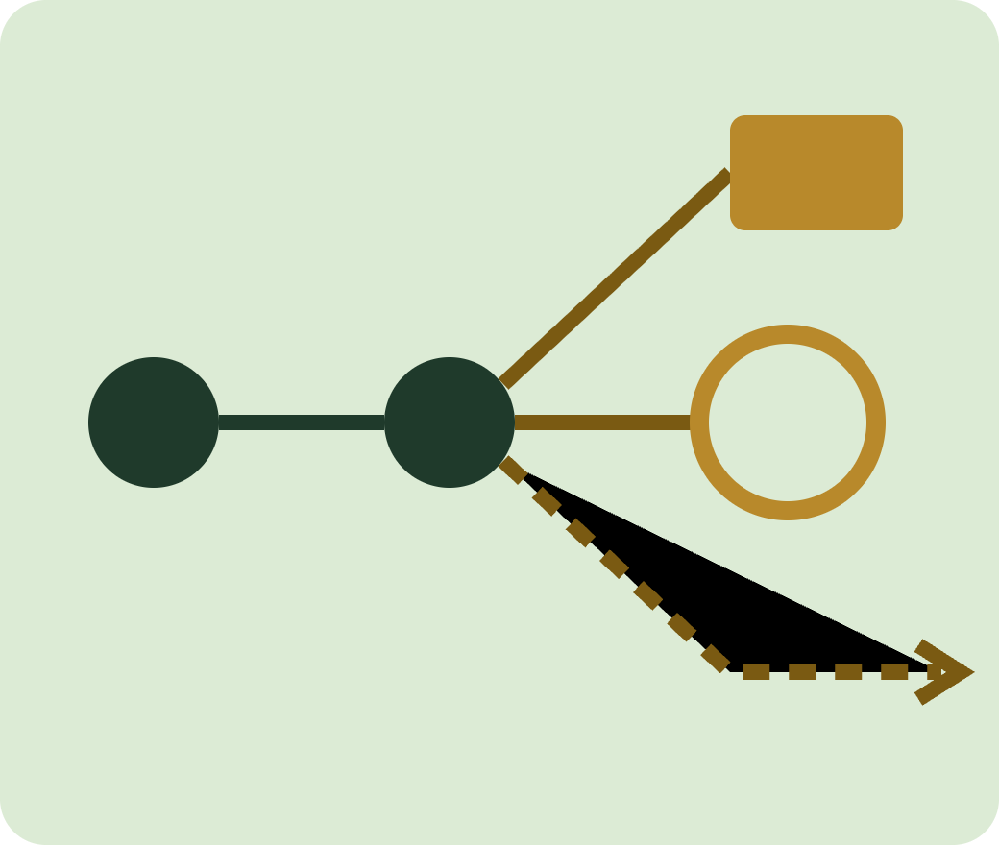
The challenge to knowledge
Most accounts say knowledge needs belief, truth and justification.
Scepticism targets the justification link: if we can’t justify our beliefs, we lack knowledge — even when the beliefs are true.
Global scepticism goes further with Agrippa’s trilemma: every chain of reasons must stop, loop, or go on forever.
Stop → foundationalism
Loop → coherentism
Forever → infinitism
Notes:
Each horn of the trilemma has produced a major theory of justification — see SEP section 6. This is the bridge to the next slide: scepticism shapes epistemology.

Slide 9

Foundationalism explained
REPLY 1 · THE CHAIN STOPS
Rejects Agrippa’s premise 2. Some beliefs are basic: justified, but not by other beliefs. Every other justified belief rests on them.
What justifies basic beliefs?
Traditional
Moderate
Basic beliefs are only about experience: “I seem to see a tomato.” We can’t be wrong here.
Experience can justify world beliefs directly: “There is a tomato.”
Experience. Experiences represent the world, like beliefs, but are not beliefs.
Notes:
SEP 6.1. Experiences can misrepresent (the Müller-Lyer illusion: the lines look different lengths without our believing they are), which shows experiences are not beliefs. A second split: deductivists say basic beliefs must logically entail the beliefs they support; non-deductivists also allow good inductive support. Traditional foundationalists tend to be deductivists; moderates tend to be non-deductivists. Traditional + deductive means no justified belief could be false — most epistemologists see that infallibilism as a reason to reject the combination.

Slide 10
Evaluating foundationalism
REPLY 1 · EVALUATION
Strengths
Problems
Chains are finite and never circular.
Traditional version: a foundation we can’t be wrong about.
Moderate version: fits how we actually know the world.
Mode of hypothesis: if no belief supports a basic belief, isn’t it a blind assertion?
Why does experience justify? Is it a brute fact, our own reflection, or a reliable link to the world?
Risk both ways: we can misjudge even our own experiences.
Judge: is “experience” a real foundation, or just the point where we stop asking?
Notes:
SEP 6.1. The three answers to “what makes epistemic principles true?”: primitivism (bedrock facts, nothing more to say — Chisholm), internalism (facts about us, e.g. what we’d accept on deep reflection — Foley), externalism (experiences reliably connected to truth — Goldman 1979). Moderate’s reply to traditional: we can be wrong about which beliefs about our own experiences are basic — e.g. believing we are in pain when the feeling is only acute discomfort.

Slide 11
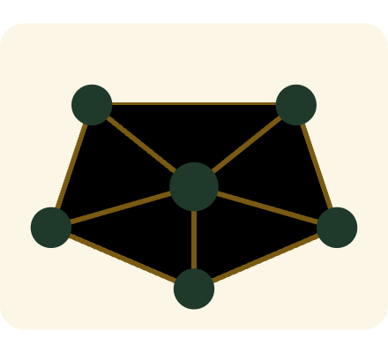
Coherentism explained
REPLY 2 · THE CHAIN LOOPS
Rejects Agrippa’s premise 3. Justification is not a line of single beliefs but a web of beliefs supporting each other.
Symmetrical
Holistic
A matter of degree
Belief A can support B while B also supports A.
Whole systems are justified first; single beliefs by belonging to one.
The more beliefs explain each other, the more coherent.
Notes:
SEP 6.3. Coherentists reject two features of Agrippa’s picture: that justification is asymmetrical, and that the unit of justification is the single belief. Coherence is comparative: system B1 is better justified than B2 if it is more coherent. Many coherentists use explanatory relations to measure coherence (Quine and Ullian, The Web of Belief; BonJour 1978).

Slide 12
Evaluating coherentism
REPLY 2 · EVALUATION
Strengths
The isolation objection
No arbitrary starting point.
Matches how science tests theories as a whole.
Explains why justification comes in degrees.
You are reading; I am swimming. We somehow swap belief systems. Each stays just as coherent — yet now you believe you’re swimming. Coherence kept, justification lost.
Reply: a system must include beliefs about current experience (BonJour, Lehrer).
Judge: the SEP notes there is no agreement that this reply works. Does it quietly bring back foundations?
Notes:
SEP 6.3. The objection rests on the strong intuition that experience plays a very important role in justification, which pure coherence among beliefs ignores. The “science as a whole” strength is a teaching gloss linked to Quine, not a claim made in the SEP entry.

Slide 13
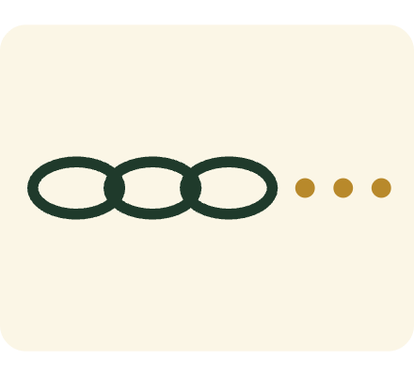
Infinitism explained
REPLY 3 · THE CHAIN NEVER ENDS
Rejects Agrippa’s premise 5. An infinite chain of reasons can justify a belief. Its main defender is Peter Klein.
No stop
No loop
Available reasons
Unlike foundationalism, no belief is accepted without a reason.
Unlike coherentism, a reason never returns to support itself.
Reasons need only be implicit: ready if someone asks.
Notes:
SEP 6.2. Infinitism has had the least attention of the three replies, partly because of its apparently serious obstacles. Klein 1999 and 2007 and Aikin 2011 defend it. The implicit-beliefs idea is the infinitist’s reply to the objection on the next slide.

Slide 14
Evaluating infinitism
REPLY 3 · EVALUATION
Strengths
Problems
Every belief has a reason behind it.
Avoids both the arbitrary stop and the circle.
Finite minds: nobody has infinitely many beliefs. Reply: implicit ones are enough — but what is an implicit belief?
Borrowed justification: one unjustified reason can’t justify; why would endless unjustified ones?
Isolation: like coherentism, it ignores experience.
Today: many philosophers combine views, e.g. Haack’s mix of foundationalism and coherentism.
Notes:
SEP 6.2 and 6.5. The second problem rests on the Principle of Inferential Justification: if S is justified in believing p on the basis of q, S must be justified in believing q. The infinitist replies that each reason is justified by the next, but the critic says the same worry applies to the whole chain. Haack 1993: Evidence and Inquiry. The SEP calls the continuing struggle a sign of how lasting Pyrrhonian scepticism is.

Slide 15



Few believe it — so why study it?
Almost no philosopher thinks scepticism is true. It matters because its arguments are hard to answer, and the answers shape modern theories of knowledge.
Forces us to define what justification really is.
Produced foundationalism, coherentism, contextualism and more.
Teaches intellectual humility about how certain we are.
Notes:
The SEP states that contemporary philosophers find Pyrrhonian scepticism interesting not because they think it might be true, but because responding to its arguments shapes epistemological theory (section 2). The humility point is a teaching extension, not from the source.

Slide 16
Glossary
Term | Meaning
Scepticism | The view that we lack knowledge we usually think we have
Suspension of judgement | Neither believing nor disbelieving a claim
Local / global | Doubt about one area of knowledge / about all knowledge
Induction | Reasoning from past cases to new ones
Uniformity of Nature | The assumption that the future will resemble the past
Sceptical hypothesis | A scenario we can’t tell apart from reality, e.g. the evil demon
Closure Principle | If you’re justified in p, and p entails q, you’re justified in q
Contextualism | The standard for “know” changes with the conversation
Agrippa’s trilemma | Reasons must stop, loop, or run on forever

Slide 17
Questions
1 · Recall What is the difference between ordinary and philosophical scepticism? Give an example of each.
2 · Recall Explain the difference between local and global scepticism.
3 · Explain Set out the Cartesian sceptical argument in three steps.
4 · Apply Why does Hume think induction is circular?
5 · Evaluate “Scepticism cannot be refuted, but it is still worth studying.” Discuss.
Notes:
Questions build from recall to evaluation so every student has an entry point. Q5 suits an extended response.

