Slide 1
Cosmological argument

Slide 2
Technical terminology
Necessary - a proposition that must be true or false, a state of affairs that must hold.
Contingent – a proposition that may or may not hold.
Sufficient reason – a reason that explains why something is X and not Y.
Temporal cause – a cause of an event, that comes first in a temporal sequence.
A sustaining cause – a process that sustains another thing in existence over a period of time.

Slide 3
Cosmological argument
The cosmological argument for the existence of God is an argument that in some sense reaches right back to Aristotle, who understood there to be a first mover of all things in the world. However, Aristotle was working in a pre-Christian age and understood the world to be eternal.
In the words of Anselm, the argument wants to prove the existence of a first ‘supreme’ being, that exists through itself’.

Slide 4
Anselm writes that…
‘That there exists a nature, through which everything that exists exists, which exists through itself, and which is, of all things that exist, supreme.’
Anslem of Canterbury; The monologion

Slide 5
There are some basic mediaeval axioms that were accepted.
‘Everything that exists, exists either through something or through nothing. But nothing exists through nothing.’
That everything that exists, has a cause of its existence.
An infinite regress of causes is not possible. There must be some one thing that is the cause of itself.

Slide 6
The first form of the argument…
The first form of the argument we are aware of, is the Kalam argument, developed by the Islamic schools of the early middle ages. This argument can be put as follows.
1. Everything that exists has a cause.
2. The world (universe) exists.
3. Therefore, the world (universe) has a cause.

Slide 7
Temporal and sustaining cause.
In order to fully understand the cosmological argument as developed by Aquinas, it is necessary to understand the distinction between a temporal and a sustaining cause.
1. A temporal cause is a cause which can cease to exist, even while its effect continues.
2. A sustaining cause, is a cause that is concomitant with its effect.
In both arguments it is sustaining cause that he is interested in.

Slide 8
Aquinas’ argument from motion
1. We find in the world sustaining causes and effects.
Nothing can causally sustain itself and thus depend on itself.
Sustaining causes follow in order, the first causes, the second which, causes the third.
If you remove the cause, you remove the effect.
If there is no one cause that does not depend on any other causes we have an infinite regress.
There cannot be an infinite regress.
So, there must be a first sustaining cause, which is not itself caused.
God is the first sustaining cause.
Ergo, God exists.

Slide 9
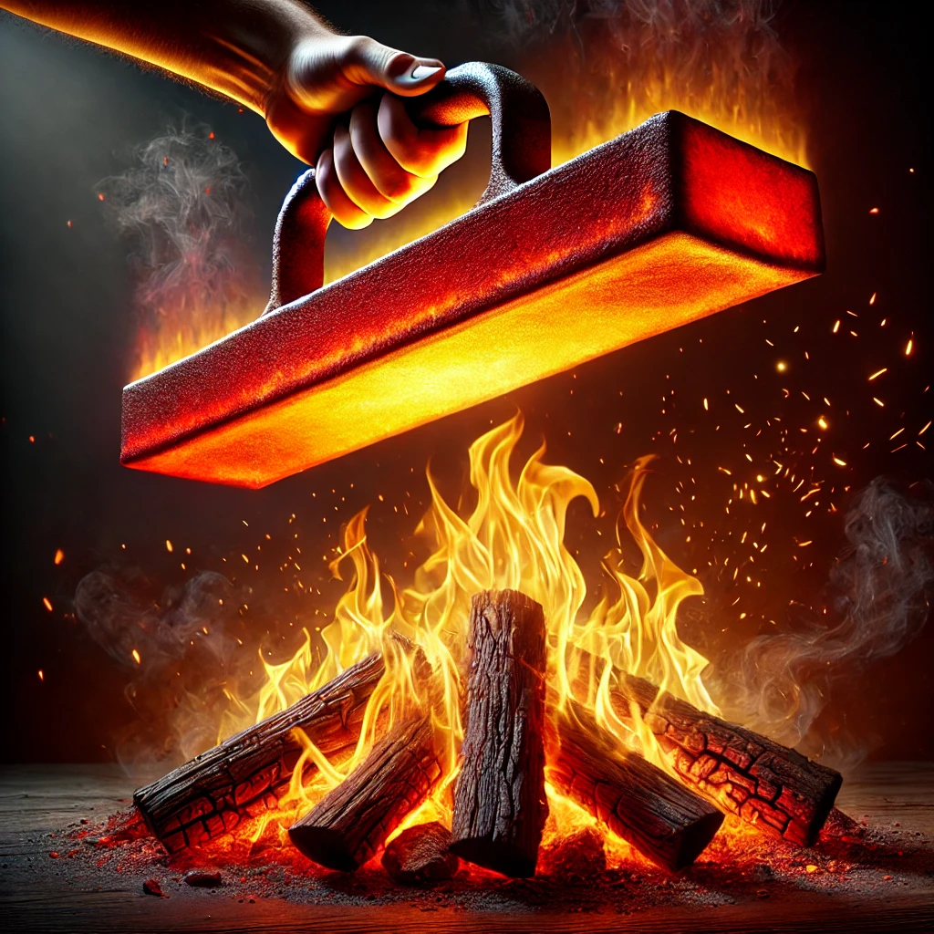
Commentary
Aquinas used the following passage from the Bible, Romans in which we read, ‘For from Him and through him and unto him are all things’.
We are bound to conclude that everything that is at all real, is from God. For when we encounter a subject which shares in a reality then this reality must needs be caused there by a thing which possesses it of its nature, as when, for example, iron is made red-hot by fire’.

Slide 10
Aquinas continued
‘It follows that all things that are diversified by their diverse sharing in existence, so that some are fuller beings than others, are caused by one first being which simply is in the fullest sense of the word.’ Aquinas

Slide 11
Three problems with the cosmological argument
1: The causal principle (the idea that everything has a cause) cannot be known analytically.
2: An infinite regress is possible.
3: We cannot infer the existence of God, from the existence of a first cause.

Slide 12
We cannot know the causal principle a priori
‘Tis a general maxim of philosophy in philosophy, that whatever begins to exist, must have a cause of existence. This is commonly taken for granted in all reasonings, without any proof given or demanded’.
Hume we cannot know that all objects have a cause a priori. The claim that all the events have causes is only a matter the fact that we constantly see certain causes and effects combined. We cannot know this a priori.

Slide 13
Hume and the causal principle…
‘We can never demonstrate the necessity of a cause to every new existence , or new modification of existence , without without shewing at the same time the impossibility, that any thing can begin to exist without some productive principle; and where the latter proposition cannot be proved, we must despair of ever being able to prove the former. Now that the latter proposition is utterly incapable of a demonstrative proof, we may satisfy ourselves by considering, that all distinct ideas are separable from each other, and as the ideas of cause and effect are evidently distinct, twill be easy for us to conceive an object to be non-existent this moment, and existent the next, without conjoining to it the idea of a cause or productive principle ’ David Hume.

Slide 14
The possibility of an infinite regress of causes
Some argue that it is not possible for there to be an infinite regress of causes. That if there was we could not explain the age of the universe. For example, we if the universe is infinitely old, then infinity plus one is infinity, and that would make the universe the same age everyday. That seems absurd so it cannot be true.
However, the idea of a universe is not self contradictory, and so we cannot rule it out a priori.
Aquinas will argue that even though the idea of an infinity is possible, the reality of impossible.

Slide 15
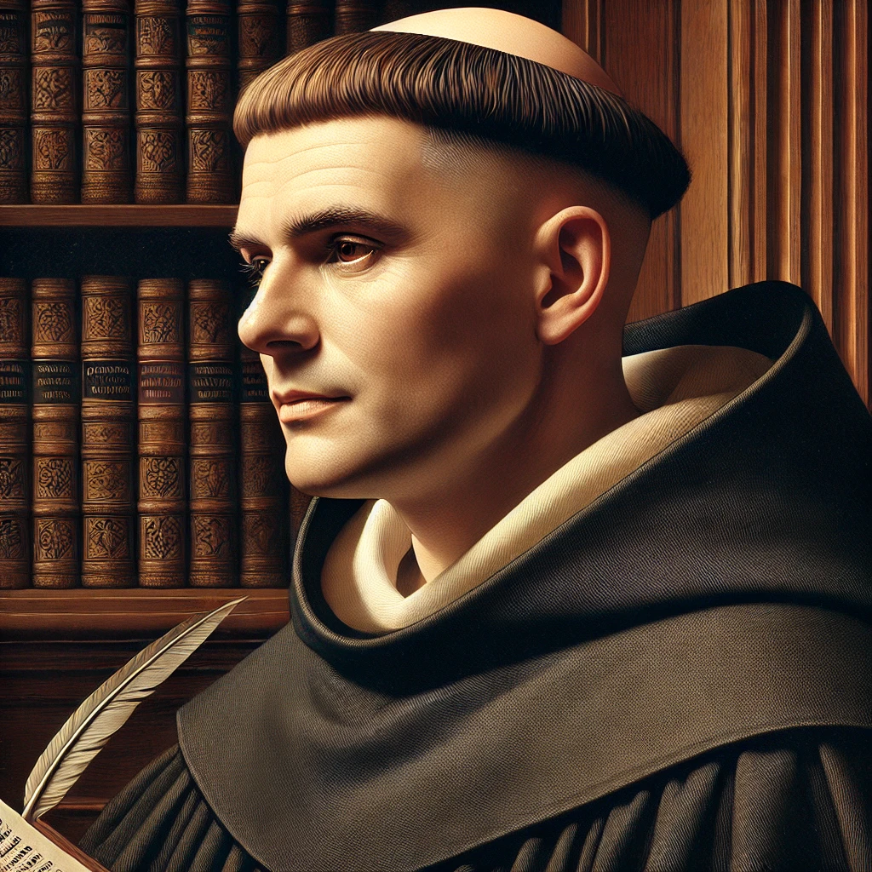
Aquinas’ Third way
Things in the universe exist contingently.
If it is possible for something not to exist, there is a time it did not exist.
If everything exists contingently then it is possible that there was a time when nothing existed.
From nothing, nothing can come into existence.
Since things do exist, there was never nothing in existence.
Therefore there is something that is not contingent but necessary.
This necessary being is God.

Slide 16
Leibniz’s argument from contingency
Leibniz thinks that every event has a ‘sufficient reason’. A sufficient explanation gives the reason why X is as it is, and not otherwise.
‘For neither in any one single thing, nor in the whole aggregate and series of things, can there be found the sufficient reason for existence…And so however far back to earlier states, you will never find in those states a full reason why there should be any world rather than none, and why it should be such as it is.’

Slide 17
Leibniz cosmological argument
1. Every fact has a sufficient reason why it is as it is, and not otherwise.
2. There are truths of reason and truths of fact.
3. Truths of reasoning (e.g maths) are necessary. And we can find the sufficient reason but understanding why it is necessary.
4. Truths of facts are contingent, and their reason can be given in more and more detail. But we cannot get a sufficient reason for them, from them alone.
5. All facts need to be explained by recourse to other facts.
6. To find a sufficient reason for contingent facts we must look outside the sequence of facts.
7. The sufficient condition for a fact must be necessary.
8. This sufficient reason is God.

Slide 18
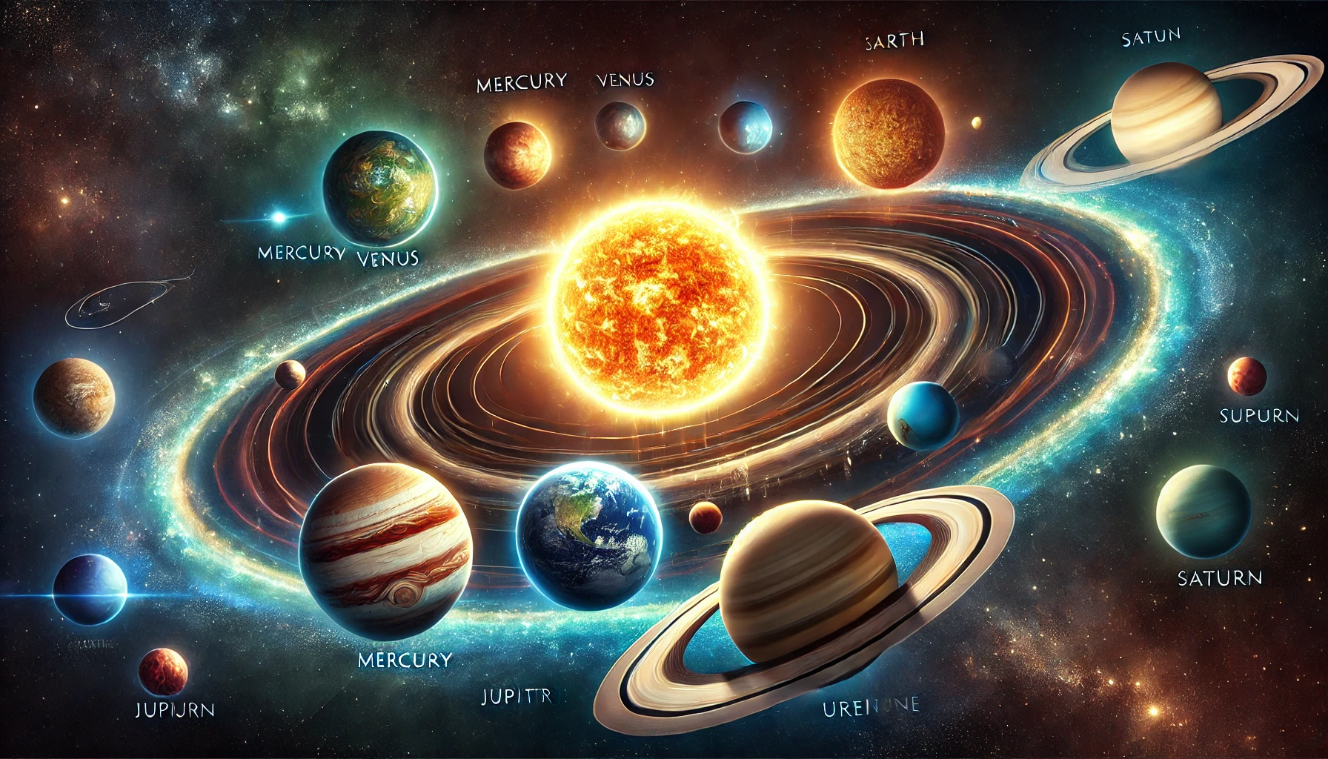
The reason of the world
‘The reason of the world then life in something extramundane, different from the chain of states, or series of things, whose aggregate constitute the world.’
A sufficient reason (God)
Nothing

Slide 19

Bertrand Russell
1. Russell claims that was committing two mistakes. Firstly, he denied that we can know a priori that every event has a sufficient cause. In undermining this principle he was doing what Hume had also done.
2. He claimed that Leibniz and Aquinas were committing the fallacy of composition. This is the mistake of attributing something true of the parts to the whole. For example, even though every sheet of paper in the pile of papers is thin, that does not make the pile of papers thin.

Slide 20
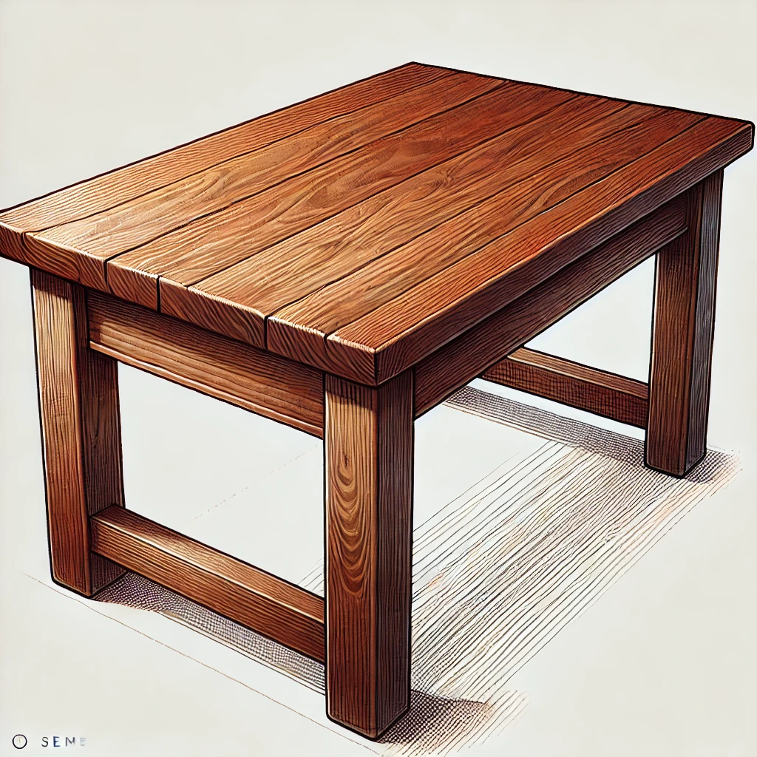
Response to Russell
1. Not all instances of inference from parts to whole commits the fallacy of composition. For example, each piece of a wooden table is wooden, which would also mean that the table is wooden.

Slide 21
The impossibility of a necessary being
Hume and Russell denied that there can be such a thing as a necessary being. This is based on the idea that conceivability entails possibility. In other words that which we can imagine is possible.
The claim is that we can imagine a God existing and a God not existing and this means that there is no clear idea of a necessary being, only of a contingent one. The only things that are necessary are ‘relations of ideas’.

Slide 22
Questions
1. Outline and explain the first cause argument for the existence of God. (12)
2. Outline and explain some objections to the first cause argument (12)
3. Outline and explain Aquinas’ third way (12)
4. Outline and explain Leibniz’s cosmological argument from sufficient reason (12)
5. Outline and explain the objections to this from Hume and Russell. (12)

