Slide 1
Infallibilism

Slide 2
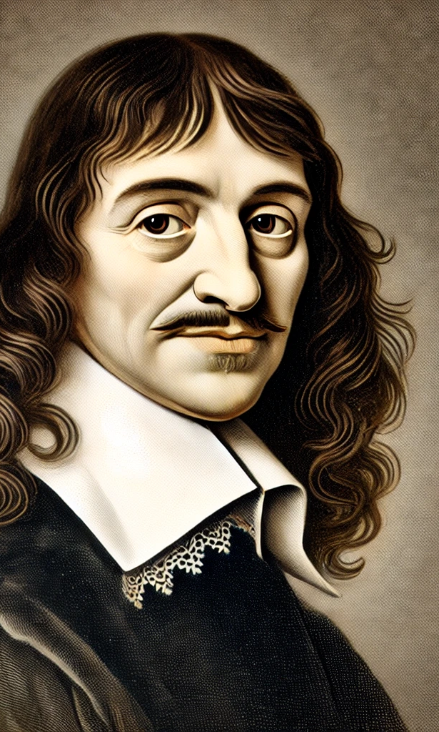
infallibilism
Key thesis: To be knowledge a belief must be certain, if we can doubt a belief then it is not certain, and so it is not knowledge.
We could perhaps put it like this, to know, you must know that you know.

Slide 3
Infallibilism is about justification
The tripartite view of knowledge claims that for your knowledge to count as belief, you need justification, however, it is not clear on what we mean by justification (other then the fact it is some evidence that counts towards the belief).
For infallibilism justification requires certainty, that is actual justification makes one certain. We could say that if a belief is not held with certainty by a person, it is a stretch to count it as knowledge. Which means that beliefs are rarely if every fully justified.

Slide 4
Infallibilism
The problem that any definition of truth has, is how to ensure that justification can guarantee knowledge. The fact is that we can think of justification as something that raises our evidence for knowledge, or we can think of justification as coming from the knowledge. The first does not guarantee truth, while the second cannot be known in advance.
The concept certainty can work in different ways.
I can feel certain.
or
(2) The belief itself can be impossible to doubt.

Slide 5

(1) The feeling of certainty does not equate to knowledge.
The feeling of certainty clearly will not count as a form of justification. This is because one can feel certain and most certainly be wrong about that which you feel certain. For example, I may believe that the earth is flat and yet it is, was and always will be round. Just because there is a psychological or subjective feeling that attends a belief does not make it true.

Slide 6
(2) The belief can be impossible to doubt when considered.
This version of certainty is caused by the belief not supportive of the belief. In other words when one is considering the belief, the belief authenticates itself. This is why the cogito, is a good example of certainty, because entertaining the belief is what causes the certainty in it.
No one can know what is false.
Ergo, if I know P, I can’t be mistaken about P.
Therefore, justification must guarantee truth.
If I am justified in believing that P, I can’t possibly be mistaken.
Therefore, if it is possible that I am mistaken, then I can’t be justified in believing that P.
Therefore, infallibilism is true.

Slide 7

Infallibilism
So infallibilism is a form of the tripartite definition of truth. It claims that the reason Jones does not know the proposition that ‘The man who will get the job has 10 coins in his pocket’ is that Jones is not justified in that belief.

Slide 8
Infallibilism claims that…
To know P, it must be impossible to doubt P.
1: It must be true.
2: it is believed because it is impossible to doubt.
3. It is justified because of 2.

Slide 9
Infallibilism
Two problems with infallibilism
if infallibilism is true then we have very little knowledge. This is because the level of justification we would need for knowledge would be too high.
Might infallibility be a vice rather than a virtue, which does not allow us to have a definition of knowledge that is broader?

Slide 10
Ambiguity of infallibilism
There is a difference between the following to propositions.
(1) I can’t know what is false. – This is correct.
(2) If I know I can’t possibly have been mistaken. – This is not correct, because even when we know, from sense-perception, that does not mean we were guaranteed to know. Infallibilism seems to go with this stronger claim.

Slide 11
Questions
1. What is infallibilism? (3)
2. Explain the difference between feeling certain about a belief and being certain because you have entertained the belief. (5)
3. Explain what the difference between the claim, that ‘You cannot know what is false’ and the claim that ’when you know you could not possibly have been wrong’. (5)
4. Outline and explain how infallibilism tries to solve with the Gettier problem. (12)

Slide 12
Question 1: answer plan
Aim: a precise definition in two or three sentences. No examples needed.
Infallibilism is a theory of justification: a belief is only knowledge if its justification guarantees that it is true.
So knowledge requires certainty: if it is possible to doubt P, then you do not know P.
It keeps the tripartite (JTB) definition but raises the standard for the justification condition.

Slide 13
Question 2: answer plan
Plan: define each kind, give one example of each, then state the difference.
Feeling certain is a psychological state: strong confidence in a belief. Someone can feel certain the earth is flat and still be wrong, so the feeling is not justification.
Certainty from entertaining a belief means the belief is impossible to doubt while you consider it, because considering it confirms it.
Example: Descartes’ cogito. Doubting that I am thinking is itself thinking, so the belief cannot be false while I hold it.
The difference: the first is about the believer (subjective, can be mistaken); the second is about the belief (self-confirming, cannot be false). Only the second could meet the infallibilist standard.

Slide 14
Question 3: answer plan
Plan: explain claim 1, explain claim 2, give an example that separates them, conclude.
“You cannot know what is false” is true by definition: knowledge requires truth, so if I know P, P is true. It describes what knowledge is.
“If you know, you could not possibly have been wrong” is a much stronger claim about justification: my evidence must rule out every possibility of error.
Example: I see my keys on the table and know they are there. P is true, so claim 1 is met. But my eyes could have misled me, so claim 2 fails, yet we still call it knowledge.
Conclusion: infallibilism moves from the true claim 1 to the stronger claim 2, but claim 2 does not follow from claim 1.

Slide 15
Question 4: answer plan
No evaluation needed: marks come from precise terms and each step following from the last.
1. Tripartite view: S knows P if and only if P is true, S believes P, and S is justified in believing P.
2. Gettier’s job case: Smith has strong evidence that Jones will get the job and has 10 coins, so infers “the man who will get the job has 10 coins”. In fact Smith gets the job, and he also has 10 coins.
3. The problem: Smith’s belief is true, believed and justified, but true by luck, so it is not knowledge. JTB is not sufficient.
4. Diagnosis: the case only works because Gettier assumes justification can be fallible: Smith is justified in a false belief (that Jones gets the job).
5. Infallibilist response: justification must guarantee truth. Smith’s evidence could be doubted and led him to a falsehood, so he was never justified. The J condition fails, so it is not a counterexample.
6. Conclusion: a guaranteed belief cannot be true by accident, so infallibilism removes the luck and keeps the tripartite definition, at the cost of a much stricter J condition.

