Slide 1
The design argument

Slide 2
The design argument
Key Idea: The design argument for the existence of God, claims that the order, sophistication, and functional properties that we find in the universe, can best be explained, as the result of a deliberate act of design by an intelligent being. This being is best understood as the God of monotheism.
There are two forms of the design argument:
From the existence of spatial order.
From the existence of temporal order.

Slide 3
Two forms of design
The existence of spatial order. – The existence of an eye.
The existence of temporal order. – The movement of the planets.

Slide 4
The spatial form has two versions
The first form of the argument we consider is that developed by David Hume (which is a pure analogical version of the design argument). It claims that we can infer by analogy a personal intelligent designer of the world, in the same way we make the claim with human objects of design.
The second form of the argument, which is similar although different from analogical versions, is that developed by William Paley. His claim is that we can attribute the same property of intelligence to the creator for the world, that we can attribute to human beings.

Slide 5
Hume dialogues of natural religion
‘The curious adapting means to ends, throughout all nature, resembles exactly, though it much exceeds, the production of human contrivance, of human design, thought, wisdom, and intelligence. Since the effects resemble each other, we are led to infer, by all the rules of analogy, that the causes also resemble; and that the author of nature is rather similar to, the mind of man; though possessed of much larger faculties, proportioned to the grandeur of the work, which he has executed. By this argument a posteriori, and by this argument alone, we can prove at once the (the) existence of a Deity, and his similarity to human mind and intelligence.’
Hume dialogues on natural religion.

Slide 6
David Hume: The analogical version
1. The products of nature, resemble the products of human design, this is because these objects have properties that mean that they can fulfil a specific function. (think of the properties of the human eye).
2. Similar effects have similar causes.
3. The cause of a product of human design is an intelligent mind that had intended the object and worked according to a blueprint in the mind.
4. Ergo, the cause of nature is an intelligent mind, that had the blueprint in its mind and intended the design.

Slide 7

William Paley’s design argument
‘In crossing a heath, suppose I pitched my foot against a stone, and were asked how the stone came to be there; I might possibly answer, that, for anything I knew to the contrary, it had lain there forever: nor would it perhaps be very easy to show the absurdity of this answer. But suppose I had found a watch upon the ground, and it should be inquired how the watch happened to be in that place; I should hardly think of the answer I had before given, that for anything I knew, the watch might have always been there. (...)’

Slide 8
William Paley’s design argument
‘There must have existed, at some time, and at some place or other, an artificer or artificers, who formed [the watch] for the purpose which we find it actually to answer; who comprehended its construction, and designed its use. (...) Every indication of contrivance, every manifestation of design, which existed in the watch, exists in the works of nature; with the difference, on the side of nature, of being greater or more, and that in a degree which exceeds all computation.’
— William Paley, Natural Theology (1802)

Slide 9
Formal version
1. Anything that has parts to serve a purpose if designed.
2. Nature contains things which have parts that are organized to serve a purpose.
3. Therefore, nature contains things that are designed.
4. Design can only be explained in terms of a designer.
5. A designer must have a mind and be distinct from what is designed.
6. Therefore, nature was designed by a mind that is distinct from nature.
7. Ergo, Such a mind exists. (God is this mind).

Slide 10
Hume’s 5 objections
1. The analogy between objects of human design and objects of nature is weak. Also, it is inconsistent with religious ideas that we should not use anthropomorphism.
2. A designer is not the best explanation.
3. We only have one case of the world to go on.
4. We must not attribute more to the cause then we are entitled to.
5. Even if we accept that there is a designer it need not be the God of classical theism.

Slide 11
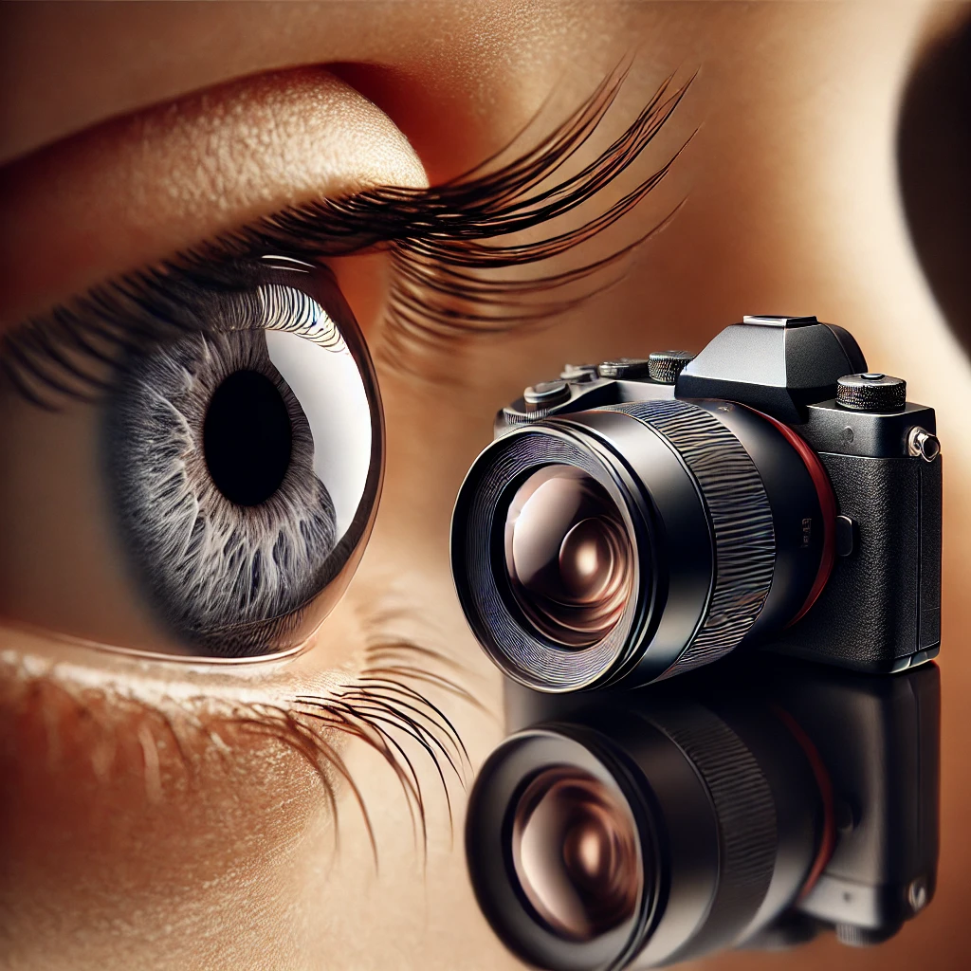
1. Weak analogy
Hume claims that an argument from analogy is only as good as the analogy itself, and it is far from clear that the analogy used here is very good.
Hume then claims that the property of objects being designed by mankind, and the property of the universe being itself designed, are so different that we cannot use analogy in this case.

Slide 12
Hume writes…
‘If we see a house Cleanthes, we conclude with the greatest certainty, that it had an architect or builder; because this is precisely that species of effect, which we have experienced to proceed from that species of cause. But surely you will not affirm that the universe bears such resemblance to a house, that we can with the same certainty infer a similar cause, or that the analogy here is entire and perfect. The dissimilarity is so striking, that the upmost you can pretend to is a guess, a conjecture, a presumption concerning a similar cause; and how that pretension will be received in the world, I leave you to consider.’
David Hume: The dialogues on natural religion.

Slide 13
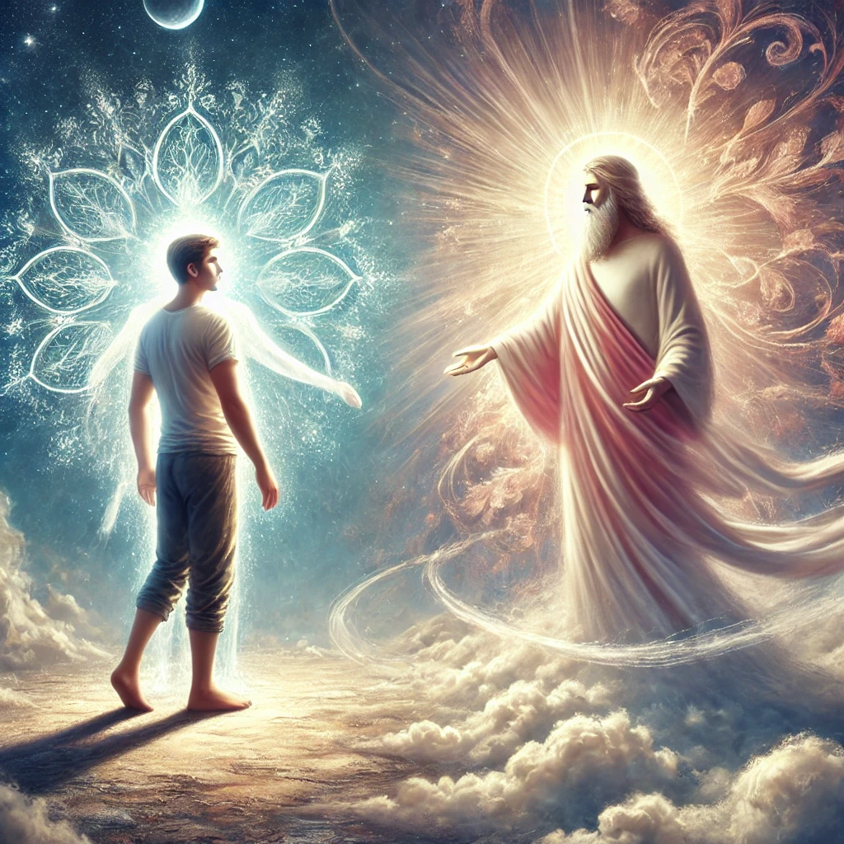
Hume and anthropomorphism
‘Your theory itself cannot pretend to any such advantage; even though you have run into anthropomorphism, the better to preserve a conformity to common experience.’

Slide 14
2. A Designer is not the best explanation
There is no reason a priori to rule out other causes of apparent design in nature, and we should need to rule them out for our belief in a designer to amount to a proof. There could be any number of possible explanations for the order of the universe.

Slide 15
Hume: the epicurean hypothesis
For aught we can know a priori, nature may contain the source or spring of order originally, within itself…’
‘Instead of supposing matter infinite, as Epicurus did; let us suppose it finite. A finite number of particles is only susceptible of finite transportations: And it must happen, in an eternal duration, that every possible order or position must be tied to an infinite number of times. This world, therefore, with all its event even the most minute, has before been produced and destroyed, and will again be produced and destroyed, without any bounds and limitations. No one, who has the conception of the powers of infinite, in comparison with finite, will ever scruple this determination.'

Slide 16
3. We only have one case to go on.
Our justification in the case of inferring causes from effects, is usually a function of experience. If we have seen water boil a 100C countless times, then we will justly assume the same effect to have the same cause. But we only have one instance of the universe to go with, and we cannot with any justice jump from our experience of the universe, to a conclusion about its cause.

Slide 17

hume
‘When two species of objects have been always observed to be conjoined to together, I can infer by custom the existence of one, wherever I see the existence of the other: and this I call an argument from experience. But how this argument can have place, where the object, as in the present case, are single and individual, without parallel, or specific resemblance, may be difficult to explain…To ascertain this reasoning, it were requisite, that we had experience of the origin of the worlds; and it is not sufficient surely, that we have ships and cities arise from human art and contrivance’.

Slide 18
4. We cannot attribute more to the cause than we are entitled to.
Hume makes an important methodological point about just reasoning. Here he claims that when we contemplate causes, we should only, attribute properties to the cause that we need, in order, to explain the effect.
In other words, we should not attribute properties to a hypothetical cause, which are not needed, in order to, explain the effect. There are some inferences we can make about the cause of the world, but not others.

Slide 19

5. Even if there is a designer, it need not be God
This objection claims that even if we could prove the existence of a designer, there is no reason to think that this designer is the God of classical theism, that is omnipotent, omniscient, and omnibenevolent.

Slide 20
William Paley’s argument evaluated
Hume’s objection of analogy does not touch Paley’s argument. This is because Paley does not offer an analogy, what he does it point to the fact that objects of human design have a specific property, say having a function. He then makes the claim that any object which also has that property, must have the same kind of cause, so for example an eye, will have the same type of cause as a camera.
‘Every observation which was made…concerning the watch…, may be repeated with strict propriety…concerning all the organized parts of the works of nature’.

Slide 21
Paley continued
Even though we have never seen the creation of a world, we are entitled, by strict propriety, to conclude that since the world has the same property as a watch it does is caused by the same type of thing as a watch, i.e. a designer.
Paley agrees with Hume that in theory it is possible that something other than God is responsible for the creation of the world, however, he believes that those explanations are logically less plausible than the belief in a God.

Slide 22
Evolution via natural selection
The development of the theory of evolution via natural selection, went a long way to explaining in an empirical way, the phenomenon of apparent design, and also, the fact that animals also have apparent imperfections. The elegance, coherence and empirical justification for the theory lends it a much higher level of credence than the argument from design. Given that the theory does not at first need to postulate the existence of God to make sense of the phenomena, it seems reasonable to abandon the design argument.
The problem that cannot, however, be evaded, is why the laws of nature are such as to enable the existence of animals at all. This means, we need to explain, where, why or how the laws of nature have come into existence.

Slide 23
Swinburne and the argument from temporal design.
There are only two ways to explain regularities in the world. Either, by recourse to impersonal laws of physics, for example the motion of the planets. Or that certain regularities are best explained via decisions and actions of a will. There are no other reasons we can explain regularity.

Slide 24

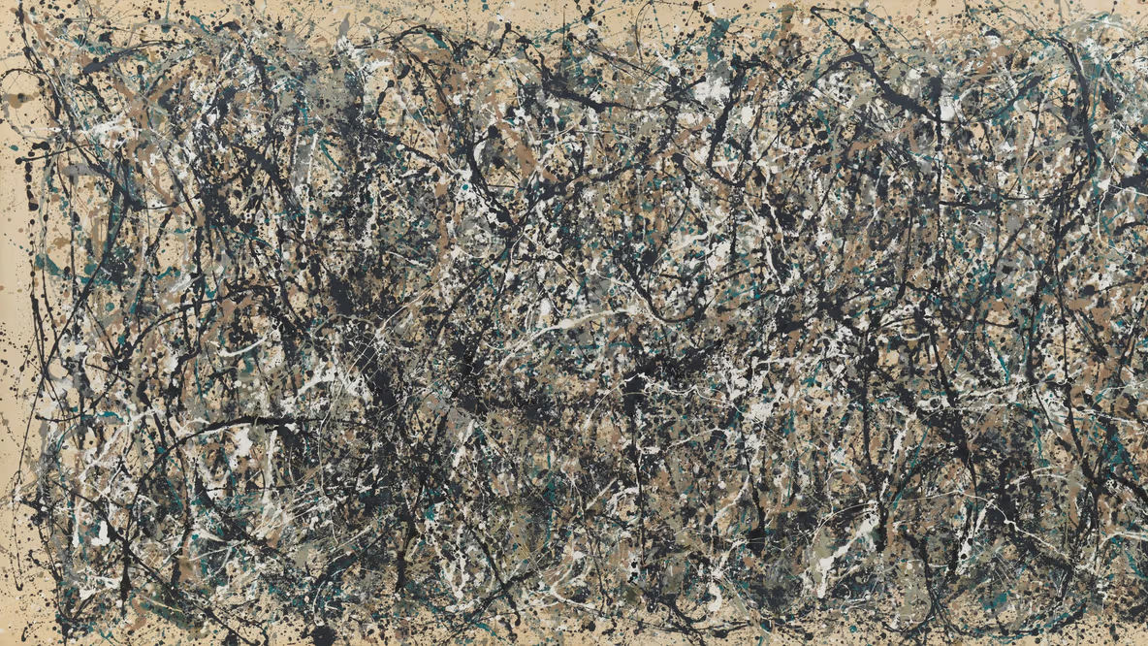
Compare natural regularity and human regularity

Slide 25
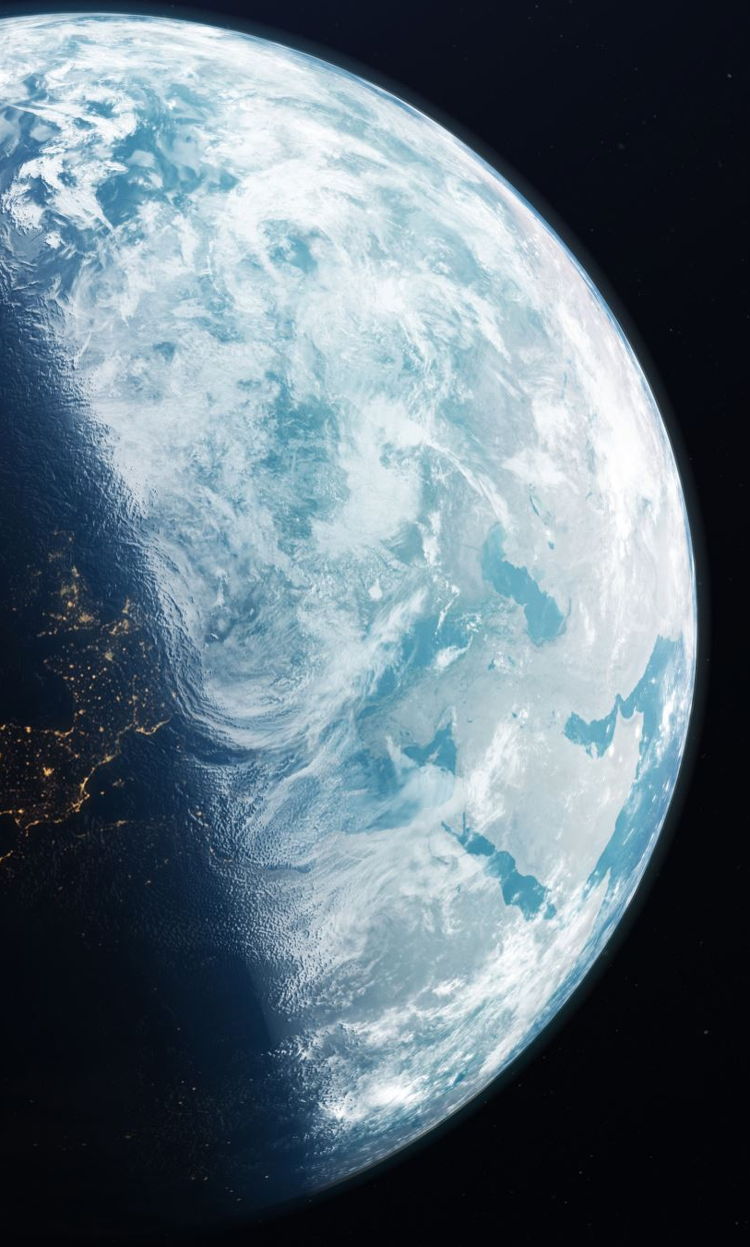
Two origins of regularity
1. Something acts according to the laws of nature. In other words, they keep to these laws, because of their intrinsic nature and relationship to other things. – For example, planets, move around the solar system, according to laws.
2. A person or a will acts under a law, that they could decide to break. In other words, they follow a law. For example, a person may go to work at the same time each day, though they could decide not to follow that law.

Slide 26
Swinburne’s argument
Swinburne claims that we cannot explain the existence of the laws of nature by recourse to other laws of nature. Because that would assume the very thing that we seek to explain. The only alternative we have left is to assume that there is some will that has designed the laws of nature to be the way that they are.

Slide 27
Swinburne’s argument
1. There are temporal regularities related to human action.
2. There are other temporalities related to the laws of nature.
3. So, we can explain the regularities of nature by analogy with personal regularities.
4. There is no scientific explanation for the regularities of nature.
5. There are only two types of explanation. (1 and 2).
6. Therefore, we should explain 2 by recourse to 1.
7. Therefore, the regularities of 2 are explain by a person who wills them.
8. Therefor, such a will exists.

Slide 28
Swinburne against Hume
The reason that Swinburne chooses the human model as opposed to the scientific one is a matter of principle. Swinburne claims that if we only accept a scientific explanation of the laws of nature, then we ask science to explain science, this leaves us with unanswered questions.
Therefore, if we want a complete explanation of the existence of design, we must turn to a non-scientific explanation that has recourse to a will outside nature, that is its designer.
Furthermore, Swinburne claims that scientists are just as guilty of drawing conclusions that cannot be proved as are the religious (for example we postulate dark matter, which we cannot see). So, we can postulate the existence of God.

Slide 29
Swinburne and Ockham’s razor
It can be argued that the postulating the existence of a God breaks the principle that we should not ‘multiply entities beyond necessity’. In other words, of two theories that can equally explain phenomena, one is to be preferred the postulated the existence of a smaller number of entities. We do not need God so the argument for him collapses.
For example, if we can explain an illusion by reference to light, we should use that rather than a hypothesis that assumed light and another factor.

Slide 30
Is the designer God?
It is important to recognize that we must make an ‘inductive leap’ from the existence of a designer to that claim that the designer is God.
Hume gives 6 objections based on this claim…

Slide 31
Hume’s objections
1. The scale and quality of the design reflect the power and ability of the designer. Since the universe is not infinite, neither is the designer.
2. The universe and animals in it are imperfect, so we have no need to believe in the perfection of the designer.
3. Designers are not always creators.
4. The designer could be many gods.
5. We find mind always connected to body, but God is not meant to have a body.
6. Designer can cease to exist even as the creations continue.

Slide 32
Swinburne
Against 3 and 4 Swinburne uses Ockham’s razor. Even though we can imagine more than one God, it makes more sense to hypothesis one God.

