Slide 1
The Knowledge Argument

Slide 2
Technical terms
Epiphenomenalism – In the philosophy of mind, this is the claim that mental experience is a by-product of the brain, with no causal influence on the physical world.
Qualia – The intrinsic phenomenological experience of seeing a colour or hearing a sound. The subjective awareness when one senses something. For example, there is a quale of seeing red or smelling coffee.

Slide 3
Thesis
The knowledge argument developed by Frank Jackson in his paper ‘Epiphenomenal Qualia’ was an argument against physicalism.
At its core, the argument claims that knowing all the physical facts about someone is not knowing everything there is to know about them. This means that what there is to be known cannot be reduced to the realm of the physical.

Slide 4

Mary the brilliant scientist
‘Mary is a brilliant scientist who is, for whatever reason, forced to investigate the world from a black and white room via a black and white television monitor. She specializes in the neuro-physiology of vision and acquires, let us suppose all the physical information there is to obtain about what goes on when we see ripe tomatoes or the sky, and use terms like ‘red’, ‘blue’ and so on. She discovers, for example, just which wavelength combinations from the sky stimulate the retina, and exactly how this produces via the central nervous system the contraction of the vocal chords, and expulsion of air from the lungs that results in uttering of the sentence ‘The sky is blue’…’
‘What will happen when Mary leaves the black and white room or is given a colour television monitor. Will she learn anything or not? It seems obvious that she will learn something about the world, and visual experience of it. But it is inescapable that her previous knowledge was incomplete. But she had all the physical information. Ergo there is more to have than that, and physicalism is false.’
Frank Jackson

Slide 5
The argument
1. Mary (before her release) knows everything physical there is to know about people.
2. Mary (before her release) does not know everything there is to know about other people (because she learns something about them on her release).
Therefore,
3. There are truths about other people (and herself) which escape the physicalist story.

Slide 6
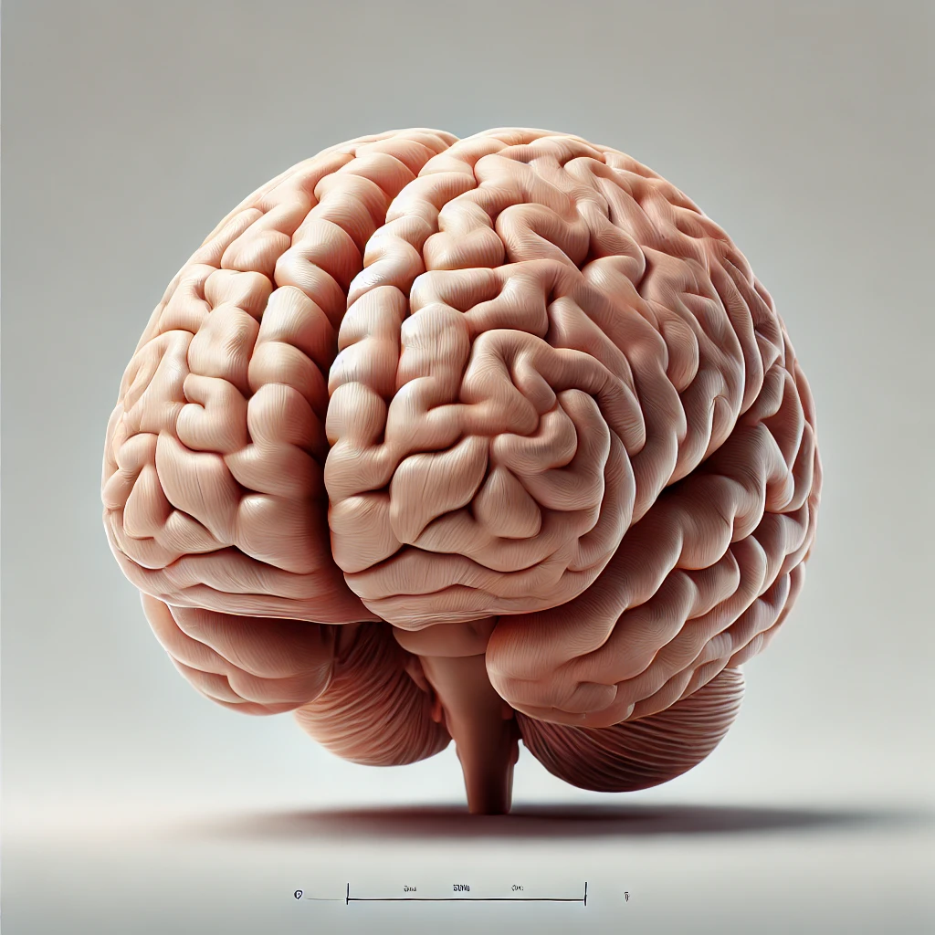

The knowledge argument continued…
The knowledge argument works against any purely physicalist theory of mind, because the argument is taken to prove the existence of qualia, which implies either property dualism or substance dualism is true.

Slide 7
Three consequences of the knowledge argument
1. This means that both forms of behaviourism, mind-brain identity theory, and most functionalist theories are vulnerable to the knowledge argument.
2. Remember: if knowledge about the mind is not fully contained in physical facts about the mind, there is a domain of knowledge that physicalism does not cover.
3. Given that Mary has all physical knowledge, she should know everything there is to know about others, and yet she does not.

Slide 8
Four responses to the knowledge argument
(4) Qualia do not exist.
(3) We can know one thing in two ways.
(2) Propositional knowledge is not acquaintance knowledge.
(1) Ability knowledge is not propositional knowledge.

Slide 9
(1) There is a difference between propositional and ability knowledge.
David Lewis claimed that rather than gaining any propositional knowledge, Mary gains ability knowledge, by learning ‘what it is like’ to see the colour red. Learning what it is like ‘is the possession of the abilities to remember, imagine, and recognise…it is not knowing that it is knowing-how’.

Slide 10
(2) There is a difference between propositional and acquaintance knowledge.
Jackson is confusing ‘knowledge by description’ (propositional knowledge: describing the physical truths) with knowledge by acquaintance (being acquainted with a colour etc.). In other words, there is a difference between knowing the fact that red is a certain wavelength and having seen red. The first is ‘knowing about’ something, the second is knowing it per se (in itself).

Slide 11

(3) We can know one thing in two ways.
Michael Tye: we can know the same thing in two ways. This is the claim that one can know what it is like to see red, with physical truths, and one can know the same physical truths, as phenomenal concepts. This is a little like knowing water is H₂O and knowing water. Both concepts are about water, but they are different ideas. This is sometimes known as the New Knowledge/Old Fact view. What makes up the phenomenal concept of red is the physical facts.

Slide 12
Conclusion
If 3 is correct, then the ontological belief in qualia is discredited, because after all, physicalism and dualism are doctrines about what exists, not about concepts. In other words, they are ontological claims, not conceptual claims.

Slide 13
Further reading
1. The knowledge argument. Frank Jackson
2. What experience teaches: David Lewis

