Slide 1
Mind-Brain identity theory

Slide 2
Key thesis
This is the thesis that sensations, such as the experience of seeing ‘a red patch’ or ‘feeling pain’, are identical to physical-chemical brain processes.
It is a physicalist theory.

Slide 3
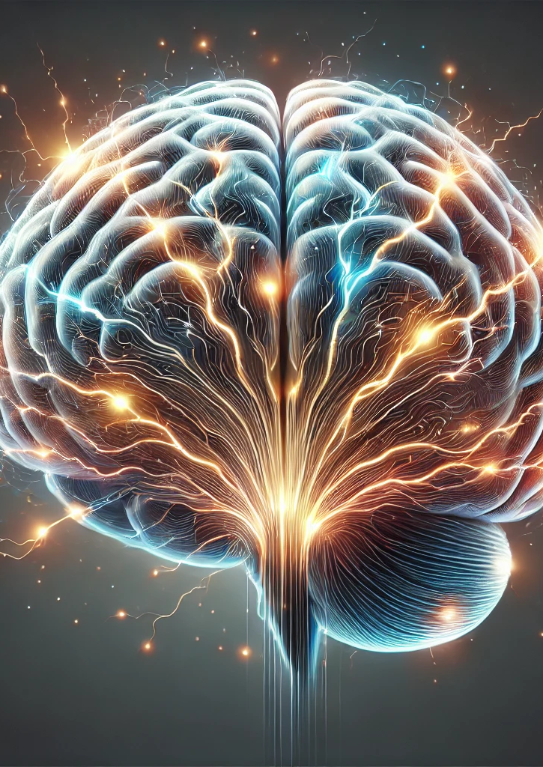
Sensations and brain processes
‘Insofar as ‘after-image’ or ‘ache’ is a report of a process, it is a report of a process that happens to be a brain process…All it claims is that in so far as a sensation statement is a reporting of something, that something is in fact a brain process. Sensations are nothing over and above brain processes.’ (In the same way that nations are nothing ‘over and above’ their citizens). J.J.C. Smart, ‘Sensations and Brain Processes’ (1959)

Slide 4
Two types of mind-brain identity theory
(1) The theory that mental states are just certain kinds of brain states.
(2) The theory that mental states are specific individual brain events.

Slide 5
Advantage 1: it solves the problem of causation
If sensations are identical with brain processes, then we do not need to postulate any non-physical cause of human behaviour. This means we can explain the two-way link between the mind and the world in a way consistent with physics.

Slide 6
Identity
“When I say that a sensation is a brain process or that lightning is an electrical discharge, I am using ‘is’ in the sense of strict identity” J.J.C. Smart, ‘Sensations and Brain Processes’ (1959)

Slide 7
Objection 1
‘Any illiterate peasant can talk perfectly well about his after-images, or how things look or feel to him, or about his aches and pains, and yet he may know nothing whatsoever about neurophysiology’.
Response: You may as well say that someone who never saw the morning star and only ever saw the evening star, never spoke about the same entity. You can refer to X and not know that X is also Y.

Slide 8
Objection 2
Maybe science will move on and prove that sensations are not brain processes. So, when we report a sensation, we do not report a mental state.
Reply: “The objection only proves that when we say ‘I have an after-image’ we cannot mean something of the form ‘I have such and such a brain process’.” The same can be said about lightning and a discharge of electricity.

Slide 9
Objection 3
‘The after-image is not in physical space but the brain process is. So, the after-image is not the brain process.’
Reply: “I am not arguing that an after-image is a brain process but that the experience of an after-image is a brain process. It is the experience which is reported in the introspective report”.
In one sense an after-image does not exist, only the experience of it exists.

Slide 10
Objection 4
Sensations are private and brain processes are public. I can never be wrong about what I am experiencing, but even if a neuroscientist could see the processes of my brain, they could not know with the same certainty what my sensation was.
Reply: We do not yet know enough about brain processes, but when we do, we may well get equal access to the sensations of another person.

Slide 11
Objection 5
I can imagine having sensations without having brain processes. So, sensations and brain processes are not identical.
Reply: Conceivability does not prove truths about physical reality. It only proves that we cannot know a priori that brain processes are identical to sensations. However, the identity is necessary, but we only know it a posteriori. The same is true of water and H₂O.

Slide 12

Objection 6
Animals can also suffer pain, and their brains are totally different from ours, so it cannot make sense to think that brain states are identical with mental states.
This is called the argument from ‘multiple realisability’.

Slide 13
Questions
1. Explain mind-brain identity theory (5)
2. Outline and explain the objections to mind-brain identity theory (12)
3. What are some responses to these objections? (12)

