Slide 1
Property dualism

Slide 2
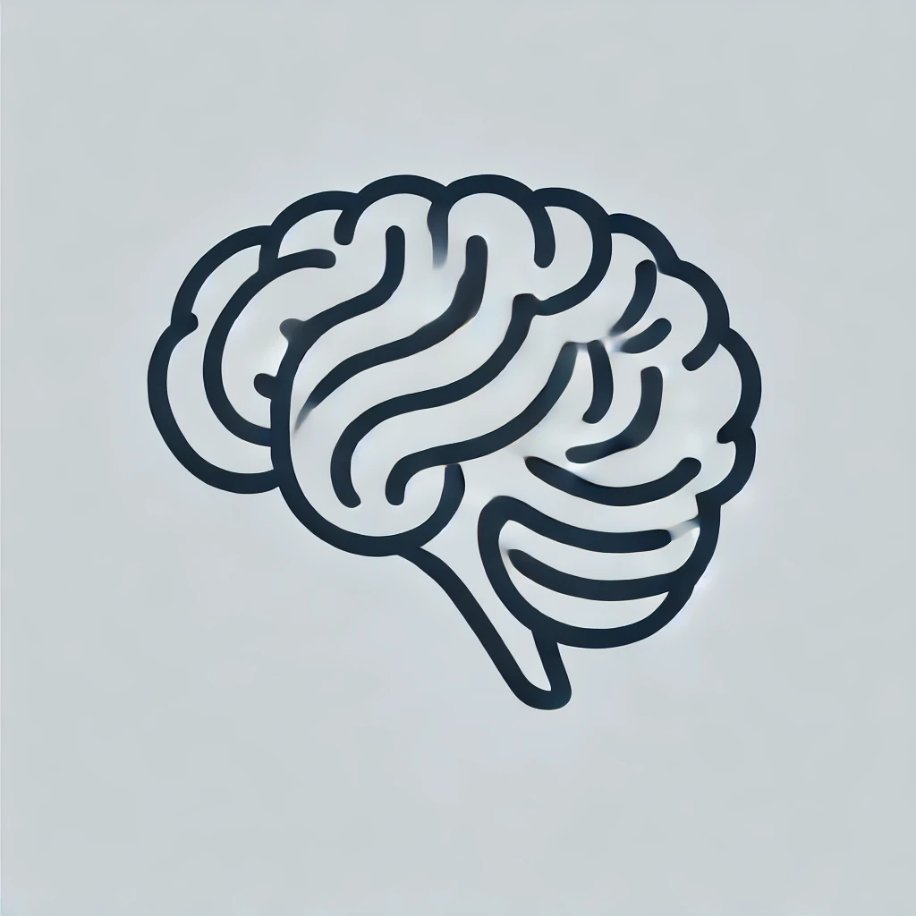
What is property dualism?
Key thesis: Property dualism is the thesis that there is only one category of substance, physical substance, but that there are two categories of properties, physical and mental properties. As regards consciousness, the mind needs the brain as a physical substance in order to exist; however, the brain has both physical properties, such as its size, and weight (for example it might be 1 kilo). It also has mental properties such as being elated or seeing a bright colour. Property dualism is an umbrella term which covers several theories.

Slide 3
There are two categories of property dualism
1: Interactionist property dualism
2: Epiphenomenal property dualism

Slide 4

Interactionist property dualism
Interactionist property dualism is the thesis that there is a two-way interaction between the physical world and mental properties. For example, if I take a specific medicine, which is a chemical and physical substance, it will interact with mental properties of the brain. If I have the mental property of feeling hungry, it may cause me to go to the kitchen to eat food. This means that the mental properties are ‘causally efficacious’ and have import into the physical world.

Slide 5

Epiphenomenal property dualism
Epiphenomenal property dualism is the thesis that there is only a one-way interaction between the physical world and the mental world. That is, that the physical world can affect the mental properties, but that mental properties have no import (they cannot cause anything to happen in the physical world). It is a doctrine that has been defended by Frank Jackson as a consequence of the Mary thought experiment. He writes
‘What I will be concerned to defend is that it is possible to hold that certain properties of certain mental states, namely those I have called qualia, are such that their possession or absence makes no difference to the physical world’.

Slide 6
Four objections to EPD
It is ‘counter-intuitive’
01
It is inconsistent with naturalism (it goes against Darwin’s theory of evolution)
02
It leads to the problem of other minds.
03
A category error?
04

Slide 7
Objection (1)
‘It is supposed to be just obvious that the hurtfulness of pain is partly responsible for the subject seeking to avoid pain, saying ‘it hurts’ and so on.’ In other words, if EPD is true, then our intuition that we have gone to the kitchen at least in part as a consequence of feeling hungry is false.

Slide 8
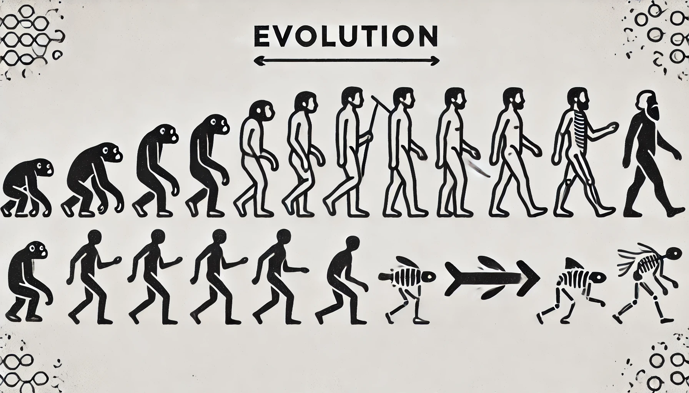
Objection (2)
‘According to Darwinism, traits that evolve over time are those conducive to physical survival.’ Qualia probably evolved over time and, therefore, if they are not helpful to survival (and they would not be if EPD is correct, because they cannot affect the physical world) then we cannot explain qualia.

Slide 9
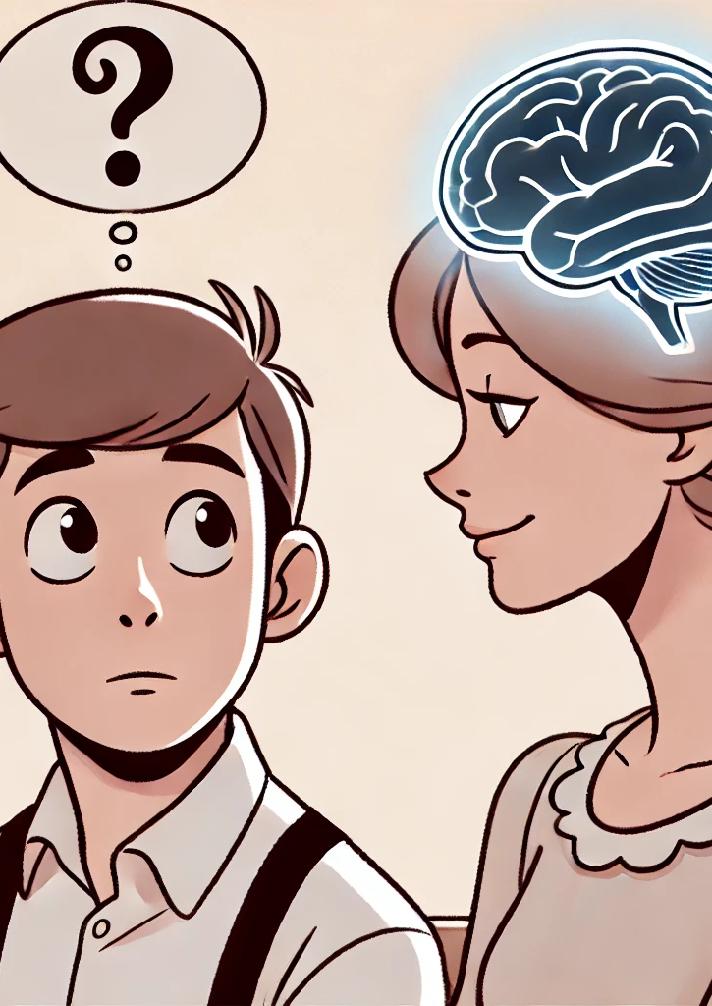
Objection (3)
We believe in other minds, partly because we think of people’s behaviour as a product of their mental properties. If these mental properties are not responsible for behaviour, what makes us think that other people possess them at all?

Slide 10
Objection (4)
If the idea of immaterial substance makes the error of thinking there is something ‘over and above the physical’, perhaps the same happens with property dualism. Is our belief in mental properties the same as our belief in immaterial substances?

Slide 11
Further reading
David Chalmers – The Conscious Mind
Jaegwon Kim – Physicalism, or Something Near Enough

