Slide 1

Philosophy of mind
‘Zombies’

Slide 2
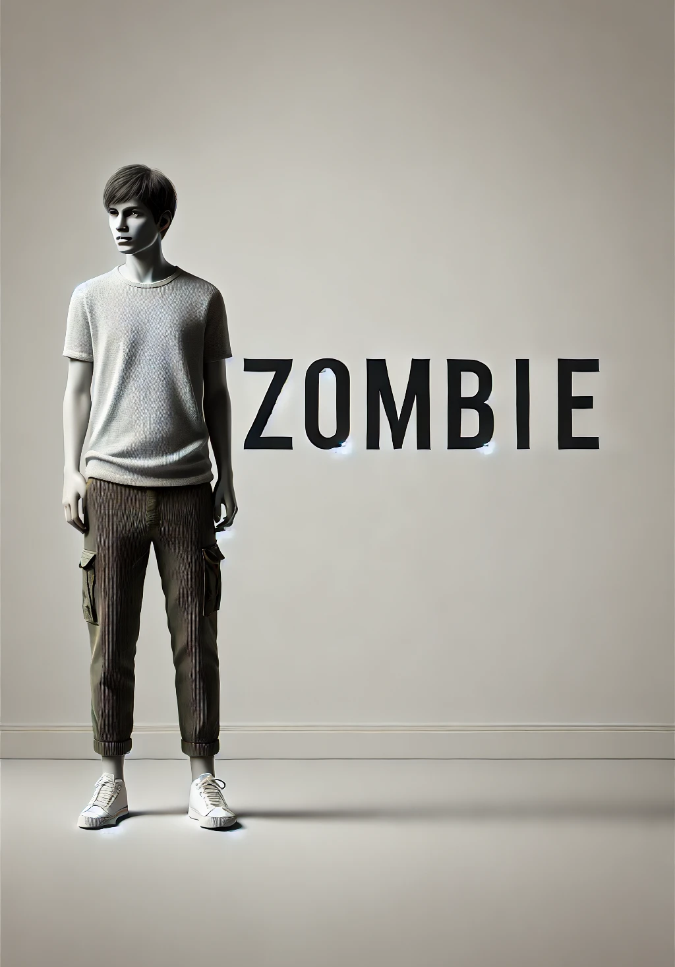
The Zombies argument
This was first developed by David Chalmers, in his essay, ‘Consciousness and its Place in Nature’, and in a previous book called ‘The Conscious Mind’. This presentation is a detailed explanation of the Zombie thought experiment which aims to show that consciousness cannot be reduced to physical facts.
‘Consciousness fits uneasily into our conception of the natural world, the natural world is the physical world. But on the most common conception of consciousness, it is not easy to see how it could be part of the physical world. So, it seems that to find the place for consciousness within the natural order, we must either revise our conception of consciousness, or revise our conception of nature’. D. Chalmers

Slide 3

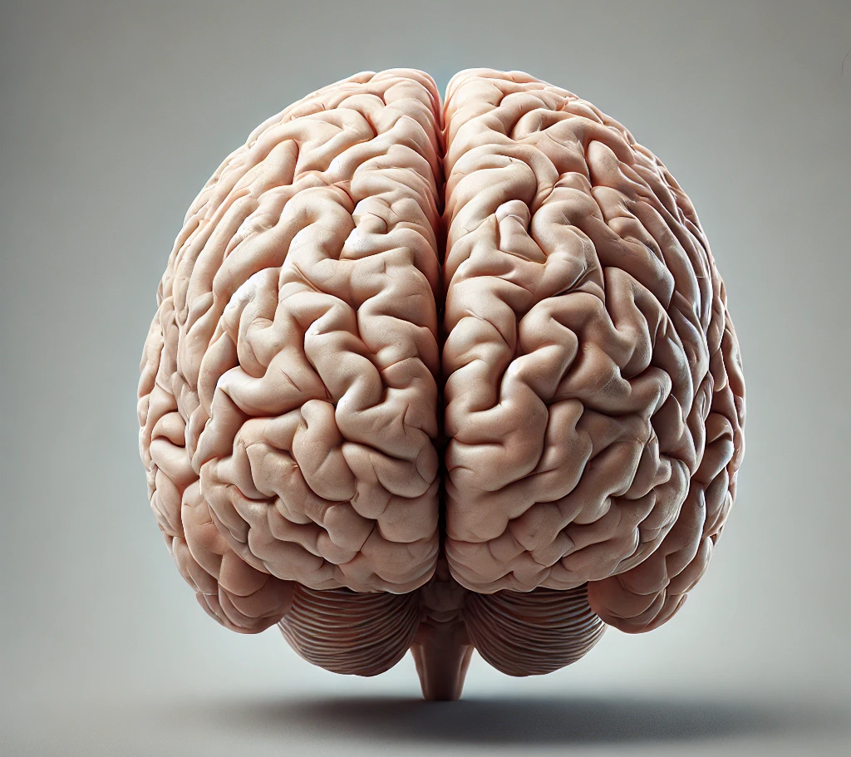
The hard problem of consciousness
‘The hard problem of consciousness is the problem of experience. Human beings have subjective experience: there is something it is like to be them. We can say a being is conscious, as it is sometimes put – when there is something it is like to be that being…There is no question that experience is closely associated with physical processes in systems such as brains. It seems that physical processes give rise to experience…But how and why do physical processes give rise to experience? Why do these processes take place ‘in the dark’ without any accompanying states of experience? This is the central mystery of consciousness.’

Slide 4
The argument
‘it is conceivable that there is a system that is physically identical to a conscious being, but that lacks at least some of that being’s conscious states. Such a system might be a zombie: a system that is physically identical to a conscious being but that lacks consciousness entirely…These systems will look identical to a normal conscious being from the third-person perspective: in particular their brain process will be molecule for molecule identical with the original, and their behaviour will be indistinguishable. But things will be different from the first-person point of view…There is nothing it is like to be a Zombie.’ David Chalmers.
There is little reason to think that Zombies exist in the actual world. But many hold that they are at least conceivable; we can coherently imagine Zombies, and there is no contradiction in the idea that reveals itself even on reflection…

Slide 5
The argument put formally
1: It is conceivable that there be Zombies
2: If it is conceivable that there are Zombies, it is metaphysically possible that there be Zombies.
3: If it is metaphysically possible that there be Zombies, then consciousness is not physical.
4: Therefore, consciousness is non-physical.

Slide 6
Responses to the Zombie argument
A philosophical Zombie is not conceivable. Type-A materialism.
01
A philosophical Zombie is conceivable but not metaphysically possible.
02
What is metaphysically possible tells us nothing about the actual world.
03

Slide 7
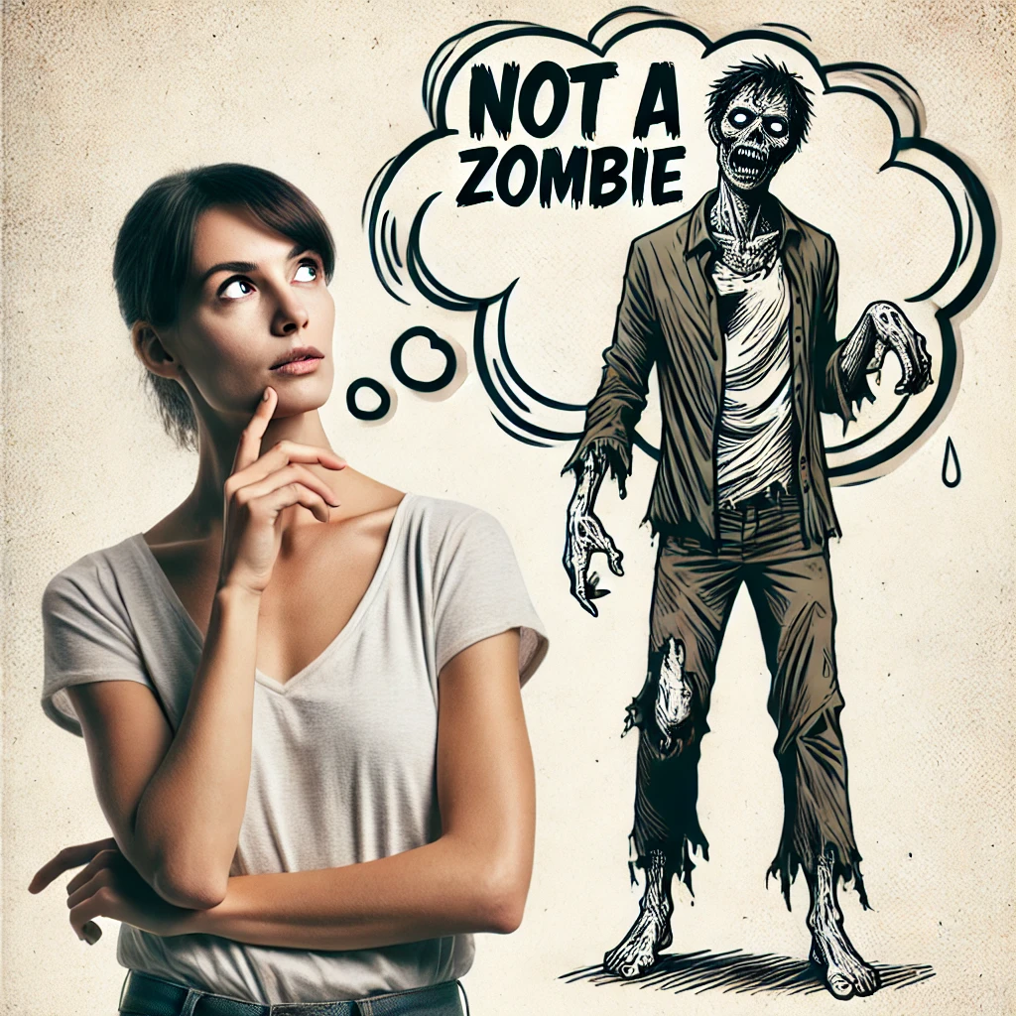
(1) It is not actually possible to imagine a Zombie
This form of materialism claims that even though it seems to us that we can conceive of a Zombie, what we are really thinking of is incoherent. It is like thinking that 2+2=5: although we can make the mistake of thinking this, we are not really thinking properly of the numbers 2 and 5 and thus we are just confused. The same applies to a Zombie. If we really were thinking of a Zombie, we would understand that it must be conscious. Chalmers calls this type-A materialism.

Slide 8

(2) We can conceive of Zombies but they are not in fact possible.
This form of materialism claims that although Zombies are conceivable, they are not in fact possible. This argument works on the claim that conceivability is not a guide to possibility. For example, I could conceive of myself jumping over Mount Everest in one leap, and although this is logically possible (i.e. we do not contradict ourselves in imagining it, unlike a square circle), it is in fact impossible both physically and metaphysically. For example, we may think that water could have been something other than H₂O, but actually this was never possible. If water is H₂O, it is H₂O everywhere it exists, including all other possible worlds.

Slide 9
(3) What is metaphysically possible does not tell us about the actual world.
Whether Zombies are possible or not, in a metaphysical sense, is irrelevant to our world, which is the only world that exists. Possible worlds are of no consequence.

Slide 10
Further reading
David Chalmers, ‘Consciousness and its Place in Nature’.
David Chalmers, The Conscious Mind.

