Slide 1
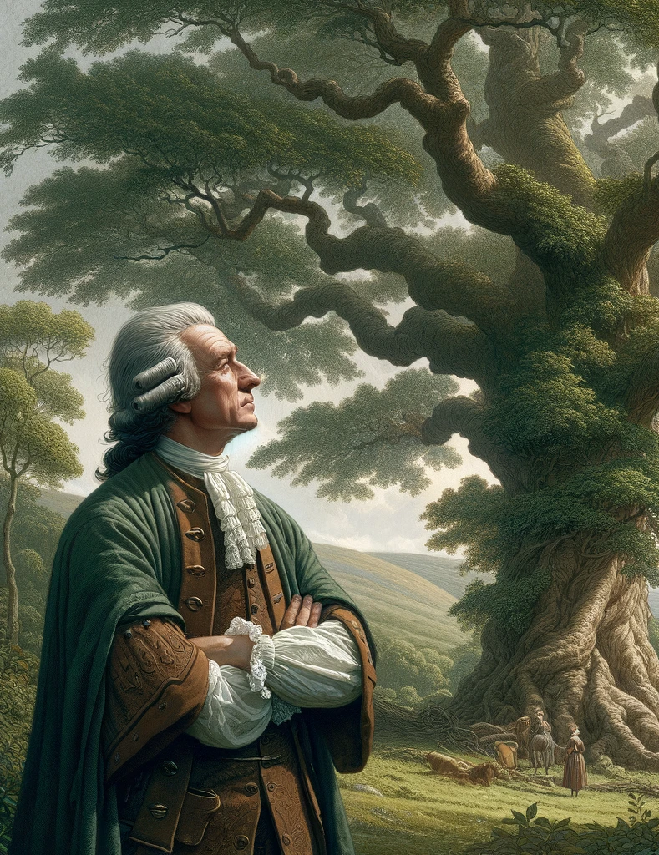
Idealism
Bishop Berkeley

Slide 2

Technical terminology
Substance: That Thing which stays the same while its properties change. For example, the chair is the same even as its colour fades, and it is reupholstered.
Substance=that which stands under the properties)
Primary property: Remember intrinsic properties, same thing.
Secondary properties: These need the mind, smell, taste, colour.
Idea: Images in front of the mind.

Slide 3

What is Idealism?
Idealism is the belief that all that exists are minds and ideas in the mind. All external objects are mind dependent. Without consciousness/mind there is no existence.
The slogan of idealism is ‘Esse es principi“ - “To be is to be perceived”.

Slide 4
Why does Berkeley come to this thesis?
There are 3 key arguments Berkeley makes…
The idea of ‘Substance’ is confused.
Locke’s primary secondary distinction does not work.
The ‘master’ argument.

Slide 5
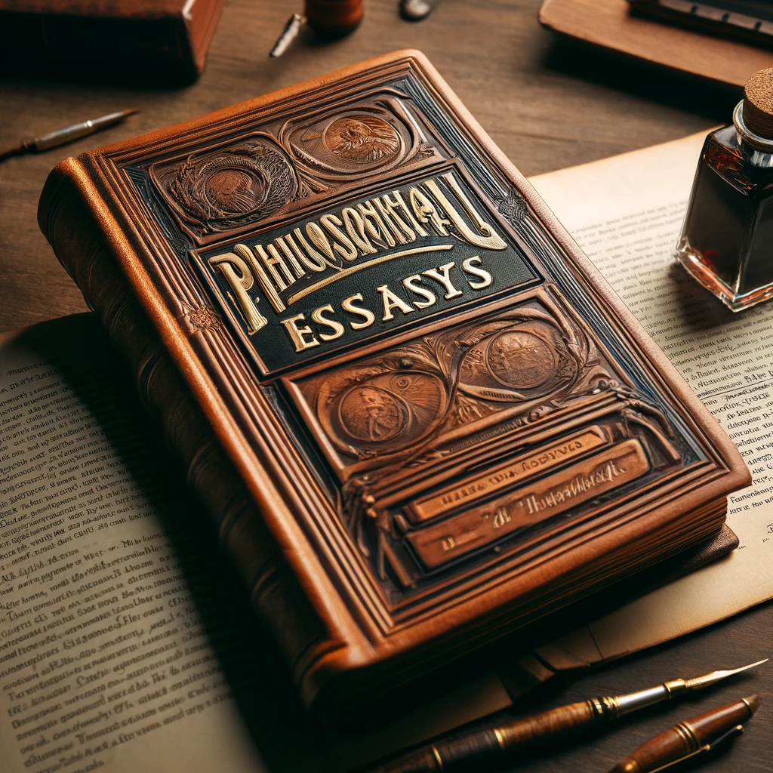
Substance does not exist
If you take away all the properties of something you will not have any thing left over.
1. If you take away the colour.
2. If you take away extension.
3. If you take away weight
THERE IS NO SUCH THING AS
SUBSTANCE

Slide 6
THE PRIMARY SECONDARY QUALITY DISTINCTION
John Locke had developed the ‘primary secondary quality distinction’ to make sense of perceptual variation.
The primary qualities are the powers the objects have to cause sensations in our mind. For example, if an object has a shape, then it causes a specific sensation in our mind.
The secondary qualities are the powers that an object has that are mind-dependent. So, for example, the colour of an object cannot exist if there is no mind to experience it.

Slide 7
Table of Primary secondary quality distinction
Mind independent – these properties belong to the substance itself and do not need the mind. Volume Number | Mind dependent – these are relational properties that need a mind to exist. Color Smell Sound Taste

Slide 8
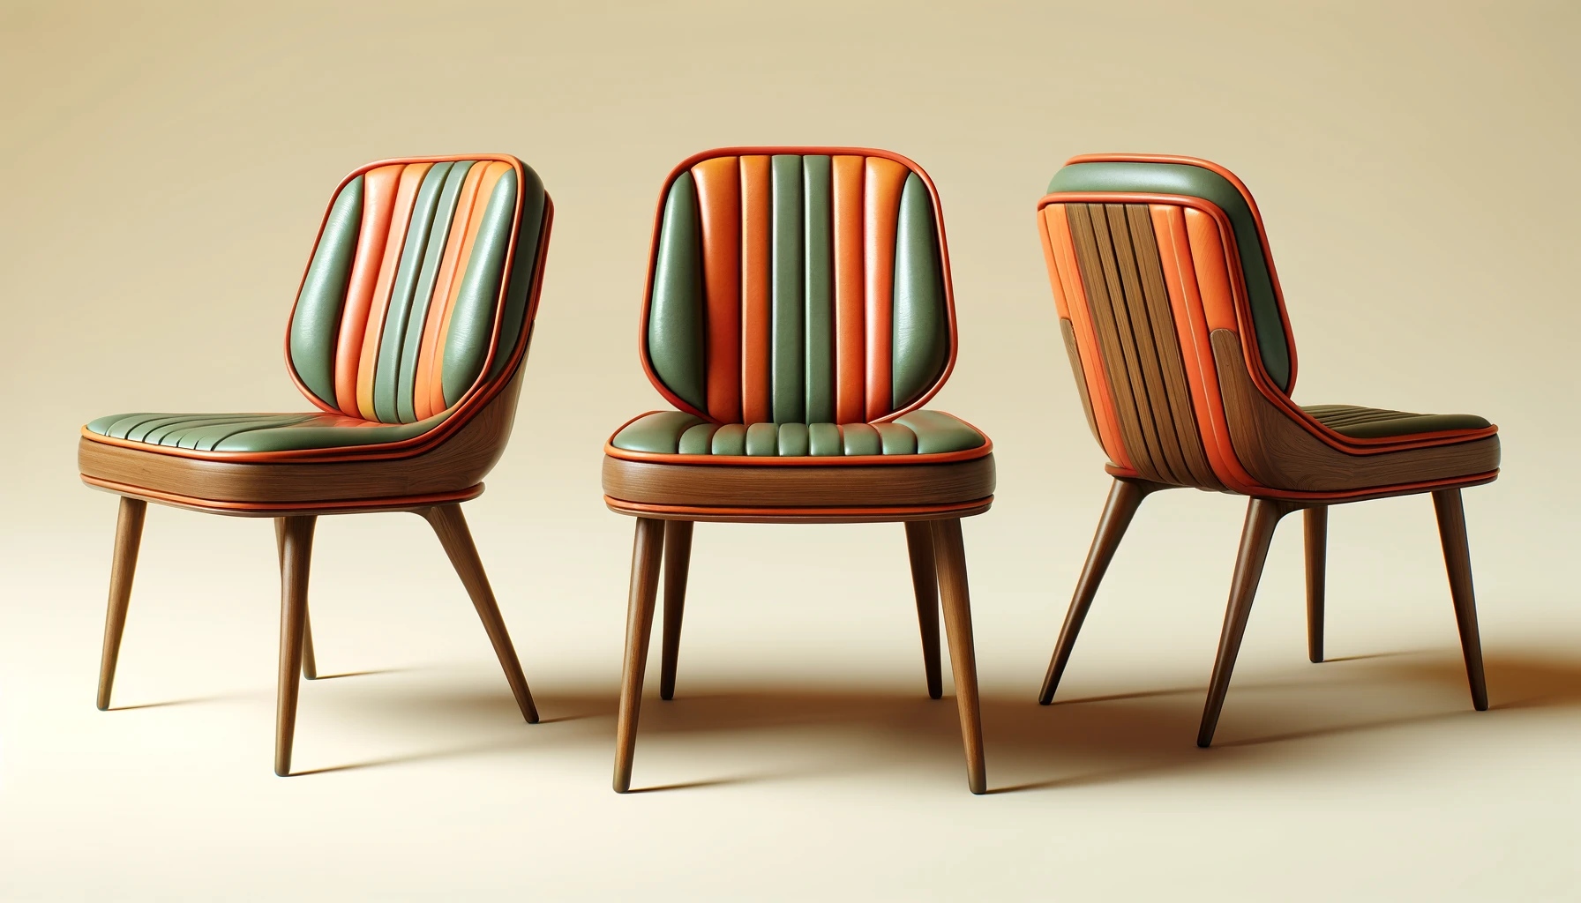
Table of Primary secondary quality distinction
Berkeley claimed that all properties (both primary and secondary) are mind dependent. Because we know that the size of something (its volume) will change when you see it from different distances and also that the number of things can change depending on if you put your finger to your eye and make the chairs double. This means that number and size are also secondary properties and need the mind to exist, i.e. are mind dependent.

Slide 9

The ‘Master’ argument
Berkeley presents his ‘master argument’ against the idea of mind-independent physical objects in his dialogues. There Berkeley portrays a fictional character Philonus, who challenges Hylas (Greek for matter) to think of something that exists outside the mind. Because if Hylas fails, Berkeley will have shown that the very idea of a mind-independent thing is absurd. Hylas claims that this is easy ‘(For) what could be more easy than to conceive of a tree or a house existing by itself, independent of, and unperceived by any mind whatsoever’.

Slide 10
The ‘Master’ argument
Philonus then says…
‘is it not a great contradiction to conceive of a house, unconceived? How then came you to say you conceived a house or a tree existing independently and out of all minds whatsoever?’

Slide 11
Mind and ideas in the mind
So, we are left with only two fundamental things in existence. ‘Minds’ and ‘ideas’ (images) in the mind.

Slide 12

Ideas can only come from the mind of God, Why?
Berkeley’s develops an argument from elimination which starts with these three proposition. An argument from elimination eliminates all possibilities until it comes to one final proposition.
Either
Ideas come from the external world. (But this can’t be true).
Ideas come from our own mind.
They come from the mind of God.

Slide 13
Ideas can only come from the mind of God, Why?
Berkeley does not consider proposition 1 as it has already been ruled out by the master argument.
He considers proposition 2 because we can control and create ideas with imagination. But then he realizes that we cannot control all our sense experiences, as many are involuntary.
Thus, he is left with proposition 3. Ideas must be created in the mind of God.

Slide 14
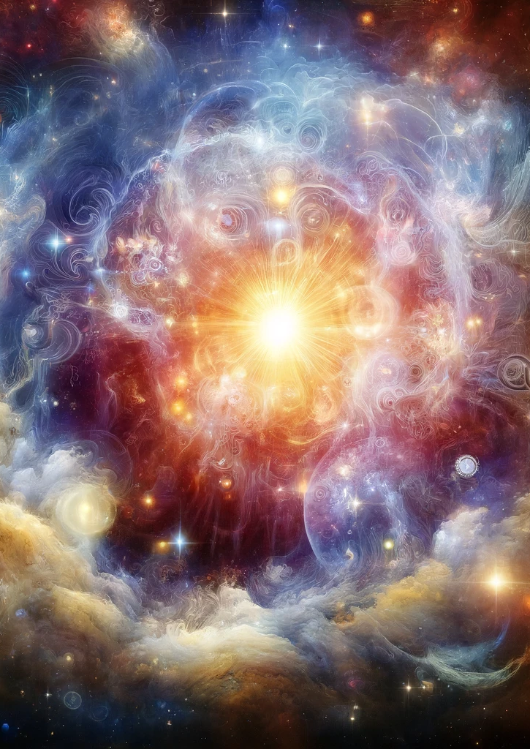
All ideas have their origin in the mind of God.
For Berkeley God understands all ideas in his mind, in that he comprehends them. However, God does not experience them as we do, as this would make him subject to suffering and pain, which is of course, impossible.

Slide 15
Questions
Explain idealism (5)
Explain the argument against substance (5)
Outline and explain the argument against primary and secondary qualities. (12)
Explain the master argument (5)
Explain why Berkeley thinks that ideas have their origin in the mind of God. (12)

