Slide 1
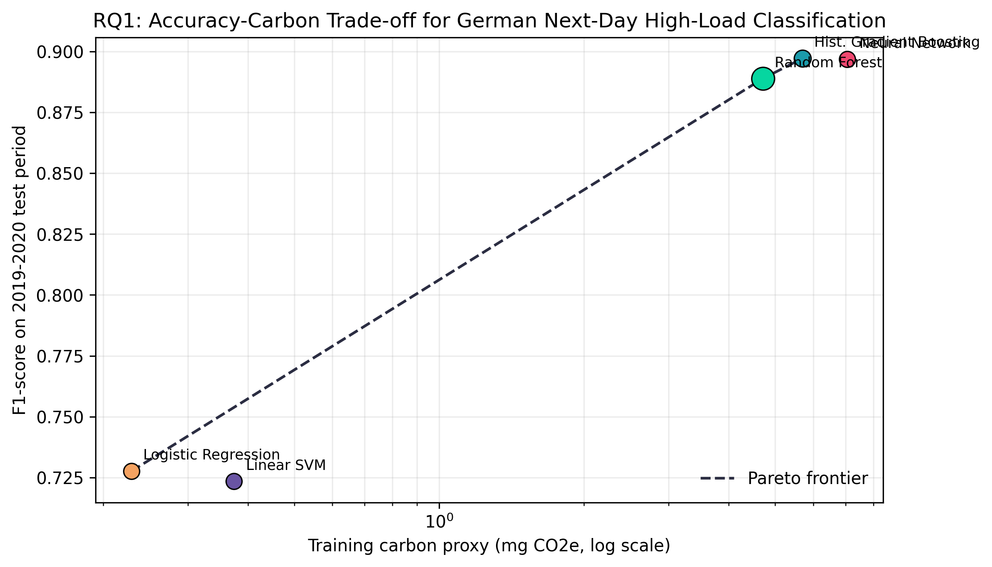
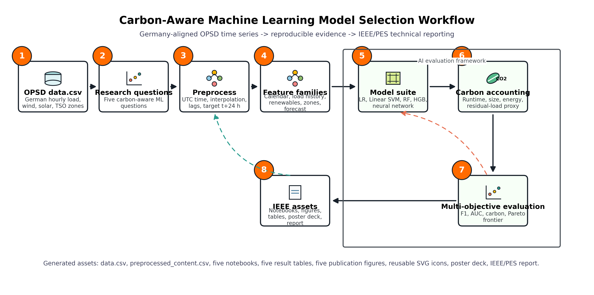
Accuracy versus Sustainability: Carbon-Aware ML for German Power-System Load Risk
Poster Option A: Pareto frontier narrative
Problem
Methods
Machine-learning model selection in power systems is usually optimized for accuracy. This poster reframes the choice as a multi-objective decision: predictive performance, runtime, model size, and carbon-aware deployment cost.
Chronological train/test split; logistic regression, linear SVM, random forest, histogram gradient boosting, and neural network; runtime and model-size instrumentation; residual-load carbon proxy.
Key Evidence
Pareto-efficient models are identified by maximizing F1-score while minimizing estimated training carbon. Seasonal testing checks whether rankings survive Germany's operating regimes.
Dataset
Open Power System Data hourly time series for Germany, 2015-2020. Target: whether German load 24 hours ahead enters the top quintile of next-day load.
Governance Lens
The analysis treats accuracy as one objective among several. The recommended model is the one whose marginal accuracy justifies its marginal computational and auditability burden.
Contribution
A reproducible carbon-aware model ranking pipeline with five research questions, publication-ready figures, CSV result tables, and IEEE/PES reporting assets.
Takeaway
For course presentation, lead with the Pareto plot and use the workflow as the credibility anchor: each artifact is reproducible from data.csv through the notebooks.

Slide 2
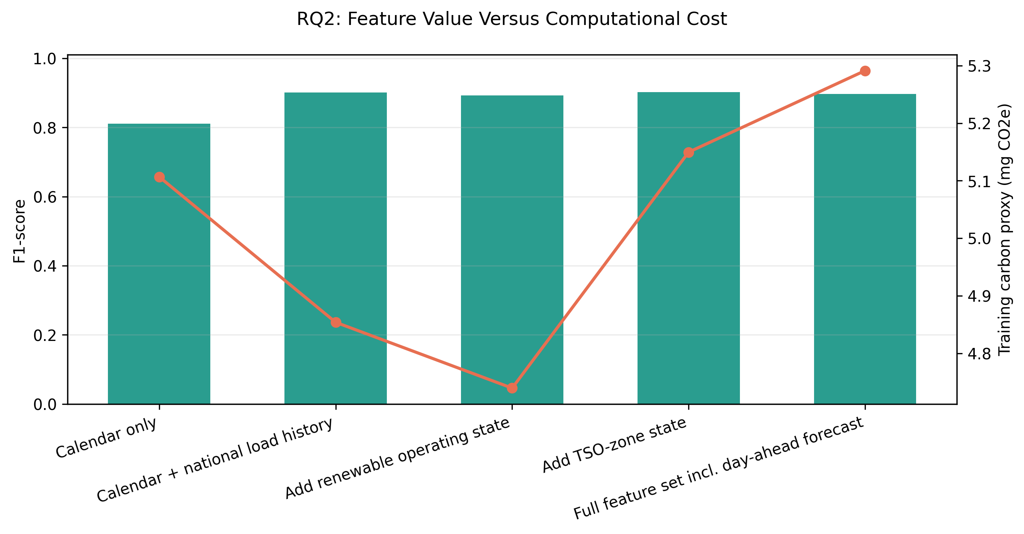
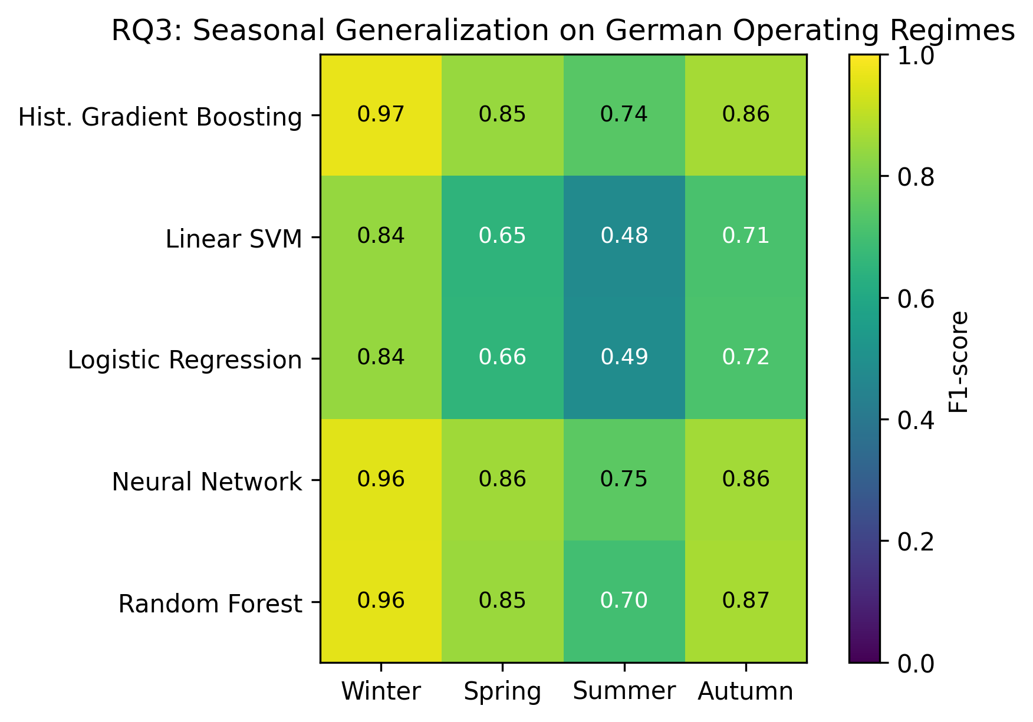
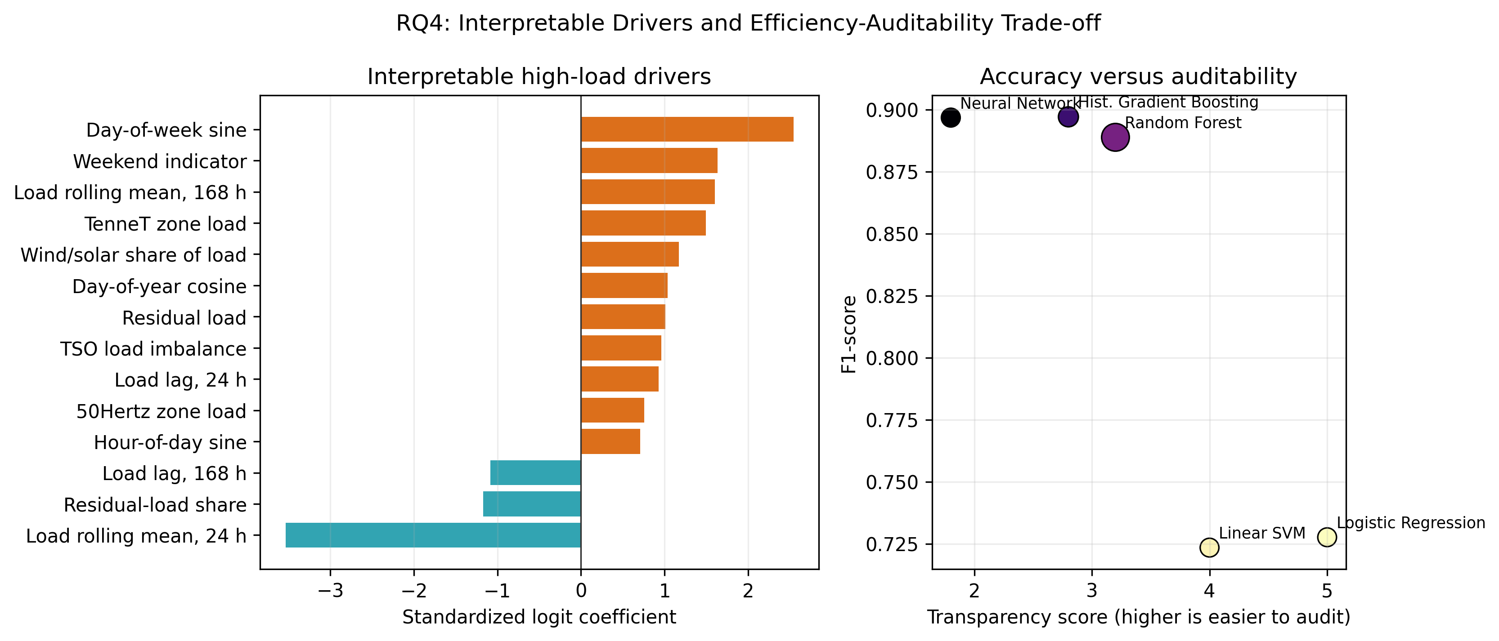
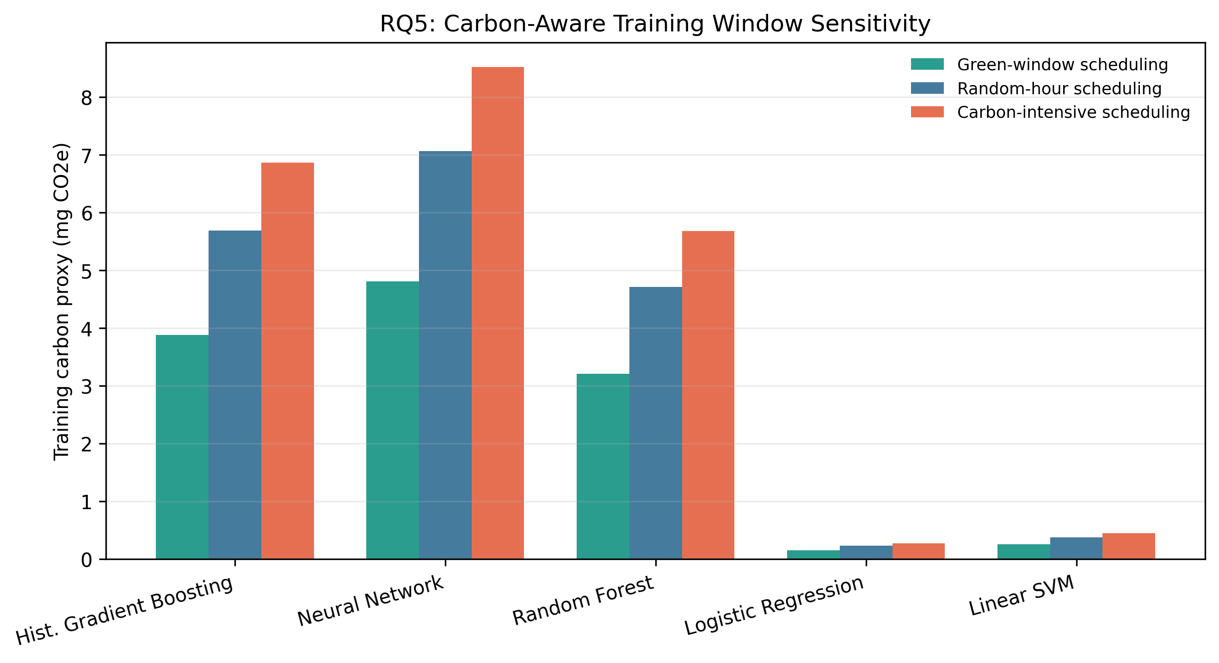
Accuracy versus Sustainability: Carbon-Aware ML for German Power-System Load Risk
Poster Option B: five research questions as an evidence matrix
RQ1: Accuracy-carbon Pareto
RQ2: Feature value
RQ3: Seasonal robustness
RQ4: Interpretability
RQ5: Training windows
PS26 Interdisciplinary Elective: AI, Power & Responsibility

Slide 3
Accuracy versus Sustainability: Carbon-Aware ML for German Power-System Load Risk
Poster Option C: responsible AI and deployment governance briefing
Decision Principle
Select models on a Pareto frontier: accuracy, carbon proxy, memory footprint, inference latency, and auditability must be reviewed together.
Operational Policy
Schedule retraining in lower residual-load windows where practicable; publish model cards that include runtime, model size, and carbon-proxy assumptions.
Scientific Control
Use chronological splits, seasonal stress tests, and feature ablations to separate real predictive value from coincidental correlations.
Primary Result
Limitations
Recommended Use
The full report ranks models by carbon-adjusted score and marks Pareto-efficient candidates. This makes the final recommendation traceable rather than preference-driven.
The carbon estimate is a proxy based on runtime, assumed CPU power, and residual-load intensity. It should be replaced with measured hardware energy for formal deployment.
Use this poster for a methods-and-governance oral presentation: start with the workflow, then defend the model recommendation using RQ1 and RQ5.

