Slide 1
Uber Data Analytics Project
Hari Charan V V. Niranjhani

Slide 2
Introduction
Uber, generates vast amounts of data from its platform. Analyzing this data can provide valuable insights into ride patterns, user behavior, and operational efficiency. This analysis can help Uber optimize its services, improve customer experience, and inform business decisions.

Slide 3
Libraries Used
pandas – for data processing
numpy – for numerical operations
matplotlib – for plotting
seaborn – for advanced visualizations

Slide 4
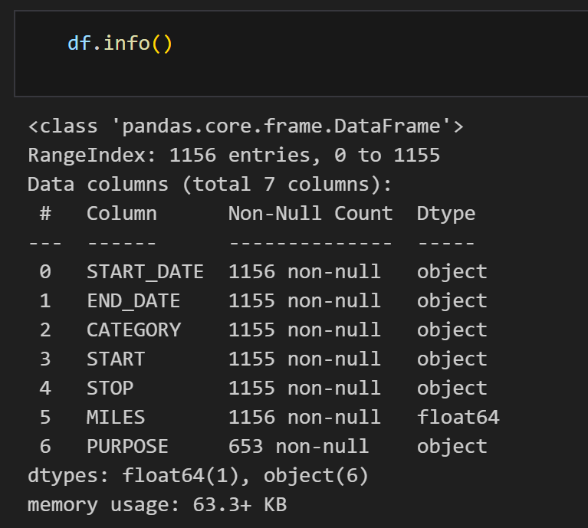
Dataset Information
File: UberDataset.csv
Rows: 1156 | Columns: 7
Columns: START_DATE, END_DATE, CATEGORY, START, STOP, MILES, PURPOSE

Slide 5
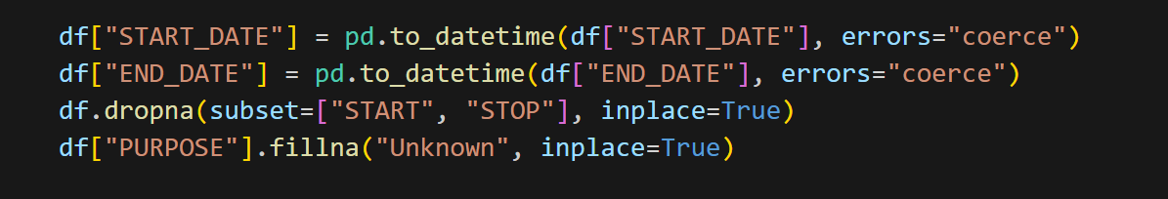
Data Cleaning Steps
Converted START_DATE and END_DATE to datetime
Dropped rows with missing START or STOP locations
Filled missing PURPOSE values with 'Unknown'

Slide 6
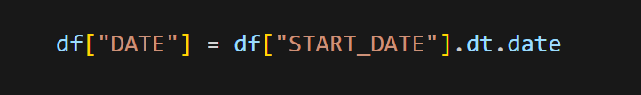
Date Column Creation
Extracted date from START_DATE
Created new column DATE for daily trend analysis

Slide 7
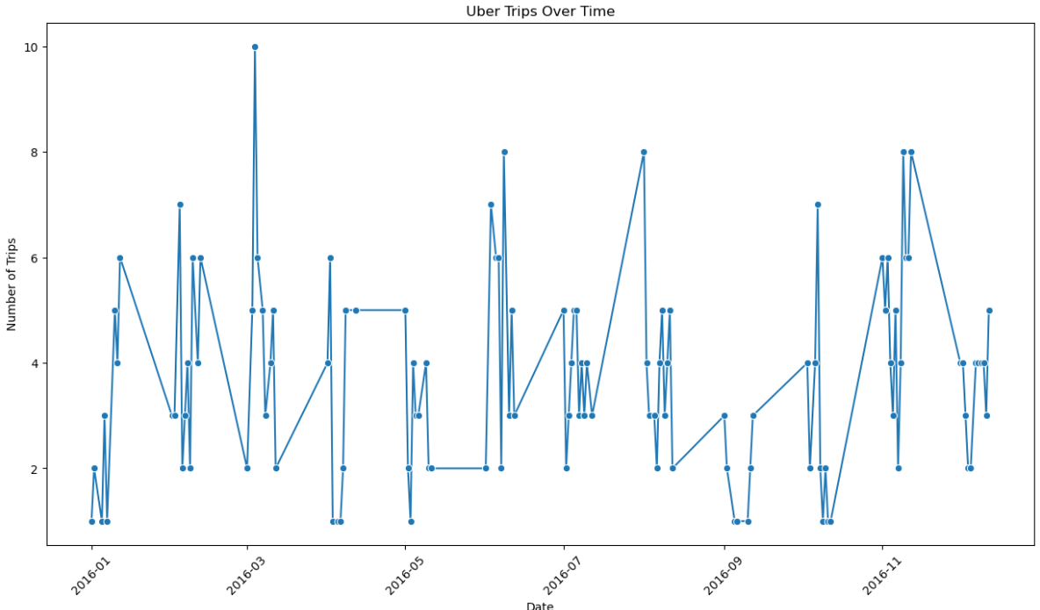
Trips Over Time
Line plot shows daily number of trips
Highlights usage patterns and trends

Slide 8
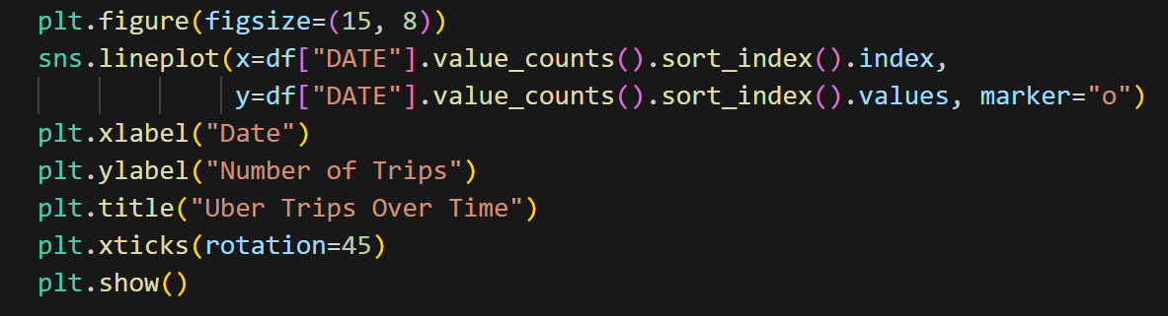

Slide 9
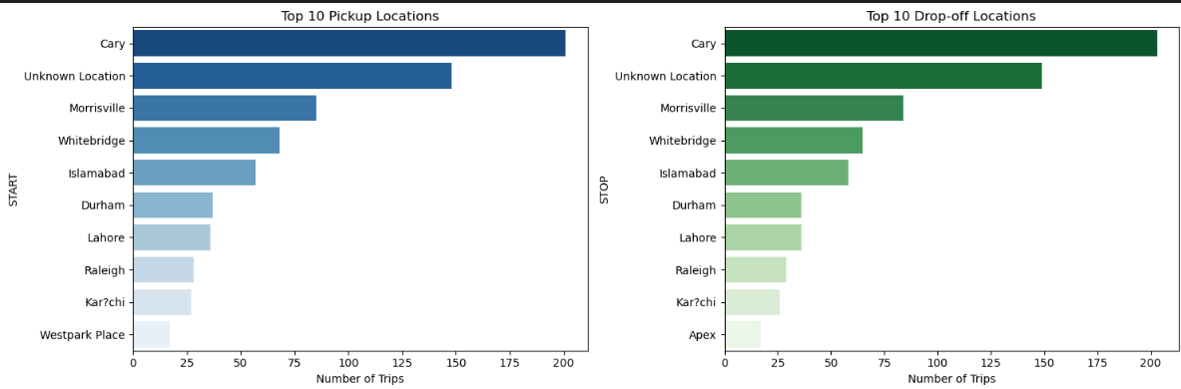
Top Pickup & Drop-off Locations
Bar charts for top 10 START and STOP locations
Useful for identifying popular areas

Slide 10
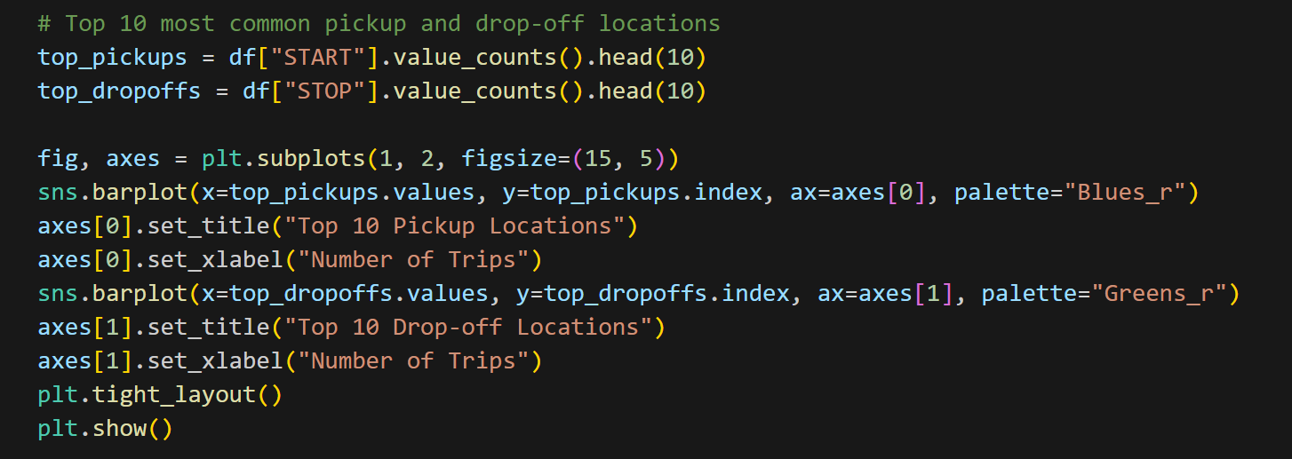

Slide 11
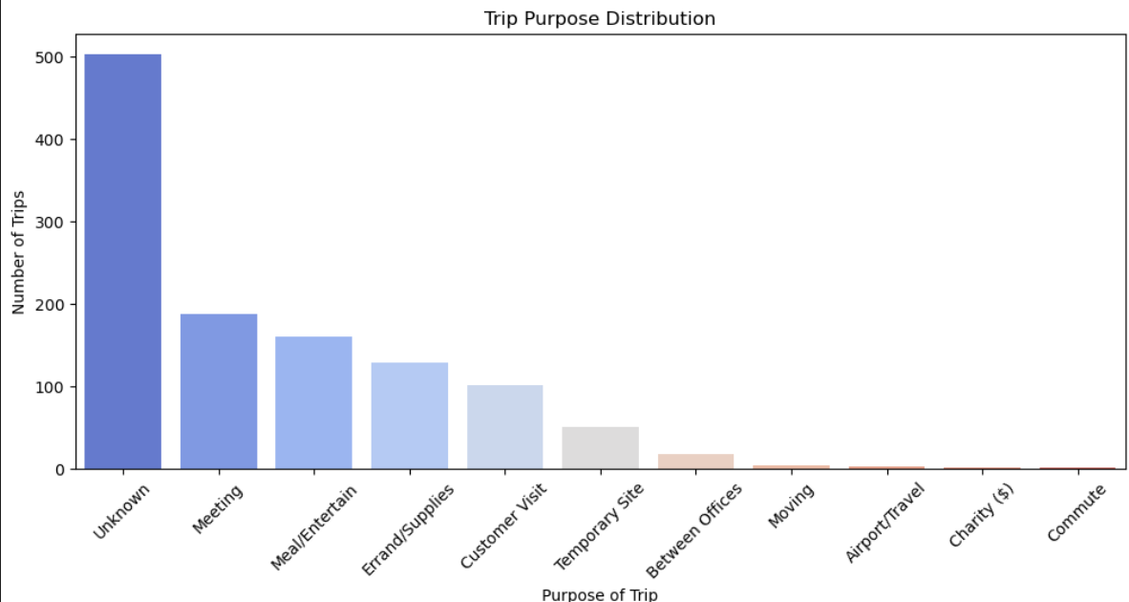
Trip Purpose Distribution
Bar chart shows count of trips for each purpose
Common purposes: Meeting, Meal, Errand, Customer Visit, etc.

Slide 12
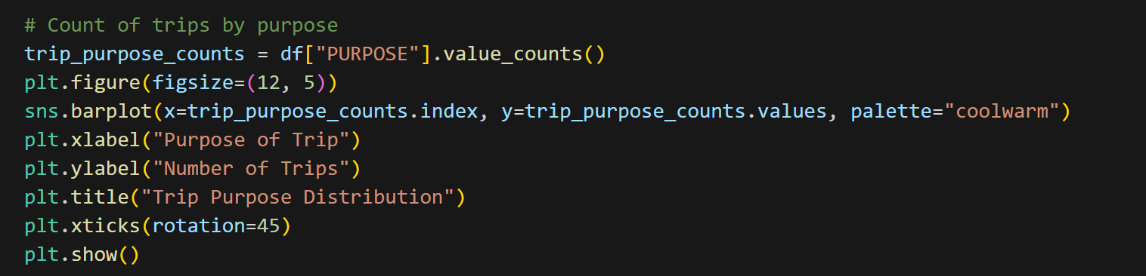

Slide 13
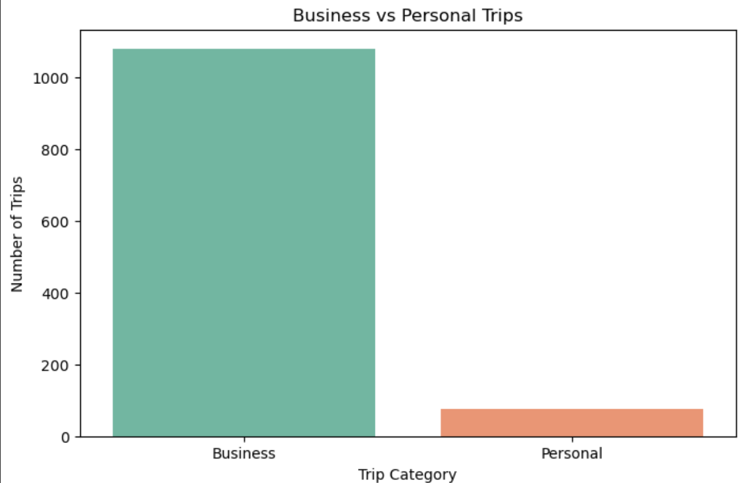
Trip Category
Bar chart compares Business vs Personal trips
Most trips are categorized as Business

Slide 14
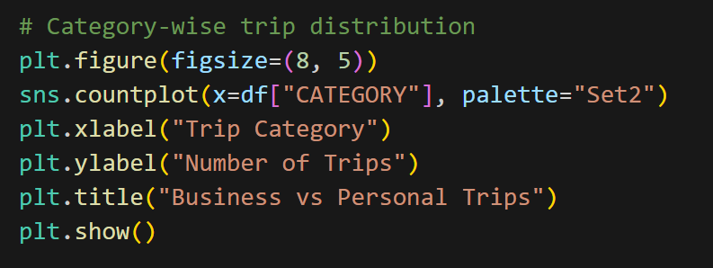

Slide 15
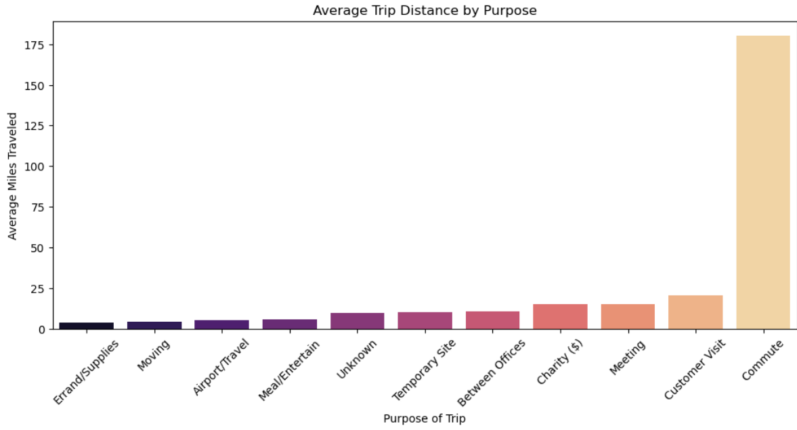
Average Distance by Purpose
Shows average MILES per PURPOSE
Helps understand trip length patterns

Slide 16
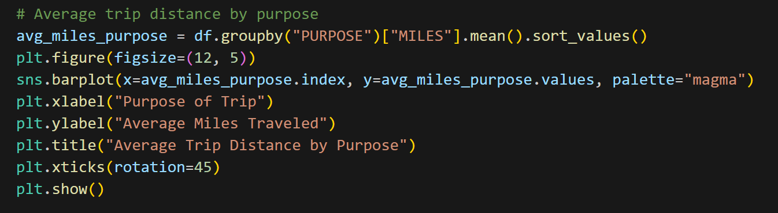

Slide 17
Conclusion
📈 Trip Frequency Over Time: Most trips occurred during specific dates, indicating peak travel periods—valuable for scheduling optimization.
📍 Common Locations: Repeated pickup and drop-off points show key business zones or operational hubs.
🎯 Trip Purpose Analysis: Majority of trips are for Business purposes like Meetings, Errands, and Customer Visits. "Unknown" entries indicate areas for improved data logging.
🕒 Time-based Usage: Most rides happen during working hours, suggesting travel aligns with professional schedules.
🚘 Distance by Purpose: Longest trips are associated with Customer Visits and Temporary Sites, while shorter ones are for Meetings or Errands.

