Slide 1
MELANOMA DETECTION BASED ON DEEP NEURAL NETWORKS PHASE 3
CSE 6363-003 Machine Learning

Slide 2
TEAM – GROUP 4
Sai Venkat Reddy Kopparthi (UTA ID : 1002113962)
Niranjana Subramanian (UTA ID : 1002046305)
Rohan Rajan Vaidya(UTA ID: 1001987656)

Slide 3
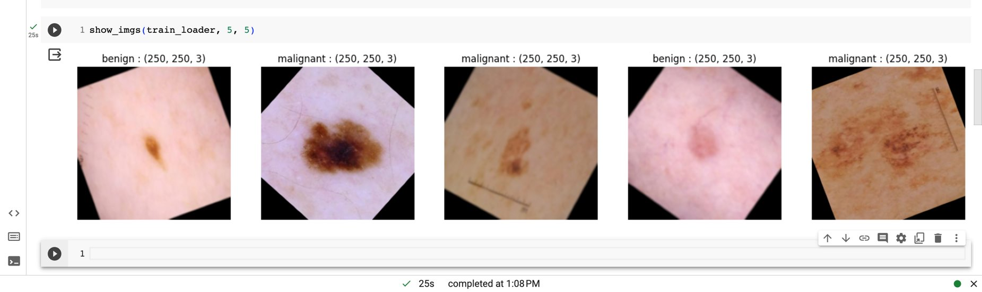
Phase-2 Preprocessing

Slide 4
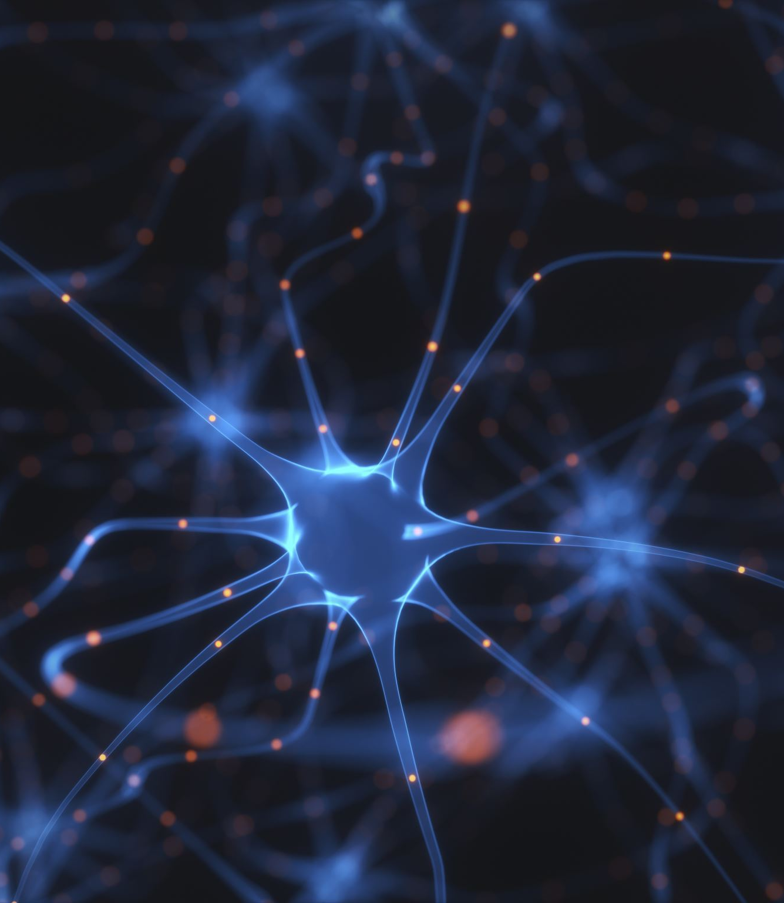
Building the model
VGG16 stands for "Visual Geometry Group."
VGG are convolutional neural networks (CNNs) which are powerful feature extractors. They capture hierarchical and abstract features from images through convolutional and pooling layers.
After the feature extraction, the fully connected layers (dense layers) in the traditional head of the neural network learn to map these features to the final classes.

Slide 5
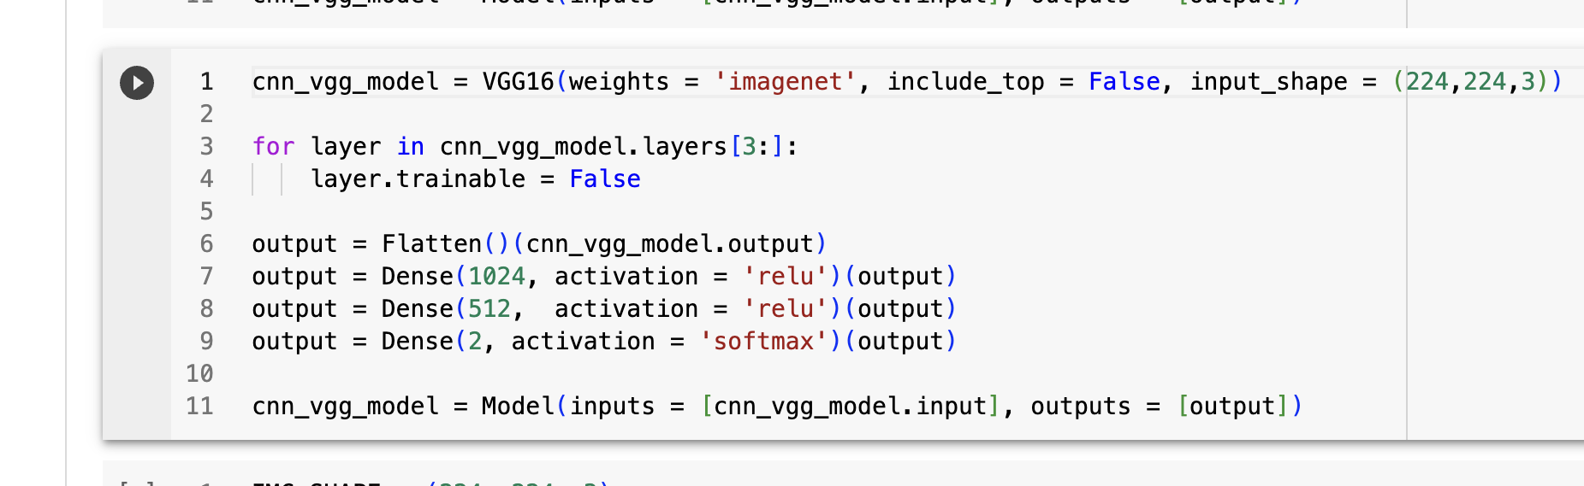
VGG16 model

Slide 6
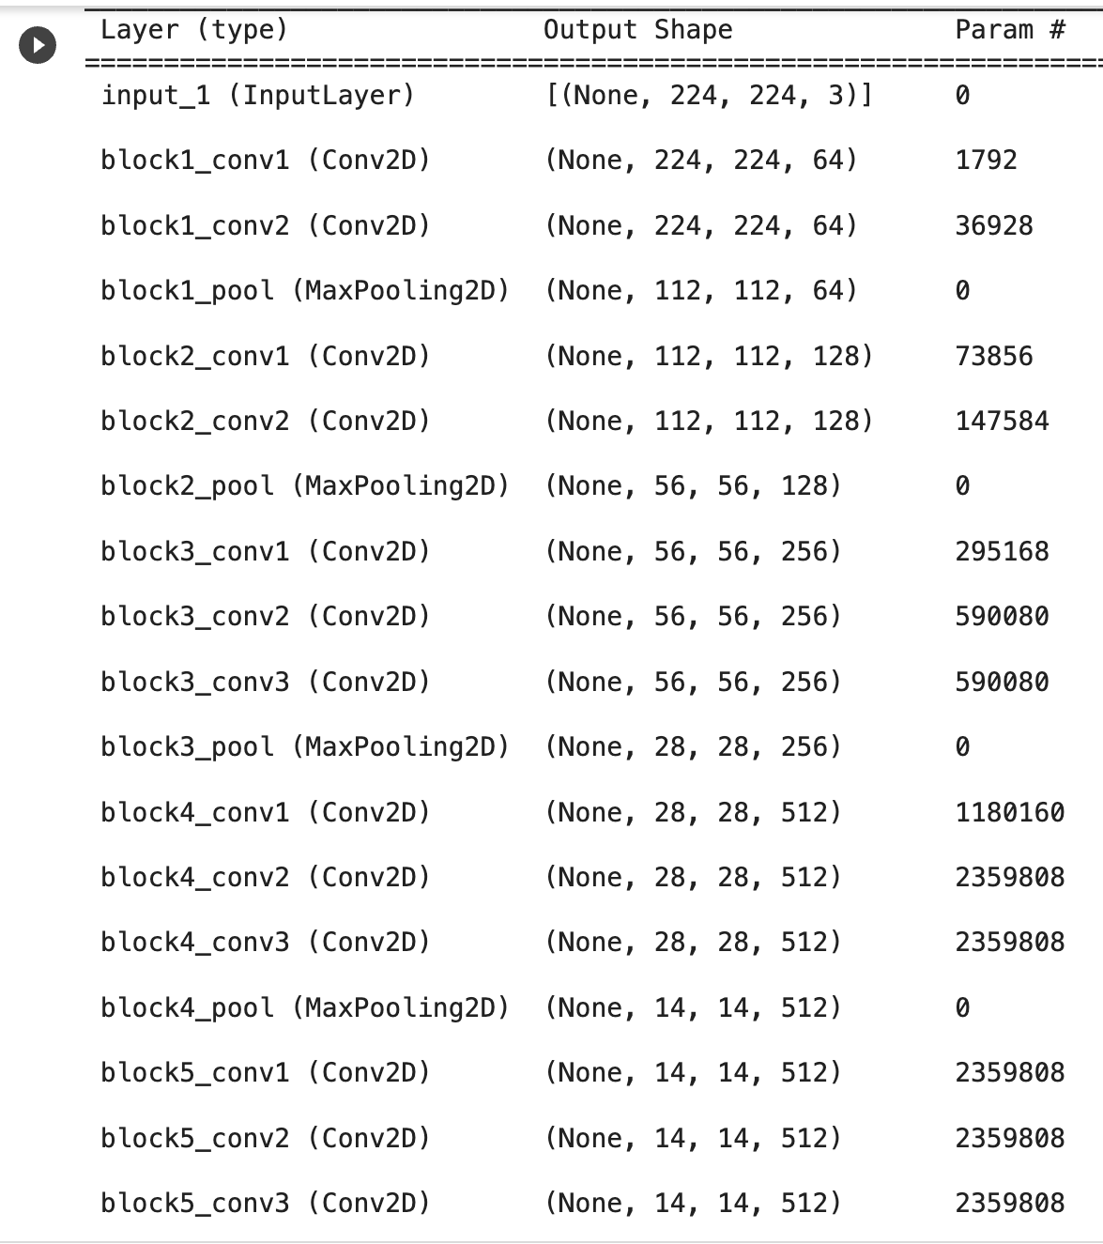
MODEL SUMMARY

Slide 7
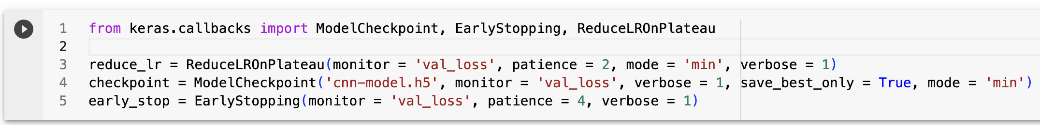
CALLBACKS
ReduceLROnPlateau:
Monitors validation loss.
Adjusts learning rate when improvement plateaus.
Aims to enhance convergence during training.
ModelCheckpoint:
Monitors validation loss.
Saves the model at the end of each epoch.
Ensures only the best-performing model is saved.
EarlyStopping:
Monitors validation loss.
Stops training when improvement stalls.
Prevents overfitting by ending training at an optimal point.

Slide 8
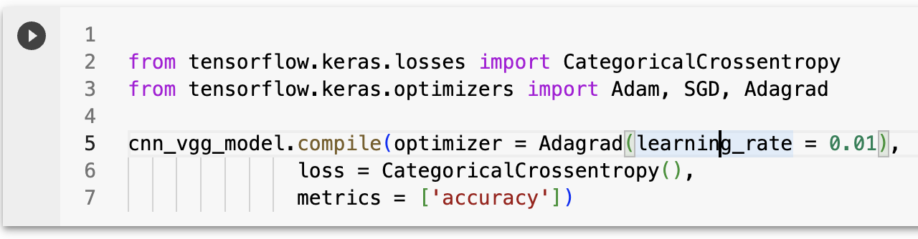
OPTIMIZER AND LOSSFUNCTION
Optimizer (Adagrad):
Adapts learning rates for each parameter.
Helps converge faster in different directions.
Loss Function (Categorical Crossentropy):
Measures the difference between predicted and actual distributions.
Suitable for multi-class classification tasks.
Metrics (Accuracy):
Evaluates model performance during training.
Represents the proportion of correctly classified instances.

Slide 9
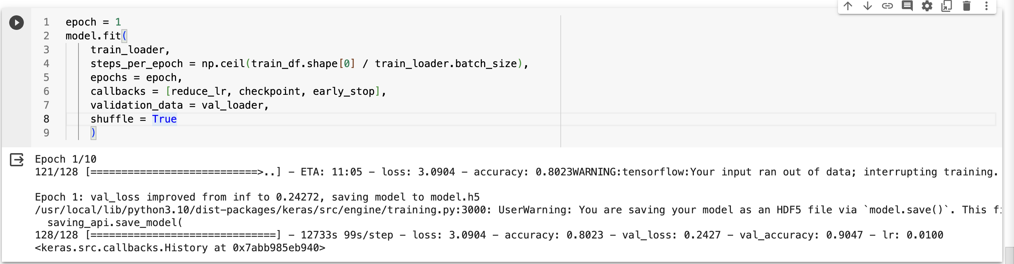
MODEL TRAINING

