Slide 1
British Airline On-Time Performance & Reliability Control Tower
Operations Analytics Capstone Project
Nirosha Jayasundara
15 April 2026

Slide 2
Business Problem & Objective
Delays caused by inbound propagation, congestion, turnaround inefficiencies.
Objective: Build a control tower for proactive intervention.

Slide 3
Data & Methodology
Flight operations, airport performance, weather data.
KPIs, root cause analysis, dashboarding.

Slide 4
Operational KPIs
D15 Rate
Avg Departure Delay
Delay Propagation Rate
Turnaround Overrun Rate.

Slide 5
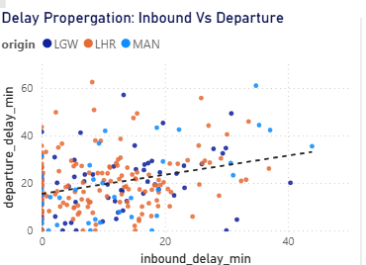
Key Finding 1
Inbound delay strongly drives departure delay.

Slide 6
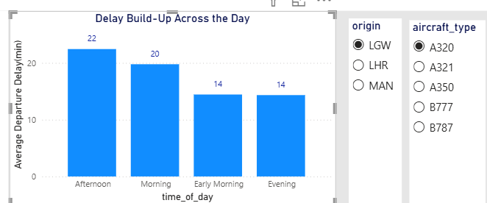
Key Finding 2
Delays accumulate through the day, peaking in the afternoon.

Slide 7
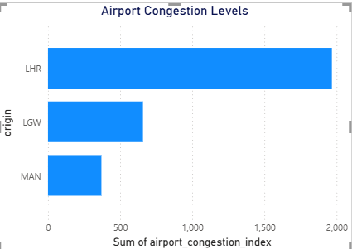
Key Finding 3
Major hub congestion worsens performance.

Slide 8
Decision Options
Option | Benefit | Trade-off
Increase buffer time | Reduce delays | Lower utilization
Focus on high-risk flights | Targeted improvement | Requires monitoring
Improve turnaround ops | Faster recovery | Resource cost

Slide 9
Recommended Actions
Reduce propagation
manage high‑risk flights
optimize airports
adjust schedules.

Slide 10
Expected Impact
Improved D15
lower average delays
higher reliability.

Slide 11
Risks & Assumptions
Synthetic data
simplified weather
no real‑time constraints.

Slide 12
Next Steps
Real‑time monitoring
predictive model
crew & maintenance integration.

