Slide 1
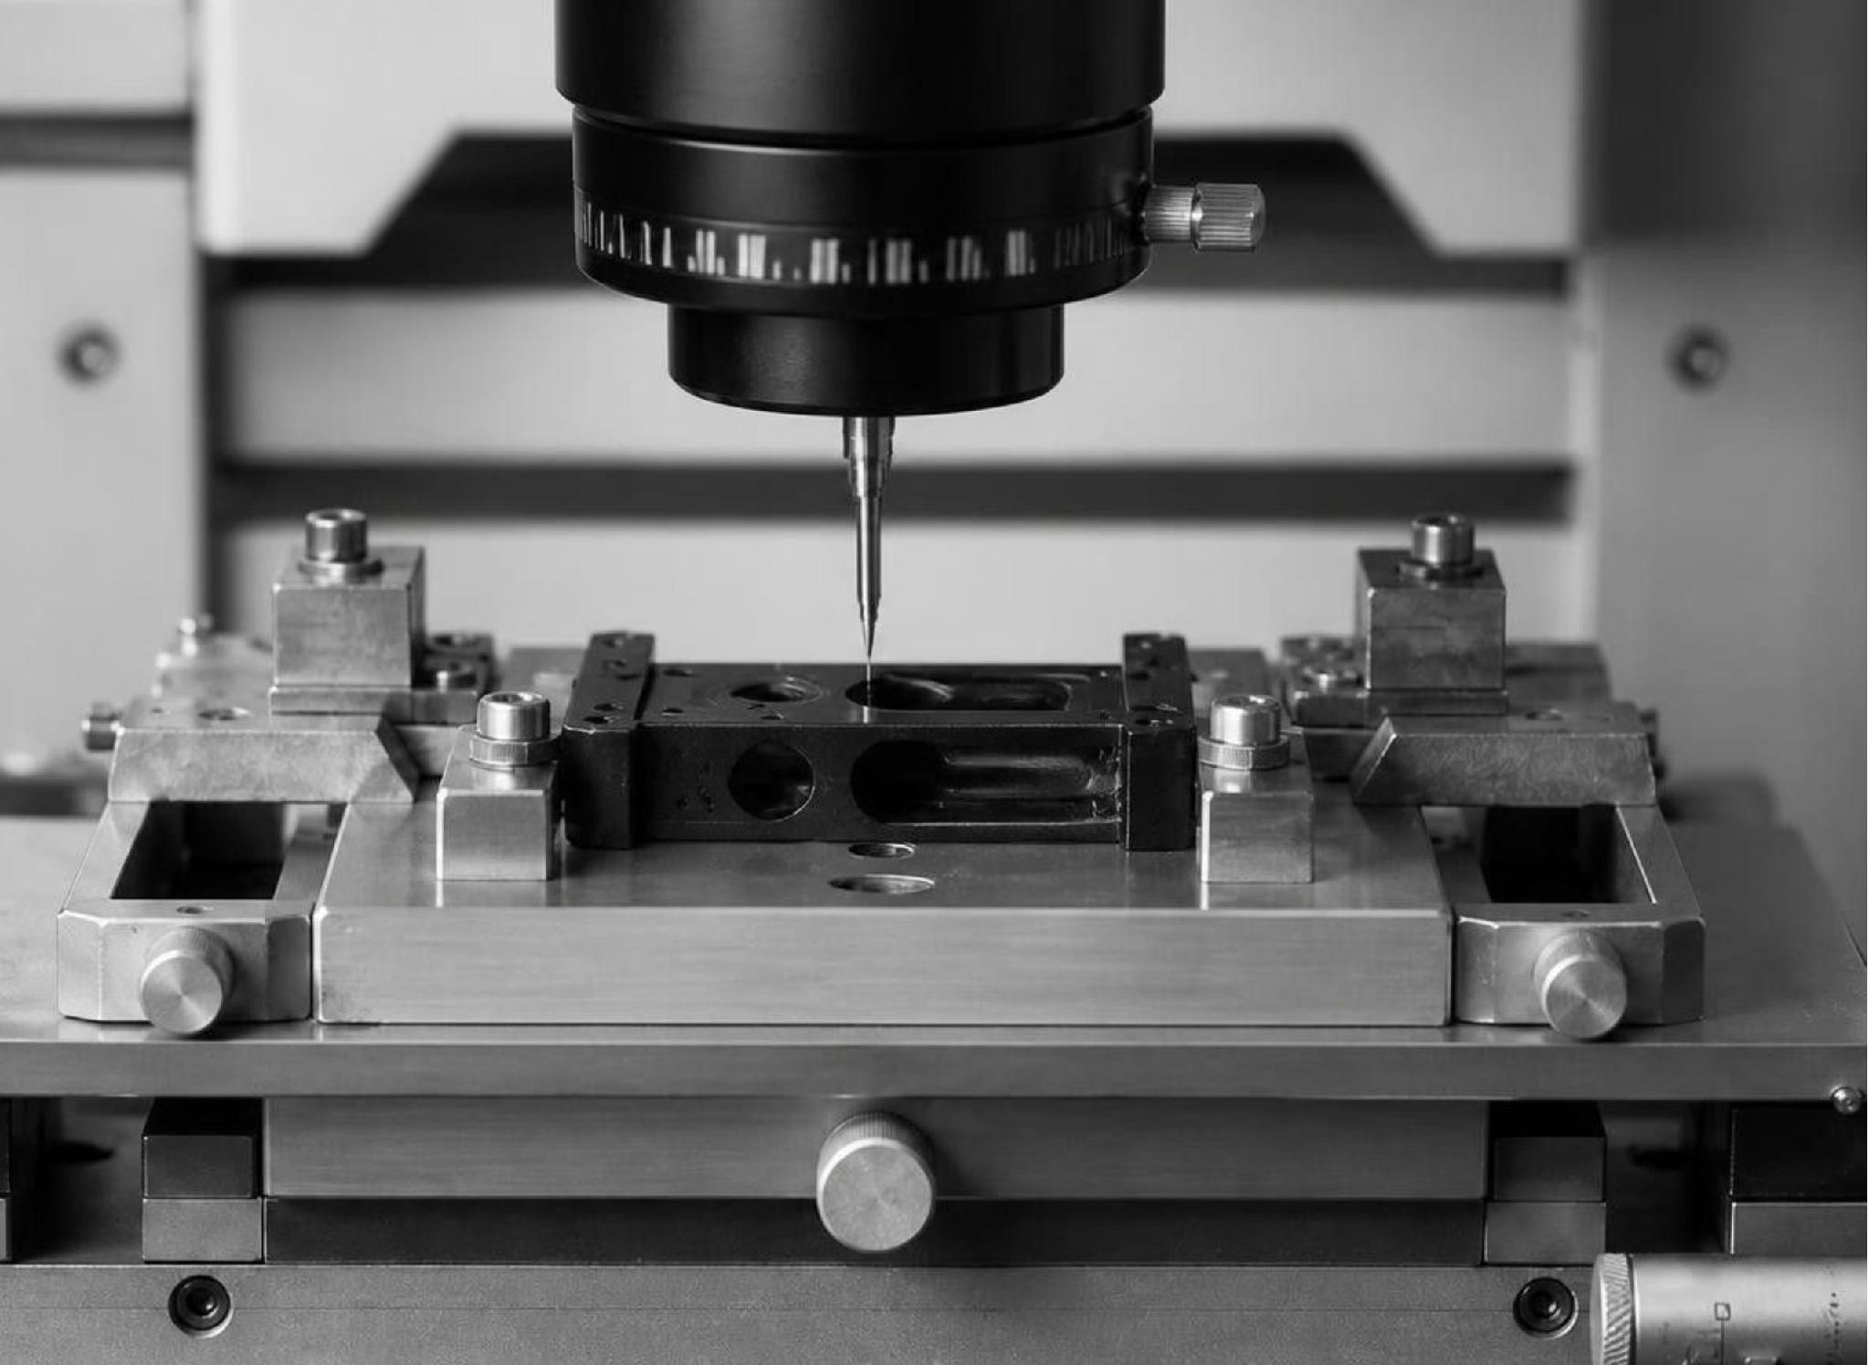

ST. MARTINS ENGINEERING COLLEGE
Nano
technology
From nanoscale behavior to engineered commercial value.
BY PRAJWAL & OMKAR
MATERIALS & DEVICES
APPLICATIONS
SCALE-UP
MARKET READINESS

Slide 2
THE CORE PROPOSITION
THE NANOSCALE
MATTERS WHEN IT
CHANGES PERFORMANCE.
NM
Nanotechnology is the understanding and control of matter at the nanoscale.
SCALE
WORKING RANGE
PRODUCT EFFECT
1 nm = 10⁻⁹ m
Usually 1–100 nm
Surface, size, and structure

Slide 3
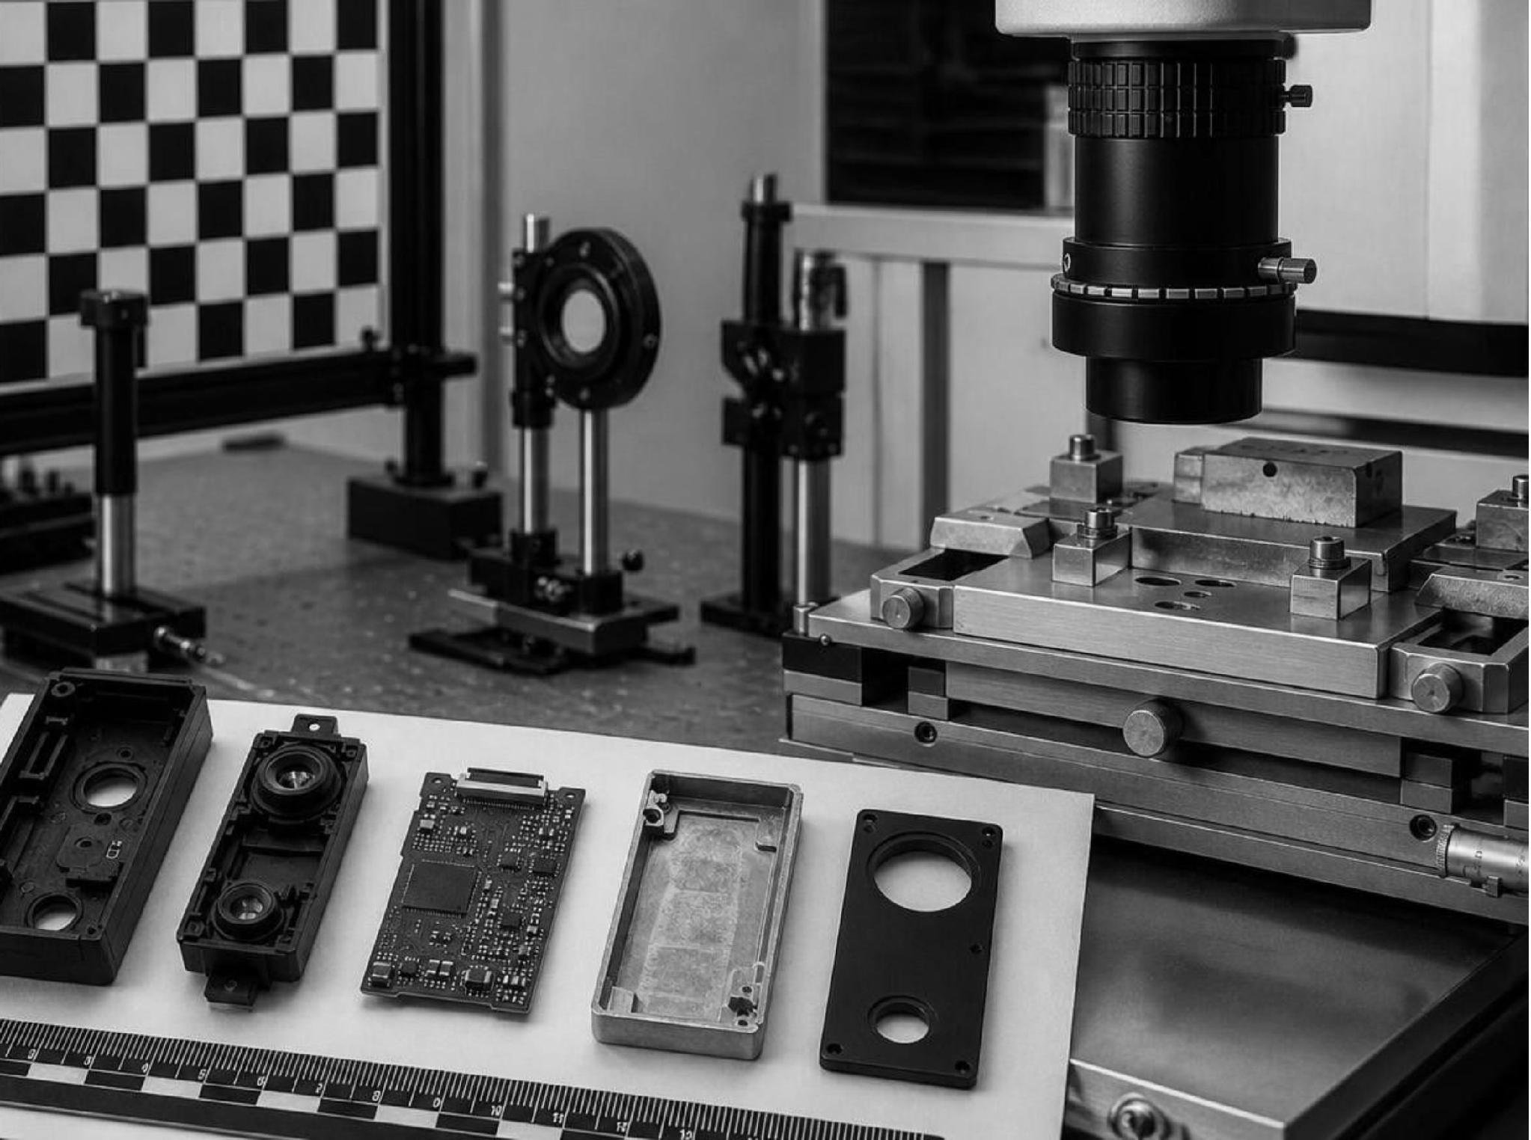
ABOUT NANOTECHNOLOGY
Small structures.
Different behavior.
At the nanoscale, matter can differ from bulk materials, single atoms, and molecules in useful ways.
STRONGER / MAGNETIC
THERMAL / ELECTRICAL
REACTIVE / OPTICAL

Slide 4
NANOMANUFACTURING
Making nano useful means
making it repeatable.
Nanomanufacturing is the scaled-up, reliable, and cost-effective production of nanoscale materials, structures, devices, and systems.
01
02
03
04
Define
Build
Control
Integrate
Specify the target size, surface, or structure.
Use top-down patterning or bottom-up self-assembly.
Hold quality, yield, and safety across batches.
Fit the material into a working product system.
TOP-DOWN · CARVE OR ETCH | BOTTOM-UP · BUILD OR SELF-ASSEMBLE

Slide 5




APPLICATION LANDSCAPE
Real-world value appears across four application zones
Healthcare
Electronics
Targeted delivery, diagnostics, imaging, and antimicrobial surfaces. Value is paid through better outcomes, earlier detection, or cleaner care.
Smaller features, conductive nanomaterials, sensors, and quantum devices. Value is paid through function per device and per unit area.
Energy & environment
Consumer & industrial
Catalysts, membranes, coatings, batteries, and solar materials. Value is paid through efficiency, selectivity, and resource savings.
Stronger composites, scratch-resistant coatings, pigments, and filtration. Value is paid through durability, quality, and lower maintenance.

Slide 6
USE-CASE CARDS
Three use cases show how nano earns its place
01
MEDICINE
02
ELECTRONICS
03
WATER & ENERGY
Move the therapy.
Find the signal.
Pack more function
into less space.
Separate.
Convert. Repeat.
Problem: treatment or detection can lack selectivity.
Mechanism: tune particle size and surface chemistry.
Value: improve where therapy travels or what a diagnostic detects.
Problem: device area and sensing limits constrain function.
Mechanism: engineer nanoscale structures and conductive materials.
Value: smaller devices or a stronger response to a target.
Problem: conventional separation or conversion wastes energy.
Mechanism: use high surface area, selective pores, or catalytic surfaces.
Value: improve throughput, selectivity, or conversion efficiency.
HURDLE · safety, clinical evidence, and reproducible formulation
HURDLE · integration, yield, and qualification
HURDLE · fouling, lifetime, and operating cost

Slide 7




TECHNO-ECONOMIC FUNNEL
Economic feasibility is a scale-up problem,
not just a lab problem
Performance only creates value when it survives manufacturing, regulation, and customer qualification.
Lab performance
1
Does the nanoscale mechanism work?
Throughput
2
Can output rise without losing quality?
Unit economics
3
Do materials, energy, yield, purification, QC, and waste fit?
4
Qualified product
Will safety, price, and customer adoption hold?
COMMERCIALIZATION BARRIERS · MATERIAL QUALITY · FORMULATION · SCALE-UP · PRODUCTION COST

Slide 8
COUNTRY PROGRESS MATRIX
Countries are competing across different layers of the value chain
Leadership is multidimensional: research, patents, manufacturing, and market adoption do not move together.
Country | Public strategy | Strongest layer | Commercialization signal
United States | Interagency R&D platform | Research infrastructure | FY2025 NNI request: $2.2B2025 request; cumulative funding above $45B since 2001
China | National scale and patent activity | Patents and enterprise base | 464,000 authorized patents; 34,500 enterprises2025 white paper
European Union | Coordinated research and commercialization programs | Translation and scale-up networks | Scale-up and cost treated as explicit barriers
Japan | Frontier technology linked to competitiveness and economic security | Advanced materials and devices | Mature industrial base for integration
India | Nano Mission and continuing national programs | Capacity building and advanced materials | National Program on Nano Science and Technology

Slide 9
COMMERCIALIZATION GATES
Market success requires safety, quality,
and repeatability
Nanoscale materials can present health or environmental hazards that differ from the same substance in bulk form; long-term repeated-exposure evidence can remain incomplete.
01
02
03
04
01 · Benefit
02 · Repeatability
03 · Safe use
04 · Willingness to pay
Measure a customer-relevant improvement over the baseline product.
Specify size, surface, composition, yield, and batch-to-batch quality.
Plan exposure controls, lifecycle effects, and evidence for intended use.
Show that the performance gain is worth the installed cost and qualification effort.
A NANO MATERIAL IS MARKET-READY WHEN ITS SPECIFICATION, SAFETY CASE, AND VALUE PROPOSITION TRAVEL TOGETHER.

Slide 10
SYNTHESIS / CLASS DISCUSSION
Nanotechnology wins when
the economics are engineered too
01
Keep the science focused
Size, surface, and structure are tools for changing product performance.
02
Judge value, not novelty
Ask what is created per unit cost, not merely what is technically new.
03
Read country progress in layers
Research, infrastructure, patents, manufacturing, and adoption do not move together.
NANOTECHNOLOGY · APPLICATIONS · SCALE-UP · MARKET READINESS

