Slide 1





SMART INDIA HACKATHON 2026
Problem Statement ID – 26093
Problem Statement Title – AI-Based Real-Time Stress and Trauma Assessment Module for Victims/Complainants Accessing NHAA (14566) and Integrated Portal
Theme – Healthtech
PS Category – Software
Team ID –
Team Name – JARVIS

Slide 2
AI CHATBOT
JARVIS is proposing an AI-based interactive assistance system that can continuously interact with a user, understand changes in their emotional state, identify possible risk indicators, and provide appropriate support or escalation when necessary.
It combines:
AI-based conversational interaction
Real-time audio and video analysis
Basic psychological and emotional assessment
Trauma and relevant medical-history analysis
Mood and sleep monitoring
Emergency SOS functionality
Multilingual and regional-dialect communication
Personalized immediate-care guidance
Risk-level classification
Recovery monitoring and reporting
@SIH Idea submission- Template
2

Slide 3
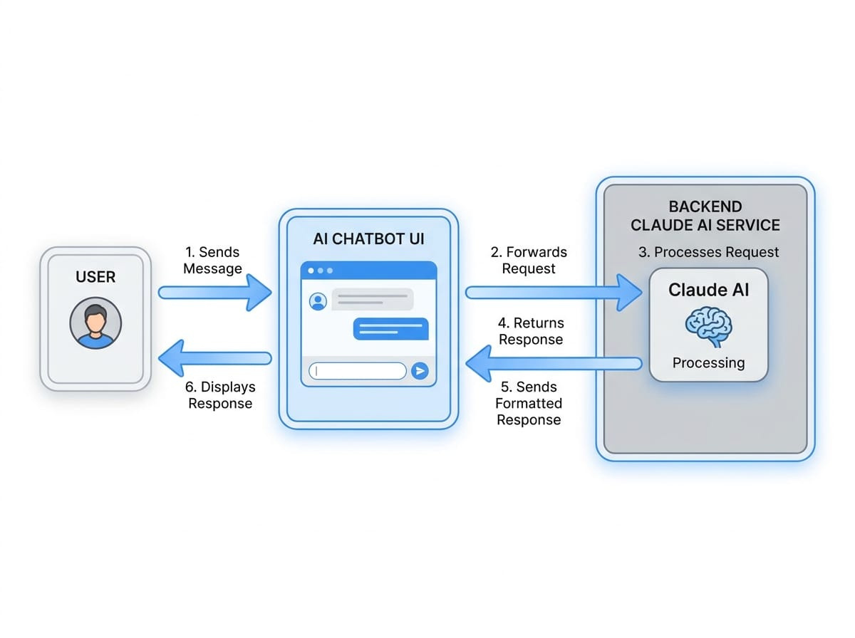
TECHNICAL APPROACH
TECHNOLOGIES USED:
Large Language Models (LLMs) & Foundation APIs
OpenAI, Chatgpt
Developer Frameworks & RAG Libraries
Haystack,lamalndex,longchain,rasa
Front-End SDKs & Integration Tools
Chainlit,Gradio/streamlit ,matrix protocols
Natural Language Processing and Speech Analytics, and Emotion AI
Acoustic Feature Extraction Tools (openSMILE, Librosa)
Open-Source Speech Models (Wav2Vec 2.0, Whisper)
Clinical NLP & Transformer Models (MentalBERT, RoBERTa, SpaCy, SpeechBrain
METHADOLOGY AND PROCESS OF IMPLEMENTATION
We are developing an interactive chatbot for real time stress and trauma assessment
What will it provide
1. Real time Audio Video Analysis
2. Special care for:
• Senior citizens • Minors • Disabled people
3. Emergency SOS and Rapid response button which will directly send signals through the NHA helpline number.
4. Basic psychological analysis
5. Trauma and medical history analysis
6. Detect suicidal thoughts tendencies through real time interaction.
7. Peaceful themed
8. User guide
9. Immediate care regarding health like breathing exercises, first aid, words of assurance, CPR etc.
10. Limitations.
11. Recovery report
12. Sleep analysis and tips for sleep
13. Weekly Mood tracker
14. Local emergency helpline numbers
15. Chatbot able to communicate in Languages and regional dialects
16. NHA can analyse high risk, low risk and moderate cases regionally and take actions accordingly
@SIH Idea submission- Template
3

Slide 4
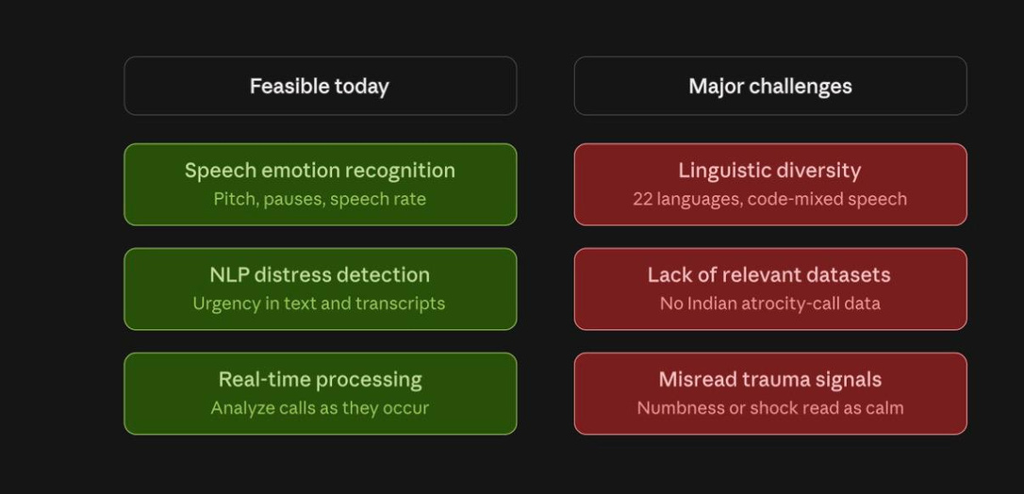
FEASIBILITY AND VIABILITY
Viability Analysis
Ethical & Legal Concerns
1. Consent Issues:
Some victims may become less willing to report incidents.
2. Bias & Misclassification
False Negatives and False Positive
3. Data Privacy
Sensitive information includes:
Strong compliance with the Digital Personal Data Protection (DPDP) Act is essential.
4. Human Oversight
AI should:
Recommend priority levels
AI should NOT:
Automatically reject
Automatically deprioritize
Automatically close cases
5. Accountability
If an AI system makes a wrong recommendation and harm occurs, responsibility becomes unclear.
@SIH Idea submission- Template
4

Slide 5
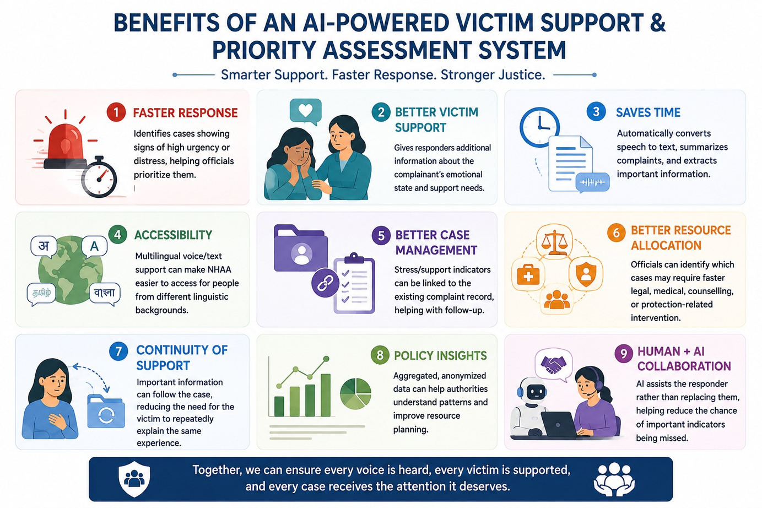
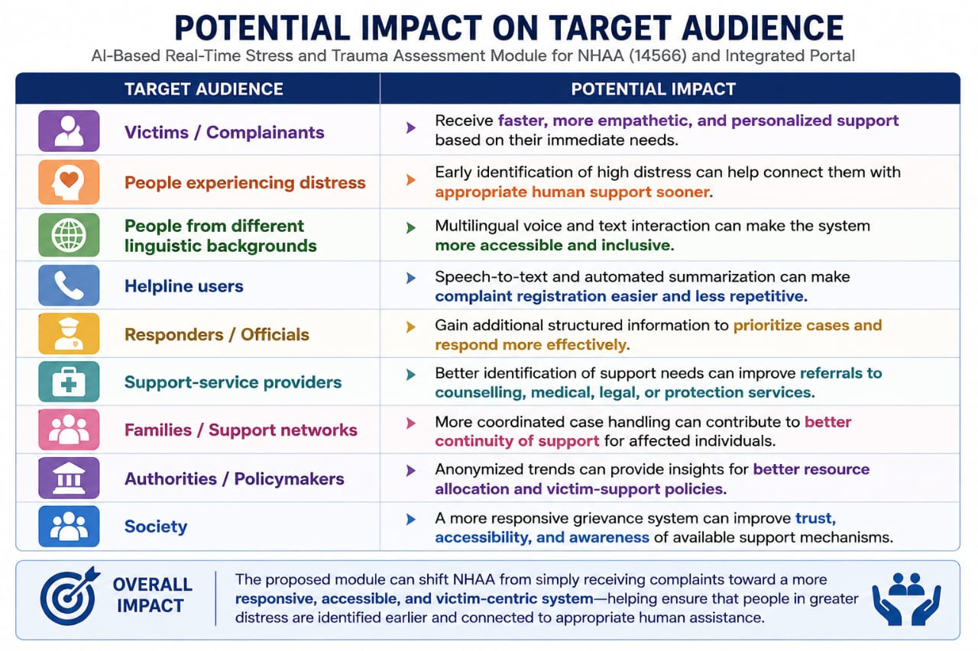
@SIH Idea submission- Template
5

Slide 6
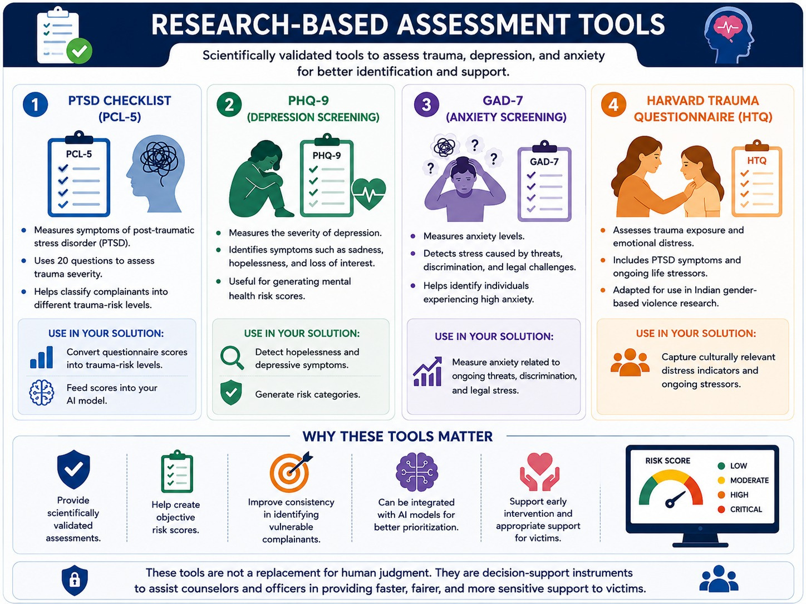
@SIH Idea submission- Template
6

