Slide 1
Congestion Control using ML/DL
From a simulator to a real Wi-Fi network, in eight stages
Nirupam Raut (24BAI0345) · Aaditya Yadav (24BDS0450) · Computer Networks, Slot F2 · October 2026
Notes:
Introduce yourself and the title. One sentence: this project asks whether machine learning can fix two known weaknesses of TCP congestion control, and tests the answer in a simulator built for the purpose.

Slide 2
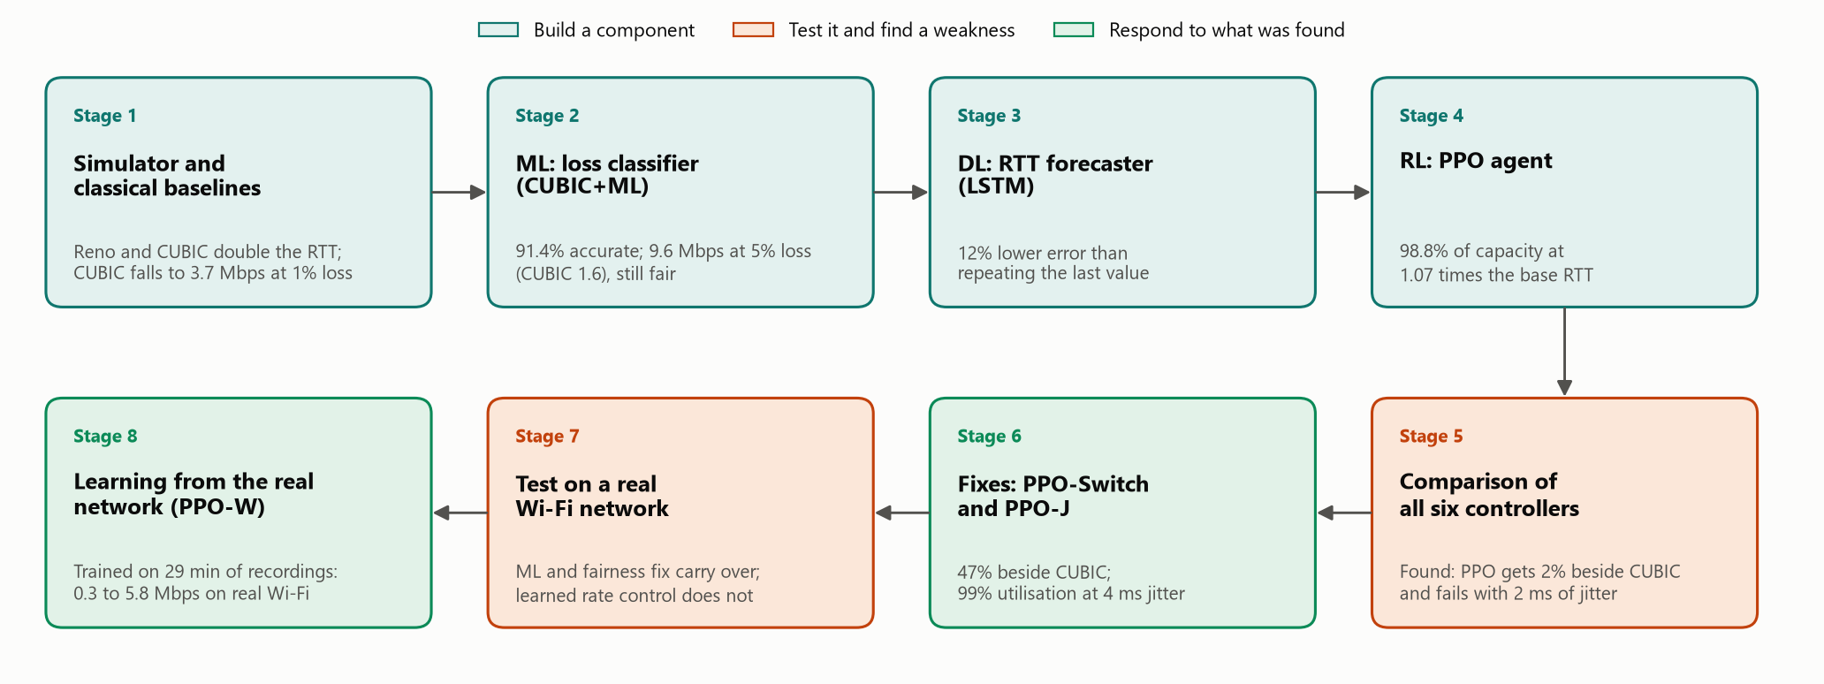
How the project progressed
INTRODUCTION
Notes:
The project is told in the order we did it. Stages 1 to 4 built the simulator and the three learned components. Stage 5 compared all six controllers and found two weaknesses in the agent. Stages 6 to 8 responded: we fixed the weaknesses in simulation, tested everything on a real Wi-Fi network, and finally trained the agent on recordings of that network. Each stage was prompted by what the one before found. The dots at the top right of every slide show where we are.

Slide 3
What congestion control does
INTRODUCTION
Sender 1
Too slow
Queue
Link capacity is wasted.
Sender 2
link
Receiver
Too fast
The queue fills, delay rises and packets are dropped.
Sender 3
drops when full
The job
Find the highest rate that keeps the queue short, using only ACKs.
ACKs return to the senders
Notes:
Congestion control decides how fast a sender transmits. Senders share a queue in front of the slowest link. If they send too slowly, capacity is wasted. If they send too fast, the queue fills, delay rises and packets are dropped. The only feedback is the stream of acknowledgements coming back.

Slide 4
Fixed rules fail in two ways
INTRODUCTION
Every loss is treated as congestion
The queue is kept full
A noisy wireless link drops packets for reasons that have nothing to do with congestion. The sender slows down anyway.
Reno and CUBIC back off only after the queue overflows, so every packet waits in a nearly full queue.
10 → 3.7 Mbps
2×
CUBIC at only 1% random loss
the round-trip time of an empty queue
The question: can learned components fix both?
Notes:
Reno and CUBIC follow fixed rules: increase until a packet is lost, then cut. First weakness: every loss is read as congestion, so on a noisy wireless link the sender slows down for nothing. In our simulator CUBIC drops from 10 to 3.7 megabits at only 1% random loss. Second weakness: the sender reacts only after the queue overflows, so the queue stays nearly full and the round-trip time roughly doubles.

Slide 5
Goal and objectives
INTRODUCTION
1
Build a packet-level simulator and three baselines: Reno, CUBIC and BBR
GOAL
Test whether machine learning, deep learning and reinforcement learning can fix both weaknesses, and report honestly where they cannot.
2
ML: classify each loss as congestion or random, and use it inside CUBIC
3
DL: forecast round-trip time with an LSTM
4
DRL: train a PPO agent to set the sending rate, plus a CUBIC+PPO hybrid
5
Compare all six on throughput, delay, loss and fairness
6
Fix the weaknesses found, and test everything on a real Wi-Fi network
Notes:
The goal is to test whether learned components can fix both weaknesses, and to say honestly where they cannot. Six objectives: build the simulator and baselines; a machine-learning classifier for loss type; a deep-learning forecaster for round-trip time; a reinforcement-learning agent plus a hybrid; a comparison of all six controllers; and, added as the project went on, fixing the weaknesses found and testing on a real Wi-Fi network.

Slide 6
1
2
3
4
5
6
7
8
STAGE 1 OF 8
Simulator and baselines
WHY THIS STAGE
To compare controllers fairly we need one network that every controller sees in the same way, and classical baselines to beat.
Notes:
Stage 1 builds the test bench: a packet-level simulator of a bottleneck link, and Reno, CUBIC and BBR as the baselines.

Slide 7
How the project fits together
STAGE 1 · SIMULATOR AND BASELINES
1
2
3
4
5
6
7
8
Network simulator: senders, a queue and one bottleneck link
labelled losses
RTT series
episodes
Loss classifier (ML)
RTT forecaster (DL)
PPO training (DRL)
XGBoost, trained on 64,256 labelled losses
LSTM, trained on 195,027 samples; evaluated on its own
1,000,000 decisions on random links
Reno
CUBIC
BBR
CUBIC+ML
PPO
CUBIC+PPO
Evaluation in the same simulator: throughput, delay, loss and fairness
Notes:
One simulator does three jobs. It generates the labelled data for the classifier and the forecaster, it is the environment in which the PPO agent is trained, and it is the test bench for all six controllers. The classifier goes into CUBIC+ML, and the trained policies drive PPO and CUBIC+PPO. The forecaster is evaluated on its own.

Slide 8
The network simulator
STAGE 1 · SIMULATOR AND BASELINES
1
2
3
4
5
6
7
8
1 ms
1500 B
One interface for every controller
time step, with exact ACK timestamps
fixed packet size
Member | Purpose
cwnd | Window, in packets
pacing_rate | Packets per second
on_ack(ack) | Called for every ACK
on_loss(loss) | Called for every loss
on_tick(now) | Optional timer
Drop-tail
Tagged
queue, plus optional random loss
every loss carries its true cause
Checked against theory: Reno at 1% loss gives 3.9 Mbps; the Mathis formula predicts 3.7 Mbps.
Notes:
The simulator is written in Python. Time moves in one-millisecond steps and packets are 1500 bytes. The queue is drop-tail: a packet arriving at a full queue is dropped. The link can also drop packets at random, like a wireless link. Every lost packet is tagged with its true cause, which gives us labels for training; controllers cannot read the tag. All six controllers plug in through the same small interface. As a check, Reno at 1% loss gives 3.9 megabits and the Mathis formula predicts 3.7.

Slide 9
Six controllers compared
STAGE 1 · SIMULATOR AND BASELINES
1
2
3
4
5
6
7
8
Controller | Type | How it decides
Reno | Classical | Adds 1 packet per RTT; halves the window on loss
CUBIC | Classical | Cubic window growth; × 0.7 on loss (Linux default)
BBR | Classical | Paces at the estimated link rate; ignores loss
CUBIC+ML | Machine learning | CUBIC that ignores losses a classifier judges random
PPO | Reinforcement learning | A neural network raises or lowers the sending rate
CUBIC+PPO | Hybrid | CUBIC with a neural network scaling its window
Notes:
Three classical controllers and three learned ones. Reno and CUBIC react to loss. BBR estimates the link rate and ignores loss. CUBIC+ML is CUBIC with a classifier in front of its loss reaction. PPO is a neural-network policy that sets the sending rate. CUBIC+PPO keeps CUBIC running and lets a policy scale its window.

Slide 10
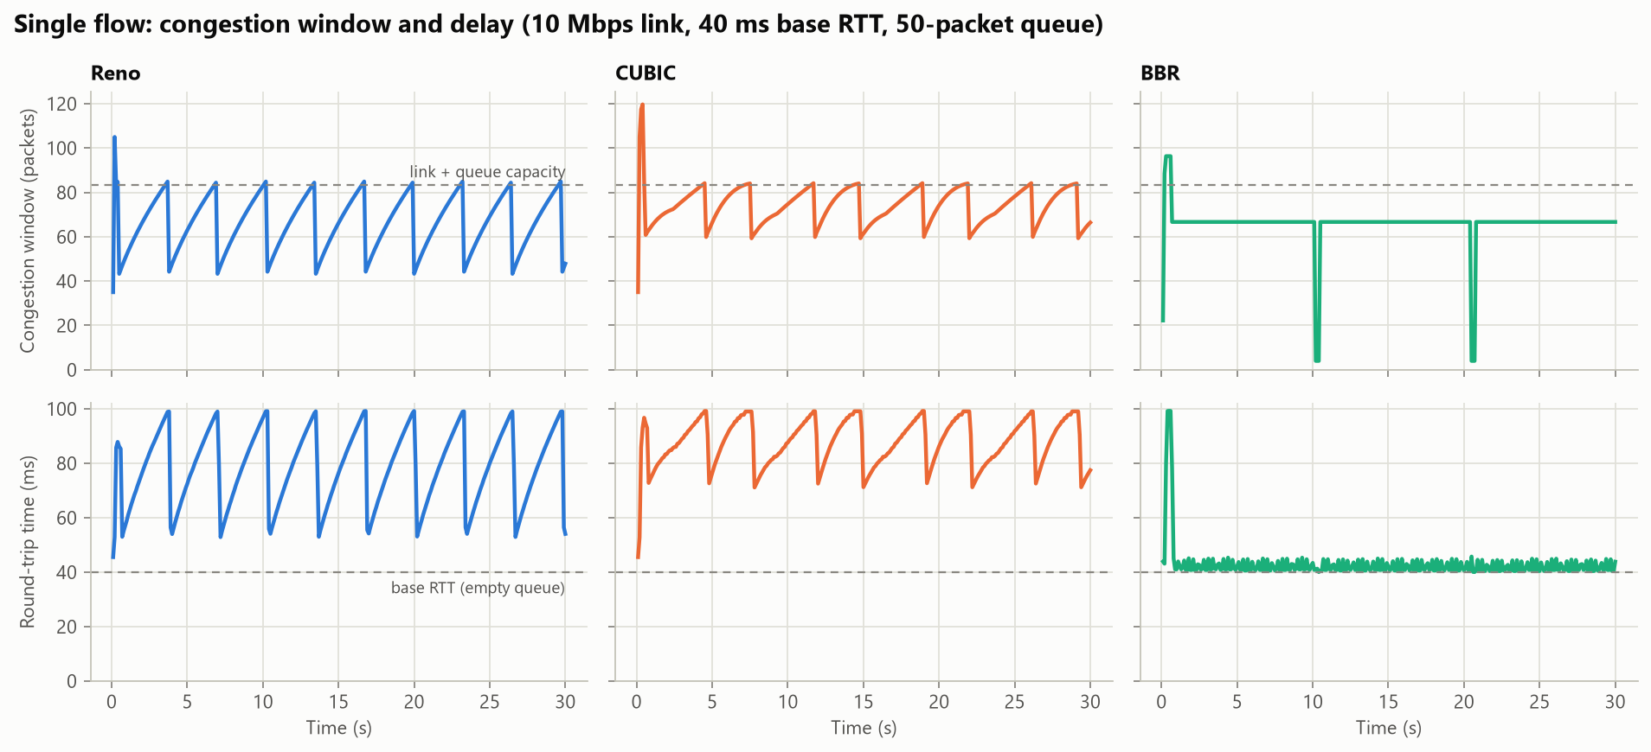
Baselines match theory
STAGE 1 · SIMULATOR AND BASELINES
1
2
3
4
5
6
7
8
79–88 ms
average RTT with Reno and CUBIC on a 40 ms path
42 ms
average RTT with BBR
3.9 Mbps
Reno at 1% loss; theory predicts 3.7
One flow on a 10 Mbps link, 40 ms base RTT, 50-packet queue. Top: congestion window. Bottom: round-trip time.
Notes:
One flow alone on a 10 megabit link. Top row is the congestion window, bottom row the round-trip time. Reno and CUBIC show the classic sawtooth: they grow until the queue overflows and then cut back, so the RTT swings between about 55 and 100 milliseconds on a 40 millisecond path. BBR stays near 40. Reno's throughput under loss matches the Mathis formula.

Slide 11
1
2
3
4
5
6
7
8
STAGE 2 OF 8
Machine learning
WHY THIS STAGE
Stage 1 confirmed that CUBIC falls from 10 to 3.7 Mbps at 1% random loss. Can a classifier tell random loss from congestion?
Notes:
Stage 2 trains a classifier on losses whose cause the simulator knows, and puts it inside CUBIC.

Slide 12
Data for the loss classifier
STAGE 2 · MACHINE LEARNING
1
2
3
4
5
6
7
8
Setting | Range across the 400 scenarios
Bandwidth | 1 to 30 Mbps
One-way delay | 5 to 80 ms
Queue size | 0.1 to 3 pipe sizes
Random loss | 0 to 3%
Changing capacity | In 40% of scenarios
Flows | 1 to 3 (Reno, CUBIC or BBR)
400
64,256
simulated scenarios, 30 s each
labelled losses
49,092 / 15,164
297 / 100
congestion / random losses
scenarios for training / testing
Whole scenarios are held out, so the test measures networks the classifier has never seen.
Notes:
A real network never tells you why a packet was lost, but the simulator knows. So we ran 400 random scenarios of 30 seconds each, with one to three Reno, CUBIC or BBR flows, and saved every loss together with its true cause: 64 thousand labelled losses. Whole scenarios are held out for testing, 297 for training and 100 for testing, so the test measures networks the classifier has never seen.

Slide 13
Ten signals describe a loss
STAGE 2 · MACHINE LEARNING
1
2
3
4
5
6
7
8
rtt_ratio | Latest RTT ÷ minimum RTT
rtt_peak_ratio | Latest RTT ÷ recent peak RTT
rtt_dev | RTT variation ÷ minimum RTT
inflight_ratio | Packets in flight ÷ pipe size
rtts_since_loss | RTTs since the previous loss
srtt_ratio | Smoothed RTT ÷ minimum RTT
rtt_trend | RTT change over 16 ACKs
rate_ratio | Delivery rate ÷ recent peak
losses_last_rtt | Other losses in the last RTT
loss_rate | Loss rate, last ~100 packets
Intuition: congestion loss happens when the queue is full, so the RTT is near its peak. Random loss can come at any RTT.
Notes:
Each loss is described by ten numbers that a real sender can compute from its own ACKs and loss reports. All are ratios, so they do not depend on the link's absolute speed. The intuition: a congestion loss happens when the queue is full, so the RTT is near its peak. A random loss can come at any moment, including when the RTT is at its minimum.

Slide 14
Four classifiers compared
STAGE 2 · MACHINE LEARNING
1
2
3
4
5
6
7
8
91.4%
of losses classified correctly by XGBoost on unseen networks
Tree ensembles beat the best single threshold by 3 points of F1
XGBoost is as accurate as the forest and much faster per loss
Misses 5.4% of congestion losses; misreads 18.6% of random ones
Notes:
Four models were trained on the same data. A single threshold on one signal, which is how older schemes work, reaches a macro F1 of 0.852. The two tree ensembles reach 0.88. XGBoost is the one deployed: it matches the random forest and is far faster at classifying one loss at a time. Its errors are on the safe side: it misses 5.4% of congestion losses, the dangerous error, and misreads 18.6% of random losses, which only costs some throughput.

Slide 15
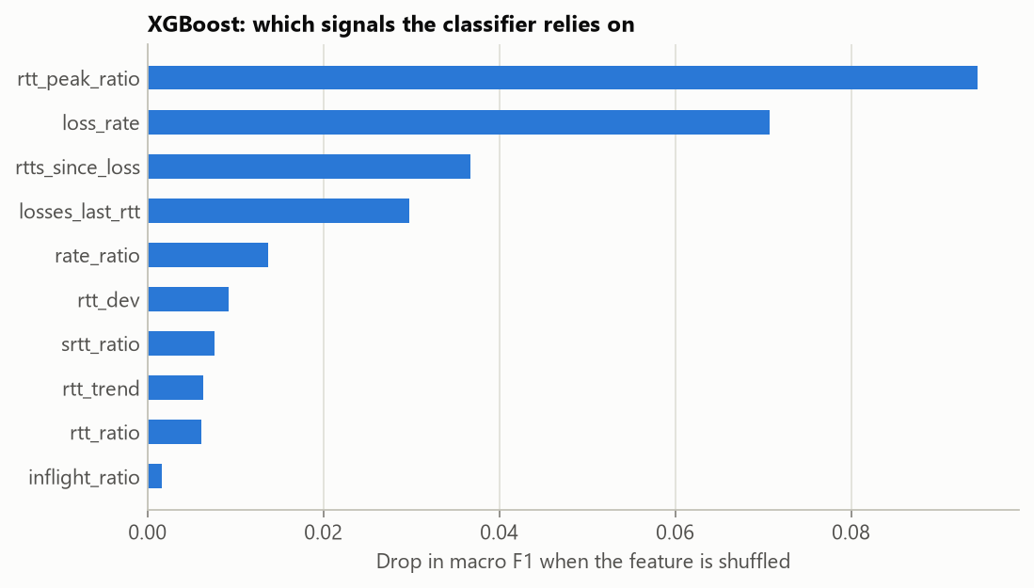
What the classifier relies on
STAGE 2 · MACHINE LEARNING
1
2
3
4
5
6
7
8
1
RTT relative to its recent peak
2
Recent loss rate
3
Time since the previous loss
A random loss looks different because it arrives when the queue is not full.
Notes:
Permutation importance on the test set: how much macro F1 falls when each signal is shuffled. The classifier relies most on how close the RTT is to its recent peak, then on the recent loss rate, then on how losses are spaced in time.

Slide 16
CUBIC+ML: using the classifier
STAGE 2 · MACHINE LEARNING
1
2
3
4
5
6
7
8
Yes: ignore the loss
Loss reported
Compute the 10 signals
Classifier gives P(congestion)
Below 0.2?
No: window × 0.7
Why 80% sure, not 50%
9.6 Mbps
50.5%
At 50% it ignored some real congestion losses and took 73% of a link from a normal CUBIC flow. At 80% the two share the link evenly.
at 5% random loss; CUBIC gets 1.6
of a link beside a normal CUBIC flow
Notes:
CUBIC+ML is ordinary CUBIC with one change. At each loss it computes the ten signals and asks the classifier. If the probability of congestion is below 0.2, meaning the classifier is at least 80% sure the loss was random, the loss is ignored. Otherwise CUBIC cuts its window as usual. The threshold is cautious on purpose: at 50% the controller ignored some real congestion losses and took 73% of a link from a normal CUBIC flow; at 80% they share evenly.

Slide 17
1
2
3
4
5
6
7
8
STAGE 3 OF 8
Deep learning
WHY THIS STAGE
CUBIC+ML fixed random loss but still fills the queue. Can a neural network see the delay coming?
Notes:
Stage 3 trains an LSTM to forecast the round-trip time half a second ahead.

Slide 18
LSTM forecaster design
STAGE 3 · DEEP LEARNING
1
2
3
4
5
6
7
8
Input
LSTM layer
Dense layer
Output
last 3 s: 30 samples × 6 signals
64 units
32 units, ReLU
change in RTT over the next 0.5 s
Trained on
How it was trained
195,027 samples from the same 400 scenarios
Split by scenario: 70% train, 15% validation, 15% test
Inputs use past measurements only
Adam, learning rate 0.001, batch size 512
Huber loss on the change in RTT
Stops after 4 epochs without improvement
About 20,500 parameters in total
Notes:
The deep-learning component forecasts a flow's round-trip time half a second ahead. The input is the last three seconds of the flow's own measurements: 30 samples of six signals. One LSTM layer with 64 units feeds a dense layer of 32 and a single output, about 20,500 parameters. It predicts the change in RTT, so a model that outputs zero is exactly the naive forecast of repeating the last value. Training data comes from the same 400 scenarios, split by scenario.

Slide 19
LSTM forecast results
STAGE 3 · DEEP LEARNING
1
2
3
4
5
6
7
8
12%
lower error than repeating the last value
21%
lower root mean square error: it avoids the largest misses
A modest gain. It still lags sudden jumps, and no controller uses the forecast yet.
Notes:
On held-out scenarios the LSTM's mean error is 7.9 milliseconds against 8.95 for simply repeating the last value: 12% better, and better than a moving average or linear extrapolation. We are honest about the size of this: it is a modest gain. The root mean square error falls by 21%, so the LSTM mainly avoids the largest misses, but it cannot predict jumps caused by things outside the flow, and no controller uses the forecast yet.

Slide 20
1
2
3
4
5
6
7
8
STAGE 4 OF 8
Reinforcement learning
WHY THIS STAGE
Forecasting alone gained only 12%. Can an agent learn to keep the link full and the queue short?
Notes:
Stage 4 trains a PPO agent that sets the sending rate, and a hybrid that adjusts CUBIC.

Slide 21
State, action and reward
STAGE 4 · REINFORCEMENT LEARNING
1
2
3
4
5
6
7
8
STATE
ACTION
REWARD
What it sees
What it does
What it wants
Four signals for each of its last 8 intervals: delay trend, delay level, send-to-ACK ratio and loss rate. 32 numbers in all.
One number a between −1 and 1. New rate = old rate × e^(0.3a): up to +35% or −26%, once every 1.5 RTTs.
Throughput − 0.5 × queueing delay − 5 × congestion loss, each normalised per link.
Every reward term is divided by the link's own capacity or base RTT, so one policy works on slow and fast links
Random loss is not penalised: the sender did not cause it
Notes:
The agent decides once per monitor interval, about one and a half round trips. Its state is four scale-free signals for each of the last eight intervals: whether delay is rising, how much queueing delay there is, whether it sends faster than ACKs return, and the loss rate. The action multiplies the sending rate. The reward is throughput minus delay minus congestion loss, each normalised by the link's own capacity and base RTT so one policy works on slow and fast links. Random loss is not penalised because the sender did not cause it.

Slide 22
How the agent was trained
STAGE 4 · REINFORCEMENT LEARNING
1
2
3
4
5
6
7
8
Setting | Range in each training episode
Bandwidth | 2 to 40 Mbps
Base RTT | 10 to 150 ms
Queue size | 0.2 to 3 pipe sizes
Random loss | None in half, else up to 3%
Capacity | Changes in half the episodes
Starting rate | 5% to 150% of capacity
8 environments each run 1,024 decisions
PPO scores each action against what it expected
Policy network updated: 10 passes, batches of 256
Repeated about 120 times
1,000,000
≈ 20 min
decisions for the main agent
on a laptop CPU, no GPU
Notes:
Training uses PPO from Stable-Baselines3 with a policy network of two hidden layers of 64 units. Each episode is 200 decisions on a newly generated random link, so the agent cannot memorise one network. Eight environments run in parallel; after each batch of 8,192 decisions the policy is updated. The main agent was trained for one million decisions, about 20 minutes on a laptop CPU.

Slide 23
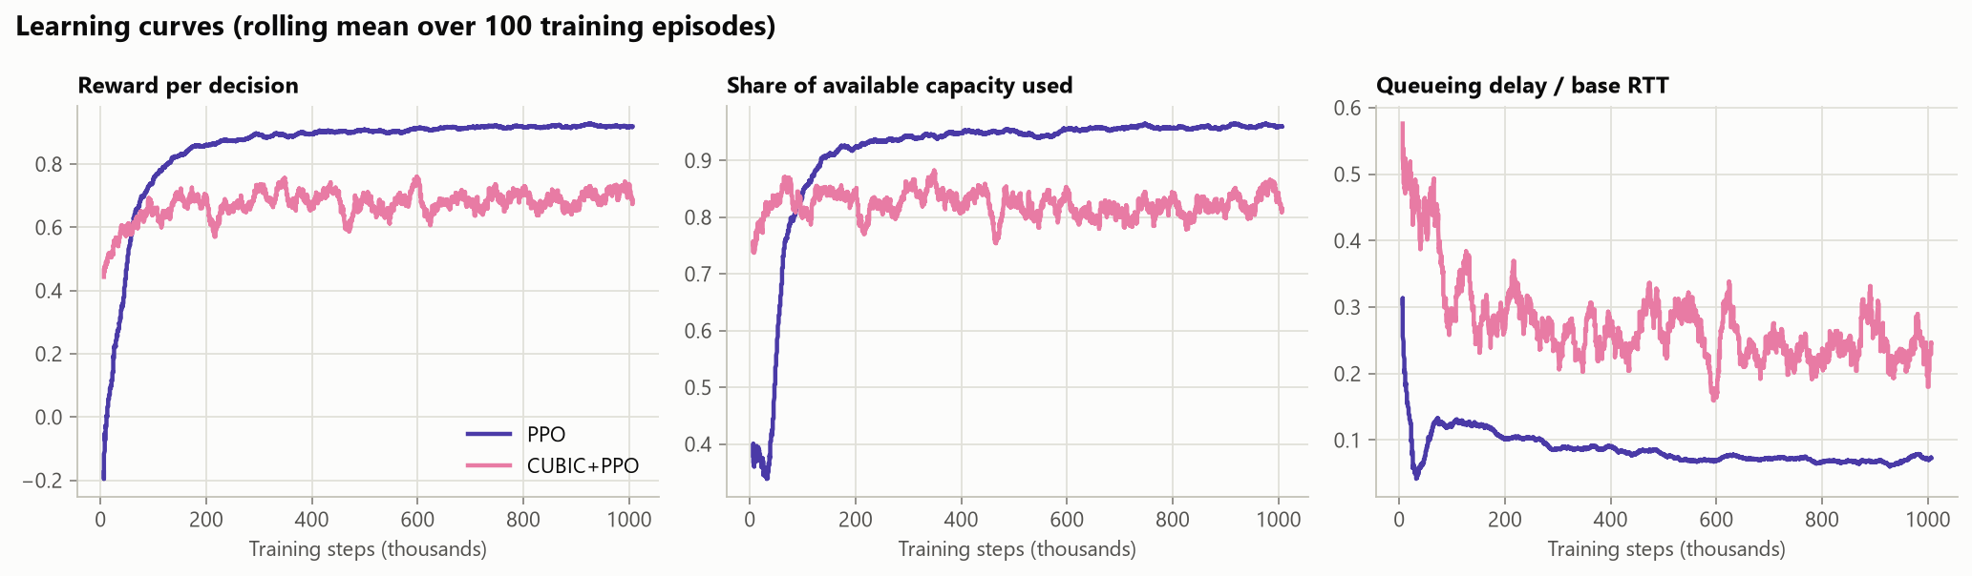
Learning curves
STAGE 4 · REINFORCEMENT LEARNING
1
2
3
4
5
6
7
8
PPO passes 90% of link capacity after about 200,000 decisions and keeps lowering delay. The hybrid's curve is lower partly because 30% of its episodes include a competing flow.
Notes:
Training progress of the two main policies. The PPO agent passes 90% of link capacity after about 200 thousand decisions and keeps lowering its queueing delay after that. The hybrid's curve sits lower partly because 30% of its training episodes include a competing flow, where delay cannot be avoided.

Slide 24
1
2
3
4
5
6
7
8
STAGE 5 OF 8
Comparison
WHY THIS STAGE
Four learned and classical controllers are ready. How do all six compare on the same links?
Notes:
Stage 5 compares all six controllers on unseen links, random loss, changing capacity, extreme conditions and shared links.

Slide 25
Results: unseen links
STAGE 5 · COMPARISON
1
2
3
4
5
6
7
8
PPO uses 98.8% of capacity at only 1.07× the base RTT. Reno and CUBIC lose throughput on lossy links and still nearly double the delay.
Notes:
Each controller runs alone for 30 seconds on the same 30 random links it has never seen; half have random loss and half have changing capacity. PPO uses 98.8% of capacity with an RTT only 7% above the minimum. BBR is close on throughput but adds more delay. Reno and CUBIC lose throughput on the lossy links and still nearly double the delay. CUBIC+ML reaches the highest utilisation but, being loss-based, still fills the queue.

Slide 26
Results: random loss
STAGE 5 · COMPARISON
1
2
3
4
5
6
7
8
At 5% loss CUBIC delivers 1.6 Mbps; CUBIC+ML delivers 9.6 and PPO 9.5. PPO was never told which losses are random.
Notes:
Throughput of one flow on a 10 megabit link as random loss rises. On the left, Reno and CUBIC collapse. On the right, CUBIC+ML holds almost the full 10 megabits up to 2% loss and 9.6 at 5%, six times plain CUBIC. PPO does as well although nothing tells it which losses are random: it learned that loss without rising delay is no reason to slow down. The hybrid only partly recovers.

Slide 27
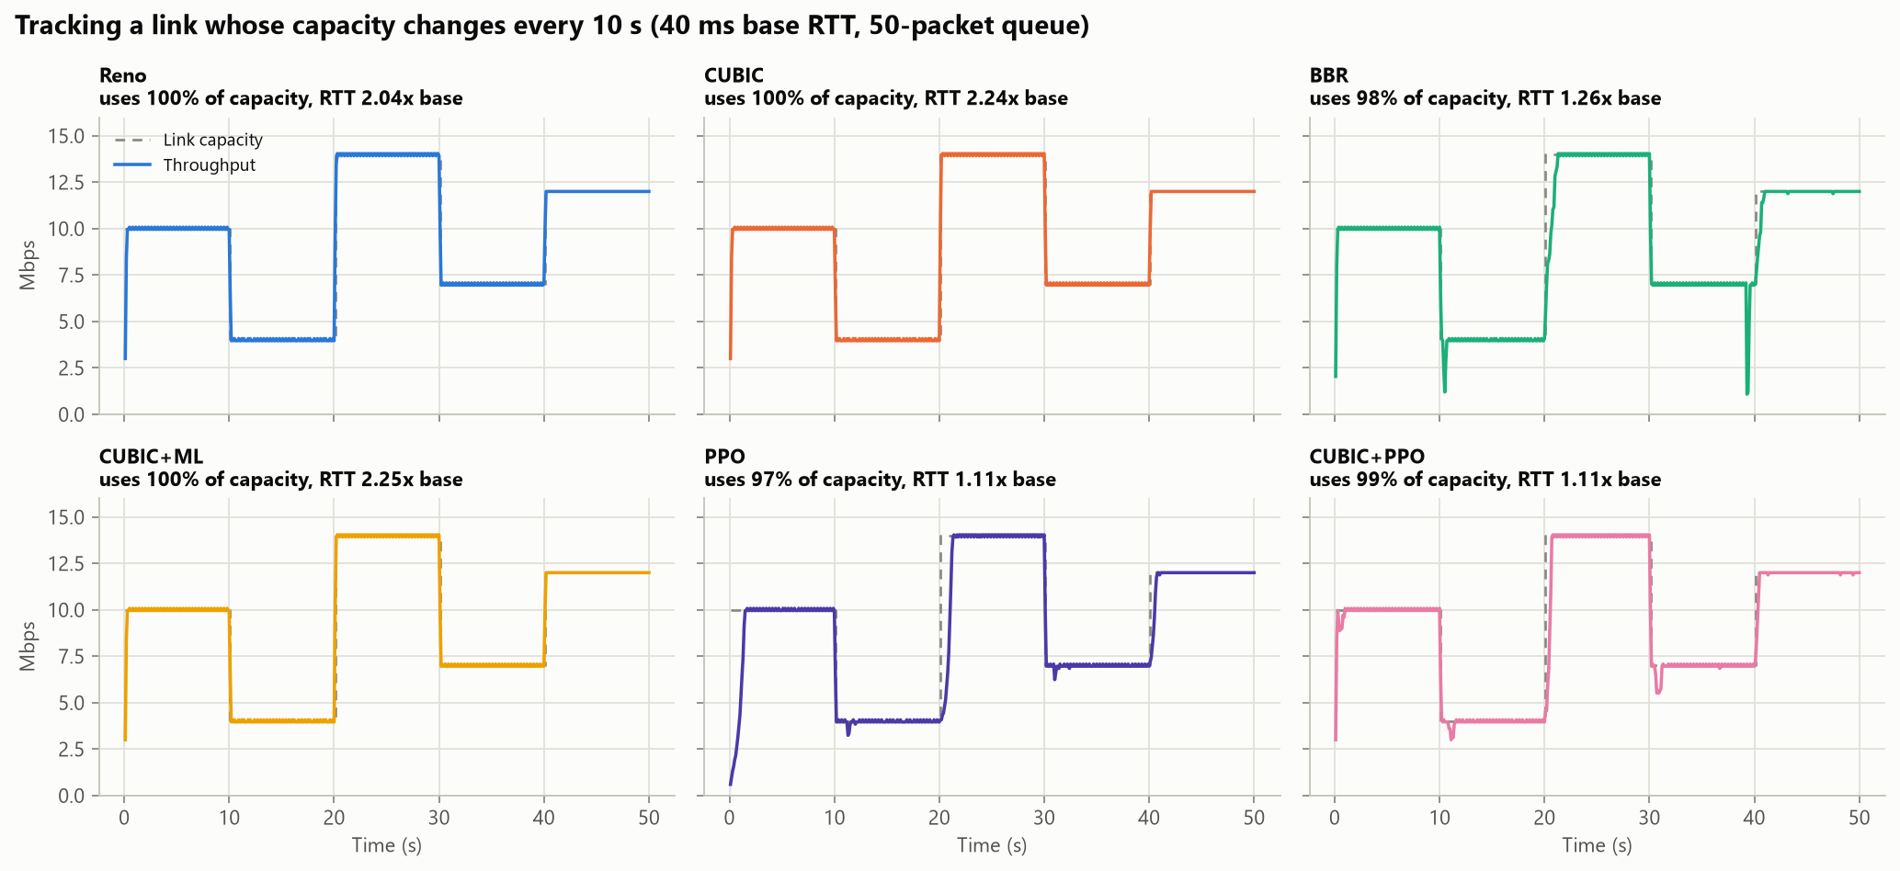
Results: changing capacity
STAGE 5 · COMPARISON
1
2
3
4
5
6
7
8
1.2×
worst-case RTT with PPO, relative to the base
4.6×
with CUBIC on the same link
97%+
of capacity used by every controller
Capacity steps 10, 4, 14, 7, 12 Mbps. Worst case is the 95th percentile RTT.
Notes:
A link whose capacity jumps every ten seconds, like a mobile connection. Every controller follows the capacity and uses at least 97% of it, so throughput does not separate them. Delay does. When capacity drops, Reno, CUBIC and BBR are left with a full queue: CUBIC's 95th percentile RTT is 4.6 times the base and BBR's is 3.1. PPO and the hybrid stay at 1.2.

Slide 28
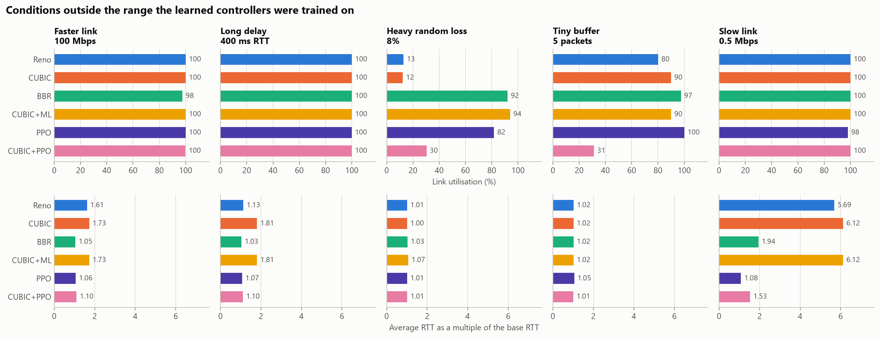
Results: unfamiliar conditions
STAGE 5 · COMPARISON
1
2
3
4
5
6
7
8
PPO holds at least 98% utilisation in four of five cases. The hybrid fails under 8% loss and with a 5-packet buffer.
Notes:
Five conditions outside what the learned controllers saw in training: a 100 megabit link, a 400 millisecond RTT, 8% random loss, a five-packet buffer and a half-megabit link. PPO keeps at least 98% utilisation in four of the five; under 8% loss it falls to 82%. The hybrid does not generalise: 30% under heavy loss and 31% with the tiny buffer.

Slide 29
Results: fairness
STAGE 5 · COMPARISON
1
2
3
4
5
6
7
8
PPO gets 2% beside CUBIC: it reads the delay CUBIC causes as congestion and backs off. CUBIC+ML shares evenly.
Notes:
The main negative result. When the PPO agent shares a link with one ordinary CUBIC flow it ends up with 2% of the link. CUBIC keeps the queue full; the agent reads the delay as a signal to slow down, and CUBIC takes whatever it releases. Two PPO flows also split a link unevenly. This is a known weakness of delay-sensitive controllers. CUBIC+ML does not have it: it takes 50.5% beside CUBIC.

Slide 30
1
2
3
4
5
6
7
8
STAGE 6 OF 8
Fixing the weaknesses
WHY THIS STAGE
Stage 5 found that the agent gets 2% of a link beside CUBIC, and that it collapses with 2 ms of RTT jitter. Can both be fixed?
Notes:
Stage 6 adds a competitive mode for sharing, and retrains the agent with random jitter.

Slide 31
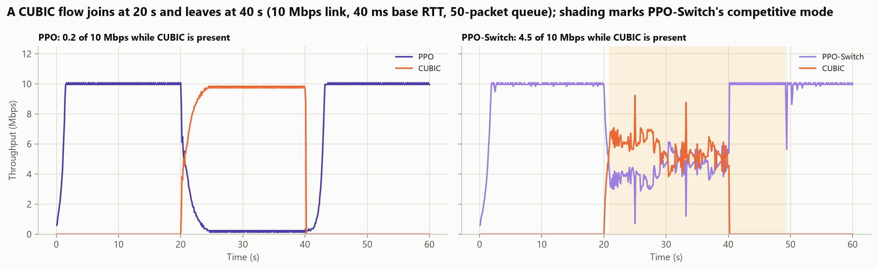
Fixing fairness: PPO-Switch
STAGE 6 · FIXES
1
2
3
4
5
6
7
8
Learned policy (PPO-J)
low delay
CUBIC+ML
competes fairly
2% → 47%
49% · 43%
0 of 30
share beside one CUBIC flow
beside Reno · beside BBR
mistaken switches when alone
another flow holds the queue
probe drains the queue: it was ours, switch back
Notes:
PPO lost almost all its bandwidth beside CUBIC because it read CUBIC's full queue as its own congestion. PPO-Switch borrows Copa's competitive mode. It runs the learned policy normally. When another flow is clearly holding the queue, either the delay stays high for six intervals or the agent's rate slides steadily to half while a queue persists, it hands control to our loss-aware CUBIC. Every few seconds it briefly drains its own share of the queue, like BBR's ProbeRTT; if the RTT drops to the base RTT, the other flow has gone and the policy takes over again. Beside CUBIC it now gets 47% instead of 2%, and alone it never switched by mistake. The timeline shows CUBIC joining at 20 seconds and leaving at 40.

Slide 32
Real networks jitter: PPO-J
STAGE 6 · FIXES
1
2
3
4
5
6
7
8
3% → 99%
utilisation at 4 ms of jitter, PPO → PPO-J
Trained with random jitter in 75% of episodes
Reads the minimum RTT, not the average, as Copa does
Clean links: 98.5% utilisation, RTT 1.17× base (PPO: 98.8%, 1.07×)
Notes:
On a real network every round-trip sample carries a few milliseconds of random delay from Wi-Fi and operating-system timers. Our original agent was trained on perfectly clean RTTs, so with only 2 milliseconds of jitter it saw a growing queue that was not there and slowed down to 21% utilisation; at 4 milliseconds, 3%. CUBIC and BBR keep their throughput. PPO-J fixes this with two changes: it is trained with random jitter in three quarters of its episodes, which is called domain randomisation, and it reads the minimum RTT of each half interval instead of the average, as Copa does, because jitter inflates the average but hardly the minimum. It keeps 99% utilisation at 4 milliseconds and loses almost nothing on clean links. The cost is a slightly larger queue.

Slide 33
1
2
3
4
5
6
7
8
STAGE 7 OF 8
A real Wi-Fi network
WHY THIS STAGE
Both weaknesses are fixed in simulation. Does any of it hold on a real network?
Notes:
Stage 7 runs every controller over Wi-Fi between our two laptops, and records what the Wi-Fi does.

Slide 34
Testing over a real network
STAGE 7 · REAL NETWORK
1
2
3
4
5
6
7
8
Windows laptop
the controllers (sender)
MacBook
receiver + 10 Mbps queue
Wi-Fi
data packets → ← ACKs with real RTT, jitter and loss
On real Wi-Fi (second run) | Simulator | Real Wi-Fi
CUBIC alone | 10.0 Mbps | 8.6 Mbps, 70 ms
CUBIC+ML / CUBIC, 1% loss | 9.9 / 3.4 Mbps | 8.7 / 2.9 Mbps
BBR alone | 9.9 Mbps | 9.4 Mbps, 33% loss
PPO / PPO-J alone | 10.0 Mbps | 0.3 / 3.3 Mbps
PPO-Switch beside CUBIC | 44% of the link | 45% of the link
CARRIED OVER
The loss classifier and the fairness fix.
Not the learned rate controllers: why, on the next slide.
Notes:
We then took every controller off the simulator. The same controller code sends real UDP packets from the Windows laptop to a receiver script on the MacBook over Wi-Fi, so round-trip times, jitter and losses come from a real wireless link and two real operating systems. To compare with the simulator on equal terms, the receiver adds the simulator's standard bottleneck: a 10 megabit queue of 50 packets and a 40 millisecond base round-trip time. We ran the whole test twice and got nearly the same numbers. Two things carried over: the loss classifier, CUBIC+ML keeps 8.7 megabits with 1% random loss where CUBIC keeps 2.9, and the fairness fix, PPO-Switch takes 45% of the link beside CUBIC. The learned rate controllers did not: the original PPO got 0.3 megabits and PPO-J 3.3.

Slide 35
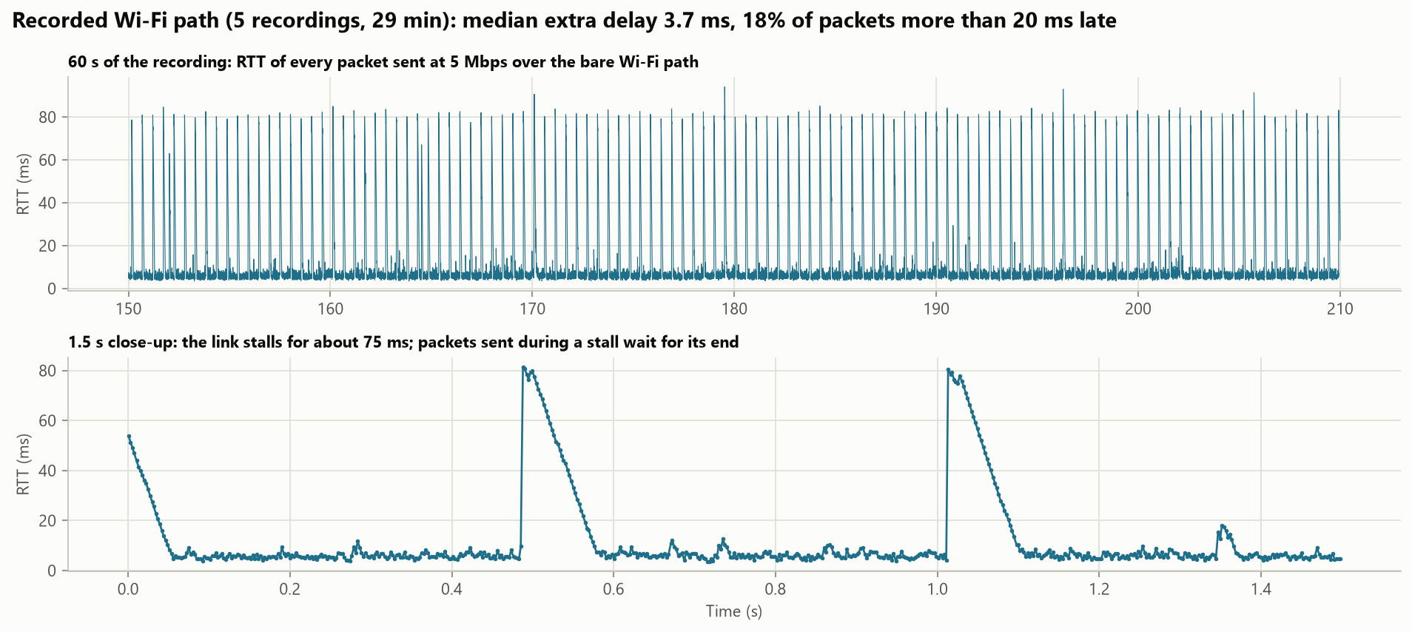
What real Wi-Fi does
STAGE 7 · REAL NETWORK
1
2
3
4
5
6
7
8
75 ms
stalls, about twice a second
18%
of packets more than 20 ms late
±1.3 Mbps
replay of the recordings vs the real test
Notes:
Why did the learned agents struggle? We recorded the bare Wi-Fi path for 29 minutes, about 700,000 packets. Most packets arrive within 4 milliseconds of the minimum, but about twice a second the link stalls for roughly 75 milliseconds: nothing gets through, then everything arrives at once. That is what the sawtooth in the close-up shows. A stall looks exactly like congestion to a delay-based agent. And with a 50-packet queue, the backlog of each stall floods the bottleneck afterwards, so on this path nobody can have full throughput and low delay at the same time. Replaying these recordings in our simulator reproduced every controller's real throughput within 1.3 megabits, including BBR's heavy packet loss.

Slide 36
1
2
3
4
5
6
7
8
STAGE 8 OF 8
Learning from the real network
WHY THIS STAGE
On real Wi-Fi the agent fell to 0.3 Mbps, because the Wi-Fi stalls for 75 ms twice a second. Can it learn from recordings of that network?
Notes:
Stage 8 records 29 minutes of our Wi-Fi, replays it in the simulator, and trains a new agent, PPO-W, on it.

Slide 37
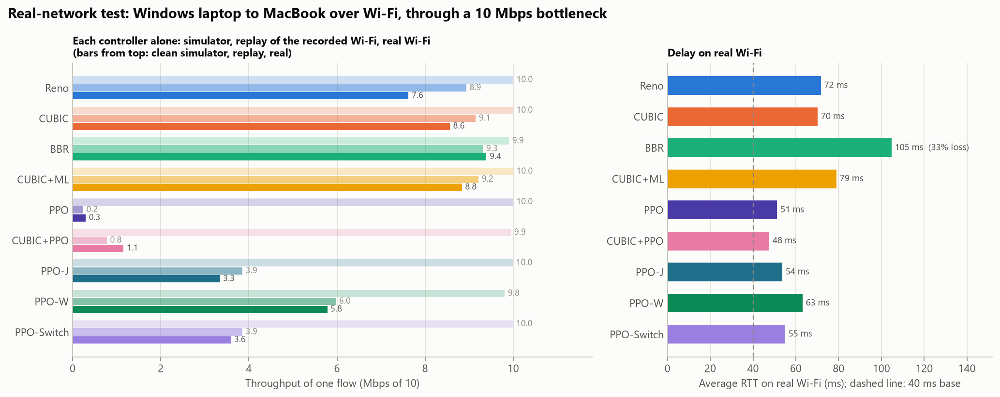
Training on recorded Wi-Fi: PPO-W
STAGE 8 · LEARNING FROM WI-FI
1
2
3
4
5
6
7
8
0.3 → 5.8
Mbps on real Wi-Fi, PPO → PPO-W
6.0
Mbps predicted by the replay
63 ms
RTT, vs 70 ms for CUBIC
Notes:
So we trained the agent on our own Wi-Fi. PPO-W is trained like PPO-J, but half of its training episodes replay the first 70% of each recording; the last 30% is kept for testing. Our first attempt learned to hold back, because its reward also punished stall delay that no sender can remove. Scoring only the queue the sender builds itself fixed that. On the real Wi-Fi it delivers 5.8 megabits, against 3.3 for PPO-J and 0.3 for the original agent, almost exactly the 6.0 that the replay predicted, and with less delay than CUBIC. CUBIC still gets more throughput on this path because it accepts a full queue.

Slide 38
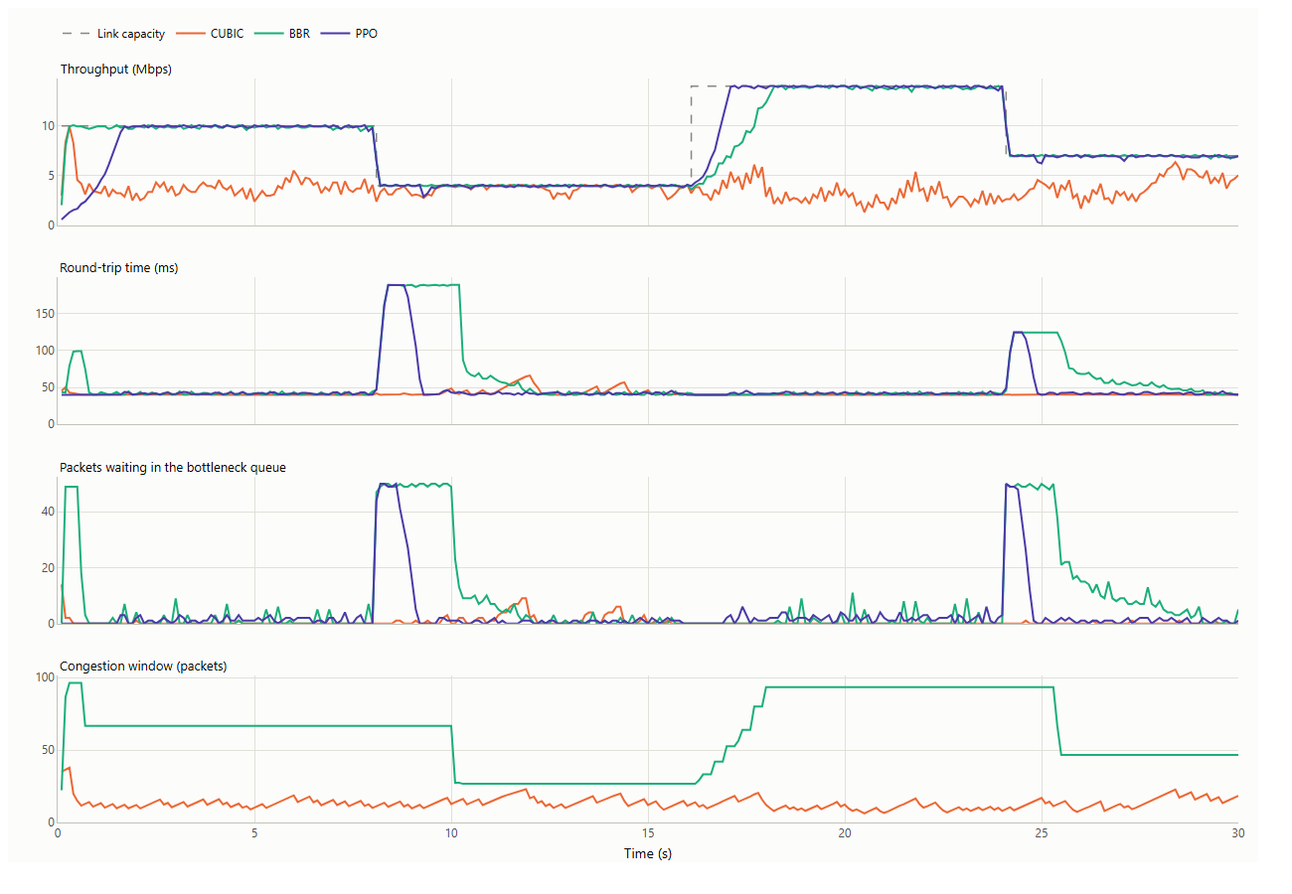
Live dashboard
CONCLUSION
Network presets, or set bandwidth, delay, queue size and loss by hand
Up to four controllers, side by side or competing on one link
Throughput, RTT, queue and window update while it runs
Summary table and Jain fairness index after each run
streamlit run dashboard/app.py
Notes:
The dashboard runs the simulator live. Choose a network preset or set the link by hand, pick up to four controllers, and run them side by side or competing on one link. Demo plan: Lossy Wi-Fi with CUBIC, CUBIC+ML and PPO side by side; then Home broadband with CUBIC, BBR and PPO to show the queue; then competing mode with CUBIC and PPO to show the fairness limit, and with CUBIC and PPO-Switch to show the fix.

Slide 39
What each stage achieved
CONCLUSION
Stage | What we did | What we found | What it led to
1 | Simulator; Reno, CUBIC, BBR | Queues kept full; CUBIC 3.7 Mbps at 1% loss | Two weaknesses to fix
2 | Loss classifier inside CUBIC | 9.6 Mbps at 5% loss (CUBIC 1.6); fair | Random loss fixed
3 | LSTM forecast of the RTT | 12% better than the last value | A modest gain
4 | PPO agent sets the rate | 98.8% of capacity at 1.07× base RTT | Full queues fixed, alone
5 | Six controllers compared | Agent gets 2% beside CUBIC | Fix the agent
6 | PPO-Switch; PPO-J | 47% beside CUBIC; 99% at 4 ms jitter | Test for real
7 | Real Wi-Fi, two laptops | ML and fairness hold; agent 0.3 Mbps | Learn from the network
8 | PPO-W on 29 min of Wi-Fi | 5.8 Mbps real (6.0 predicted) | The conclusions
Notes:
The whole project in one table, in the order we did it. Each stage answered a question and raised the next one: the baselines showed the two weaknesses; the classifier fixed random loss; the forecaster was a modest gain; the agent fixed full queues on its own link; the comparison showed it could not share or cope with jitter; the fixes solved both in simulation; the real Wi-Fi test showed what transfers; and training on recordings of that Wi-Fi closed much of the remaining gap.

Slide 40
The numbers at a glance
CONCLUSION
Measure | Reno | CUBIC | BBR | CUBIC+ML | PPO | CUBIC+PPO | PPO-Switch
Utilisation, 30 unseen links (%) | 81.6 | 83.2 | 98.3 | 99.5 | 98.8 | 95.8 | 98.5
Average RTT ÷ base RTT | 1.63 | 1.77 | 1.18 | 1.88 | 1.07 | 1.15 | 1.17
Mbps at 5% random loss (of 10) | 1.7 | 1.6 | 9.5 | 9.6 | 9.5 | 4.4 | 9.7
Share beside one CUBIC flow (%) | 42 | 50 | 61 | 51 | 2 | 5 | 47
Jain index, two of its own kind | 1.000 | 1.000 | 0.999 | 1.000 | 0.609 | 0.992 | 0.645
Utilisation with 4 ms jitter (%) | 99.7 | 100.0 | 98.1 | 100.0 | 2.8 | 22.9 | 99.2
Real Wi-Fi, alone (Mbps) | 7.6 | 8.6 | 9.4* | 8.8 | 0.3 | 1.2 | 3.6
Shaded = best in the row. For sharing, best means closest to an equal 50%. *BBR lost 33% of its packets on real Wi-Fi.
Notes:
The main measurements in one table; the shaded cell is the best in each row. PPO is best on delay and close to best on throughput when alone. CUBIC+ML is best under random loss and shares a link fairly. PPO and the hybrid fail the fairness row and PPO fails under jitter. The last column is PPO-Switch, the improved agent from the next section: it keeps PPO's low delay, shares fairly with CUBIC and survives jitter.

Slide 41
Limitations
CONCLUSION
One real network
Two learned flows
The hybrid is not robust
The Wi-Fi test covers one path, in user-space UDP; PPO-W is trained on it.
PPO-Switch fixes sharing with CUBIC; two learned flows still split a link unevenly.
CUBIC+PPO fails at 8% loss and with very small buffers.
Below CUBIC on Wi-Fi
One run per policy
LSTM not used for control
PPO-W gets 5.8 Mbps against CUBIC's 8.6 there, with less delay.
Small gaps between variants could change with another seed.
Its gain is modest and no controller uses it yet.
Notes:
Six limits on what these results show, before the conclusions. The real-network test covers one Wi-Fi path, as user-space UDP rather than a kernel TCP stack, and PPO-W is trained on recordings of that same path. On that stalling path the learned agents still get less throughput than CUBIC, though with less delay. PPO-Switch shares fairly with CUBIC, but two learned flows still split a link unevenly. The hybrid is not robust outside its training range. Random loss is modelled as independent per packet, while real loss comes in bursts. Each policy was trained once. And the LSTM forecast is not used by any controller.

Slide 42
What we take from this project
CONCLUSION
1
Small and inside
2
Sharing needs design
3
Train for reality
A learned part inside CUBIC was the most reliable gain, in simulation and on real Wi-Fi.
More training did not stop starvation beside CUBIC; a competitive mode did.
Trained on exact RTTs, the agent failed with 2 ms of jitter.
4
Measure, then replay
5
Reward what it controls
6
Test on the real thing
29 min of Wi-Fi predicted real results within 1.3 Mbps, and took the agent 0.3 → 5.8 Mbps.
Counting only its own queue raised the agent from 42% to 60%.
The simulator ranked the agent first; real Wi-Fi did not.
Learned components can fix both weaknesses; learned rate control still needs real data, the right reward and a mechanism for sharing.
Notes:
Six things we take from the project. One: the most reliable gain was a small learned part inside a proven algorithm; CUBIC+ML worked in simulation and on real Wi-Fi. Two: reinforcement learning beats the rules on its own link, but sharing needs explicit design; more training did not fix it, a competitive mode did. Three: a learned controller is only as good as its training conditions; trained on exact RTTs it failed with 2 milliseconds of jitter. Four: measuring the real network and replaying it works; 29 minutes of recordings predicted real results within 1.3 megabits, and training on them took the agent from 0.3 to 5.8. Five: the reward must count only what the agent controls; that alone raised it from 42 to 60 percent on the replay. Six: a simulated result is a hypothesis until tested on a real network; the simulator ranked the agent first, real Wi-Fi did not. So: learned components can fix both weaknesses, but learned rate control still needs real data, the right reward and a mechanism for sharing.

Slide 43
Key references
CONCLUSION
Jacobson. Congestion avoidance and control. SIGCOMM 1988
Mathis et al. Macroscopic behavior of TCP congestion avoidance. CCR 1997
Ha, Rhee, Xu. CUBIC. ACM SIGOPS OSR 2008
Winstein, Balakrishnan. TCP ex Machina (Remy). SIGCOMM 2013
Cardwell et al. BBR. ACM Queue 2016
Schulman et al. Proximal policy optimization. arXiv 2017
Arun, Balakrishnan. Copa. NSDI 2018
Dong et al. PCC Vivace. NSDI 2018
Jay et al. Aurora: deep RL for congestion control. ICML 2019
Abbasloo, Yen, Chao. Orca. SIGCOMM 2020
Yen, Abbasloo, Chao. Sage. SIGCOMM 2023
Liao et al. Astraea. EuroSys 2024
Notes:
The papers the project builds on. Aurora is the source of the agent's state and action; Orca is the idea behind the hybrid; Copa and Astraea describe the fairness problem and two ways to address it.

Slide 44
Thank you
Questions, and a live demo in the dashboard
Notes:
Take questions. If asked for a demo: Lossy Wi-Fi preset with CUBIC, CUBIC+ML and PPO side by side; then Home broadband with CUBIC, BBR and PPO; then competing mode with CUBIC and PPO to show the fairness limit, and CUBIC with PPO-Switch to show the fix.

