Slide 1

ClaimSure
14
16,760
collections
documents
A NoSQL-based health insurance claim processing and analytics system using MongoDB
50
19
indexes of nine types
aggregation reports
Database Management Systems | Project review
Presented by Nirupam
Notes:
Introduce the project: ClaimSure runs the full life of a health insurance claim on MongoDB, from intimation to payment, and reports on it. The four numbers on the right are the scale of what was built.

Slide 2
What this presentation covers
OVERVIEW
1
2
3
4
5
6
Problem and goals
System and data
Schema design
Claim processing
Optimisation and analytics
Administration and results
Why claims are hard to process, and what the project sets out to do
Architecture, the 14 collections and how they relate
Embedding, references, six patterns and validation
Lifecycle, adjudication, ACID settlement, concurrency control
100,000-document index benchmark and 19 reports
Security, change streams, migration, backup, sharding, results
In one line: a document database that runs the full life of a health insurance claim, keeps the money consistent, and reports on the result.
Notes:
Six parts. The first three explain what was built and how the data is modelled. Parts four and five are the database features in action. The last part shows the application and what comes next.

Slide 3




Why claims are a hard data problem
PROBLEM
Every claim has a different shape
One claim in ClaimSure
Bills, diagnoses, documents and queries vary from one case to the next.
11
6-8
Policy wording decides the payout
Waiting periods, room-rent limits, sub-limits and co-pay all apply.
bill heads
documents per claim
7
9
Money has to stay consistent
A payment must update the claim, the policy cover and the ledger together.
deduction categories
fraud rules checked
10
4
Fraud and audit never stop
Inflated bills and duplicate stays must be caught, and every change traced.
lifecycle states
collections updated on payment
Notes:
Four reasons this is a database problem and not just a form. The panel on the right shows how much a single claim carries in this system; each number is a real property of the schema.

Slide 4






Project objectives
GOALS
Model the full claim lifecycle
Design a schema that fits the data
Intimation to settlement, with approval limits and escalation.
Clear embed-or-reference decisions and six design patterns.
Guarantee data quality
Make queries fast
$jsonSchema validators on all 14 collections.
50 indexes of nine types, checked against query plans.
Turn data into insight
Keep the money safe
19 reports, each one an aggregation pipeline.
Settlement as a multi-document ACID transaction.
Notes:
Six objectives. The left column is about modelling and correctness; the right column is about performance, analytics and transactional safety. Each one maps to a later slide.

Slide 5
Why a document database fits
APPROACH
Relational model
Document model
One claim is split across nine tables
One claim is one document
claims
bill_items
diagnoses
claim
documents
queries
status_history
bill{}
diagnosis[]
documents[]
queries[]
deductions
fraud_flags
payments
status_history[]
deductions[]
fraud.flags[]
Every read is a multi-way join, and a status change touches several tables.
One read loads the whole case file, and one atomic update changes status and history together.
Shared data is still referenced, as in a relational design: members, policies, hospitals and payments keep their own collections.
Notes:
The core design argument. A claim is a self-contained case file whose shape varies, so embedding its parts avoids joins and makes a status change one atomic write. Shared entities are still referenced, so this is not 'everything in one document'.

Slide 6




System architecture
SYSTEM
Interfaces
Web application
Command-line console
mongosh scripts
FastAPI, Jinja2, Chart.js; 15+ pages
Interactive menu on the same services
Nine scripts, run on MongoDB 8.0
Core package
services
adjudication
fraud
analytics
transactions
schema
indexes
workflow
policy rules
risk scoring
19 pipelines
ACID settle
validation
query plans
Data layer
MongoDB Atlas (M0)
mongomock (fallback)
Shared definitions
Replica set: transactions, change streams
In-memory; runs with no network
validators.json, indexes.json, data/*.json
The connection string lives in a git-ignored .env file; CLAIMSURE_MODE=mock switches to the in-memory fallback. The code path is the same.
Notes:
Three layers. Both interfaces call the same core package, so the business rules live in one place. The data layer can be a real MongoDB or an in-memory mock, which is what makes the demo run on any laptop.

Slide 7
The dataset at a glance
DATA
16,760
14
documents
collections
5,288
2,591
insured lives
claims
₹34.40 Cr
99
claimed in total
hospitals in 26 cities
Synthetic and repeatable: tools/generate_data.py builds the same data every time from a fixed seed. All names are fictional.
Notes:
The scale of the data. Members, audit entries and claims are the largest collections. The data is generated, not copied from anywhere, and the generator uses the same adjudication engine as the live app so the amounts are consistent.

Slide 8
Data model: 14 collections
DATA
tpas
N:M
insurers
1:N
plans
users
grievances
audit_logs
6 docs
10 docs
35 docs
24 docs
253 docs
3,631 docs
1:N
decides
1:N
members
policies
claims
payments
Master data
N:M
1:N
1:1
5,288 docs
2,200 docs
2,591 docs
2,039 docs
Transactions
The claim case file
1:N
1:N
1:N
Claims also reference members directly (member_id). audit_logs records every change.
agents
icd_codes
hospitals
1:N
doctors
45 docs
55 docs
99 docs
484 docs
Labels give cardinality. A 15th utility collection, counters, issues claim and payment numbers.
Notes:
Read it from the top left: insurers offer plans, plans are sold as policies, policies cover members, and policies are claimed on. The dark box is the claim, the centre of the model. Amber boxes are transactional collections, the tinted ones are master data.

Slide 9
Embed or reference: the decisions
SCHEMA
Relationship | Technique | Why
Claim to bill, diagnoses, documents, history | Embedded | Owned by the claim, read together, bounded in size
Policy to insured members | Embedded subset + reference | Adjudication needs only name, relation, DOB and declared conditions
Policy to renewal history | Embedded array | One small entry per policy year; feeds premium analytics
Claim to member and hospital | Reference + snapshot | Shared masters; the snapshot keeps lists fast and history accurate
Claim to payment | Reference, unique index | A separate ledger, with one payment per claim enforced
Hospital to doctors, insurer to plans | Reference | Shared data that is also queried on its own
Rule of thumb: embed what is read together and bounded; reference what is shared or grows without limit.
Notes:
Six relationships and the choice made for each. The two that examiners usually ask about are the insured members, where only a subset is embedded, and the snapshot, which copies a few fields from the member and hospital into the claim.

Slide 10





Six schema design patterns
SCHEMA
Embedding
Extended reference
Subset
A claim embeds its bill, documents, queries and status history.
Claims keep a snapshot of patient and hospital names, so lists need no $lookup.
A policy embeds only the member fields that adjudication needs.
Computed
Bounded array
Sequence counter
Turnaround days, available cover and fraud score are stored at write time.
renewal_history holds one entry per policy year, so it cannot grow unchecked.
A counters collection with an atomic $inc issues claim and payment numbers.
Notes:
These are named MongoDB design patterns, each used for a specific reason. Extended reference and computed are the two that make the dashboard fast, because lists and KPIs do not need joins or recalculation.

Slide 11
Anatomy of a claim document
SCHEMA
{
claim_number: "CLM-2026-002207",
status: "Settled",
policy_number: "RNI-HL-2018-000875", // 1
member_id: "MEM002135", hospital_id: "HSP0062", // 1
snapshot: { member_name: "Sunita Khan", member_age: 64, // 2
hospital_city: "Kolkata", hospital_tier: 1 },
diagnosis: [ { icd_code: "A01.0", // 3
description: "Typhoid fever", type: "Primary" } ],
bill: { room_charges: 48000, medicines: 13990, ..., // 3
total: 86080 },
adjudication: { decision: "Partially Approved",
payable_amount: 40476,
deductions: [ { category: "Room Rent Excess", // 3
amount: 23000 }, ... ] },
status_history: [ { status: "Intimated", // 3
at: ISODate(...), by: "HOSPITAL" }, ... ],
fraud: { score: 0, risk_level: "Low", flags: [...] }, // 4
tat_days: 42.7 // 4
}
1
References
policy_number, member_id and hospital_id point to shared master collections.
2
Extended reference
snapshot copies names, age, city and tier as they were on admission.
3
Embedded data
Bill, diagnoses, deductions and status history live inside the claim.
4
Computed fields
tat_days and the fraud score are stored whenever the claim changes.
Notes:
A real claim from the data set, shortened. The numbers in the comments match the four points on the right. This one document is everything the claim detail page needs, loaded in a single read.

Slide 12

Schema validation with $jsonSchema
SCHEMA
Required
18 mandatory fields on every claim
Insert rejected
claim_number, status, bill, status_history
Type
Dates are BSON dates, amounts are numbers
db.claims.insertOne({
claim_number: "CLAIM-42", status: "Paid",
claimed_amount: -5000, diagnosis: [] })
admission_date: { bsonType: "date" }
Enum
Status is limited to the 10 lifecycle states
status: { enum: ["Intimated", ..., "Settled"] }
claim_number does not match the pattern
status 'Paid' is not an allowed value
claimed_amount -5000 is below the minimum 0
diagnosis needs at least one item
Pattern
Business keys follow a fixed format
claim_number: ^CLM-[0-9]{4}-[0-9]{6}$
Range
Amounts can never be negative
bill.total: { minimum: 0 }
One validators.json file is used by MongoDB itself (collMod) and by the app's own checker, across all 14 collections.
Notes:
Five kinds of rule, each with a real example from the claims validator. On the right is the live demo from the DB Console: an invalid claim is refused with a list of what is wrong. The same JSON file drives both the server and the mock mode.

Slide 13
The claim lifecycle
WORKFLOW
payable is above the reviewer's approval limit
Escalated
Approved
Settled
Intimated
Documents Pending
Under Review
Partially Approved
paid through an ACID transaction
Rejected
a manager can re-open it
Withdrawn
question sent to the insured or hospital
Query Raised
Approval limits by role
₹75,000
₹2,00,000
₹3,00,000
₹10,00,000
Claims Executive
Medical Officer
Senior Adjuster
Claims Manager
Notes:
Ten states. The service layer enforces which moves are allowed, so a settled claim cannot be put back under review by hand. Escalation is automatic: if the payable amount is above the reviewer's limit, the claim goes to someone with a higher limit.

Slide 14
The adjudication engine
WORKFLOW
1
Eligibility
2
Deductions
Policy in force on the admission date
Patient is an insured member
Initial 30-day wait (accidents exempt)
Specific-illness wait of 24 months
Pre-existing disease wait, up to 48 months
Maternity cover and its waiting period
Treatment is not excluded
Non-payable consumables and admin charges
Room rent above the eligible rate
Proportionate cut on associated charges
Ambulance limit
Disease sub-limits and the maternity cap
Co-payment (20% on senior plans)
Available sum insured
Any failure is a rejection with a coded reason (R01 to R11).
What is left is the amount payable by the insurer.
The same engine prices all 2,591 seeded claims and every new one, so stored amounts always agree with the rules.
Notes:
Adjudication is a pure function with two steps: is the claim payable at all, and if so, how much. The rules follow real Indian health policy wording, including the proportionate deduction when a patient takes a costlier room than they are eligible for.

Slide 15
How ₹86,080 becomes ₹40,476
WORKFLOW
Typhoid fever, 5-day stay, Raksha Senior Citizen Care with ₹5,00,000 sum insured
Eligible room rent is 1% of sum insured, ₹5,000 a day; the room cost ₹9,600
So nursing, doctor and investigation charges are paid at 52%
Senior plans carry a 20% co-payment
Each deduction is stored in the claim with its reason
Notes:
A real claim from the data. Read the chart left to right: the bill, then each deduction in the order the engine applies it, then what the insurer pays. The biggest cuts come from the room choice, which is the most common reason for a partial approval in real life too.

Slide 16

Settlement as an ACID transaction
WORKFLOW
One transaction: snapshot read, majority write
Commit
1
claims
2
policies
All four writes are applied together.
Status set to Settled; payment details and a history entry added
Available cover reduced by the approved amount, only if cover is enough
3
payments
4
audit_logs
Failure midway: rollback
New payment row with its bank reference
CLAIM_SETTLED entry written
The claim stays Approved, cover is unchanged and no payment row exists.
Guarded update
Unique index
Automatic retry
available_cover: { $gte: amount } stops overspending
payments.claim_number blocks a second payment
with_transaction() re-runs the payment if another transaction hit the same policy
Notes:
Paying a claim writes to four collections. Without a transaction, a crash after step two would reduce the cover with no payment recorded. The demo button fails on purpose after step two and shows everything rolled back. On Atlas this is a native session transaction with snapshot reads and majority writes.

Slide 17
Two payments, one policy, same instant
CONCURRENCY CONTROL
A. Read-modify-write ($set)
B. Atomic $inc
C. Optimistic locking
D. Transaction
₹4,00,000
₹3,00,000
₹3,00,000
₹3,00,000
lost update: ₹1,00,000 vanished
correct
correct
correct
Start cover ₹5,00,000 and two simultaneous payments of ₹1,00,000: the correct result is ₹3,00,000. Real threads, lined up with a barrier.
Scenario D on MongoDB 8.0: the losing transaction gets a WriteConflict and is retried
Where ClaimSure uses each fix
1.1 ms A attempt 1: reads cover = 500,000
1.2 ms B attempt 1: reads cover = 500,000
16.2 ms A WriteConflict -> aborted, retry 2
17.4 ms A attempt 2: reads cover = 500,000
17.9 ms B attempt 1: writes cover = 400,000 + payment row
31 ms B committed
40.4 ms A WriteConflict -> aborted, retry 3
41.6 ms A attempt 3: reads cover = 400,000
42.6 ms A attempt 3: writes cover = 300,000 + payment row
46.1 ms A committed
Claim forms carry the version you saw; a stale action is refused
Policy cover only changes through a guarded $inc
Settlement runs in with_transaction(), which retries conflicts
Notes:
The classic lost-update problem, reproduced with two real threads. A shows a payment vanishing. B lets the server do the arithmetic. C detects the clash with a version number and retries. D is a transaction: MongoDB raises a WriteConflict for the second writer, aborts it and with_transaction runs it again on fresh data. All four run live from the Concurrency Lab page or python main.py lab.

Slide 18
Rule-based fraud detection
WORKFLOW
Nine red-flag rules add points to a 0 to 100 score
14 claims are high risk (60 or more), 94 medium and 2,483 low
Member histories are built with one $group and $push aggregation, not a query per claim
Four watch-listed hospitals add 20 points to any claim from them
Analysts mark each alert cleared, under investigation or confirmed
Notes:
Fraud scoring is rule-based and explainable: each flag has a reason and a number of points. The scan is efficient because the member histories it needs are collected with one aggregation instead of thousands of small queries.

Slide 19
Indexing strategy: nine index types
OPTIMISATION
Index type | Example in ClaimSure | What it serves
Unique | payments.claim_number | A claim can never be paid twice
Compound (ESR rule) | claims { status, submitted_at } | Work queues: one status, newest first
Multikey | claims diagnosis.icd_code | Search on any diagnosis in the array
Text | claims: patient, hospital, diagnosis | Full-text search with relevance
Partial | claims fraud.score >= 30 | Fraud watch-list; only risky claims are indexed
Sparse | policies.agent_id | Agent leaderboard; online sales have no agent
TTL | audit_logs.timestamp, 3 years | Automatic clean-up after the retention period
2dsphere | hospitals.location | Nearest network hospital to a point
50 secondary indexes across 14 collections, all defined in schema/indexes.json. Plain single-field indexes are the ninth type.
Notes:
Each index type is used where it earns its place. The compound index follows the equality, sort, range rule. The partial index is small because it only covers claims with a fraud score of 30 or more. Indexes are built after the bulk load, which is faster than maintaining them during inserts.

Slide 20
Index benchmark: 100,000 documents
OPTIMISATION
Measured on MongoDB 8.0 with explain("executionStats"); median of three runs
Member history: 100,000 documents examined without an index, 20 with one
Covered query: answered from the index alone, 0 documents read (114x)
Five indexes built in 2.39 s; red bars are where an index did not help
Notes:
This is real explain output on 100,000 documents, run from the Scale Benchmark page or python main.py bench. Teal bars are big wins. The red bars matter just as much: they are the next slide, and they show the examiner that indexing was understood, not just applied.

Slide 21
When an index helps, and when it does not
OPTIMISATION
Query | Plan with indexes | Keys | Docs | ms | Lesson
Covered query | IXSCAN(member_submitted) > PROJECTION_COVERED | 20 | 0 | 68.4 > 0.6 | Filter and projection use only indexed fields: no documents read
Claims above ₹10 lakh | IXSCAN(claimed_amount) > FETCH | 12 | 12 | 79 > 0.8 | Selective range: 12 of 100,000 rows
Claims since a date | COLLSCAN | 0 | 100,000 | 66.3 > 89.6 | Prefix rule: submitted_at is not the leading field, so a full scan
State contains 'desh' | IXSCAN(hospital_state) > FETCH | 100,000 | 17,842 | 210.7 > 279.1 | Unanchored regex cannot seek: every index key is read
Status = Settled | IXSCAN(status_submitted) > FETCH | 78,107 | 78,107 | 678.2 > 861.9 | 78% of rows: random index reads lose to one sequential scan
Rule: index what you filter on, in Equality > Sort > Range order, and keep queries selective. An index that is never chosen still costs every write.
Notes:
Five rows from the same benchmark. The first two are why indexes exist. The last three are the traps: a missing leading field, an unanchored regex, and a filter that matches most of the collection. The times are in milliseconds, before and after indexing.

Slide 22


Analytics with aggregation pipelines
ANALYTICS
Every chart and KPI is computed inside the database: 19 reports, each one a pipeline.
db.claims.aggregate([
{ $project: { hospital_id: 1,
settled_amount: 1, status: 1 } },
{ $group: { _id: "$hospital_id",
claims: { $sum: 1 },
paid: { $sum: "$settled_amount" },
rejected: { $sum: { $cond: [
{ $eq: ["$status", "Rejected"] }, 1, 0 ] } } } },
{ $sort: { paid: -1 } },
{ $limit: 15 },
{ $lookup: { from: "hospitals", localField: "_id",
foreignField: "hospital_id", as: "h" } },
{ $unwind: "$h" },
{ $project: { _id: 0, name: "$h.name",
city: "$h.address.city", claims: 1, paid: 1 } }
])
$facet
$group
$lookup
$unwind
$bucket
$match
$project
$cond
$sort
$limit
$addToSet
$dateToString
Project early
Keep only the fields a pipeline needs before grouping.
Group before lookup
Join 15 grouped rows, not 2,592 claims.
Top hospitals by payout: claims are grouped to 99 rows, cut to 15, and only then joined to hospitals.
Notes:
The analytics page shows each pipeline next to its chart. This one is the hospital report. Two habits make pipelines cheap: drop unused fields first, and group before joining so the lookup runs on a handful of rows.

Slide 23
Claim inflow and payout by month
ANALYTICS
Monthly claims grew from 42 in Apr 24 to 189 at the August 2026 peak
62% of dengue, typhoid and malaria admissions fall in July to September
Settled amounts dip in the latest months because those claims are still being processed
One $group on $dateToString produces the whole series
Notes:
Thirty months of data. The line shows growth and a monsoon peak each year, which is how the generator was designed to behave. The drop in the settled line at the far right is not a problem: recent claims simply have not been paid yet.

Slide 24
Insurer scorecard
ANALYTICS
Settlement ratio (claims paid out of claims decided) runs from 82.8% to 88.3%
Incurred claim ratio (claims paid over premium earned) runs from 61.4% to 86.2%
Two pipelines: claims grouped then joined to insurers, and premium summed from the embedded renewal history
Notes:
Two standard insurance measures per insurer. The settlement ratio counts claims; the incurred claim ratio compares money paid with premium earned. The second one is only possible because each policy embeds its renewal history with the premium for every year.

Slide 25
Product profitability and deductions
ANALYTICS
Group cover pays out more than it earns (140.7%), while Premier plans are the most profitable (32.5%).
Room choice costs members the most: the proportionate cut and room-rent excess are the two largest deductions after non-payables.
Notes:
Left: the profitability question every insurer asks. Group policies have no waiting periods, so they lose money, which matches the real market. Right: an $unwind over the deductions array shows which policy conditions reduce payouts the most.

Slide 26
Claim outcomes and turnaround
ANALYTICS
84.9%
2.5 days
17.6 days
claim settlement ratio
average cashless decision
average reimbursement decision
Notes:
About 84 in every 100 decided claims are paid. Cashless claims are decided in days because the hospital deals with the insurer directly; reimbursement takes longer because the member submits papers afterwards. The turnaround chart is a $bucket aggregation on a stored field.

Slide 27

Least privilege, enforced by the server
SECURITY
Database user | Role | Can | Cannot
claimsure_app | readWrite | Run the web app and CLI | Create users or drop the database
claimsure_analyst | read | find, aggregate, views | Insert, update, delete, drop
claimsure_auditor | custom role | find on audit_logs only | See claims or members
claimsure_dba | dbAdmin | Validators, indexes, backups | Manage other users
Connected as the analyst
Count claims
allowed
Aggregate by status
allowed
Read the masked view
allowed
Insert a claim
denied
Masked view for analysts: members_masked
Change a policy's cover
denied
{ member_id: "MEM000001", name: "L***", phone: "XXXXXX3387",
birth_year: 1979, address: { city: "Chennai" },
pre_existing_conditions: [ "Asthma" ] } no KYC, no full name
Delete payments
denied
Drop the audit log
denied
Notes:
Security is enforced by MongoDB, not by the app. The analyst account is read-only: the Security page connects with it and tries seven operations. The server refuses every write: Atlas returns error 8000, a self-hosted server returns error 13, Unauthorized. Analysts read members through a view that masks personal data. On Atlas the users are created under Database Access; scripts/09_security.js does the same on a self-managed server.

Slide 28


Change streams, views and a materialised view
LIVE DATA
Claim settled
MongoDB primary
Change stream
Server-Sent Events
Live Feed page
in the web app
writes the oplog
db.watch(pipeline)
/api/live
and CLI watch
Events received when one claim was paid
View
Materialised
18:47:23 claims update CLM-2026-002588 Settled
18:47:23 policies update cover reduced
18:47:23 payments insert PAY-2026-002042
A stored pipeline, computed on every read
Always fresh, stores nothing
members_masked, open_claims_queue
A real collection refreshed with $merge
Read in 0.9 ms vs 4.5 ms live
mv_insurer_monthly
Needs a replica set (it reads the oplog). A saved resume token lets a consumer continue after a restart without missing events.
Notes:
Change streams push every insert and update to subscribers. Paying one claim produced three events at the same instant, one per collection in the transaction. On the right, two kinds of derived data: a view is a saved query and always fresh; a materialised view is a stored result that is faster to read but only as fresh as its last refresh.

Slide 29


Schema evolution, batch jobs and backup
ADMINISTRATION
Schema versioning
Renewal batch job
Backup and restore
Claims carry schema_version
v2 adds the optimistic-locking version field
Idempotent update_many: 2,591 claims in 0.26 s
Code reads both versions while it runs
Renews every policy whose term has ended
One bulk_write round trip: 304 policies in 111 ms
Guarded by the old end date, so a second run renews 0
Also runs at start-up
Every collection to Extended JSON plus a manifest
Backup of 17,076 documents: 1.5 s
Restore re-applies validators and indexes (10.6 s)
mongodump and Atlas point-in-time restore in production
Timings measured on MongoDB 8.0 (single-node replica set). The audit log also has a TTL index that deletes entries after three years.
Notes:
Three administration jobs. A schemaless database still needs managed change: documents carry a schema version and a migration upgrades them in place. The renewal job shows bulk writes and idempotency. Backup and restore round-trips the whole database, re-applying validators and indexes.

Slide 30
Scaling plan: sharding the claims
SCALING
Collection | Shard key | Why
claims | { member_id: hashed } | Even writes; a member's history stays on one shard
policies | { policy_number: hashed } | Point lookups by policy number
payments | { claim_number: hashed } | Keeps the one-payment-per-claim unique index possible
audit_logs | { entity_id: hashed } | Spreads append-heavy writes
masters | not sharded | Small and read-mostly; cheap to $lookup
mongos router
Shard A
Shard B
Shard C
~33%
~33%
~33%
Keys rejected
claim_number: always increasing, so every insert hits one shard
status: too few values, and it changes
admission_date: all current writes in one range
Atlas M0 cannot shard, so this is the growth plan. Transactions still work across shards (MongoDB 4.2+), so settlement is unchanged.
Notes:
A design for when one replica set is not enough. Hashing the member id spreads claims evenly across shards, while everything about one member stays together. The keys on the right look natural but would create a hot shard or uneven chunks.

Slide 31
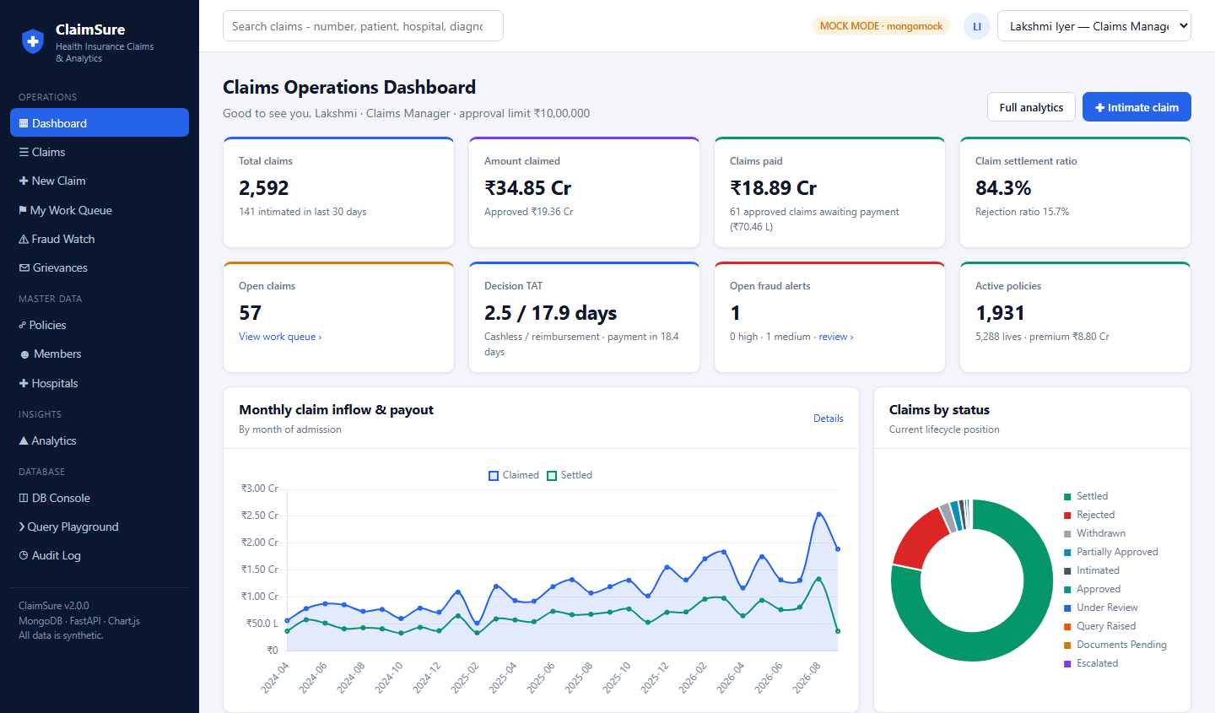


Web application: operations dashboard
APPLICATION
One $facet for the KPI row
Totals, status counts, turnaround and fraud alerts come from a single aggregation.
Role-aware work queue
Each user sees the open claims assigned to them and their own approval limit.
Search, filter and export
Claims can be searched by number, patient, hospital or diagnosis, and exported to CSV.
Notes:
The landing page. If the demo is live, switch here to the browser. Point out the user switcher at the top right: acting as a different member of staff changes what can be approved.

Slide 32
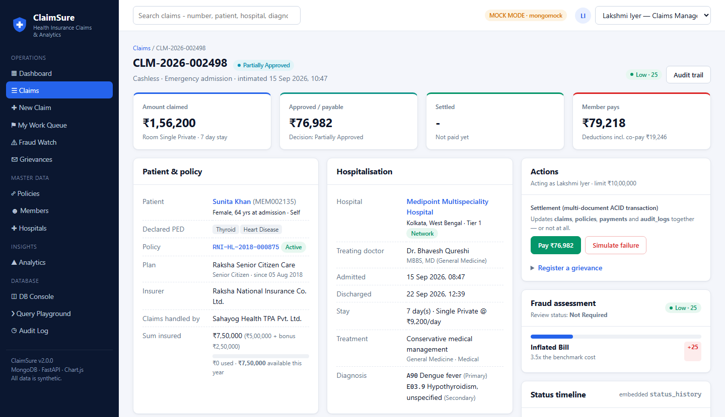
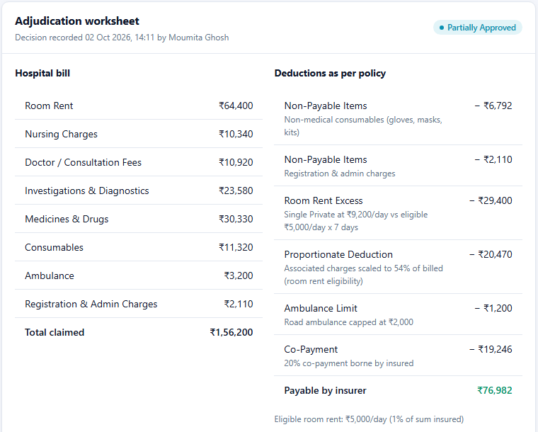
Claim detail: the full case file
APPLICATION
The worksheet lists every deduction with its reason. Pay and Simulate failure run the settlement transaction.
Patient, policy, hospital stay, actions and fraud assessment on one page, from one document.
Notes:
This is the claim from the worked example. Everything on the page comes from the one claim document plus its policy and plan. The two buttons on the right are the ACID demo: one commits, one fails on purpose.

Slide 33
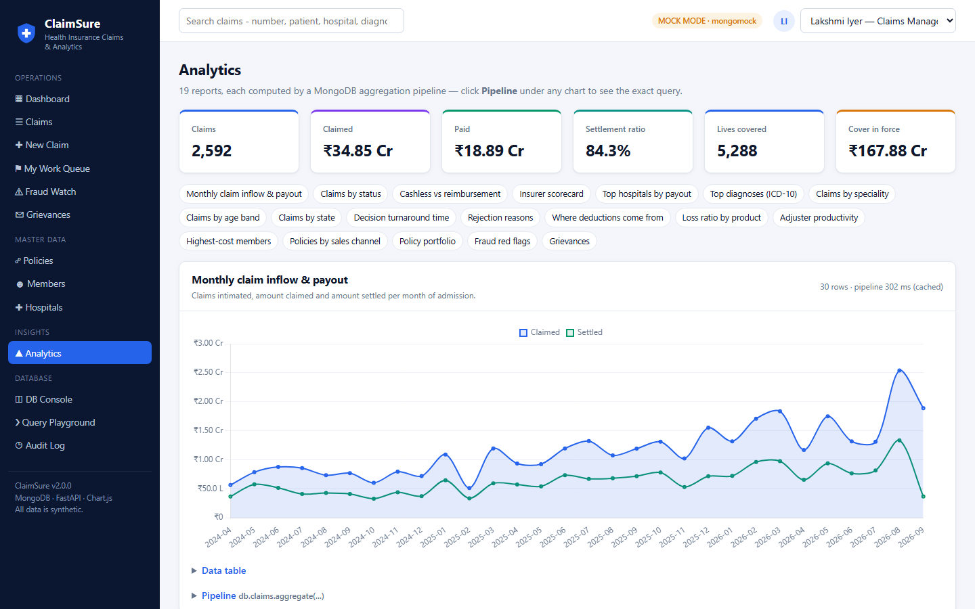
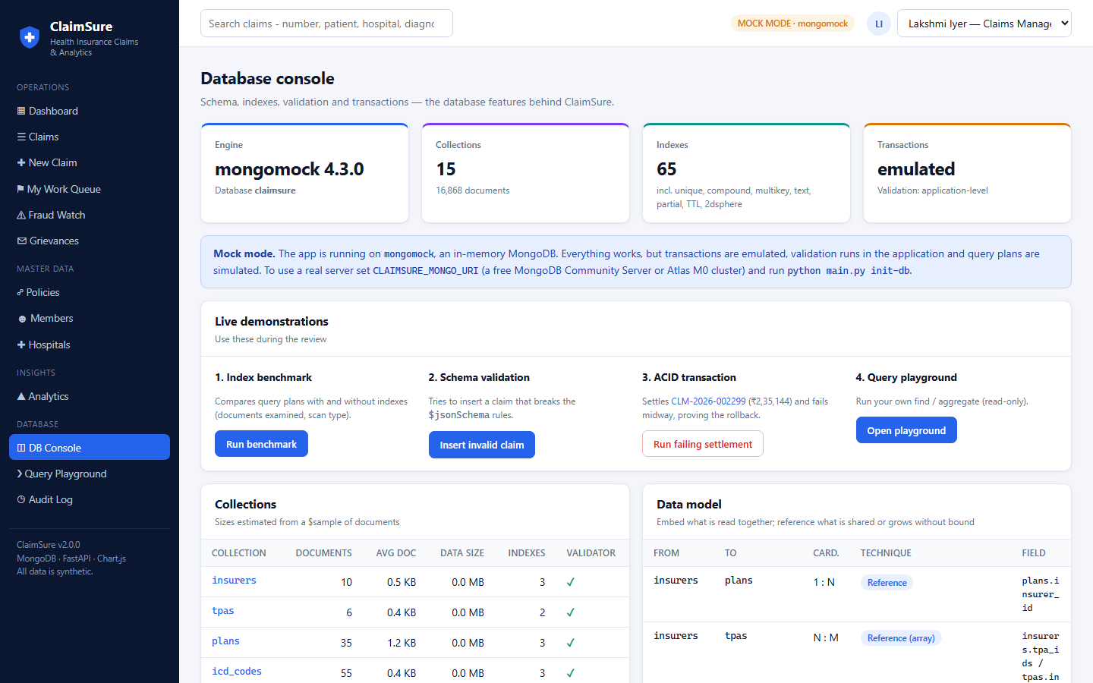
Analytics page and database console
APPLICATION
Analytics
DB console
19 reports, each with its chart, data table and the exact pipeline behind it.
Collections, data model, index catalogue and validators, plus live demos and a read-only query playground.
Notes:
Two pages built for a database review. The analytics page proves that the numbers come from pipelines. The console exposes the schema, the indexes and the validators, and has buttons for the index benchmark, the validation demo and the failing transaction.

Slide 34


Interfaces and automated testing
APPLICATION
120
automated tests: 91 on the mock, 29 against a real MongoDB replica set
Web application
15+ pages on FastAPI and Jinja2, with Chart.js bundled so it runs offline.
Command-line console
The same features from a menu; it can also start the web app.
mongosh scripts
Nine scripts, run on MongoDB 8.0: window functions, $merge, $geoNear, roles.
Notes:
Three ways to use the system, and two test suites. The mock suite runs anywhere. The live suite, python main.py test-live, runs against the real server in a separate database and checks server-side validation, real explain plans, a real WriteConflict and retry, change streams, views and the benchmark.

Slide 35
Meeting the review criteria
RESULTS
Schema design
Query optimisation
Advanced features
14 collections, with each embed-or-reference choice explained
Six named design patterns
$jsonSchema validators on every collection
Data model documented in the DB Console
50 indexes of nine types
100,000-document benchmark with real explain()
Covered queries; where indexes do not help
Pipelines project early and group before joining
ACID settlement with write-conflict retry
Optimistic locking and a concurrency lab
Roles, masked view, change streams
Migration, views, backup and restore
Every point runs live on MongoDB Atlas: DB Console, Scale Benchmark, Concurrency Lab, Security, Live Feed and Maintenance pages.
Notes:
The three review criteria and the evidence for each. Every bullet can be shown live: the DB Console for schema and indexes, the benchmark page for plans, and the claim page for the transaction.

Slide 36


Limitations and next steps
RESULTS
Current limitations
Next steps
Atlas M0: no sharding and no point-in-time backup
The data is synthetic (fictional people and companies)
No login screen: staff are picked from a dropdown, although database roles exist
Fraud scoring is rule-based, not a trained model
Shard on hashed member_id when volume outgrows one replica set
Continuous backup with point-in-time restore on a paid tier
Log-in mapped to database roles, replacing the user switcher
Train a fraud model on the aggregated claim history
Everything shown runs on MongoDB Atlas; CLAIMSURE_MODE=mock falls back to the in-memory mock if the network is unavailable.
Notes:
Be direct about the limits: the free tier cannot shard or do point-in-time restore, and the data is synthetic. The next steps follow from the design work already done, such as the shard-key choice.

Slide 37
Thank you
Run it yourself
Questions are welcome
pip install -r requirements.txt
python main.py web
Put the Atlas connection string in .env, run python main.py init-db once, then open http://127.0.0.1:8000.
1
Document model
One claim is one document; shared data is referenced.
Source code
2
Database features
github.com/nirupamraut-2062/
Health_Insurance_Claim_Processing-_System
Validation, indexes, transactions, locking, roles, change streams.
3
Working system
On MongoDB Atlas, with 120 automated tests.
ClaimSure | Database Management Systems project
Notes:
Close with the three takeaways, then open the floor. If there is time, offer to run any of the live demos again: the failing transaction and the invalid insert are the quickest.

