Slide 1
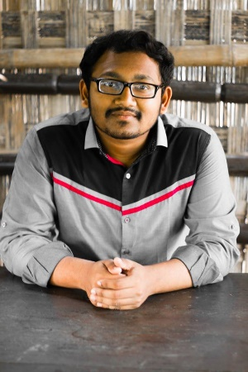
Nirupam Sutradhar Shuvo
Computer Engineer
Career Objectives
Searching for a position in your company as a IOT Expert to utilize my skills in critical thinking ability
Email:
nirupamshuvo1@gmail.com
Mobile No:
+8801521333105
+8801788856519
Address:
504, West Shewrapara Mirpur Dhaka 1216
EDUCATION
• Computer Science &Engineering
Independent University Bangladesh
• HSC
Saint Joseph Higher Secondary School
2013-2015
• SSC
Monipur High School & College
2013
Languages
Bangla - Fluent
English - Fluent
Hindi - Fluent
OTHERS SKILLS
Excellent time management skill
Strong Communication Skill
Organized
Hardworking
Creativity and innovative thinker
PROGRAMMING SKILLS
C++
Html
Java Script
Java

