Slide 1
ASP.NET
Presented By:Er.Sudan Prajapati

Slide 2
INTRODUCTION
The latest version of ASP is known as ASP.NET
ASP.NET is a server side technology for creating dynamic web pages using Fully Fledged programming languages supported by .NET
Visual Studio .NET is a developer application used to create ASP.NET Web applications
There are two main types of Web resources created with ASP.NET applications
WebForms are ASP.NET pages within an ASP.NET application
Web Services are ASP.NET Web pages that contain publicly exposed code so that other applications can interact with them
Web Services are identified with the file extension .asmx

Slide 3
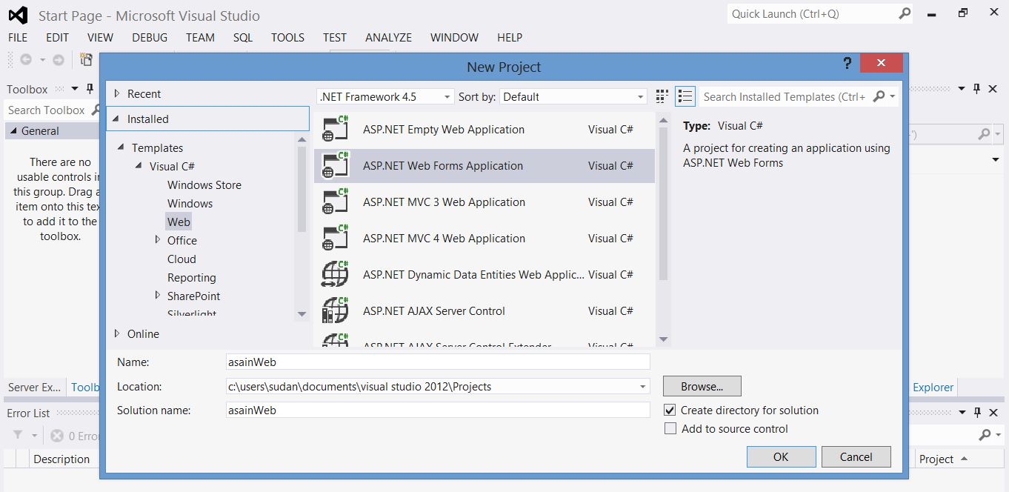
Creating a New Project
Open Visual Studio Create a new web project and press ok

Slide 4
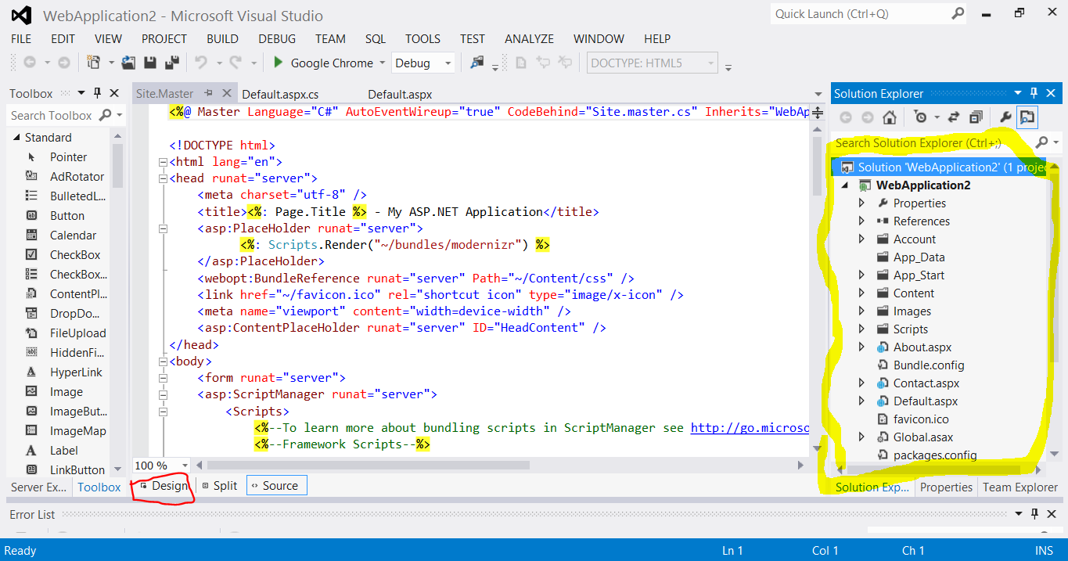

Slide 5
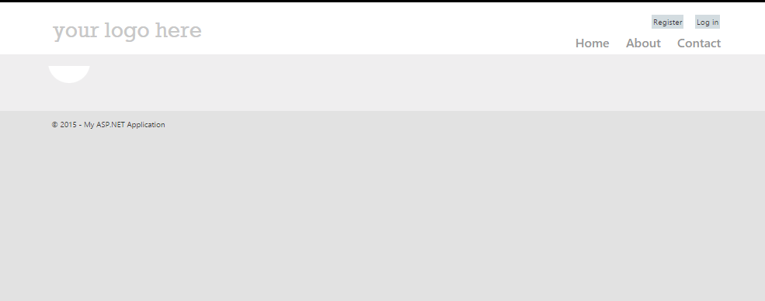
Press F5 to run in default browser

Slide 6
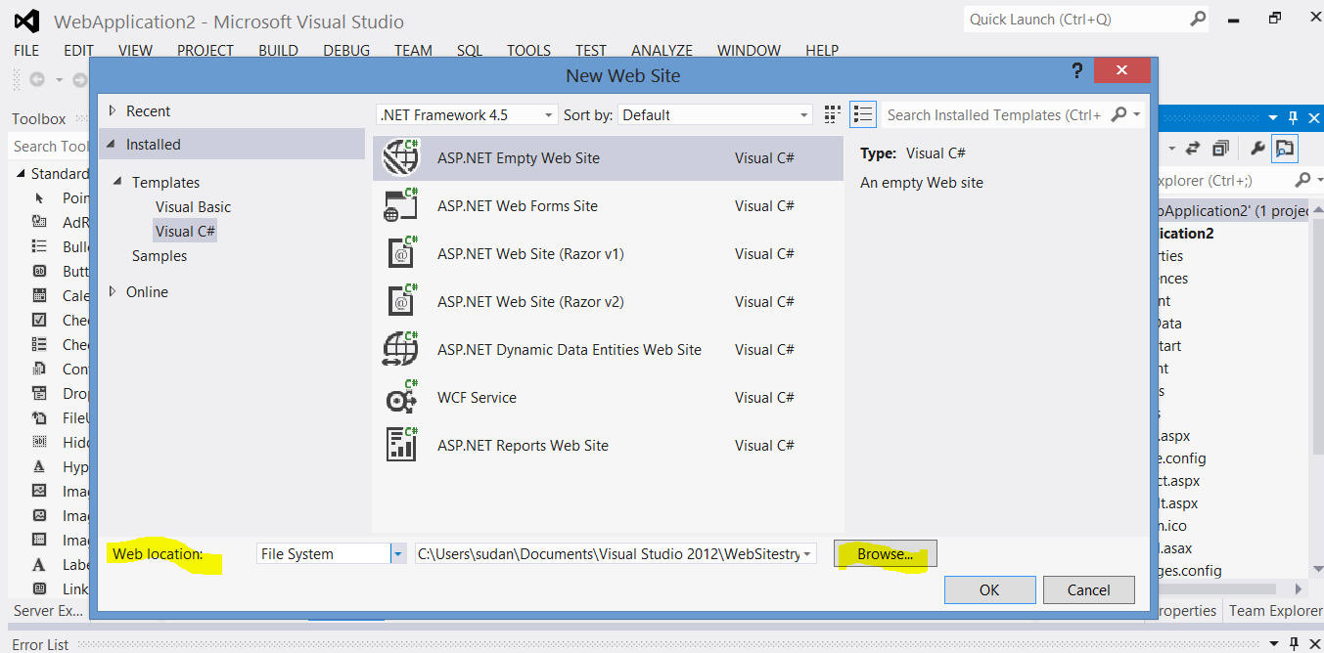
Strating From Empty Project

Slide 7
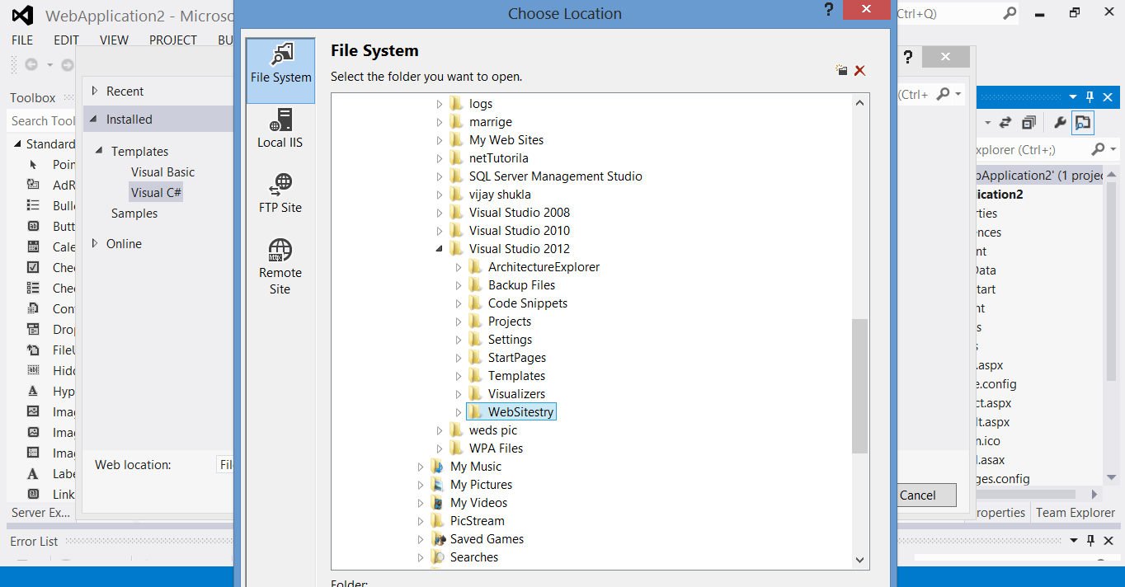
You will get the file system

Slide 8
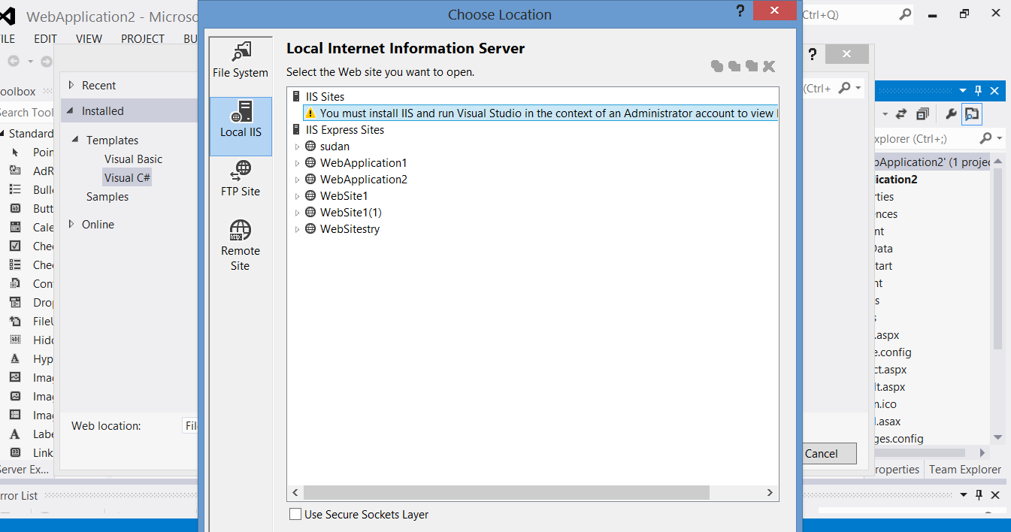
Using Local Server

Slide 9
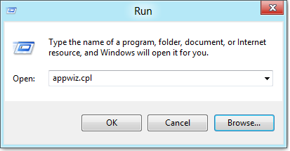
Install Internet Information Services(IIS)
One of the first things Web Developers using ASP.NET will want to install on Windows is IIS .
Keeping with Microsoft modular design of, uhm, everything these days, IIS in Windows is still an optional “Windows Feature”.
To install it, press the Windows + R key combination to bring up a run box, then type appwiz.cpl and press enter.

Slide 10
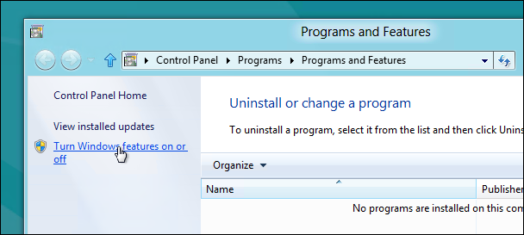
This will open the Program and Features part of Control Panel, on the left hand side click on the “Turn Windows features on or off” link.

Slide 11
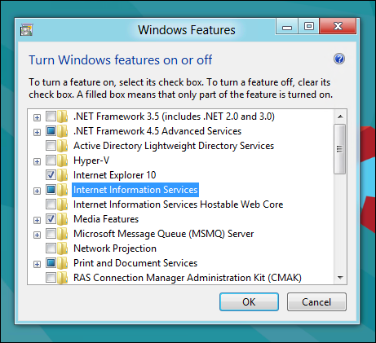
Now click on the Internet Information Services check box.

Slide 12
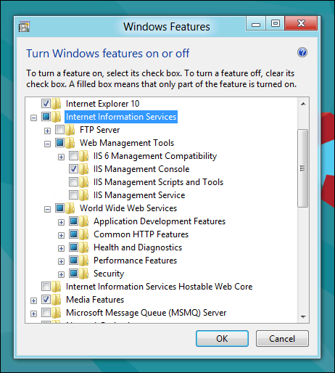
If you’re a developer you are going to want to expand it and explore the sub-components as well.
By default it installs all the stuff needed to host a website, and you are probably going to need some of the more developer centric components as well.

Slide 13
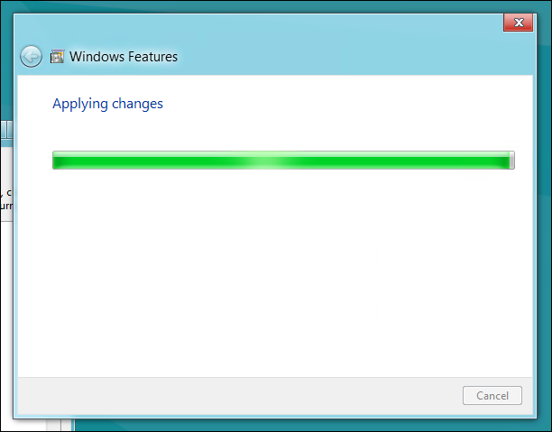
After clicking OK, this dialog will appear on your screen for a while.

Slide 14

When its done, fire up your browser and navigate to localhost.

Slide 15
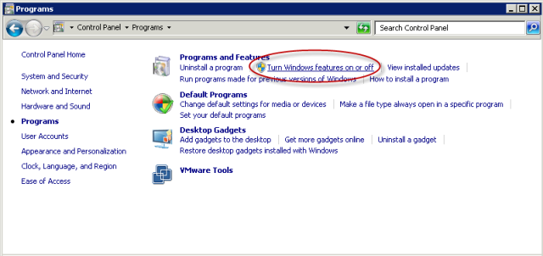
For Windows 7

Slide 16
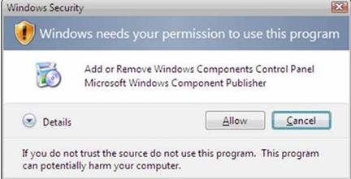

Slide 17
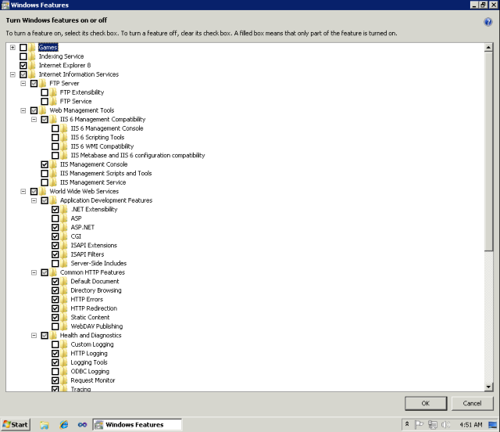

Slide 18
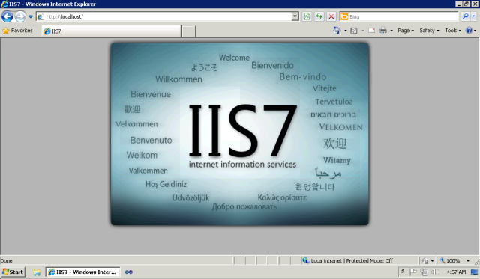

Slide 19
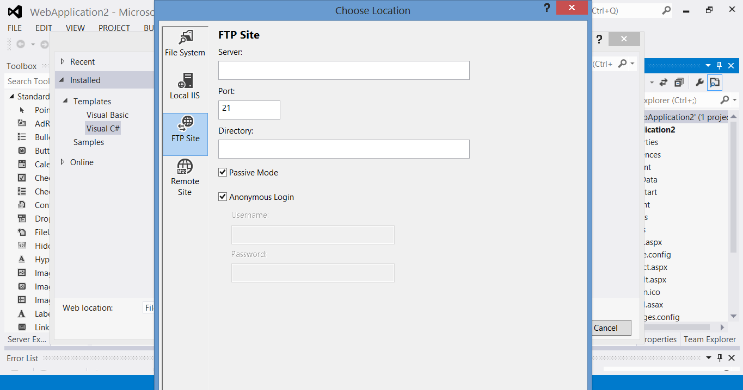
Using File Transfer Protocal (FTP) Server

Slide 20
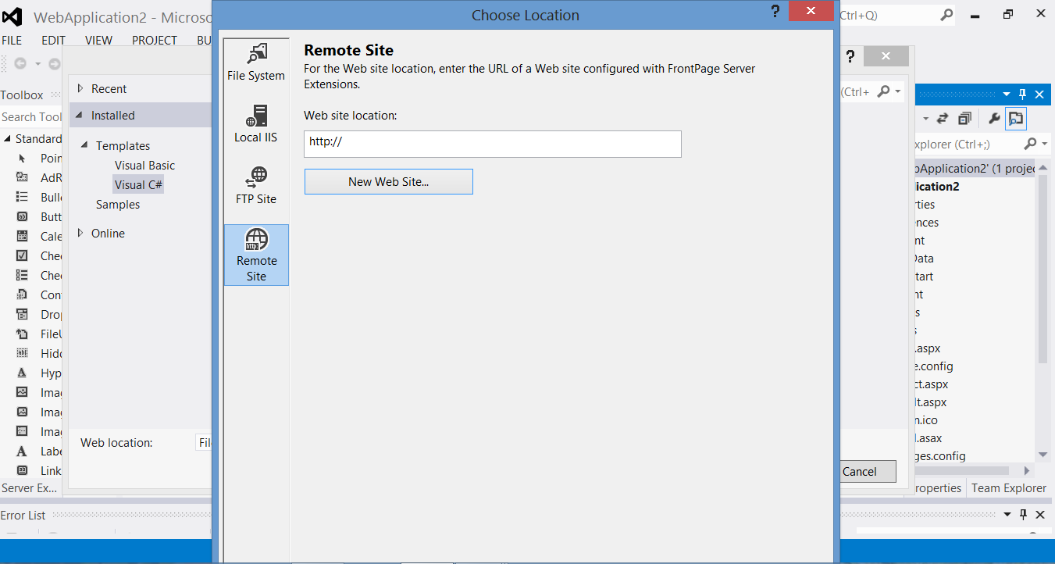
Using Remote Server

Slide 21
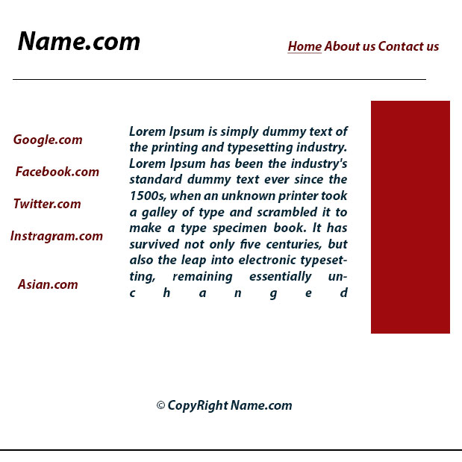
Design website

