Slide 1
Extra Professional course: .NET framework
Presented by:Er. Sudan Prajapati
Sr. Developer
Codelio Pvt. Ltd.

Slide 2
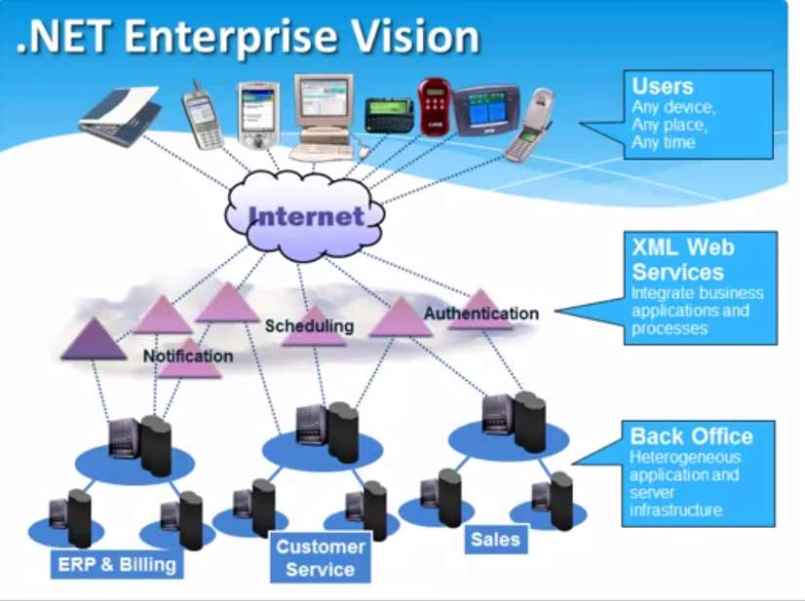
T

Slide 3
Types Of Programmers
System Programmers
One who programs directly for a given hardware
eg:Device drivers or extremely low level o/p services.
Application Programmers
One who programs applications used by people for their requirements
Eg: Calculators,Calenders,MS-Office like packages etc.

Slide 4
Definitions
Platform is an environment for developing and executing application.
Framework is ready to use collection of classes and interfaces used for developing a particular type of application.
Are .Net Framework are Platform independent ??

Slide 5
Evolution of .NET
Around 1995, Java was gaining popularity because of its platform independent approach and sun microsystems open policy .
In 2002 J2EE was released it declined the Microsoft market share.
Microsoft started the project called next generation windows services (NGWS) to regain the market share .

Slide 6
Introduction
What is .NET ?
.NET is the software framework developed by Microsoft.
Software framework: software platform is an environment for developing and running software application featuring ease of development which includes compilers, libraries, api etc where developer use to develop applications, products.
MS.Net is a Framework built on open internet protocols (SOAP(Simple object access protocol) & standards with tools and services the meld computing and communication in new ways.

Slide 7
. Net Version
Version 1.0 in Year 2002
Version 1.1 in Year 2003
Version 2.0 in Year 2005(stable version )
Version 3.0 in Year 2006 (extended over 2.0)
Version 3.5 in Year 2007(introduced LINQ and AJAX in .net)
Version 4.0 in Year 2010( mvc)
Version 4.5 in Year 2012
All versions can be installed side by side on same machine.

Slide 8
Introduction (contd.)
.NET programs are executed in environment known as Common Language Runtime (CLR).
CLR is an application virtual machine providing memory management, security, exception handling.
Cluster of technologies:
.NET languages: C#, VB.NET, J#, C++.
CLR
.NET framework class library: ADO.NET etc.
ASP.NET
Visual Studio
Latest version of .NET framework: 4.5.1, Visual Studio 2013

Slide 9
Top View:
C# code
VB.NET code
Other .NET lang. code
C# compiler
VB.NET compiler
Other .NET language compiler
CLR
Common Intermediate Language (CIL)
Just In Time Compiler (JIT)
Native Code
Execute (10010111100 ….)

Slide 10
Common Language Runtime(CLR)
Important component of .NET
Known as Runtime.
Provides functionality such as memory management., exception handling ,debugging ,security , thread execution, verification and compilation.
Can host a variety of languages and ensures interportability between their code.
Automatic memory management resolves the issues of memory leaks and invalid memory references.
Runtime imposes a code access security (CAS) on the code of and application.

Slide 11
Why learn .NET ?
Strong Object-oriented design/programming.
Productivity.
Current market scope.

Slide 12
Benefits of .NET Framework
Consistent programing model.
Cross platform support.
Language interportability.
Automatic Management of resources.
Ease of deployement.

Slide 13
C# language:
Strongly typed language.
Data Types:
bool : true/false
int : signed/unsigned
string : storing text, number of chars
char : single character
float

Slide 14
C# language (contd.)
Variable declaration:
int myInt;
int myInt = 5;
SomeClass myclassObj = new SomeClass();
If statement: if { //.. }
Switch statement:
switch(var) {
case 0: { //.. Break;}
}

Slide 15
C# language (contd.)
Loops:
while
do while
for
foreach:
foreach(char c in strObj) { //.. }
Arrays:
Int[] intArray = new int[100];
String[] strArray = new string[10];
Int[] intArr = new int[3] { 1, 2, 3 };
Array index starts from 0 (same as C/C++).

