Slide 1
Inheritance
Presented by: Er.Sudan Prajapati

Slide 2
Introduction
Inheritance is one of the three foundational principles of Object-Oriented Programming (OOP).
Inheritance allows us to define a class in terms of another class, which makes it easier to create and maintain an application.
Provides an opportunity to reuse the code functionality and fast implementation time.
In the language of C#, a class that is inherited is called a base class.
The class that does the inheriting is called the derived class.
The idea of inheritance implements the IS-A relationship.
For example, mammal IS A animal, dog IS-A mammal hence dog IS-A animal as well and so on.

Slide 3
Base and Derived Classes
A class can be derived from more than one class or interface.
The syntax used in C# for creating derived classes is as follows:
<acess-specifier> class <base_class>
{ ...}
class <derived_class> : <base_class>
{ ... }

Slide 4
public class ParentClass
{
public ParentClass()
{
Console.WriteLine("Parent Constructor.");
}
public void print()
{
Console.WriteLine("I'm a Parent Class.");
}
}
public class ChildClass : ParentClass
{
public ChildClass()
{
Console.WriteLine("Child Constructor.");
}
}

Slide 5
class Program
{
static void Main(string[] args)
{
ChildClass child = new ChildClass();
ParentClass parent = new ParentClass();
}
}

Slide 6
Points to remember
C# supports only single class inheritance.
But C# supports multilevel inheritance.
Child class is a specialization of base class.
Base classes are automatically instantiated before derived classes.
Parent class constructor executes before child class constructor.

Slide 7
Derived Class Communicating with Base Class
public class Parent {
string parentString;
public Parent() {
Console.WriteLine("Parent Constructor."); }
public Parent(string myString)
{ parentString = myString;
Console.WriteLine(parentString); }
public void print() {
Console.WriteLine("I'm a Parent Class."); }}

Slide 8
public class Child : Parent
{
public Child() : base("From Derived")
{
Console.WriteLine("Child Constructor.");
}
public new void print()
{
base.print();
Console.WriteLine("I'm a Child Class.");
}
}

Slide 9
Class Progarm{
Svm(){
Child child = new Child();
child.print();
((Parent)child).print();
}
}

Slide 10
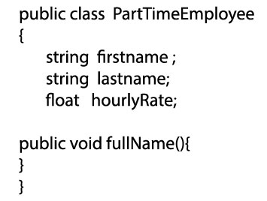
Why Inheritance

Slide 11
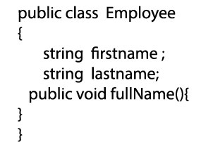



Slide 12
Task
Now implement the inheritance in previous slide diagram assign full time employ name ramu shrestha and salary 100000 and part time suman maharjan hourly rate 600 print in the diplay function .

Slide 13
Information Hiding
Add public void display in each of the class Employee, Part time employee and full time employee.
Make a object of full time and part time and call the display method through each object .
The method of base class will be overridden as the derived class get the chance of execution of method first.
There exits a warning ‘Inheritance and polymorphism hides inherited members.use new keyword if hiding was intended.

Slide 14
Base Keyword
Base keyword helps to call the base class method from the child or inherited classes.
Example
class ClassA:ClassB
{ public void Display1()
{ Console.WriteLine("ClassA Display1");
base.Display1();
}
}

Slide 15
class ClassB
{
public int x = 100;
public void Display1()
{
Console.WriteLine("ClassB Display1");
}
public void Display2()
{
Console.WriteLine("ClassB Display2");
}
}

Slide 16
Polymorphism
Polymorphism is one of the primary pillar of OOPs.
Polymorphism allows you to invoke derived class methods through a base class reference during runtime.
There are mainly 2 types of Polymorphism
Compile Time
Run Time
Compile Time
By compile time it means all the method overloading and constructor overloading

Slide 17
Run time Polymorphism
In run time polymorphism in base class method virtual should be declared and in derived class with keyword override the same method is overridden.
The virtual keyword indicates that the method can be overridden in any derived class.

Slide 18
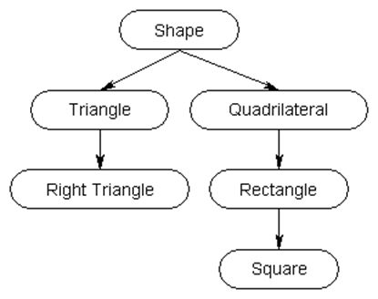
Assignment
Implement the concept of oops in following diagram

